Slide 1
Learning by Demonstration for Motion Planning of Upper-Limb Exoskeletons
C. LAURETTI, f. Cordella, A Ciancio, E. Trigili, j Catalan, F.Badesa, S. Crea, S. pagliara , s sterzi, n. vitiello, n. aracil, l. zollo
Presented by Ivan Panchenko

Slide 2
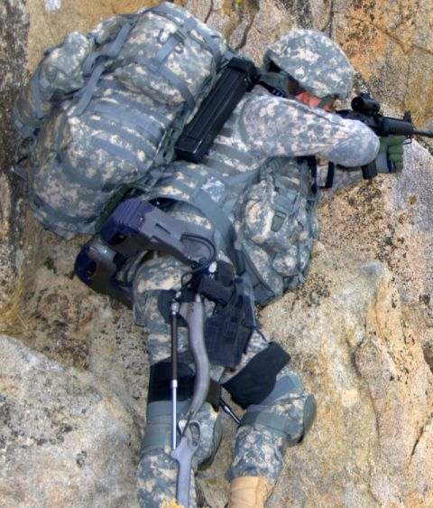
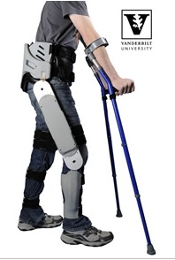
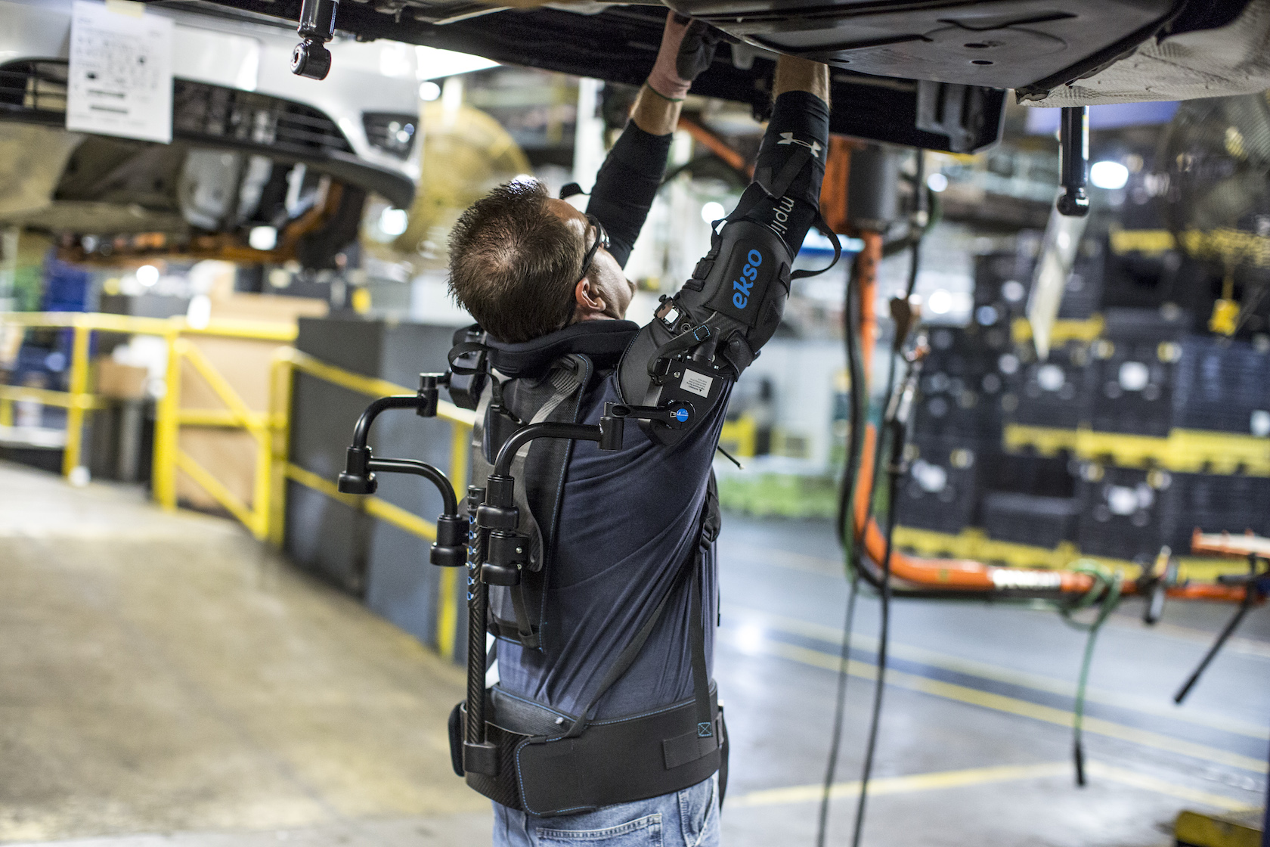
Usage of exoskeletons.
Military Cargo Rehabilitation

Slide 3
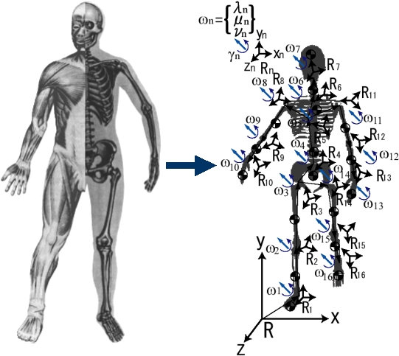
Exoskeleton, as a kinematic model.
Degrees of flexibility:
3 in shoulder/hip
1 in elbow/knee
3 in wrist/ankle
28 total
Degrees of freedom:
3 in each joint
36 total
All possible, but not all necessary to implement.

Slide 4
Analytical methods
Mapping: spline decomposition, etc.
Ad hoc developed objective functions optimization.
Successful only in structural environments.
Cartesian motion planner.
Requires Inverse Kinematics (computationally hard) and does not guarantee meeting anthrophomorphic criteria.

Slide 5
Proposed method: Learning by Demonstration
The human subject is observed during the task execution and the robotic system replicates the learnt movement.
It allows avoiding motion planning in the Cartesian space and inverse kinematics, but it requires to learn the target joint configuration to be reached through supervised learning.
It utilizes Neural Network that learns the motion features and the robot inverse kinematics.

Slide 6
Advantages
it does not require the formulation of mathematical models of human motor behavior in order to accomplish the task in a way similar to humans;
it allows performing the task also in unstructured environments (where a variability can be caused, for example, by the object position changes and subject different anthropometries);
it guarantees the task accomplishment in the feasible workspace by preserving anthropomorphic configurations of the assisted human arm.

Slide 7
Basics
The proposed motion planner is based on Dynamic Movement Primitives (DMPs), with a well-defined landscape attractor.
This attractor allows replicating the recorded trajectory by means of a weighted sum of optimally spaced Gaussian Kernels.
Weight parameters (DMP parameters) are extracted from demonstrated movements with a Locally Weighted Regression (LWR) algorithm and are used to train a neural network through supervised learning.
The neural network has the aim to define DMP parameters and joint target position and receives in input context factors (such as object position or task type). The DMP parameters are then processed by the DMP computation module that provides the exoskeleton reference joint trajectories.

Slide 8
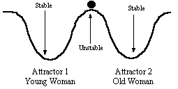
Basics
In the mathematical field of dynamic systems, an attractor is a set of numerical values toward which a system tends to evolve, for a wide variety of starting conditions of the system. System values that get close enough to the attractor values remain close even if slightly disturbed.

Slide 9
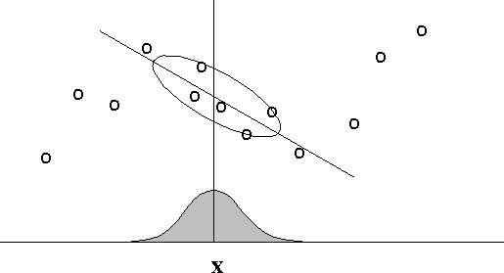
Basics
In locally weighted regression (LWR), points are weighted by proximity to the current x in question using a kernel. A regression is then computed using the weighted points.

Slide 10
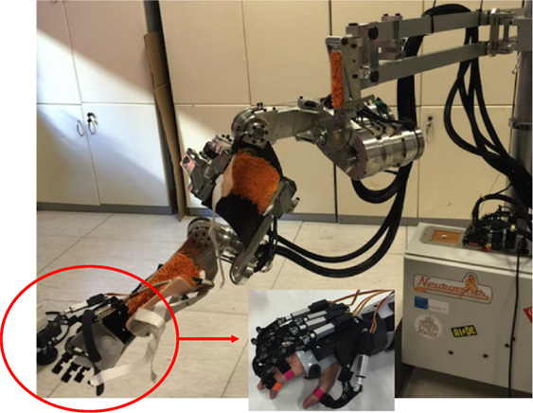
Exoskeleton
The exoskeleton was made of :
4-DoF shoulder-elbow exoskeleton (i.e., NeuroExos Shoulder-Elbow Module (NESM) for reaching movements,
5-DoF wrist-hand exoskeleton responsible for the grasping phase.

Slide 11
NESM
An upper-limb exoskeleton consisting of four active DoFs addressing the shoulder abduction/adduction (sA/A), flexion/extension (sF/E) and internal/external rotation (sI/E), as well as the elbow flexion/extension (eF/E) movements
Additional passive degrees of freedom and size regulations are included within the kinematic chain to improve the safety and wear ability of the device: this system automatically compensates for joint misalignments of the elbow and shoulder complex and allows users with different anthropometries wearing the device.
Motion ranges (the zero configuration is arm downward): 0° to −90° for sA/A and sF/E, −75° to 25° for sI/E and 0° to 120° for eF/E.

Slide 12
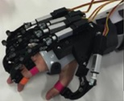
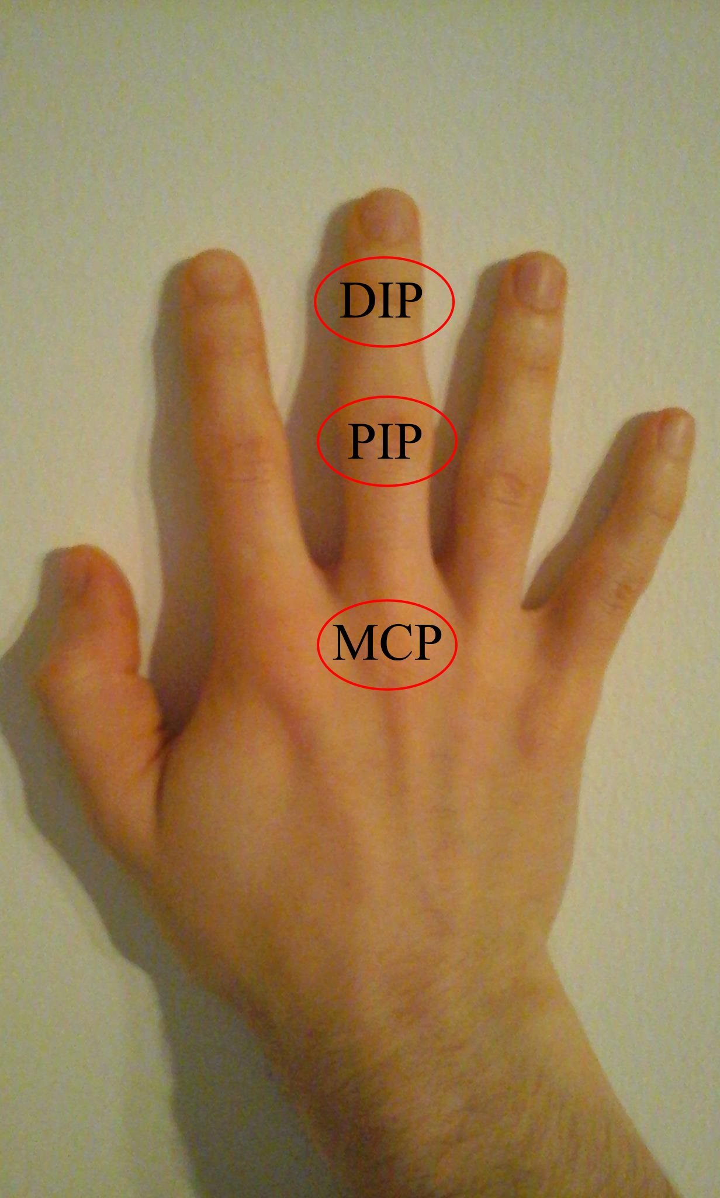
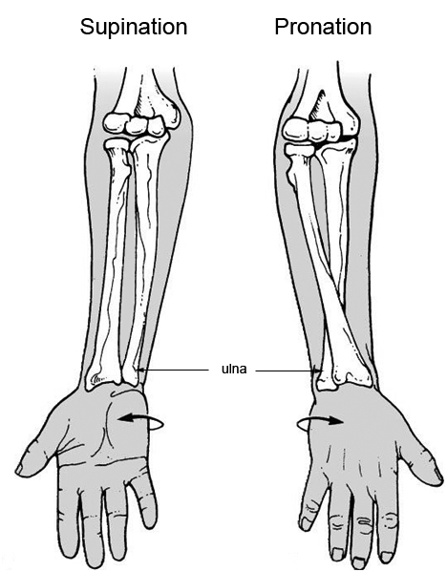
Wrist-Hand Exoskeleton
The wrist exoskeleton guarantees the activation of the prono/supination movements.
The hand exoskeleton has 4 active DoFs: F/E of the index finger Metacarpophalangeal (MCP) joint, F/E of the middle finger MCP joint, F/E of the ring and little finger MCP joints, and F/E of the thumb MCP joint. A linkage mechanism between the M regulator as well. When a reference MCP and the Proximalinterphalangeal (PIP) joint is adopted on each finger and is driven by a linear actuator, for moving both PIP and MCP joints. A unique linear actuator is used for driving the PIP and MCP joints of both the third and the fourth fingers. The thumb A/A is fixed in a suitable position.
Joint limits are mechanically provided, but, if necessary they can be reduced via software for increasing the safety in the human-robot interaction.

Slide 13
Low Level Control (LLC)
The control system used to operate the NESM implements two control strategies: joint position and joint torque control modes.
When controlled in position, each actuation unit drives the joint position along a reference value or trajectory. The controller is based on a proportional-integral-derivative (PID) regulator, which operates on the difference between the reference joint angle and the measured one. The output is a current commanded to the elastic actuator to provide the torque necessary to achieve the movement with null steady-state error.
In the torque control mode, each motor is controlled to provide a certain amount of torque. The closed-loop torque controller output is dependent on the difference between the desired joint torque and the measured one, and it is built on a PID regulator as well. When a reference torque of 0 Nm is commanded on each joint, the device can be used in transparent mode, allowing the user to freely move the arm. Conversely, the wrist module and the hand exoskeleton could be controlled only in position; the controller used to operate these devices is based on a PID regulator, which operates on the difference between the reference joint angle and the measured one.

Slide 14
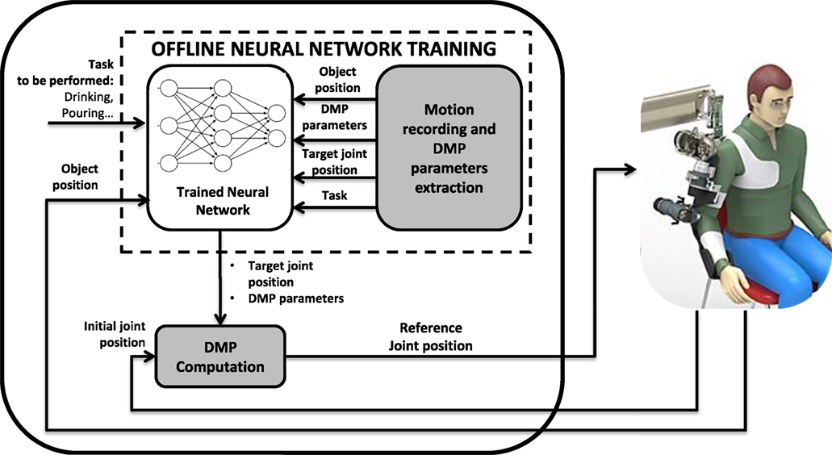
Motion planning based on LbD

Slide 15
Motion planning stages
In the off-line neural network training, the trajectories executed by a healthy human, are recorded, and distinctive features, named DMP parameters, are subsequently extracted using a LWR algorithm Hence, a neural network is trained through the Levenberg-Marquardt (LM) supervised learning algorithm in order to associate DMP parameters and robot joint target position to context factors taken in input (i.e., object position and task to be performed).
In the DMP computation, the patient can perform an ADL task with the assistance of the exoskeleton. Depending on the task and object position, the trained neural network provides the proper set of DMP parameters and robot joint target positions for computing the set of DMPs that best fit the desired task.

Slide 16
DMP computation
The computation of the DMPs is obtained through the resolution of a non-linear second order system, expressed as
τ - time constant,
α_{q,} β_{q} - positive constants,
q_{0,} g - initial and final points of the trajectory, respectively,
f - forcing term that implements the landscape attractor of the system,
q - generic joint position of the robot to be computed for each joint (i.e., q₁, q₂ … q₅).
A possible formulation of the forcing term, namely the landscape attractor is
ω_{i} - DMP parameters, namely the weight parameters adopted to reconstruct the recorded motion,
x - state variable of the system that makes equation (1) a time-independent system.

Slide 17
DMP computation (continued)
X identified as
α_{x} - positive constant.
On the other hand, Ψ_{i}(x) is Gaussian kernels expressed as
σ_{i}, c_{i}, and N - width, the centers, and the number of Gaussian functions, respectively.
The state variable x as well as centers c_{i} range between 0 and 1.

Slide 18
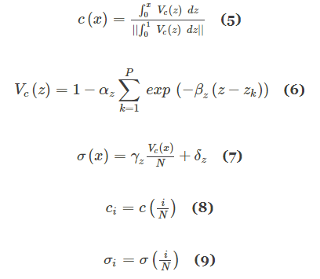
DMP computation (continued)
An optimized spatial allocation of the Gaussian kernels is adopted, depending on the complexity of the recorded trajectory. Hence, c_{i} and σ_{i} are defined as
α_{z}, β_{z}, γ_{z}, and δ_{z} - positive constants,
N - number of critical points of the recorded trajectory,
z_{k} is the normalized time instant of each critical point.

Slide 19
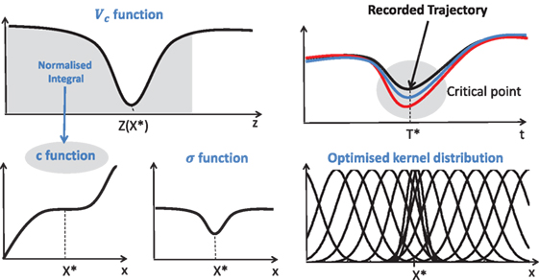
DMP computation (continued)
A graphical representation of c and σ functions

Slide 20
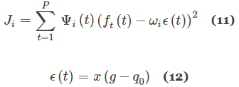
Off-Line NN training
DMP parameters extraction
DMP parameters ω_{i} are extracted through a LWR algorithm. The recorded motion and derivatives (q_{d,} q˙d, q̈ d) are inserted in the forcing term in equation (2) as follows
and a function approximation problem is formulated. Hence, a locally weighted quadratic error is minimized by means of the following cost function
and ω_{i} parameters that make f_{t} as close as possible to f are found, for each kernel function Ψ_{i}(t), in order to reconstruct the trajectory q_{d,} q˙d, q̈ d through q, q˙, q̈ respectively.
ϵ is the error between the target joint position to be reached g and the initial joint position of the exoskeleton q₀.

Slide 21
Off-Line NN training (continued)
Neural Network
A Levenberg-Marquardt algorithm (LM) has been adopted for the off-line neural network training. Given a parameter vector p ∈ Rn and a measurement vector x ∈ Rm, the LM algorithm finds the functional relation (f) that maps the parameter vector p into an estimated measurement
x^ (x^ = f(p)). A linear approximation of f in the neighborhood of p is provided by a Taylor series expansion
Neglecting the higher order terms o(p), equation (12) could be approximated as
J - Jacobian matrix δf(P)/δP
At each step of the iterative process, LM looks for the δ_{p} that minimizes the error defined as

Slide 22
Off-Line NN training (continued)
The error is minimized when Jδ_{p}–ϵ is orthogonal to the column space of J, namely when the following condition holds
In the LM method, equation (16), called normal equation, is written as
J^{T}J and μ are called damping and damping term, respectively.
One iteration of LM algorithm consists of finding an acceptable value of the damping term that reduces the error ϵ_{p}. In other words, if δ_{p} computed from equation (17), leads to a reduction of the error ϵ_{p}, the damping term is decreased and the following iteration is processed; otherwise, the damping term is increased and equation (17) is solved again.
The LM algorithm stops running when, at least:
J^{T}ϵ_{p} of equation (17) is lower than a preset threshold ϵ₁
or δ_{p} is lower than a threshold ϵ₂
or a maximum number of iteration N_{MAX} is reached.

Slide 23
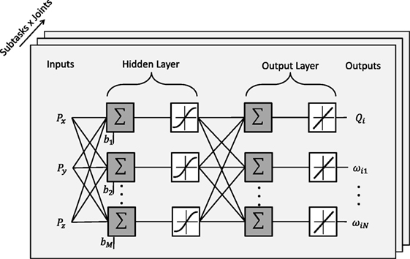
Structure of the adopted NN
A two layer feed-forward network with M sigmoid hidden neurons and N + 1 linear output neurons is used for each joint and for each task the user wants to perform. The inputs of each network are the Cartesian target positions to be reached, P_{x}, P_{y}, and P_{z} (e.g., object position); on the other hand, the outputs of each network are the DMP parameters, ω₁, ω₂…ω_{N}, and the target joint angles, Q_{i} (N is the number of DMP parameters computed for the i-th joint).

Slide 24
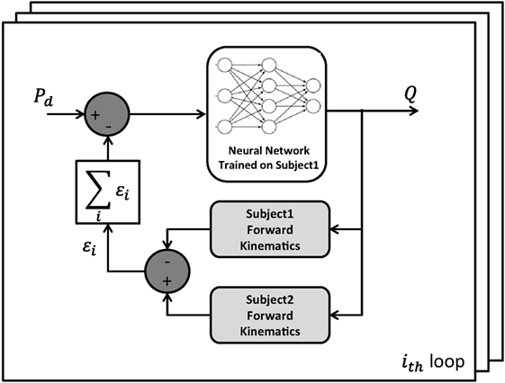
Adapting NN outputs to different subject anthropometries
The recursive method used to adjust the NN outputs for different subject anthropometries. P_{d} is the Cartesian target position to be reached, Q is the output configuration of the robot joints, subject 1 is the person involved in the NN training phase while subject 2 is the assisted person, who wants to perform an ADL thanks to the exoskeleton assistance.

Slide 25
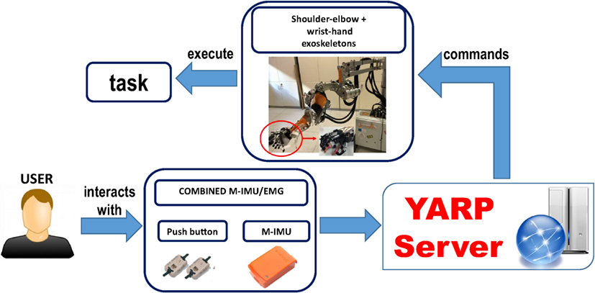
Experimental setup
Block scheme of the platform.

Slide 26
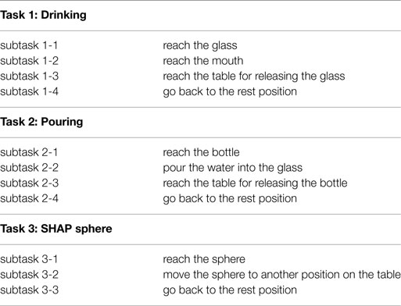
Experimental setup (continued)
Tasks description

Slide 27
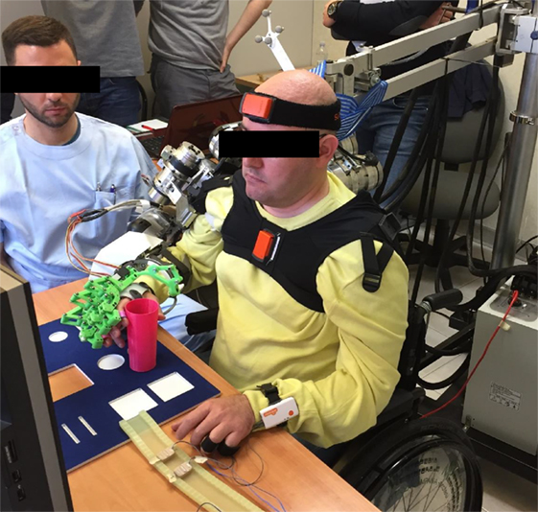
Experimental setup (continued)
YARP components.
The interface adopted to detect the user movement intention is based on the combined use of 2 push-buttons and 2 M-IMUs.
The 2 push-buttons were placed on a table in order to be activated by the index and the thumb fingers and to be used as a switch. Moreover, the two M-IMUs were placed on the user’s trunk and head in order to detect his neck motion.
The user may exploit:
the head yaw motion in the negative direction to operate the upper-limb exoskeleton movements and the head yaw motion in the positive direction to abort the task;
the index finger and thumb residual motion to trigger the hand opening and the hand closing.

Slide 28
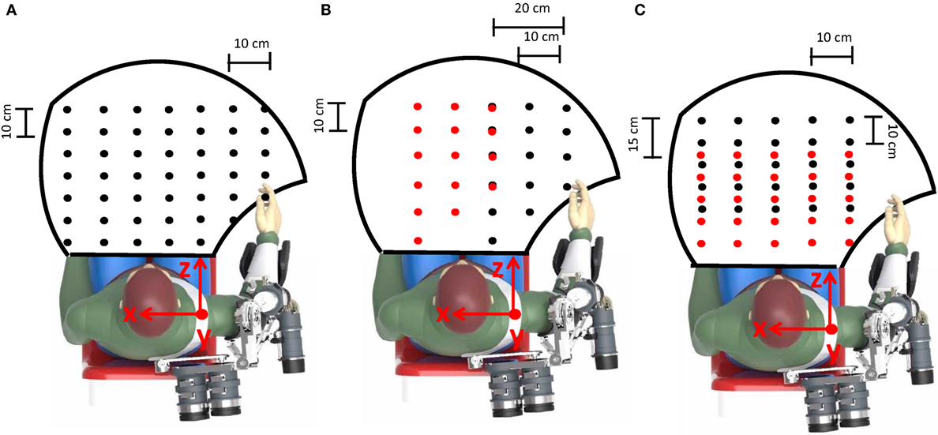
Experimental protocol
Off-Line NN training
The workspace reached during the assistive tasks is delimited by the black line. Object positions during training are indicated by black dots [the glass in the drinking task in (A), the bottle in the pouring task in (B) and the initial position of the sphere in the SHAP task in (C)]. Conversely, the glass positions during the pouring task and the sphere final positions in the SHAP task are indicated by red dots in (B, C), respectively.
About 70% of the recorded data was used to train the neural network; the remaining 30% was used to validate and test the neural network in order to avoid over-fitting issues.

Slide 29
DMP computation and control
The experimental session was aimed to measure performance of the proposed motion planning system, compare with the traditional approach based on inverse kinematics. The system was tested during the fulfillment of the same ADLs used for training, i.e., drinking, the pouring, and reach-grasp-move-release a sphere.
The validation was performed in simulation and in the real setting with patients. Simulation tests allowed evaluating system performance in the whole human-robot workspace (238, 75, and 125 object positions were considered for task 1, 2, and 3, respectively). On the other hand, in the real setting, system performance was assessed on four patients with Limb Girdle Muscular Dystrophy (LGMDs). They, aged 38.5 on average (Standard Deviation 14.6).
The subjects were asked to perform three repetitions of the three tasks thanks to the assistance of the 4-DoF upper-limb and 5-DoF wrist-hand exoskeletons (3 object positions for each task were considered in this case).

Slide 30
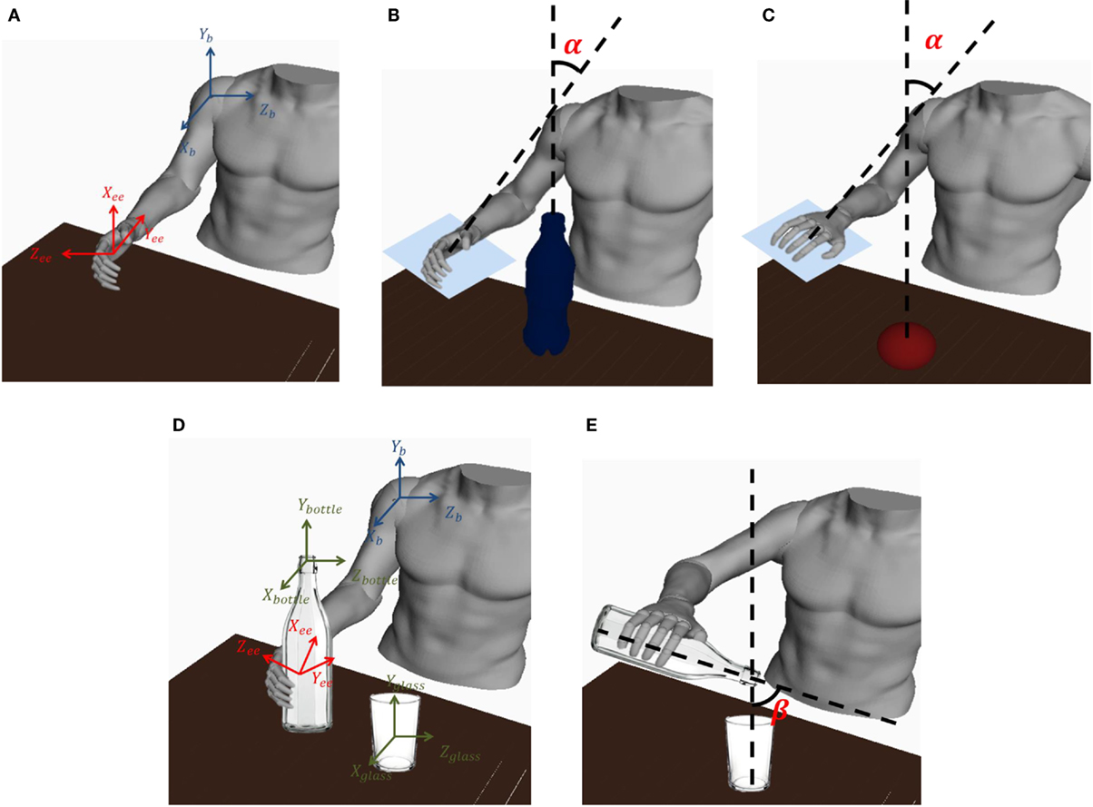
Metrics

Slide 31
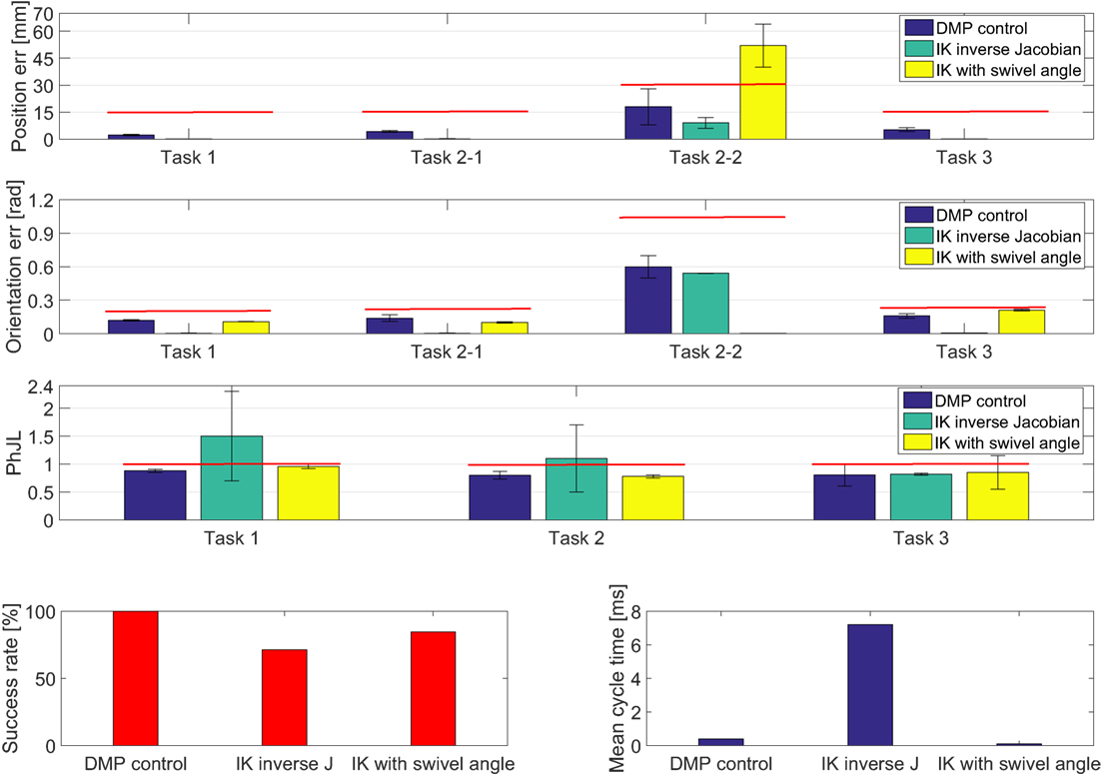
Results
Experimental results obtained. The red lines denote the range within which the task is considered successfully accomplished.

Slide 32
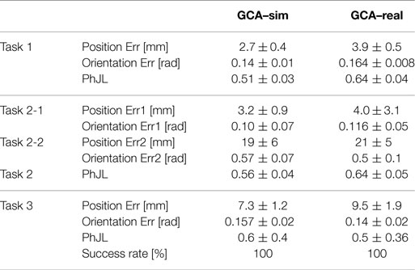
Generalization Capability Assessment
Mean value and standard deviation of position error, orientation error, and PhJL are reported. They were computed for GCA–sim on 238, 75, and 125 object positions (for task 1, 2, and 3, respectively) and 25 different subject anthropometries. Instead, for GCA–real they were calculated on the four subjects and 3 object positions for each task.
PhJL – physiological joint limits

Slide 33
Conclusions
The results achieved for the comparative analysis showed that the DMP-based control guarantees a 100% success rate in the task fulfillment, with an acceptable position and orientation error for the targeted application.
Moreover, it also ensures that the exoskeleton always has configurations within the physiological joint limits, differently from methods based on path planning and inverse kinematics.
Furthermore, the computational time required by the proposed approach is lower than the one required by the IK algorithm with inverse Jacobian and comparable with the IK with swivel angle.
Finally, the results achieved in simulation as well as in the experimental setting also showed a high generalization level of the DMP based motion planning with respect to the different object positions and subjects anthropometries. A success rate of 100% for all tasks was reported.

