Slide 1
Chapter 11: File-System Interface

Slide 2
Chapter 11: File-System Interface
File Concept
Access Methods
Disk and Directory Structure
File-System Mounting
File Sharing
Protection

Slide 3
File Concept
Contiguous logical address space
Types:
Data
numeric
character
binary
Program
Contents defined by file’s creator
Many types
Consider text file, source file, executable file

Slide 4
File Attributes
Name – only information kept in human-readable form
Identifier – unique tag (number) identifies file within file system
Type – needed for systems that support different types
Location – pointer to file location on device
Size – current file size
Protection – controls who can do reading, writing, executing
Time, date, and user identification – data for protection, security, and usage monitoring
Meta Information kept in the directory structure
Possibly extended file attribute, e.g. file checksum

Slide 5
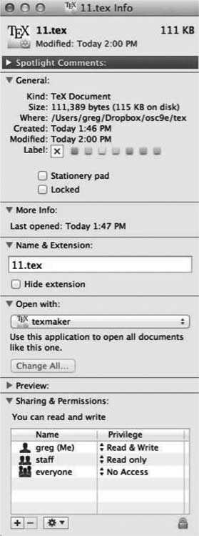
File info Window on Mac OS X

Slide 6
File Operations
File is an abstract data type
Create
Write – at write pointer location
Read – at read pointer location
Reposition within file - seek
Delete
Truncate
Open(F_{i}) – search the directory structure on disk for entry F_{i}, and move the content of entry to memory
Close (F_{i}) – move the content of entry F_{i} in memory to directory structure on disk

Slide 7
Open Files
Several pieces of data are needed to manage open files:
Open-file table: tracks open files
File pointer: pointer to last read/write location, per process that has the file open
File-open count: counter of number of times a file is open – to allow removal of data from open-file table when last processes closes it
Disk location of the file: cache of data access information
Access rights: per-process access mode information

Slide 8
Open File Locking
Provided by some operating systems and file systems
Similar to reader-writer locks
Shared lock similar to reader lock – several processes can acquire concurrently
Exclusive lock similar to writer lock
Mediates access to a file
Mandatory or advisory:
Mandatory – access is denied depending on locks held and requested
Advisory – processes can find status of locks and decide what to do

Slide 9
File Locking Example – Java API
import java.io.*;
import java.nio.channels.*;
public class LockingExample {
public static final boolean EXCLUSIVE = false;
public static final boolean SHARED = true;
public static void main(String arsg[]) throws IOException {
FileLock sharedLock = null;
FileLock exclusiveLock = null;
try {
RandomAccessFile raf = new RandomAccessFile("file.txt", "rw");
// get the channel for the file
FileChannel ch = raf.getChannel();
// this locks the first half of the file - exclusive
exclusiveLock = ch.lock(0, raf.length()/2, EXCLUSIVE);
/** Now modify the data . . . */
// release the lock
exclusiveLock.release();

Slide 10
File Locking Example – Java API (Cont.)
// this locks the second half of the file - shared
sharedLock = ch.lock(raf.length()/2+1, raf.length(), SHARED);
/** Now read the data . . . */
// release the lock
sharedLock.release();
} catch (java.io.IOException ioe) {
System.err.println(ioe);
}finally {
if (exclusiveLock != null)
exclusiveLock.release();
if (sharedLock != null)
sharedLock.release();
}
}
}

Slide 11
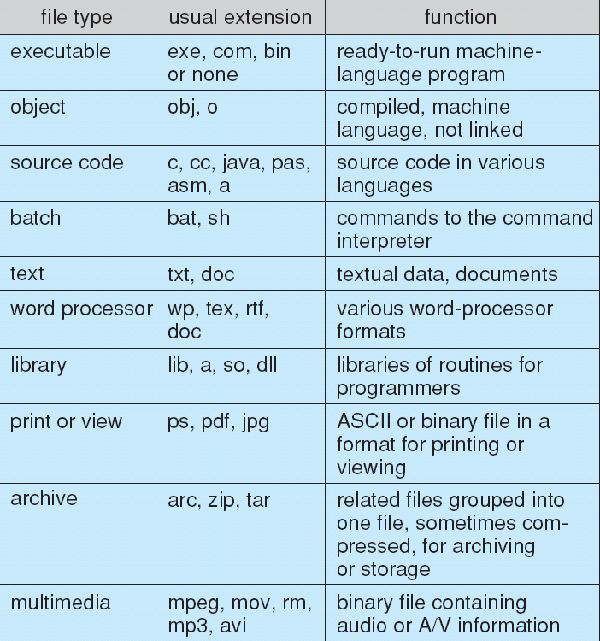
File Types – Name, Extension

Slide 12
File Structure
None - sequence of words, bytes
Simple record structure
Lines
Fixed length
Variable length
Complex Structures
Formatted document
Relocatable load file
Can simulate last two with first method by inserting appropriate control characters
Who decides:
Operating system
Program

Slide 13
Sequential-access File

Slide 14
Access Methods
Sequential Access
read next
write next
reset
no read after last write
(rewrite)
Direct Access – file is fixed length logical records
read n
write n
position to n
read next
write next
rewrite n
n = relative block number
Relative block numbers allow OS to decide where file should be placed
See allocation problem in Ch 12

Slide 15
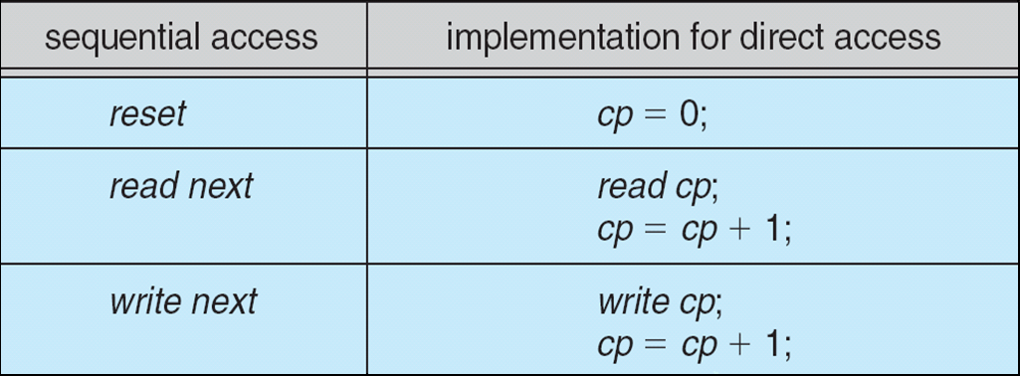
Simulation of Sequential Access on Direct-access File

Slide 16
Other Access Methods
Can be built on top of base methods
General involve creation of an index for the file
Keep index in
If too large, index (in memory) of the index (on disk)
IBM indexed sequential-access method (ISAM)
Small master index, points to disk blocks of secondary index
File kept sorted on a defined key
All done by the OS
VMS operating system provides index and relative files as another example (see next slide)

Slide 17
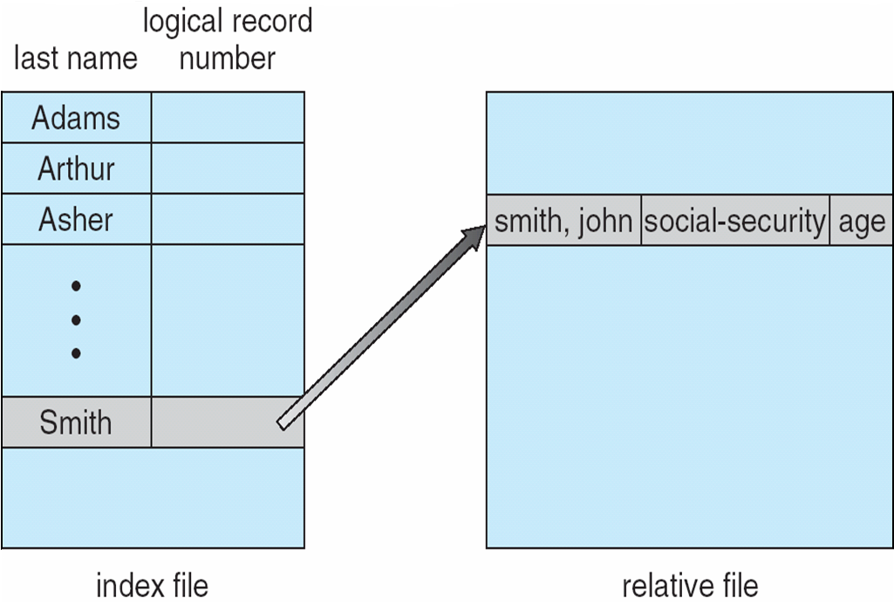
Example of Index and Relative Files

Slide 18
Directory Structure
A collection of nodes containing information about all files
Directory
Files
F 1
F 2
F 3
F 4
F n
Both the directory structure and the files reside on disk

