Slide 1
Exception Handling
Chapter 9

Slide 2
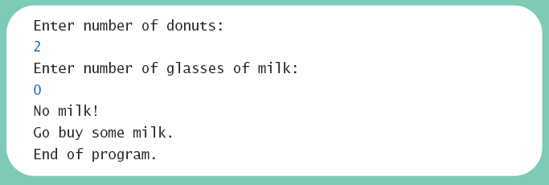
Exceptions in Java
Consider a program to assure us of a sufficient supply of milk
View possible solution, listing 9.1
class GotMilk
Sample
screen output

Slide 3
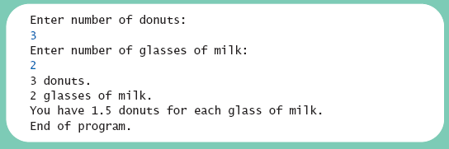
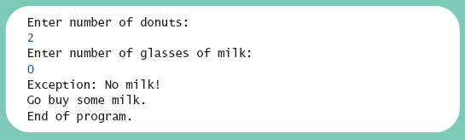
Exceptions in Java
Now we revise the program to use exception-handling
View new version, listing 9.2
class ExceptionDemo9_2 (9_2..9_4 same, see comments)
Sample
screen output 1
Sample
screen output 2

Slide 4
Exceptions in Java
Note try block
  Contains code where something could possibly go wrong
  If it does go wrong, we throw an exception
Note catch block
  When exception thrown, catch block begins execution
  Similar to method with parameter
  Parameter is the thrown object
  Parameter must “match” type of exception thrown

Slide 5
Exceptions in Java
Note flow of control when no exception is thrown
View demo with no exception, listing 9.3
class ExceptionDemo9_3
Sample
screen output with no exception

Slide 6
Exceptions in Java
Note flow of control when exception IS thrown
View demo with exception, listing 9.4
class ExceptionDemo9_4
Sample
screen output when exception is thrown

Slide 7
Exceptions in Java
An exception is an object – use pre-existing one or define your own
  Signals the occurrence of unusual event during program execution
  It represents an exceptional circumstance
  Some coders will use it for input validation
Throwing an exception – Code you write may need to throw an exception
  Creating the exception object
  Then throwing it
  Can say a method throws a (checked) exception
Handling the exception – Code you use or write may generate Exceptions that you have to, or want to, handle
  Exceptions can be caught (catched)
  Should be caught at some point where the code can deal with the exceptional circumstance

Slide 8
Predefined Exception Classes
Java has predefined exception classes within Java Class Library
  Can place method invocation in try block
  Follow with catch block for this type of exception
Example classes: note _______Exception pattern
  ClassNotFoundException – JVM not finding class file (class path error)
  IOException – General I/O Exception
  ArithmeticException – General arithmetic exception, e.g. division by zero

Slide 9
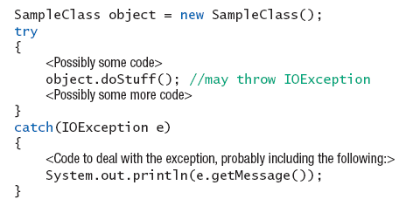
Predefined Exception Classes
Example code

Slide 10
Defining Your Own Exception Classes
Must be derived class of some predefined exception class
  Text uses classes derived from class Exception
View sample class, listing 9.5
class DivideByZeroException
extends Exception
View demo program, listing 9.6
class DivideByZeroDemo
View demo (does integral division) – can use predefined
class ArithmeticDivByZeroDemo

Slide 11
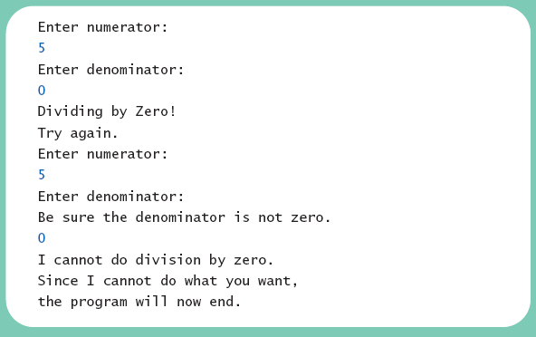
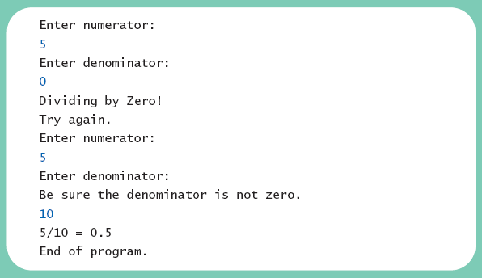
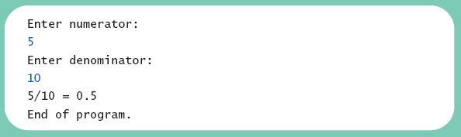
Defining Your Own Exception Classes
Different runs of the program
Sample
screen output 1
Sample
screen output 3
Sample
screen output 2

Slide 12
Defining Your Own Exception Classes
Guidelines
Use the Exception as the base class
Define at least two constructors
  Default, no parameter
  With String parameter
Start constructor definition with call to constructor of base class, using super
Do not override inherited getMessage
Note method getMessage defined in exception classes
  Returns string passed as argument to constructor
  If no actual parameter used, default message returned
The type of an object is the name of the exception class

Slide 13
More About Exception Classes: Outline
Declaring Exceptions (Passing the Buck)
Kinds of Exceptions
Errors
Multiple Throws and Catches
The finally Block
Rethrowing an Exception
Case Study: A Line-Oriented Calculator

Slide 14
Declaring Exceptions
Consider method where code throws exception
  May want to handle immediately
  May want to delay until something else is done
Method that does not catch an exception
  Notify programmers with throws clause
  Programmer then given responsibility to handle exception

Slide 15
Declaring Exceptions
Note syntax for throws clause
Note distinction
  Keyword throw used to throw exception
  Keyword throws used in method heading to declare an exception

Slide 16
Declaring Exceptions
If a method throws exception and exception not caught inside the method
  Method ends immediately after exception thrown
    i.e. regular order of execution
A throws clause in overriding method
  Can declare fewer exceptions than declared
  But not more
View program example, listing 9.7
class DoDivision

Slide 17
Kinds of Exceptions
In most cases, exception is caught …
  In a catch block … or
  Be declared in throws clause
But Java has exceptions you do not need to account for
Categories of exceptions
  Checked exceptions
  Unchecked exceptions

Slide 18
Kinds of Exceptions
Checked exception –Non-RuntimeException Exception
  Must be caught in catch block
  Or declared in throws clause
Unchecked exception – Descendent of RunTimeException
  Also called run-time
  Need not be caught in catch block or declared in throws
  Exceptions that coding problems exist, should be fixed
    When you know a problem exists it is better to simply report the exceptional situation and let the programmer fix it versus requiring the programmer to work backwards from the eventual side effects to the source

Slide 19
Kinds of Exceptions
Checked Exceptions – most prior examples are Checked
Examples why unchecked exceptions to are thrown
  Attempt to use array index out of bounds
  Division by zero
Uncaught runtime exception terminates program execution

Slide 20
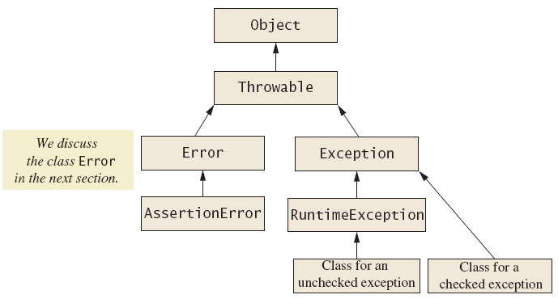
Kinds of Exceptions
Figure 9.1 Hierarchy of the predefined exception classes

Slide 21
Errors
An error is an object of class Error
  Similar to an unchecked exception
  Need not catch or declare in throws clause
  Object of class Error generated when abnormal conditions occur
Errors are more or less beyond your control
  Require change of program to resolve

Slide 22
Multiple Throws and Catches
A try block can throw any number of exceptions of different types
Each catch block can catch exceptions of only one type
  Order of catch blocks matter
View example program, listing 9.8
class TwoCatchesDemo
View exception class used, listing 9.9
class NegativeNumberException

Slide 23
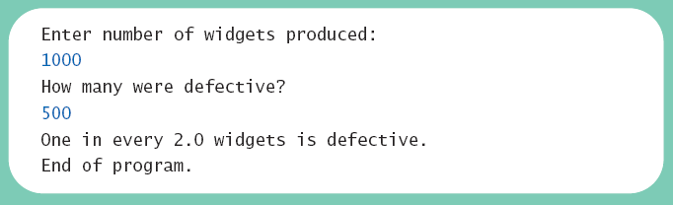
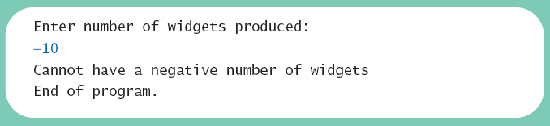
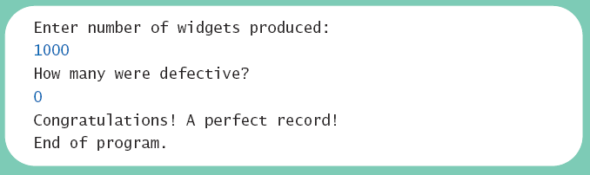
Multiple Throws and Catches
Note multiple sample runs
Sample
screen output 1
Sample
screen output 2
Sample
screen output 2

Slide 24
Multiple Throws and Catches
Exceptions can deal with invalid user input
To handle an exception thrown by a method
  It does not matter where in the method the throw occurs
Use of throw statement be should be reserved for cases where it is unavoidable
Text suggests separate methods for throwing and catching of exceptions
Nested try-catch blocks rarely useful

Slide 25
The finally Block
Possible to add a finally block after sequence of catch blocks
Code in finally block executed
  Whether or not execution thrown
  Whether or not required catch exists

Slide 26
Rethrowing an Exception
Legal to throw an exception within a catch block
Possible to use contents of String parameter to throw same or different type exception

Slide 27
Case Study
A Line-Oriented Calculator
  Should do addition, subtraction, division, multiplication
  Will use line input/output
User will enter
  Operation, space, number
  Calculator displays result

Slide 28
Case Study
Proposed initial methods
  Method to reset value of result to zero
  Method to evaluate result of one operation
  Method doCalculation to perform series of operations
  Accessor method getResult: returns value of instance variable result
  Mutator method setResults: sets value of instance variable result

Slide 29
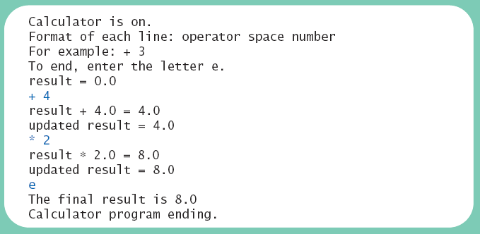
Case Study
View exception class, listing 9.10
class UnknownOpException
View first version of calculator, listing 9.11
class PreLimCalculator
Sample
screen output

Slide 30
Case Study
Final version adds exception handling
Ways to handle unknown operator
  Catch exception in method evaluate
  Let evaluate throw exception, catch exception in doCalculation
  Let evaluate, doCalculation both throw exception, catch in main
Latter option chosen

Slide 31
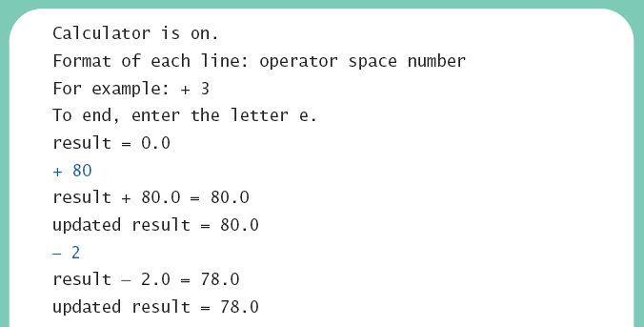
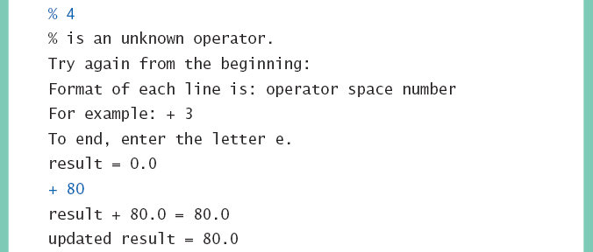
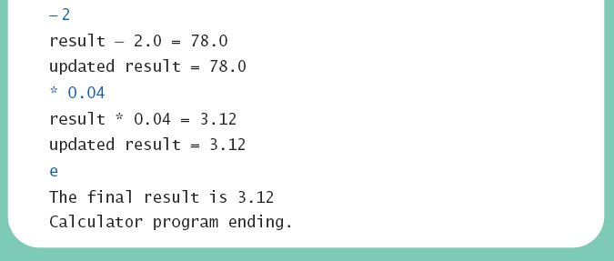
Case Study
View final version, listing 9.12
class Calculator
Sample
screen output

