Slide 1
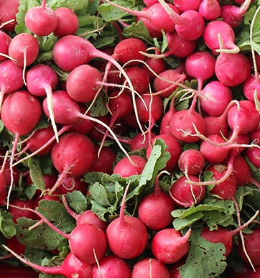
ICICLE.OSU.EDU
Opportunities and Needs in AI and CI for Direct Market Farming and Farmers Markets
Sadia Khan, PhD student, Informatics, Indiana University
Alfonso Morales Vilas Distinguished Achievement Professor and Chair, Department of Planning and Landscape Architecture, UW-Madison
Beth Plale, Burns McRobbie Bicentennial Professor of Computer Engineering, Executive Director of the Pervasive Technology Institute, Indiana University
Gabriel Wilkins, MS student, Urban and Regional Planning, UW-Madison

Slide 2



Bottom Line Up Front
Computer Science / Domain Science
Design Systems
Relate different organizations and knowledge systems
The AI Institutes work in WFD, BPC, PADI, and etc.
ICICLE connects farmers and AI in Digital Ag
…wildlife ecology and AI …smart foodsheds and AI
Ontology, KG, from edge inward, or at the edge, integrating various domain scientists, LLMs, etc
Relating AI institutes to each other, e.g. AI4Opt at GA Tech. on regional food logistics and food security.
DOMAIN SCIENCE NEEDS CS PARTNERS…
Improve Services
Enable answering difficult questions
Deliver Value
Decision-support, etc

Slide 3
ONE Partner - The Kaufman Lab
Alfonso Morales, Edna Ely-Ledesma
F2F collects key data
For institutions, farmers, and markets
The Kaufman Lab supports food system actors around the country. Food distribution, regulation and law, and marketplace organization are among our topics. Our farm2facts.org toolkit makes farmers market managers the PI of their market. For instance, the F2F toolkit (since 2014 supported by 19 USDA, NSF, and NIH grants, subawards, and contracts) is used around the country to foster food security, entrepreneurship, and climate smart agriculture.
...on ecosystem services
To support good environmental practices
...and economics
To support good purchasing decisions

Slide 4
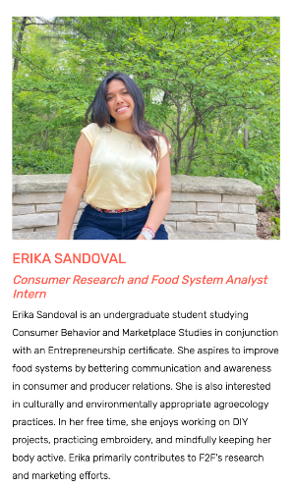
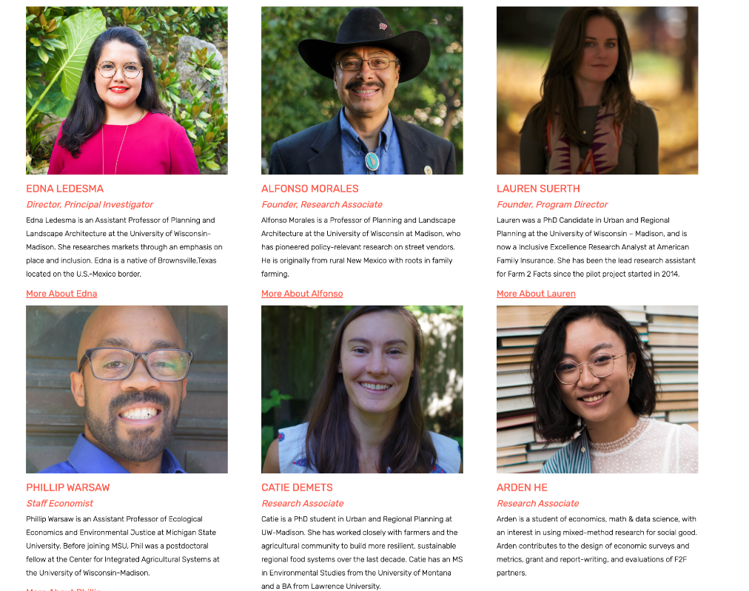
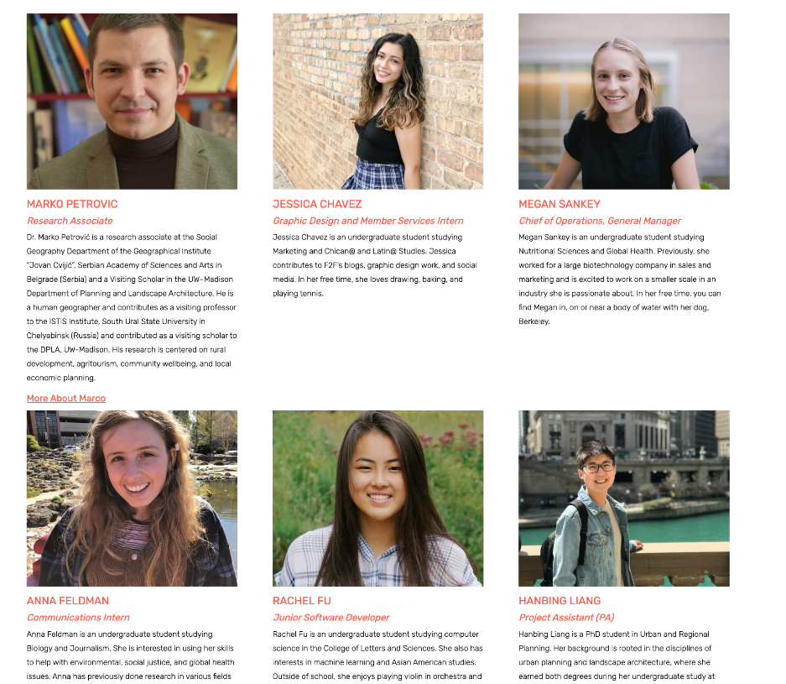
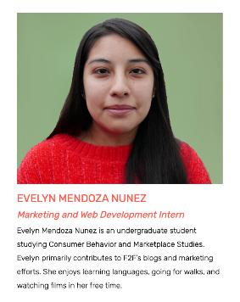

Who We Are

Slide 5


OUR PHILOSOPHY of F2F METRICS
PHILOSOPHY
MISSION
Practicing the co-creation and use of common and unique metrics.
Amplifying farmers market manager’s voice by delivering impactful tools (software and storytelling) to collect, analyze and visualize data.
VISION
Co-producing empowered markets enhancing communities in achieving their objectives.
ETHICS and VALUES
Ethics relate ends, interests, and values. Market manages vary all three. We foster JEDI, engagement, integrity, and innovation.
Notes:
How do we know? Science is social. Citizen Science capacitates orgs for interaction with academics, and academics to learn from community. Through partnerships deploying tools to achieve community and organizational goals and promote innovation in academic and community organizations. The mission of Farm2Facts is to lend farmers markets a voice in delivering impactful tools for data collection, analysis and visualization. We focus on empowering markets for community growth, and we do this through community engagement in citizen science, integrity, and innovation.

Slide 6
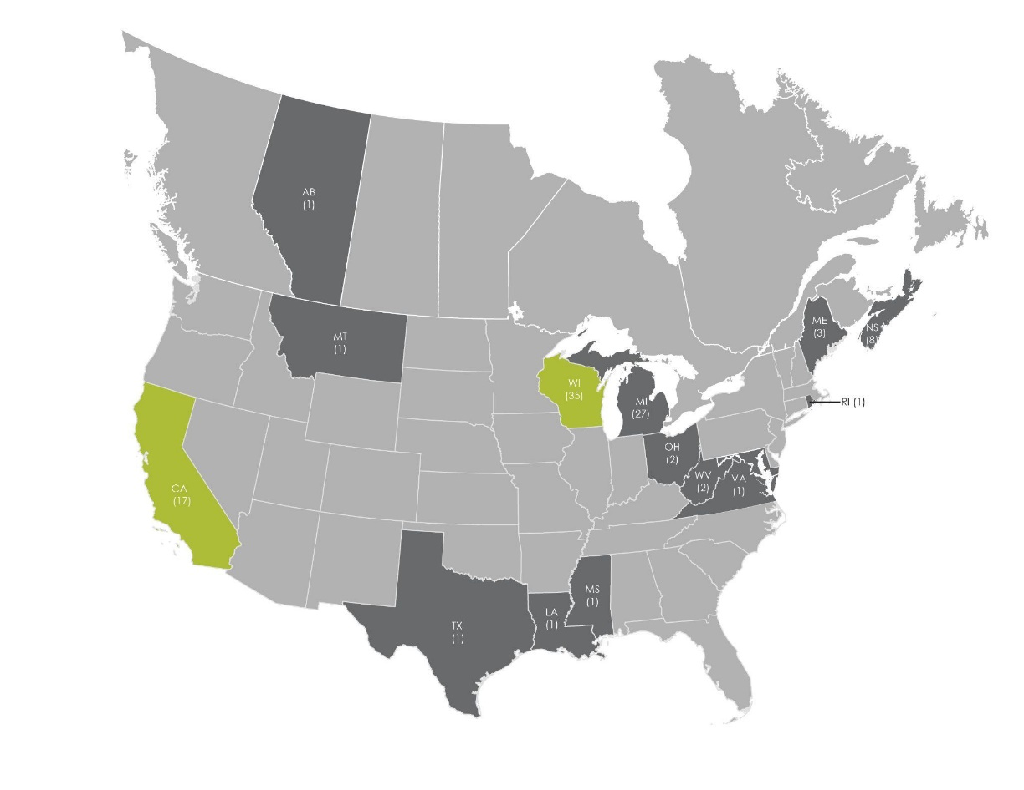
FARM 2 FACTS REACH
WISCONSIN
A.
FoodWise
FarmShed
CALIFORNIA
ACE
MICHIGAN
Michigan Farmers Markets Association
Notes:
The boundaries of F2F as a service are permeable and increasingly wide. Due to its experimental nature as a program born from a research lab, as well as the range of expertise among the concurrent F2F employees/Kaufman Lab members, the services of F2F are always emergent. F2F member markets and market organizations are often the initiators as well as the beta testers of new metrics. For example, Farmers Markets of Nova Scotia (FMNS) suggested that an LGBTQ+ vendor be added, and the feature was subsequently deployed exclusively to FMNS markets.
These services won immediate interest in the U.S. and Canada and F2F became a subcontract on a number of grant awards. Since it’s development, F2F has expanded its reach beyond Wisconsin working with farmers markets across twelve states in the U.S., and one Canadian province. This maps shows the number of market partners by state. This year we solidified new partnerships which will expand our reach to Michigan and Texas.
Over time the F2F toolkit and team has grown to provide customized marketing support, custom data analysis, custom metric creation, support in market design and place-making for cities and towns, as well as continued scientific development, policy work, and specialized data collection to support the local food sector and farmers markets in particular. In short, F2F is now a one stop shop for many types of needs market managers have.

Slide 7
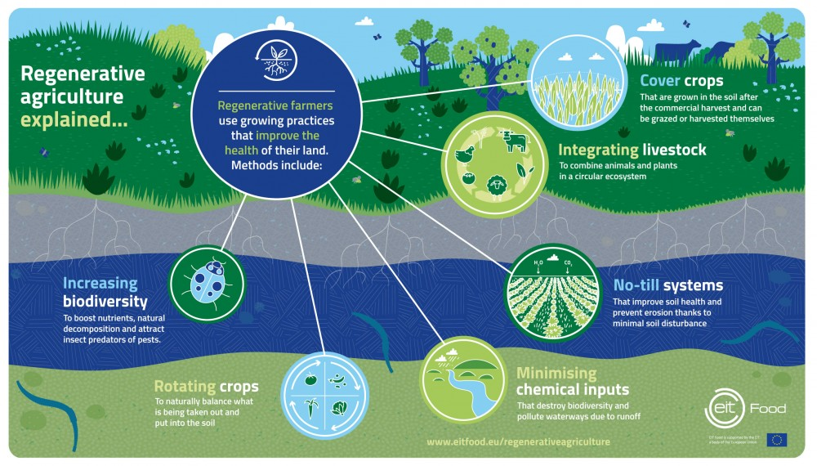
Ecosystem Services Metric
Notes:
Now I want to talk a little bit about one of our latest features/services within F2F. We all know that farms, especially those practicing generally sustainable or regenerative practices, are providing important ecosystem services. These are practices like cover cropping, integrating livestock, no-till systems, minimizing chemical inputs, rotating crops, and increasing biodiversity. These things all seem really great -- farms doing this stuff MUST be having positive impacts, right?

Slide 8
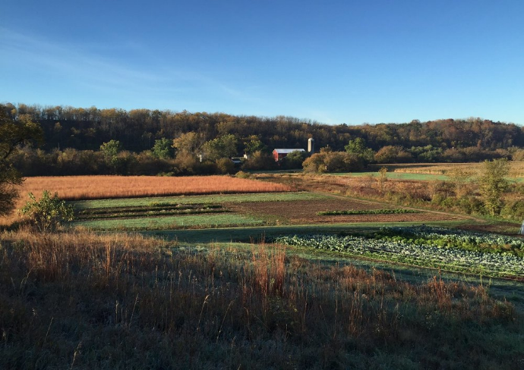
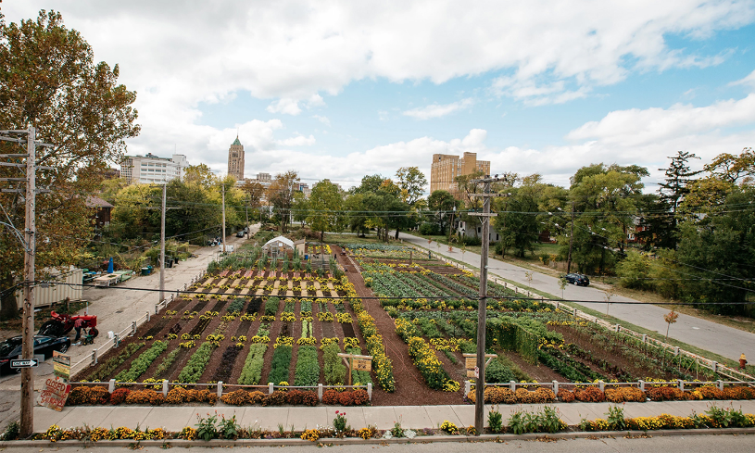
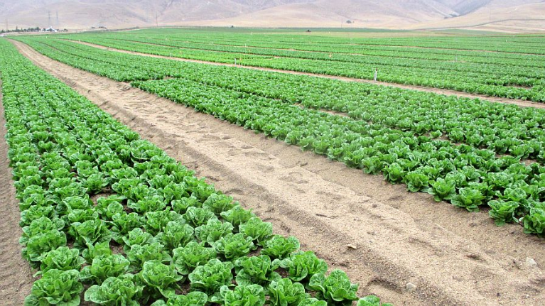
Ecosystem Services Metric
???
© Michigan Urban Farming Initiative
© Plowshares & Prairie Farm
© growingproduce.com
Notes:
Or at least we THINK they’re having positive impacts. But, turns out, it’s pretty hard to quantify! What is the impact of these practices specifically? And how does collective action add up when lots of farmers are ALL doing these practices? A lot of farmers are left making statements about their practices that can be hard to back up because they’re so challenging to track and quantify. This is especially true for farms that might look like this (point), where they have a patchwork of many different practices and conservation measures, or this (point), an urban market farm whose ecosystem functions might be just a drop in the bucket, but are still a critical drop in the bucket that we want to know about! Compared to this (point), whose carbon impacts might be more easily measurable but which doesn’t serve any of the same other kinds of social or economic functions for local community or quality local food access (and clearly that soil isn’t looking very healthy or alive either).
We’ve talked with a lot of farmers and farmers markets and institutions including hospitals across the US and in Canada who really want to know more about their farms’ ecosystem impacts and be able to tell that story of impact. This is where Farm2Facts comes in. (CLICK)

Slide 9

Ecosystem Services Metric
Alternative Power
Soil Health
Biodiversity
Livestock
Infra-
structure & Machinery
Hauling to Markets
Notes:
Prompted by FMNova Scotia in 2019, we’ve been working on developing a tool that captures an array of information about on-farm ecosystem services. This is especially challenging for small, diverse, integrated farms, whereas for many commodity operations there’s a lot more uniformity and neat boxes to capture information about practices. This is why there are already several tools that can support large farms in quantifying soil carbon storage for carbon market purposes, but there are not many robust tools yet available for capturing this kind of information on small farms. Our tool is helping fill that gap.
Actually, our tool does a lot more than capture just information about soil carbon storage, because the farms we work with are providing many more important ecosystem functions than just sequestering carbon! We’re collaborating closely with a variety of farmers and other sustainable ag experts across the US to identify six key areas of ecosystem services (point): soil health, livestock, on-farm infrastructure and machinery, hauling to markets, biodiversity, and alternative power.

Slide 10
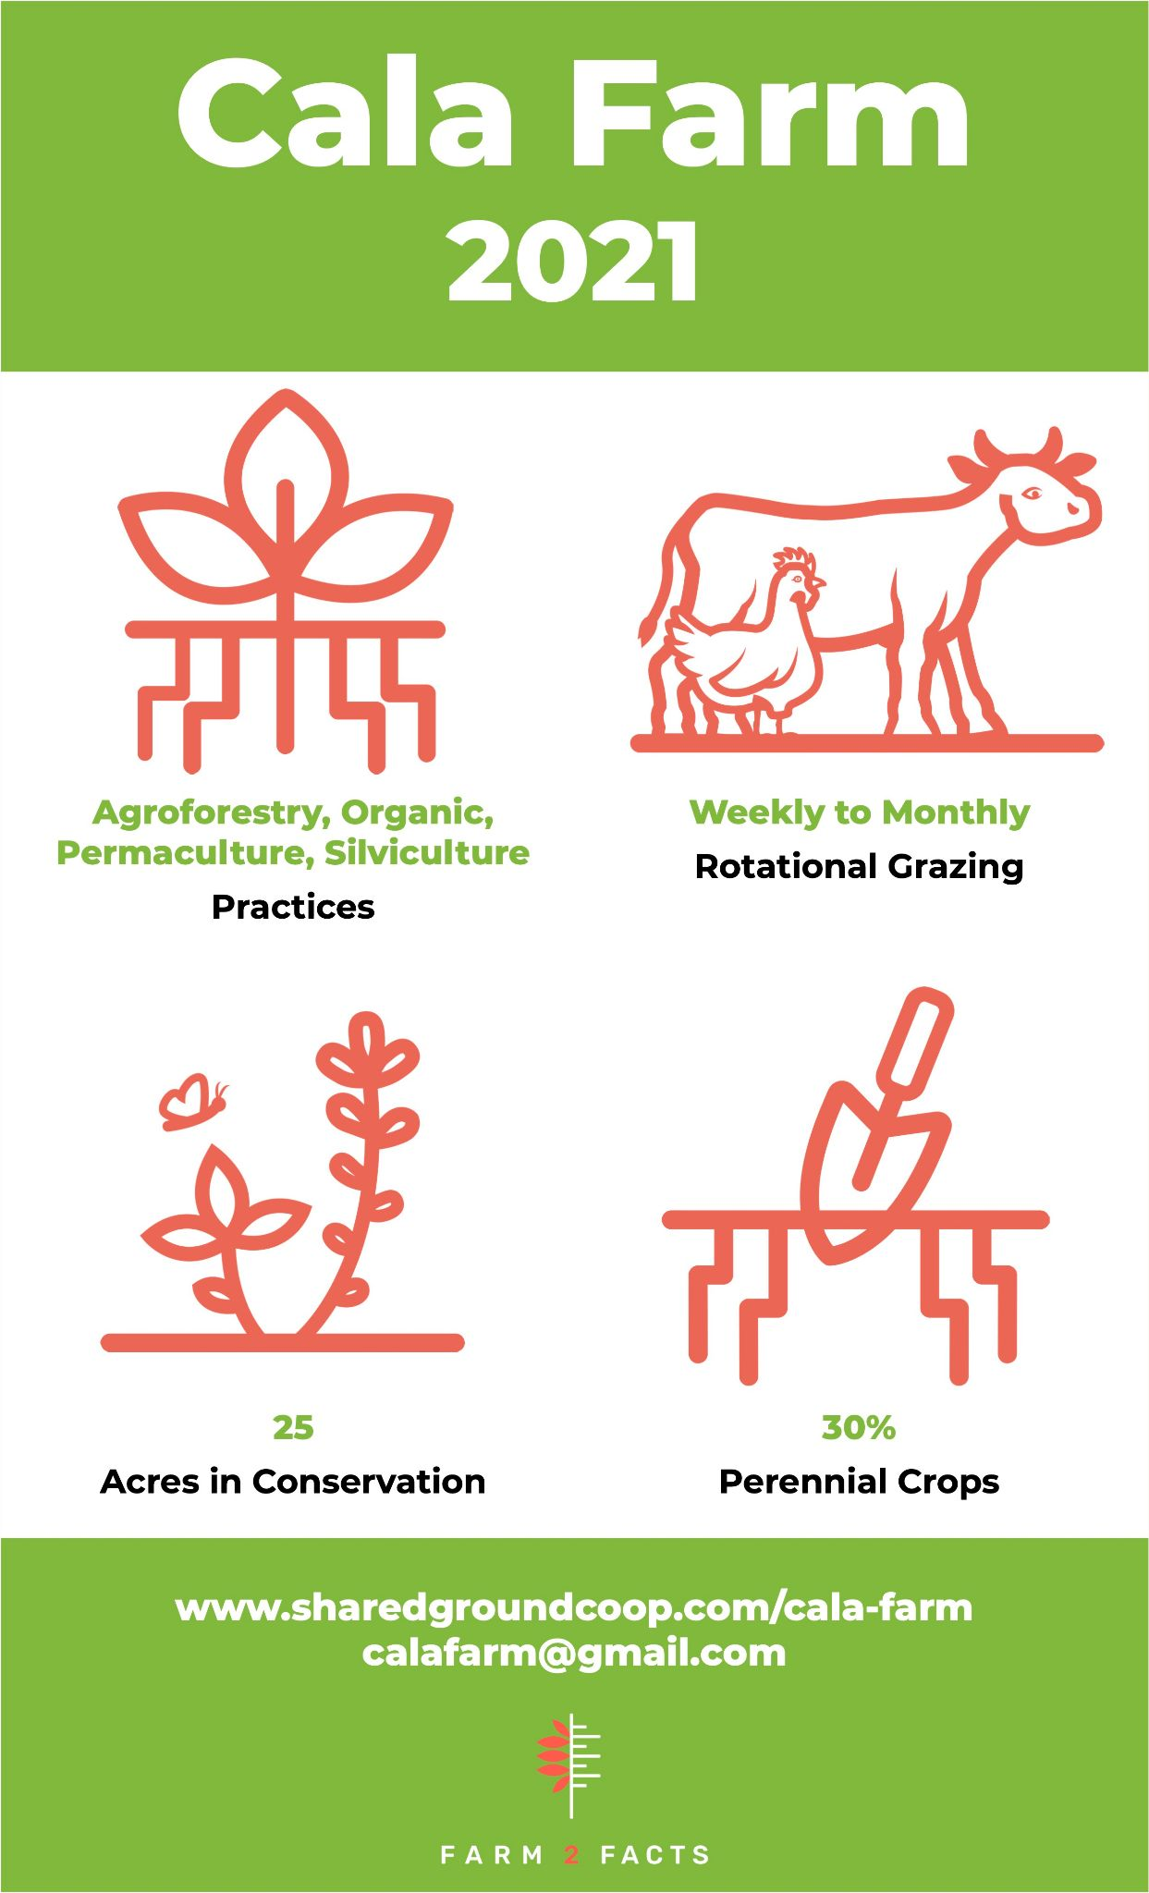
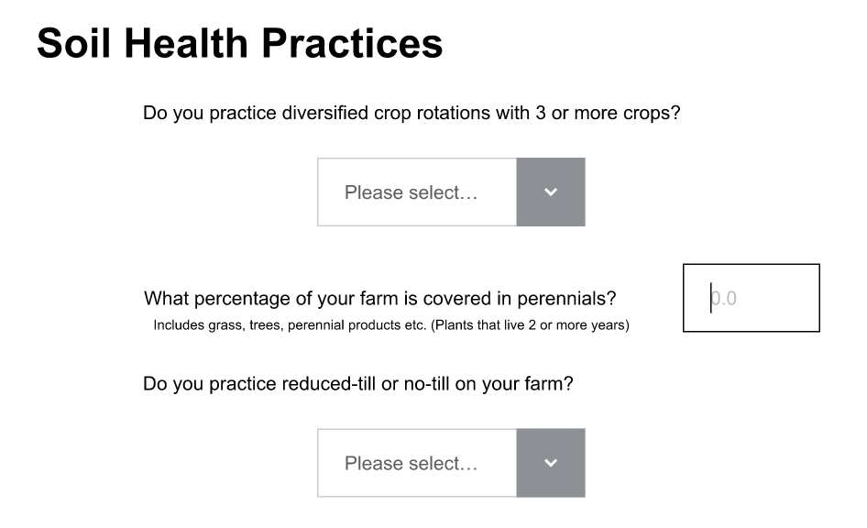
Ecosystem Services Metric
Notes:
Within these categories, we tested a streamlined series of questions that farmers will get asked as part of their farmers market or institution’s membership with Farm2Facts. During the piloting face the testing of the questions was an iterative back-and-forth process with farmers to help us refine and clarify our questions to make sure we’re capturing the most important information. This is a small sample of the kinds of questions we’ll be asking and what it will look like for farmers responding to the survey.
Within each of the six key areas from the last slide, we’ll be giving the farmer an additive score that will allow them to really highlight the good work that they’re doing. It will also encourage them to think about opportunities for improvement in areas where they might not be as strong. Farmers will get a copy of their responses for their internal use, and a colorful, customized infographic similar to ones we create for other metrics within Farm2Facts, like this (point), that they can use to market their practices at the farmers market or through other channels.

Slide 11
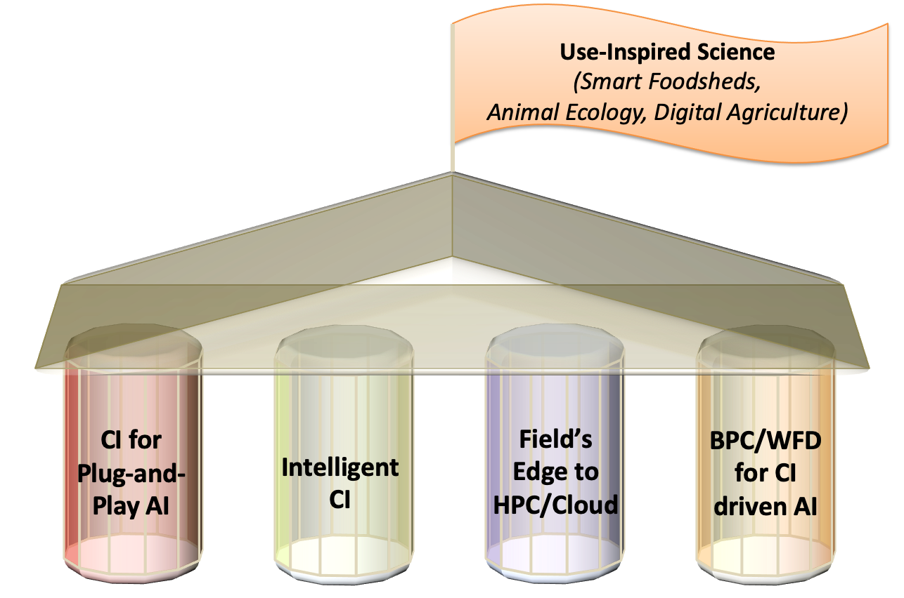
The future: AI/CI
Icicle.net 20m NSF AI/CI institute
OSU-DK Panda and 13 organizations
Democratizing AI ethically

Slide 12

Integrating software into CI
Cyberinfrastructure is a set of cloud-hosted services
Frameworks exist, and are being improved, for integrating desktop tools to work with cloud services
Tools often communicate with cloud services through Application Programming Interfaces (APIs)
New digital tools (e.g., drones, smart devices, field sensors) pose new challenges to integration
AI could facilitate this cyber communication and improve human-machine interaction

Slide 13
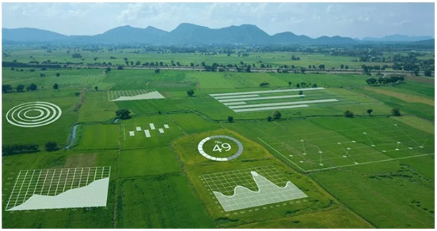
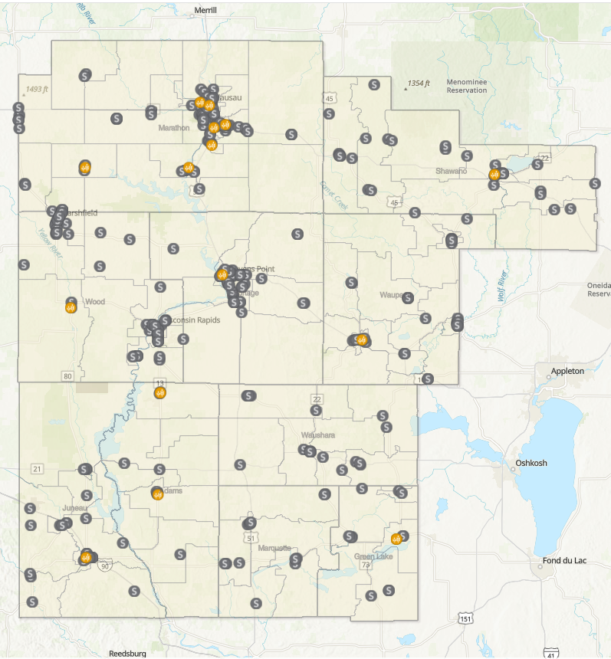



Incorporating Geographic Information Systems
Maps for Metrics
Foodsheds, supply chains, and market networks
Remote Sensing
Monitoring crop health, biodiversity, and trends over space and time
Maps for Marketing
Showcase local food networks, farm organization, wildlife habitat restored

Slide 14
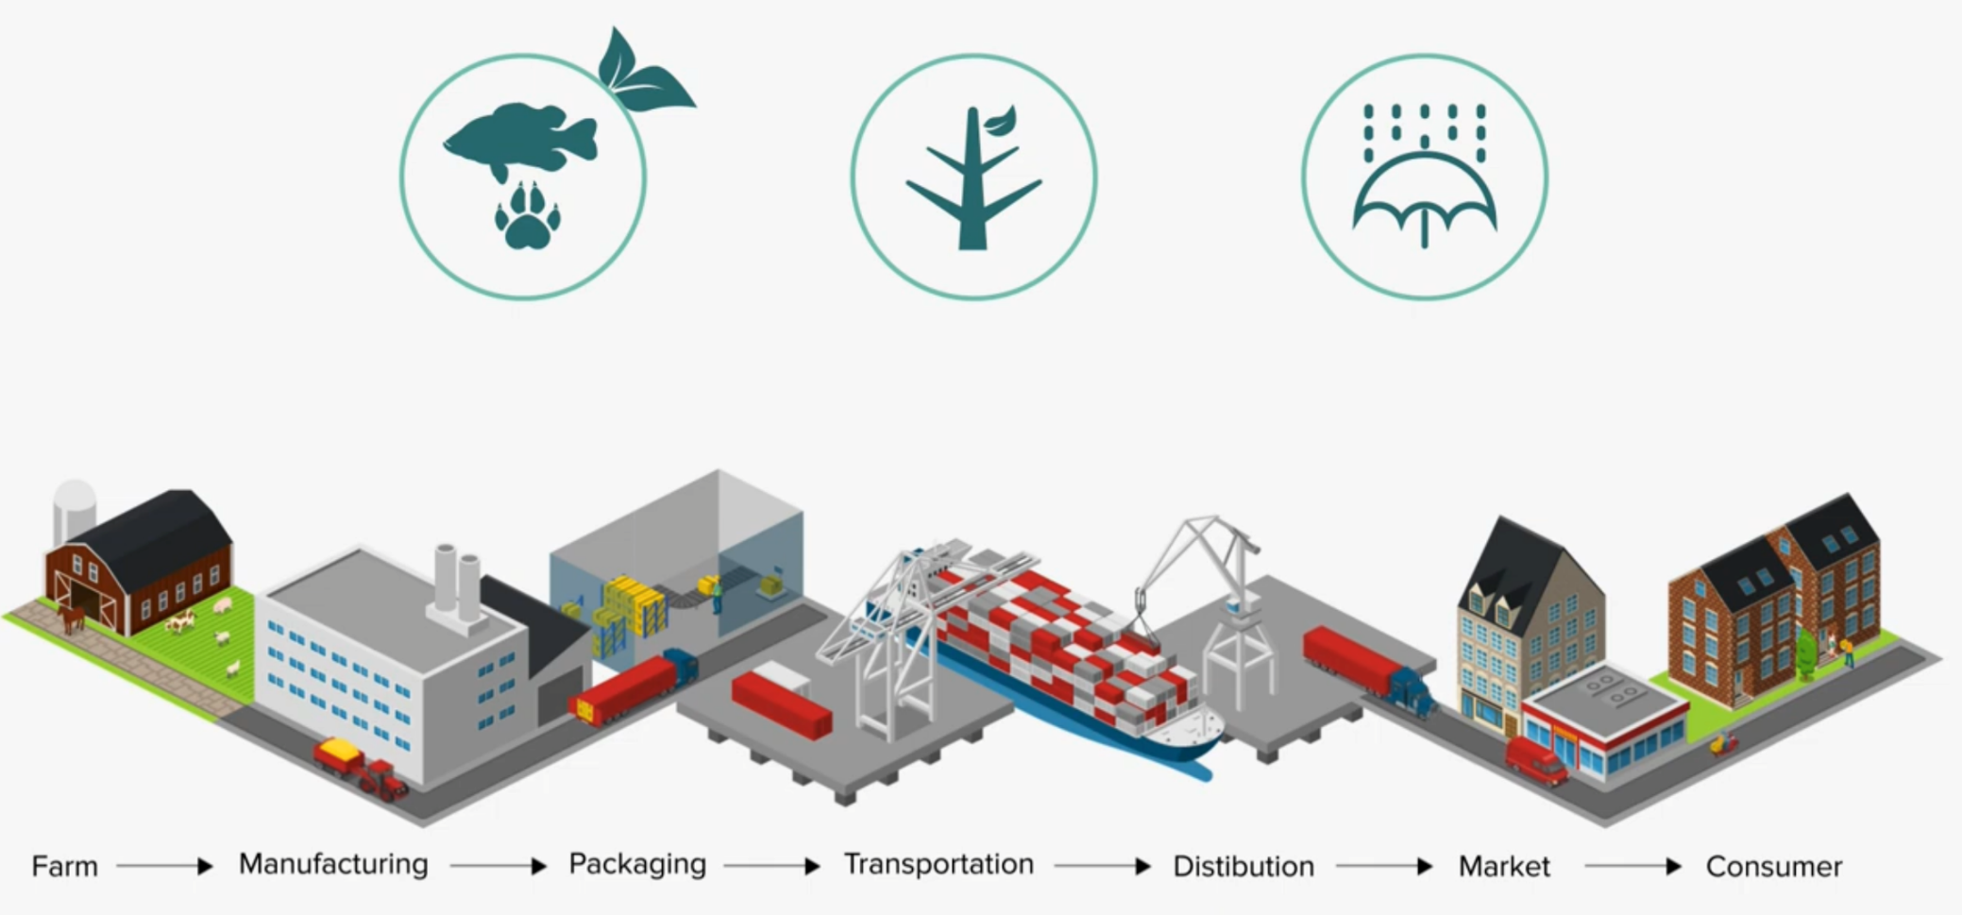
ICICLE AI Institute – Supply Chain Processes/Practices

Slide 15
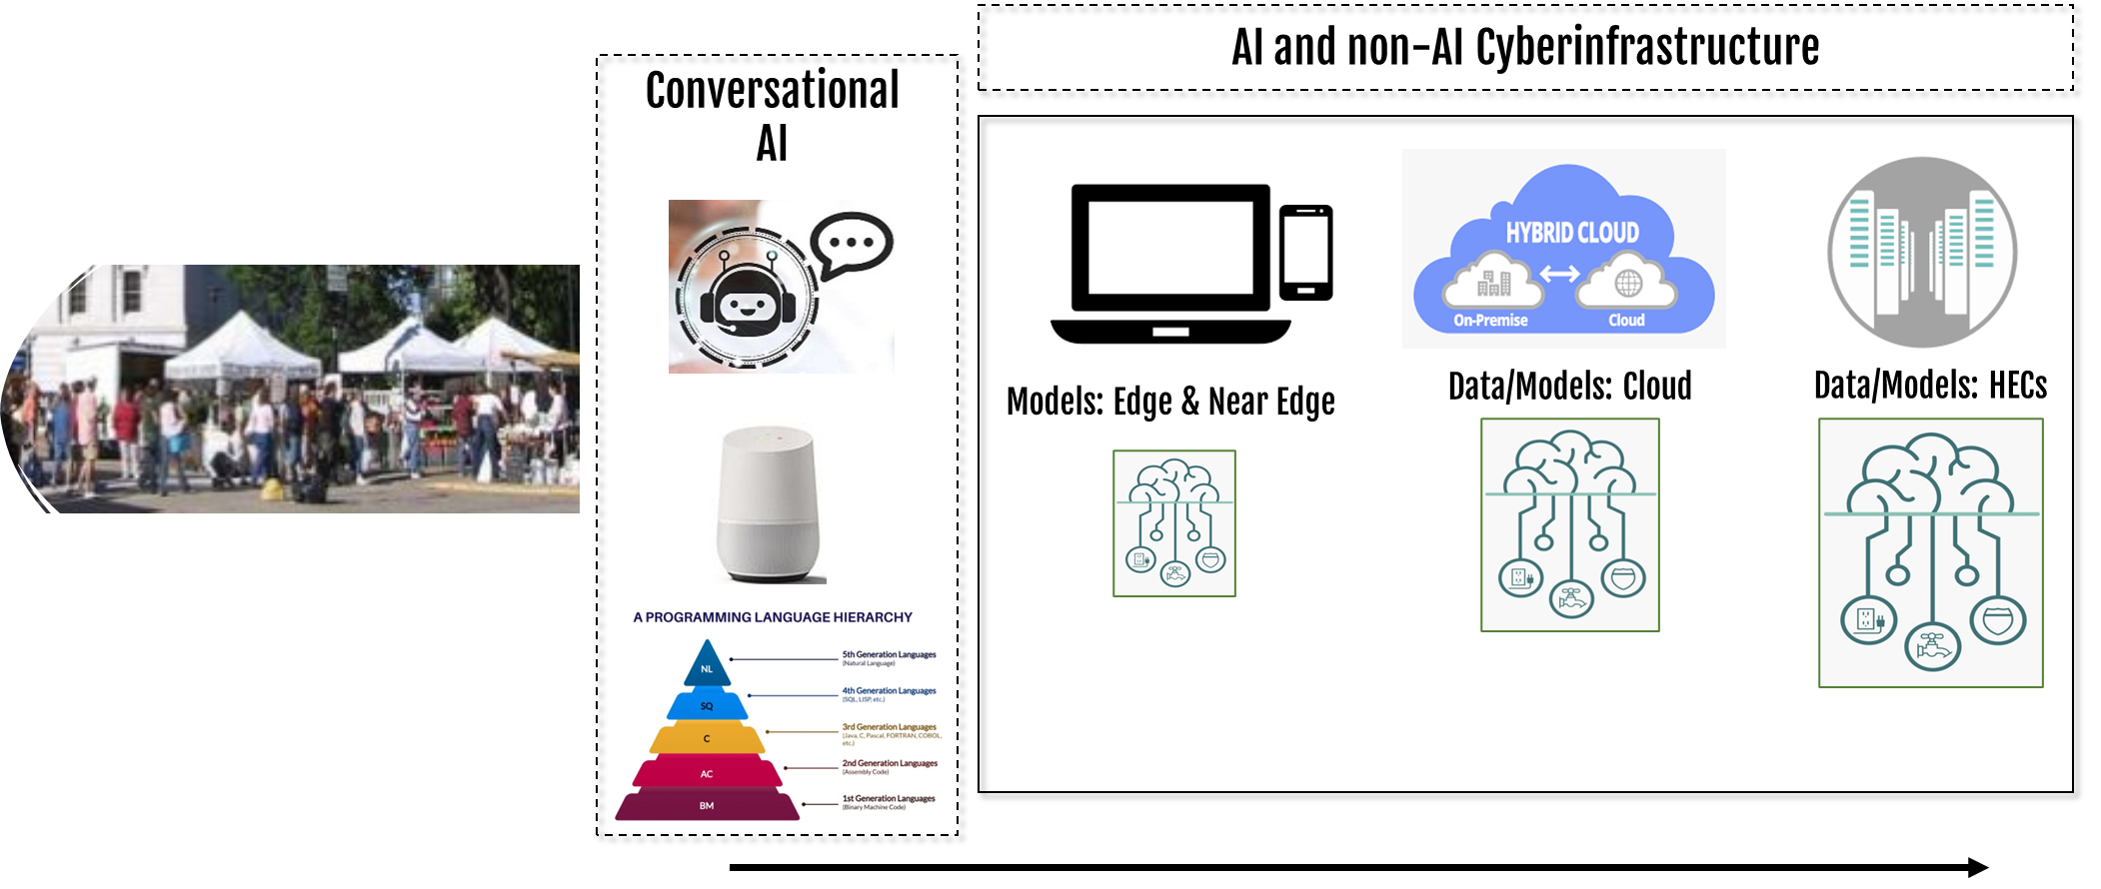
Market creativity in context: how AI helps

Slide 16
Software for the non-professional, e.g.
Farm2facts.org
Dignity/Self Representation
Acknowledging Interaction and Perspective
Foster Consent/Autonomy
And appropriate Interdependencies
Enables decision-Support
for local government and other users
Distribute Power/Control
Enable Planning, Preparedness and Responsiveness
Complimentary Software, e.g. for GIS
Dimensions of Privacy
Dimensions of Software Integration
Multiple and Divergent Perspectives

Slide 17
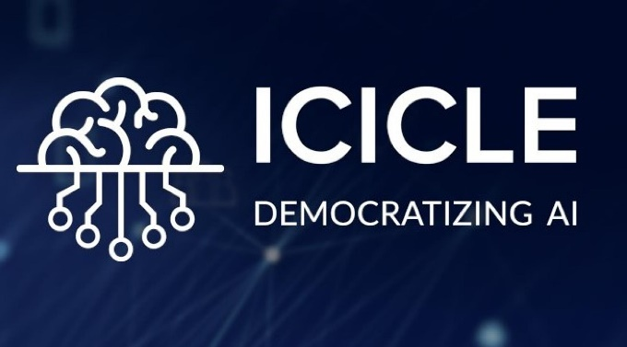
Centering ICICLE within the landscape of
AI ethics:
Resurfacing historical concerns around moral norms and justice
(STS and Information Theory)
Drawing on contemporary work on AI ethics
(participating in the discourse on FAIR /FACT and ethical AI)
Bringing real-world issues of bias and social harm into focus
(thinking about stakeholders in the context of the risks of AI)
Implementing contemporary data security best-practices
(Building off the Census Bureau’s differential privacy and statistical safeguards)
Notes:
We use ally tips to build DEI into workforce and through ethics tips we try to bring awareness of ethical issues within ICICLE. Through a series of videos, we build awareness that AI is not inevitable and encourage forethought about ethical implications among those working on the ICICLE project. In each video, we do the following:

Slide 18
Public/Private Disclosure of Facts
Dignity/Self Representation
Consent/Autonomy
Intrusion Upon Seclusion
Power/Control
Right to be Let Alone
Dimensions of Privacy
Dimensions of Privacy
False Light
Prosser (1960)
Warren and Brandeis (1890)
Prosser (1960)
Prosser (1960)
Prosser, W. (1960). Privacy, 48 California Law Review 383. (Prosser divided privacy into four tortious acts.)
Warren, S. D., & Brandeis, L. (1890). Warren & Brandeis, The Right to Privacy, 4 HARV. L. Rv. 193 (1890). Harvard Law Review, 4 (5), 193.
Notes:
we define one ethical concern, such as privacy concerns

Slide 19
Human Threatened species
Places as ‘Persons’ and rights of species
Habitat Preservation
Human Use (or exploitation) of Ecosystem Data
Habitat Restoration
Climate change – or second-order threats
Dimensions of Privacy
Aspects of Non-human Privacy

Slide 20
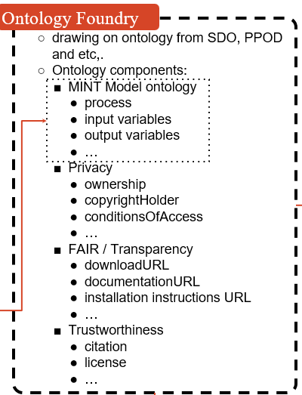
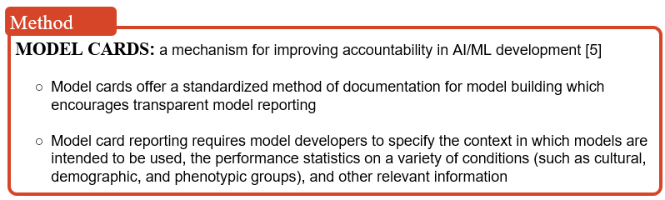
Use model cards to build trust through accountability and contextuality.
Model cards need regular revisiting as conditions/perspectives (e.g., regulatory) change
MODEL CARDS: a mechanism for improving accountability in AI/ML development
Model cards offer a standardized method of documentation for model building which encourages transparent model reporting.
Model card reporting requires model developers to specify the context in which models are intended to be used, the performance statistics on a variety of conditions (such as cultural, demographic, and phenotypic groups) and other relevant information.
Model cards must be regularly revisited as conditions (e.g., regulatory, technical) change
Notes:
And we implement solutions to operationalize concepts such as trustworthiness. In this case, model cards.

Slide 21
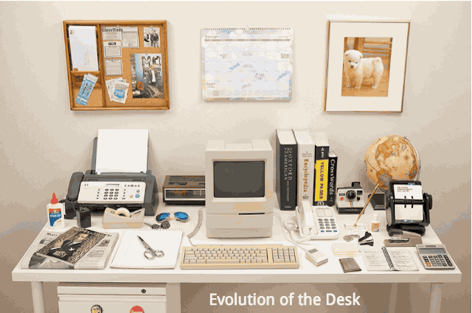
Farms, Markets, AI, and Trust
Vendors and Consumers start with interest(s),
Markets realize those in a trusting context, produced by vendors, and stakeholders
Trust developed and modified by relationships and knowledge of data/AI tools/processes
AI may enable data synthesis across existing data tools and data collection practices
Earning and deserving that trust depends on transparency and ethical AI development

Slide 22


Summary & Conclusion
How do we know?
F2F collects key data
Assumptions, research, risks, relationships, trust (iterative and reciprocal)
On ecology and economy for institutions, farmers, and markets
Cyberinfrastrucutre adds capabilities
ICICLE enhances and grows these efforts
Ethics must be prioritized
From the conceptual beginning through to flexible, in-field improvements

Slide 23

Questions?
Alfonso Morales
morales1@wisc.edu
farm2facts.org
info@farm2facts.org
Notes:
Thank you for your time, and now I open up for questions.

