Slide 1
Checkers is Solved
By Kevin Madison and Emma Drobina

Slide 2
Solving Games
Superhuman playing ability =/= solving
Ultraweakly solved - Prove whether the first player will win, lose, or draw from the initial position, given perfect play on both sides. (Often considered the most interesting solution classification as an ultraweak solution requires reasoning about the abstract properties of the game.)
Weakly solved - Provide an algorithm that secures a win for one player, or a draw for either, against any possible moves by the opponent, from the beginning of the game.
Strongly solved - Provide an algorithm that can produce perfect moves from any position, even if mistakes have already been made on one or both sides. (Brute force approach)

Slide 3
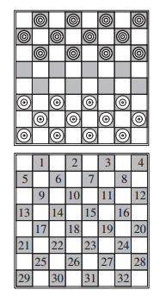
Checkers
Checkers has been weakly solved
Checkers has 5 x 10^20 positions
Most computationally complex game solved to date

Slide 4
Background
1963: First AI victory in checkers
1989: Chinook program began
1992: World champion beat Chinook
1996: Chinook a stronger player than any human

Slide 5
How hard is it to solve a game?
Decision complexity
Moves require skill
Space complexity
Search space size

Slide 6
Solving Checkers
Endgame databases (backward search)
Proof-tree manager (forward search)
Proof solver (forward search)

Slide 7
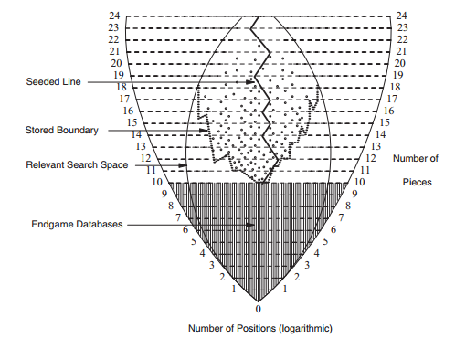
Forward and Backward Search

Slide 8
Backward Search
The technique used in backward search is retrograde analysis.
It works by starting at an end-game position and working toward the start, first enumerating all one-piece positions (a trivial win for the side of the piece) then enumerating all two-piece positions until arriving at a one-piece position with a known value or a repeat position (a draw).
The database is comprised of all board positions with <= 10 pieces.

Slide 9
Forward Search
Proof-tree manager
Builds the proof by identifying positions that need assessment
Maintains the proof as a whole
Uses Proof Number search algorithm
Proof solver
Searches individual positions
Evaluates to see if a position is
Proven
Partially proven
Heuristic

Slide 10
Forward Search Cont.
Alpha-beta search
Widely used for games
Depth-first, left-to-right
Df-pn algorithm
Variant of Proof Number search

Slide 11
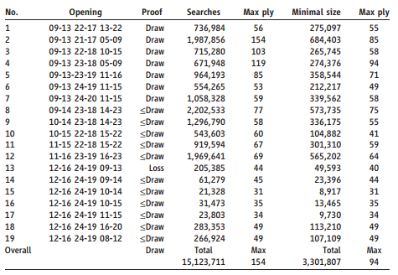
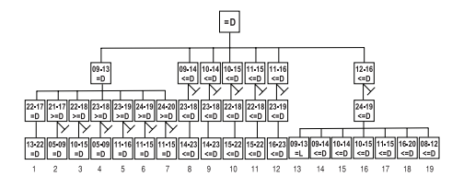
Results
Checkers is a draw
No errors were found when compared to human analysis

Slide 12
Conclusions
Advancements made in both AI and parallel computing
Predicts increase in importance of search-intensive approaches to AI
Chess will remain unsolved for the foreseeable future

Slide 13
References
Jonathan Schaeffer, Neil Burch, Yngvi Bjornsson, Akihiro Kishimoto, Martin Mueller, Robert Lake, Paul Lu, Steve Sutphen. "Checkers Is Solved." Science, 317, 14 September 2007, 1517-1521.

