Slide 1
Job Fair Preparation
Update your resume, prepare for the job fair with employer research & know how to network/capitalize on this experience to search for internships!

Slide 2

Raise your hand if….
Are looking for a summer 2023 internship or co-op?
Asking yourself what companies you can work for upon graduation?
Curious to what jobs you can do with your major and what responsibilities they entail?
What step(s) should you take in the next few semesters to get you to your career goals?

Slide 3
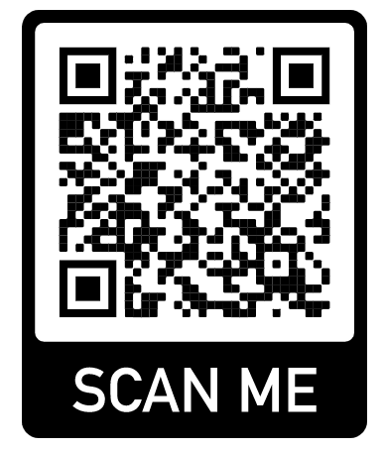

Helpful Knowledge & Links
UofSC Students Trello page for documents & assistance
HANDSHAKE = https://sc.joinhandshake.com/
What does the Career Center do?
More than just the resume place → Here to
assist you with anything regarding the topics
to the left & utilize Handshake to promote success!
Lifelong career management skills ☺
Located in Swearingen 1A03 next to Wired Cafe

Slide 4
Upcoming Career Fairs
STEM Job Fair → 3 Days!
  Wednesday, September 28th = VIRTUAL in Handshake from 12-4pm
    You MUST register for this day and sing up for group or individual sessions through Handshake → Let us know if you need to cancel!
  Thursday, September 29th = In-Person @ the Carolina Coliseum from 12-4pm
    We have 120 employers coming of all STEM Majors for jobs/internships
  Friday, September 30th = In-Person @ the Carolina Coliseum from 10am-2pm
    We have 70+ employers coming of all STEM Majors for jobs/internships
    Some of these employers will overlap from the day before
    We recommend coming to BOTH in-person days based on the research you do!

Slide 5





BEFORE THE FAIR
Take the following steps seriously BEFORE you attend the fair to be prepared
Create a checklist for yourself of what to complete before the fair
Get started early to avoid stress or not being able to research companies, update your resume and/or meet with a career coach, if needed!
Believe in yourself and practice being confident and meeting new people!
Craft Your Research Practice Prepare
Professional & Develop Your Elevator for the
Documents a Plan Pitch Day of

Slide 6
Create/Update your resume
Reminders on formatting & how to build a tailored resume, emphasize your academic projects/achievements, experiences (career-related or other) and your skills!

Slide 7
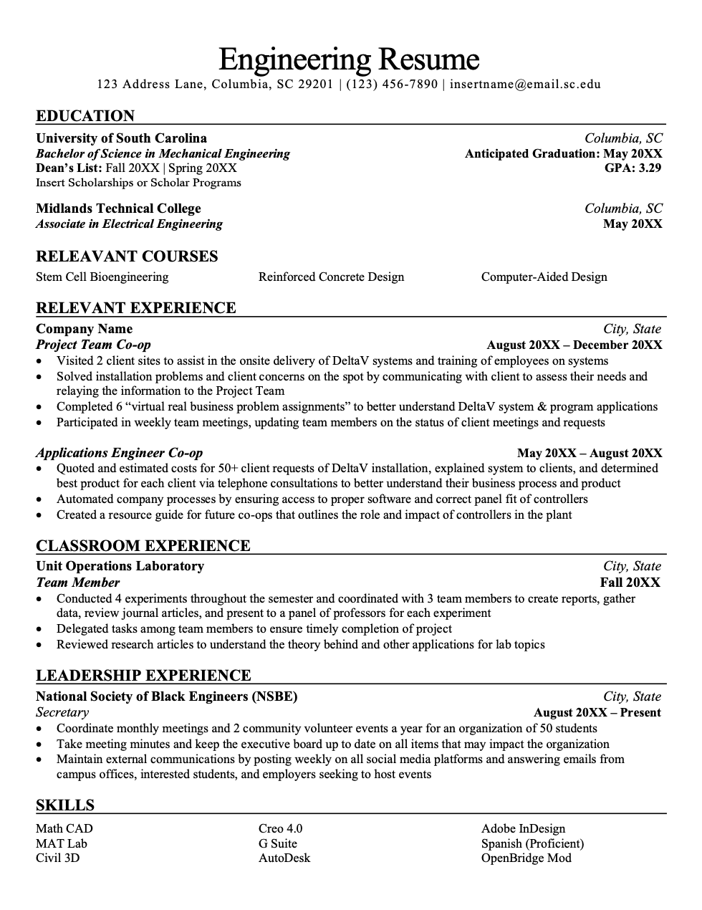
Resume appearance
Page length → 1 page
Margins → 0.5-1 inch
Font Style → Times New Roman, Arial, Calibri
Font Size → 10-12 pt. *Only exception is your name (14-18 pt.)
Spacing → Single-spacing between bullets/content
Double-spacing between sections/headers
Emphasis → Bold, italics, UPPER CASE, underline
No colors
*** Your format will assist in impressing potential employers!
Notes:
We’ll start by cleaning up the format and appearance. This, not the content, is what’s going to give the employer the very first impression of your resume. For current undergraduate students, your resume generally shouldn’t exceed 1 page. This might require cutting some sections, condensing, and being as concise as possible. For graduate students, 2-3 pages is fine. For those with experience prior to pursuing their degree: the “rule of thumb” is that you can add 1 page for every 10 years of relevant experience you have. Regardless of the number of pages you’re working with, each page on your resume needs to be a full page, no half- or quarter-pages, please! Margins should be between half an inch and one inch. In Microsoft Word, you can click on the “Layout” tab and choose the “Narrow” margins option to save you some room. Keep the font style clean, professional, and between sizes 10 and 12. Whatever size you choose, everything on the resume should be that size. The only exception to this is your name, which can be between size 14 and 18. This creates visual consistency. Keep to single-spacing for your content, except for double-spaces between section headers. Rather than use color, instead rely on the consistent use of bolding, italics, underlining, and/or using all capital letters. Lastly, please avoid templates. We suggest building your document from scratch. It will look much cleaner, employers will be able to find the information they need faster, and it will be much easier for you to edit and update.

Slide 8
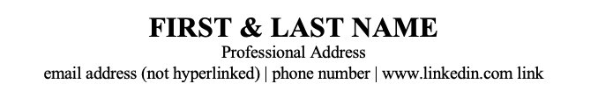
Header
Full Name
Phone number
Professional Email Address
Address (optional)
  Permanent and/or local
  Or location (city, state)
Personal Website or LinkedIn (optional)
  Remove hyperlink (blue font and underline)
  Personal website could be a GitHub or link to your personal projects for employers to view and grasp an understanding of your technical achievements!

Slide 9
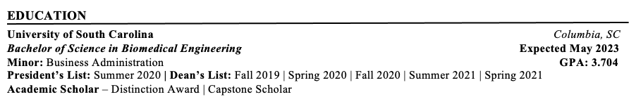

Education
Name of the school or university
  Reverse chronological order if more than one school
  City and state in which the school is located
  Expected graduation date (Month Year)
  Degree (Bachelor of…)
  Major, minor, concentration or specialization
  GPA if above a 3.0 (cumulative or major)
Awards/Honors/Scholarships
  Consider a separate section if more than 3
  Dean’s List, President’s List, Scholarship Programs, Honors College, Capstone Scholars
Study abroad experiences
Relevant coursework
  Typically, only specific majors need this
Notes:
In the education section, you need to include the name of the school where you earned a degree and the city and state in which it’s located. No need for the full mailing address. Include your expected graduation date, but do not include the date you started attending. List your accurate degree title and check the Academic Bulletin online to be sure about this. For example, some students are pursuing a bachelor of science in Public Health, and some are pursuing a bachelor of arts in Public Health. Include the name of your major, as well as any minor, concentration, or specialization you have. If your major or cumulative GPA is above a 3.0, go ahead and include either or both. If your GPA isn’t above 3.0, you don’t need to include it, but be prepared to talk about it with employers. If you are an alumni and have been out of school for about 2 years or more, you can take your GPA off your resume. This section can also include any awards you’ve earned, study abroad experiences, and a short list of relevant coursework. Your Education section can be listed up at the top of your resume if you are a current student or recent graduate, but once you’ve gained years of work experience you can move it down and have your Relevant Work Experience section above it. Note that after your freshman year, anything from high school really should be removed from the resume, unless it is 100%, directly relevant (as in, you interned during high school at the same company you are applying for now). If you’re a freshman that only has experience from high school, you can keep it on your resume for about a year.

Slide 10

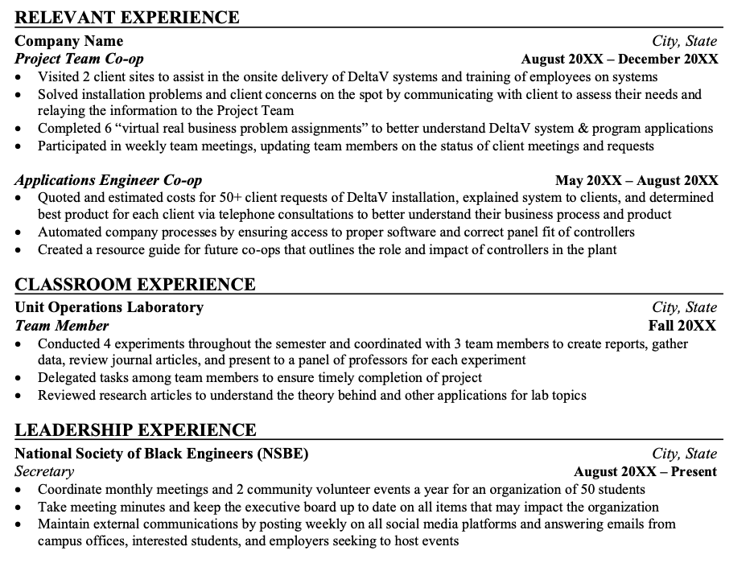
Experience
Start By Asking Yourself…
What experiences in my past support my career goals?
What experiences have I had that are relevant to this position?
Label Options
Work Experience
Relevant Experience
Research Experience
Volunteer Experience
Notes:
Alright, now we’re moving into the most content-heavy portion of the resume. This section is where you can really drive home the connection between your background and the position you’re applying for. To start, ask yourself: “What experiences in my past support my career goals?” As you reflect, begin jotting down notes about those experiences. Think about where you have demonstrated your technical proficiencies and where you have demonstrated that team spirit they talk about in the position description. Once you’ve done your brainstorming, start categorizing those experiences. What is directly relevant experience? Which experiences might be more important than others?

Slide 11
Sample Bullet Point Rewrites
“Took care of children” “Managed caretaking duties for 4 children ages 4-8, including planning educational, recreational, and social activities.”
“Worked in food service.” “Delivered exemplary customer service in high volume operations, completing an average of 15 transactions per hour.”
“Tutored students in math courses.” “Planned developmental activities designed to support student learning within 2 SI sessions per week.”
“Trained new employees.” “Onboarded 3 new employees per month, cultivating their skills and abilities to manage sales, create positive customer experiences, and be effective representatives of the company’s brand.”

Slide 12
Experience
Elements Include
  Employer Name
  Employer Location (City, State OR School)
  Your position title
  Dates of employment
Bullet Points
  Describe your most essential tasks and biggest accomplishments
  Use “formula” : Situation + Task + Action + Scope
  Use short, concise sentences (no more than 1-2 lines per bullet point)
  3-6 bullets per experience
  Describe “soft” (transferable) skills you utilized (e.g. communication, teamwork, customer service)
  Use Quantifiers e.g. #’s, %’s, and $’s
  Past tense for past experience(s), present tense for current experience(s)
Notes:
Once you have your categories created, it’s time to start putting that information on paper. So, every experience on your resume should contain the following components: - The name of the company or organization, - The city and state in which you worked. You can include the country if outside the United States as well. - Your position title, - The dates of your employment. Here, it’s okay to give a start date and an end date. Make sure it’s in the month year to month year format. - Finally, you always want to include strong bullet points. Each should begin with an action verb and describe your contributions to the organization. Having bullet points is your opportunity to make a case for yourself and highlight your skill sets. In them, describe your most essential tasks and your biggest accomplishments. These should be concise, and you should try not to exceed 6 bullet points per experience. In this section, absolutely do focus on your technical skills. However, this is your opportunity to also showcase your soft skills. Be sure to provide enough detail that the employer understands the context of the work you’re doing. Where possible and reasonable, use numbers!

Slide 13

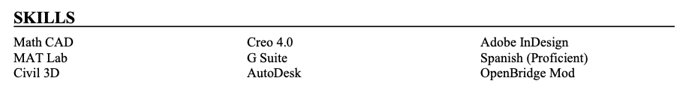
Skills
Avoid listing “soft skills”
Things like teamwork, communication, organization, problem solving, etc.
  These skills are subjective and hard to qualify
  Instead, prove that you have soft skills through descriptive bullet points in the experience section
Focus on “hard skills”
  Technical proficiencies
  Sub-Categories, if needed:
    Programming Languages
    Networking
    Design Software
    Foreign Languages
    Web Systems & Technologies
    Platform Technologies
Notes:
The skills section is your opportunity to highlight the technical proficiencies that you possess – in other words, your “hard skills.” In this section, avoid listing your soft skills – things like teamwork, communication, problem solving, etc. These skills are incredibly important in the job search, no matter what field you’re going into. However, they’re also incredibly subjective, and hard to qualify. So, instead of listing them in a skills section, prove to me that you have those skills through the descriptive bullet points that you share in your experience section. If your skills section starts to get a bit long, consider dividing your skills into subcategories. Programming languages, foreign languages you speak, lab equipment you operate, and design software are all examples of that.

Slide 14


Optional Sections
Interests / Activities Section
  Format like an experience OR include as a list
  Demonstrate your involvement in the community/on campus
  Including professional associations can display your involvement in the field
  Avoid personal interests/activities like knitting or rock climbing – those won’t carry much weight unless you’re applying for very specific industries
Honors / Awards Section
  If less than 3, include in the Education section at the top
  If more than 3, include in it own separate section
Academic / Course Projects Section
  Include if relevant work experience is limited
  Demonstrates theory → practice
  Even if relevant work experience is not limited, it’s usually good to include a Capstone project!
Notes:
At this point, you might have a few other sections on your resume that we haven’t talked about. Or, you might have a few other experiences you’re proud of that you don’t know how to include. Here are a few other considerations you might want to be thinking about. An activities section can be a great way to demonstrate your involvement in the community or include professional associations to demonstrate your involvement in the field. You can format these in a few ways: some people include these as a list (particularly if they’re not very actively involved) and others format their activities as they would a work or research experience. Whichever format you choose, just make sure you maintain consistency throughout the section. Avoid including very personal activities or interests like knitting or rock climbing – those won’t carry much weight unless you’re applying for a very specific industry. A Course Projects section can be great to include if you’re sitting here thinking “wait a minute…I don’t have relevant experience in the field yet…” This is your opportunity to demonstrate that you know how to put theory to practice. Pick 1 or 2 of the projects that are most relevant to the positions you’re applying for and format them as you would a work or research experience.

Slide 15

Resume → Job Fair & Internship search
Ensure your resume has been checked over and is ready to go!
Sometimes you will need to tailor your resume to each job when necessary
Broaden your search! Make sure you are searching on a variety of platforms, using your network and reaching out to those you know!
Follow instructions, precisely! E.g. if asked for a cover letter, submit one!
Print out 10-15 copies to hand out at a job fair!
Don’t get discouraged – all experiences is good (learning) experiences ☺

Slide 16

The Importance of Networking
80% of job vacancies: never advertised
The overall time needed to
find a job can be drastically
reduced.
  4-6 months if networking
  6-9 months if not networking
Learn about occupations, employers, and industries of interest
START EARLY!
Notes:
Therefore, it’s important to follow up appropriately!

Slide 17

Do Your Research: The Industry & Outlook
Use your resources: Company website & Social Media, Handshake, LinkedIn, GlassDoor, Vault, Forbes, your personal network!
  Typical job titles
  Day-to-day duties and responsibilities
  Required qualifications/skills (hard & soft)
  Industry outlook
  Salary range & typical benefits
  Location & remote vs. in-person vs. hybrid
  Any relevant news, articles, etc.

Slide 18

Do Your Research: Employers
Review the list of employers attending the fair!!!! They are in alphabetical order and will list if they are looking for internship vs. full-time, years of students desired as well as what majors they could employ.
  Handshake → Career Center Tab → Events → Career Fair
Narrow your focus & prioritize what is most important!
Next Slides are what you can follow to review!
Notes:
PREP

Slide 19
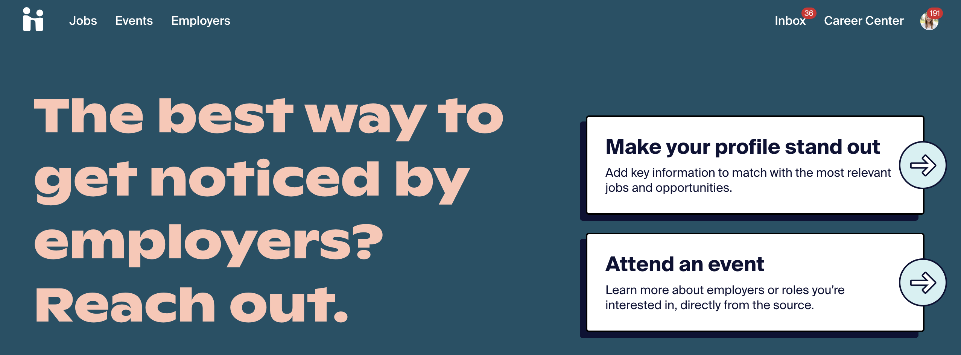
Go to your student handshake account

Slide 20
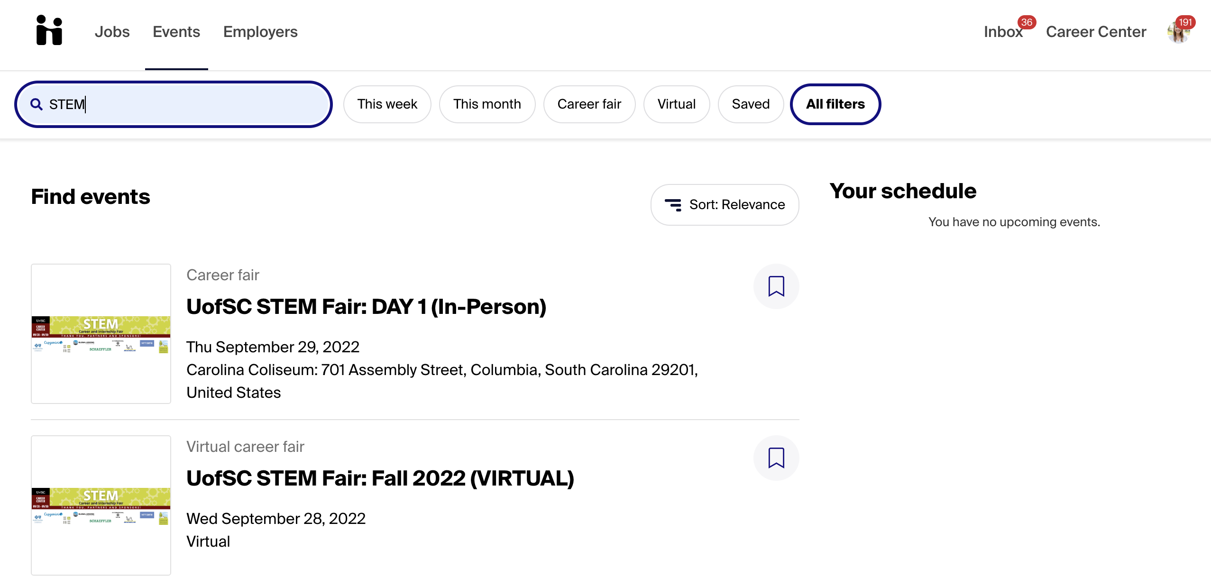
Click events & then search STEM to narrow job fairs

Slide 21
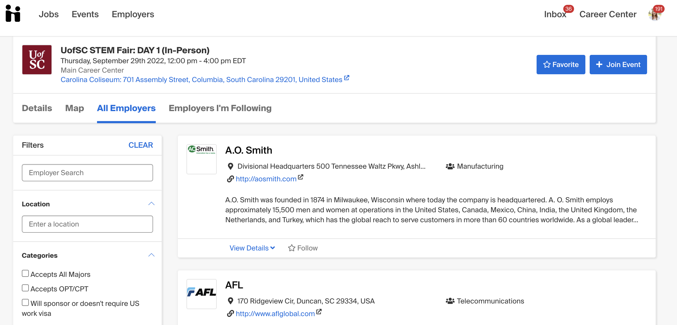
Go to the main page and click employers on the left → scroll down to Majors and select yours to filter out employers hiring for you!

Slide 22
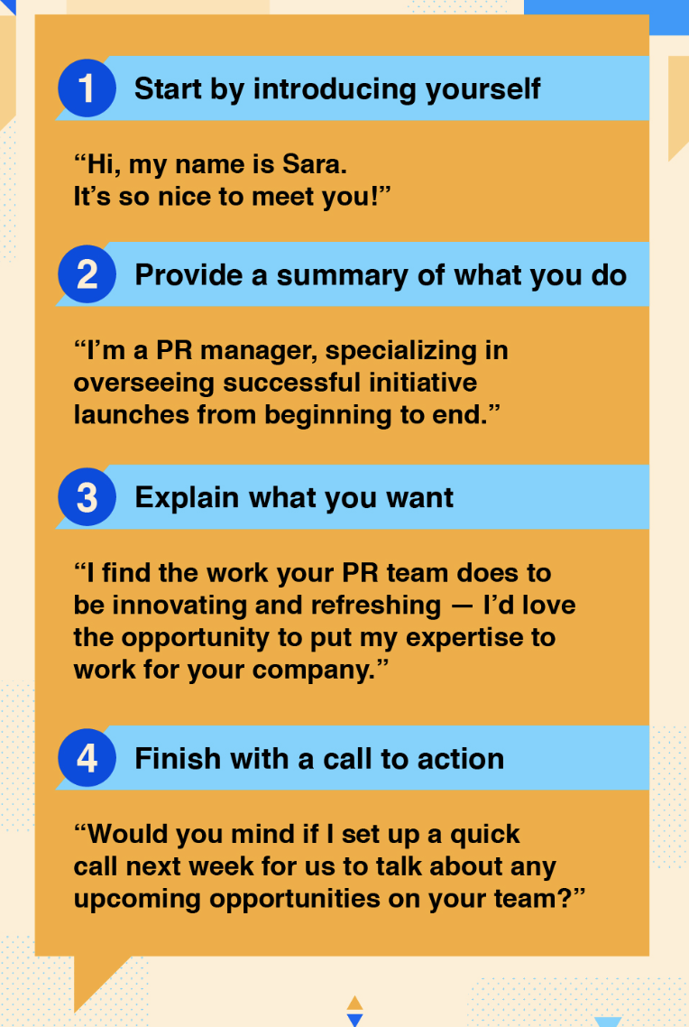

Prepare your Pitch
Elevator Pitch:
Marketing message for your professional self –
  Clear, concise, inviting, enthusiastic
Your qualifications + Your interests/goals = Your Pitch
30-60 seconds
Practice, practice, practice!
Notes:
Articulate who you are, where you’ve been, and where you want to go
*The image is hyperlinked to an elevator pitch video.

Slide 23

Elevator Pitch Questions to assist you
What sparked your interest in this field?
What are some supporting experiences that have helped you further develop the skills that would be useful for this job?
What have you already learned about the field and what are you hoping to learn from this opportunity?
What activities or groups are you affiliated with? What experiences or exposure are you gaining from the affiliation?
What about this company do you find particularly exciting?
What questions do you have for the employer?

Slide 24

Suit Up!
Dress as if the career fair is an interview
Make sure clothes are clean and pressed
Minimal or no overwhelming fragrances – Be Hygienic!
Avoid excessive jewelry or makeup that
Avoid clothing that is too short, revealing, ill-fitting
If wearing a new suit, CUT the vent stitch in the back
Make sure you are still dressing like yourself!
Notes:
AT THE FAIR
Remember the Carolina Closet
If you can’t/don’t want to wear a suit, “business casual” is usually very appropriate as well. Nice slacks/skirt and collared shirt/blouse

Slide 25

Think Ahead!
Be prepared for all weather, good and bad
Consider travel time/parking
  Allow ample time for delays!
Talk to professors about class conflicts
Notes:
PREP

Slide 26
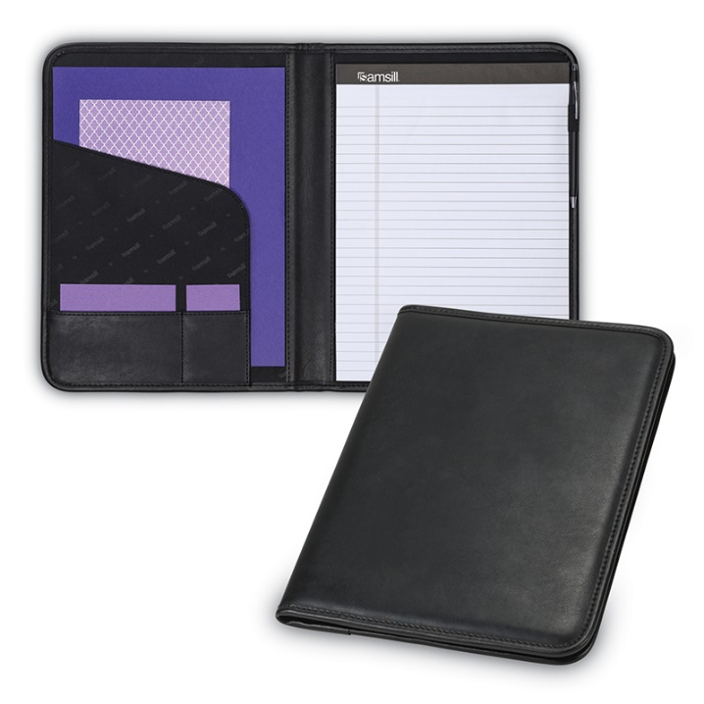
What Do I Bring?
15-20+ copies of your critiqued resume on nice paper (you always want to err on the side of having too many)
A list of questions based on your employer research
A list of the companies that fit your search
At least 2 pens and a notepad
A folder or padfolio to keep resumes, business cards, notes, brochures, and giveaways organized
Anticipate mishaps:
  Umbrella/raincoat
  Lint brush
  Comb
  Mints

Slide 27

AT THE FAIR
Keep these elements in mind while you are AT the fair to make the best impression!

Slide 28


Make a Good Impression
Arrive within the 1p-5p window
Behave professionally
Establish rapport with the recruiters
Remember your body language
LISTEN to the recruiter
Don’t ramble
Ask at least TWO intelligent questions of each organization
Notes:
AT THE FAIR

Slide 29
What’s My Skill Set?
Analytical
Computer literacy
Conflict resolution
Conscientiousness
Creativity
Critical thinking
Customer service
Dependability
Diversity-oriented
Enthusiastic
Etiquette
Financial Management
Flexibility
Fund-raising
Honesty/Integrity
Initiative
Independent
Interpersonal
Leadership
Listening skills
Maturity
Multi-tasking
Organizational
Persuasive
Positive attitude
Problem solving
Punctuality
Purposeful
Quick learner
Recruiting
Resourcefulness
Responsibility
Sales
Self confidence
Self discipline
Time management
Team player
Notes:
5 min – articulating skills

Slide 30

Nonverbal Communication
Smile!
Maintain eye contact while speaking
Stand up straight
Give a firm, friendly handshake
Practice your listening face

Slide 31
Career Fair Tips & Tricks
Network with the other students
Wear comfortable, appropriate shoes
Take the literature/freebies from the employers you’ve spoken to
  But DON’T take freebies from employers you don’t talk to
Request business cards and take good notes to send a follow up email!
  Step to the side to take notes before moving to the next employer
Notes:
Network…while in line, talk to other students about the recruiters with whom they have already spoken
Consider coming up with a ranking system so you can keep your thoughts (and “gut feelings”) straight when you begin to follow up/pursue leads later

Slide 32

AFTER THE FAIR
Take these next steps to maintain a professional relationship, reiterate your interest and continue your networking with employers of interest!

Slide 33

Always Follow Up
If conducting Day-After Interviews,
submit your application materials
well before the deadline!
Email thank-you note (and resume) to selected employers as soon as possible (within 24 hours)
  Don’t expect an immediate response
Organize your notes
Excel spreadsheet to keep everything in one place

Slide 34
Develop a plan with goals
Secure an internship
Earn 2-4 internship offers
Interview with 8 companies
Apply to 20 jobs
Connect with 25 employers
Research 40 employers attending STEM Fair or beyond
Create candidate documents
  Resumes, Cover Letters, LinkedIn Profile
Notes:
Start with the end in mind and walk it back

Slide 35
Monitor your progress
Save & clearly label your application materials
  Last name, First name – Resume – Employer Name.pdf
  Last name, First name – Cover Letter – Employer Name.pdf
Take notes on interview questions, responses, communication, etc.
Reflect on your observations & gut instincts
Remember, the job/internship search is a process.
Notes:
Be sure to monitor your progress and reflect regularly.
As I mentioned before, keep track of your applications in an Excel document or something similar. Also be sure to save a PDF of the position description and the cover letter and resume you used for the position – keep these materials in a folder labeled by the position and organization.
Be sure to take good notes before, during, and after the interview process. If questions came up that stumped you, jot them down! If you thought of a question afterward that you might like to ask in a future interview, make a note of it! Taking notes will help you improve your job search skills – whether for this search or the next one!
And finally, take some time to thoughtfully reflect on your application and interviewing experience. Did you get any “gut feelings” during the interview? Pay attention to those! Your instincts are trying to tell you something important. But don’t let gut instincts make the decision for you, because nerves could, of course, be a factor!
Remember, the job search is a process. It takes time, it takes energy, and it will look different for every single person. Do not compare your job search to others, be kind to yourself, and be patient. Keep at it and something good will come.

Slide 36
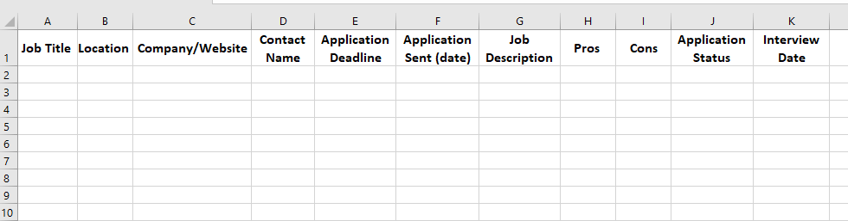
Internship search organizational document

Slide 37
Come see us!
If you need additional assistance with your documents, preparing your elevator pitch, interview prep once you land some interviews etc. we are here for you!
These are just some tips to start this process and utilize the fair to start your networking process and land interviews and then a job!

