Slide 1
CSCE 330
Programming Language Structures
Introduction and History
Fall 2017
Marco Valtorta and James O’Reilly
mgv@cse.sc.edu and oreillyj@email.sc.edu

Slide 2
Textbooks: Levesque [L] and Hutton [H]
We use Levesque as an introduction to the logic language Prolog
Hutton’s text is a primer for Haskell 2010, the standard version of the functional language Haskell
Good general textbooks on PLs:
  Michael L. Scott. Programming Language Pragmatics, 3rd ed., Morgan-Kaufmann, 2009 [S]
  Robert W. Sebesta. Concepts of Programming Languages, 11th ed. Addison-Wesley, 2016 [Sebesta]
  Allen B. Tucker and Robert E. Noonan. Programming Language: Principles and Paradigms, 2nd ed. McGraw-Hill, 2007 [T]
  Carlo Ghezzi and Mehdi Jazayeri. Programming Language Concepts, 3rd ed. Wiley, 1998 [G] or [G&J].
A more comprehensive treatment of Haskell:
  Bryan O. Sullivan, John Goertzen, and Don Stewart. Real World Haskell. O’Reilly, 2009. This text is available on line, with comments by readers.

Slide 3
A Typical Textbook: Scott [S]
Foundations
  Introduction: history, translation
  Syntax, names, scopes and bindings, static semantics
  Semantics (not fully covered in [S])
Core Issues in Language Design:
  Control flow
  Data types
  Subroutines and control abstractions
  Data abstraction and object orientation
Programming models (paradigms):
  Imperative languages
  Object-oriented languages
  Functional languages
  Logic languages
  Concurrency

Slide 4
Disclaimer
The slides are based on many sources, including several other fine textbooks for the Programming Language (PL) Concepts course
The PL Concepts course covers topics PL1 through PL11 in Computing Curricula 2001
One or more PL Concepts course is almost universally a part of a Computer Science curriculum
  In some curricula, the contents of our course are divided into two semesters, the first of which is devoted to functional and logic programming

Slide 5
Why Study PL Concepts?
Increased capacity to express ideas
Improved background for choosing appropriate languages
Increased ability to learn new languages
Better understanding of the significance of implementation
Increased ability to design new languages
Background for compiler writing
Overall advancement of computing

Slide 6
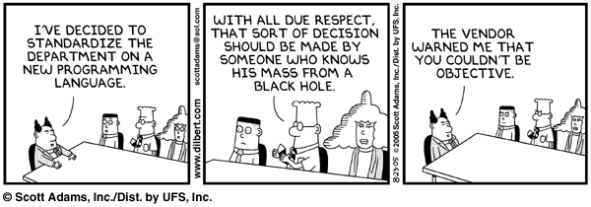
Improved background for choosing appropriate languages
Source: http://www.dilbert.com/comics/dilbert/archive/dilbert-20050823.html

Slide 7
Improved background for choosing appropriate languages
C vs. Modula-3 vs. C++ for systems programming
Fortran vs. APL vs. Ada for numerical computations
Ada vs. Modula-2 for embedded systems
Common Lisp vs. Scheme vs. Haskell for symbolic data manipulation
Java vs. C/CORBA for networked PC programs
Notes:
[Scott]

Slide 8
Increased ability to learn new languages
Easy to walk down language family tree
Concepts are similar across languages
If you think in terms of iteration, recursion, abstraction (for example), you will find it easier to assimilate the syntax and semantic details of a new language than if you try to pick it up in a vacuum
  Analogy to human languages: good grasp of grammar makes it easier to pick up new languages (at least Indo-European)

Slide 9
Increased capacity to express ideas
Sapir-Whorf hypothesis: “language is not simply a way of voicing ideas, but is the very thing that shapes those ideas. One cannot think outside the confines of their language.”
Figure out how to do things in languages that don't support them:
lack of suitable control structures in Fortran
    use comments and programmer discipline for control structures
lack of recursion in Fortran, CSP, etc
    write a recursive algorithm then use mechanical recursion elimination (even for things that aren't quite tail recursive)
lack of named constants and enumerations in Fortran
    use variables that are initialized once, then never changed
lack of modules in C and Pascal
    use comments and programmer discipline
lack of iterators in just about everything
    fake them with (member?) functions
Notes:
[S]; Whorf hypothesis statement from http://www.mnsu.edu/emuseum/cultural/language/whorf.html, retrieved 2010-08-17

Slide 10
What makes a language successful?
Easy to learn (BASIC, Pascal, LOGO, Scheme)
Easy to express things, easy use once fluent, "powerful” (C, Common Lisp, APL, Algol-68, Perl)
Easy to implement (BASIC, Forth)
Possible to compile to very good (fast/small) code (Fortran)
Backing of a powerful sponsor (COBOL, PL/1, Ada, Visual Basic)
Wide dissemination at minimal cost (Pascal, Turing, Java)
Notes:
[Scott]

Slide 11
What makes a successful language?
According to [T], the following key characteristics:
  Simplicity and readability
  Clarity about binding
  Reliability
  Support
  Abstraction
  Orthogonality
  Efficient implementation
Notes:
[T]

Slide 12
Simplicity and Readability
Small instruction set
  E.g., Java vs Scheme
Simple syntax
  E.g., C/C++/Java vs Python
Benefits:
  Ease of learning
  Ease of programming
Notes:
[T]

Slide 13
Clarity about Binding
A language element is bound to a property at the time that property is defined for it.
So a binding is the association between an object and a property of that object
  Examples:
    a variable and its type
    a variable and its value
  Early binding takes place at compile-time
  Late binding takes place at run time
Notes:
[T]

Slide 14
Reliability
A language is reliable if:
  Program behavior is the same on different platforms
    E.g., early versions of Fortran
  Type errors are detected
    E.g., C vs Haskell
  Semantic errors are properly trapped
    E.g., C vs C++
  Memory leaks are prevented
    E.g., C vs Java
Notes:
[T]

Slide 15
Language Support
Accessible (public domain) compilers/interpreters
Good texts and tutorials
Wide community of users
Integrated with development environments (IDEs)
Notes:
[T]

Slide 16
Abstraction in Programming
Data
  Programmer-defined types/classes
  Class libraries
Procedural
  Programmer-defined functions
  Standard function libraries
Notes:
[T]

Slide 17
Orthogonality
A language is orthogonal if its features are built upon a small, mutually independent set of primitive operations.
Fewer exceptional rules = conceptual simplicity
  E.g., restricting types of arguments to a function
Tradeoffs with efficiency
Notes:
[T]

Slide 18
Efficient implementation
Embedded systems
  Real-time responsiveness (e.g., navigation)
  Failures of early Ada implementations
Web applications
  Responsiveness to users (e.g., Google search)
Corporate database applications
  Efficient search and updating
AI applications
  Modeling human behaviors
Notes:
[T]

Slide 19
Software Development Process
Three models of the Software Development process:
  Waterfall Model
  Spiral Model
  RUDE
    Run, Understand, Debug, and Edit
Different languages provide different degrees of support for the three models

Slide 20
The Waterfall Model
Requirements analysis and specification
Software design and specification
Implementation (coding)
Certification:
  Verification: “Are we building the product right?”
  Validation: “Are we building the right product?”
  Module testing
  Integration testing
  Quality assurance
Maintenance and refinement

Slide 21
PLs as Components of a Software Development Environment
Goal: software productivity
Need: support for all phases of SD
Computer-aided tools (“Software Tools”)
  Text and program editors, compilers, linkers, libraries, formatters, pre-processors
  E.g., Unix (shell, pipe, redirection)
Software development environments
  E.g., Interlisp, JBuilder, Eclipse
Intermediate approach:
  Emacs (customizable editor to lightweight SDE)

Slide 22
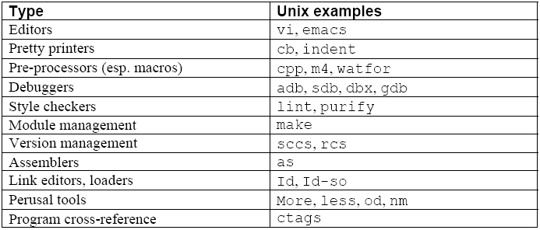
Programming Environment Tools
Copyright © 2009 Elsevier

Slide 23
What is a language for?
Why do we have programming languages?
  way of thinking---way of expressing algorithms
    languages from the user's point of view
  abstraction of virtual machine---way of specifying what you want the hardware to do without getting down into the bits
    languages from the implementor's point of view
Copyright © 2009 Elsevier
Notes:
[S]

Slide 24
PLs as Algorithm Description Languages
“Most people consider a programming language merely as code with the sole purpose of constructing software for computers to run. However, a language is a computational model, and programs are formal texts amenable to mathematical reasoning. The model must be defined so that its semantics are delineated without reference to an underlying mechanism, be it physical or abstract.”
Niklaus Wirth, “Good Ideas, through the Looking Glass,” Computer, January 2006, pp.28-39.

Slide 25
Influences on PL Design
Software design methodology (“People”)
  Need to reduce the cost of software development
Computer architecture (“Machines”)
  Efficiency in execution
A continuing tension

Slide 26
Software Design Methodology and PLs
Example of convergence of software design methodology and PLs:
  Separation of concerns (a cognitive principle)
  Divide and conquer (an algorithm design technique)
  Information hiding (a software development method)
  Data abstraction facilities, embodied in PL constructs such as:
    SIMULA 67 class, Modula 2 module, Ada package, Smalltalk class, CLU cluster, C++ class, Java class

Slide 27
Abstraction
Abstraction is the process of identifying the important qualities or properties of a phenomenon being modeled
Programming languages are abstractions from the underlying physical processor: they implement “virtual machines”
Programming languages are also the tools with which the programmer can implement the abstract models
Symbolic naming per se is a powerful abstracting mechanism: the programmer is freed from concerns of a bookkeeping nature

Slide 28
Data Abstraction
In early languages, fixed sets of data abstractions, application-type specific (FORTRAN, COBOL, ALGOL 60), or generic (PL/1)
In ALGOL 68, Pascal, and SIMULA 67 Programmer can define new abstractions
Procedures (concrete operations) related to data types: the SIMULA 67 class
In Abstract Data Types (ADTs),
  representation is associated to concrete operations
  the representation of the new type is hidden from the units that use the new type
Protecting the representation from attempt to manipulating it directly allows for ease of modification.

Slide 29
Control Abstraction
Control refers to the order in which statements or groups of statements (program units) are executed
From sequencing and branching (jump, jumpt) to structured control statements (if…then…else, while)
Subprograms and unnamed blocks
  methods are subprograms with an implicit argument (this)
  unnamed blocks cannot be called
Exception handling

Slide 30
Non-sequential Execution
Coroutines
  allow interleaved (not parallel!) execution
  can resume each other
    local data for each coroutine is not lost
Concurrent units are executed in parallel
  allow truly parallel execution
  motivated by Operating Systems concerns, but becoming more common in other applications
  require specialized synchronization statements
Coroutines impose a total order on actions when a partial order would suffice

Slide 31
Computer Architecture and PLs
Von Neumann architecture
  a memory with data and instructions, a control unit, and a CPU
  fetch-decode-execute cycle
  the Von Neumann bottleneck
Von Neumann architecture influenced early programming languages
  sequential step-by-step execution
  the assignment statement
  variables as named memory locations
  iteration as the mode of repetition

Slide 32
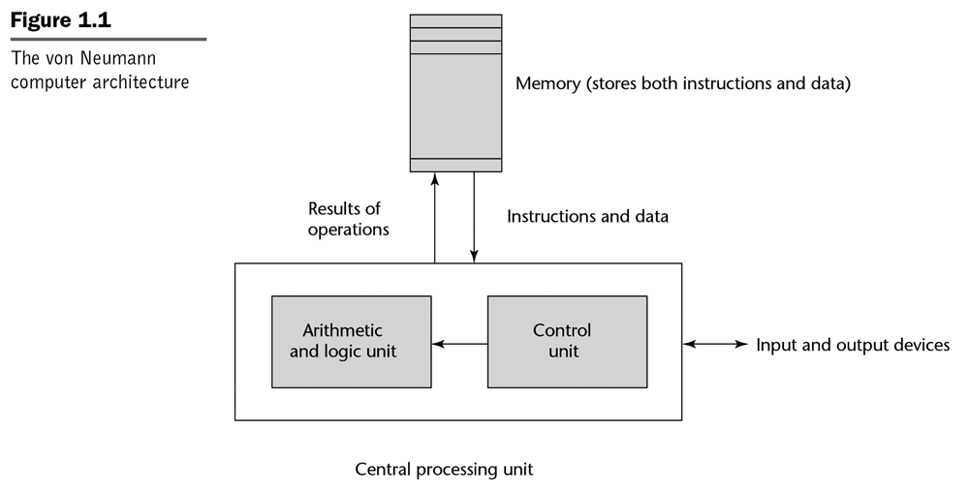
The Von Neumann Computer Architecture
Notes:
[Sebesta]

Slide 33
Other Computer Architectures
Harvard
  separate data and program memories
Functional architectures
  Symbolics, Lambda machine, Mago’s reduction machine
Logic architectures
  Fifth generation computer project (1982-1992) and the PIM
Overall, alternate computer architectures have failed commercially
  von Neumann machines get faster too quickly!

Slide 34
Language Design Goals
Reliability
  writability
  readability
  simplicity
  safety
  robustness
Maintainability
  factoring
  locality
Efficiency
  execution efficiency
  referential transparency and optimization
    optimizability: “the preoccupation with optimization should be removed from the early stages of programming… a series of [correctness-preserving and] efficiency-improving transformations should be supported by the language” [Ghezzi and Jazayeri]
  software development process efficiency
    effectiveness in the production of software

Slide 35
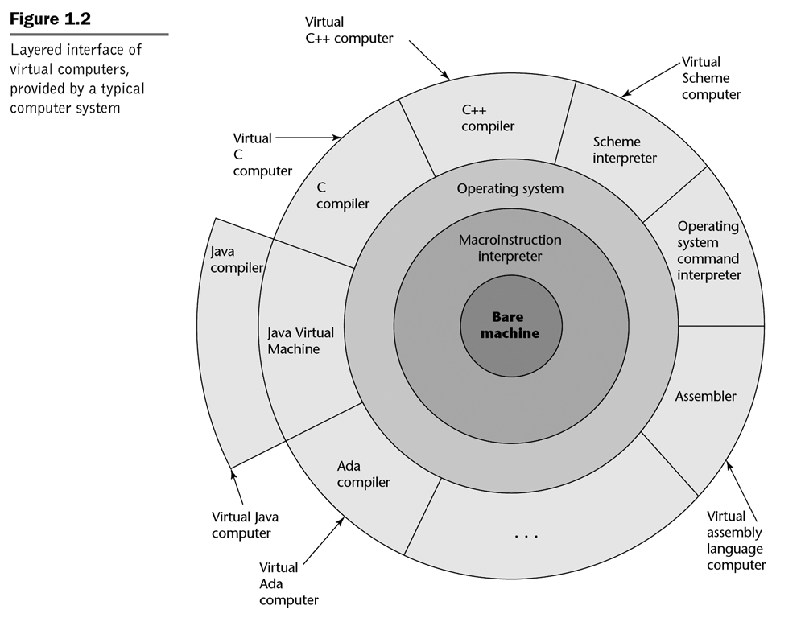
The Onion Model of Computers
Notes:
[Sebesta]

Slide 36
Language Translation
A source program in some source language is translated into an object program in some target language
An assembler translates from assembly language to machine language
A compiler translates from a high-level language into a low-level language
  the compiler is written in its implementation language
An interpreter is a program that accepts a source program and runs it immediately
An interpretive compiler translates a source program into an intermediate language, and the resulting object program is then executed by an interpreter

Slide 37
Example of Language Translators
Compilers for Fortran, COBOL, C, C++
Interpretive compilers for Pascal (P-Code), Prolog (Warren Abstract Machine) and Java (Java Virtual Machine)
Interpreters for APL, Scheme, Haskell, Python, and (early) LISP

Slide 38
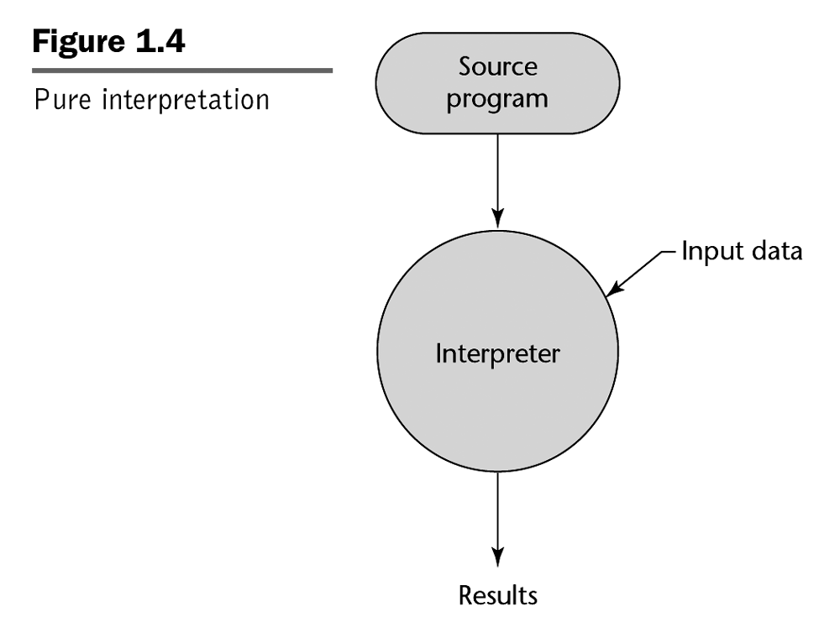
Notes:
[Sebesta]

Slide 39
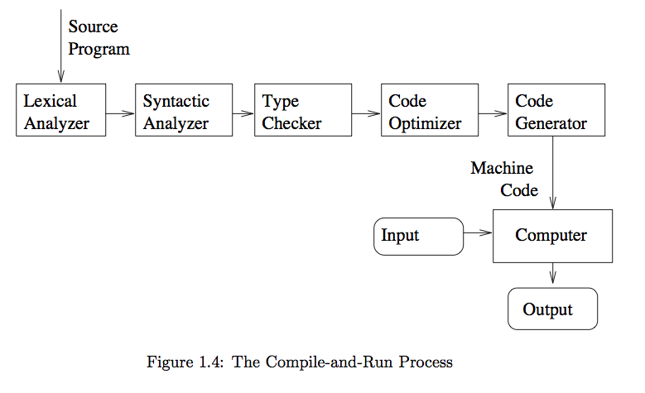
The Compiling Process
Notes:
[T]

Slide 40
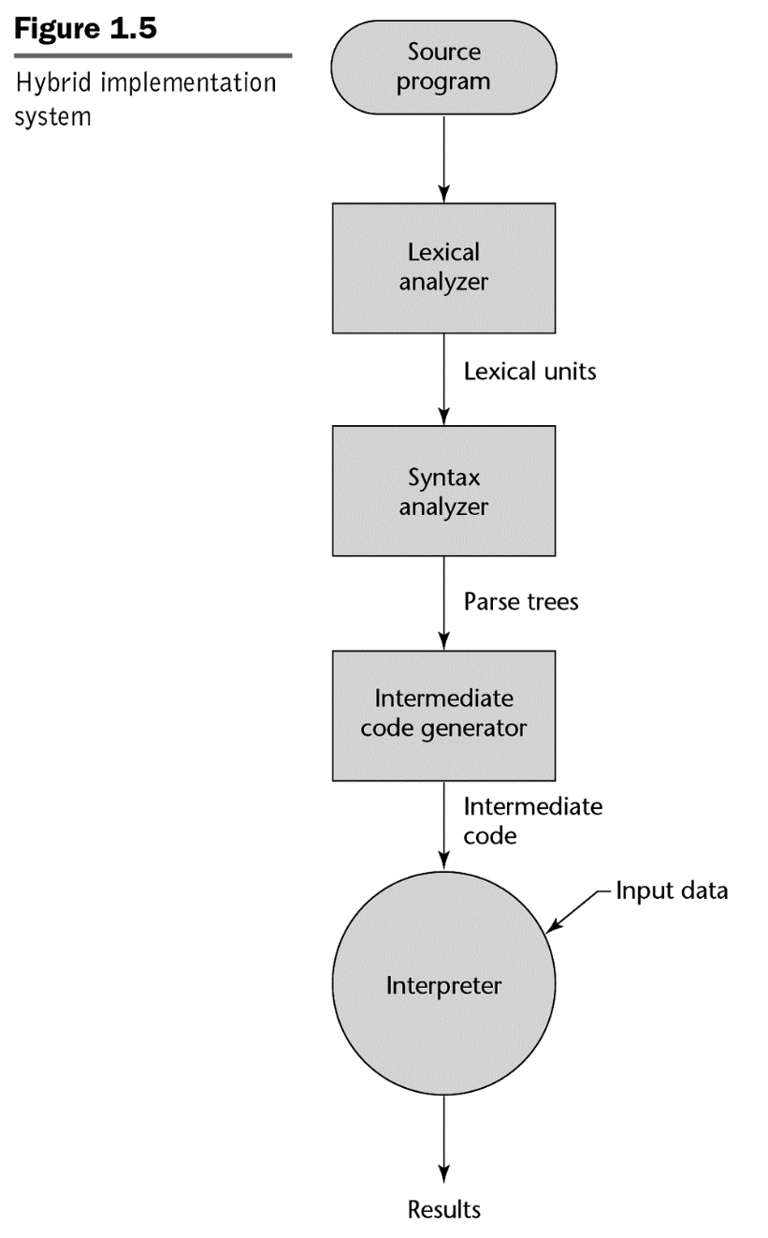
Hybrid Compilation and Interpretation
Notes:
[Sebesta]

Slide 41
Language Families
Imperative (or Procedural, or Assignment-Based)
Functional (or Applicative)
Logic (or Declarative)

Slide 42
Imperative Languages
Mostly influenced by the von Neumann computer architecture
Variables model memory cells, can be assigned to, and act differently from mathematical variables
Destructive assignment, which mimics the movement of data from memory to CPU and back
Iteration as a means of repetition is faster than the more natural recursion, because instructions to be repeated are stored in adjacent memory cells

Slide 43
GCD (Euclid’s Algorithm) in C
To compute the gcd of a and b, check to see if a and b are equal. If so, print one of them and stop. Otherwise, replace the larger one by their difference and repeat.
#include <stdio.h>
int gcd(int a, int b) {
while (a != b) {
if (a > b) a = a - b;
else b = b - a;
}
return a;
}
Notes:
[S] Also:
int main()
{
int i, j;
scanf("%d %d", &i, &j);
printf("%d\n", gcd(i, j));
}

Slide 44
Functional Languages
Model of computation is the lambda calculus (of function application)
No variables or write-once variables
No destructive assignment
Program computes by applying a functional form to an argument
Program are built by composing simple functions into progressively more complicated ones
Recursion is the preferred means of repetition

Slide 45
GCD (Euclid’s Algorithm) in Scheme
The gcd of a and b is defined to be (1) a when a and b are equal, (2) the gcd of b and a-b when a > b and (3) the gcd of a and b-a when b > a. To compute the gcd of a given pair of numbers, expand and simplify this definition until it terminates
(define gcd2 ; 'gcd' is built-in to R5RS
(lambda (a b)
(cond ((= a b) a)
((> a b) (gcd2 (- a b) b))
(else (gcd2 (- b a) a)))))

Slide 46
GCD (Euclid’s Algorithm) in OCaml
The gcd of a and b is defined to be (1) a when a and b are equal, (2) the gcd of b and a-b when a > b and (3) the gcd of a and b-a when b > a. To compute the gcd of a given pair of numbers, expand and simplify this definition until it terminates
let rec cgd a b =
if a = b then a
else if a > b then gcd b (a – b)
else gcd a (b – a)
Notes:
[S], Fourth Edition (2016)

Slide 47
Logic Languages
Model of computation is the Post production system
Write-once variables
Rule-based programming
Related to Horn logic, a subset of first-order logic
AND and OR non-determinism can be exploited in parallel execution
Almost unbelievably simple semantics
Prolog is a compromise language: not a pure logic language

Slide 48
GCD (Euclid’s Algorithm) in Prolog
The proposition gcd(a,b,g) is true if (a) a,b, and g are equal; (2) a is greater than b and there exists a number c such that c is a-b and gcd(c,g,b) is true; or (3) a is less than b and there exists a number c such that c is b-a and gcd(c,a,g) is true. To compute the gcd of a given pair of numbers, search for a number g (and various numbers c) for which these rules allow one to prove that gcd(a,b,g) is true
gcd(A,B,G) :- A = B, G = A.
gcd(A,B,G) :- A > B, C is A-B, gcd(C,B,G).
gcd(A,B,G) :- B > A, C is B-A, gcd(C,A,G).

Slide 49
Some Historical Perspective
“Every programmer knows there is one true programming language. A new one every week.”
  Brian Hayes, “The Semicolon Wars.” American Scientist, July-August 2006, pp.299-303
  http://www.americanscientist.org/template/AssetDetail/assetid/51982#52116
Language families
Evolution and Design

Slide 50
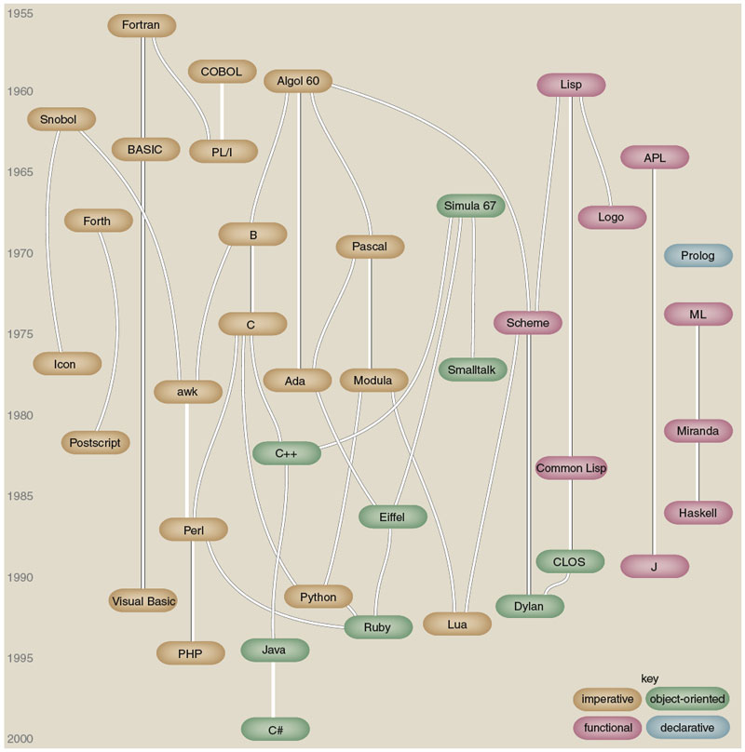
Figure by Brian Hayes
(who credits, in part, Éric Lévénez and Pascal Rigaux):
Brian Hayes, “The Semicolon Wars.” American Scientist, July-August 2006, pp.299-303
Notes:
Also see figure A.1 in [S], p.820.

Slide 51
Some Historical Perspective
Plankalkül (Konrad Zuse, 1943-1945)
FORTRAN (John Backus, 1956)
LISP (John McCarthy, 1960)
ALGOL 60 (Transatlantic Committee, 1960)
COBOL (US DoD Committee, 1960)
APL (Iverson, 1962)
BASIC (Kemeny and Kurz, 1964)
PL/I (IBM, 1964)
SIMULA 67 (Nygaard and Dahl, 1967)
ALGOL 68 (Committee, 1968)
Pascal (Niklaus Wirth, 1971)
C (Dennis Ritchie, 1972)
Prolog (Alain Colmerauer, 1972)
Smalltalk (Alan Kay, 1972)
FP (Backus, 1978)
Ada (UD DoD and Jean Ichbiah, 1983)
C++ (Stroustrup, 1983)
Modula-2 (Wirth, 1985)
Delphi (Borland, 1988?)
Modula-3 (Cardelli, 1989)
ML (Robin Milner, 1978)
Haskell (Committee, 1990)
Eiffel (Bertrand Meyer, 1992)
Java (Sun and James Gosling, 1993?)
C# (Microsoft, 2001?)
Scripting languages such as Perl, etc.
Etc.

Slide 52
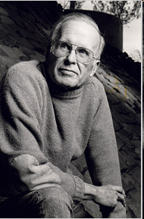

Alain Colmerauer and John Backus
Alain Colmerauer (1941-), the creator of Prolog
John Backus (1924-2007), the creator of FP
Notes:
http://alain.colmerauer.free.fr/, accessed 2010-08-17
http://en.wikipedia.org/wiki/John_Backus and http://www.nytimes.com/2007/03/20/business/20backus.html?_r=2&hp&oref=slogin accessed 2010-08017, accessed 2010-08-17

Slide 53
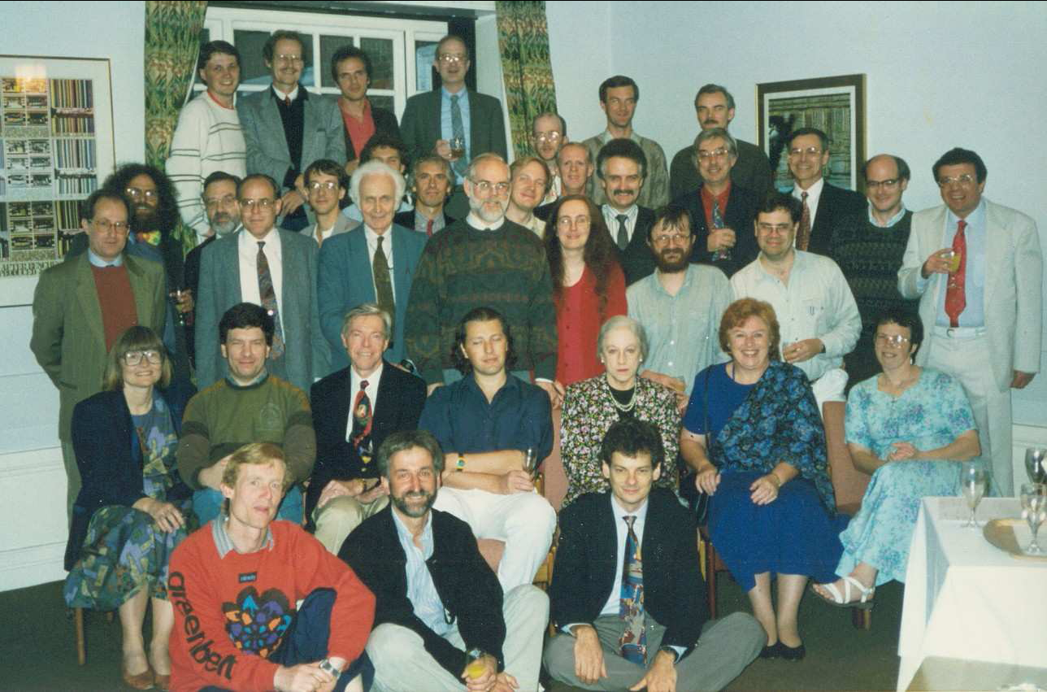
Haskell committee, 1992---history from www.haskell.org

Slide 54
Haskell Timeline

Slide 55
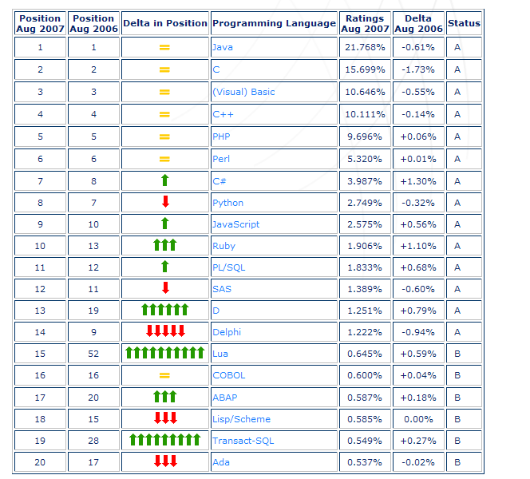
August 2007 Tiobe PL Index
Notes:
Source: http://www.tiobe.com/index.htm?tiobe_index accessed on 2007-08-23

Slide 56
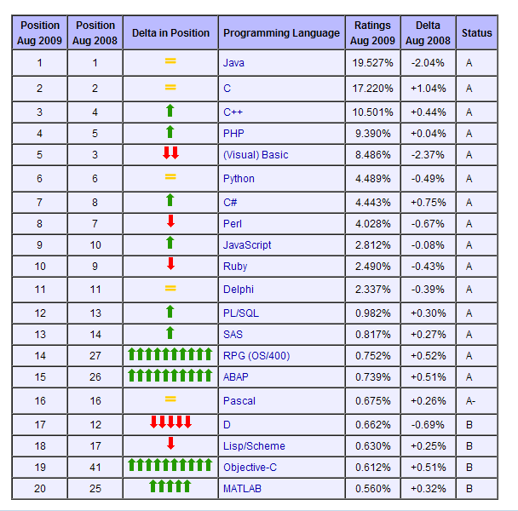
August 2009 Tiobe PL Index

Slide 57
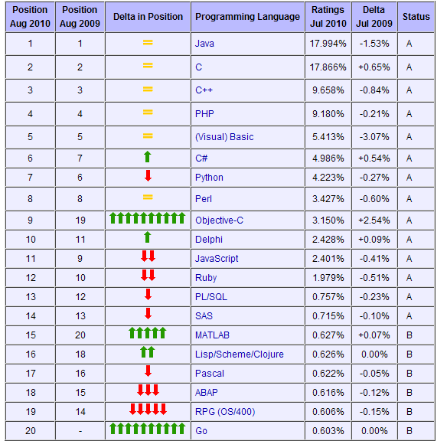
August 2010 Tiobe PL Index
Notes:
http://www.tiobe.com/index.php/content/paperinfo/tpci/index.html, accessed 2010-08-17. Haskell is #36 (between Fortran and Logo), Prolog is #43, ML is #45, and Caml/F# is #47.

Slide 58
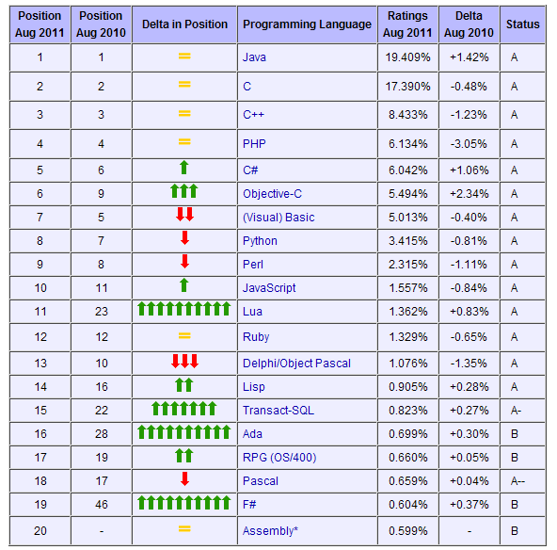
August 2011 Tiobe PL Index
Notes:
http://www.tiobe.com/index.php/content/paperinfo/tpci/index.html, accessed 2010-08-11. Haskell is #35, Prolog is #50, Fortran is #24ML is #45, and Caml/F# is #47. From the same site, accessed 2011-08-11: Q: How come that Assembly is so popular nowadays? A: It seems as if Assembly is new in the top 20. This is not the case. Through the years we had a lot of discussions with followers of the index whether Assembly should be part of the index or not. Until now we could convince them to leave Assembly out. However, recently we defined objective criteria to qualify for the index and Assembly appeared to meet these criteria. So we added Assembly at the end of 2010. Since no historical data is available, it seems as if it comes out of nowhere, whereas it was probably in the past at least as popular as it is now.

Slide 59
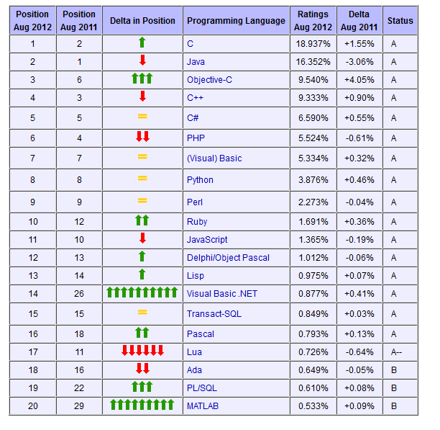
August 2012 Tiobe PL Index
Notes:
http://www.tiobe.com/index.php/content/paperinfo/tpci/index.html, accessed 2012-08-23. Haskell is #34 (was #35 in August 2011), Prolog is #31 (was #50 in August 2011), Fortran is #26. ML is #45, and Caml/F# is #47.

Slide 60
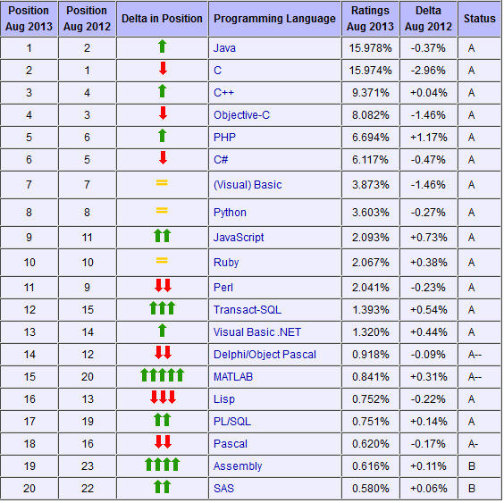
August 2013 Tiobe PL Index
Notes:
Accessed 2013-08-20. Haskell is #34 (was #34 in August 2012), Prolog is #36 (was #31 in August 2012), Fortran is #31, and ML is #40.

Slide 61
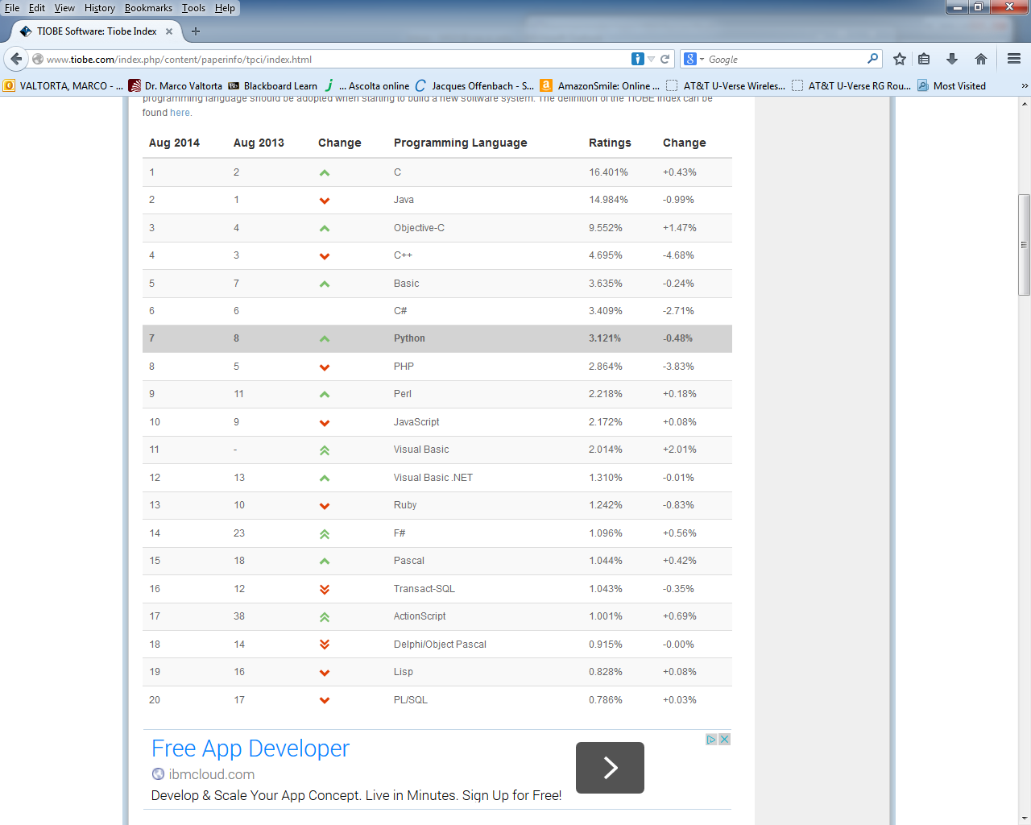
August 2014 Tiobe PL Index
Notes:
Accessed 2014-08-21. Haskell is #40 (was #34 in August 2013 and 2012), Prolog is #46 (was #36 in August 2013, #31 in August 2012), Fortran is #34, and ML is #25.

Slide 62
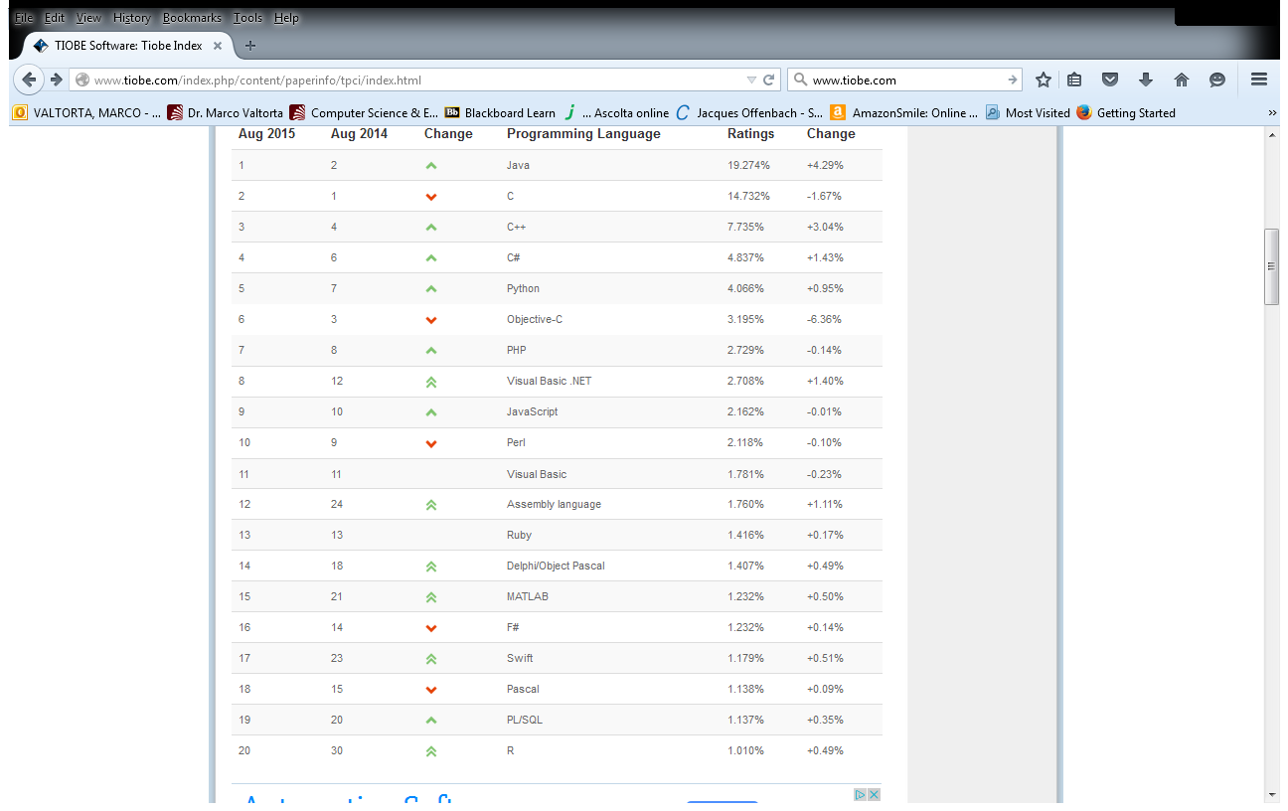
August 2015 Tiobe PL Index
Notes:
Accessed 2014-08-18. Haskell is #41 (was #40 in August 2014, #34 in August 2013 and 2012), Prolog is #32 (was #46 in August 2014, #36 in August 2013, #31 in August 2012), Fortran is #24 (was #34 in August 2014), and ML is #46.

Slide 63
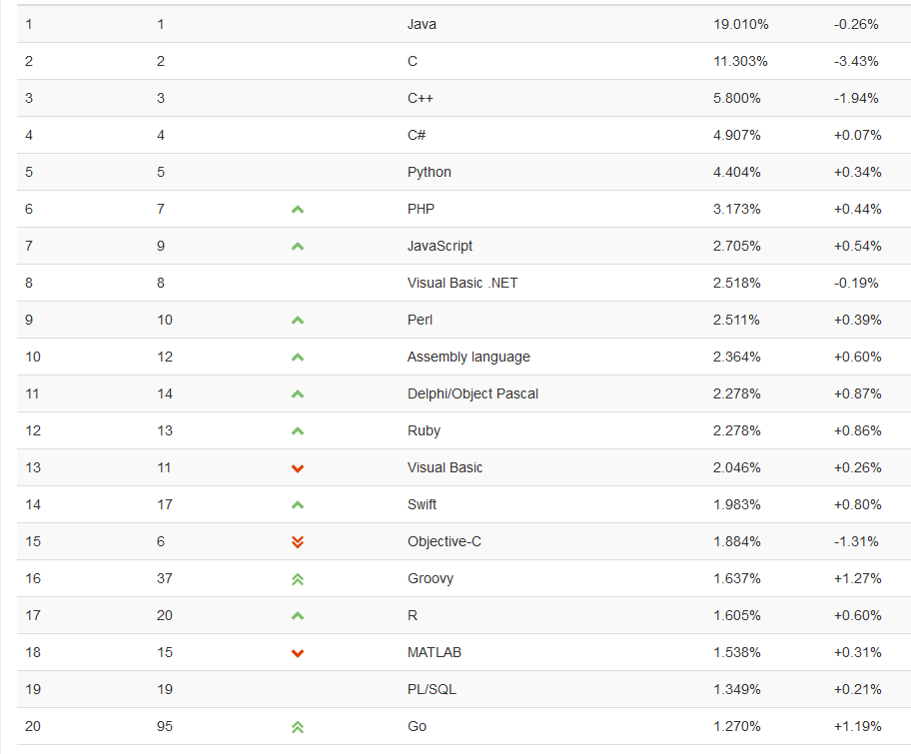
August 2016 Tiobe PL Index
Notes:
Accessed 2016-08-17. Haskell is #39 (was #41 in August 2015, #40 in August 2014, #34 in August 2013 and 2012), Prolog is #33 (was #32 in August 2015, #46 in August 2014, #36 in August 2013, #31 in August 2012), Fortran is #28 (was #24 in August 2015, #34 in August 2014), and ML is in the 51-100 range (was #46 in August 2015).

Slide 64
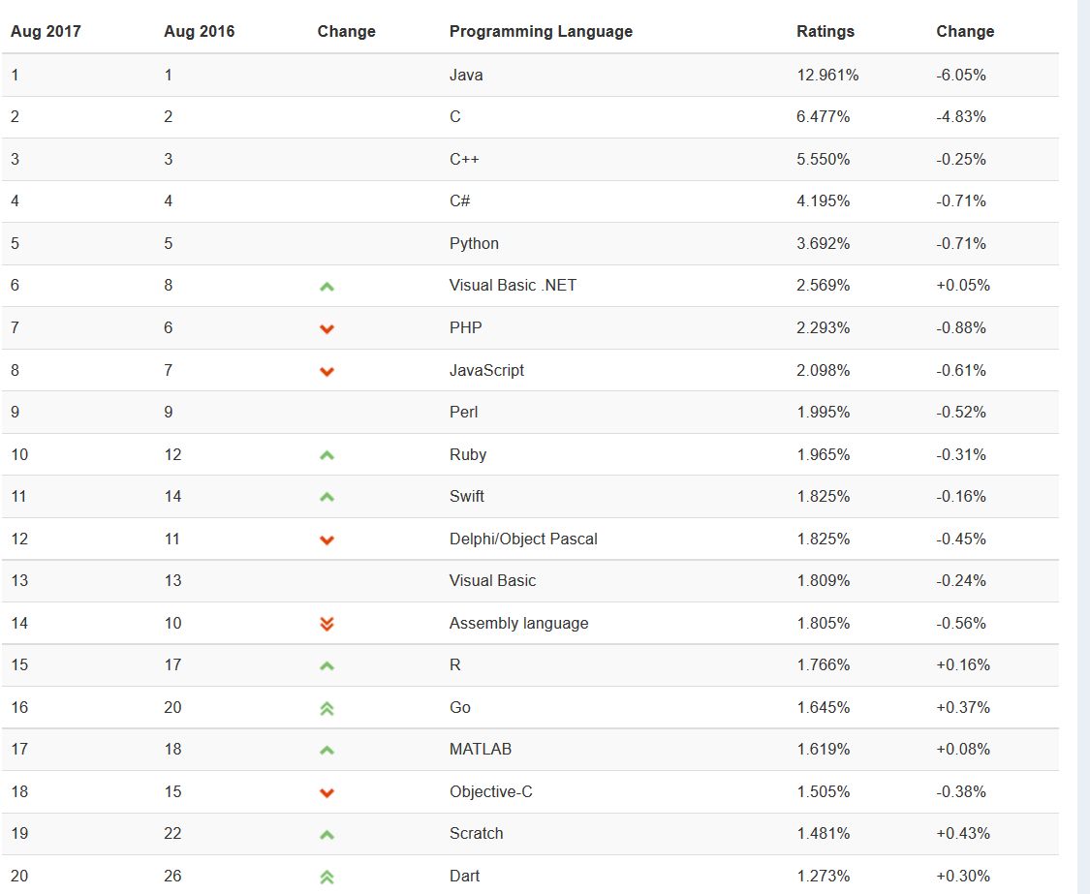
August 2017 Tiobe PL Index
Notes:
Accessed 2017-08-23. Haskell is #47 (was #39 in August 2016, #41 in August 2015, #40 in August 2014, #34 in August 2013 and 2012), Prolog is #30 (was #33 in August 2016, #32 in August 2015, #46 in August 2014, #36 in August 2013, #31 in August 2012), Fortran is #35 (was #28 in August 2016, #24 in August 2015, #34 in August 2014), and ML is in the 51-100 range (was in that range in August 2016, #46 in August 2015).

Slide 65
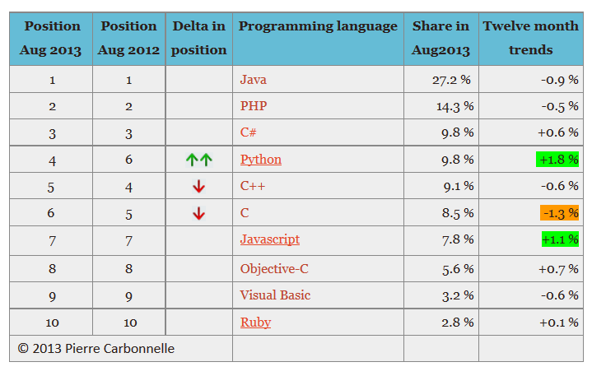
August 2013 PYPL Index
Notes:
PYPL is a competing (with respect to Tiobe)PL popularity index. This chart and the commentary below were downloaded on 2013-08-15 from https://sites.google.com/site/pydatalog/pypl/PyPL-PopularitY-of-Programming-Language.
The PYPL PopularitY of Programming Language index is created by analyzing how often language tutorials are searched on Google : the more a specific language tutorial is searched, the more popular the language is assumed to be. It is a leading indicator. The raw data comes from Google Trends, so that anyone can verify it, or make the analysis for his own country.

Slide 66
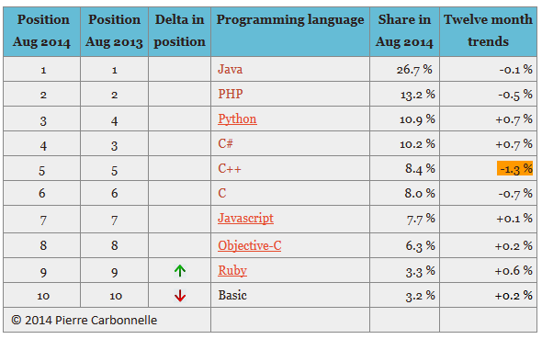
August 2014 PYPL Index
Notes:
PYPL is a competing (with respect to Tiobe) PL popularity index. This chart and the commentary below were downloaded on 2014-08-19 from https://sites.google.com/site/pydatalog/pypl/PyPL-PopularitY-of-Programming-Language.
The PYPL PopularitY of Programming Language index is created by analyzing how often language tutorials are searched on Google : the more a specific language tutorial is searched, the more popular the language is assumed to be. It is a leading indicator. The raw data comes from Google Trends, so that anyone can verify it, or make the analysis for his own country.

Slide 67
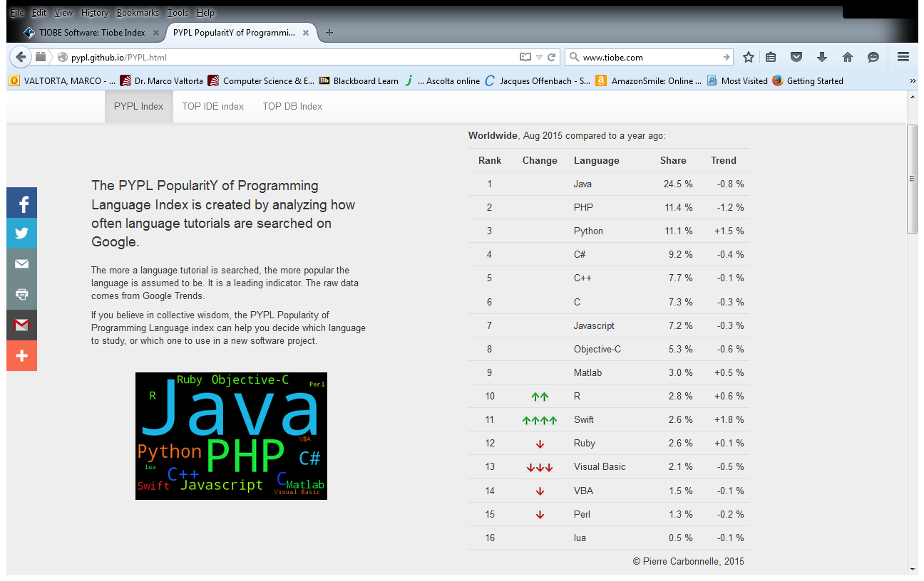
August 2015 PYPL Index
Notes:
PYPL is a competing (with respect to Tiobe) PL popularity index. This chart and the commentary below were downloaded on 2015-08-18 from http://pypl.github.io/PYPL.html. The site includes a custom search engine to construct charts and graphs for specific languages and geographic regions. The PYPL PopularitY of Programming Language index is created by analyzing how often language tutorials are searched on Google : the more a specific language tutorial is searched, the more popular the language is assumed to be. It is a leading indicator. The raw data comes from Google Trends, so that anyone can verify it, or make the analysis for his own country.

Slide 68
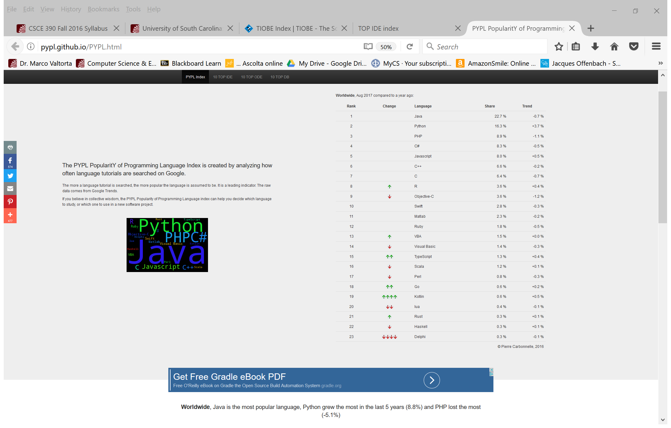
August 2017 PYPL Index
Notes:
PYPL is a competing (with respect to Tiobe) PL popularity index. This chart and the commentary below were downloaded on 2017-08-23 from http://pypl.github.io/PYPL.html. The site includes a custom search engine to construct charts and graphs for specific languages and geographic regions. The PYPL PopularitY of Programming Language index is created by analyzing how often language tutorials are searched on Google : the more a specific language tutorial is searched, the more popular the language is assumed to be. It is a leading indicator. The raw data comes from Google Trends, so that anyone can verify it, or make the analysis for his own country.

Slide 69
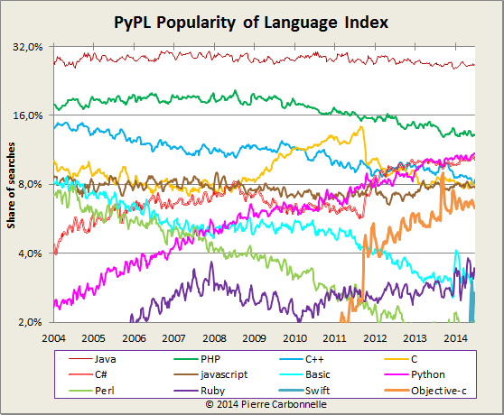
August 2014 PYPL Long-Term Index
Notes:
PYPL is a competing (with respect to Tiobe) PL popularity index. This chart and the commentary below were downloaded on 2014-08-19 from https://sites.google.com/site/pydatalog/pypl/PyPL-PopularitY-of-Programming-Language.
The PYPL PopularitY of Programming Language index is created by analyzing how often language tutorials are searched on Google : the more a specific language tutorial is searched, the more popular the language is assumed to be. It is a leading indicator. The raw data comes from Google Trends, so that anyone can verify it, or make the analysis for his own country.

Slide 70
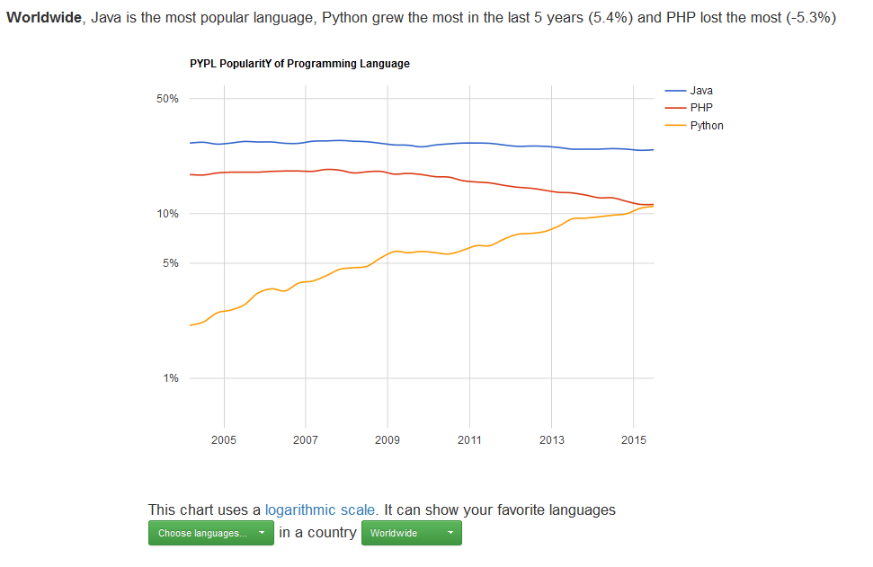
August 2015 PYPL Long-Term Index
Notes:
PYPL is a competing (with respect to Tiobe) PL popularity index. This chart and the commentary below were downloaded on 2015-08-18 from http://pypl.github.io/PYPL.html. The site includes a custom search engine to construct charts and graphs for specific languages and geographic regions. The PYPL PopularitY of Programming Language index is created by analyzing how often language tutorials are searched on Google : the more a specific language tutorial is searched, the more popular the language is assumed to be. It is a leading indicator. The raw data comes from Google Trends, so that anyone can verify it, or make the analysis for his own country.

Slide 71
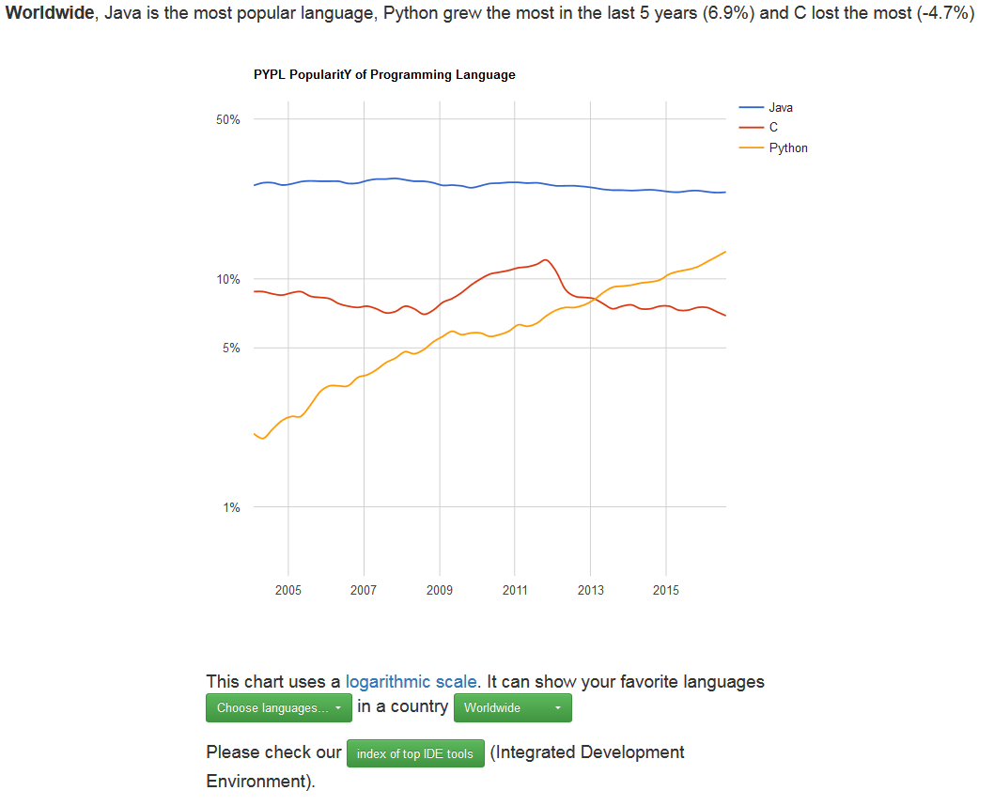
August 2016 PYPL Long-Term Index
Notes:
PYPL is a competing (with respect to Tiobe) PL popularity index. This chart and the commentary below were downloaded on 2016-08-17 from http://pypl.github.io/PYPL.html. The site includes a custom search engine to construct charts and graphs for specific languages and geographic regions. The PYPL PopularitY of Programming Language index is created by analyzing how often language tutorials are searched on Google : the more a specific language tutorial is searched, the more popular the language is assumed to be. It is a leading indicator. The raw data comes from Google Trends, so that anyone can verify it, or make the analysis for his own country. The table is covered by the Creative Commons Attribution 3.0 Unported License (https://creativecommons.org/licenses/by/3.0/).

Slide 72
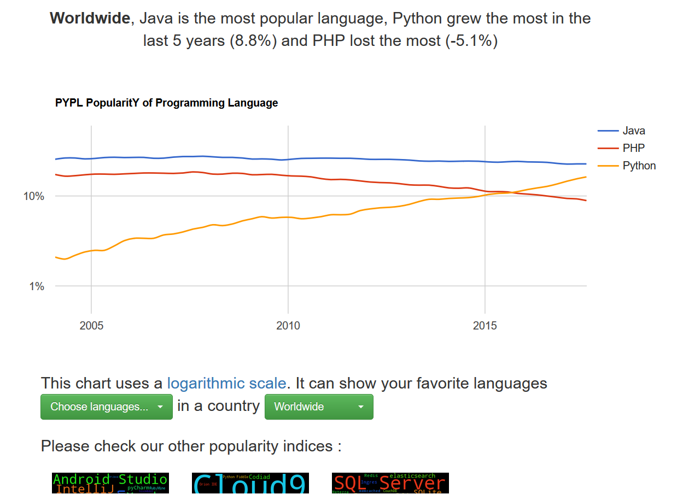
August 2017 PYPL Long-Term Index
Notes:
PYPL is a competing (with respect to Tiobe) PL popularity index. This chart and the commentary below were downloaded on 2017-08-23 from http://pypl.github.io/PYPL.html. The site includes a custom search engine to construct charts and graphs for specific languages and geographic regions. The PYPL PopularitY of Programming Language index is created by analyzing how often language tutorials are searched on Google : the more a specific language tutorial is searched, the more popular the language is assumed to be. It is a leading indicator. The raw data comes from Google Trends, so that anyone can verify it, or make the analysis for his own country. The table is covered by the Creative Commons Attribution 3.0 Unported License (https://creativecommons.org/licenses/by/3.0/).

Slide 73
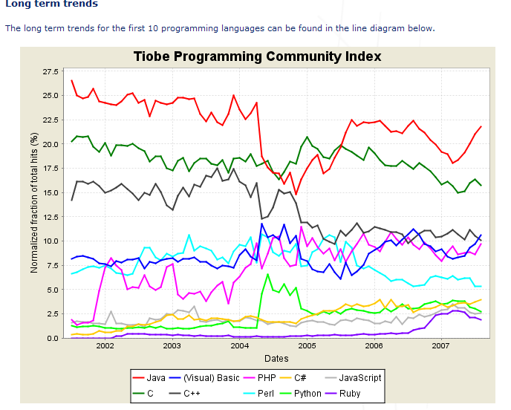
Tiobe Index Long Term Trends, August 2007
Notes:
The end of 2004 drop for Java is due to a change in Google. See http://www.tiobe.com/index.htm?tiobe_index, accessed on 2007-08-23.

Slide 74
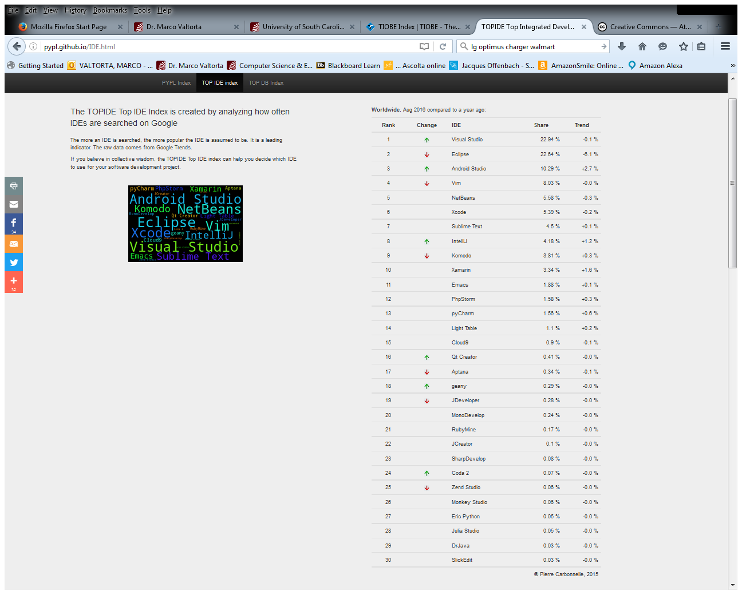
TOPIDE Top IDE Index, August 2016
Notes:
http://pypl.github.io/IDE.html, accessed 2016-08-17.

Slide 75
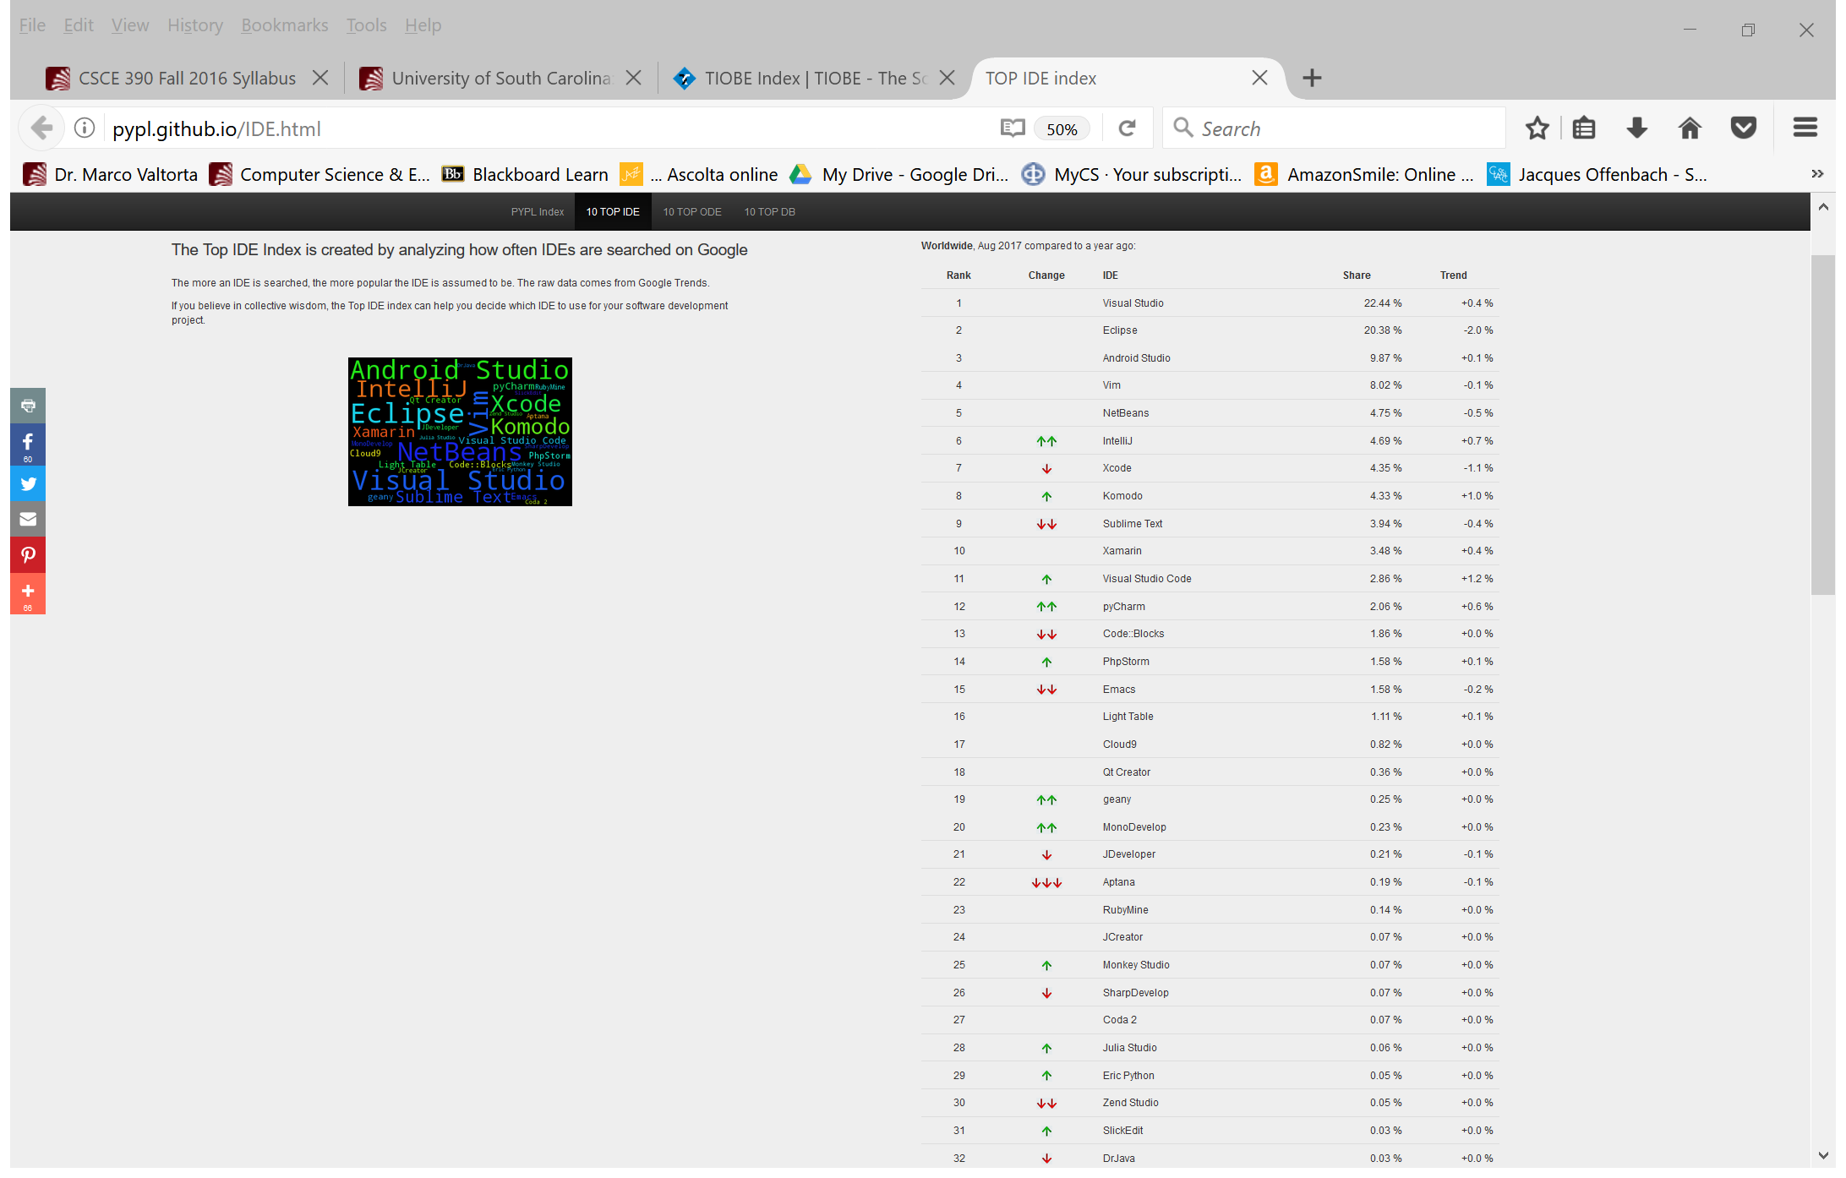
TOPIDE Top IDE Index, August 2017
Notes:
http://pypl.github.io/IDE.html, accessed 2016-08-17.

Slide 76
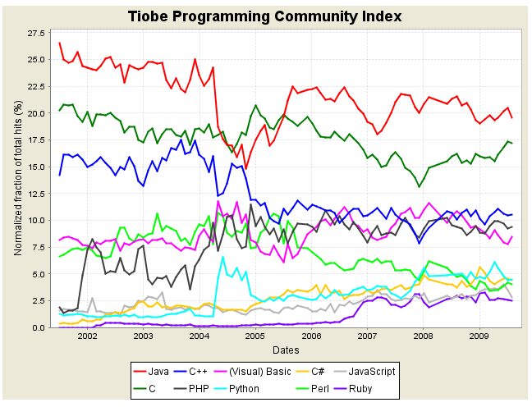
Tiobe Index Long Term Trends, August 2009
Notes:
The end of 2004 drop for Java is due to a change in Google. See http://www.tiobe.com/index.htm?tiobe_index, accessed on 2007-08-23.

Slide 77
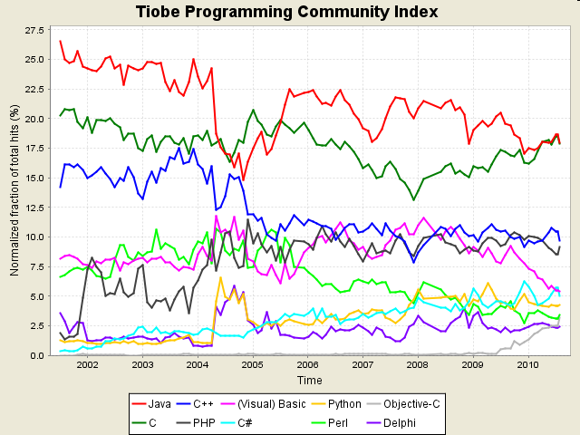
Tiobe Index Long Term Trends, August 2010
Notes:
http://www.tiobe.com/index.php/content/paperinfo/tpci/index.html, accessed 2010-08-17. The end of 2004 drop for Java is due to a change in Google. See http://www.tiobe.com/index.htm?tiobe_index, accessed on 2007-08-23.

Slide 78
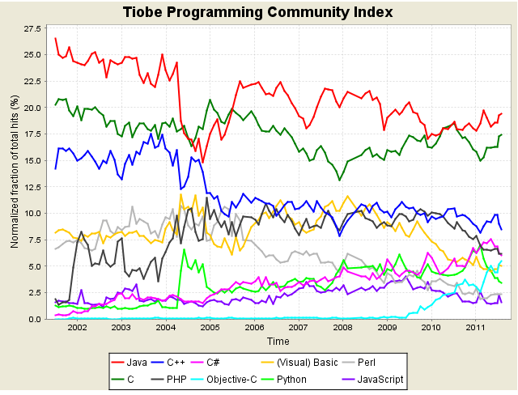
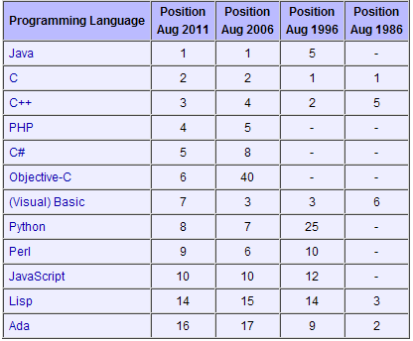
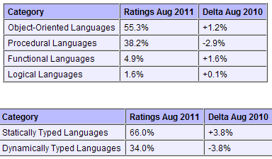
Tiobe Index Long Term Trends, August 2011
Notes:
http://www.tiobe.com/index.php/content/paperinfo/tpci/index.html, accessed 2010-08-11. The end of 2004 drop for Java is due to a change in Google. See http://www.tiobe.com/index.htm?tiobe_index, accessed on 2007-08-23.
Static vs. Dynamic Typing will be explained in a later lecture.

Slide 79
Tiobe Index Long Term Trends, August 2011
Notes:
http://www.tiobe.com/index.php/content/paperinfo/tpci/index.html, accessed 2010-08-23. The end of 2004 drop for Java is due to a change in Google. See http://www.tiobe.com/index.htm?tiobe_index, accessed on 2007-08-23.
Static vs. Dynamic Typing will be explained in a later lecture.

Slide 80
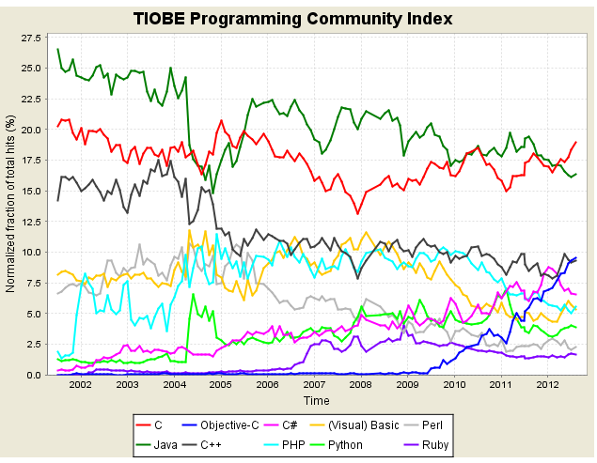
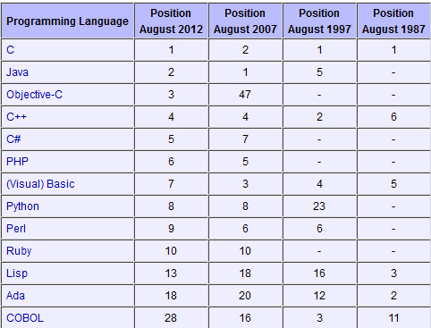
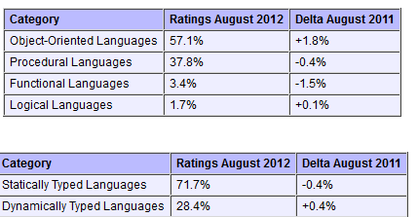
Tiobe Index Long Term Trends, August 2012
Notes:
http://www.tiobe.com/index.php/content/paperinfo/tpci/index.html, accessed 2012-08-23. The end of 2004 drop for Java is due to a change in Google. See http://www.tiobe.com/index.htm?tiobe_index, accessed on 2007-08-23.
Static vs. Dynamic Typing will be explained in a later lecture.

Slide 81
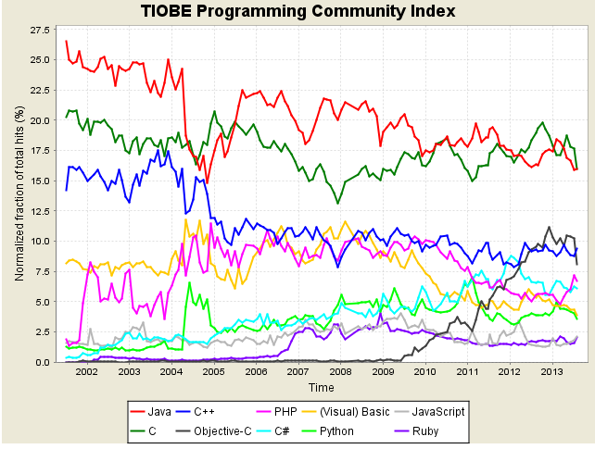
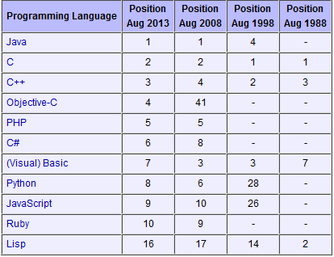
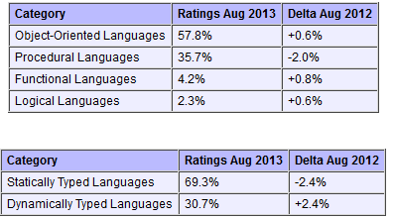
Tiobe Index Long Term Trends, August 2013
Notes:
http://www.tiobe.com/index.php/content/paperinfo/tpci/index.html, accessed 2013-08-20. The end of 2004 drop for Java is due to a change in Google. See http://www.tiobe.com/index.htm?tiobe_index, accessed on 2007-08-23.
Static vs. Dynamic Typing will be explained in a later lecture.

Slide 82
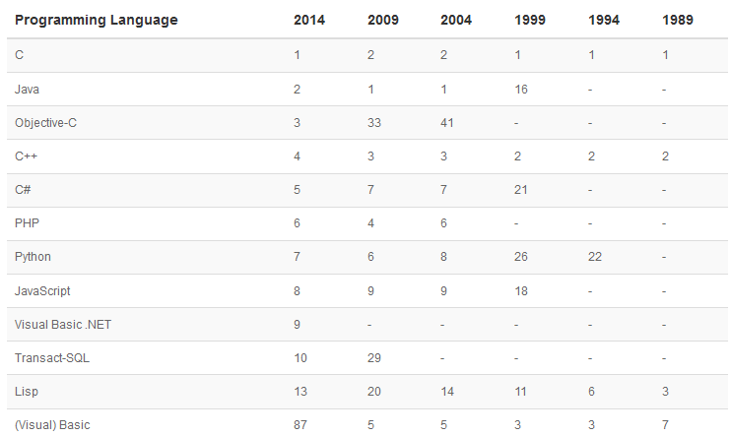
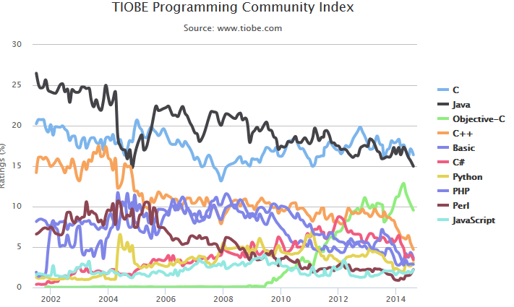
Tiobe Index Long Term Trends, August 2014
Notes:
http://www.tiobe.com/index.php/content/paperinfo/tpci/index.html, accessed 2014-08-19. The end of 2004 drop for Java is due to a change in Google. See http://www.tiobe.com/index.htm?tiobe_index, accessed on 2007-08-23. Apparently, Tiobe no longer provides “category” tables.
Static vs. Dynamic Typing will be explained in a later lecture.

Slide 83
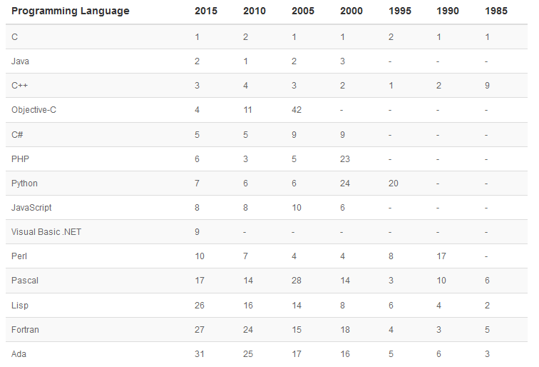
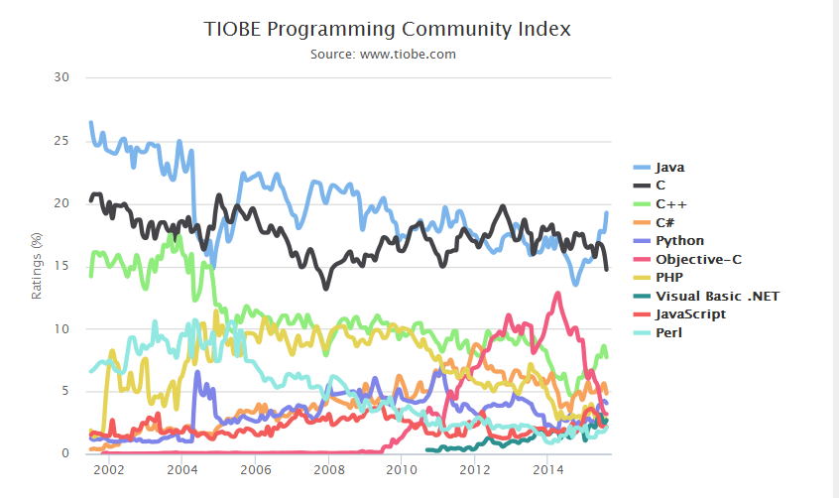
Tiobe Index Long Term Trends, August 2015
Notes:
http://www.tiobe.com/index.php/content/paperinfo/tpci/index.html, accessed 2015-08-18. The end of 2004 drop for Java is due to a change in Google. See http://www.tiobe.com/index.htm?tiobe_index, accessed on 2007-08-23. Apparently, Tiobe no longer provides “category” tables.
Static vs. Dynamic Typing will be explained in a later lecture.

Slide 84
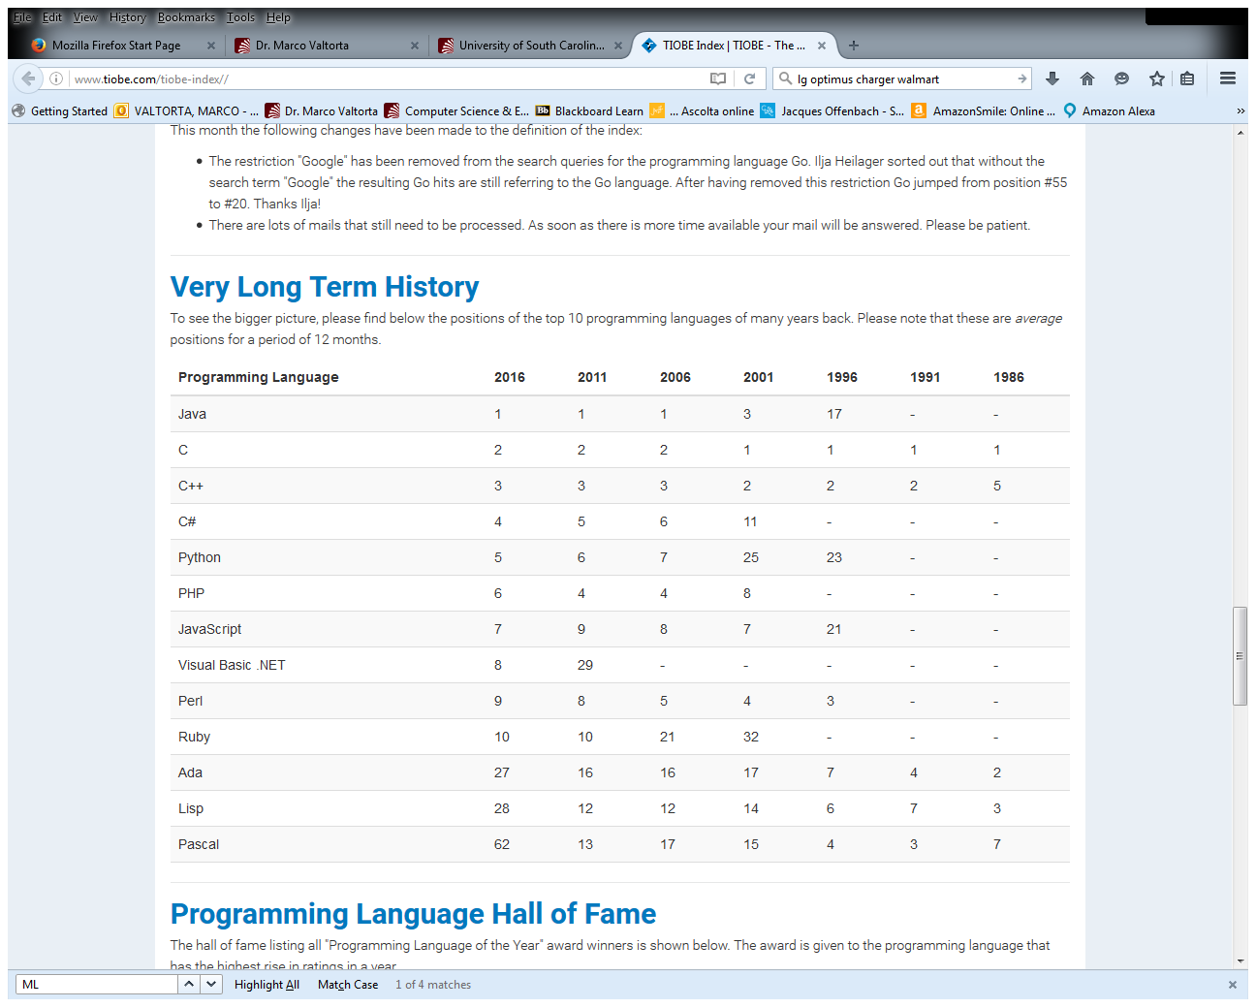
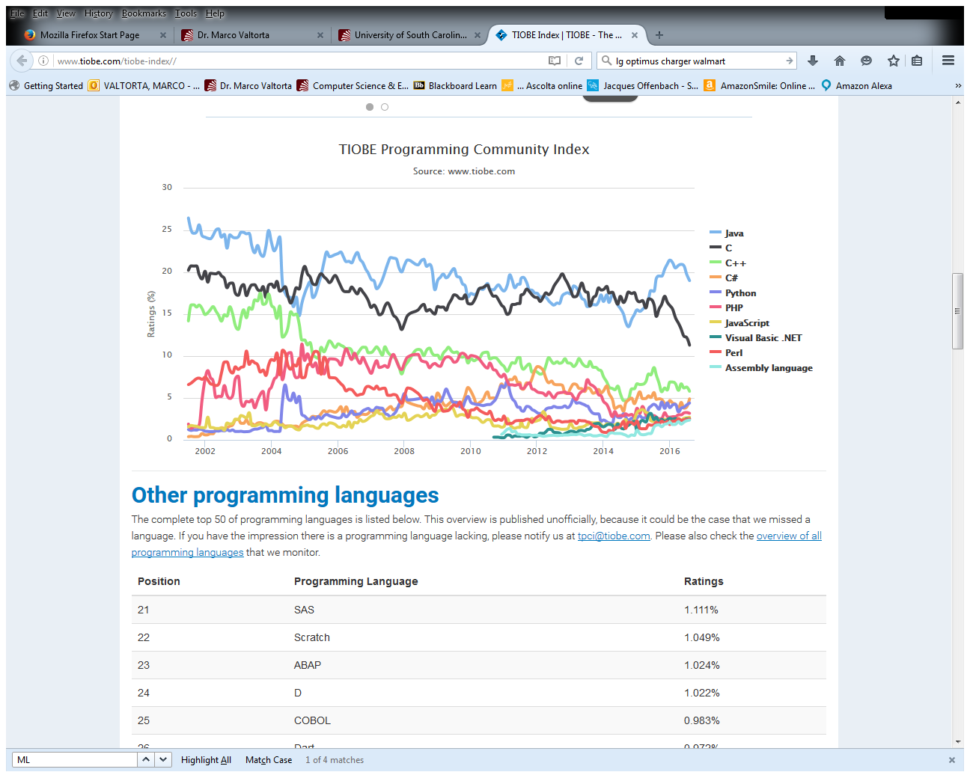
Tiobe Index Long Term Trends, August 2016
Notes:
http://www.tiobe.com/index.php/content/paperinfo/tpci/index.html, accessed 2016-08-17. The end of 2004 drop for Java is due to a change in Google. See http://www.tiobe.com/index.htm?tiobe_index, accessed on 2007-08-23. Apparently, Tiobe no longer provides “category” tables.
Static vs. Dynamic Typing will be explained in a later lecture.

Slide 85
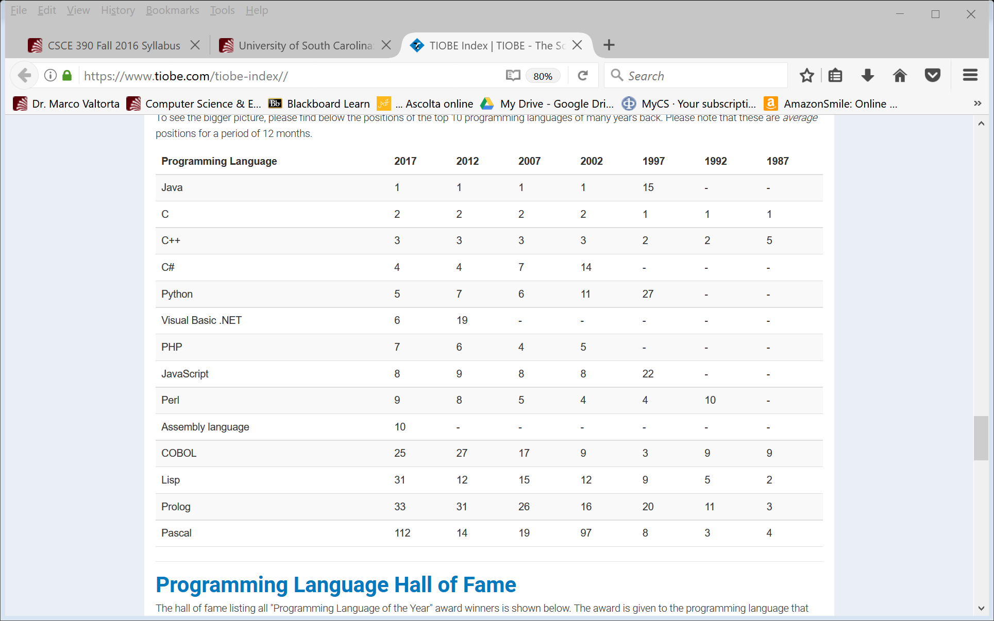
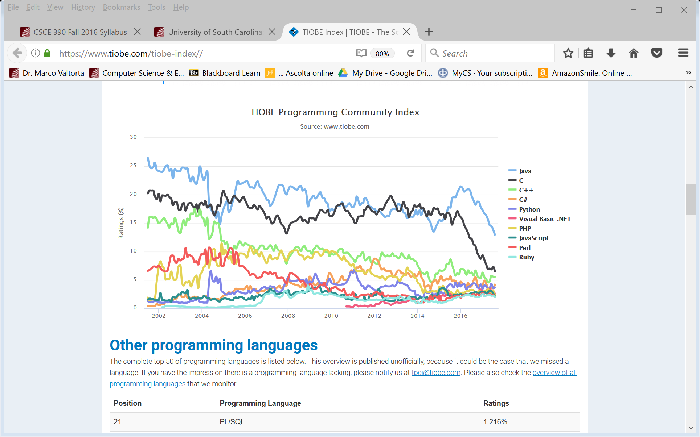
Tiobe Index Long Term Trends, August 2017
Notes:
http://www.tiobe.com/index.php/content/paperinfo/tpci/index.html, accessed 2017-08-23. The end of 2004 drop for Java is due to a change in Google. See http://www.tiobe.com/index.htm?tiobe_index, accessed on 2007-08-23. Apparently, Tiobe no longer provides “category” tables.
Static vs. Dynamic Typing will be explained in a later lecture.

