Slide 1



Slide 2
Live it
Our Mission
Live it.
The mission of the University of South Carolina Career Center is to educate and empower students in their development of lifelong career management skills
Experience it.
Decide it.

Slide 3
Live it.
Our Location
The College of Engineering & Computing has its very own Career Center located in 1A01E Swearingen!
Experience it.
Stop by & see us during on-call hours:
Monday – Friday: 1-4pm
NO appointment necessary!
Decide it.

Slide 4
What does the Career Center help with?
Live it.
-Resume Reviews
-Company Research
-Mock Interviews
-SET Fair Prep
-Salary Negotiations
-JobMate Full Access
-Professional Development
-Internship and Co-op Search
Experience it.
Decide it.

Slide 5

What is a Resume?
Summary of your Qualifications
  Education
  Experiences
  Skills
Notes:
LIVING DOCUMENT THAT WILL GROW AND CHANGE BUT A GOOD FORMAT WILL STAY

Slide 6

General Resume Review:
Resume Appearance
Use light colored resume paper.
Keep font size between 10.5 and 14 pt
Use common fonts
You may use simple graphics such as lines to create a border, but don't overdo it.
Maintain reasonable margins. ( In general, 1 inch margins are preferable)

Slide 7
Specific Parts of a Resume
Identifying Information/Heading
Objective
Education
Experience
Skills
Related Coursework
Volunteer/Community Service
Professional Organizations
Activities
Honors

Slide 8
Identifying Information/Heading:
Cap the top of your resume with:
  Full name
  Complete address
  Phone numbers
  E-mail address
  Personal website (if appropriate)

Slide 9
Objective
The objective is an optional category that indicates the type of work you are seeking
Employers prefer objectives that are specific and concise. If you know the exact position you are pursuing or field that you are considering, you may include an objective. Otherwise, you may omit this category

Slide 10
Example Objectives
OBJECTIVE
An internship at Computer Sciences Corporation in computer programming.
OR
A management training position at Bank of America.
OBJECTIVE
An internship utilizing my skills and training.
OR
A position in financial services where I can learn and progress in my career.
Good
Bad

Slide 11
Education
Degrees should be listed in reverse chronological order
Include only those schools in which you earned a degree
Names and locations of schools or programs
Graduation date
Degrees or certificates
Major, minor or cognate
Grade point average (if 3.0 or above)
Awards/Honors/Scholarships (consider a separate section if more than 3)
Study abroad experiences

Slide 12
Example of How to Show Your Education
University of South Carolina, Columbia, SC
Bachelor of Science in Computer Engineering, May 2016
GPA: 3.6/4.0
Universidad de las Americas, Puebla, Mexico
Summer 2014
Enrolled in language, cultural and science courses

Slide 13
Related Coursework
This category is optional and can also be part of the Education section
Mainly used when you are lacking related experience but want to demonstrate specific knowledge
List the titles of courses you’ve taken that relate to the position for which you are applying
Notes:
General Chemistry
Organic Chemistry
Physics
Calculus
Statistics
Biology

Slide 14

You know, like nunchuck skills, bowhunting skills, computer hacking skills... Girls only want boyfriends who have great skills.

Slide 15
Skills Section
This section is optional, but valuable
Some Categories include: computer, technology, language
List product names and version numbers if possible
Students seeking positions specifically in technology should break this list down (programming languages, hardware, software, operating systems, databases, peripherals)

Slide 16
Skills Example
SKILLS
  Computer
  Languages: C++, java, HTML, CSS
  Applications: Eclipse, Microsoft Office, Putty, MATHLAB
  Machines: Unix, Linux, Solaris
  Languages
  Fluent in French and Spanish, Basic knowledge of German

Slide 17
Experience
Can be labeled as/broken-up into:
  Experience, Work Experience, Relevant Experience, Research Experience
Always include in this section:
  Employer Name & Location
  Dates of Employment
  Your position/title
  A bulleted list of accomplishments/contributions that you achieved; each bullet should begin WITH AN ACTION VERB
  Include Skills with Tasks!

Slide 18
Experience
When developing the action bullet points, consider:
  Describing the tasks which you did
  Describing the soft or transferrable skills (communication, teamwork, handling difficult customers) which you utilized
  Describing the meaning & takeaway you exited the experience with
  Describing how you can utilize the skills you learned/developed in future schoolwork &/or classes

Slide 19
Experience Examples
Here’s how to make that experience look awesome on your resume:
  Brainstorm transferable skills that you used
    Did you communicate with your crew-mates?
      #1 skill employers are looking for is Communication
    Did you manage your time well?
    Did you adapt to a fast paced environment?
  Then Create Entry
    Communicated with a diverse customer base in order to ensure customer satisfaction
    Managed time effectively in order to balance work and school life
You say:
“But all I did over the summer was work at a restaurant…. “
We say:
Let’s make meaning out of this.

Slide 20
DESCRIBE A WAITER
DO NOT DESCRIBE IT THIS WAY……
Served food
Took care of customers
Bussed tables
Took money from patrons
Learned the nightly menu specials
Kept dining space clean

Slide 21
DESCRIBE A WAITER
SOME BETTER OPTIONS MIGHT BE……
Managed time efficiently and effectively while providing dining service for 70-covers
Monitored, controlled and successfully handled food and beverage operations
Forged strong relationships with customers, staff members, guests and team organizers
Commended by patrons and supervisors for developing excellent dining ambience and providing exceptional customer service
Developed interpersonal, verbal and written communication skills.
Demonstrated adaptability and problem-solving capabilities when dealing with kitchen issues, customer complaints and understaffing
Assisted with the training of new staff hires

Slide 22
Let’s Practice
Think of a resume entry for someone who bags groceries at Publix.
What tasks would you include?
What skills would you include?
Can you quantify?
Or qualify?

Slide 23

Notes:
Remember the resume is the SCREENING tool that gets you the interview.

Slide 24
Additional Categories
HONORS, ACTIVITIES, RESEARCH, PROFESSIONAL AFFILIATIONS
  You may specifically want to list:
    Activities or leadership positions that demonstrate job related skills
    Honors or awards (Scholarships may or may not be relevant)

Slide 25
To Review
A resume is composed of 8 main headings:
  Identifying Information/Heading
  Objective
  Education
  Experience
  Skills
  Related Coursework
  Volunteer/Community Service/Professional Organizations
  Activities/Honors

Slide 26
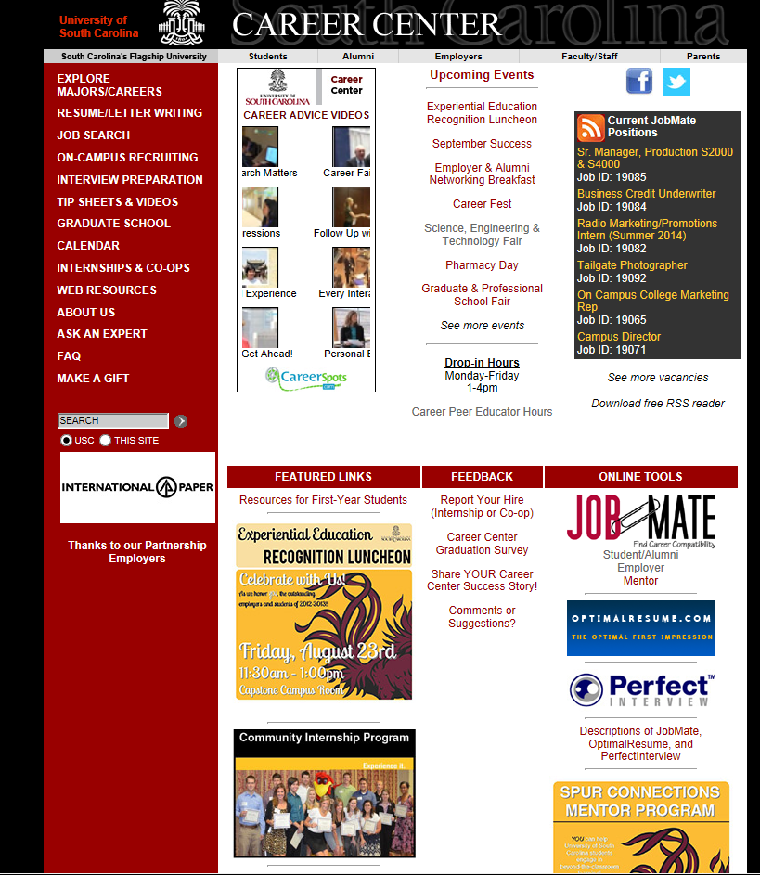
Live it.
If you need help, USC offers Resume Writing Tools at:
www.sc.edu/career
Go to RESUME/LETTER WRITING
Experience it.
More great resources under TIP SHEETS & VIDEOS
Decide it.
Or check out the FEATURED LINKS
Notes:
You all probably have a resume by now:
Make sure formmating is easy to read
2. Content – tailor to the position
Write a bullet
Give out tip sheet

Slide 27

Live it.
What is JobMate?
Experience it.
The USC JobMate database allows students to search for jobs, internships, co-ops, and research employers.
You can search for CIP internships too!!!
Decide it.
Notes:
Stand up sit down

Slide 28
Live it.
Basic Access
vs.
Full Access
Look at job postings but cannot apply for ANYTHING
Can apply for ANY position posted
Sign up for mock interviews and on-campus interviews
Upload resume, cover letters, and other documents
Employers can search for YOU
Experience it.
*To obtain Full Access to JobMate, your resume will need to be reviewed by a Career Center staff member during drop in hours or by scheduling an appointment!
Decide it.

Slide 29

YOU!
Family
Family Friends
Professors & Advisors
Service Providers
Classmates
Former Co-workers
Peers
Clergy
Doctors
Dentist
Parents
Friends
Career Center & Other Campus Resources
Former Students
Classmates
Organizations
Notes:
1st Step is to identify contacts…make a list of people you know and trust
Not just who you know – who & what do the people your network know?
Networking is interconnected and unpredictable
Meet new people! Connect with alumni

Slide 30
Network with Confidence!
“Working the Room….”
Personal Introduction
30 Second Commercial or Elevator Pitch
  In 30 seconds or less….
    Who you are…
    What you want to do…
    What you can offer…
Practice, practice, practice!
Notes:
SAMPLE –
Personal Introduction + "I became interested in the human resources field last summer when I interned at The Greater Houston YMCA and I got to know the Human Resources Director there. I had always planned on following the traditional route to graduate school but her job really fascinated me. I liked the variety of her job and the fact that she was a very positive influence in the YMCA. When I returned to school this fall, I decided to add a business class and I also joined the Human Resources Management Association. I have enjoyed my business class and it's a good complement to my psychology classes. Next semester I will begin taking courses as a management major and I hope to obtain an internship in human resources next summer."

Slide 31
Network with Confidence!
“Working the Room….”
Appearance
Proper Handshake
Eye Contact & Body Language
Active Listening
Ask Questions
Resumes
Collect Business Cards
Never ASK for a job
Follow Up Appropriately
Know What Topics to Avoid
Notes:
FOLLOW UP APPROPRIATELY!!!

Slide 32
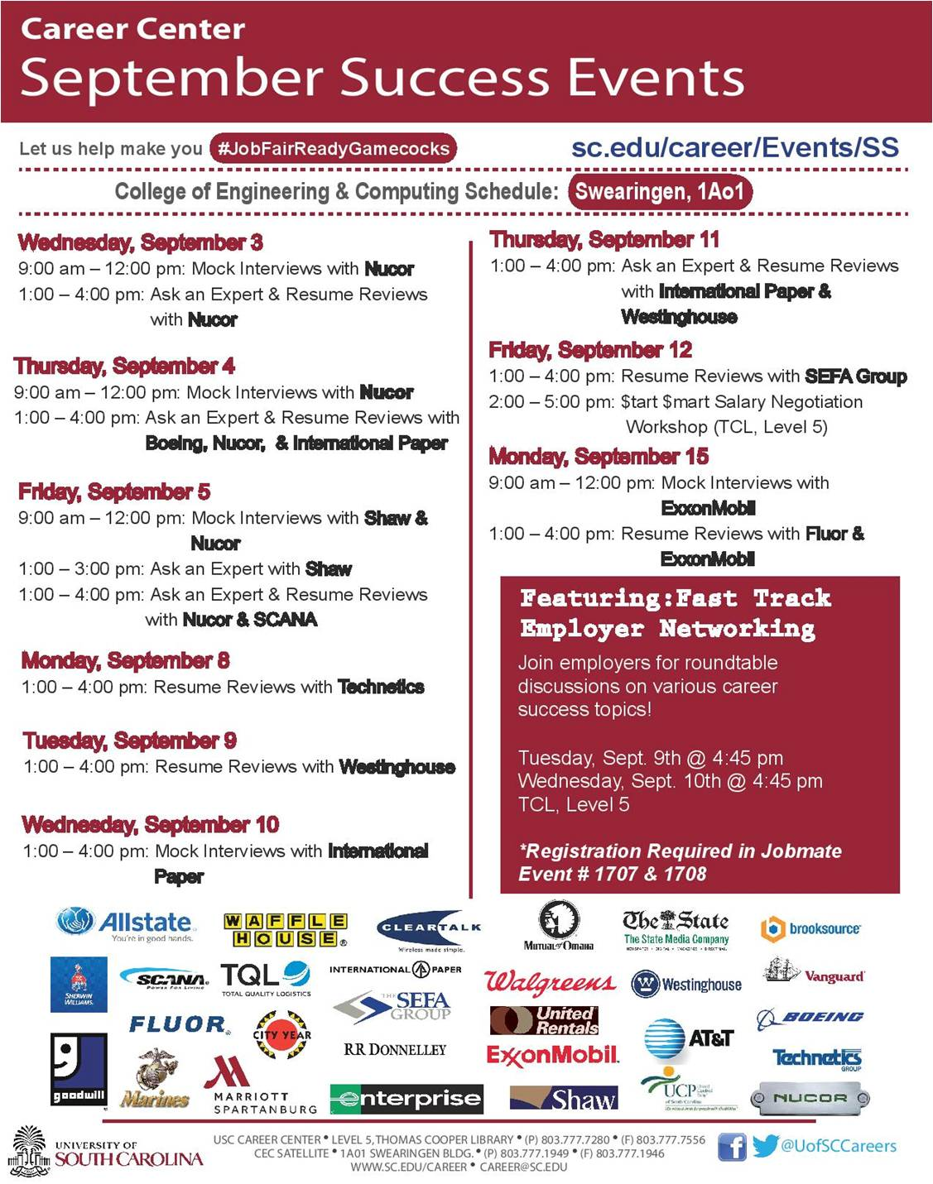

Slide 33


Slide 34
RESEARCH EMPLOYERS
ATTENDING THE FAIR
Review list of employers attending the fair via JobMate (accessible from www.sc.edu/career)
Visit employer web sites and use employer research sites found on the Career Center’s web resources page
Use Company/Organization Information tip sheet to organize your research
Narrow and prioritize number of employers to whom you will focus your attention

Slide 35
PREPARE TO MAKE A
GOOD IMPRESSION
Have a well-written, critiqued resume – bring 20+ copies
Develop a list of questions for employers based on research
Prepare to speak a “skills” language
Know how to express your qualifications and goals
Know how to express what you are looking for and what you want
Prepare a Career Fair Employer Log to use for note-taking during the fair
Notes:
Know how to relate your past work, academic and out-of-class experiences, to the career field.
Prepare a career log in advance to document career fair information (i.e., To whom have you given a resume?, Are they scheduled to return to USC ?, etc.)

Slide 36
MAKE A GOOD IMPRESSION
Arrive early and give yourself enough time to not rush through the fair
Dress and act professionally
Establish rapport with the recruiters
Remember your body language
LISTEN to the recruiter
Don’t ramble
Ask at least TWO intelligent questions of each organization
Notes:
Smile, make eye contact, and shake hands confidently and firmly. Introduce yourself with your full name, major, and graduation date.
Remember your body language…don’t fidget or look around. Act interested, focused, and enthusiastic. Be friendly, assertive, mature, and sincere.
Ask at least 2 intelligent questions of each organization, about such topics as: organizational statistics, company mission, client base, internship or co-op opportunities, summer or part-time employment, full-time career paths, trainee programs, benefits, hiring procedures, etc.

Slide 37

Live it.
Experience it.
Decide it.
Notes:
Stand up/sit down

Slide 38
What Do I Wear?
First impression do matter
Dress as if the career fair or your set meeting were an interview
A suit is always safe
Little to no cologne/perfume
Make sure your clothes are clean and pressed
Avoid excessive jewelry or make up
Avoid clothing that is too short or revealing
Notes:
Dress the part. As with a job interview, first impressions at a job fair are important. How you represent yourself sends an immediate message to employers about how serious you are in your job search. It isn't always necessary to wear a suit to a job fair - unless you are looking for a job that would require you to dress professionally at work. However, you should leave the jeans and t-shirts at home. "Business Casual" is usually the most appropriate at a job fair - nice slacks and a collared shirt for men and nice slacks or a skirt and a blouse for women are appropriate.

Slide 39
What Do I Bring?
20 Copies of your resume on nice paper
A list of questions to ask employers based on your research of their organization
Pen and notepad to take notes
A portfolio to keep resumes, business cards, notes, brochures, etc. organized
Anticipate mishaps: bring umbrella/rain coat, sewing kit, lint brush, comb, etc.

Slide 40
Importance of Networking
80% of job vacancies are never advertised.
Most employers would prefer to hire a person referred by a colleague, peer or friend and believe they will be exposed to a higher quality candidate in this manner.
The overall time needed to find a job can be drastically reduced.
  4-6 months if networking
  6-9 months without networking
You can learn more about your field of interest and occupations within it, as well as specific organizations

Slide 41
Verbal Communication
Know your resume and goals
When targeting a specific company:
  Research the company so that you can engage in discussion
  Match yourself to the company (abilities, interests and values)
Be able to talk intelligently about yourself if questions are asked.
Know how to express what you are looking for and what skills you have.
Know why you are networking and be prepared to be honest about that with the people with whom you network.

Slide 42
Non-verbal Communication
Maintain good eye contact
Smile ☺
Relaxed, yet confident, posture
A firm, friendly handshake
Remember body language
Listen to what the recruiter has to say: act focused, interested and enthusiastic

Slide 43
Sample Questions To Ask Employers
What unique factors set this organization apart from others?
What type of entry level positions exist in this field?
How did you personally get interested in this field?
What attracted you to this organization?
What is the typical career path of someone in this organization/field?
What values or philosophies does this organization claim to have?

Slide 44


Slide 45


