Slide 1
Life as a web developer
Richard Baldwin
Director of Web Development at Cyberwoven
Email: Richard.baldwin@cyberwoven.com
Twitter: @richardkbaldwin
@cyberwoven

Slide 2
About Me
Richard Baldwin
Director of Web Development at Cyberwoven
2000 Graduate USC College of Engineering
2010 Graduate USC Moore School of Business

Slide 4
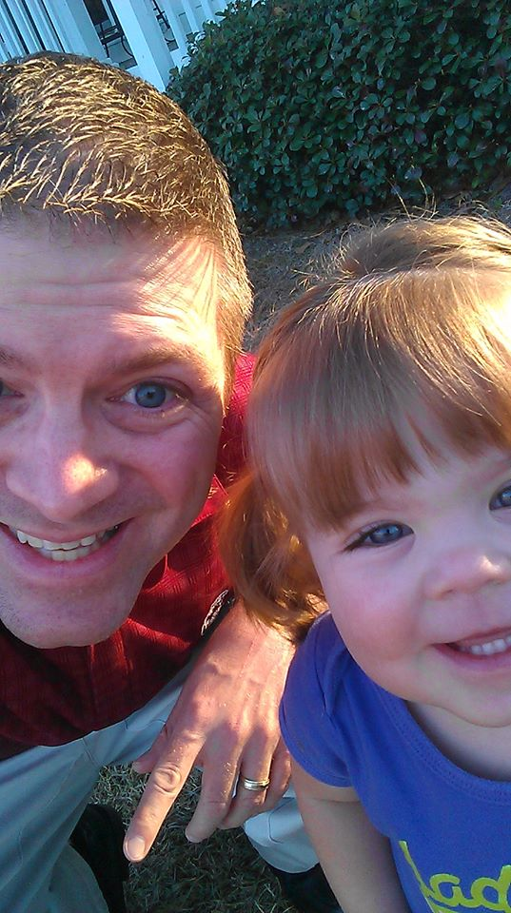

Slide 5
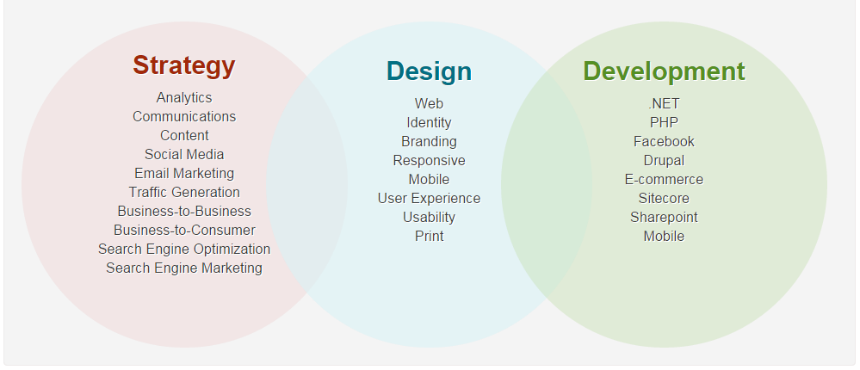
About Cyberwoven
Located in Columbia, SC
One of the largest web shops in SC
Focus on content managed websites and web applications
We have launched hundreds of web sites and applications

Slide 6
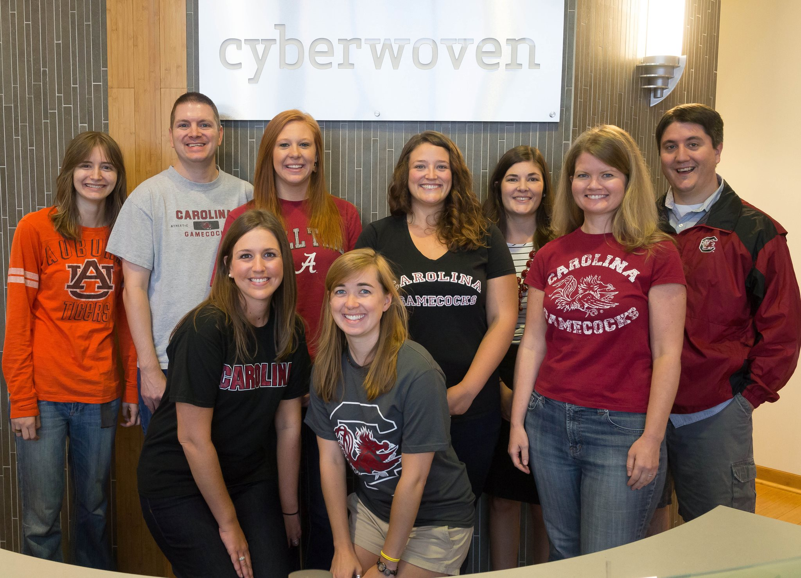

Slide 7
Terminology
Programming/Development
Writing code in any computer language to accomplish any task
Software Development
Writing code to create applications, tools or services on computers, servers or devices
Web Development
Writing code to create web sites, web applications, web tools that are typically consumed in a browser

Slide 8
Web Development
Static websites, dynamic websites, web applications, web services, data feeds, etc.
Popular Languages:
HTML
PHP
C#
JavaScript
Python
Ruby (on rails)

Slide 9
Software Development VS Web Development
$90,060 – median salary $62,500 – median salary
139,900 – US jobs 28,500 – US jobs
2.8% – unemployment 4.2% – unemployment
#1 – 2013 best jobs ranking #9 – 2013 best jobs ranking
Computer Programming
$74,280 – median salary
28,400 – US jobs
4.5% – unemployment
#30 – 2013 best jobs ranking
http://money.usnews.com/careers/best-jobs/rankings/the-100-best-jobs

Slide 10
Software Development VS Web Development II
Non-glamorous jobs Public facing work
Slow changing field Ever changing field
Large and long projects Smaller and shorter
Less ownership More ownership
Specific skills Transferable skills
More competitive Less competitive

Slide 12
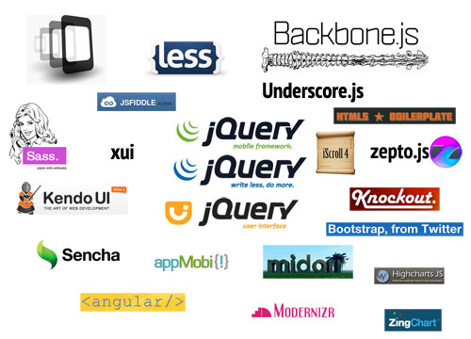

Slide 14
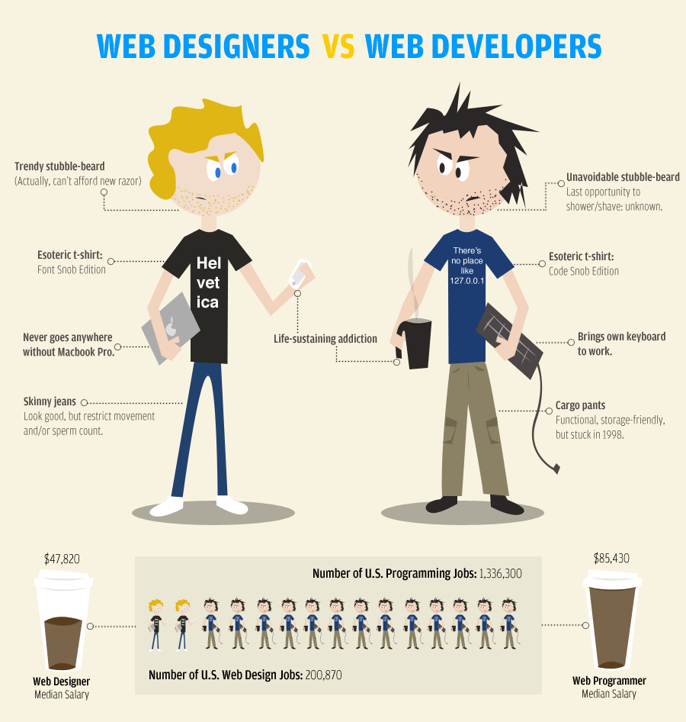

Slide 15
The Web World
Designer
Photoshop, Illustrator
Layout, fonts, colors, logos
Front-end Developer
Sublime, SASS
HTML, CSS, JavaScript
Web Developer
Visual Studio or Text Editor
C#, SQL, PHP, JavaScript
UX Designer
Workflow tools
Site flow, application flow, layout
Notes:
Funny images

Slide 16
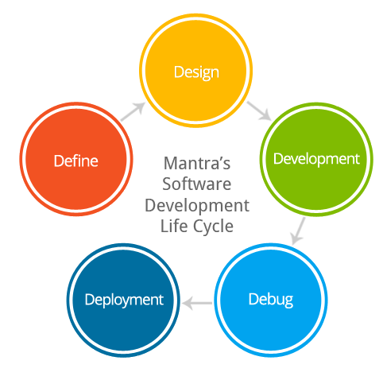

Slide 18
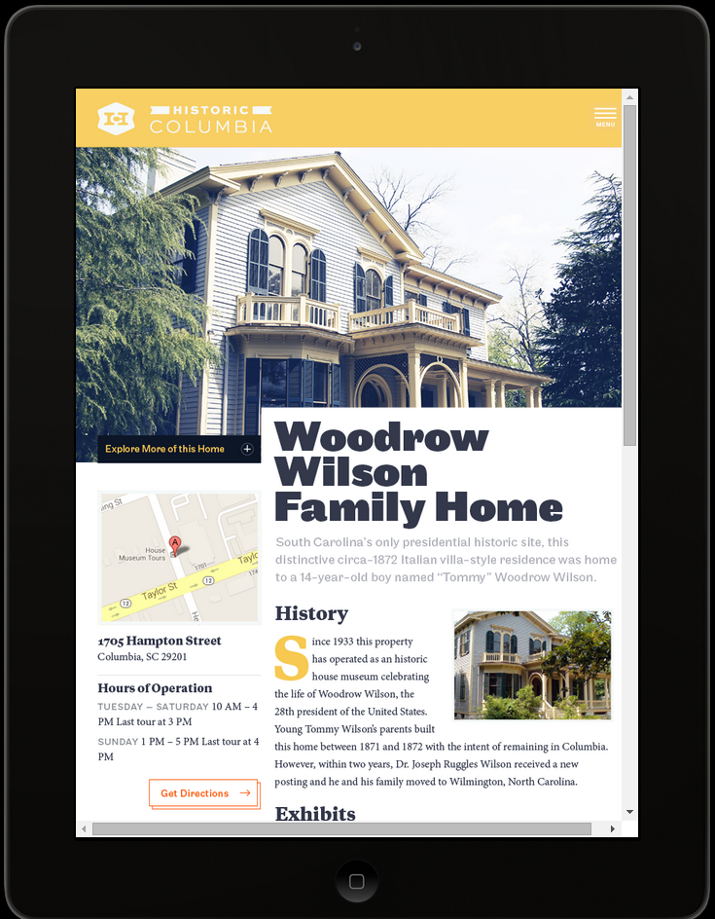

Slide 19
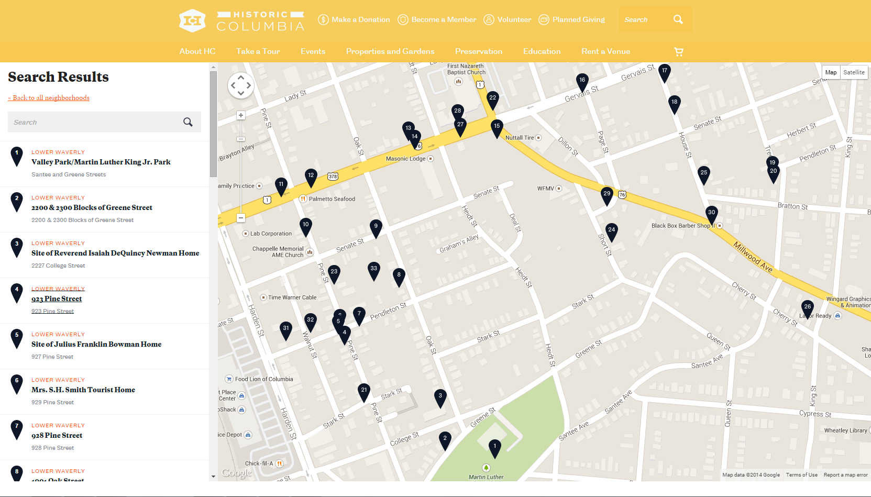

Slide 20
Find a job as a web developer
Create Stuff
Side projects
Non-profits
Clubs
Personal
Example code
Github
Develop skills
Languages
Software
Databases
Content management systems
Network, community, conferences, etc.

Slide 21
Life Lessons
Keep living like a student
Pay down debt/loans
Don’t be afraid to take risks
Look for a team you want to be a part of
Find something you can be passionate about
Notes:
Code examples

