Slide 1
CSCE 747 Software Testing and Quality Assurance
Tools 12 – Hamcrest

Slide 2
What is Hamcrest?
http://hamcrest.org/
http://code.google.com/p/hamcrest/wiki/Tutorial
http://junit.sourceforge.net/doc/cookbook/cookbook.htm
http://hamcrest.org/JavaHamcrest/javadoc/1.3/

Slide 4
Hamcrest is a framework for writing matcher objects allowing 'match' rules to be defined declaratively.
There are a number of situations where matchers are invaluble, such as UI validation, or data filtering,
but it is in the area of writing flexible tests that matchers are most commonly used.
http://code.google.com/p/hamcrest/wiki/Tutorial

Slide 5
My first Hamcrest test
import static org.hamcrest.MatcherAssert.assertThat; import static org.hamcrest.Matchers.*; import junit.framework.TestCase; public class BiscuitTest extends TestCase { public void testEquals() { Biscuit theBiscuit = new Biscuit("Ginger"); Biscuit myBiscuit = new Biscuit("Ginger"); assertThat(theBiscuit, equalTo(myBiscuit)); } }
// Note JUnit3
http://code.google.com/p/hamcrest/wiki/Tutorial

Slide 6
If you have more than one assertion in your test you can include an identifier for the tested value in the assertion:
assertThat("chocolate chips", theBiscuit.getChocolateChipCount(), equalTo(10));
assertThat("hazelnuts", theBiscuit.getHazelnutCount(), equalTo(3));
http://code.google.com/p/hamcrest/wiki/Tutorial

Slide 7
Hamcrest Common Matchers
A tour of Hamcrest comes with a library of useful matchers. Here are some of the most important ones.
Core
anything - always matches, useful if you don't care what the object under test is
describedAs - decorator to adding custom failure description
is - decorator to improve readability - see "Sugar", below
Logical
allOf - matches if all matchers match, short circuits (like Java &&)
anyOf - matches if any matchers match, short circuits (like Java ||)
not - matches if the wrapped matcher doesn't match and vice versa

Slide 8
Object
equalTo - test object equality using Object.equals
hasToString - test Object.toString
instanceOf, isCompatibleType - test type
notNullValue, nullValue - test for null
sameInstance - test object identity
Beans
hasProperty - test JavaBeans properties
http://code.google.com/p/hamcrest/wiki/Tutorial

Slide 9
Collections
array - test an array's elements against an array of matchers
hasEntry, hasKey, hasValue - test a map contains an entry, key or value
hasItem, hasItems - test a collection contains elements
hasItemInArray - test an array contains an element
Number
closeTo - test floating point values are close to a given value
greaterThan, greaterThanOrEqualTo, lessThan, lessThanOrEqualTo - test ordering
http://code.google.com/p/hamcrest/wiki/Tutorial

Slide 10
Text
equalToIgnoringCase - test string equality ignoring case
equalToIgnoringWhiteSpace - test string equality ignoring differences in runs of whitespace
containsString, endsWith, startsWith - test string matching
http://code.google.com/p/hamcrest/wiki/Tutorial

Slide 11
Syntactic Sugar
Hamcrest strives to make your tests as readable as possible.
For example, the “is” matcher is a wrapper that doesn't add any extra behavior to the underlying matcher., but increases readability.
The following assertions are all equivalent:
assertThat(theBiscuit, equalTo(myBiscuit));
assertThat(theBiscuit, is(equalTo(myBiscuit)));
assertThat(theBiscuit, is(myBiscuit));
The last form is allowed since is(T value) is overloaded to return is(equalTo(value)).
http://code.google.com/p/hamcrest/wiki/Tutorial

Slide 12
Writing custom matchers
matcher for testing if a double value has the value NaN (not a number). This is the test we want to write:
public void testSquareRootOfMinusOneIsNotANumber() { assertThat(Math.sqrt(-1), is(notANumber())); }
http://code.google.com/p/hamcrest/wiki/Tutorial

Slide 13
isNotANumber Implementation
package org.hamcrest.examples.tutorial; import org.hamcrest.Description; import org.hamcrest.Factory; import org.hamcrest.Matcher; import org.hamcrest.TypeSafeMatcher;
http://code.google.com/p/hamcrest/wiki/Tutorial

Slide 14
public class IsNotANumber extends TypeSafeMatcher<Double> { @Override public boolean matchesSafely(Double number) { return number.isNaN(); } public void describeTo(Description description) { description.appendText("not a number"); } @Factory public static <T> Matcher<Double> notANumber() { return new IsNotANumber(); } }
http://code.google.com/p/hamcrest/wiki/Tutorial

Slide 15
assertThat(1.0, is(notANumber()));
fails with the message
java.lang.AssertionError: Expected: is not a number got : <1.0>
http://code.google.com/p/hamcrest/wiki/Tutorial

Slide 16
Sugar generation
create an XML configuration file listing all the Matcher classes
<matchers> <!-- Hamcrest library --> <factory class="org.hamcrest.core.Is"/> <!-- Custom extension --> <factory class= "org.hamcrest.examples.tutorial.IsNotANumber"/> </matchers>
http://code.google.com/p/hamcrest/wiki/Tutorial

Slide 17
Run the org.hamcrest.generator.config.XmlConfigurator command-line tool that comes with Hamcrest
http://code.google.com/p/hamcrest/wiki/Tutorial

Slide 18
// Generated source
package org.hamcrest.examples.tutorial; public class Matchers { public static <T> org.hamcrest.Matcher<T> is(T param1) { return org.hamcrest.core.Is.is(param1); } public static <T> org.hamcrest.Matcher<T> is(java.lang.Class<T> param1) { return org.hamcrest.core.Is.is(param1); } public static <T> org.hamcrest.Matcher<T> is(org.hamcrest.Matcher<T> param1) { return org.hamcrest.core.Is.is(param1); } public static <T> org.hamcrest.Matcher<java.lang.Double> notANumber() { return org.hamcrest.examples.tutorial.IsNotANumber.notANumber(); } }
http://code.google.com/p/hamcrest/wiki/Tutorial

Slide 19
update our test to use the new Matchers class
import static org.hamcrest.MatcherAssert.assertThat; import static org.hamcrest.examples.tutorial.Matchers.*; import junit.framework.TestCase; public class CustomSugarNumberTest extends TestCase { public void testSquareRootOfMinusOneIsNotANumber() { assertThat(Math.sqrt(-1), is(notANumber())); } }
http://code.google.com/p/hamcrest/wiki/Tutorial

Slide 20
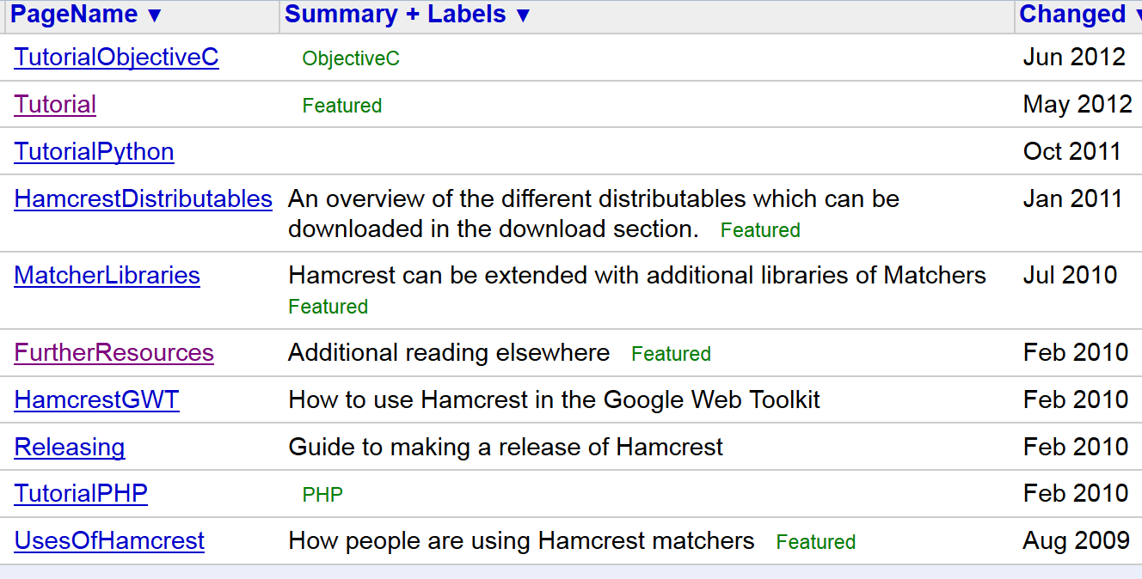

Slide 22
import static org.junit.Assert.*;
import static org.hamcrest.CoreMatchers.*;
public class Junit4FeaturesTest {
@org.junit.Test
public void testArrays() {
assertThat(new Integer[] {1,2,3,4,5}, equalTo(new Integer[]{1,2,3,4,5})); assertThat(new Integer[] {1,2,3,4,5}, not(new Integer[] {1,2}));
}
}

Slide 23
import static org.junit.Assert.*;
import static org.hamcrest.Matchers.*;
// provided by additional jar
import org.junit.Test;
public class Junit4FeaturesTest {
@Test public void testNumericComparison() { assertThat(1,lessThan(2)); assertThat(2,greaterThan(1));
assertThat(2,greaterThanOrEqualTo(2)); assertThat(1,lessThanOrEqualTo(1));

Slide 24
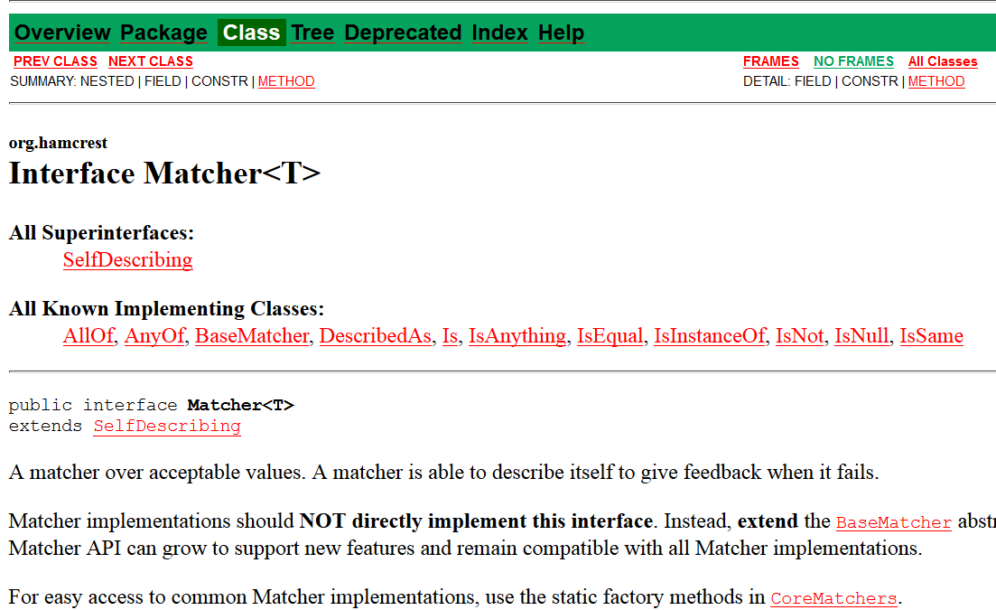
Hamcrest API

Slide 25
http://hamcrest.org/JavaHamcrest/javadoc/1.3/
org.hamcrest Interface Matcher<T>
All Superinterfaces: SelfDescribing
All Known Implementing Classes: AllOf, AnyOf, BaseMatcher, BigDecimalCloseTo, CombinableMatcher, CustomMatcher, CustomTypeSafeMatcher, DescribedAs, DiagnosingMatcher, Every, FeatureMatcher, HasProperty, HasPropertyWithValue, HasToString, HasXPath, Is, IsAnything, IsArray, IsArrayContaining, IsArrayContainingInAnyOrder, IsArrayContainingInOrder, IsArrayWithSize, IsCloseTo, IsCollectionContaining, IsCollectionWithSize, IsCompatibleType, IsEmptyCollection, IsEmptyIterable, IsEmptyString, IsEqual, IsEqualIgnoringCase, IsEqualIgnoringWhiteSpace, IsEventFrom, IsIn, IsInstanceOf, IsIterableContainingInAnyOrder, IsIterableContainingInOrder, IsIterableWithSize, IsMapContaining, IsNot, IsNull, IsSame, OrderingComparison, SamePropertyValuesAs, SamePropertyValuesAs.PropertyMatcher, StringContains, StringContainsInOrder, StringEndsWith, StringStartsWith, SubstringMatcher, TypeSafeDiagnosingMatcher, TypeSafeMatcher

Slide 26
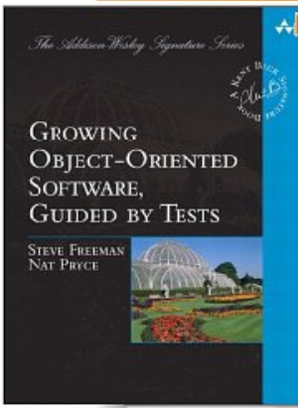
Freeman, Steve; Pryce, Nat (2009-10-12). Growing Object-Oriented Software, Guided by Tests

Slide 27
The Dilemma
One of the dilemmas posed by the move to shorter and shorter release cycles is how to release more software in less time— and continue releasing indefinitely.
Kent Beck
Freeman, Steve; Pryce, Nat (2009-10-12). Growing Object-Oriented Software, Guided by Tests

Slide 28
What if?
What if instead, we treated software more like a valuable, productive plant, to be nurtured, pruned, harvested, fertilized, and watered?
Traditional farmers know how to keep plants productive for decades or even centuries.
How would software development be different if we treated our programs the same way?

Slide 29
“A complex system that works is invariably found to have evolved from a simple system that works.”
John Gall 2003
Freeman, Steve; Pryce, Nat (2009-10-12). Growing Object-Oriented Software, Guided by Tests

Slide 30
Growing Objects
Alan Kay’s concept of objects being similar to biological cells that send each other messages.
Alan Kay was one of the authors of Smalltalk and coined the term “object-oriented.”
Freeman, Steve; Pryce, Nat (2009-10-12). Growing Object-Oriented Software, Guided by Tests

Slide 31
Test Driven Development (TDD)
Test-Driven Development (TDD) is a deceptively simple :
Write the tests for your code before writing the code itself.
it transforms the role testing plays in the development process
Testing is no longer just about keeping defects from the users;
instead, it’s about helping the team to understand the features that the users need
and to deliver those features reliably and predictably.
TDD
radically changes the way we develop software
dramatically improves the quality of the systems
Freeman, Steve; Pryce, Nat (2009-10-12). Growing Object-Oriented Software, Guided by Tests

Slide 32
What Is the Point of Test-Driven Development?
One must learn by doing the thing; for though you think you know it, you have no certainty, until you try. —Sophocles
Software Development as a Learning Process
developers learn
customers learn - codify business rules/goals
Feedback Is the Fundamental Tool
Freeman, Steve; Pryce, Nat (2009-10-12). Growing Object-Oriented Software, Guided by Tests

Slide 33
Test-Driven Development in a Nutshell
Freeman, Steve; Pryce, Nat (2009-10-12). Growing Object-Oriented Software, Guided by Tests

Slide 34
Writing tests:
makes us clarify the acceptance criteria for the system
encourages us to write loosely coupled components, so they can easily be tested in isolation and, at higher levels, combined together
adds an executable description of what the code does
adds to a complete regression suite
whereas running tests:
detects errors while the context is fresh in our mind
lets us know when we’ve done enough, discouraging “gold plating” and unnecessary features (design).
Freeman, Steve; Pryce, Nat (2009-10-12). Growing Object-Oriented Software, Guided by Tests

Slide 35
Golden Rule of Test-Driven Development
Never write new functionality without a failing test.
Freeman, Steve; Pryce, Nat (2009-10-12). Growing Object-Oriented Software, Guided by Tests

Slide 36
Refactoring. Think Local, Act Local
“Refactoring means changing the internal structure of an existing body of code without changing its behavior.
The point is to improve the code so that it’s a better representation of the features it implements, making it more maintainable.
Freeman, Steve; Pryce, Nat (2009-10-12). Growing Object-Oriented Software, Guided by Tests

Slide 37
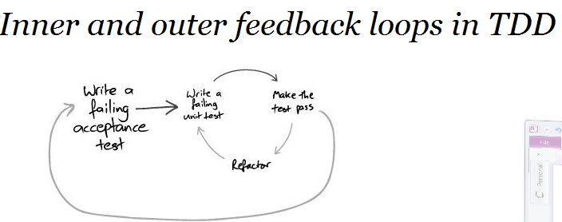
Freeman, Steve; Pryce, Nat (2009-10-12). Growing Object-Oriented Software, Guided by Tests

Slide 38
Coupling and Cohesion
Coupling and cohesion are metrics that (roughly) describe how easy it will be to change the behavior of some code.
They were described by Larry Constantine in [Yourdon79].
Elements are coupled if a change in one forces a change in
Freeman, Steve; Pryce, Nat (2009-10-12). Growing Object-Oriented Software, Guided by Tests

Slide 39
Coupling
Elements are coupled if a change in one forces a change in the other
For example, if two classes inherit from a common parent, then a change in one class might require a change in the other.
Freeman, Steve; Pryce, Nat (2009-10-12). Growing Object-Oriented Software, Guided by Tests

Slide 40
Cohesion
Cohesion is a measure of whether its responsibilities form a meaningful unit.
For example, a class that parses both dates and URLs is not coherent, because they’re unrelated concepts.
Freeman, Steve; Pryce, Nat (2009-10-12). Growing Object-Oriented Software, Guided by Tests

Slide 41
Object Oriented
Music is the space between the notes. —Claude Debussy
The big idea is “messaging” [...] The key in making great and growable systems is much more to design how its modules communicate rather than what their internal properties and behaviors should be. - Alan Kay [1998]
Freeman, Steve; Pryce, Nat (2009-10-12). Growing Object-Oriented Software, Guided by Tests

Slide 42
An object communicates by messages:
An object-oriented system is a web of collaborating objects.
A system is built by creating objects and plugging them together so that they can send messages to one another.
Freeman, Steve; Pryce, Nat (2009-10-12). Growing Object-Oriented Software, Guided by Tests

Slide 43
Man is a tool-using animal. Without tools he is nothing, with tools he is all. —Thomas Carlyle
Freeman, Steve; Pryce, Nat (2009-10-12). Growing Object-Oriented Software, Guided by Tests

Slide 44
NUnit Behaves Differently from JUnit
.Net should note that NUnit reuses the same instance of the test object for all the test methods,
so any values that might change must either be reset in [Setup] and [TearDown] methods (if they’re fields) or made local to the test method.
Freeman, Steve; Pryce, Nat (2009-10-12). Growing Object-Oriented Software, Guided by Tests

Slide 45
Test Fixtures
A test fixture is the fixed state that exists at the start of a test.
A test fixture ensures that a test is repeatable—
every time a test is run it starts in the same state so it should produce the same results.
Freeman, Steve; Pryce, Nat (2009-10-12). Growing Object-Oriented Software, Guided by Tests

Slide 46
Test Fixture Example
public class CatalogTest {
final Catalog catalog = new Catalog();
final Entry entry = new Entry(" fish", "chips");
@ Before public void fillTheCatalog(){
catalog.add( entry);
}
@ Test public void containsAnAddedEntry() {
assertTrue( catalog.contains( entry));
}
@ Test public void indexesEntriesByName() {
assertEquals( equalTo( entry), catalog.entryFor(" fish"));
Freeman, Steve; Pryce, Nat (2009-10-12). Growing Object-Oriented Software, Guided by Tests

Slide 47
assertNull( catalog.entryFor(" missing name"));
}
@ Test( expected = IllegalArgumentException.class)
public void cannotAddTwoEntriesWithTheSameName() {
catalog.add( new Entry(" fish", "peas");
}
}
Freeman, Steve; Pryce, Nat (2009-10-12). Growing Object-Oriented Software, Guided by Tests

Slide 48
Freeman, Steve; Pryce, Nat (2009-10-12). Growing Object-Oriented Software, Guided by Tests

