Slide 1
CSCE 747 Software Testing and Quality Assurance
Lecture 15 GUI Testing

Slide 2
A Little more Ham(crest) anyone?
http://hamcrest.org/JavaHamcrest/javadoc/1.3/
Class Summary
AllOf<T> | Calculates the logical conjunction of multiple matchers.
AnyOf<T> | Calculates the logical disjunction of multiple matchers.
CombinableMatcher<T>
CombinableMatcher.CombinableBothMatcher<X>
CombinableMatcher.CombinableEitherMatcher<X>
DescribedAs<T> | Provides a custom description to another matcher.
Every<T>
Is<T> | Decorates another Matcher, retaining the behaviour but allowing tests to be slightly more expressive.

Slide 3
Hamcrest Core continued
IsAnything<T> | A matcher that always returns true.
IsCollectionContaining<T>
IsEqual<T> | Is the value equal to another value, as tested by the Object.equals(java.lang.Object) invokedMethod?
IsInstanceOf | Tests whether the value is an instance of a class.
IsNot<T> | Calculates the logical negation of a matcher.
IsNull<T> | Is the value null?
IsSame<T> | Is the value the same object as another value?
StringContains | Tests if the argument is a string that contains a substring.
StringEndsWith | Tests if the argument is a string that contains a substring.
StringStartsWith | Tests if the argument is a string that contains a substring.
SubstringMatcher

Slide 4
Overview of GUI Testing
Chapter 19 of text
event-driven nature
events
callbacks
UML of little help with event based systems
The Currency Conversion Program

Slide 5
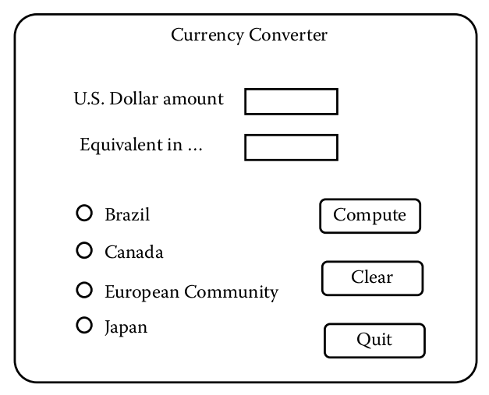
The Currency Conversion Program
GUI

Slide 7
Integration Testing for the Currency Conversion Program

Slide 8
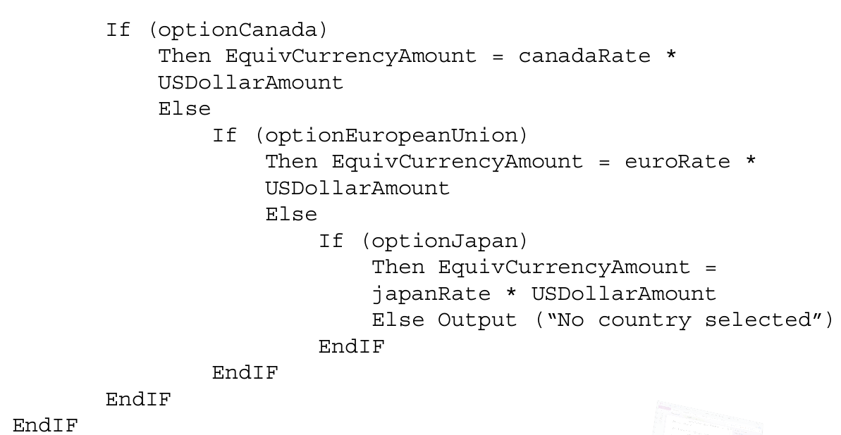

Slide 9
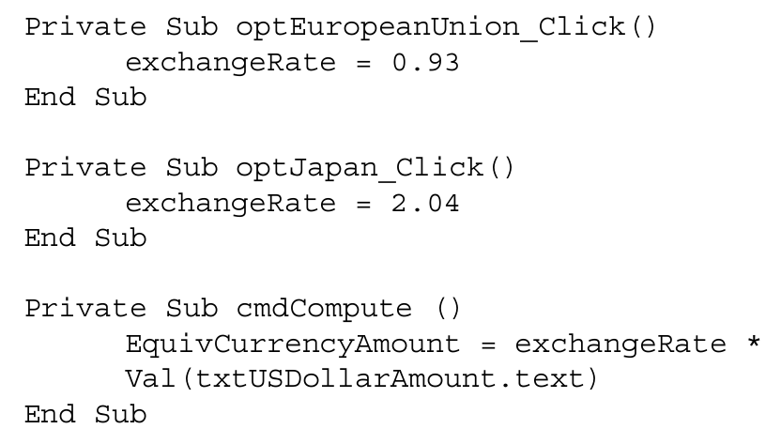
Refactored

Slide 10
Event Driven Petri Nets (EDPN)
System Testing for the Currency Conversion Program

Slide 11
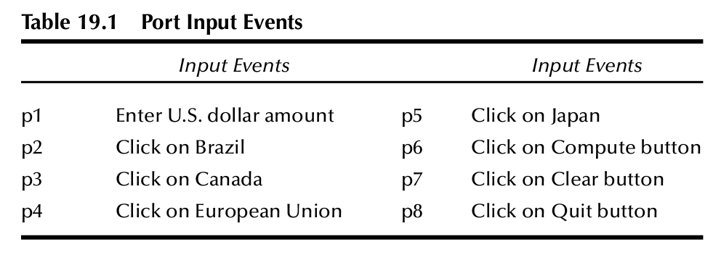
Input Events

Slide 12
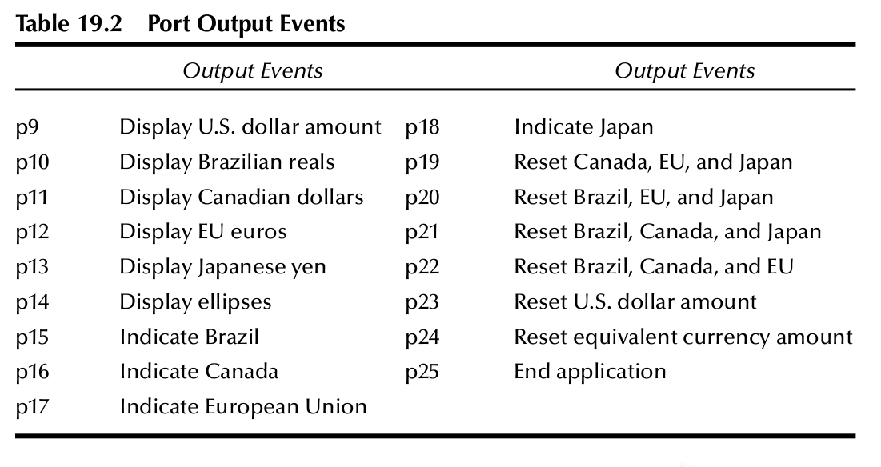
Output Events

Slide 13
What set of threads
exercise a set of threads that:
Use every atomic system function
Use every port input
Use every port output

Slide 14
Threads with ASF sequences
T1 = <s1, s4, s6, s7>
T2 = <s1, s2, s6, s7>
T3 = <s3, s1, s6, s8>
T4 = <s5, s1, s7, s8>

Slide 15
T5 = <s1, s2, s6, s3, s6, s4, s6, s5, s6, s7, s8>
is a good example, where the user
converts a U.S. dollar amount to each of the four currencies,
then clears the screen and
quits.

Slide 16
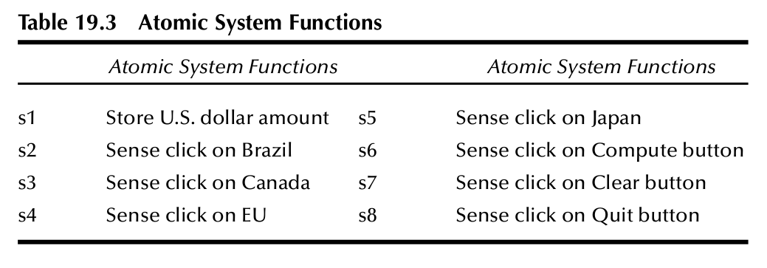
Atomic System Functions

Slide 17
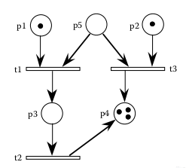
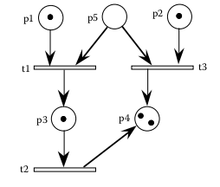
Petri Net Fig 4.9
Before Firing
After firing

Slide 18
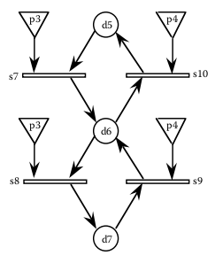
Event-Driven Petri Nets (EDPNs)
EDPN=(P, D, S, In, Out)
P set of ports
D set of data places
S a set of transitions
In subset of (P U D) x S
Out subset of S x (P U D)

Slide 19
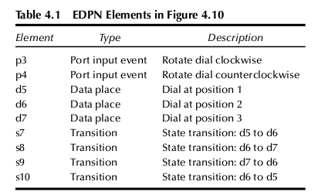
EDPN – Windshield Wiper Control

Slide 20
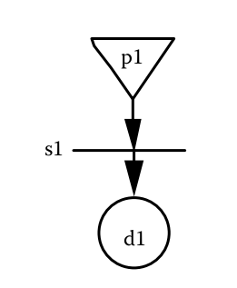
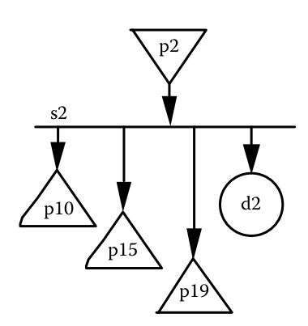
Fig 19.2 EDPNs of atomic system functions

Slide 21
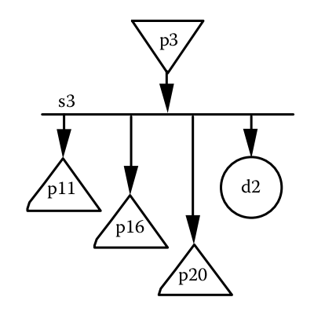

Slide 22
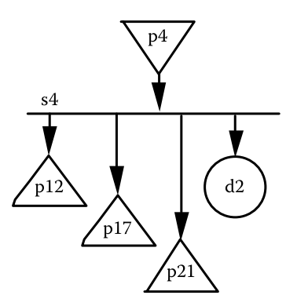

Slide 23
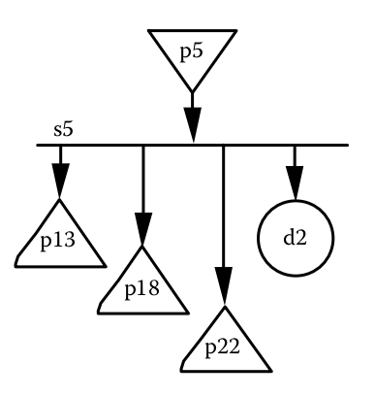

Slide 24
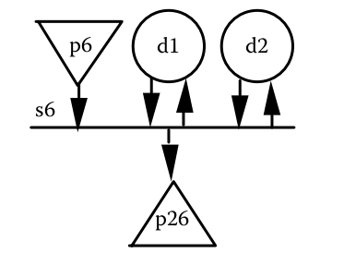

Slide 25
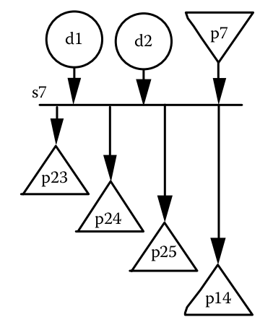

Slide 26
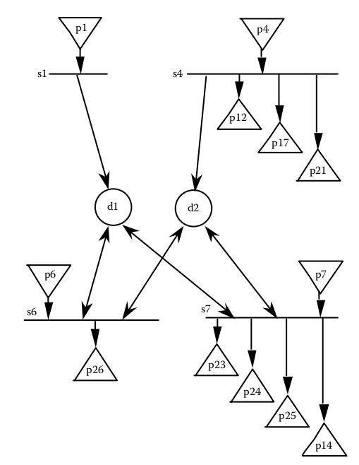
Composition of four ASFs

Slide 27
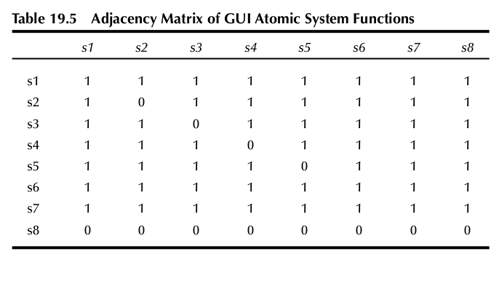

Slide 28
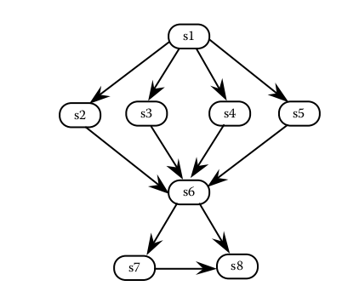

Slide 29
