Slide 1
CSCE 747 Software Testing and Quality Assurance
Tools 12 – Hamcrest

Slide 2
Ant vs Make
Make (Unix) – build systems with minimal compilation
http://en.wikipedia.org/wiki/Make_(software)
Look at edits see which files need to be recompiled p.c ➔ p.o
Ant (Apache)
http://en.wikipedia.org/wiki/Apache_Ant

Slide 3
MAKE(1) LOCAL USER COMMANDS MAKE(1)
NAME
make - GNU make utility to maintain groups of programs
SYNOPSIS
make [ -f makefile ] [ options ] ... [ targets ] ...
WARNING
This man page is an extract of the documentation of GNU make. It is
updated only occasionally, because the GNU project does not use nroff.
For complete, current documentation, refer to the Info file make.info
which is made from the Texinfo source file make.texi.
DESCRIPTION - The purpose of the make utility is to:
1) determine automatically which pieces of a large program need to be recompiled, and
2) issue the commands to recompile them.

Slide 4
Make Advantages
Make saves time - both typing and recompilation
The Makefile documents the dependencies and how to build the software.
For distribution of software one can `make' and `make install' a package with knowing anything about it.

Slide 5
Makefiles - Make Specification Files
Definitions of the form
name=value
Target Groups of the form
target_1 : dependency list_1
<TAB> cmdlist_1
target_2 : dependencylist_2
<TAB> cmdlist_2
...

Slide 6
A Simple Makefile
# Makefile Example
prog: main.o routines.o
cc -o prog main.o routines.o
# Each command line starts with a \tab
main.o: main.c defs.h
cc -c main.c
routines.o: routines.c defs.h
cc -c routines.c

Slide 7
Make Tree actually forest
To determine if we make a target we check the modification time of all its dependencies (things/files it depends on); if any is newer rebuild the target
Macros –
Built-in Rules –
make –n
make -p

Slide 8
# Another Makefile Example
FILES = Makefile defs.h main.c routines.c
OBJS = main.o routines.o
LIBES = -lm
CFLAGS = -g
LP = /fac/matthews/bin/p2c
INSTALL_DIR = /fac/matthews/bin
prog: main.o routines.o
$(CC) $(CFLAGS) $(OBJS) $(LIBES) -o prog
$(OBJS): defs.h
cleanup:
-rm *.o
-du
install: prog
mv prog $(INSTALL_DIR)
print: $(FILES)
pr $? > /tmp/manton
$(LP) /tmp/manton
touch print
-rm /tmp/manton

Slide 9
Make Implementation Algorithm
Procedure newest(target)
If target is not in the target tree then
If file exists return(modification_time)
Else return(FAIL)
Else
min = modification_time of target
Foreach child in the dependency list Do
child_time = newest(child)
If child_time < min Then min = child_time
End
If min < modification_time of target Then
build(target)
min = now
EndIf
End
End
Begin {Main}
Parse Specification File
Build Dependency Tree
newest(target)
End
Build(target)?

Slide 10
GNU Make
http://www.gnu.org/software/make/
``Makefile conventions'' (147 k characters) of the GNU Coding Standards (147 k characters).
Downloading GNU ftp server:
http://ftp.gnu.org/gnu/make/
Documentation for Make
http://www.gnu.org/software/make/manual/

Slide 11
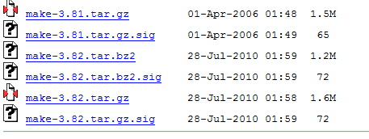
Downloading
http://ftp.gnu.org/gnu/make/
mv make-3.82.tar.gz GNU
cd GNU
tar xcfz make-3.82.tar.gz
more INSTALL README
./configure -- takes a while

Slide 12

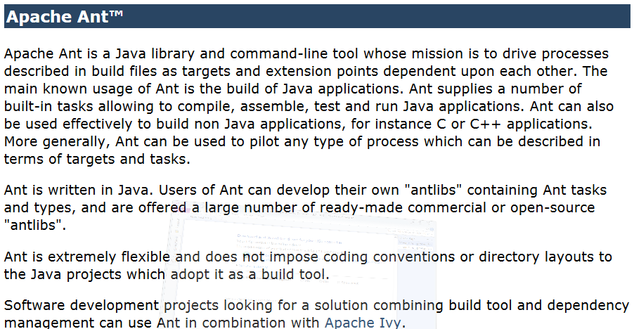
Ant

Slide 13
Why Ant?
Make-like tools are inherently shell-based: they evaluate a set of dependencies, then execute commands not unlike what you would issue on a shell.
Makefiles are inherently evil as well.
the dreaded tab problem.
configuration files are XML-based
Cross platform

Slide 14
Writing a Simple Buildfile
A project has three attributes:
name
default
Basedir
Targets
Tasks
Builtin or write your own

Slide 15
Ant: example Buildfile
<project name="MyProject" default="dist" basedir="."> <description> simple example build file </description>
<!-- set global properties for this build -->
<property name="src" location="src"/>
<property name="build" location="build"/>
<property name="dist" location="dist"/>
<target name="init">
<!-- Create the time stamp -->
<tstamp/>
<!-- Create the build directory structure used by compile --> <mkdir dir="${build}"/>
</target>

Slide 16
Ant
<target name="compile" depends="init"
description="compile the source " >
<!-- Compile the java code from ${src} into ${build} -->
<javac srcdir="${src}" destdir="${build}"/>
</target>
<target name="dist" depends="compile"
description="generate the distribution" >
<!-- Create the distribution directory -->
<mkdir dir="${dist}/lib"/>
<!-- Put everything in ${build} into the MyProject-${DSTAMP}.jar file -->
<jar jarfile="${dist}/lib/MyProject-${DSTAMP}.jar" basedir="${build}"/>
</target>

Slide 17
Ant
<target name="clean"
description="clean up" >
<!-- Delete the ${build} and ${dist} directory trees -->
<delete dir="${build}"/>
<delete dir="${dist}"/>
</target>
</project>

