Slide 1
CSCE 747 Software Testing and Quality Assurance
Tools 11 – Mockito

Slide 2
What is Mockito?
Mockito is an open source testing framework for Java released under the MIT License.^{[1][2]}
The framework allows the creation of Test Double objects (called "Mock Objects") in automated unit tests
for the purpose of Test-driven Development (TDD) or Behavior Driven Development (BDD).
http://docs.mockito.googlecode.com/hg/latest/org/mockito/Mockito.html

Slide 3
Getting Mockito
http://code.google.com/p/mockito/
Download mockito-all-x.x.x.jar and put it on the classpath.
If you use a fancy build system with declarative dependencies like Gradle or Maven please -> Click HERE <-
Ant, Maven later so no “fancy build system” for now

Slide 4
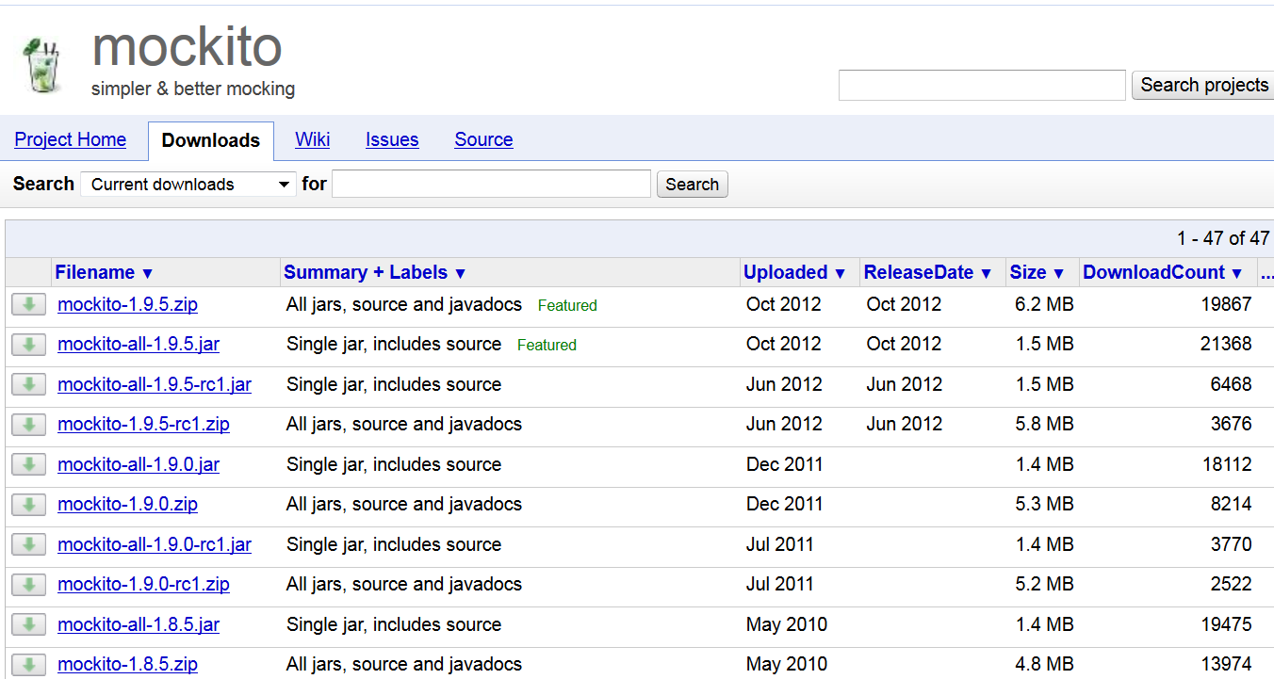

Slide 5
Who? With What?
Mockito is served to you by Szczepan Faber and friends. First people who tried Mockito were developers of the Guardian project in London in early 2008. Here is how Szczepan explained why we need another mocking framework?
Firstly, hats down before EasyMock folks for their ideas on beautiful and refactorable mocking syntax. First hacks on Mockito were done on top of the EasyMock code.
Here are just some of my friends who contributed ideas to Mockito (apologize if I missed somebody): Igor Czechowski, Patric Fornasier, Jim Barritt, Felix Leipold, Liz Keogh, Bartosz Bańkowski
Special thanks to Steve Christou for setting up the continuous builds at his Hudson server. Previously, Erik Ramfelt hosted Mockito builds for a couple of years (big thanks!).
Thanks to Karol Poźniak for the logo (and a decent web page in future, hopefully :)
Finally, thanks to Erik Brakkee and Igor Czechowski for helping out with maven central stuff.
Thanks to YourKit for the profiler!
YourKit is kindly supporting open source projects with its full-featured Java Profiler. YourKit, LLC is the creator of innovative and intelligent tools for profiling Java and .NET applications. Take a look at YourKit's leading software products: YourKit Java Profiler, YourKit .NET Profiler

Slide 6
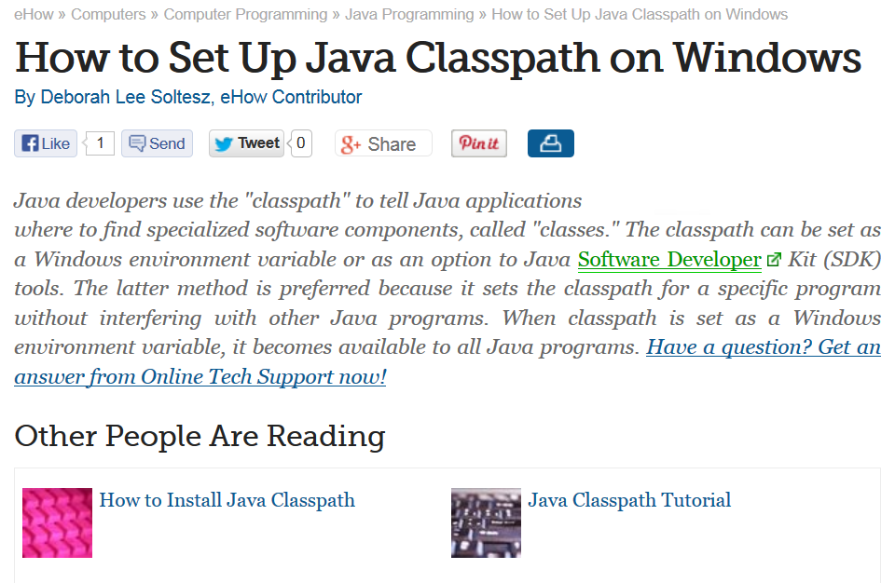
Java Classpath

Slide 7
Setting the Java CLASSPATH: SDK
Instructions: Option to Java SDK Tools
Type the Java SDK tool command on the Windows command line. For example, if you are compiling code, type "javac" at the command
C:> javac
Add a space after the SDK tool command name and type "-classpath" followed by another space to start the classpath option. Continuing the earlier example:
C:> javac –classpath
Type the path to your classes. If your classes are stored in a folder, type the full path of the folder. For example:
C:> javac -classpath C:\project\classes
If your classes are stored in a JAR or ZIP file, type the full path to the file, including the file name. For example:
C:> javac -classpath C:\project\classes\myclasses.jar
Separate multiple paths with a semicolon (";"). For example:
C:> javac -classpath C:\project\classes\;C:\thirdparty\classes\game.jar
Java will use the first matching class it finds as it searches each path.
Add any additional options needed to complete the SDK tool command and hit "Enter" to run the tool. The SDK Tool will use the paths your provided to find the classes needed to execute the command.

Slide 8
Setting the Java CLASSPATH: Eclipse
Java Build Path
The options in this page indicate the build path settings for a Java project. You can reach this page through the project properties (Project > Properties > Java Build Path...

Slide 9
Setting the Java CLASSPATH: Windows 7 Environment Variable
Right-click "Computer" on the desktop or in the Start menu. A pop-up menu appears near your mouse cursor.
Select "Properties" from the menu. The Control Panel "System" window opens.
Click the "Advanced system settings" item on the left side of the window. The "System Properties" window opens with the "Advanced" tab visible.
Click the "Environment variables" button near the bottom of the window.
Click "New" under "User variables.“
Type "classpath" for the "Variable name.“
Type the full path to your Java classes for the "Variable value." Separate multiple paths with a semicolon (";").
Click "OK" to add the new classpath variable.
Click "OK" to close the "System Properties" window.
Read more: http://www.ehow.com/how_7166816_set-up-java-classpath-windows.html#ixzz2fvA6McJE

Slide 10
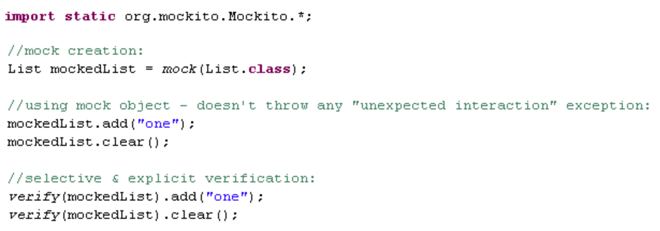
After Download/CLASSPATH Test

Slide 11
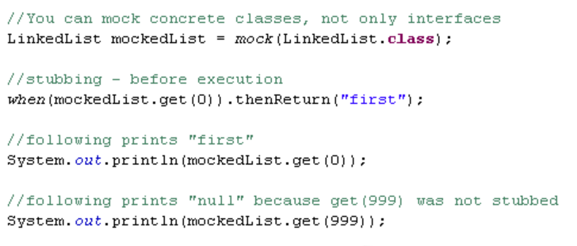
Stubbing Method Calls

Slide 12
Mocks, Stubs and Test Spies
EasyMock
…
Groovy – java meets python
Scripting language with Java like syntax
Mocking capabilities builtin

Slide 13
Car Interface
public interface Car{
boolean needsFuel();
double getEngineTemp();
void driveTo(String dest);
}
Car myFerrari = Mockito.mock(Car.class)

Slide 14
Imports Always needed (Not always shown)
import org.junit.Test;
import static org.mockito.Mockito.*;
import org.junit.Assert.assertTrue;
public class FirstMockitoTest {
private Car myFerrari = mock(Car.class);
@Test
public void testIfCarIsACar(){
assertTrue(myFerrari instanceof Car);
}
}

Slide 15
Returning Default Values
public class MockitoDefaultValuesTest {
private Car myFerrari = mock(Car.class);
@Test
public void testDefaultBehaviorOdTestDouble(){
assertFalse(“new needs should be false”,
myFerrari.needsFuel());
assertEquals(“new returns 0.0”, 0.0,
myFerrari.getEngineTemp());

Slide 16
Returning What we Want it To
public class MockitoReturningdesiredValuesTest {
private Car myFerrari = mock(Car.class);
@Test
public void testStubbing(){
assertFalse(“new needs should be false”,
myFerrari.needsFuel());
when(myFerrari.needsFuel()).thenReturn(true);
assertTrue(“now needs fuel”, 0.0,
myFerrari.needsFuel());

Slide 17
Throwing Exceptions
public class MockitoThrowingExceptionsTest {
private Car myFerrari = mock(Car.class);
@Test (expected = RuntimeException.class)
public void throwException(){ when(myFerrari.needsFuel()) .thenThrow(new RuntimeException());
myFerrari.needsFuel();

Slide 18
Expectations Met
public class MockitoVerificationTest {
private Car myFerrari = mock(Car.class);
@Test
public void testVerification() { myFerrari.driveTo(“Kentucky”);
myFerrari.needsFuel();
verify(myFerrari).driveTo(“Kentucky”))
verify(myFerrari).needsFuel())

Slide 19
Expectations Not Met
public class MockitoFailedVerificationTest {
private Car myFerrari = mock(Car.class);
@Test
public void testVerificationFailure() {
myFerrari.needsFuel();
verify(myFerrari).needsFuel())

Slide 20
Output of Failed Test
.

Slide 21
Bad Arguments
public class MockitoFailedVerificationArgsTest {
private Car myFerrari = mock(Car.class);
@Test
public void testVerificationFailure Args() { myFerrari.driveTo(“Kentucky”);
myFerrari.needsFuel();
verify(myFerrari).driveTo(“Honolulu”))
verify(myFerrari).needsFuel())

Slide 22
Output of Bad Args – Don’t match expectations

Slide 23
Types of Test Doubles
Test-double type | Also known as | Description
Dummy object | Dummy | Needs to exist; no real interaction
Test stub | Stub | Used for passing values to SUT
Test spy | Spy | Used to verify collaboration
Mock object | mock

Slide 24
Example Code to be Tested
public class Messenger {
private TemplateEngine te;
private MailServer mailServer;
public Messenger(MailServer mailServer, TemplateEngine templateEng) {
this.mailServer = mailServer;
this.te = templateEng;
}
public sendMessage(Client client, Template tmpl) {
String msg = templateEngine.prepareMessage(tmpl, client);
mailServer.send(client.getMail(), msg);
}
}

Slide 25
public sendMessage(Client client, Template tmpl) {
String msg = templateEngine.prepareMessage(tmpl, client);
mailServer.send(client.getMail(), msg);
}

Slide 27
Using Test Double as Dummy

Slide 28
Use of Test Stub

Slide 29
Test Spy: Controlling Inputs

Slide 30
Mock

Slide 31
MessengerTest
public class MessengerTest {
private static final String CLIENT_MAIL=“some@email.com”;
private static final String MSG_CONTENT =“You’re Fired!”;
@Test
public void shouldSendEmail() {
Template template = mock(Template.class);
Client client = mock(Client.class);
Mailserver ms = mock(MailServer.Class)
TemplateEngine tempEng = mock(TemplateEngine.class);
Messenger sut = new Messenger(ms, tempEng);
}

Slide 32
when(client.getMail()).thenReturn(CLIENT_MAIL);
when(tempEng.prepareMessage(template, client)) .thenReturn(MSG_CONTENT);
sut.sendMessage(client, template);
verify(ms).send(CLIENT_EMAIL, MSG_CONTENT);

Slide 33
Test Driven Design

Slide 37
Glitches in what I presented earlier

Slide 38
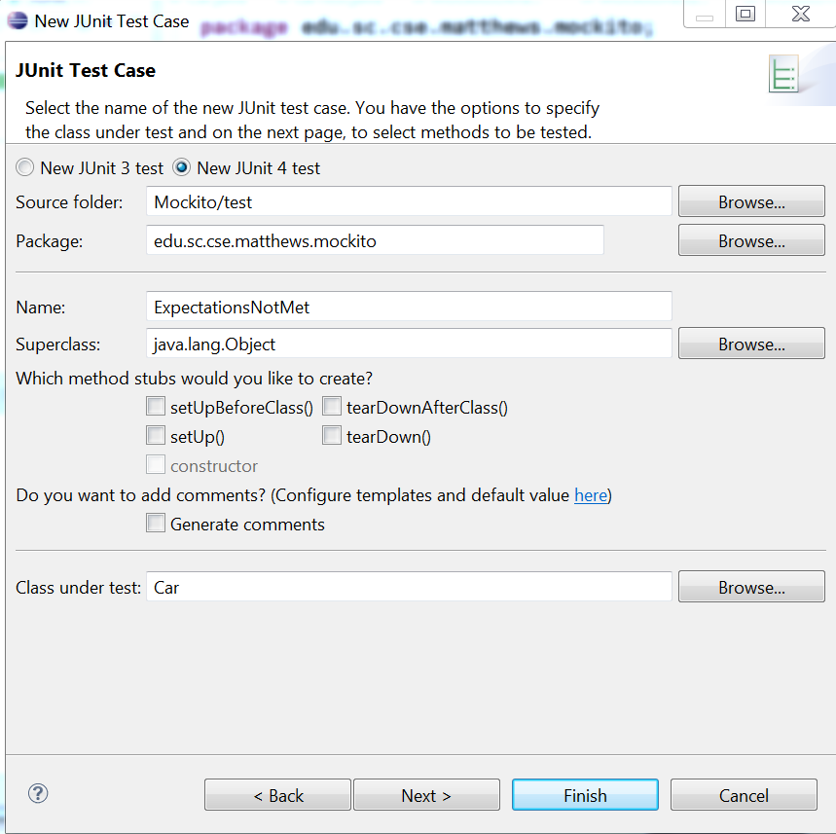
test Right-Click
New➔ Other
Junit Test

Slide 39
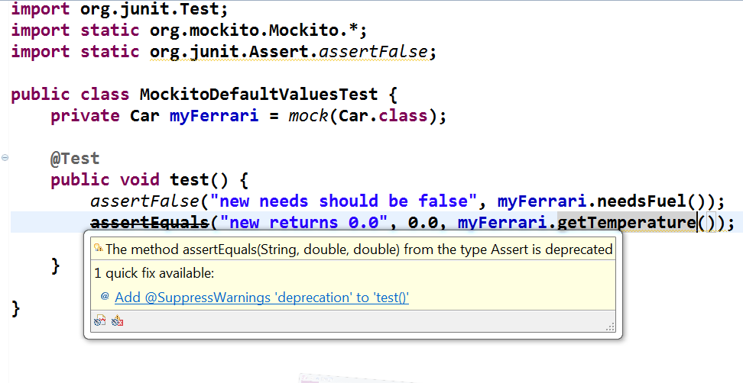
Glitches in what I presented earlier

Slide 40
package edu.sc.cse.matthews.mockito;
import static org.junit.Assert.*;
import org.junit.Test;
import static org.mockito.Mockito.*;
import static org.junit.Assert.assertFalse;
public class MockitoDefaultValuesTest {
private Car myFerrari = mock(Car.class);
//@SuppressWarnings("deprecation")
@Test
public void test() {
double delta = .0001;
assertFalse("new needsFuel should be false", myFerrari.needsFuel());
assertEquals(0.0, myFerrari.getTemperature(), delta);
}
}

Slide 41
MockitoVerificationTest.java
package edu.sc.cse.matthews.mockito;
import static org.junit.Assert.*;
import org.junit.Test;
import org.junit.Test;
import static org.junit.Assert.*;
import static org.mockito.Mockito.*;
import static org.junit.Assert.assertFalse;
import static org.junit.Assert.assertTrue;
public class MockitoVerificationTest {
private Car myFerrari = mock(Car.class);
@Test
public void testVerification() {
myFerrari.driveTo("Kentucky");
myFerrari.needsFuel();
verify(myFerrari).driveTo("Kentucky");
verify(myFerrari).needsFuel();
}
}

Slide 42
ExpectationsMet
Glitches: quotes wrong kind, extra ‘)’, missing ‘;’, imports

Slide 43
