Slide 1
CSCE 747 Software Testing and Quality Assurance
Lecture 10 – Integration Testing

Slide 2
Last Time
Integration & System Testing Part III
Levels of Testing Ch 12, pp 181-199
Today
Integration & System Testing Part III
Integration Testing Ch 13, pp 201-227
Jorgensen, Paul C. Software Testing
A Craftsman Approach

Slide 3
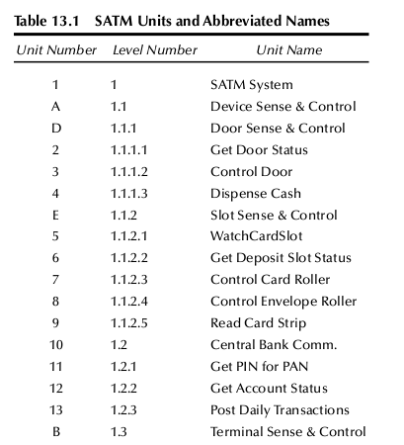
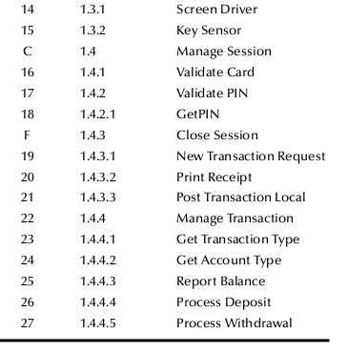
Table 13.1 SATM Units

Slide 4
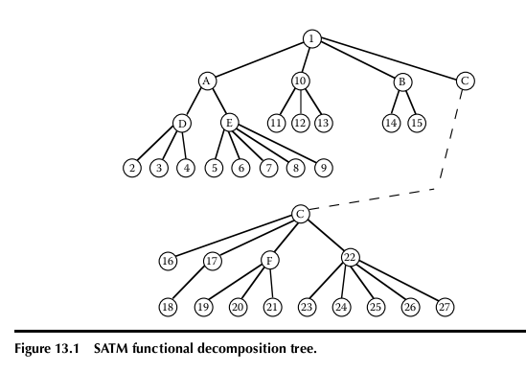
SATM Functional Decomposition

Slide 5
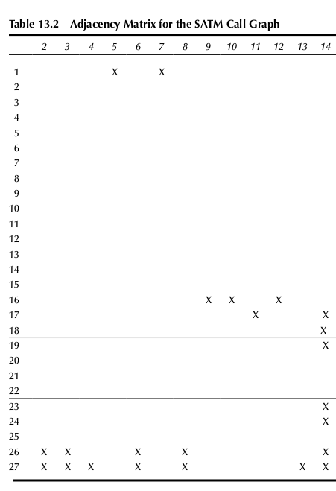
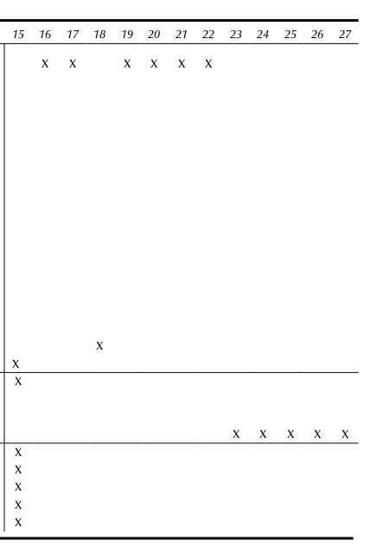

Slide 6
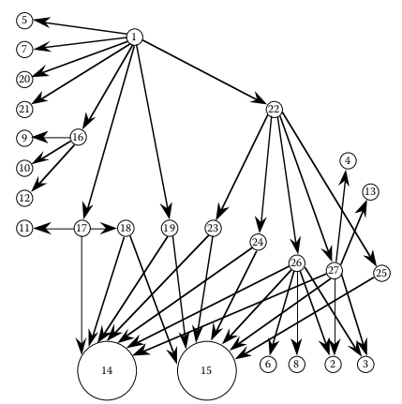
SATM Call Graph

Slide 7
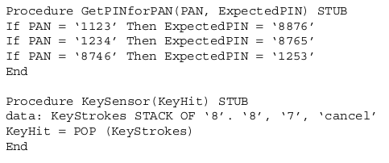
Stubs for Top Down Integration

Slide 8
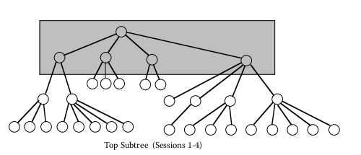
Figure 13.3 Top-down Integration

Slide 9
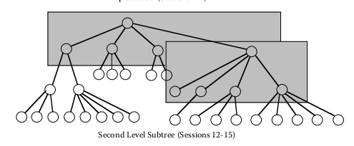
Figure 13.3 Top-down Integration

Slide 10
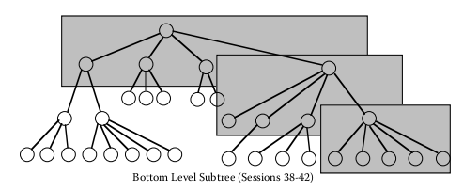
Figure 13.3 Top-down Integration

Slide 11
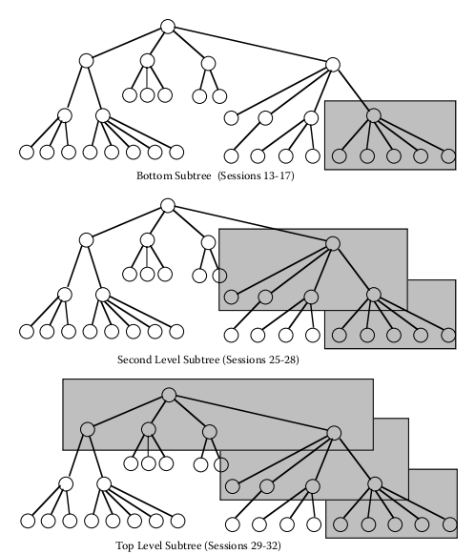
Bottom-Up Integration

Slide 12
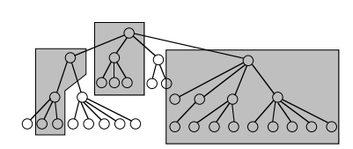
Sandwich Integration
John Montagu, 4th Earl of Sandwich

Slide 13
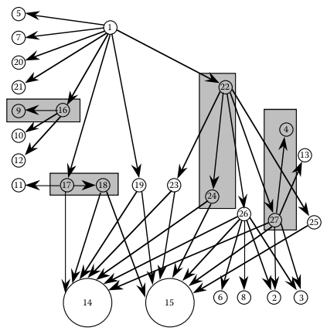
Call Based Graph Integration
Pairwise integration
Neighborhood integration
InteriorNodes = nodes – sources – sinks
Neighborhoods
Interior+source node

Slide 14
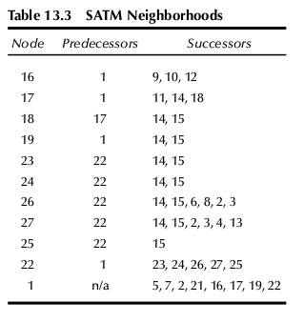
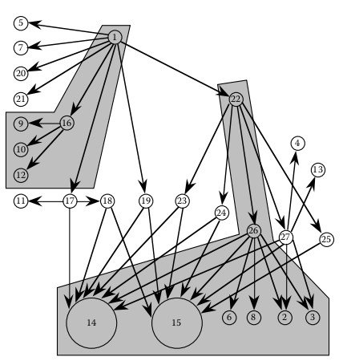
Neighborhood Integration

Slide 15
Path Based Integration

Slide 16
New and Extended Concepts
Definition: A source node in a program is a statement at which program execution begins or resumes.
Definition: A sink node in a program is a statement at which program execution stops.
Definition: A module execution path is a sequence of statements that begins with a source node and ends with a sink node, with no intervening sink nodes.

Slide 17
Definition: A message is a programming language mechanism by which one unit transfers control to another unit.
Definition: An MM-Path is an interleaved sequence of module execution paths and messages.

Slide 18
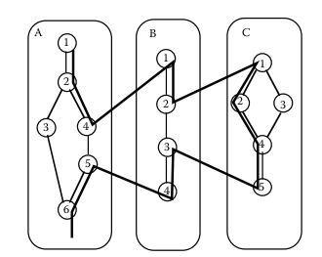
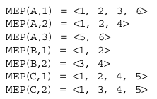
Fig 13.8 MM-Paths across three Units

Slide 19
Definition: Given a set of units, their MM-Path graph is the directed graph in which nodes are module execution paths and edges correspond to messages and returns from one unit to another.

Slide 20
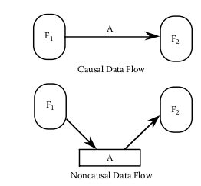
Figure 13.10 Data Quiescence

Slide 21
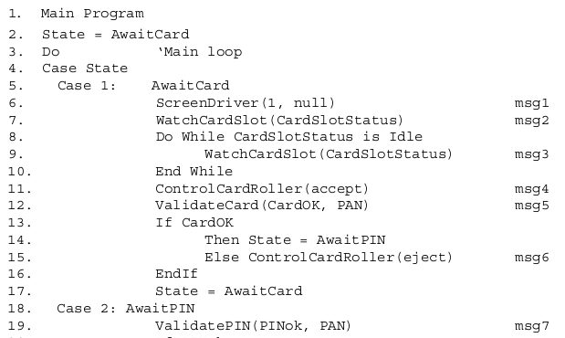
SATM code

Slide 22
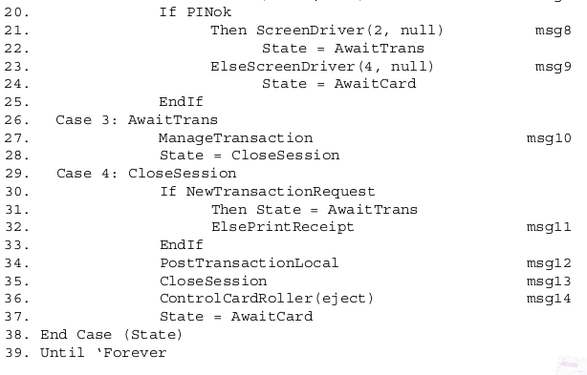

Slide 23
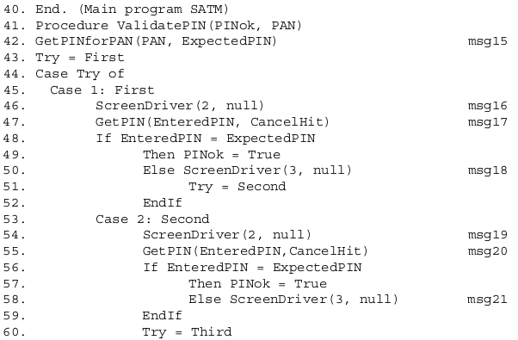

Slide 24
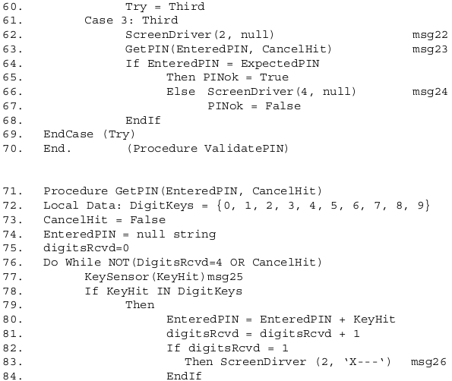

Slide 25
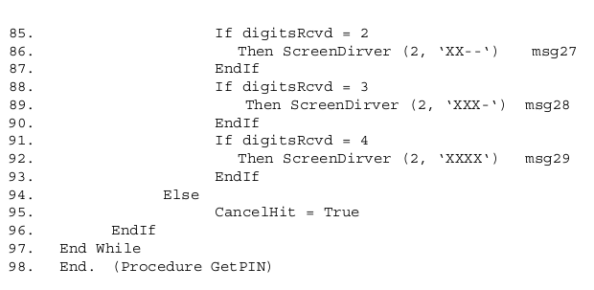

Slide 26
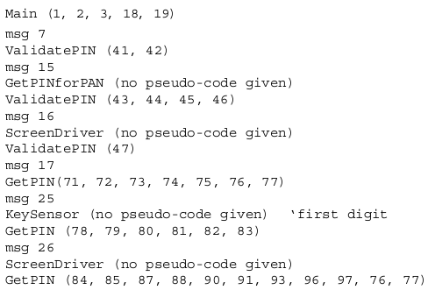

Slide 27
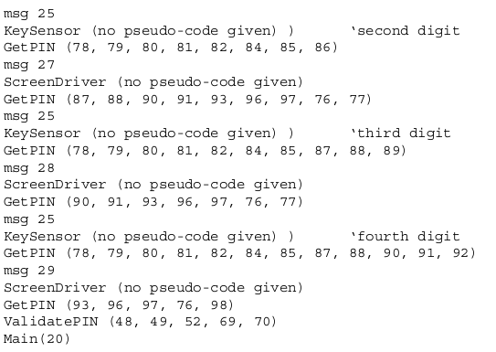

Slide 28
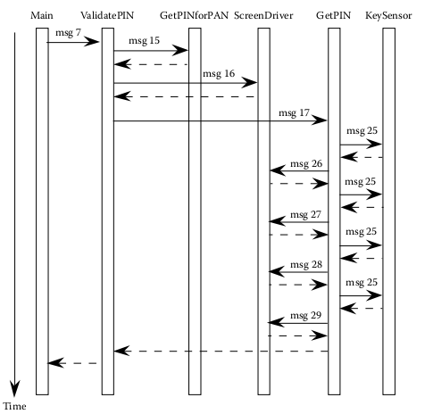
UML Sequence Diagram a sample MM-Path

Slide 29
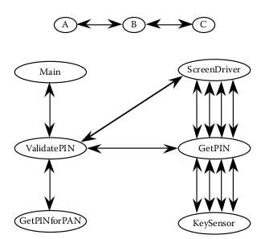
MM-Path directed graphs

Slide 30
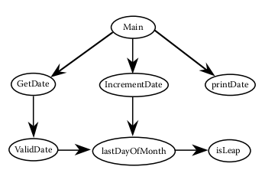
Call Graph of “Integration” Version

Slide 31
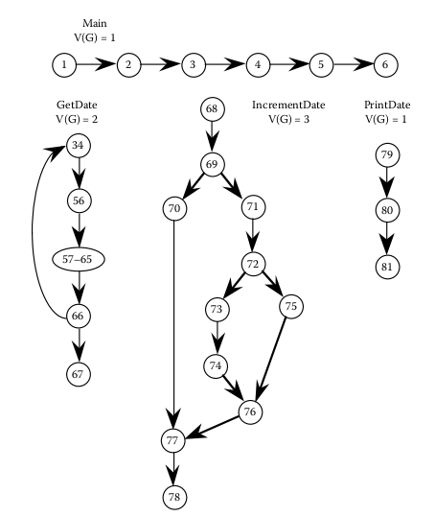
SATM Integration Version
Function
isLeapYear(year)
lastDayOfMonth( )
getDate()

Slide 32
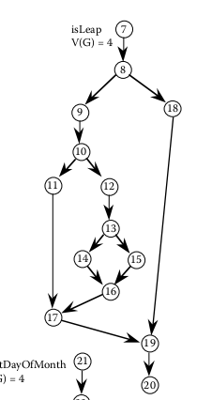
isLeap()

Slide 33
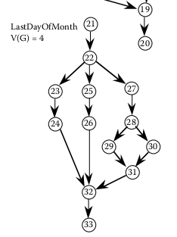
lastDayOfMonth

Slide 34
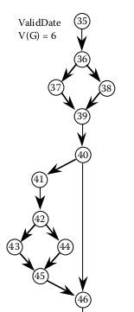
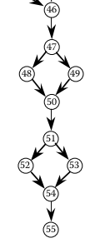
validDate()

Slide 35
Decomposition Based Integration

Slide 36
Call Graph Based Integration

Slide 37
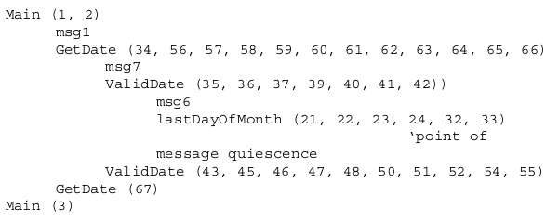
MM-Path-Based Integration

Slide 38
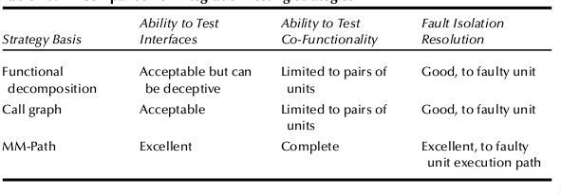
Table13.4 Comparison of Integration Testing Strategies

Slide 39
