Slide 1
CSCE 747 Software Testing and Quality Assurance
Lecture 09-Integration and System Testing

Slide 2
Last Time
Structural Testing WrapUp
Ch 11, pp 169-177
Today
Integration & System Testing Part III
Levels of Testing Ch 12, pp 181-1
Jorgensen, Paul C. Software Testing
A Craftsman Approach

Slide 3
Levels of Testing
Unit Tests

Slide 4
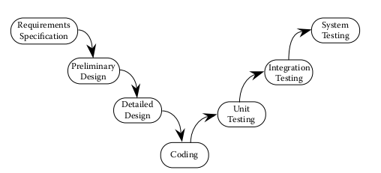
Waterfall Life Cycle

Slide 5
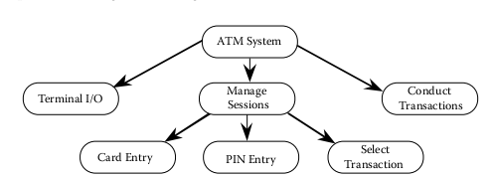
Fig 12.2 Decomposition of ATM system
Integrate subsystems

Slide 6
Functional decomposition Sculpting analogy
Functional decomposition
Can only be done well when we understand the final system
Sculpting analogy
Marble sculpture
Wax Sculpture
Clay - pottery

Slide 7
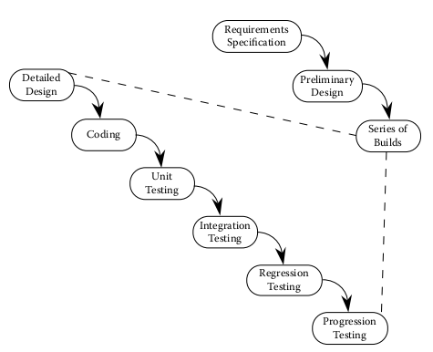
Life Cycle with Builds

Slide 8
Specification-based Life Cycle Models

Slide 9
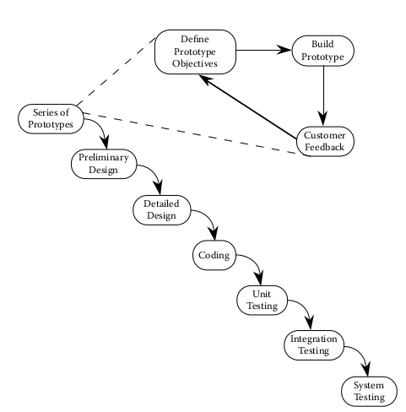
Rapid Prototyping life cycle

Slide 10
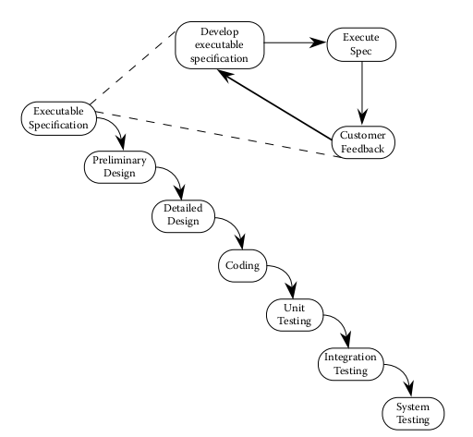
Executable Specifications

Slide 11
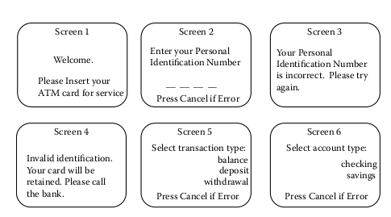
Screens of the SATM

Slide 12
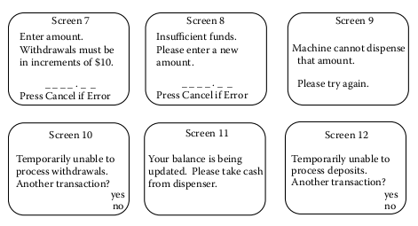
Screens of the SATM

Slide 13
Screens of the SATM

Slide 14
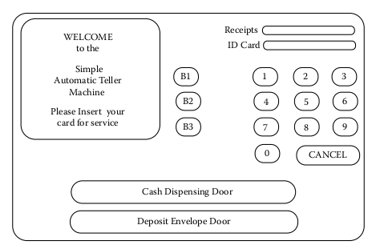
SATM Interface

Slide 15
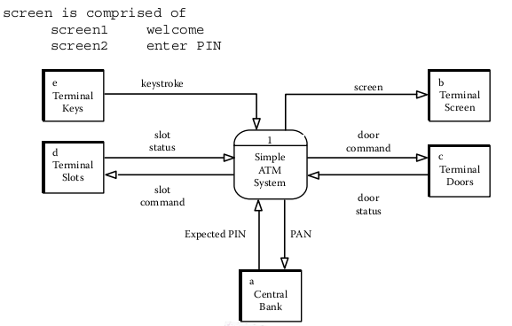
SATM: Screen 1 Welcome/Enter PIN

Slide 16
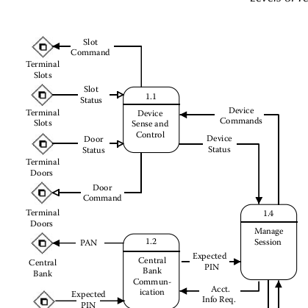
SATM Dataflow
More

Slide 17
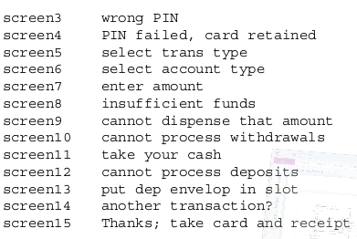

Slide 18
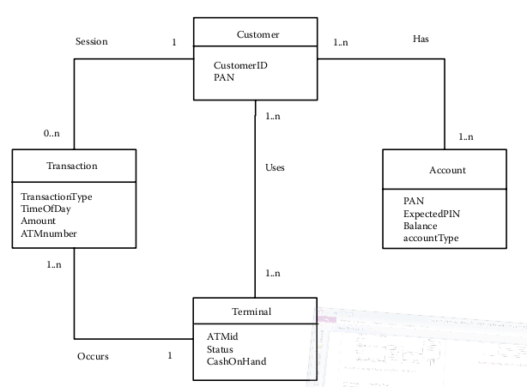
ER Model of the SATM

Slide 19
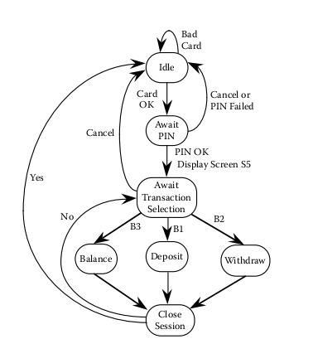
Finite State Model of SATM

Slide 20
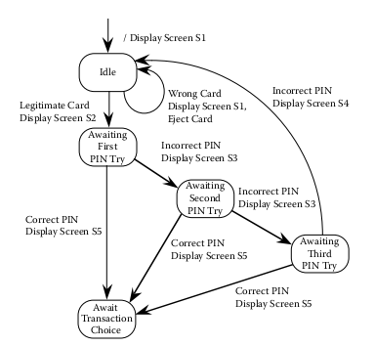
FS Model of SATM: PIN-entry

Slide 21
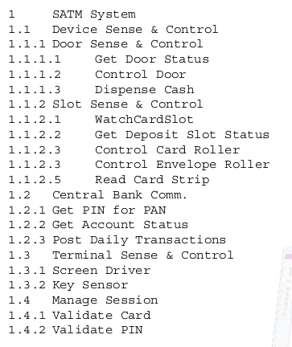
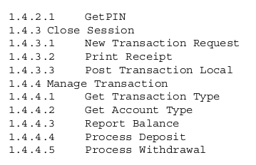
Functional Decomposition

Slide 22
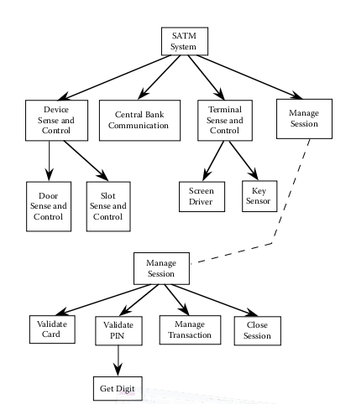
SATM Functional Decomposition

