Slide 1
CSCE 747 Software Testing and Quality Assurance
Lecture 07 – Dataflow Testing

Slide 2
Last Time
Lecture 06 Slides 1-19 covered last time
Case Study Question after class
Path Testing continued
Ch 9 pp 131-149
Today
Dataflow Testing
Ch 10, pp 151-167
Jorgensen, Paul C. Software Testing
A Craftsman Approach

Slide 3
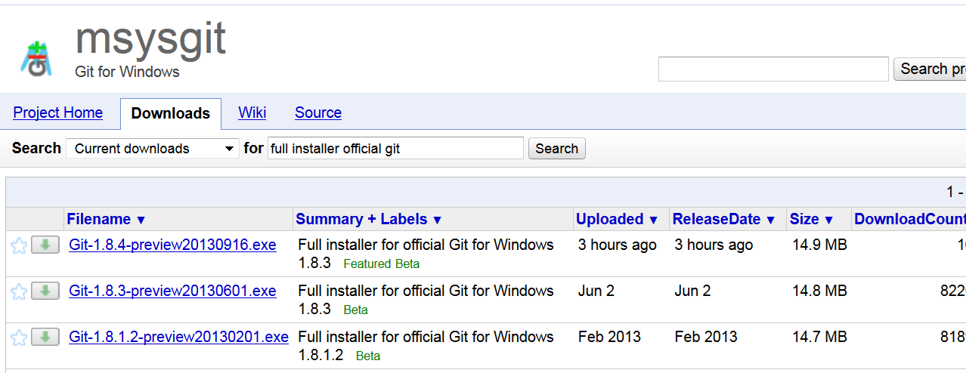
MSYSGIT

Slide 4
Dataflow Testing
Dataflow testing refers to forms of structural testing that focus on:
the points at which variables receive values and
the points at which these values are used
Dataflow testing serves as a reality check on path testing;
Jorgensen, Paul C. Software Testing
A Craftsman Approach

Slide 5
Forms of dataflow testing
Two main forms of dataflow testing:
One provides a set of basic definitions and a unifying structure of test coverage metrics
The other based on a concept called a program slice.
Start with program graph but move back towards functional testing

Slide 6
Define/Use of Variables
Define/Use information
x = y +3*z
Define a new x; use variables y and z
Concordances that list statement numbers in which variable names occur
Define/reference anomalies:
A variable that is defined but never used
A variable that is used before it is defined
A variable that is defined twice before it is used

Slide 7
Static Analysis
Static analysis: finding faults in source code without executing it.

Slide 8
Define/Use Testing
define/use testing was done by
Rapps and Weyuker, IEEE Transactions on
Software Engineering, Vol. SE-11, 1985
Definitions: Given a program P
G(P) – the program graph; single entry; single exit
PATHS(P) – the set of all paths in P

Slide 9
“Definition” and “Usage” nodes for variable
Definition: Node n ∈ G(P) is a defining node of the variable v ∈ V, written as DEF(v, n)
Definition: Node n ∈ G(P) is a usage node of the variable v ∈ V, written as USE(v, n)
Definitions(n) – variables v that are defined in statement n
Usage(n) – variables that are used in statement n
Definitions(v) – statements that define v
Usage(v) – statements that use v
Next-Use(n, v) – list of statements following n that use v
Node n: statement fragment x = y + z

Slide 10
Example (Commission)
10. totalLocks = 0
11. totalStocks = 0
12. totalBarrels = 0
13. Input(locks)
While NOT(locks = -1) ‘loop condition uses -1
Input(stocks, barrels)
16. totalLocks = totalLocks + locks
17. totalStocks = totalStocks + stocks
18. totalBarrels = totalBarrels + barrels
19. Input(locks)
20. EndWhile
21. Output(“Locks sold: “, totalLocks)

Slide 11
Predicate/Computation Use
USE(v, n) can be classified as
Predicate use (P-use)
Computation use(C-use)
USE(a, 7) ?
USE(a,9)?
‘Step 2: Is A Triangle? Modified
6. t1 = b + c
7. t2 = a + c
8. t3 = a + b
9. If (a < t1) AND (b < t2) AND(c < t3)
10. Then IsATriangle = True
11. Else IsATriangle = False
12. EndIf
…

Slide 12
definition-use path
Definition: A definition-use path with respect to a variable v (denoted du-path) is a path in PATHS(P) such that
for some v ∈ V, there are define and usage nodes DEF(v, m) and USE(v, n) such that
m and n are the initial and final nodes of the path.

Slide 13
Definition-Clear Path
Definition: A definition-clear path with respect to a variable v (denoted dc-path) is a definition-use path in PATHS(P)
with initial and final nodes DEF (v, m) and USE (v, n) such that no other node in the path is a defining node of v
Du-paths and dc-paths describe the flow of data across source statements from points at which the values are defined to points at which the values are used.
Du-paths that are not definition-clear are potential trouble spots.

Slide 14
Compilers Again: Register Allocation

Slide 15
1. Program Commission (INPUT,OUTPUT)
2. Dim …
7. lockPrice = 45.0
8. stockPrice = 30.0
9. barrelPrice = 25.0
10. totalLocks = 0
11. totalStocks = 0
12. totalBarrels = 0
13. Input(locks)
14. While NOT(locks = -1)
15. Input(stocks, brrls)
16. totalLocks = totalLocks + locks
17. totalStocks = totalStocks + stocks
18. totalBarrels = totalBarrels + brrls
19. Input(locks)
20.EndWhile
21. Output(“Locks sold: “, totalLocks)
22. Output(“Stocks sold: “, totalStocks)
23. Output(“Barrels sold: “, totalBarrels)
24. lockSales = lockPrice * totalLocks
25. stockSales = stockPrice * totalStocks
26. barrelSales = barrelPrice * totalBarrels
27. sales = lockSales + stockSales + barrelSales
28. Output(“Total sales: “, sales)
29. If (sales > 1800.0)
Then
commission = 0.10 * 1000.0
32. commission = comm. + 0.15 * 800.0
33. comm. = comm. + .20 *(sales-1800.0)
34. Else If (sales > 1000.0)
35. Then
36. commission = 0.10 * 1000.0
37. comm=comm + .15 *(sales-1000)
38. Else
39. commission = 0.10 * sales
40. EndIf
41. EndIf
42. Output(“Commission is $”, commission)
43. End Commission

Slide 16
DD-Paths in Figure 10.1 (previous slide)
Table 10.1 DD-Paths in Figure 10.1
DD-Path Nodes
A 7, 8, 9, 10, 11, 12, 13
B 14
C 15, 16, 17, 18, 19,20
D 21, 22, 23, 24, 25, 26, 27, 28
E 29
F 30, 31, 32, 33
G 34
H 35, 36, 37
I 38, 39
J 40
K 41, 42, 43

Slide 17
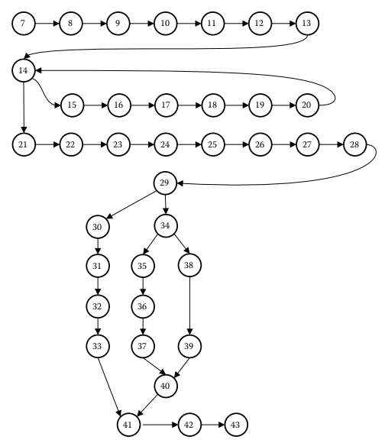
Fig 10.1 program graph for commission program

Slide 18
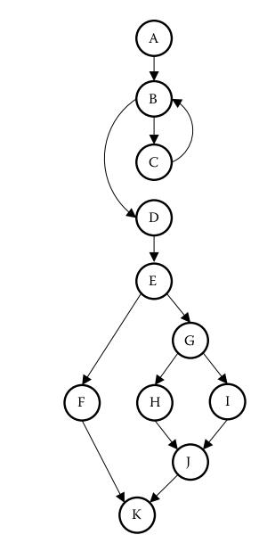
Figure 10.2 DD-Path graph of the commission program.

Slide 19
10.1.2 du-Paths for Stocks
Def(stocks, 15 )
Use(stocks, 17 )

Slide 20
10.1.3 du-Paths for Locks
p1 = <13, 14>
p2 = <13, 14, 15, 16>
p3 = <19, 20, 14>
p4 = <19, 20, 14, 15, 16>

Slide 21
10.1.4 du-Paths for Total-Locks
p6 = <10, 11, 12, 13, 14, 15, 16, 17, 18, 19, 20, 14, 21>
p7 = <10, 11, 12, 13, 14, 15, 16, 17, 18, 19, 20, 14, 21, 22, 23, 24>
p7 = < p6, 22, 23, 24>
p8 = <16, 17, 18, 19, 20, 14, 21>
p9 = <16, 17, 18, 19, 20, 14, 21, 22, 23, 24>

Slide 22
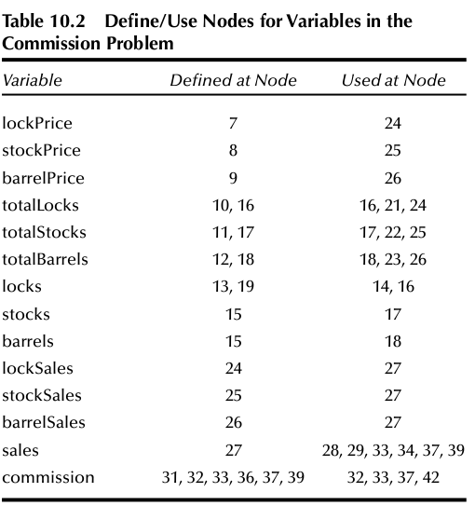

Slide 23
10.1.5 du-Paths for Sales
p10 = <27, 28>
p11 = <27, 28, 29>
p12 = <27, 28, 29, 30, 31, 32, 33>
p13 = <27, 28, 29, 34>
p14 = <27, 28, 29, 34, 35, 36, 37>
p15 = <27, 28, 29, 34, 38,39>

Slide 24
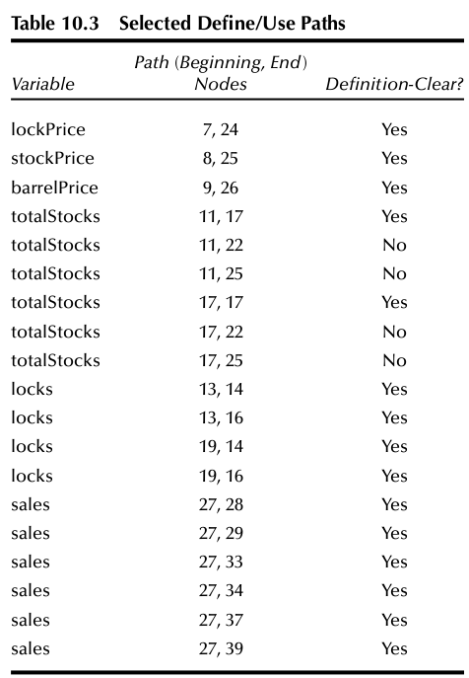
Du-Paths for commission

Slide 25
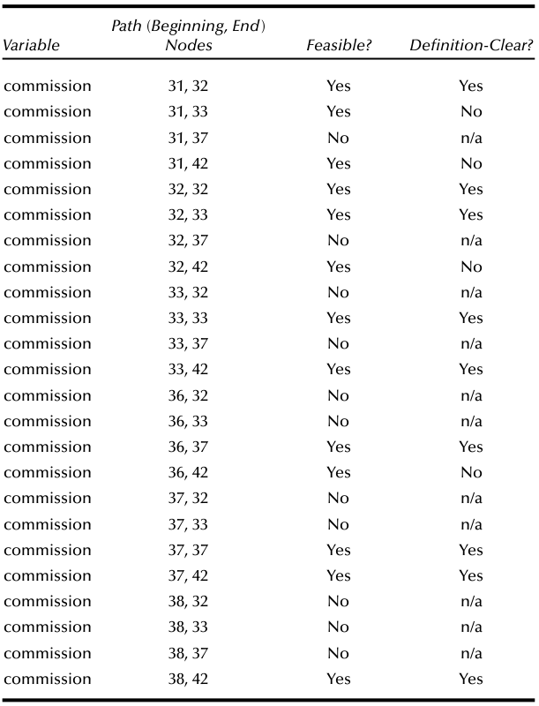
Table 10.4 Define/Use Paths for Commission

Slide 26
10.1.7 du-Path Test Coverage Metrics
Definition: The set T satisfies the All-Defs criterion for the program P iff for every variable v ∈ V, T contains definition-clear paths from every defining node of v to a use of v.
Definition: The set T satisfies the All-Uses criterion for the program P iff for every variable v ∈ V, T contains definition-clear paths from every defining node of v to every use of v, and to the successor node of each USE(v, n).
Definition: The set T satisfies the All-P-Uses/Some C-Uses criterion for the program P iff for every variable v ∈ V, T contains definition-clear paths from every defining node of v to every predicate use of v;
if a definition of v has no P-uses, a definition-clear path leads to at least one computation use.

Slide 27
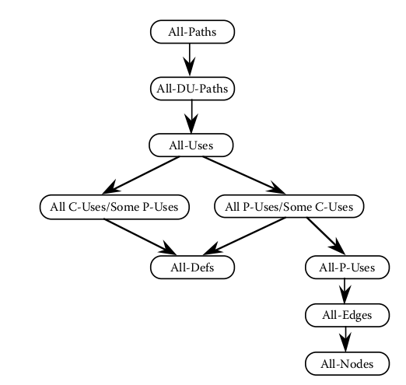
Rapps–Weyuker hierarchy of dataflow coverage metrics.

Slide 28
Definition: The set T satisfies the All-C-Uses/Some P-Uses criterion for the program P iff for every variable v ∈ V, T contains definition-clear paths from every defining node of v to every computation use of v;
if a definition of v has no C-uses, a definition-clear path leads to at least one predicate use.
Definition: The set T satisfies the All-du-paths criterion for the program P iff for every variable v ∈ V, T contains definition-clear paths from every defining node of v to every use of v and to the successor node of each USE(v, n), and that these paths are either single-loop traversals or cycle-free.

Slide 29
Slices
Slices of History:
American History
Western Civ.
Chinese History
Russian History
… history focusing on one group
Slices of program
“set of program statements that contributes to or
affects a value for a variable at some point in the program”

Slide 30
10.2 Slice-Based Testing
Program slices have surfaced and submerged in software engineering literature since the early 1980s.
They were originally proposed in Weiser (1988), used as an approach to software maintenance in Gallagher and Lyle (1991), and more recently
used to quantify functional cohesion in Bieman and Ott (1994)
Part of this versatility is due to the natural, intuitively clear intent of the program slice concept.
Informally, a program slice is a set of program statements that contributes to or affects a value for a variable at some point in the program.

Slide 31
slice on the variable set V
Definition: Given a program P and a set V of variables in P, a slice on the variable set V at statement n, written S(V, n), is the set of all statements in P prior to node n that contribute to the values of variables in V at node n.

Slide 32
Use nodes
USE relationship pertains to five forms of usage:
P-use Used in a predicate (decision)
C-use Used in computation
O-use Used for output
L-use Used for location (pointers, subscripts)
I-use Iteration (internal counters, loop indices)

Slide 33
Definition Nodes
two forms of definition nodes:
I-def Defined by input
A-def Defined by assignment

Slide 34
Slices on the locks
S1: S(locks, 13) = {13}
S2: S(locks, 14) = {13, 14, 19, 20}
S3: S(locks, 16) = {13, 14, 19, 20}
Jorgensen, Paul C. (2011-07-16). Software Testing (Page 162). Auerbach Publications. Kindle Edition.

Slide 35
Slices and Loops
S9: S(totalLocks, 10) = {10}
S10: S(totalLocks, 16) = {10, 13, 14, 16, 19, 20}
S11: S(totalLocks, 21) = {10, 13, 14, 16, 19, 20}

Slide 36
S12: S(totalStocks, 11) = {11}
S13: S(totalStocks, 17) = {11, 13, 14, 15, 17, 19, 20}
S14: S(totalStocks, 22) = {11, 13, 14, 15, 17, 19, 20}
S15: S(totalBarrels, 12) = {12}
S16: S(totalBarrels, 18) = {12, 13, 14, 15, 18, 19, 20}
S17: S(totalBarrels, 23) = {12, 13, 14, 15, 18, 19, 20}

Slide 37
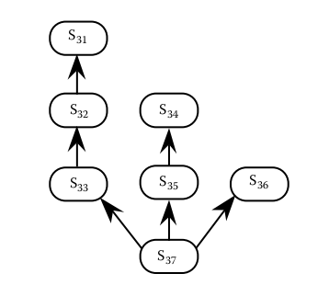
Lattice of Slices for Commission Problem
S31: S(commission, 31) = {31}
S32: S(commission, 32) = {31, 32}
S33: S(commission, 33) = {7, 8, 9 10, 11, 12, 13, 14, 15, 16, 17, 18, 19, 20, 24, 25, 26, 27, 29, 30, 31, 32, 33}
S34: S(commission, 36) = {36}
S35: S(commission, 37) = {7, 8, 9 10, 11, 12, 13, 14, 15, 16, 17, 18, 19, 20, 24, 25, 26, 27, 36, 37}
S36: S(commission, 39) = {7, 8, 9 10, 11, 12, 13, 14, 15, 16, 17, 18, 19, 20, 24, 25, 26, 27, 29, 34, 38, 39}
S37: S(commission, 41) = {7, 8, 9 10, 11, 12, 13, 14, 15, 16, 17, 18, 19, 20, 24, 25, 26, 27, 29, 30, 31, 32, 33, 34, 35, 36, 37, 38, 39}

