Slide 1
CSCE 747 Software Testing and Quality Assurance
Lecture 06 – Path Testing Part II

Slide 2
Last Time
JUnit-4 Vogel tutorial finish
Wrapup Functional Testing
Ch 8 pp 117-127
Testing Effort
Testing Efficiency
Testing Effectiveness
Guidelines
Case Study – Insurance Premium
Slides 1-19 of this set were covered in class during Lec05
Testing Overview Again
Definition of Testing
Verification vs Validation
Path Testing
Ch 9 pp 131-149
Today
Lecture 06 Slides 1-19 covered last time
Case Study Question after class
Path Testing continued
Ch 9 pp 131-149
Jorgensen, Paul C. Software Testing
A Craftsman Approach

Slide 3
Exam = Wednesday, Dec 11 @ 9:00AM
Email
I think we said it would be the earlier of two choices.
Again there were two choices since this is an APOGEE class and MW APOGEE classes follow the T-Th schedule.
So the two closest matches for MWF classes were:
Saturday, December 14 - 9:00 a.m.
Wednesday, December 11 - 9:00 a.m.
I have heard no complaints from the class about doing the exam on Wednesday, December 11 @ 9:00AM.
So this is the exam time.
MM

Slide 4
Test Coverage Metrics
Metric - Description of Coverage
C₀ - Every statement
C₁ - Every DD-Path (predicate outcome)
C_{1p} - Every predicate to each outcome
C₁₂ - C₁1 -coverage + loop coverage
C_{d} - C₁1 -coverage + every dependent pair of DD-Paths
C_{MCC} - Multiple condition coverage
C_{ik} - Every program path that contains up to k repetitions of a loop (usually k = 2)
C_{stat} - Statistically significant fraction of paths
C∞ - All possible execution paths
Based on work of E.F. Miller (Miller, 1977)

Slide 5
Questions from last class
From Lec05 slide 24
Note that quite the usual form of Decision table.
Conditions A1-A5, P1-P5
10 conditions give 2¹⁰ =1024 rules
So what is that 2¹⁰?

Slide 6
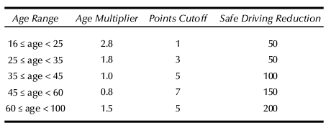
Lec07 slide 18 - Safe Driving Reduction Table Points cutoffs
Note two cases for each age!
Jorgensen, Paul C. Software Testing
A Craftsman Approach

Slide 7
Decision Table for Case Study: Insurance Premium Program Ch08 1rst try
Cond/Acts | R1 | R2 | R3 | R4 | R5 | R6 | R7 | R8 | R9 | R10
A1? | T | T | F | F | F | F | F | F | F | F
A2? | - | - | T | T | F | F | F | F | F | F
A3? | - | - | - | - | T | T | F | F | F | F
A4? | - | - | - | - | - | - | T | T | F | F
A5? | - | - | - | - | - | - | - | - | T | T
P1? | T | F | - | - | - | - | - | - | - | -
P2? | F | T | T | F | - | - | - | - | - | -
P3? | - | - | F | T | T | F | - | - | - | -
P4? | - | - | - | - | F | T | T | F | - | -
P5? | - | - | - | - | - | - | F | T | T | F
Rule count | 2⁷ 128 | 2⁷ 256 | 2⁶ 320 | 2⁶ 384 | 2⁵ 416 | 2⁵ 448 | 2⁴ 464 | 2⁴ 480 | 2⁴ 496 | 2⁴ 512
Act’s
Woops!
512!=1024

Slide 8
Decision Table for Case Study: Insurance Premium Program Ch08 2nd try
Cond/Acts | R1 | R2 | R3 | R4 | R5 | R6 | R7 | R8 | R9 | R10
A1? | T | T | F | F | F | F | F | F | F | F
A2? | - | - | T | T | F | F | F | F | F | F
A3? | - | - | - | - | T | T | F | F | F | F
A4? | - | - | - | - | - | - | T | T | F | F
A5? | - | - | - | - | - | - | - | - | T | T
P1? | T | F | - | - | - | - | - | - | - | -
P2? | F | T | T | F | - | - | - | - | - | -
P3? | - | - | F | T | T | F | - | - | - | -
P4? | - | - | - | - | F | T | T | F | - | -
P5? | - | - | - | - | - | - | F | T | T | F
Rule count | 2⁷ 128 | 2⁷ 256 | 2⁶ 320 | 2⁶ 384 | 2⁵ 416 | 2⁵ 448 | 2⁴ 464 | 2⁴ 480 | 2⁴ 496 | 2⁴ 512
Act’s
????

Slide 9
Why? Explanation ???
Note ignored some errors!
Point cases that matter are different for different ages
This means that can’t us induced equiv. classes on product A x P
But there are two equivalence classes for each A_{j} even though the P_{i} depends on A_{j}.

Slide 11
DD-Paths revisited
Program graphs
basic blocks = DD-paths ?
one entry=leader

Slide 12
Miller’s test coverage metrics are based on program graphs in which nodes are full statements,

Slide 13
Most quality organizations now expect the C1 metric (DD-Path coverage) as the minimum acceptable level of test coverage.

Slide 14
Metric-Based Testing
Metric-Based Testing
Statement and Predicate Testing
What’s a statement anyway?
S→ IF Condition THEN S1 ELSE S2
predicate outcome coverage.
Really better to use ideas from compilers
cover each basic block

Slide 15
DD-Path Testing
For if-then and if-then-else statements, this means that both the true and the false branches are covered (C1p coverage).
For CASE statements, each clause is covered.

Slide 16
Dependent Pairs of DD-Paths
C_{d},
the problem of infeasible paths.

Slide 17
Multiple Condition Coverage
Look closely at the compound conditions in DD-Paths B and H.
Instead of simply traversing such predicates to their true and false outcomes, we should investigate the different ways that each outcome can occur.
One possibility is to make a truth table; a compound condition of three simple conditions would have eight rows, yielding eight test cases.
Another possibility is to reprogram compound predicates into nested simple if-then-else logic, which will result in more DD-Paths to cover.
We see an interesting trade-off: statement complexity versus path complexity.

Slide 18
Loop Coverage
loops are a highly fault-prone portion of source code.
Beizer taxonomy

Slide 19
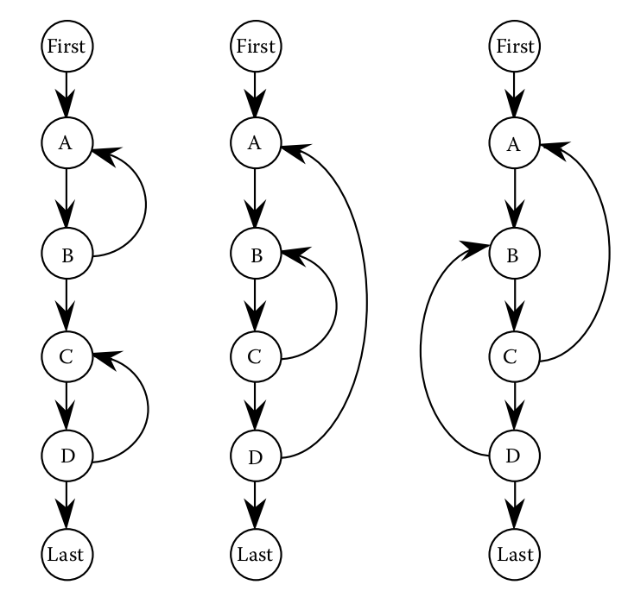
Loops: Concatenated, Nested, Knotted

Slide 20
Knotted loops cannot occur when the structured programming precepts are followed,
but they can occur in languages like Java with try/catch.
simple view of loop testing is that every loop involves a decision, and we need to test both outcomes of the decision:

Slide 21
9.2.2 Test Coverage Analyzers
.

Slide 22
Basis Path Testing
Recall vector spaces and basis
“view a program as a vector space, then the basis for such a space would be a very interesting set of elements to test”

Slide 23
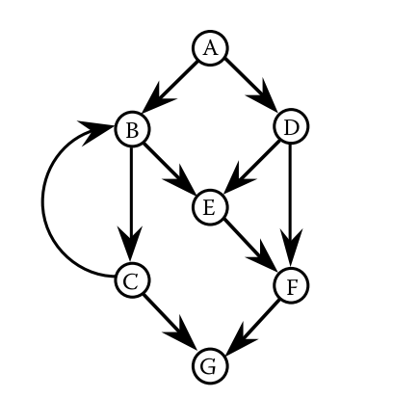
McCabe’s Basis Path Method
McCabe’s control graph
cyclomatic number
V(G) = e – n + 2p = 10 – 7 + 2(1) = 5

Slide 24
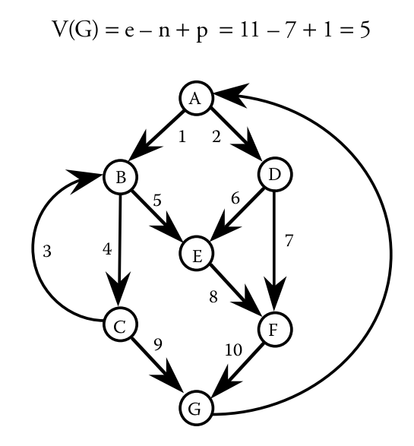

Slide 25
The cyclomatic complexity of the strongly connected graph in Figure 9.7 is 5;
thus, there are five linearly independent circuits.
p1: A, B, C, G
p2: A, B, C, B, C, G
p3: A, B, E, F, G
p4: A, D, E, F, G
p5: A, D, F, G

Slide 26
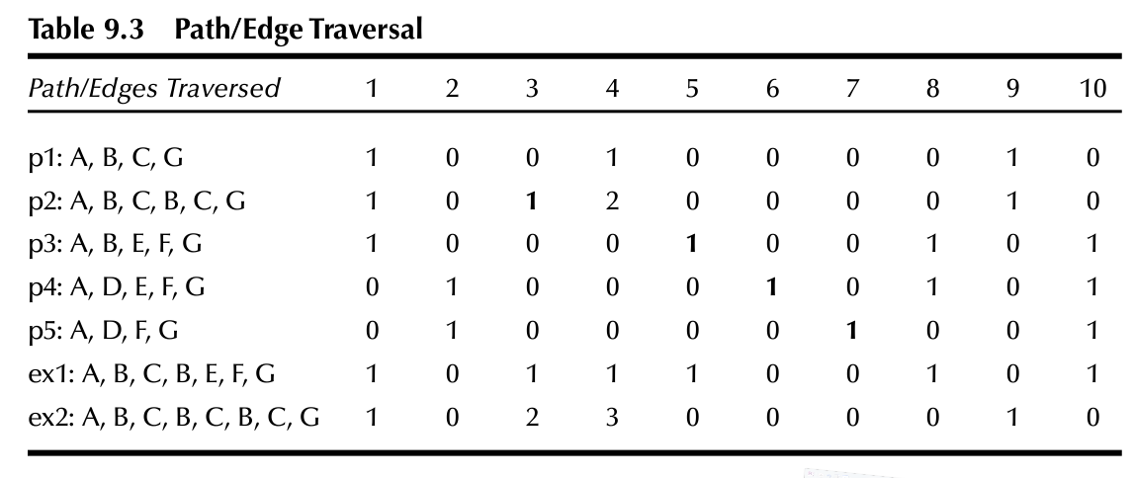

Slide 27
McCabe’s baseline method
McCabe’s baseline method to determine a set of basis paths.
Select a baseline path, the “normal case”
Next the baseline path is retraced
in turn each decision is “flipped”

Slide 28
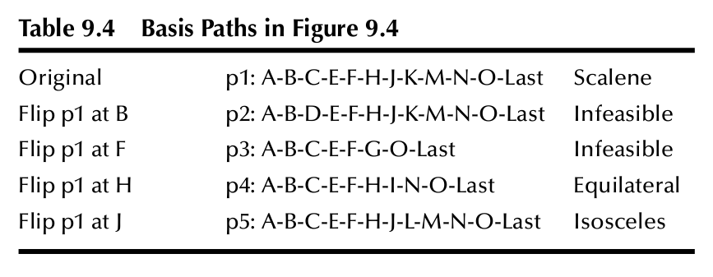
McCabe’s Method on Triangle

Slide 29
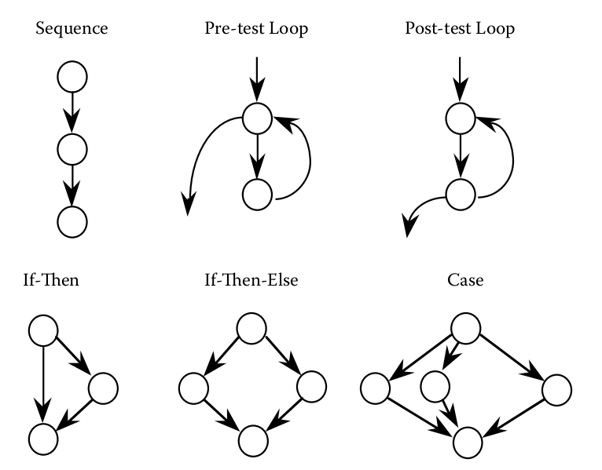
Essential Complexity
x

Slide 30
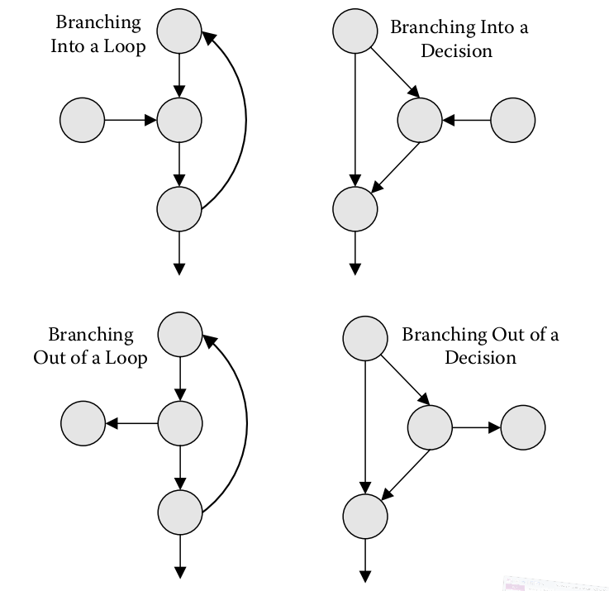
Violations of structured programming

Slide 31
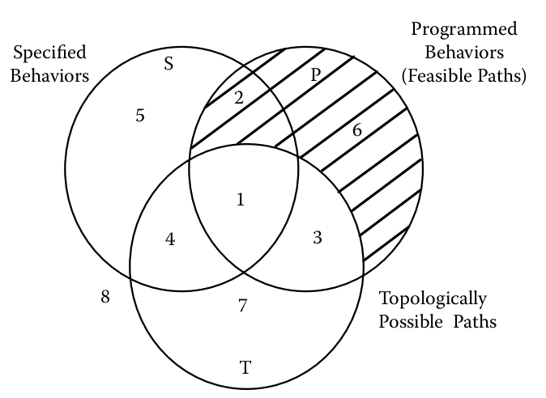

Slide 32
References
McCabe, T.J., Structural Testing: A Software Testing Methodology Using the Cyclomatic Complexity Metric, 1982.
Beizer, Boris, Software System Testing and Quality Assurance, 1984.

