Slide 1
CSCE 747 Software Testing and Quality Assurance
Lecture 06 – Path Testing

Slide 2
Last Time
Wrapup Functional Testing
Ch 8 pp 117-127
Testing Effort
Testing Efficiency
Testing Effectiveness
Guidelines
Case Study – Insurance Premium
Today
Testing Overview Again
Definition of Testing
Verification vs Validation
Path Testing
Ch 9 pp 131-149
Jorgensen, Paul C. Software Testing
A Craftsman Approach

Slide 3
Attributes of Software
Functional Attributes – testing focusses here
Quality (non-functional) Attributes
Availability
Usability
Security
Modifiability
Maintainability
Performance
Testability
…
Can we test for these?
Can we measure these?
Can we design to achieve these?
yes CSCE 742 Software Architecture

Slide 4
Testing Overview Again
“Software testing is the process of analyzing a software item to detect the differences between existing and required conditions and to evaluate the features of the software item.”
IEEE, "ANSI/IEEE Standard 1008-1987, IEEE Standard for Software Unit Testing," no., 1986.
“Software testing is an activity that should be done throughout the whole development process”
A. Bertolino, "Chapter 5: Software Testing," in IEEE SWEBOK Trial Version 1.00, May 2001.
Both of these are “quotes” (indirect references) from L. Williams http://agile.csc.ncsu.edu/SEMaterials/BlackBox.pdf

Slide 5
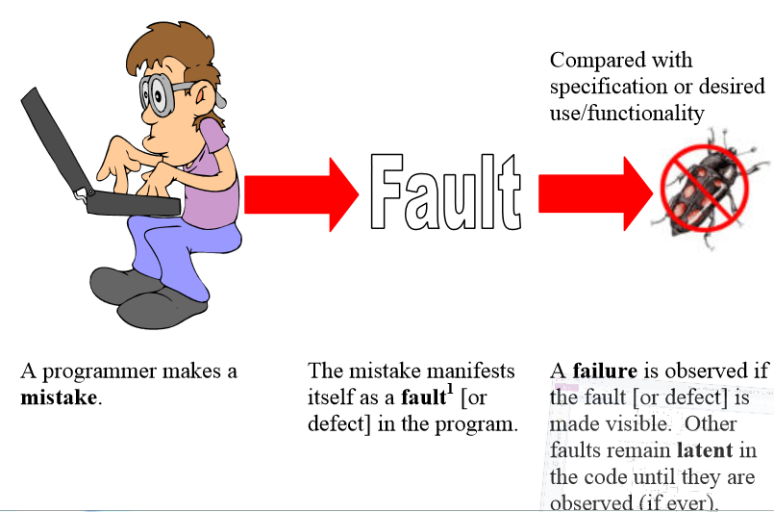
Terminology Again
http://agile.csc.ncsu.edu/SEMaterials/BlackBox.pdf

Slide 6
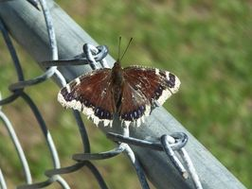
The First Debugging Session .
“A Buggy Relay - One of the earliest computers, the Mark II Aiken Relay Calculator, was at Harvard University. The first attempts at building computers used relays as the active devices.
Grace Murray Hopper, a mathematician and computer programmer, is often wrongly credited with coining the term bug.
On September 9th, 1947, an operator fixed a Mark II computer by removing a moth wedged between the contacts of Relay #70 in Panel F. The machine had been "debugged," and that term soon spread.”
Read more: http://www.ehow.com/facts_7691819_called-computer-program-crashes-unexpectedly.html#ixzz2e9Qlqrpl

Slide 7
Earlier Uses of the Term "Bug"
While the previous story is perhaps responsible for catapulting the term "debugging" into our mainstream language, the word "bug" can be traced back to an 1896 electrical handbook titled, "Hawkins New Catechism of Electricity," lists "bug" as a term used to designate any trouble or fault in the connections or working of an electric apparatus.
The term bug originated in the 14th century where bugge was the Middle English word for hobgoblin.

Slide 8
Verification and Validation
Testing is a verification and validation software practice as are:
Inspections
Pair programming
Verification: Are we building the product right?
Validation: Are we building the right product?

Slide 11
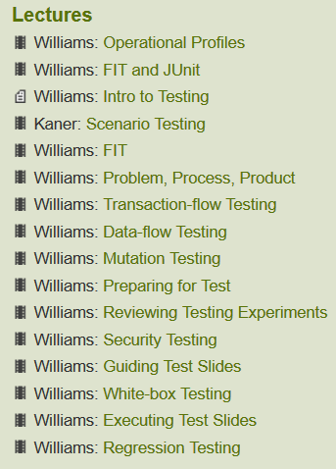
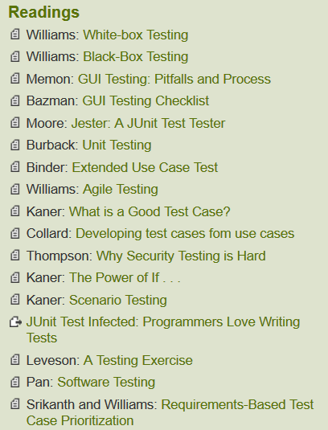
Software Engineering Open Seminar

Slide 14
Functional Testing Review
Black-box testing –
Approaches
Boundary values
Equivalence Class
Decision Table

Slide 15
1. Program triangle 2 ‘Structured programming version of simpler specification
2. Dim a,b,c As Integer
3. Dim IsATriangle As Boolean
‘Step 1: Get Input
Output (“Enter 3 integers which are sides of a triangle”)
5. Input (a,b,c)
6. Output (“Side A is “,a)
7. Output (“Side B is “,b)
8. Output (“Side C is “,c)
‘Step 2: Is A Triangle?
9. If (a < b + c) AND (b < a + c) AND (c < a + b)
10. Then IsATriangle = True
11. Else

Slide 16
‘Step 3: Determine Triangle Type
13. If IsATriangle
14. Then If (a = b) AND (b = c)
15. Then Output (“Equilateral”)
16. Else If (a ≠ b) AND (a ≠ c) AND (b ≠ c)
17. Then Output (“Scalene”)
18. Else Output (“Isosceles”)
19. EndIf
20. EndIf
21. Else Output (“Not a Triangle”)
22. EndIf
23. End triangle2

Slide 17
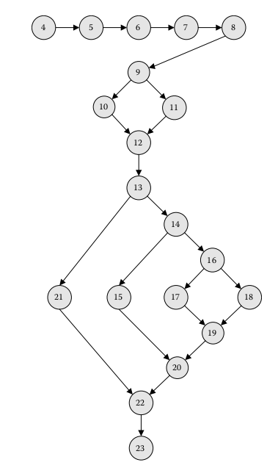
Program Graph for Simple Triangle
Statement coverage
Path coverage
Path through the graph
No loops == DAG
Product rule
Npaths = 2 * 4 = 8 paths
Loops complicate
Loop 22➔13 executed 100 times yields 2* 4¹⁰⁰ paths

Slide 18
Definition of Decision to Decision Paths
Definition DD-Path - a sequence of nodes in a program graph such that:
Case 1: It consists of a single node with indeg = 0.
Case 2: It consists of a single node with outdeg = 0.
Case 3: It consists of a single node with indeg ≥ 2 or outdeg ≥ 2.
Case 4: It consists of a single node with indeg = 1 and outdeg = 1.
Case 5: It is a maximal chain of length ≥ 1.

Slide 19
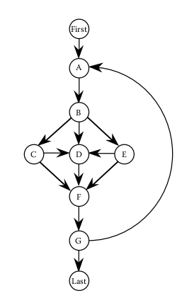
Path Coverage Usually Impossible
This example show the impossibility of completely testing even simple programs
(Schach, 1993).
Suppose loop executed 10 times.
How many distinct paths?
What about 100 times?
5.15 e +47

Slide 20
Test Coverage Metrics
Metric - Description of Coverage
C₀ - Every statement
C₁ - Every DD-Path (predicate outcome)
C_{1p} - Every predicate to each outcome
C₁₂ - C₁1 -coverage + loop coverage
C_{d} - C₁1 -coverage + every dependent pair of DD-Paths
C_{MCC} - Multiple condition coverage
C_{ik} - Every program path that contains up to k repetitions of a loop (usually k = 2)
C_{stat} - Statistically significant fraction of paths
C∞ - All possible execution paths
Based on work of E.F. Miller (Miller, 1977)

