Slide 1
CSCE 747 Software Testing and Quality Assurance
Lecture 05 –
Wrapping Up Functional Testing

Slide 2
Last Time
Decision Table Based Testing
Ch 7 pp 103-116
Decision Trees
Decision Tables for Business Logic
Decision Tables for Testing
Junit testing
Today
Wrapup Functional Testing
Ch 8 pp 117-127
Testing Effort
Testing Efficiency
Testing Effectiveness
Guidelines
Case Study – Insurance Premium
Jorgensen, Paul C. Software Testing
A Craftsman Approach

Slide 3
Functional Testing Review
Black-box testing –
Approaches
Boundary values
Equivalence Class
Decision Table

Slide 4
Testing Effort

Slide 5
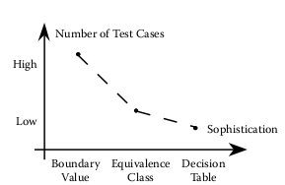
Testing Effort
Fig 8.1 Trendline of test cases by testing method
Jorgensen, Paul C. Software Testing
A Craftsman Approach

Slide 6
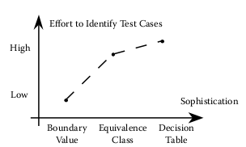
Testing Effort
Fig 8.1 Trendline of test case identification by testing method
Jorgensen, Paul C. Software Testing
A Craftsman Approach

Slide 7
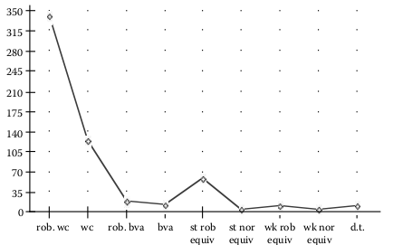
Test Cases per Method –Triangle Problem
Jorgensen, Paul C. Software Testing
A Craftsman Approach

Slide 8
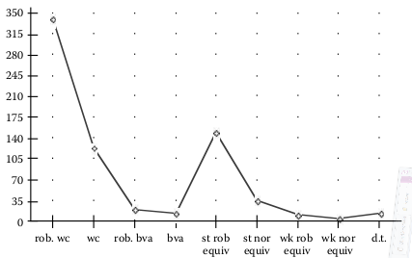
Test Cases per Method –NextDate
Jorgensen, Paul C. Software Testing
A Craftsman Approach

Slide 9
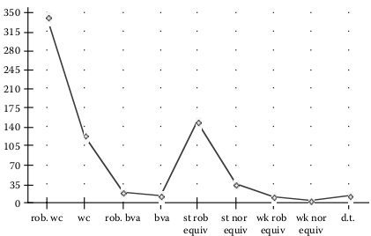
Test Cases per Method –Commission Problem
Jorgensen, Paul C. Software Testing
A Craftsman Approach

Slide 10
Limitation of Functional Testing
fundamental limitation of functional testing:
the twin possibilities of
gaps of untested functionality and
redundant tests.
Jorgensen, Paul C. Software Testing
A Craftsman Approach

Slide 11
Guidelines
Jorgensen, Paul C. Software Testing
A Craftsman Approach

Slide 12
Looking for your keys Story
Here is one of my favorite testing stories. An inebriated man was crawling around on the sidewalk beneath a streetlight. When a policeman asked him what he was doing, he replied that he was looking for his car keys. “Did you lose them here?” the policeman asked. “No, I lost them in the parking lot, but the light is better here.”
Jorgensen, Paul C. Software Testing
A Craftsman Approach

Slide 13
Analogy to Testing
This little story contains an important message for testers:
Testing for faults that are not likely to be present is pointless.
It is far more effective to have a good idea of the kinds of faults that are most likely (or most damaging) and then to select testing methods that are likely to reveal these faults.
Jorgensen, Paul C. Software Testing
A Craftsman Approach

Slide 14
Attributes for Selecting Testing Methods
Whether the variables represent physical or logical quantities
Whether dependencies exist among the variables
Whether single or multiple faults are assumed
Whether exception handling is prominent
Jorgensen, Paul C. Software Testing
A Craftsman Approach

Slide 15
an “Expert System” on Functional Testing Approach Selection
“If the variables refer to physical quantities, domain testing and equivalence class testing are indicated.
If the variables are independent, domain testing and equivalence class testing are indicated.
If the variables are dependent, decision table testing is indicated.
If the single fault assumption is warranted, boundary value analysis and robustness testing are indicated.
If the multiple fault assumption is warranted, worst-case testing, robust worst-case testing, and decision table testing are indicated.
If the program contains significant exception handling, robustness testing and decision table testing are indicated.
If the variables refer to logical quantities, equivalence class testing and decision table testing are indicated.”
Jorgensen, Paul C. Software Testing
A Craftsman Approach

Slide 16
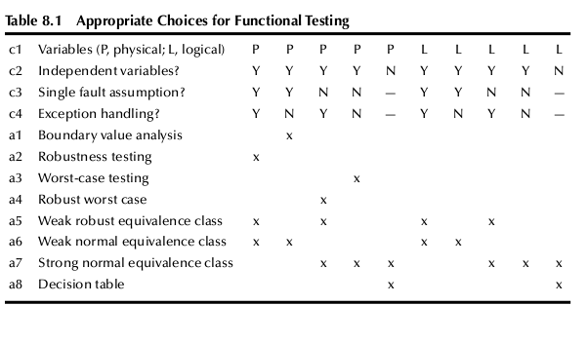
Decision Table for Technique Selection
Jorgensen, Paul C. Software Testing
A Craftsman Approach

Slide 17
Case Study From Text
“An insurance premium program computes the semiannual car insurance premium based on two parameters:
the policyholder’s age and
driving record:
Using Premium = BaseRate*ageMultiplier - safeDrivingReduction
The ageMultiplier is a function of the policyholder’s age, and
the safe driving reduction is given when the current points (assigned by traffic courts for moving violations) on the policyholder’s driver’s license are below an age-related cutoff.
Policies are written for drivers in the age range of 16 to 100.
Once a policyholder has 12 points, the driver’s license is suspended (thus, no insurance is needed).
The BaseRate changes from time to time; for this example, it is $500 for a semiannual premium.”
Jorgensen, Paul C. Software Testing
A Craftsman Approach

Slide 18
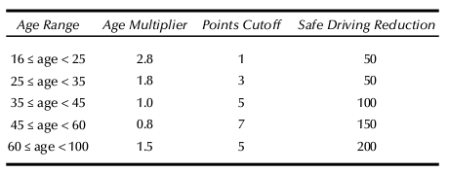
Safe Driving Reduction Table
Jorgensen, Paul C. Software Testing
A Craftsman Approach

Slide 19
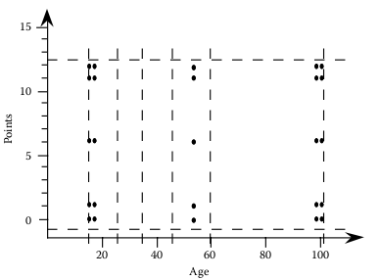
Worst–case boundary value test cases
Jorgensen, Paul C. Software Testing
A Craftsman Approach

Slide 20
Refinement of Partition
A1 = {age: 16 ≤ age < 25}
A2 = {age: 25 ≤ age < 35}
A3 = {age: 35 ≤ age < 45}
A4 = {age: 45 ≤ age < 60}
A5 = {age: 60 ≤ age < 100}
P1 = {points = 0, 1}
P2 = {points = 2, 3}
P3 = {points = 4, 5}
P4 = {points = 6, 7}
P5 = {points = 8, 9, 10, 11, 12}
A x P has 25 induced equivalence classes
Jorgensen, Paul C. Software Testing
A Craftsman Approach

Slide 21
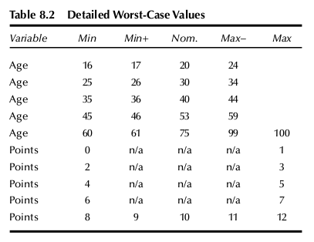
Jorgensen, Paul C. Software Testing
A Craftsman Approach

Slide 22
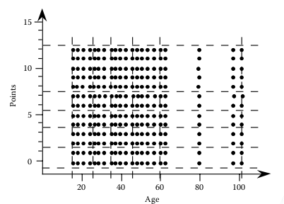
Fig 8.8 Detailed worst-case boundary test cases
Jorgensen, Paul C. Software Testing
A Craftsman Approach

Slide 23
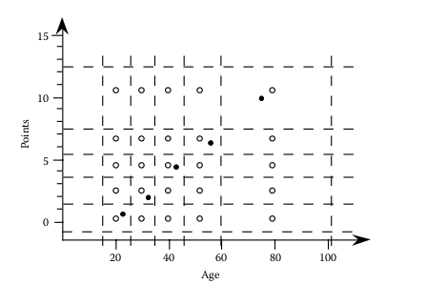
Weak and Strong Eq. Class Test Cases
Weak
◦ Strong
Jorgensen, Paul C. Software Testing
A Craftsman Approach

Slide 24
Decision Table Test Cases
Jorgensen, Paul C. Software Testing
A Craftsman Approach

Slide 25
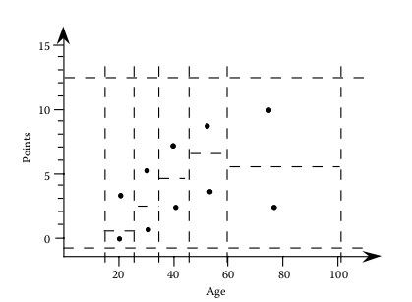
Decision Table Test Cases
Jorgensen, Paul C. Software Testing
A Craftsman Approach

Slide 26
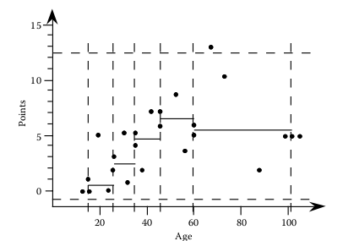
Hybrid Test Cases
Jorgensen, Paul C. Software Testing
A Craftsman Approach

