Slide 1
CSCE 747 Software Testing and Quality Assurance
Lecture 04 –
Decision Tables Based Testing

Slide 2
Last Time
Equivalence Class Testing
Revision Control Systems
Git intro
Today
Decision Table Based Testing
Ch 7 pp 103-116
Decision Trees
Decision Tables for Business Logic
Decision Tables for Testing
Jorgensen, Paul C. Software Testing
A Craftsman Approach

Slide 3
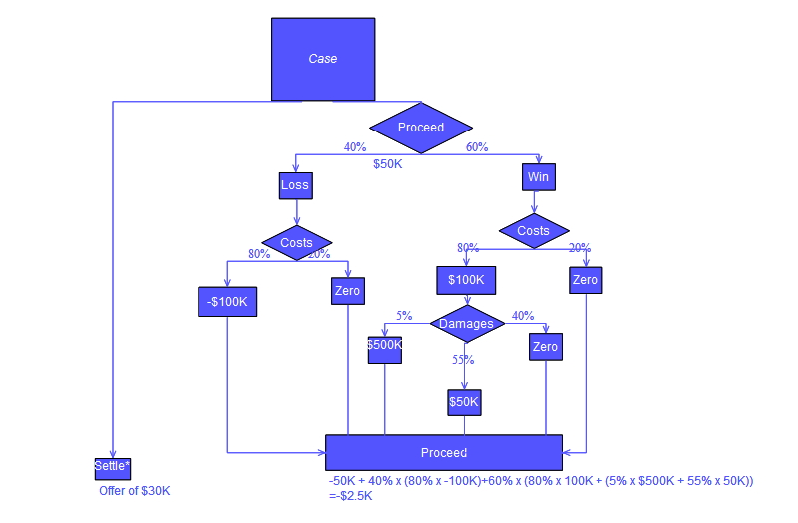
Decision Trees
http://en.wikipedia.org/wiki/Decision_tree

Slide 4
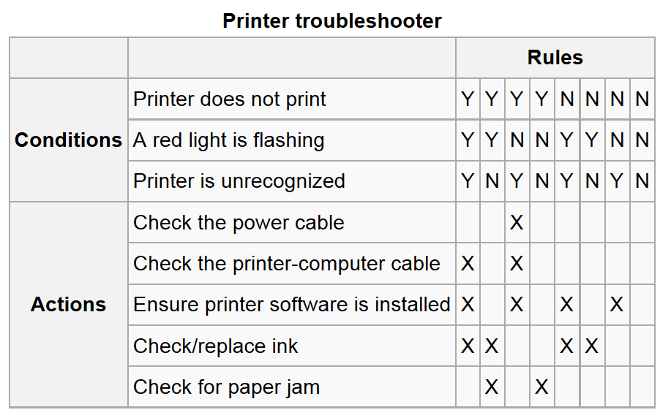
Decision Tables
http://en.wikipedia.org/wiki/Decision_table

Slide 5
Decision Tables
Decision tables have been used to represent and analyze complex logical relationships since the early 1960s.
Ideal for describing situations in which a number of combinations of actions are taken under varying sets of conditions
Capture “Business Logic”
Capture = describe = document = display for stakeholders
Jorgensen, Paul C. Software Testing
A Craftsman Approach

Slide 6
Decision Tables Support Completeness
Decision table with boolean conditions like rotated truth table
Supports complete coverage of the logic
Testing based on decision tables enforce logical rigor.
Related methods are used:
cause–effect graphing (Elmendorf, 1973; Myers, 1979) and
the decision tableau method (Mosley, 1993).
Jorgensen, Paul C. Software Testing
A Craftsman Approach

Slide 7
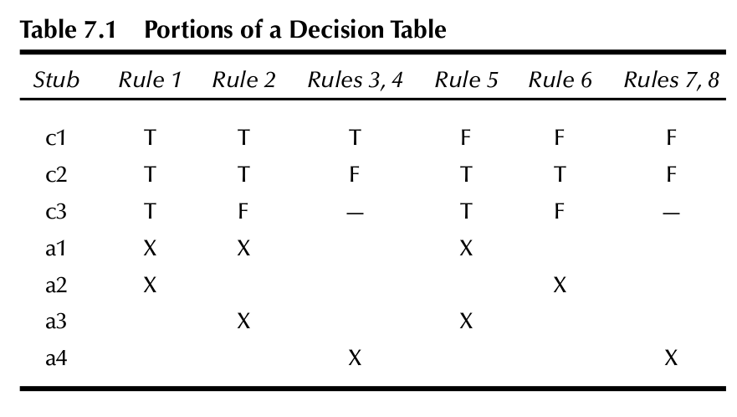
Decision Table for Triangle Problem01
Jorgensen, Paul C. Software Testing
A Craftsman Approach

Slide 8
Decision Tables to Test Cases
“To identify test cases with decision tables, we:
Interpret conditions as inputs and actions as outputs.
Sometimes conditions end up referring to equivalence classes of inputs, and
Actions refer to major functional processing portions of the item tested.
The rules are then interpreted as test cases.
Because the decision table can mechanically be forced to be complete, we know we have a comprehensive set of test cases.”
Jorgensen, Paul C. Software Testing
A Craftsman Approach

Slide 9
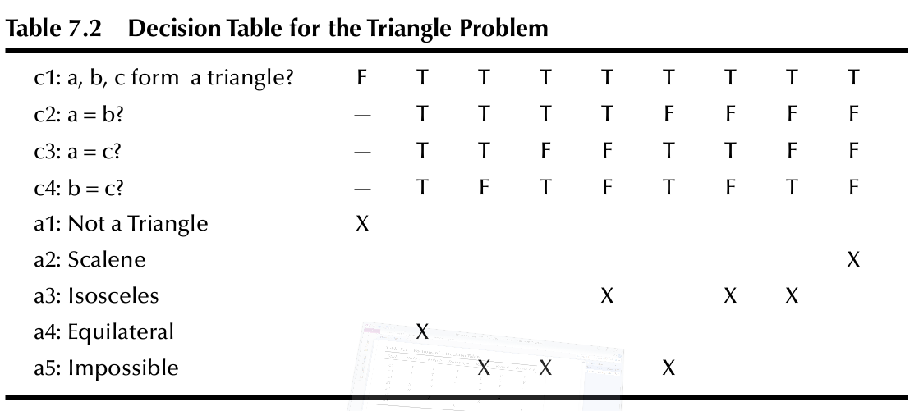
Jorgensen, Paul C. Software Testing
A Craftsman Approach

Slide 10
Jorgensen, Paul C. Software Testing
A Craftsman Approach

Slide 11
NextDate Decision tables
What are meaningful decisions for NextDate?
Months
M1 ={ months that have 30 days}
M2 ={ months that have 31 days}
M3 ={February}
Days
D1 ( ), D2( ), D3( ), D4( )
Years Y1(2000), Y2(non-century-leap-year), Y3()
So how big is the table?
9 boolean tests ➔ 2¹⁰=1024
3*4*3
Jorgensen, Paul C. Software Testing
A Craftsman Approach

Slide 12
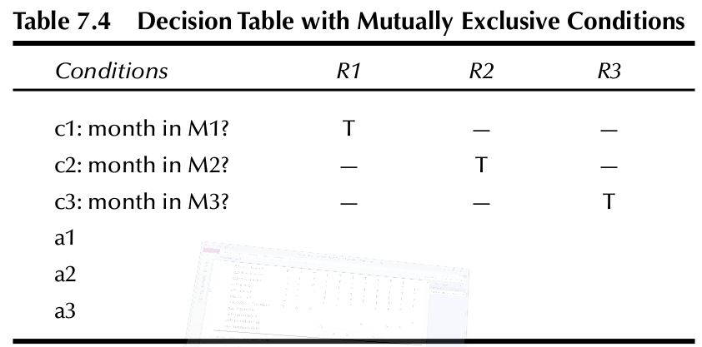
When conditions refer to equivalence classes
In NextDate
Consider equivalence class = sameLengthMonth
Jorgensen, Paul C. Software Testing
A Craftsman Approach

Slide 13
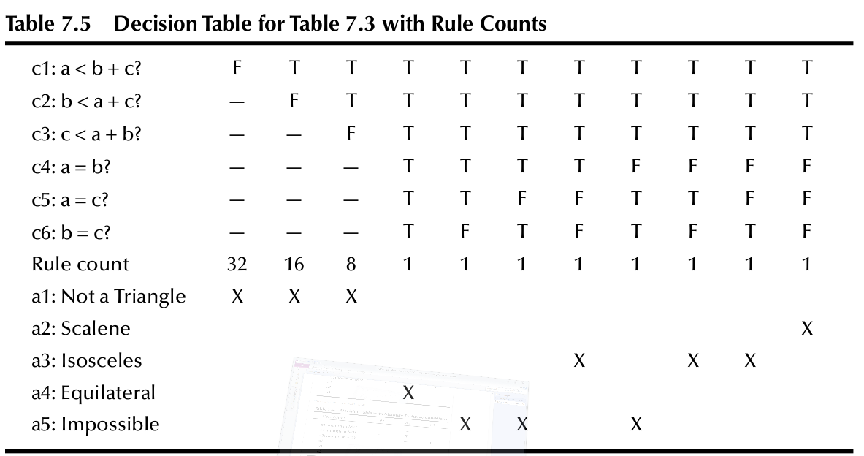
Rule Counts
Rule Count – number of corresponding cases
Note sum of counts = 64 for complete truth table
Jorgensen, Paul C. Software Testing
A Craftsman Approach

Slide 14
Jorgensen, Paul C. Software Testing
A Craftsman Approach

Slide 15
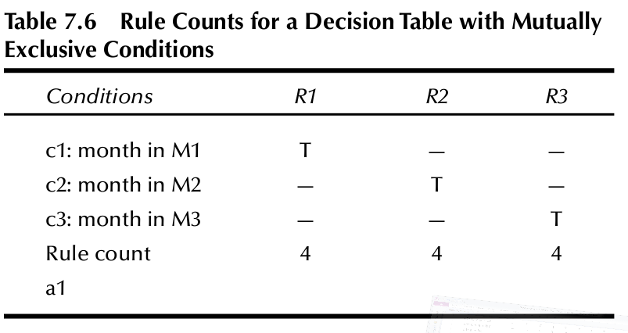
Rule Counts for NextDate
Jorgensen, Paul C. Software Testing
A Craftsman Approach

Slide 16
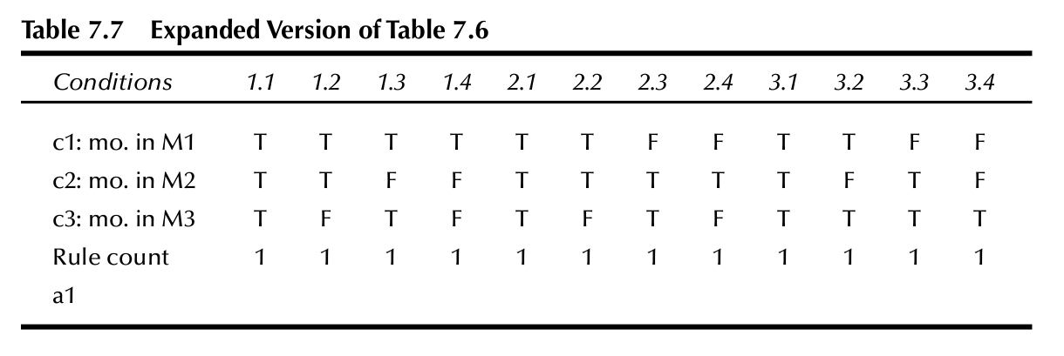
Consider Equivalence Relation M X D
Eg. 2.3 = equivalence class M2 X D3
Jorgensen, Paul C. Software Testing
A Craftsman Approach

Slide 17
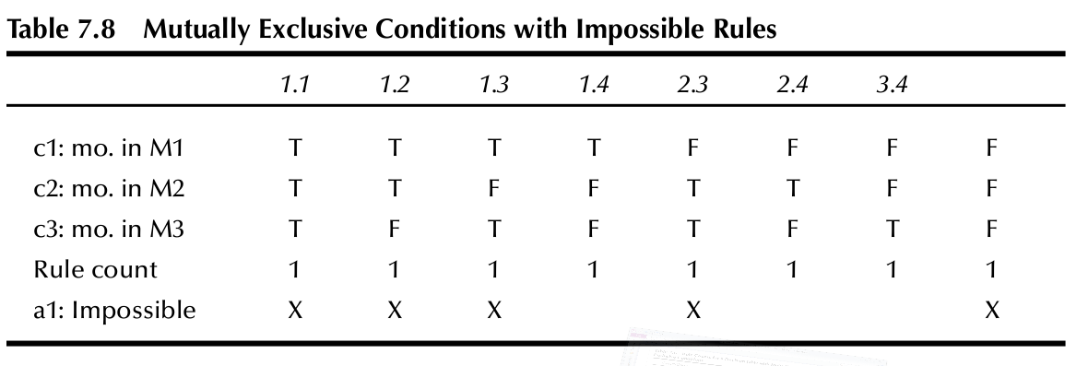
Impossible Rules
Impossible Rules – cases that cannot happen
Jorgensen, Paul C. Software Testing
A Craftsman Approach

Slide 18
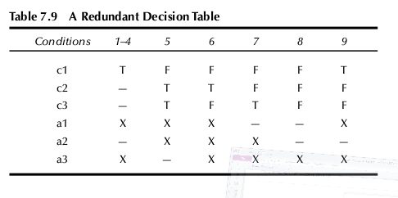
Redundancy in Decision Tables
Here rules 4 and rule 9 are identical; redundant
Jorgensen, Paul C. Software Testing
A Craftsman Approach

Slide 19
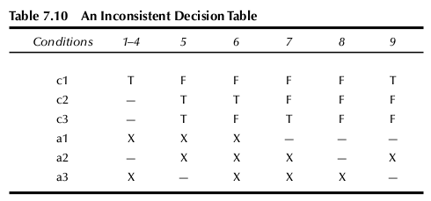
Redundancy OK; but Inconsistency?
Now consider rules 4 and 9
Jorgensen, Paul C. Software Testing
A Craftsman Approach

Slide 20
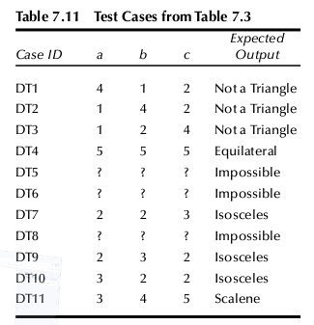
Test Cases for the Triangle Problem
11 test cases
3 impossible
3 not triangle
1 equilateral
1 scalene
3 isosceles
? means invalid
Jorgensen, Paul C. Software Testing
A Craftsman Approach

Slide 21
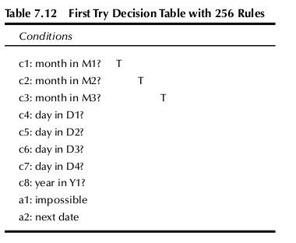
NextDate Try1
8 boolean conditions ➔ 2⁸ =256 cases
Jorgensen, Paul C. Software Testing
A Craftsman Approach

Slide 22
Test Cases for NextDate
Invalid actions
a1: Day invalid for this month
a2: Cannot happen in a non-leap year
a3: Compute the next date
3([months])*4([days])*3([year]) = 36 equiv classes
[x] = equivalence classes
<m,d,y> 36 equiv. classes on M x D x Y
36 rules/test cases – reducing by combining rules with don’t care cases yields 16 rules
Jorgensen, Paul C. Software Testing
A Craftsman Approach

Slide 23
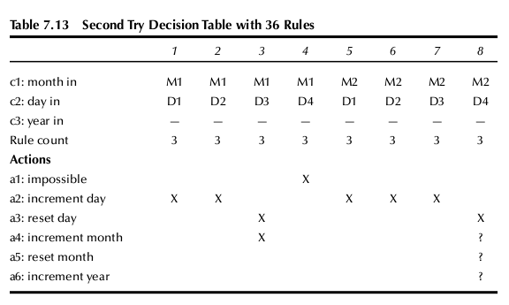
NextDate 2nd Try
Jorgensen, Paul C. Software Testing
A Craftsman Approach

Slide 24
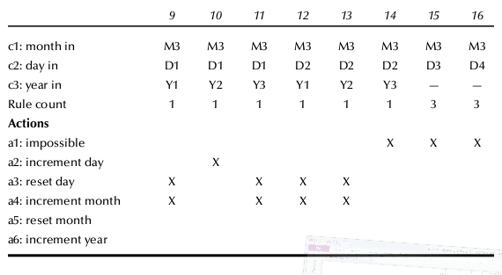
Jorgensen, Paul C. Software Testing
A Craftsman Approach

Slide 25
But Problems Remain
December problems in rule 8
Feb 28 problems in 9, 11 and 12
So new decomposition
M1 = {month : month has 30 days}
M2 = {month : month has 31 days except December}
M3 = {month : month is December}
M4 = {month : month is February}
D1 = {day : 1 ≤ day ≤ 27}
D2 = {day : day = 28}
D3 = {day : day = 29}
D4 = {day : day = 30}
D5 = {day : day = 31}
Y1 = {year : year is a leap year}
Y2 = {year : year is a common year}
note author eliminated Y3 to make tables smaller
Jorgensen, Paul C. Software Testing
A Craftsman Approach

Slide 26
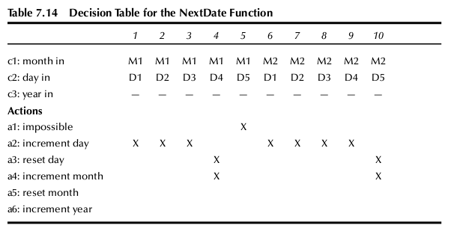
Jorgensen, Paul C. Software Testing
A Craftsman Approach

Slide 27
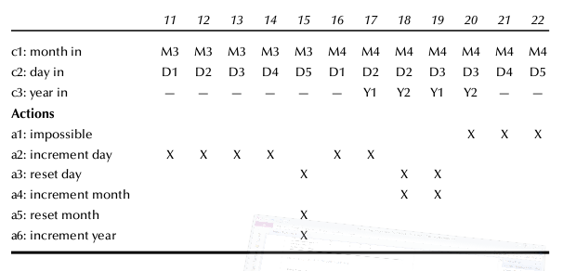
Jorgensen, Paul C. Software Testing
A Craftsman Approach

Slide 28
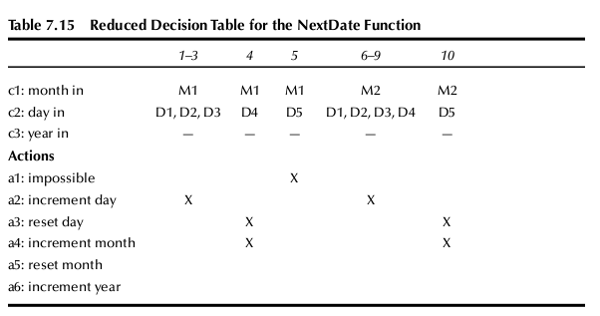
Compressing the Table
Combining columns
Table for 11-22 in text
Jorgensen, Paul C. Software Testing
A Craftsman Approach

Slide 29
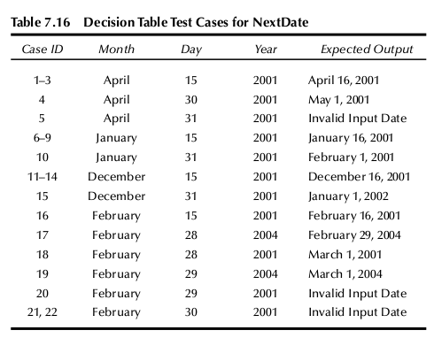
NextDate Decision Table Test cases
Jorgensen, Paul C. Software Testing
A Craftsman Approach

Slide 30
Decision Table for Commission Problem
Not well suited
Very little decision logic
Variables truly independent ➔ no impossible cases as in NextDate
3 equivalence classes:
Commission1, commission2, commission3
Jorgensen, Paul C. Software Testing
A Craftsman Approach

Slide 31
Guidelines and Observations
Decision table approach appropriate for applications with
Prominent if-then-else logic
Logical relationships among input variables
Calculations involving subsets of inputs
Decision tables do not scale up well
Iteration helps. Start then refine.
Jorgensen, Paul C. Software Testing
A Craftsman Approach

Slide 32
Homework
Consider a NextMonth function
NextMonth(Feb, 15, 2000) = (March, 15, 2000)
NextMonth(jan, 30, 2000) =? There are multiple correct answers here. Your answer here will affect #2.
Develop a decision table for NextMonth function (not ignoring days)
Jorgensen, Paul C. Software Testing
A Craftsman Approach

