Slide 1
CSCE 747 Software Testing and Quality Assurance
Lecture 03 – Equivalence Class Testing

Slide 2
Last Time
The Standard Programs
NextDate
Commission
Simple ATM (SATM)
Currency Converter
Saturn Windshield Wiper Controller
Boundary Value Testing
Min, min+,nom,max-,max
Eclipse and Java
Use JUnit4
Today
Eclipse and Java
Equivalence Class Testing
Jorgensen, Paul C. Software Testing
A Craftsman Approach

Slide 3
Equivalence Class Testing
Recall Equivalence Relations
Equivalence class
partition
Equivalence Class Testing
We would like “sense of complete testing and, at the same time, we would hope to avoid redundancy”
Idea – use representative of the equivalence class

Slide 4
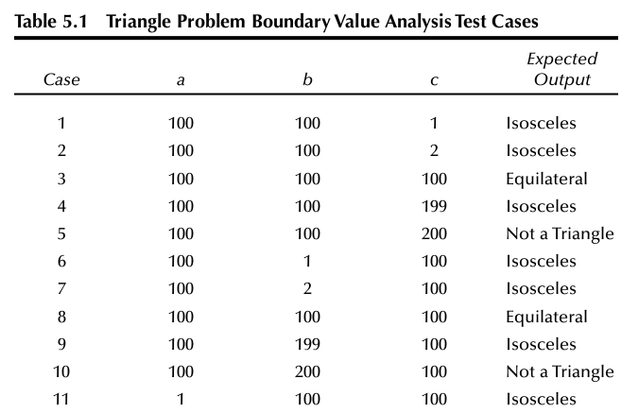
Failings of Boundary Value Testing
Redundancy
Gaps

Slide 5
Weak robust equivalence class testing
Weak robust equivalence class testing
focuses on invalid data values,
Garbage-in garbage-out
What should a program do on bad input?
Terminate?
Re-prompt and re-enter
Log-and continue with defaults
Other ideas?

Slide 6
afferent/central/efferent
Classic afferent/central/efferent architecture of structured programming,
Afferent
Central
Efferent
GUIs and strongly typed languages lessen the need for emphasis on data-validation

Slide 7
Equivalence Classes
Equivalence Classes ⬅➔ Partition
With respect to the relation under consideration two elements of the same equivalence class are equivalent
Union = input space ➔ completeness
Disjointness of partition ➔ limit redundancy

Slide 8
Perfect Relation for inducing the equivalence classes?
Candidates
R_{cov} - a R b if the program should execute the same statements for both data vectors a and b
R_{path} - a R b if the program should follow the exact same path for both data vectors a and b
R_{full} - a R b if the program should follow the same path and produce precisely the same output for both data vectors a and b

Slide 9
Choose Relation Wisely
Triangle problem
(5,5,5) ➔ equilateral but then are
(6,6,6) and (100,100,100) adding anything?
Are they treated the same by the program?
i.e. do they follow the same execution path through the program graph (=control flow graph)

Slide 10
Finding the Equivalence classes
Same execution path works fine for white-box
Black-box=Functional
Guess the implementation
a ≤ x ≤ d, with intervals [a, b), [b, c), [c, d]
e ≤ y ≤ g, with intervals [e, f ), [f, g]

Slide 11
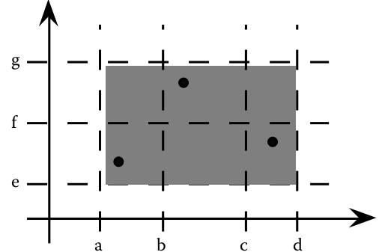
Weak Normal Equivalence Class Testing
a ≤ x ≤ d, with intervals [a, b), [b, c), [c, d]
e ≤ y ≤ g, with intervals [e, f ), [f, g]

Slide 12
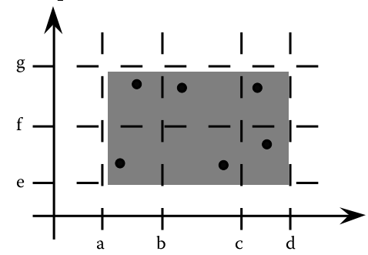
Strong Normal Equivalence Class Testing
Representative of each equivalence class
Equiv. relation in each dimension induces an eq. relation of the input space

Slide 13
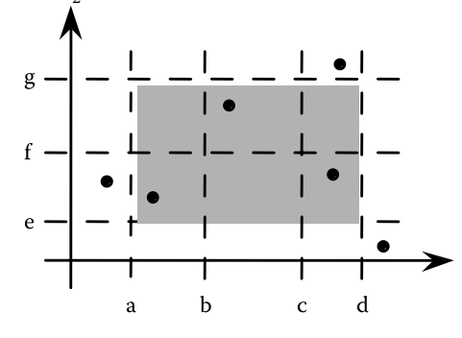
Weak Robust Equivalence Class Testing

Slide 14
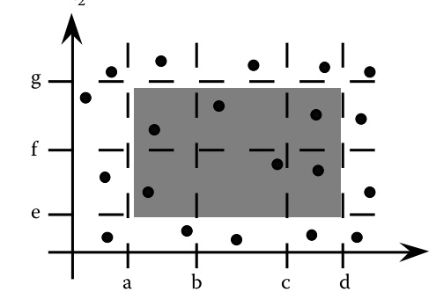
Strong robust equivalence class test cases

Slide 15
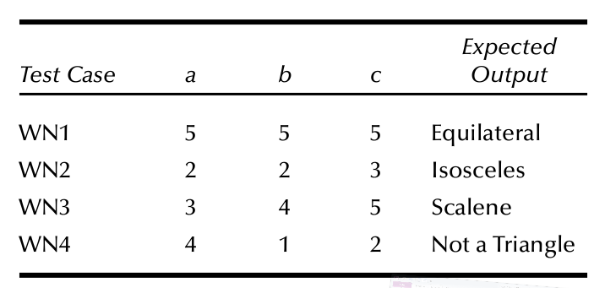
Equivalence Class Test Cases for the Triangle Problem
Output (range) equivalence classes
R2 = {<a, b, c> : the triangle with sides a, b, and c is isosceles}
R3 = {<a, b, c> : the triangle with sides a, b, and c is scalene}
R4 = {<a, b, c> : sides a, b, and c do not form a triangle}
Note
No subintervals

Slide 16
For Robustness

Slide 17
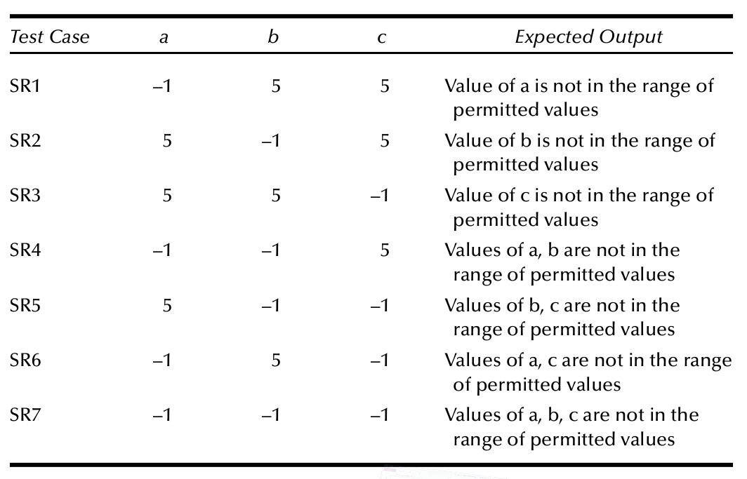

Slide 18
Equivalence Based on Input Space
D1 = {<a, b, c> : a = b = c}
D2 = {<a, b, c> : a = b, a ≠ c}
D3 = {<a, b, c> : a = c, a ≠ b}
D4 = {<a, b, c> : b = c, a ≠ b}
D5 = {<a, b, c> : a ≠ b, a ≠ c, b ≠ c}

Slide 19
Do they make a triangle.
D6 = {<a, b, c> : a ≥ b + c}
D7 = {<a, b, c> : b ≥ a + c}
D8 = {<a, b, c> : c ≥ a + b}
Or refining
D6’ = {<a, b, c> : a = b + c}
D6” = {<a, b, c> : a > b + c}

Slide 20
Equivalence Class Test Cases for the NextDate Function
See text

Slide 21
Equivalence Class Test Cases for the Commission Problem
Equivalence classes defined on input space
Equivalence classes defined on the output range of the commission function
L1 = {locks : 1 ≤ locks ≤ 70}
L2 = {locks = –1} (occurs if locks = –1 is used to control input iteration)
S1 = {stocks : 1 ≤ stocks ≤ 80}
B1 = {barrels : 1 ≤ barrels ≤ 90}
invalid classes of the input variables

Slide 22
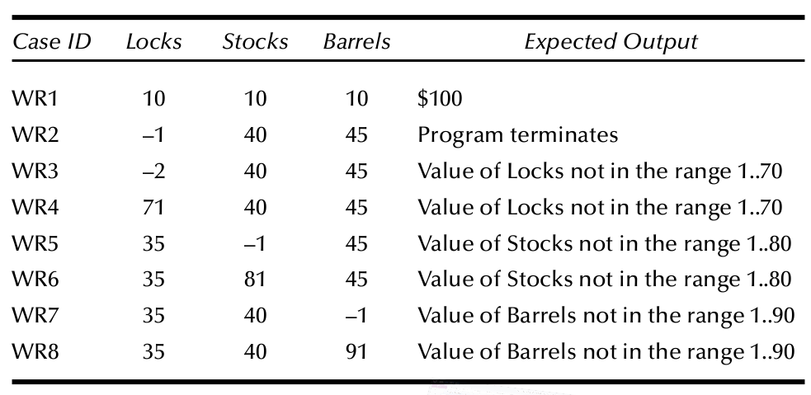
Weak Robust test cases

Slide 23
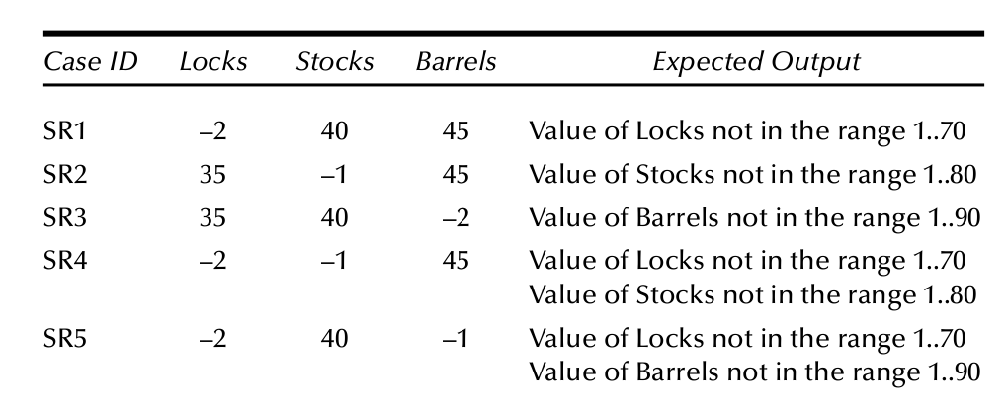
And so forth

Slide 24
Output Range Equivalence Class Test Cases
by commission ranges:
S1 = {<locks, stocks, barrels> : sales ≤ 1000}
S2 = {<locks, stocks, barrels> : 1000 < sales ≤ 1800}
S3 = {<locks, stocks, barrels> : sales > 1800}

Slide 25
Guidelines and Observations
Obviously, the weak forms of equivalence class testing (normal or robust) are not as comprehensive as the corresponding strong forms.
If the implementation language is strongly typed (and invalid values cause runtime errors), it makes no sense to use the robust forms.
If error conditions are a high priority, the robust forms are appropriate.
Equivalence class testing is appropriate when input data is defined in terms of intervals and sets of discrete values. This is certainly the case when system malfunctions can occur for out-of-limit variable values.
Equivalence class testing is strengthened by a hybrid approach with boundary value testing. (We can reuse the effort made in defining the equivalence classes.)
Equivalence class testing is indicated when the program function is complex. In such cases, the complexity of the function can help identify useful equivalence classes, as in the NextDate function.

Slide 26
Guidelines and Observations (continued)
Strong equivalence class testing makes a presumption that the variables are independent, and the corresponding multiplication of test cases raises issues of redundancy. If any dependencies occur, they will often generate “error” test cases, as they did in the NextDate function. (The decision table technique in Chapter 7 resolves this problem.)
Several tries may be needed before the “right” equivalence relation is discovered, as we saw in the NextDate example. In other cases, there is an obvious or natural equivalence relation. When in doubt, the best bet is to try to second-guess aspects of any reasonable implementation.
The difference between the strong and weak forms of equivalence class testing is helpful in the distinction between progression and regression testing (see Chapters 12 and 14).

Slide 27
References
References for Chapter 6
Mosley, D.J., The Handbook of MIS Application Software Testing, Yourdon Press, Prentice-Hall, Englewood Cliffs, NJ, 1993.
Myers, G.J., The Art of Software Testing, Wiley Interscience, New York, 1979.

Slide 28
5. The spring and fall changes between standard and daylight savings time create an interesting problem for telephone bills. In the spring, this switch occurs at 2:00 a.m. the Sunday morning (in March) when clocks are reset to 3:00 a.m. The symmetric change takes place usually on the first Sunday in November (The days are different in the European Union Countries) when the clock changes from 2:59:59 back to 2:00:00.
Develop equivalence classes for a long-distance telephone service function that bills calls using the following rate structure:
Call duration ≤ 20 minutes charged at $0.05 per each minute or fraction of a minute
Call duration > 20 minutes charged at $1.00 plus $0.10 per each minute or fraction of a minute in excess of 20 minutes
Make these assumptions:
Chargeable time of a call begins when the called party answers, and ends when the calling party disconnects.
Call durations of seconds are rounded up to the next larger minute.
No call lasts more than 30 hours.

