Slide 1
CSCE 747 Software Testing and Quality Assurance
Lecture 01 – Functional Testing

Slide 2
Last Time
Today
Jorgensen, Paul C. Software Testing
A Craftsman Approach

Slide 3
The NextDate Function
2.3.1 Problem Statement
NextDate is a function of three variables: month, day, and year. It returns the date of the day after the
input date. The month, day, and year variables have integer values subject to these conditions:
c1. 1 ≤ month ≤ 12
c2. 1 ≤ day ≤ 31
c3. 1812 ≤ year ≤ 2012
Jorgensen, Paul C. (2011-07-16). Software Testing (Page 22). Auerbach Publications. Kindle Edition.
Jorgensen, Paul C. Software Testing
A Craftsman Approach

Slide 4
The Commission Problem
2.4.1 Problem Statement
A rifle salesperson in the former Arizona Territory sold rifle locks, stocks, and barrels made by a gunsmith in Missouri. Locks cost $45, stocks cost $30, and barrels cost $25. The salesperson had to sell at least one complete rifle per month, and production limits were such that the most the salesperson could sell in a month was 70 locks, 80 stocks, and 90 barrels.
After each town visit, the salesperson sent a telegram to the Missouri gunsmith with the number of locks, stocks, and barrels sold in that town. At the end of a month, the salesperson sent a very short telegram showing –1 lock sold. The gunsmith then knew the sales for the month were complete and computed the salesperson’s commission as follows:
10% on sales up to (and including) $1000,
15% on the next $800, and
20% on any sales in excess of $1800.
The commission program produced a monthly sales report that gave the total number of locks, stocks, and barrels sold, the salesperson’s total dollar sales, and, finally, the commission.
Jorgensen, Paul C. Software Testing
A Craftsman Approach

Slide 5
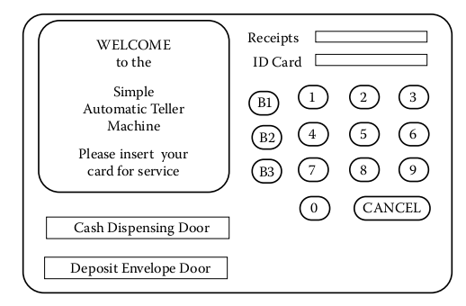
Simple ATM (SATM)
GUI/Interface
Jorgensen, Paul C. Software Testing
A Craftsman Approach

Slide 6
2.5.1 Problem Statement
The SATM system communicates with bank customers via the 15 screens shown in Figure 2.4.
Using a terminal with features as shown in Figure 2.3, SATM customers can select any of three transaction types:
deposits,
withdrawals, and
balance inquiries.
These transactions can be done on two types of accounts: checking and savings.
Jorgensen, Paul C. Software Testing
A Craftsman Approach

Slide 7
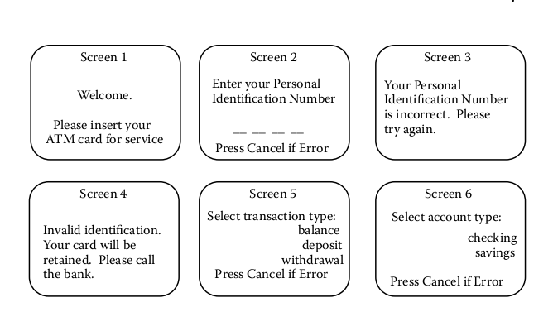

Slide 8
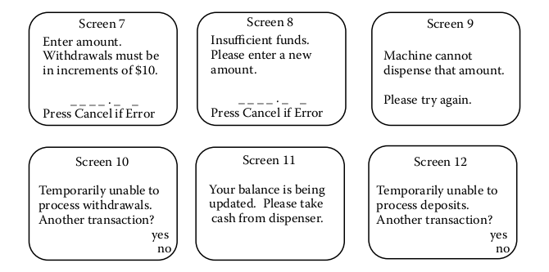

Slide 9
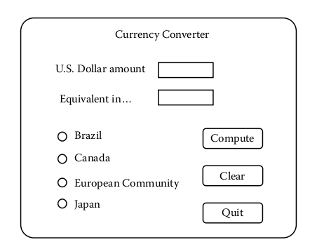
Currency Converter

Slide 10
Saturn Windshield Wiper Controller
The windshield wiper on some Saturn automobiles is controlled by a lever with a dial. The lever has four positions — OFF, INT (for intermittent), LOW, and HIGH — and the dial has three positions, numbered simply 1, 2, and 3.
The dial positions indicate three intermittent speeds, and the dial position is relevant only when the lever is at the INT position. The decision table below shows the windshield wiper speeds (in wipes per minute) for the lever and dial positions.

Slide 12
Functional Testing
Black Box testing
Jorgensen, Paul C. Software Testing
A Craftsman Approach

Slide 13
Boundary Value Testing
Consider testing f(x,y) subject to constraints
a ≤ x ≤ b
c ≤ y ≤ d
“Strongly typed languages (such as Ada®and Pascal) permit explicit definition of such variable ranges.”
Jorgensen, Paul C. Software Testing
A Craftsman Approach

Slide 14
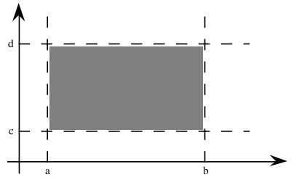
Input domain
Input domain of a function of two variables.
Automatically generate test cases
Jorgensen, Paul C. Software Testing
A Craftsman Approach

Slide 15
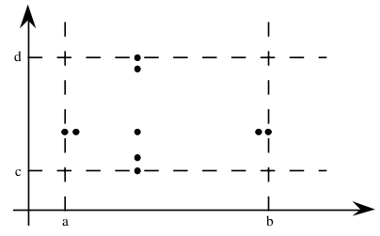
T – Test case generator
The tool T – generates test cases automatically
Min
Min+
Nom (nominal)
Max-
Max
MAXINT
-- /usr/include/limits.h
Jorgensen, Paul C. Software Testing
A Craftsman Approach

Slide 16
logical (versus physical) variables,
Physical variables – tied to a real thing, temperature, age, etc.
Logical variable – Pin numbers
Jorgensen, Paul C. Software Testing
A Craftsman Approach

Slide 17
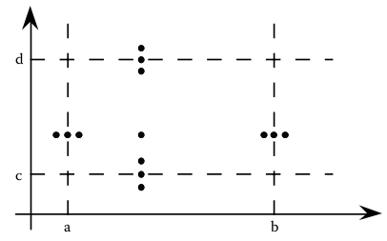
Robustness Testing
Robustness Testing adds
Max+
Min-
Jorgensen, Paul C. Software Testing
A Craftsman Approach

Slide 18
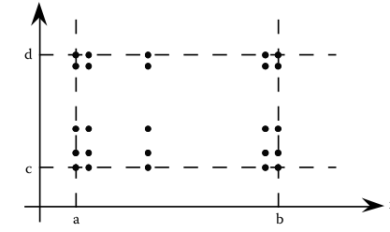
Worst-Case Testing
Worst-Case Testing
Jorgensen, Paul C. Software Testing
A Craftsman Approach

Slide 19
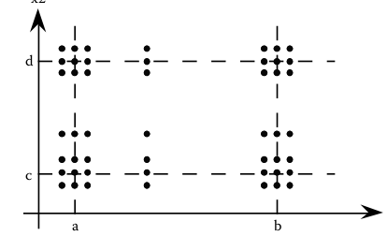
Robust worst-case test cases
Robust worst-case test cases
Combines robust and worst case
Jorgensen, Paul C. Software Testing
A Craftsman Approach

Slide 20
Special value testing
Special value testing is probably the most widely practiced form of functional testing.
most intuitive and least uniform.
Ad hoc
Jorgensen, Paul C. Software Testing
A Craftsman Approach

Slide 21
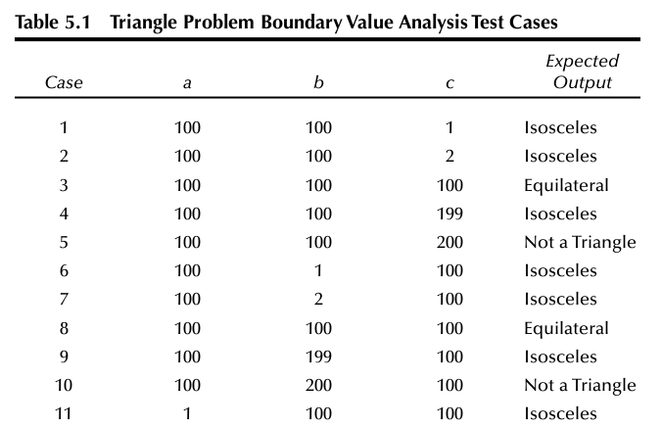
Jorgensen, Paul C. Software Testing
A Craftsman Approach

Slide 22
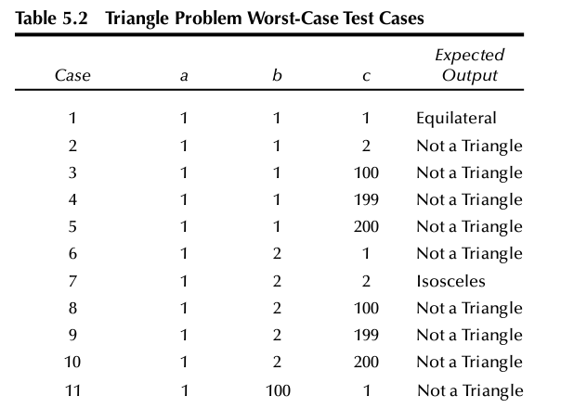
Jorgensen, Paul C. Software Testing
A Craftsman Approach

Slide 23
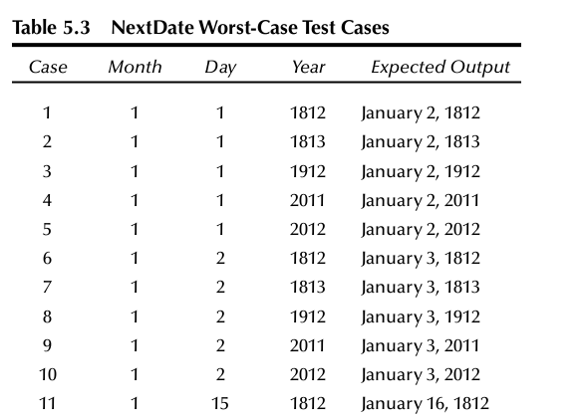
Jorgensen, Paul C. Software Testing
A Craftsman Approach

Slide 24
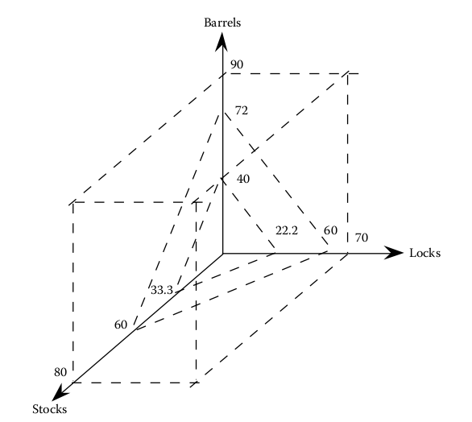
Input Space of Commission Problem
Jorgensen, Paul C. Software Testing
A Craftsman Approach

Slide 25
Jorgensen, Paul C. Software Testing
A Craftsman Approach

Slide 26
Eclipse and Java Assignment
Jorgensen, Paul C. Software Testing
A Craftsman Approach

Slide 27
Jorgensen, Paul C. Software Testing
A Craftsman Approach

Slide 28
Jorgensen, Paul C. Software Testing
A Craftsman Approach

Slide 29
Jorgensen, Paul C. Software Testing
A Craftsman Approach

Slide 30
Jorgensen, Paul C. Software Testing
A Craftsman Approach

Slide 31
Jorgensen, Paul C. Software Testing
A Craftsman Approach

Slide 32
Jorgensen, Paul C. Software Testing
A Craftsman Approach

Slide 33
Jorgensen, Paul C. Software Testing
A Craftsman Approach

Slide 34
Jorgensen, Paul C. Software Testing
A Craftsman Approach

Slide 35
Jorgensen, Paul C. Software Testing
A Craftsman Approach

Slide 36
Jorgensen, Paul C. Software Testing
A Craftsman Approach

Slide 37
Jorgensen, Paul C. Software Testing
A Craftsman Approach

Slide 38
Jorgensen, Paul C. Software Testing
A Craftsman Approach

Slide 39
Jorgensen, Paul C. Software Testing
A Craftsman Approach

Slide 40
Jorgensen, Paul C. Software Testing
A Craftsman Approach

Slide 41
Jorgensen, Paul C. Software Testing
A Craftsman Approach

Slide 42
Jorgensen, Paul C. Software Testing
A Craftsman Approach

Slide 43
Jorgensen, Paul C. Software Testing
A Craftsman Approach

Slide 44
Jorgensen, Paul C. Software Testing
A Craftsman Approach

Slide 45
Jorgensen, Paul C. Software Testing
A Craftsman Approach

