Slide 1
CSCE 747 Software Testing and Quality Assurance
Lecture 01 – Overview

Slide 2
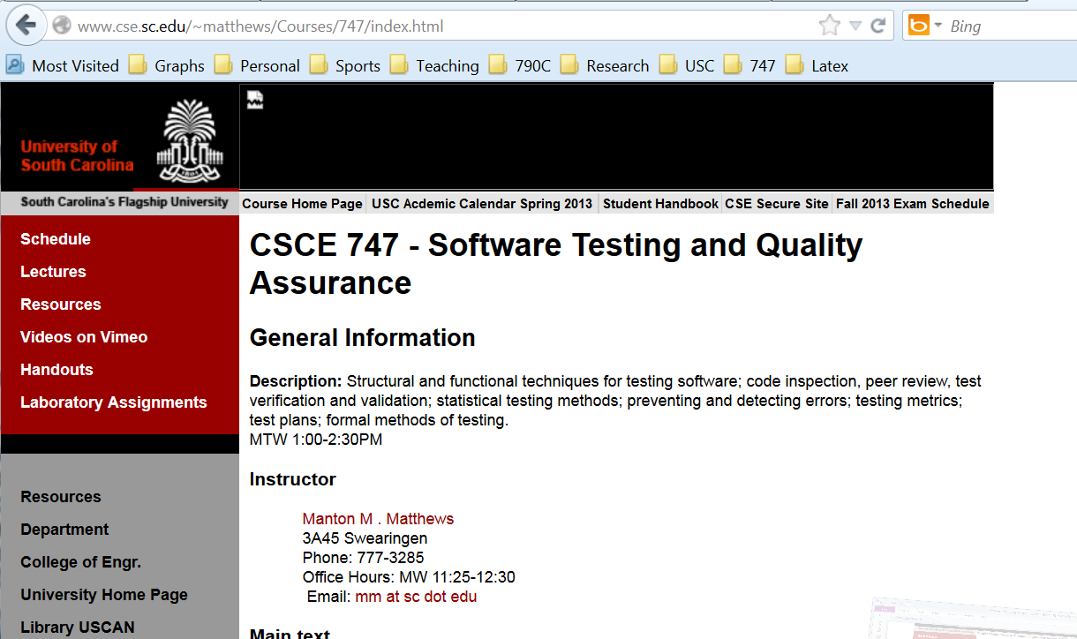
Class website/syllabus

Slide 3
References on Slides
Most of our slides a least for a while will be generated from our Text
Jorgensen, Paul C. (2011-07-16). Software Testing Auerbach Publications. Kindle Edition.
The abbreviated reference at the bottom of the slides will be
“Jorgensen, Paul C. Software Testing, Auerbach Publications” and sometimes maybe even a shortened version of this
“Software Testing-Jorgensen 2011”
Jorgensen, Paul C. (2011-07-16). Software Testing
Auerbach Publications. Kindle Edition.

Slide 4
Why test?

Slide 5
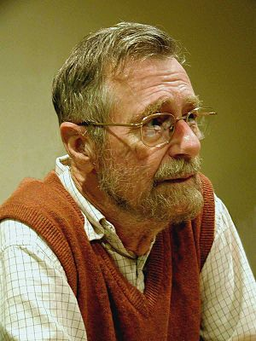
What Testing Does and Does Not Do
“Program testing can be a very effective way to show the presence of bugs, but it is hopelessly inadequate for showing their absence.”

Slide 6
More Dijkstra’s Quotes
The use of COBOL cripples the mind; its teaching should, therefore, be regarded as a criminal offense.
APL is a mistake, carried through to perfection. It is the language of the future for the programming techniques of the past: it creates a new generation of coding bums.
FORTRAN, 'the infantile disorder', by now nearly 20 years old, is hopelessly inadequate for whatever computer application you have in mind today: it is now too clumsy, too risky, and too expensive to use.
In the good old days physicists repeated each other's experiments, just to be sure. Today they stick to FORTRAN, so that they can share each other's programs, bugs included.
It is practically impossible to teach good programming to students that have had a prior exposure to BASIC: as potential programmers they are mentally mutilated beyond hope of regeneration.
Besides a mathematical inclination, an exceptionally good mastery of one's native tongue is the most vital asset of a competent programmer.
Simplicity is prerequisite for reliability.
Programming is one of the most difficult branches of applied mathematics; the poorer mathematicians had better remain pure mathematicians.
We can found no scientific discipline, nor a hearty profession, on the technical mistakes of the Department of Defense and, mainly, one computer manufacturer.
About the use of language: it is impossible to sharpen a pencil with a blunt axe. It is equally vain to try to do it with ten blunt axes instead.

Slide 7
Basic Definitions
Error or mistake
Fault or Defect
Failure
Incident
Test
Test case

Slide 8
Test Cases
Inputs to test cases:
preconditions
actual inputs
Output
Oracle
Jane Austen (2010). Pride & Prejudice (Page 5). Amazon Digital Services, Inc.. Kindle Edition.

Slide 9
Act of Testing
Act of Testing
establishing preconditions
specifying inputs
observing outputs
comparing outputs with those expected
ensuring postconditions

Slide 10
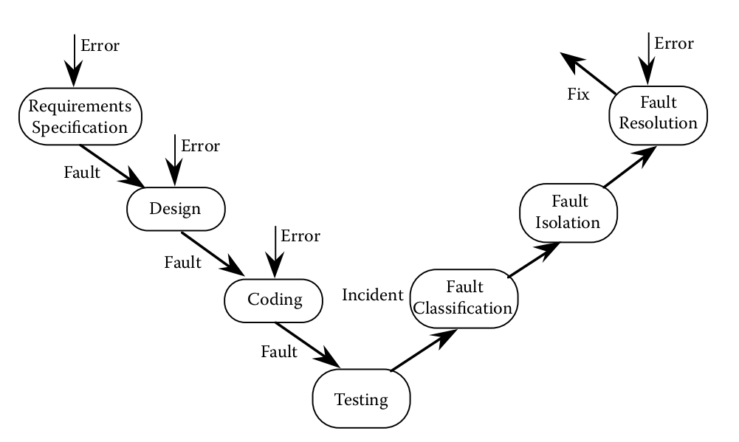
Testing Life Cycle

Slide 11
Functional Testing
Black-Box testing

Slide 12
Structural Testing
White-box
http://en.wikipedia.org/wiki/White-box_testing

Slide 13
Error and Fault Taxonomies

Slide 14
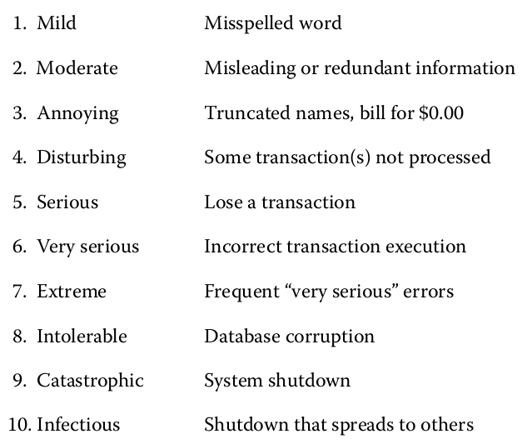
Faults classified by severity – B. Bezier

Slide 15
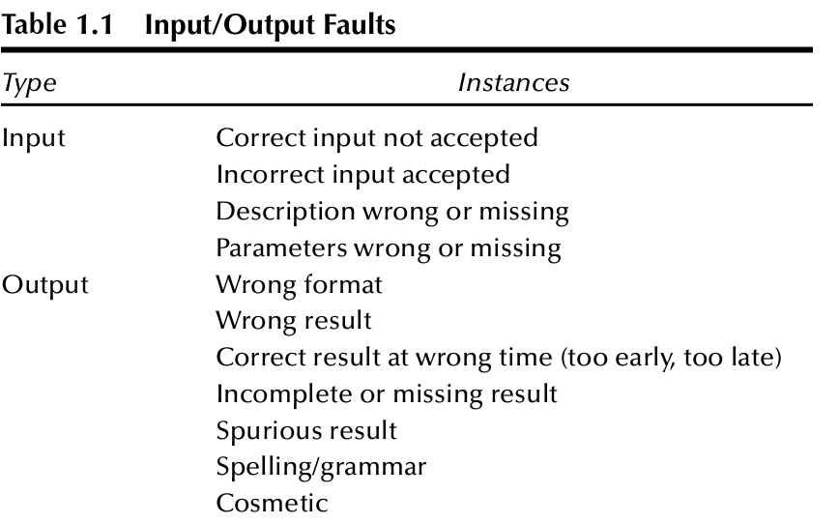

Slide 16
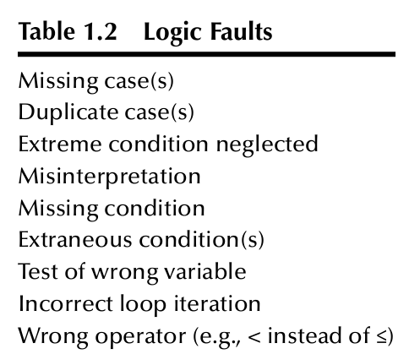

Slide 17
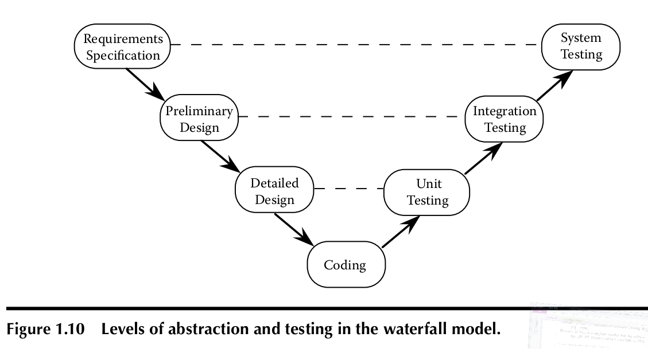
Levels of Testing

Slide 18
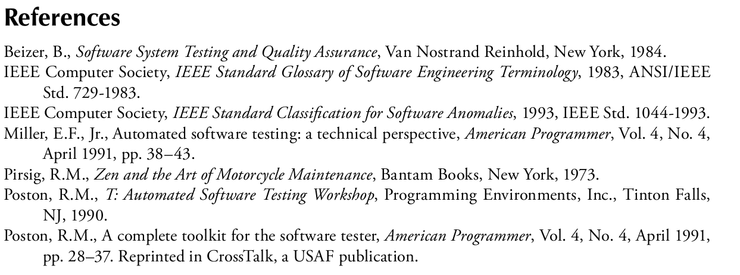

Slide 19
Java Testing Tools
Junit
Eclipse
Maven
Mockito
Hamcrest
Jenkins

Slide 20
Running Examples
The triangle problem - a venerable example in testing circles;
NextDate - a logically complex function, and
The commission problem - an example that typifies Management Information Systems (MIS) applications

Slide 21
More Examples
The simple ATM (SATM) system;
The currency converter, an event-driven application typical of graphical user interface (GUI) applications; and
The windshield wiper control device from the Saturn™ automobile.
o-oCalendar, an object-oriented version of NextDate

Slide 22
Triangle Problem
Most widely used example in software testing literature.
Problem Statement
Simple version: The triangle program accepts three integers, a, b, and c, as input. These are taken to be sides of a triangle.
The output of the program is the type of triangle determined by the three sides: Equilateral, Isosceles, Scalene, or Not A Triangle.

Slide 23
Triangle Improved
Improved version: The triangle program accepts three integers, a, b, and c, as input. These are taken to be sides of a triangle. The integers a, b, and c must satisfy the following conditions:
c1. 1 ≤ a ≤ 200 c4. a < b + c
c2. 1 ≤ b ≤ 200 c5. b < a + c
c3. 1 ≤ c ≤ 200 c6. c < a + b
The output of the program is the type of triangle determined by the three sides: Equilateral, Isosceles, Scalene, or NotATriangle. If an input value fails any of conditions c1, c2, or c3, the program notes this with an output message, for example, “Value of b is not in the range of permitted values.”
If values of a, b, and c satisfy conditions c1, c2, and c3, one of four mutually exclusive outputs is given:
1. If all three sides are equal, the program output is Equilateral.
2. If exactly one pair of sides is equal, the program output is Isosceles.
3. If no pair of sides is equal, the program output is Scalene.
4. If any of conditions c4, c5, and c6 is not met, the program output is NotATriangle.

Slide 24
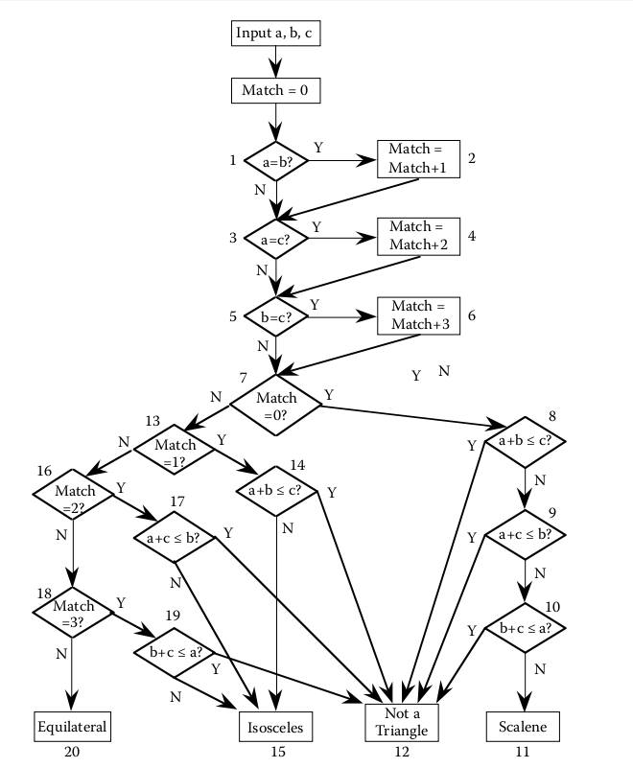
Flowchart for the traditional triangle program implementation

Slide 25
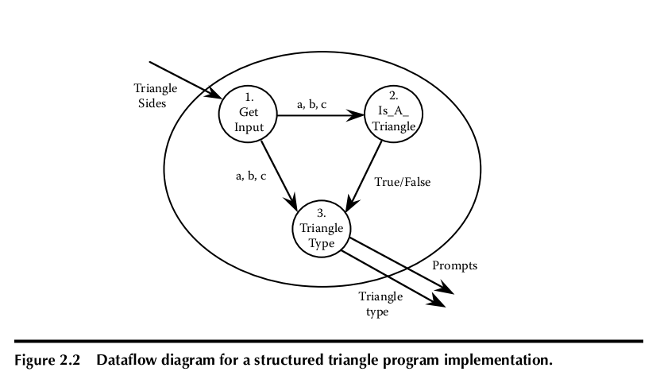
Dataflow Diagram

Slide 26
Eclipse And Java For Total Beginners
“Eclipse And Java For Total Beginners” video tutorial, which is available at http://eclipsetutorial.sourceforge.net/
Install Java: Select “Eclipse IDE for Java Developers”.
Install Eclipse: www.eclipse.org/downloads
Implement Triangle program (base problem)
Dropbox report on progress/code by Midnight Tuesday 8/27/2013

Slide 27
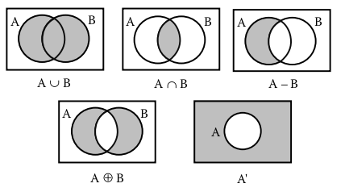
Discrete Math for Testers
Set Theory: ∅, Venn diagrams,
Subsets: ⊂ ⊆ ⊄ element of ∈ ∉
Set operations
Union, intersection, complement
Relative complement: A-B
Symmetric difference: A ⊕ B

Slide 28
Relations
Cartesian Product –
A × B = { <x,y>: x ∈ A and y ∈ B}
Ordered pairs usually (x,y) in this text <x,y>
| A × B | = |A| * |B|
Relations
Formally a relation R:A→B is just a subset of A × B
i.e., a set of ordered pairs first coordinate from A and second from B
function

Slide 29
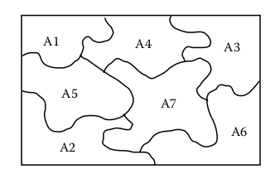
Partitions
A partition of a set A is a set of disjoint subsets A₁, A₂, A₃, … A_{n}, such that
A₁ ∪ A₂ ∪ A₃ ∪ … ∪ A_{n} =A
Note disjoint means if i ≠ j then A₂ ∩ A₃ = ∅
As in partition up test space

Slide 30
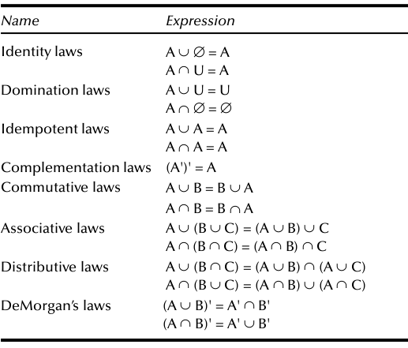
Set Identities

Slide 31
Functions
Definition
Domain and Range f: D → R
Types of functions
Onto
Into
One-to-one
Many-to-one
Composition

Slide 32
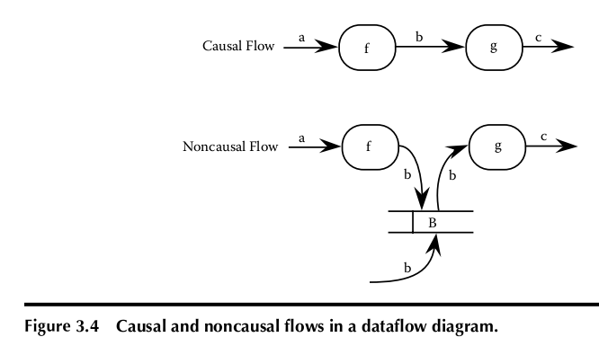
Fig 3.4 Causal Flows in DF diagram

Slide 33
Participation of a Relation
Properties of functions (a function is a relation)
One-to-many, … many-to-many
Definition Given two sets A and B, a relation R ⊆ A × B, the participation of relation R is:
Total iff every element of A is in some ordered pair in R
Partial iff some element of A is not in some ordered pair in R
Onto iff every element of B is in some ordered pair in R
Into iff some element of B is not in some ordered pair in R
Jorgensen, Paul C. (2011-07-16). Software Testing (Page 43). Auerbach Publications. Kindle Edition.

Slide 34
Properties of Relations
A relation R ⊆ A × A is:
Reflexive iff for all a ∈ A, <a, a> ∈ R
Symmetric iff <a, b> ∈ R ⇒ <b, a> ∈ R
Antisymmetric iff <a, b>, <b, a> ∈ R ⇒ a = b
Transitive iff <a, b>, <b, c> ∈ R ⇒ <a, c> ∈ R
Ordering relation is reflexive, antisymmetric, and transitive
Partial order
Common in software: predecessor, successor, ancestor…
Jorgensen, Paul C. (2011-07-16). Software Testing (Page 44). Auerbach Publications. Kindle Edition.

Slide 35
Equivalence Relation
Definition
A relation R ⊆ A × A is an equivalence relation if R is reflexive, symmetric, and transitive.
Equivalence class
.
Induces a partition
.

Slide 36
Propositional Logic
Logical operators
three basic logical operators are
and (∧),
or (∨), and
not (¬);
Propositional symbols
Expressions, Truth Tables
Well formed formulas (wwfs)
R ∧ A ∧ ¬(B ∨ C)

Slide 37
Truth Table Equivalence “Proofs”
Definition
Two propositions p and q are logically equivalent (denoted p ⇔ q) iff their truth tables are identical.
Jorgensen, Paul C. (2011-07-16). Software Testing
Auerbach Publications. Kindle Edition.

Slide 38
Graph Theory for Testers
Definition
A graph G = (V, E )

Slide 39
Graph Definitions
degree, in-degree, out-degree
adjacency matrix
incidence matrix
paths
connectedness
Connectedness is an equivalence relation
component

Slide 40
condensation graph
Definition Given a graph G = (V, E), its condensation graph is formed by replacing each component by a condensing node.

Slide 41
cyclomatic number
The cyclomatic number of a graph G is given by V(G) = e – n + p,
where e is the number of edges in G,
n is the number of nodes in G, and
p is the number of components in G.

Slide 42
Directed Graphs
sources, sinks, transfer node
A (directed ) path is a sequence of edges such that, for any adjacent pair of edges e in the sequence, the terminal node of the first edge is the initial node of the second edge.
A cycle is a directed path that begins and ends at the same node.
A (directed ) semipath is a sequence of edges such that, for at least one adjacent pair of edges in the sequence, the initial node of the first edge is the initial node of the second edge, or the terminal node of the first edge is the terminal node of the second edge.

Slide 43
Reachability Matrix

Slide 44
Connectedness in Digraphs

Slide 45
Program Graphs

Slide 46
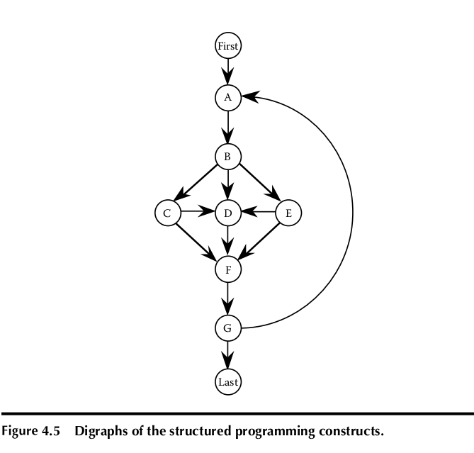

Slide 47
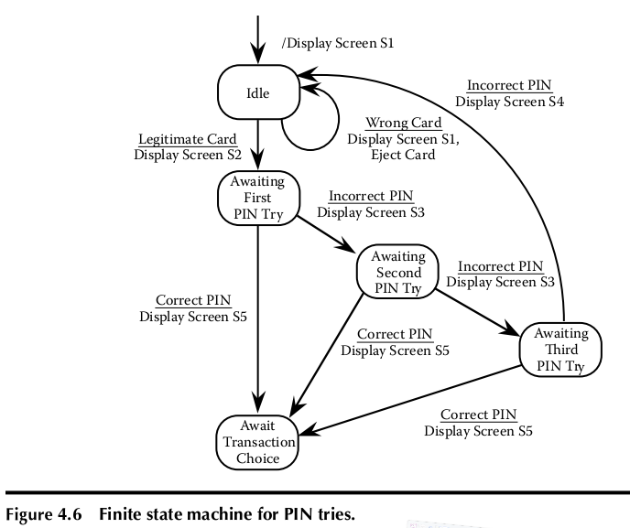
Finite State Models

Slide 48
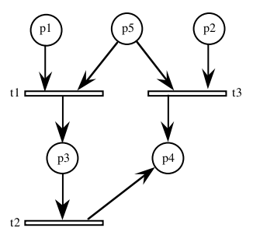
Petri Nets
Petri nets are the accepted model for protocols and other applications involving concurrency and distributed processing.

