Slide 1
CSCE 747 Software Testing and Quality Assurance
Lecture 26 How Google Tests Software

Slide 2
Last Time
Google C++ Testing Framework
Today
More WebDriver

Slide 3
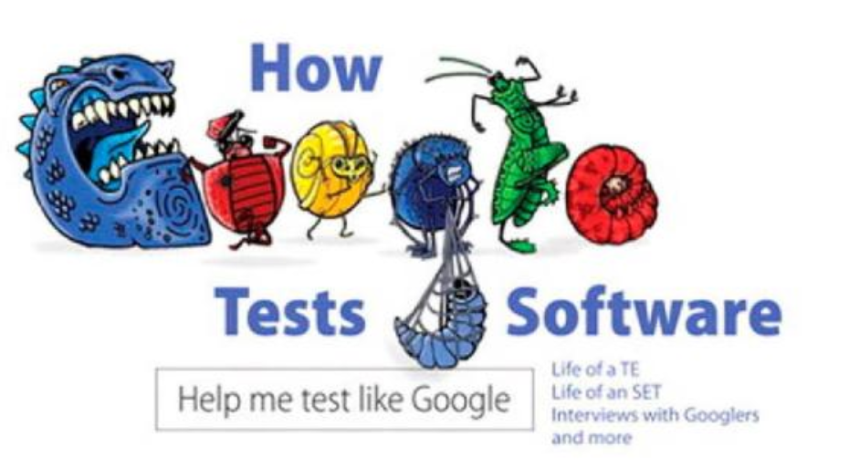

Slide 4
How Google Tests Software
Google Software testing
Software Engineer in Test
The Test Engineer
Test Engr. Manager
Improving how Google tests Software
Appendix A: Chrome OS Test Plan
Appendix B: Test Tours for Chrome
Appendix C: Blog Posts on Tools and Code

Slide 5
Appendix A. Chrome OS Test Plan
Appendix A. Chrome OS Test Plan

Slide 6
Appendix B. Test Tours for Chrome
The test tours include the following:
The Shopping Tour
The Student Tour
The International Calling Tour
The Landmark Tour
The All Nighter Tour
The Artisan’s Tour
The Bad Neighborhood Tour
The Personalization Tour

Slide 7
The Shopping Tour
Description: Shopping is a favorite pastime of many people and one of the joys of traveling to somewhere new can be finding new products to buy.
Applied: Chrome is a portal to the Internet where there’s nearly an endless number of ways to spend money.
How Google Tests Software by Whitaker, Arbon & Carollo

Slide 8
• eBay (www.eBay.com) • Amazon (www.amazon.com) • Sears (www.sears.com) • Staples (www.staples.com) • OfficeMax (www.officemax.com) • Macy’s (www.macys.com) • NewEgg (www.newegg.com) • Best Buy (www.bestbuy.com)
Whittaker, James A.; Arbon, Jason; Carollo, Jeff (2012-03-21). How Google Tests Software (Kindle Locations 5323-5330). Pearson Education. Kindle Edition.
How Google Tests Software by Whitaker, Arbon & Carollo

Slide 9
The Student Tour
Description: Many students take advantage of thechance to study abroad, and while living in their new destinations, they’ll use local resources to advance their knowledge of their area of expertise. This tour covers all the resources available for tourists such as libraries, archives, and museums.
Applied: Test how well Chrome can collect and organize data from a variety of sources.
How Google Tests Software by Whitaker, Arbon & Carollo

Slide 10
Suggested Areas to Test
A Student’s Tour of Chrome includes
Copy & Paste: Can different types of data be transferred using the Clipboard?
Moving offline content to the cloud: Web pages, images, text, and so on.
Capacity: Having multiple documents open at once and in different windows.
Transportation: Moving data across tabs and windows and between different kinds of windows (normal and incognito).
How Google Tests Software by Whitaker, Arbon & Carollo

Slide 11
The International Calling Tour
The International Calling Tour Description: While traveling, making calls back home can be an experience in and of itself.
Applied: Browse to common sites and use common features, trying out Chrome on different platforms (Windows, Mac, and Linux) if available and with different connection settings in the OS.
Suggested Areas to Test An International Calling Tour of Chrome includes
• Operating systems: Windows, Mac, and Linux
• Privilege levels: High integrity and low integrity
• Languages: Complex languages and right-to-left languages
• Network options: Proxy, Wi-Fi, wired LAN, and firewalled
How Google Tests Software by Whitaker, Arbon & Carollo

Slide 12
The Landmark Tour
The Landmark Tour Description: The Landmark Tour for exploratory testers is similar in that we will choose landmarks and perform the same landmark through the software that we would through a forest.”
Applied: In Chrome, this tour takes a look at how easily a user can navigate from one landmark to another. Verify users can get to the landmarks, such as different browser windows, opening attachments, settings, and so on.
How Google Tests Software by Whitaker, Arbon & Carollo

Slide 13
Suggested Landmarks in Chrome
• Browser window: This is the main browser window used for browsing the Web.
• Incognito window: The Incognito window is used for browsing under the radar; a trademark cloak-and-dagger character displays in the upper-left corner to notify the user.
• Compact Navigation Bar: This browser window is available from the menu; it has a search box available in the title bar of the window.
• Download Manager: The Download Manager languages displays a list of the user’s downloaded content.
How Google Tests Software by Whitaker, Arbon & Carollo

Slide 14
• Bookmark Manager: The Bookmark Manager is a full window that displays the user’s bookmarks and it supports launching them.
• Developer Tools: These tools are the Task Manager, JavaScript Console, and so on.
• Settings: These settings are launched from the menu in the upper-right corner when you select Options.
• Themes Page: A page where users can personalize the appearance of Chrome OS.
How Google Tests Software by Whitaker, Arbon & Carollo

Slide 15
The All Nighter Tour
Description: How far can you go? The All Nighter Tour challenges tourists to test their own endurance by going from attraction to attraction with little or no break in between. “Such tours are tests of the constitution.”
For software this tour challenges the product under test to see how long it can last when its features are used over a prolonged period of time.
How Google Tests Software by Whitaker, Arbon & Carollo

Slide 16
Applied (Chrome): Open lots of tabs, install extensions, change themes, and keep browsing in a single session for as long as feasible. Avoid closing tabs or windows when you’re done with them; just keep opening up more content.
Suggested Areas to Test
• Tabs and windows: Open large numbers of tabs and windows.
• Extensions: Add a large number of extensions and keep them running.
• Duration: Leave everything open for an extended period of time.
How Google Tests Software by Whitaker, Arbon & Carollo

Slide 17
The Artisan’s Tour
Description: While some travel for pleasure, others travel for business. This tour examines how easy it is to perform business operations in a tourist’s new destination. Are there local vendors? How much red tape is there to getting started?
How Google Tests Software by Whitaker, Arbon & Carollo

Slide 18
Applied: Chrome has a fair number of tools for JavaScript developers and for web developers who test and run their online content. Use this tour to check out the tools, generate sample scripts, and test online content.
Tools in Chrome
• Developer tools: Look at the page’s elements, resources, and scripts, and enable resource tracking.
• JavaScript Console: Does JavaScript in the Console execute correctly?
• Viewing source code: Is it easy to read through the use of color coding and other help, and is it easy to get to a relevant section? • Task Manager: Do processes show up correctly and is it easy to see how many resources the web page consumes?
How Google Tests Software by Whitaker, Arbon & Carollo

Slide 19
The Bad Neighborhood Tour
Description: “Every city has bad neighborhoods and areas that a tourist is well advised to avoid. Software also has bad neighborhoods— those sections of the code populated with bugs.”
Applied: The focus of Chrome is on a fast and simplified experience browsing the Web, but rich content tends to suffer. When it was first launched, it was reported that even YouTube videos didn’t play correctly, and although significant progress has been made for overcoming these challenges, rich content is still an issue.
How Google Tests Software by Whitaker, Arbon & Carollo

Slide 20
Bad Neighborhoods in Chrome OS
A Bad Neighborhood Tour of Chrome includes
• Online video: Hulu, YouTube, ABC, NBC, full-screen mode, and high definition.
• Flash-based content: Games, ads, and presentations.
• Extensions: Test-rich extensions.
• Java applets: Verify Java applets can be run successfully. Yahoo! games are popular examples of Java applets.
• O3D: Verify content written with Google’s own O3D; for example, video calls in Gmail use O3D.
• Multiple instances: Attempt to run multiple instances of rich content in different tabs and windows.
How Google Tests Software by Whitaker, Arbon & Carollo

Slide 21
The Personalization Tour
Description: The Personalization Tour lets users explore the various ways they can customize their experience and personalize their software to make it uniquely theirs.
Applied: Explore the various ways one can customize Chrome to a particular user’s taste through the use of themes, extensions, bookmarks, settings, shortcuts, and profiles.
How Google Tests Software by Whitaker, Arbon & Carollo

Slide 22
Ways to Customize Chrome
• Themes: Use themes to customize the appearance of Chrome OS.
• Extensions: Download and install extensions to Chrome OS to extend its functionality and appearance.
• Chrome settings: Customize the user’s experience by changing Chrome settings.
• Separation of profiles: Verify that preferences for one user profile aren’t able to propagate to another account.
How Google Tests Software by Whitaker, Arbon & Carollo

Slide 23
How Google Tests Software by Whitaker, Arbon & Carollo

Slide 24
How Google Tests Software by Whitaker, Arbon & Carollo

