Slide 1
CSCE 747 Software Testing and Quality Assurance
Lecture 24 Google C++ Framework

Slide 2
Last Time
WebDriver again
Today
More WebDriver

Slide 3
References
http://code.google.com/p/googletest/
http://jenkins-ci.org/
http://code.google.com/p/googletest/downloads/detail?name=gtest-1.7.0.zip

Slide 4
Test 2 Question 1

Slide 5
Getting Started
After downloading Google Test, unpack it, read the README file and the documentation wiki pages

Slide 6
External links
Google Test talk slides
Testing with Google Test
Doc translations 玩转Google单元测试框架
Testing C with Google Test
Testing embedded software
Using Google Test in Xcode
Code Coverage with Hudson
ACCU talk slides & samples
Setting up with VS 2008

Slide 7
Google Test-related open source projects
Google Test UI is test runner that runs your test binary, allows you to track its progress via a progress bar, and displays a list of test failures. Clicking on one shows failure text. Google Test UI is written in C#.
GTest TAP Listener is an event listener for Google Test that implements the TAP protocol for test result output. If your test runner understands TAP, you may find it useful.

Slide 8
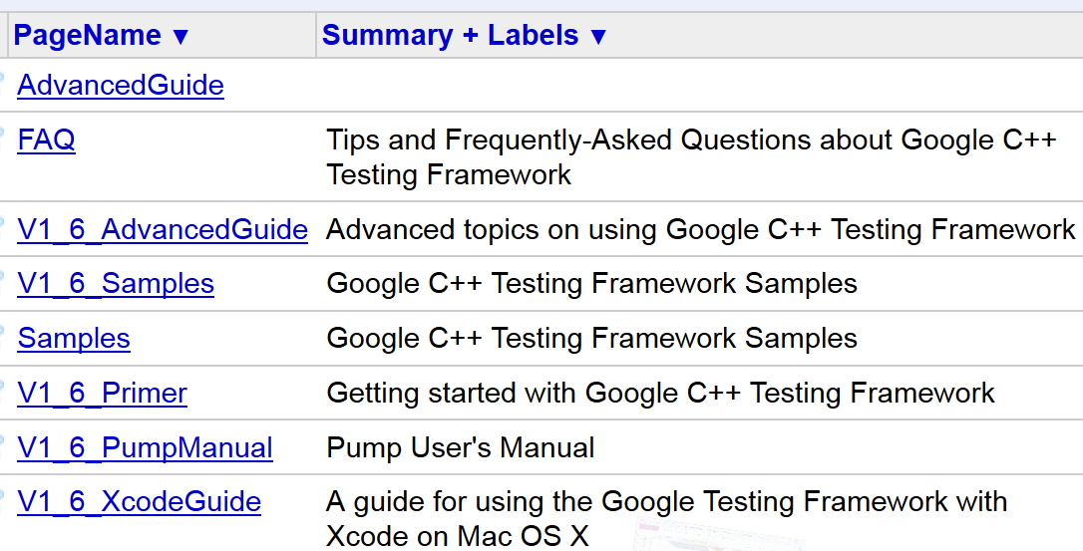
Wiki

Slide 9
V1_6_Primer Getting started with Google C++ Testing Framework Updated Apr 18, 2011 by zhanyong...@gmail.com
Introduction: Why Google C++ Testing Framework?
Setting up a New Test Project
Basic Concepts
Assertions
Basic Assertions
Binary Comparison
String Comparison
Simple Tests
Test Fixtures: Using the Same Data Configuration for Multiple Tests
Invoking the Tests
Writing the main() Function
Important note for Visual C++ users
Where to Go from Here
Known Limitations

Slide 10
So what makes a good test: 1
Tests should be independent and repeatable.
It's a pain to debug a test that succeeds or fails as a result of other tests.
Google C++ Testing Framework isolates the tests by running each of them on a different object.
When a test fails, Google C++ Testing Framework allows you to run it in isolation for quick debugging
http://code.google.com/p/googletest/wiki/V1_6_Primer

Slide 11
So what makes a good test: 2
Tests should be well organized and reflect the structure of the tested code.
Google C++ Testing Framework groups related tests into test cases that can share data and subroutines.
This common pattern is easy to recognize and makes tests easy to maintain.
Such consistency is especially helpful when people switch projects and start to work on a new code base
http://code.google.com/p/googletest/wiki/V1_6_Primer

Slide 12
So what makes a good test: 3
Tests should be portable and reusable.
The open-source community has a lot of code that is platform-neutral, its tests should also be platform-neutral.
Google C++ Testing Framework works on different OSes, with different compilers
with or without exceptions, so Google C++ Testing Framework tests can easily work with a variety of configurations
http://code.google.com/p/googletest/wiki/V1_6_Primer

Slide 13
So what makes a good test: 4
When tests fail, they should provide as much information about the problem as possible.
Google C++ Testing Framework doesn't stop at the first test failure. Instead, it only stops the current test and continues with the next.
You can also set up tests that report non-fatal failures after which the current test continues.
Thus, you can detect and fix multiple bugs in a single run-edit-compile cycle.
http://code.google.com/p/googletest/wiki/V1_6_Primer

Slide 14
So what makes a good test: 5
The testing framework should liberate test writers from housekeeping chores and
let them focus on the test content.
Google C++ Testing Framework automatically keeps track of all tests defined, and
doesn't require the user to enumerate them in order to run them.
http://code.google.com/p/googletest/wiki/V1_6_Primer

Slide 15
So what makes a good test: 6
Tests should be fast.
With Google C++ Testing Framework, you can reuse shared resources across tests and
pay for the set-up/tear-down only once, without making tests depend on each other.
http://code.google.com/p/googletest/wiki/V1_6_Primer

Slide 16
Setting up a New Test Project
http://code.google.com/p/googletest/wiki/V1_6_Primer

Slide 17
Basic Concepts
When using Google Test, you start by writing assertions, which are statements that check whether a condition is true. An assertion's result can be success, nonfatal failure, or fatal failure.
Tests use assertions to verify the tested code's behavior. If a test crashes or has a failed assertion, then it fails; otherwise it succeeds.
A test case contains one or many tests. You should group your tests into test cases that reflect the structure of the tested code. When multiple tests in a test case need to share common objects and subroutines, you can put them into a test fixture class.
A test program can contain multiple test cases.
http://code.google.com/p/googletest/wiki/V1_6_Primer

Slide 18
Assertions
Google Test assertions are macros that resemble function calls. You test a class or function by making assertions about its behavior.
ASSERT_* versions generate fatal failures when they fail, and abort the current function.
EXPECT_* versions generate nonfatal failures
http://code.google.com/p/googletest/wiki/V1_6_Primer

Slide 19
custom failure messages with <<
ASSERT_EQ(x.size(), y.size()) << "Vectors x and y are of unequal length"; for (int i = 0; i < x.size(); ++i) { EXPECT_EQ(x[i], y[i]) <<
"Vectors x and y differ at index " << i; }
http://code.google.com/p/googletest/wiki/V1_6_Primer

Slide 20
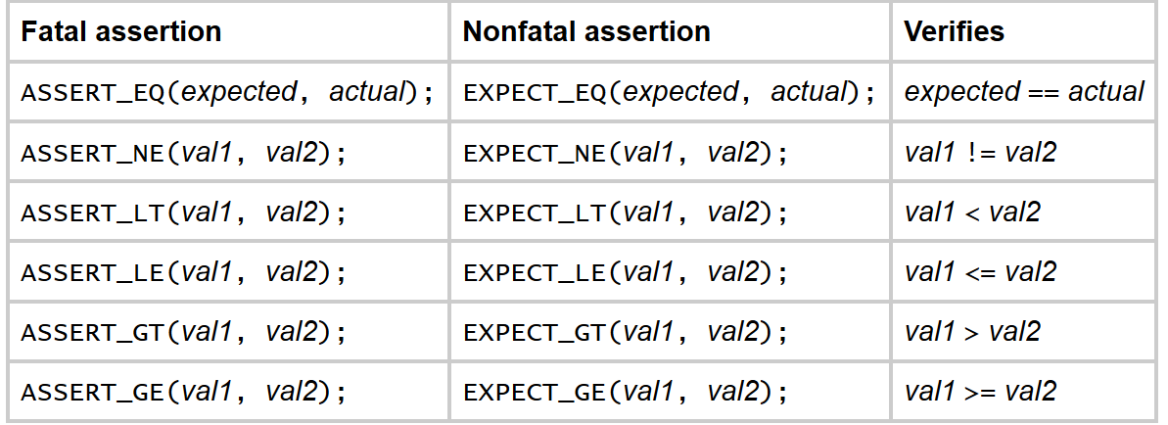
Binary Comparison
http://code.google.com/p/googletest/wiki/V1_6_Primer

Slide 21
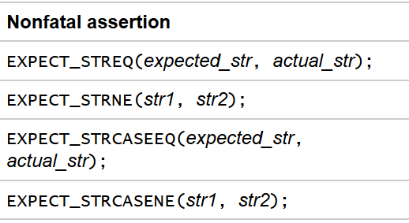
String Comparison
See also: For more string comparison tricks (substring, prefix, suffix, and regular expression matching, for example), see the Advanced Google Test Guide.
http://code.google.com/p/googletest/wiki/V1_6_Primer

Slide 22
Simple Tests
To create a test:
Use the TEST() macro to define and name a test function, These are ordinary C++ functions that don't return a value.
In this function, along with any valid C++ statements you want to include, use the various Google Test assertions to check values.
The test's result is determined by the assertions; if any assertion in the test fails (either fatally or non-fatally), or if the test crashes, the entire test fails. Otherwise, it succeeds.
TEST(test_case_name, test_name) { ... test body ... }
http://code.google.com/p/googletest/wiki/V1_6_Primer

Slide 23
Testing Factorial
// Tests factorial of 0. TEST(FactorialTest, HandlesZeroInput) { EXPECT_EQ(1, Factorial(0)); } // Tests factorial of positive numbers. TEST(FactorialTest, HandlesPositiveInput) { EXPECT_EQ(1, Factorial(1)); EXPECT_EQ(2, Factorial(2)); EXPECT_EQ(6, Factorial(3)); EXPECT_EQ(40320, Factorial(8)); }
http://code.google.com/p/googletest/wiki/V1_6_Primer

Slide 24
Test Fixtures
Test Fixtures: Using the Same Data Configuration for Multiple Tests
To create a fixture, just:
Derive a class from ::testing::Test . Start its body with protected: or public: as we'll want to access fixture members from sub-classes.
Inside the class, declare any objects you plan to use.
If necessary, write a default constructor or SetUp() function to prepare the objects for each test.
A common mistake is to spell SetUp() as Setup() with a small u - don't let that happen to you.
If necessary, write a destructor or TearDown() function to release any resources you allocated in SetUp() .
If needed, define subroutines for your tests to share.
http://code.google.com/p/googletest/wiki/V1_6_Primer

Slide 25
When using a fixture, use TEST_F() instead of TEST() as it allows you to access objects and subroutines in the test fixture:
http://code.google.com/p/googletest/wiki/V1_6_Primer

Slide 26
For each test defined with TEST_F(), Google Test will:
Create a fresh test fixture at runtime
Immediately initialize it via SetUp() ,
Run the test
Clean up by calling TearDown()
Delete the test fixture. Note that different tests in the same test case have different test fixture objects, and Google Test always deletes a test fixture before it creates the next one.
Google Test does not reuse the same test fixture for multiple tests. Any changes one test makes to the fixture do not affect other tests.
http://code.google.com/p/googletest/wiki/V1_6_Primer

Slide 27
tests for a FIFO queue class
interface
template <typename E> // E is the element type. class Queue { public: Queue(); void Enqueue(const E& element); E* Dequeue(); // Returns NULL if the queue is empty. size_t size() const; ... };
http://code.google.com/p/googletest/wiki/V1_6_Primer

Slide 28
a fixture
class QueueTest : public ::testing::Test { protected: virtual void SetUp() { q1_.Enqueue(1); q2_.Enqueue(2); q2_.Enqueue(3); } // virtual void TearDown() {} Queue<int> q0_; Queue<int> q1_; Queue<int> q2_; };
http://code.google.com/p/googletest/wiki/V1_6_Primer

Slide 29
TEST_F(QueueTest, IsEmptyInitially) { EXPECT_EQ(0, q0_.size()); } TEST_F(QueueTest, DequeueWorks) { int* n = q0_.Dequeue(); EXPECT_EQ(NULL, n); n = q1_.Dequeue(); ASSERT_TRUE(n != NULL); EXPECT_EQ(1, *n); EXPECT_EQ(0, q1_.size()); delete n; n = q2_.Dequeue(); ASSERT_TRUE(n != NULL); EXPECT_EQ(2, *n); EXPECT_EQ(1, q2_.size()); delete n; }
http://code.google.com/p/googletest/wiki/V1_6_Primer

Slide 30
Writing the main() Function
#include "this/package/foo.h" #include "gtest/gtest.h" namespace { // The fixture for testing class Foo. class FooTest : public ::testing::Test { protected: // You can remove any or all of the following functions if its body // is empty. FooTest() { // You can do set-up work for each test here. }

Slide 31
virtual ~FooTest() { // You can do clean-up work that doesn't throw exceptions here. } // If the constructor and destructor are not enough for setting up // and cleaning up each test, you can define the following methods: virtual void SetUp() { // Code here will be called immediately after the constructor (right // before each test). } virtual void TearDown() { // Code here will be called immediately after each test (right // before the destructor). }

Slide 32
// Tests that the Foo::Bar() method does Abc. TEST_F(FooTest, MethodBarDoesAbc) { const string input_filepath = "this/package/testdata/myinputfile.dat"; const string output_filepath = "this/package/testdata/myoutputfile.dat"; Foo f; EXPECT_EQ(0, f.Bar(input_filepath, output_filepath)); } // Tests that Foo does Xyz. TEST_F(FooTest, DoesXyz) { // Exercises the Xyz feature of Foo. } } // namespace int main(int argc, char **argv) { ::testing::InitGoogleTest(&argc, argv); return RUN_ALL_TESTS(); }

Slide 33
Samples
Sample #1 shows the basic steps of using Google Test to test C++ functions.
Sample #2 shows a more complex unit test for a class with multiple member functions.
Sample #3 uses a test fixture.
Sample #4 is another basic example of using Google Test.
Sample #5 teaches how to reuse a test fixture in multiple test cases by deriving sub-fixtures from it.
Sample #6 demonstrates type-parameterized tests.
Sample #7 teaches the basics of value-parameterized tests.
Sample #8 shows using Combine() in value-parameterized tests.
Sample #9 shows use of the listener API to modify Google Test's console output and the use of its reflection API to inspect test results.
Sample #10 shows use of the listener API to implement a primitive memory leak checker.

Slide 34
V1_6_AdvancedGuide Advanced topics on using Google C++ Testing Framework

Slide 36
Google Software testing
Software Engineer in Test
The Test Engineer
Test Engr. Manager
Improving how Google tests Software
Appendix A: Chrome OS Test Plan
Appendix B: Test Tours for Chrome
Appendix C: Blog Posts on Tools and Code

