Slide 1
CSCE 747 Software Testing and Quality Assurance
Lecture 22 WebDriver

Slide 2
Last Time
WebDriver again
Today
More WebDriver

Slide 3
References
https://wiki.jenkins-ci.org/display/JENKINS/Installing+Jenkins+as+a+Windows+service
http://jenkins-ci.org/

Slide 4
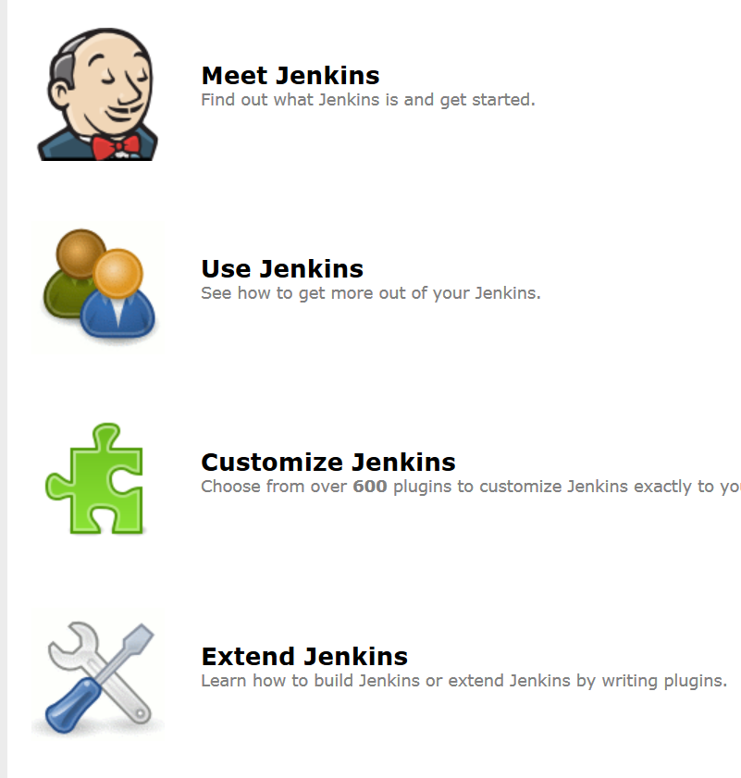
http://jenkins-ci.org/

Slide 5
What is Jenkins?
Make/ant/maven are:
Jenkins is a server
What is a server
continuously running server
monitoring projects looking for changes
when found rebuild the project
write reports

Slide 6
What is Jenkins?
Jenkins is an award-winning application that monitors executions of repeated jobs, such as building a software project or jobs run by cron.
Among those things, current Jenkins focuses on the following two jobs:
Building/testing software projects continuously,
Monitoring executions of externally-run jobs

Slide 7
Building/testing software projects continuously
Building/testing software projects continuously, just like CruiseControl or DamageControl.
In a nutshell, Jenkins provides an easy-to-use so-called continuous integration system,
making it easier for developers to integrate changes to the project, and
making it easier for users to obtain a fresh build.
The automated, continuous build increases the productivity.

Slide 8
Monitoring executions
Monitoring executions of externally-run jobs, such as
cron jobs and
procmail jobs,
even those that are run on a remote machine.
For example, with cron, all you receive is regular e-mails that capture the output, and it is up to you to look at them diligently and notice when it broke. Jenkins keeps those outputs and makes it easy for you to notice when something is wrong.

Slide 9
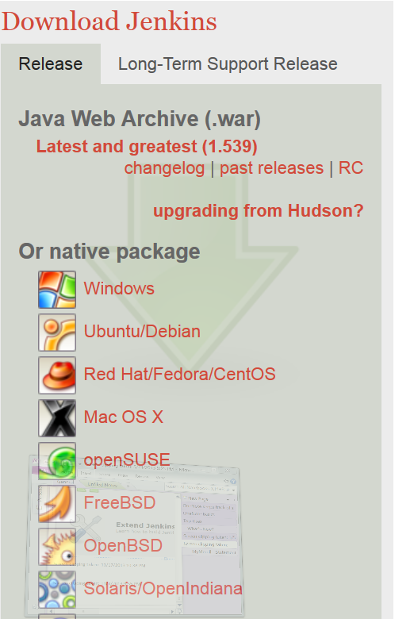
Installing Jenkins
What is a .war?
is a JAR file used to distribute a collection of:
JavaServer Pages,
Java Servlets,
Java classes,
XML files, tag libraries, static web pages (HTML and related files) and other resources that together constitute a web application.

Slide 13
Features of Jenkins
Jenkins offers the following features:
Easy installation:
Just java -jar jenkins.war, or
deploy it in a servlet container.
No additional install, no database.

Slide 14
Features: Easy configuration
Jenkins can be configured entirely from its friendly web GUI with extensive on-the-fly error checks and inline help.
There's no need to tweak XML manually anymore, although if you'd like to do so, you can do that, too.

Slide 15
Features: Change set support
Jenkins can generate a list of changes made into the build from Subversion/CVS.
This is also done in a fairly efficient fashion, to reduce the load on the repository.

Slide 16
Features: Permanent links
Jenkins gives you clean readable URLs for most of its pages, including some permalinks like "latest build"/"latest successful build", so that they can be easily linked from elsewhere.

Slide 17
Features:
RSS/E-mail/IM Integration
Monitor build results by RSS or e-mail to get real-time notifications on failures.
After-the-fact tagging:
Builds can be tagged long after builds are completed.

Slide 18
Features: JUnit/TestNG test reporting
JUnit test reports can be:
tabulated,
summarized, and
displayed with history information, such as when it started breaking, etc.
a History trend is plotted into a graph.

Slide 19
Features: Distributed builds
Jenkins can distribute build/test loads to multiple computers.
This lets you get the most out of those idle workstations sitting beneath developers' desks.

Slide 20
Features: File fingerprinting
Jenkins can keep track of which build produced which jars, and
which build is using which version of jars
This works even for jars that are produced outside Jenkins, and is ideal for projects to track dependency.

Slide 21
Features: Plugin Support
Jenkins can be extended via 3rd party plugins.
You can write plugins to make Jenkins support tools/processes that your team uses.

Slide 22
Jenkins Best Practices
Continuous Integration with automated test execution has seen broad adoption in recent years.
The ideas behind Continuous Integration have changed how companies look at:
Build Management,
Release Management,
Deployment Automation, and
Test Orchestration.

Slide 23
Jenkins Best Practices
Jenkins - A Continuous Integration Solution to provide executives, business managers, software developers and architects a better sense of the development progress and code quality of projects throughout the development lifecycle.
Jenkins Best Practices
https://wiki.jenkins-ci.org/display/JENKINS/Jenkins+Best+Practices

Slide 24
Introductory Articles
Note that many links below refer to Hudson, the original name of Jenkins.
http://www.slideshare.net/carlo.bonamico/continuous-integration-with-hudson/
Kohsuke presenting Hudson in FOSDEM 2008 (video)
Kohsuke presenting Hudson in JavaZone 2009 (video)
Continuous Integration in the Cloud with Hudson JavaOne 2009 presentation by Kohsuke (English)
Doing More With Hudson JavaOne 2010 presentation by Kohsuke
Hudson presentation at San Francisco JUG by Kohsuke (English, video and slides)
French, Spanish, Simplified Chinese, Czech

Slide 25
Using Jenkins
Installing Jenkins
Starting and Accessing Jenkins
Administering Jenkins
Building a software project
Building a maven2 project
Building a matrix project
Building an Android app and test project
Monitoring external jobs
Distributed builds
Features controlled by system properties ("hidden" & experimental features)
File fingerprint tracking
Using Jenkins plugins
Quicker navigation around Jenkins pages
Jenkins Script Console
Command-line interface
SSH access
Securing Jenkins
Remote access API
Change time zone
Splitting a big job into smaller jobs
Using Jenkins for non-Java projects
in particular for .NET
Drupal Development
Perl Development
Using other shells (for ex. Python)
Post-initialization script
Boot failure hook
Collecting more logs on what Jenkins is doing
Terminology
Jenkins/Hudson con Ant, JUnit, Emma y Sonar. (Spanish)
The 'People' listing
Removing and disabling plugins

Slide 26
Tool Integration
Programming Language specific topics
Running Jenkins as a daemon
Extreme Feedback
Issues

