Slide 1
CSCE 747 Software Testing and Quality Assurance
Lecture 21 Healthcare.gov - testing

Slide 2
Last Time
GUI testing 2
Chapter 19
Today
Test 1 take-home
TestingGeek
Testing Web Applications
Selenium

Slide 3
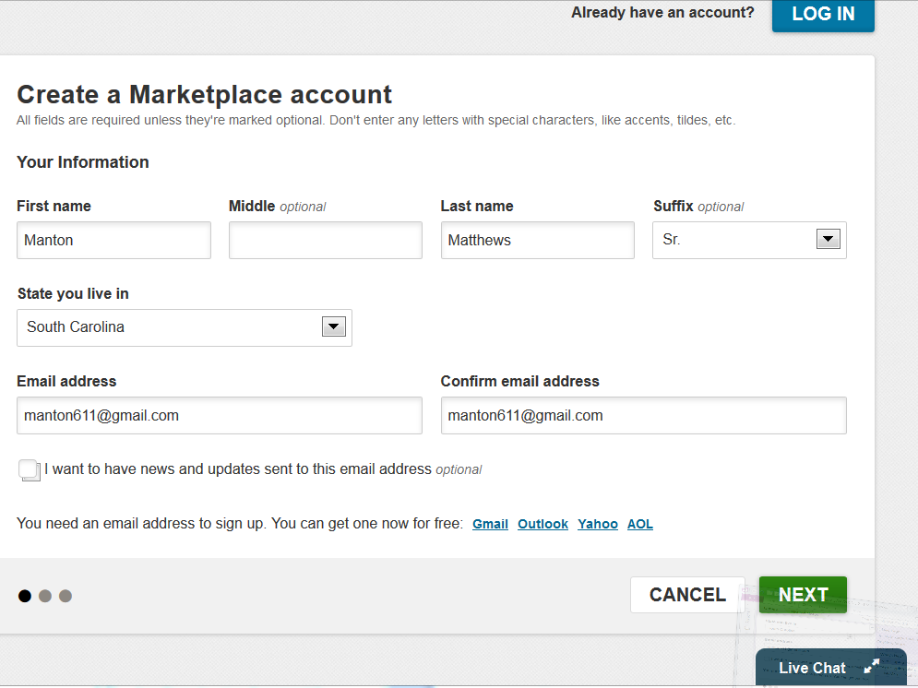

Slide 4
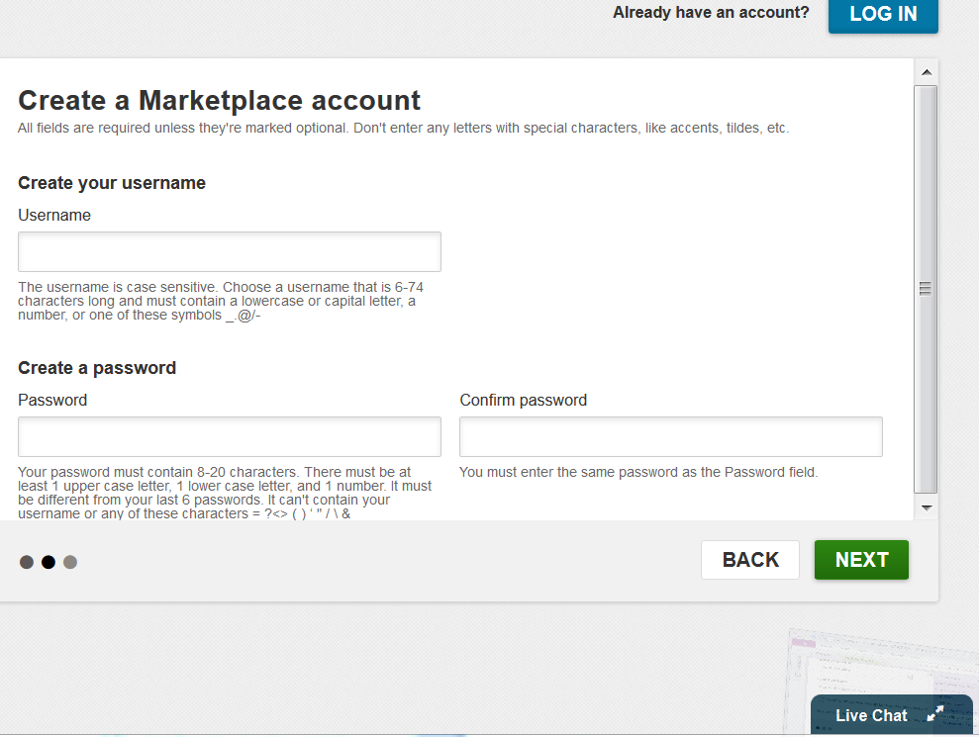

Slide 5
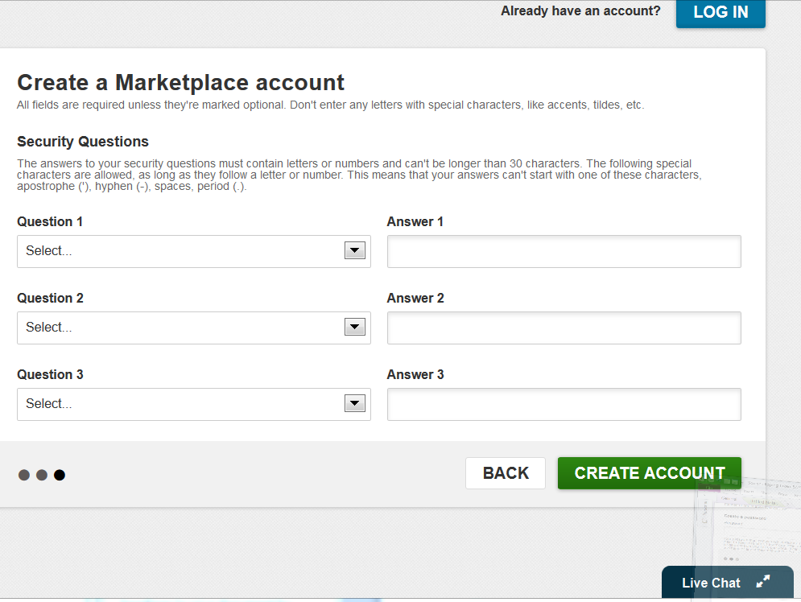

Slide 6
manager robert
buster
basketball

Slide 7
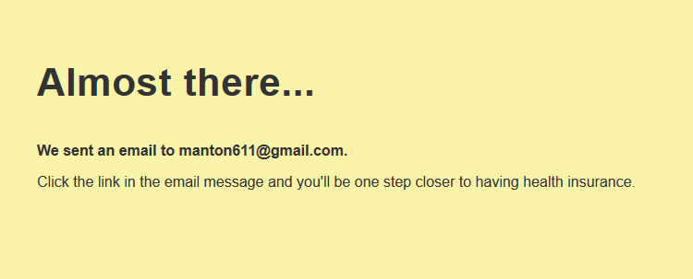

Slide 8
selenium webdriver setting radio buttons
Assuming you have selenium set up its just:
selenium.click('radio button locator');
You may want to look at the selenium javadoc http://release.seleniumhq.org/selenium-remote-control/0.9.2/doc/java/com/thoughtworks/selenium/Selenium.html

Slide 9
http://release.seleniumhq.org/selenium-remote-control/0.9.2/doc/java/com/thoughtworks/selenium/Selenium.html
list of methods

Slide 10
webdriver docs
http://docs.seleniumhq.org/docs/03_webdriver.jsp
http://docs.seleniumhq.org/docs/04_webdriver_advanced.jsp
http://docs.seleniumhq.org/docs/07_selenium_grid.jsp
http://docs.seleniumhq.org/docs/appendix_cheat_sheet.jsp
http://docs.seleniumhq.org/docs/appendix_installing_java_driver_Sel20_via_maven.jsp

Slide 11
isElementPresent
// Selenium RC isElementPresent not in Webdriver
// Implement our own
private boolean isElementPresent(By by) {
try{
driver.findElement(by);
return true;
} catch (NoSuchElementExceptione){
return false;
}
}

Slide 12
Using isElementPresent()
@Test
public void testIsElementPresent() {
//Check if element exists on Page
if (isElementPresent(By.name("airbags"))){
//Get the checkbox and select it
WebElement airbag =
driver.findElement(By.name("airbags"));
if(!airbag.isSelected())
airbag.click();
} else { fail("Airbag Checkbox doesn't exists!!");
}
}

Slide 13
Checking an Element’s Status
Method | Purpose
isEnabled() | This method checks if an element is enabled. Returns true if enabled, else false for disabled.
isSelected() | This method checks if element is selected (radio button, checkbox, and so on). It returns true if selected, else false for deselected
isDisplayed() | This method checks if element is displayed.

Slide 14
Checking an Element’s Status
Many a time a test fails to click on an element or enter text in a field as the element is disabled or exists in the DOM, but is not displayed on the page;
this will result in an error being thrown and the test resulting in failures.
For building reliable tests that can run unattended, a robust exception and error handling is needed in the test flow.

Slide 15
@Test public void testElementIsEnabled() { //Get the Checkbox as WebElement
WebElement ledheadlamp =
driver.findElement(
By.xpath("//input[@name='ledheadlamp']")); //Check if its enabled before selecting it
if (ledheadlamp.isEnabled()) {
//Check if its already selected?
// otherwise select the Checkbox

Slide 16
if (!ledheadlamp.isSelected())
ledheadlamp.click();
} else {
fail("LED Lamp Checkbox is disabled!!");
}
}

Slide 17
Identifying and handling a pop-up window by its name
In Selenium WebDriver, testing pop-up windows involves
identifying a pop-up window,
switching the driver context to the pop-up window,
then executing steps on the pop-up window, and
finally switching back to the parent window.

Slide 18
Help Popup
<button id="helpbutton" onClick='window.open("help.html","HelpWindow","width=500,height=500");'>Help</button>

Slide 19
@Test public void testWindowPopup() {
//Save the WindowHandle of Parent Browser Window
String parentWindowId = driver.getWindowHandle();
//Clicking Help Button will open Help Page
// in a new Popup Browser Window
WebElement helpButton =
driver.findElement(By.id("helpbutton"));
helpButton.click();

Slide 20
try {
//Switch to the Help Popup Browser Window
driver.switchTo().window("HelpWindow");
} catch (NoSuchWindowException e){
e.printStackTrace();
}
//Verify driver context is in Help Popup Browser Window
assertTrue(driver.getTitle().equals("Help"));
//Close the Help Popup Window
driver.close();

Slide 21
//Move back to the Parent Browser
//Move back to the Parent Browser Window
driver.switchTo().window(parentWindowId);
// Verify the driver context is in Parent Browser // Window
assertTrue(driver.getTitle().equals("Build
my Car - Configuration"));
}

Slide 22
More
The pop-up windows can be closed by calling the driver.close() method.
developers might implement the closing of a pop-up window by clicking on a button or a link.
Then, closing a pop-up window directly might lead to errors or exceptions.
The driver.switchTo().window() method throws the NoSuchWindowException exception when it fails to identify the desired pop-up window.

Slide 23
@Test public void testWindowPopupUsingTitle() {
//Save the WindowHandle of Parent Browser
String parentWindowId =
driver.getWindowHandle();
//Clicking Visit Us Button will open Visit Us Page // in a new Popup Browser Window
WebElement visitButton = driver.findElement(By.id("visitbutton"));
visitButton.click();

Slide 24
//Get Handles of all the open Popup Windows
//Iterate through the set and check if tile of each window
// matches with expected Window Title
Set<String> allWindows = driver.getWindowHandles();
if(!allWindows.isEmpty()) {
for (String windowId : allWindows) {
try{
if(driver.switchTo().window(windowId). getTitle().equals("Visit Us")) { //Close Visit Us Popup Window
driver.close();
break;
} }

Slide 25
Us")) { //Close the Visit Us Popup Window driver.close(); break; } } catch(NoSuchWindowException e) { e.printStackTrace(); } } } //Move back to the Parent Browser Window driver.switchTo().window(parentWindowId);

Slide 26
Identifying and handling a pop-up window by its content
Identifying and handling a pop-up window by its content
@Test public void testWindowPopupUsingContents() {
//Save WindowHandle of Parent Browser Window
String currentWindowId = driver.getWindowHandle();

Slide 27
//Clicking Chat Button will open Chat Page in a new Popup //Browser Window
WebElement chatButton =
driver.findElement(By.id("chatbutton"));
chatButton.click();
//There is no name or title provided for Chat Page Popup
//We will iterate through all the open Windows and check the //contents to find out if it's Chat Window
Set<String> allWindows = driver.getWindowHandles();
if(!allWindows.isEmpty()) {
for (String windowId : allWindows) {
driver.switchTo().window(windowId);

Slide 28
if(driver.getPageSource().contains("Build my Car - Configuration - Online Chat")) {
try {
//Find the Close Button on Chat Popup Window
//and close the Popup by clicking Close Button
// instead of closing it directly
WebElement closeButton =
driver.findElement(By.id("closebutton")); closeButton.click();
…

Slide 29
Performing drag-and-drop operations
@Test
public void testDragDrop() {
driver.get("http://dl.dropbox.com/u/55228056/DragDropDemo.html");
WebElement source = driver.findElement(
By.id("draggable"));
WebElement target = driver.findElement(
By.id("droppable"));
Actions builder = new Actions(driver);
builder.dragAndDrop(source, target).perform();
try { assertEquals("Dropped!",

