Slide 1
CSCE 747 Software Testing and Quality Assurance
Lecture 16 Testing Web Applications

Slide 2
Last Time
GUI testing 2
Chapter 19
Today
Test 1 take-home
TestingGeek
Testing Web Applications
Selenium

Slide 3
TestingGeek
Agile
Announcements
Automation
Case studies
Certification
Conferences
Conversation
Guest Posts
Humor Measure
Mobile
Performance Testing
Requirement
Security
Selenium
Skills
Techniques & Tips
Templates & Checklists
Test Management
Testing
Testing Types
Testometer
Tools
Video tutorials
Web Applications
Workshops

Slide 4
Web Application - Functional Testing Checklist
Links
Forms
DATA VERIFICATION AND VALIDATION
DATA INTEGRATION
NUMERIC FIELDS
ALPHANUMERIC FIELDS

Slide 5
Links
Check that the link takes you to the page it said it would.
Ensure to have no orphan pages (a page that has no links to it)
Check all of your links to other websites
Are all referenced web sites or email addresses hyperlinked?
If we have removed some of the pages from our own site, set up a custom 404 page that redirects your visitors to your home page (or a search page) when the user try to access a page that no longer exists.
Check all mailto links and whether it reaches properly

Slide 6
Forms
Acceptance of invalid input
Optional versus mandatory fields
Input longer than field allows
Radio buttons
Default values on page load/reload(Also terms and conditions should be disabled)
Is Command Button can be used for HyperLinks and Continue Links ?
Is all the datas inside combo/list box are arranged in chronolgical order?
Are all of the parts of a table or form present? Correctly laid out? Can you confirm that selected texts are in the "right place?
Does a scrollbar appear if required?

Slide 7
DATA VERIFICATION AND VALIDATION
Is the Privacy Policy clearly defined and available for user access?
At no point of time the system should behave awkwardly when an invalid data is fed
Check to see what happens if a user deletes cookies while in site
Check to see what happens if a user deletes cookies after visiting a site

Slide 8
DATA INTEGRATION
Check the maximum field lengths to ensure that there are no truncated characters?
If numeric fields accept negative values can these be stored correctly on the database and does it make sense for the field to accept negative numbers?
If a particular set of data is saved to the database check that each value gets saved fully to the database. (i.e.) Beware of truncation (of strings) and rounding of numeric values.

Slide 9
NUMERIC FIELDS
Assure that lowest and highest values are handled correctly.
Assure that numeric fields with a blank in position 1 are processed or reported as an error.
Assure that fields with a blank in the last position are processed or reported as an error an error.
Assure that both + and - values are correctly processed.
Assure that division by zero does not occur.
Include value zero in all calculations.
Assure that upper and lower values in ranges are handled correctly. (Using BVA)

Slide 10
ALPHANUMERIC FIELD CHECKS
Use blank and non-blank data.
Include lowest and highest values.
Include invalid characters & symbols.
Include valid characters.
Include data items with first position blank.
Include data items with last position blank.

Slide 11
Selenium
Selenium is a suite of tools to automate web browsers across many platforms.
Selenium runs in many browsers and operating systems
can be controlled by many programming languages and testing frameworks.
http://docs.seleniumhq.org/

Slide 12
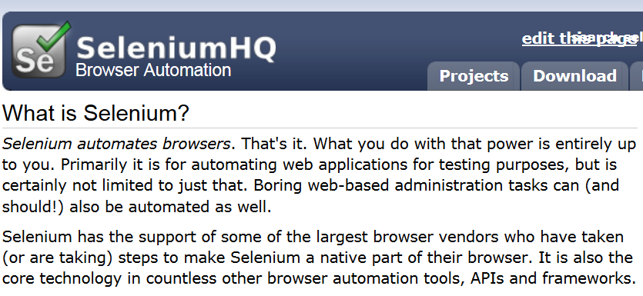
Selenium

Slide 13
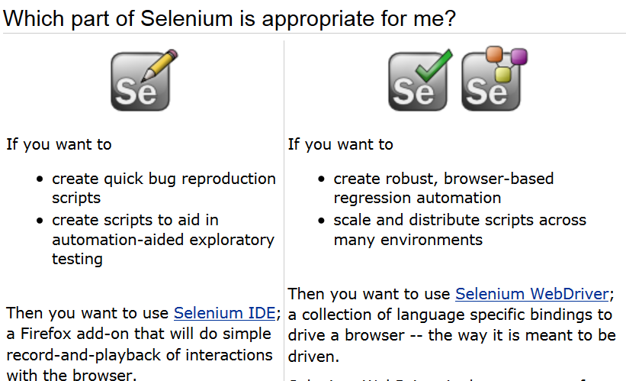

Slide 14
Testing Web Applications
The success of automated GUI (Graphical User Interface) tests depends on:
identifying and locating GUI elements from the application under test and
then performing operations and
verifications on these elements to achieve the test flow.

Slide 15
Locating Elements
Chapter 1 covers:
Using browser tools for inspecting elements and page structure
Locating an element using the findElement method
Locating elements using findElements method
Locating links Locating elements by tag name
Locating elements using CSS selectors
Locating elements using XPath
Locating elements using text
Locating elements using advanced CSS selectors Using jQuery selectors
Locating table rows and cells

Slide 16
Selenium's locator strategies
Locating Elements
Name,
ID,
CSS selectors,
XPath,

