Slide 1
CSCE 747 Software Testing and Quality Assurance
Lecture 14 Test Driven Object Oriented Design Example

Slide 2
Last Time
Growing Object Oriented Software
Agile Manifesto
Iterative Projects
Progress Tests vs Unit Tests
Start Testing with the Simplest Success Case
Unit-Test Behavior, Not Methods
Listen to the Tests
How Writing a Test First Helps the Design
The Tests Say
Only Mock Types That You Own
Today
Growing Object Oriented Software Example: Snipper
Jorgensen, Paul C. Software Testing
A Craftsman Approach

Slide 3
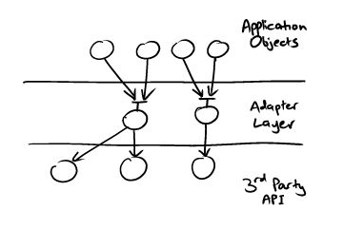
Write an Adapter Layer
If we don’t want to mock an external API, how can we test the code that drives it?
We will have used TDD to design interfaces for the services our objects need— which will be defined in terms of our objects’
Growing Object-Oriented Software, Guided by Tests Freeman and Pryce

Slide 4
Mock Application Objects in Integration Tests
As described above, adapter objects are passive, reacting to calls from our code. Sometimes, adapter objects must call back to objects from the application.
Event-based libraries, for example, usually expect the client to provide a callback object to be notified when an event happens.
In this case, the application code will give the adapter its own event callback (defined in terms of the application domain).
The adapter will then pass an adapter callback to the external library to receive external events and translate them for the application callback.
Growing Object-Oriented Software, Guided by Tests Freeman and Pryce

Slide 5
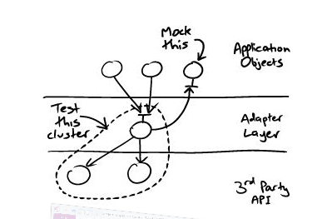
Growing Object-Oriented Software, Guided by Tests Freeman and Pryce

Slide 6
Commissioning an Auction Sniper
we are commissioned to build an application that automatically bids in auctions.
We sketch out how it should work and what the major components should be.
We put together a rough plan for the incremental steps in which we will grow the application.
Growing Object-Oriented Software, Guided by Tests Freeman and Pryce

Slide 7
Requirements: Terminology
Requirements discussions with customer and agree on some basic terms:
Item is something that can be identified and bought.
Bidder is a person or organization that is interested in buying an item price for an item.
Current price is the current highest bid for the item.
Stop price is the most a bidder is prepared to pay for an item.
Auction is a process for managing bids for an item.
Auction house is an institution that hosts auctions.
Growing Object-Oriented Software, Guided by Tests Freeman and Pryce

Slide 8
Snipper: Java Swing application
run on a desktop and allow the user to bid for multiple items at a time.
It will show the identifier, stop price, and the current auction price and status for each item it’s sniping.
Buyers will be able to add new items for sniping through the user interface, and the display values will change in response to events arriving from the auction house
Growing Object-Oriented Software, Guided by Tests Freeman and Pryce

Slide 9
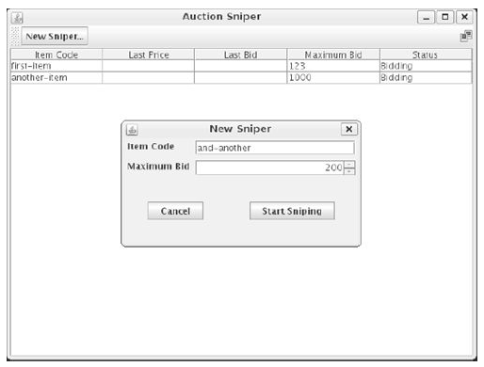
First Draft of User Interface
Growing Object-Oriented Software, Guided by Tests Freeman and Pryce

Slide 10
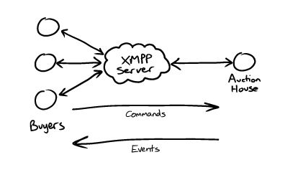
XMPP: the eXtensible Messaging and Presence Protocol
Growing Object-Oriented Software, Guided by Tests Freeman and Pryce

Slide 11
Communicating with an Auction
The Auction Protocol - The protocol for messages between a bidder and an auction house is simple.
Bidders send commands, which can be:
Join - A bidder joins an auction. The sender of the XMPP message identifies the bidder, and the name of the chat session identifies the item.
Bid - A bidder sends a bidding price to the auction.
Price - An auction reports the currently accepted price.
Close - An auction announces that it has closed. The winner of the last price event has won the auction.
Growing Object-Oriented Software, Guided by Tests Freeman and Pryce

Slide 12
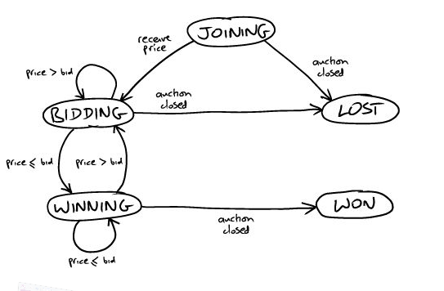
Bidder – state machine
Growing Object-Oriented Software, Guided by Tests Freeman and Pryce

Slide 13
Getting it Started
We can cut through this “first-feature paradox” by splitting it into two smaller problems.
First, work out how to build, deploy, and test a “walking skeleton,” then
use that infrastructure to write the acceptance tests for the first meaningful feature.
Growing Object-Oriented Software, Guided by Tests Freeman and Pryce

Slide 14
The Walking Skeleton
A “walking skeleton” is an implementation of the thinnest possible slice of real functionality that we can automatically build, deploy, and test end-to-end
Growing Object-Oriented Software, Guided by Tests Freeman and Pryce

Slide 15
Deciding the Shape of the Walking Skeleton
context of the first test
Growing Object-Oriented Software, Guided by Tests Freeman and Pryce

Slide 16
Prioritize Initial Requirements
Single item: join, lose without bidding
This is our starting case where we put together the core infrastructure.
Single item: join, bid, and lose
Add bidding to the basic connectivity.
Single item: join, bid, and win - Distinguish who sent the winning bid.
Show price details - Start to fill out the user interface.
Multiple items - Support bidding for multiple items in the same application.
Add items through the user interface Implement input via the user interface.
Stop bidding at the stop price - More intelligence in the Sniper algorithm.
Growing Object-Oriented Software, Guided by Tests Freeman and Pryce

Slide 17
Iteration Zero
In most Agile projects, there’s a first stage where the team is doing initial analysis, setting up its physical and technical environments, and otherwise getting started.
The team isn’t adding much visible functionality since almost all the work is infrastructure
call this step iteration zero:
“iteration” because the team still needs to time-box its activities and
“zero” because it’s before functional development starts in iteration one.
One important task for iteration zero is to use the walking skeleton to test-drive the initial architecture.
Growing Object-Oriented Software, Guided by Tests Freeman and Pryce

Slide 18
Our First Test
The thinnest slice we can imagine testing is that the Auction Sniper can
join an auction and then
wait for it to close
start by writing a test as if its implementation already exists, and then filling in whatever is needed to make it work— what Abelson and Sussman call “programming by wishful thinking”
Growing Object-Oriented Software, Guided by Tests Freeman and Pryce

Slide 19
What First; then How
focus on what we want the system to do
instead of getting caught up in the complexity of how we will make it work
Growing Object-Oriented Software, Guided by Tests Freeman and Pryce

Slide 20
A First Test: join, lose
When an auction is selling an item,
And an Auction Sniper has started to bid in that auction,
Then the auction will receive a Join request from the Auction Sniper.
When an auction announces that it is Closed,
Then the Auction Sniper will show that it lost
Growing Object-Oriented Software, Guided by Tests Freeman and Pryce

Slide 21
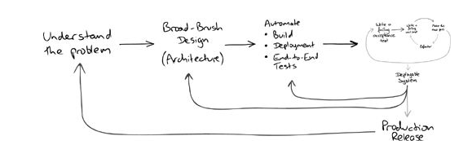
Requirements Feedback
Growing Object-Oriented Software, Guided by Tests Freeman and Pryce

Slide 22
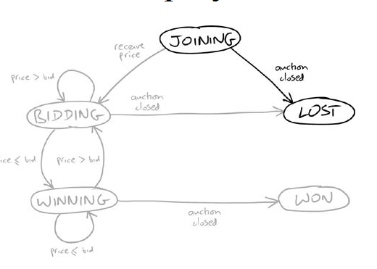
State Machine
Growing Object-Oriented Software, Guided by Tests Freeman and Pryce

Slide 23
Stub for Online Auction
Southabee’s On-Line test services are not freely available.
book ahead and
pay for each test session
We’ll need a fake auction service, a stub
simple as we can make it.
connect to an XMPP message broker
receive commands from the Sniper and
allow the test to send back events.
Growing Object-Oriented Software, Guided by Tests Freeman and Pryce

Slide 24
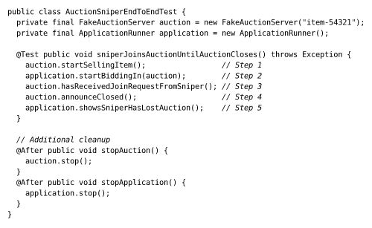
Test 1
Growing Object-Oriented Software, Guided by Tests Freeman and Pryce

Slide 25
Auction Stub
We need to find or write four components:
an XMPP message broker,
a stub auction that can communicate over XMPP,
a GUI testing framework, and
a test harness that can cope with our multithreaded, asynchronous architecture.
Growing Object-Oriented Software, Guided by Tests Freeman and Pryce

Slide 26
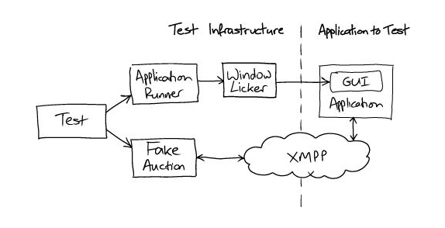
End-to-End Test Rig
Growing Object-Oriented Software, Guided by Tests Freeman and Pryce

Slide 27
Window Licker
A framework for the test-driven development of Java systems through the GUI.
Features
Provides a high-level API for controlling and making assertions about graphical user interfaces:
Swing
Dynamic HTML (aka "AJAX") including GWT
Deals with the asynchronous nature of GUI and AJAX programming so the tests don't have to
Controls the GUI by sending native mouse and keyboard events
Handles different keyboard layouts
Produces high quality error messages to help you easily diagnose test failures
Easily extensible to cope with new user interface components
https://code.google.com/p/windowlicker/

Slide 28
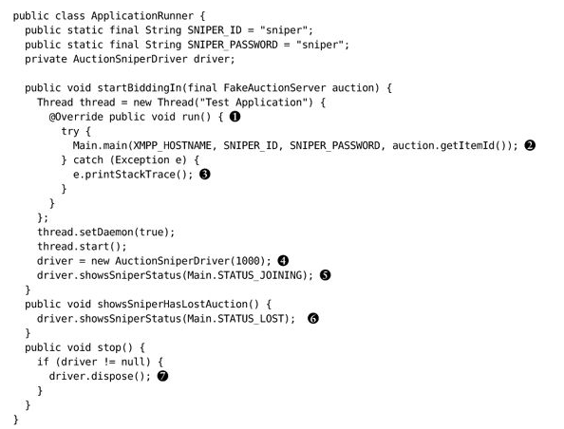
Application Runner
Growing Object-Oriented Software, Guided by Tests Freeman and Pryce

Slide 29
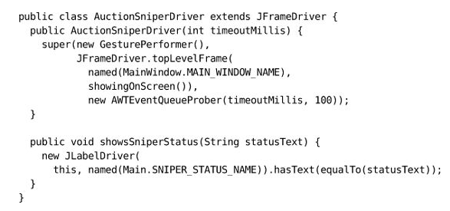
Growing Object-Oriented Software, Guided by Tests Freeman and Pryce

Slide 30
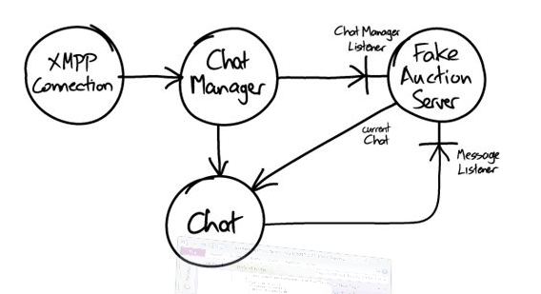
Growing Object-Oriented Software, Guided by Tests Freeman and Pryce

Slide 31
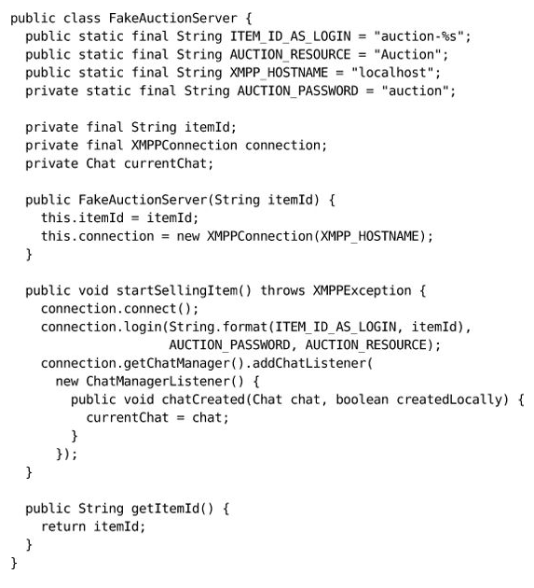
Fake Auction Server
Growing Object-Oriented Software, Guided by Tests Freeman and Pryce

Slide 32
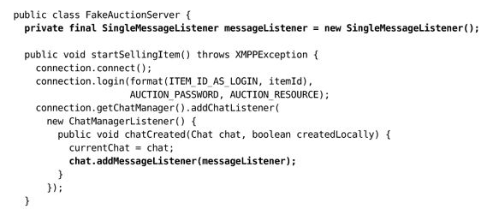
A Minimal Fake Implementation
Growing Object-Oriented Software, Guided by Tests Freeman and Pryce

Slide 33
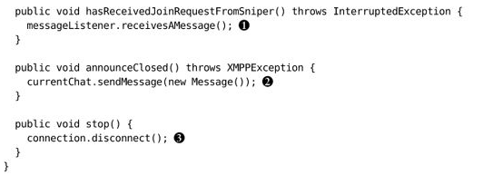
Growing Object-Oriented Software, Guided by Tests Freeman and Pryce

Slide 34
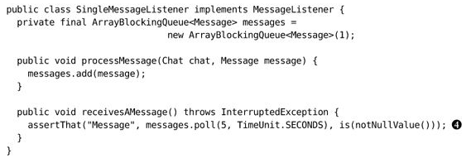
Growing Object-Oriented Software, Guided by Tests Freeman and Pryce

Slide 35
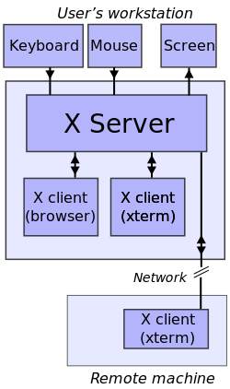
X-windows
Client-server
graphics server
runs remote clients
events
mouse click, movement
keyboard press
callbacks
http://en.wikipedia.org/wiki/X_Window_System_protocols_and_architecture

Slide 36
X-windows Design principles
Bob Scheifler and Jim Gettys set out the early principles of X
Do not add new functionality unless an implementor cannot complete a real application without it.
It is as important to decide what a system is not as to decide what it is. Do not serve all the world's needs; rather, make the system extensible so that additional needs can be met in an upwardly compatible fashion.
The only thing worse than generalizing from one example is generalizing from no examples at all.
If a problem is not completely understood, it is probably best to provide no solution at all.
If you can get 90 percent of the desired effect for 10 percent of the work, use the simpler solution. (See also Worse is better.)
Isolate complexity as much as possible.
Provide mechanism rather than policy. In particular, place user interface policy in the clients' hands.
http://en.wikipedia.org/wiki/X_Window_System_protocols_and_architecture

Slide 37
X-windows
the client and the server exchange four types of packets :
Request: the client requests information from the server or requests it to perform an action.
Reply: the server responds to a request. Not all requests generate replies.
Event: the server sends an event to the client, e.g., keyboard or mouse input, or a window being moved, resized or exposed.
Error: the server sends an error packet if a request is invalid. Since requests are queued, error packets generated by a request may not be sent immediately.
The X server provides a set of basic services. The client programs realize more complex functionalities by interacting with the server.
http://en.wikipedia.org/wiki/X_Window_System_protocols_and_architecture

Slide 38
X-windows
Windows
Identifiers
Attributes and properties
Events
Color modes
Xlib and other client libraries
Selections, cut buffers, and drag-and-drop
Window manager
http://en.wikipedia.org/wiki/X_Window_System_protocols_and_architecture

Slide 39
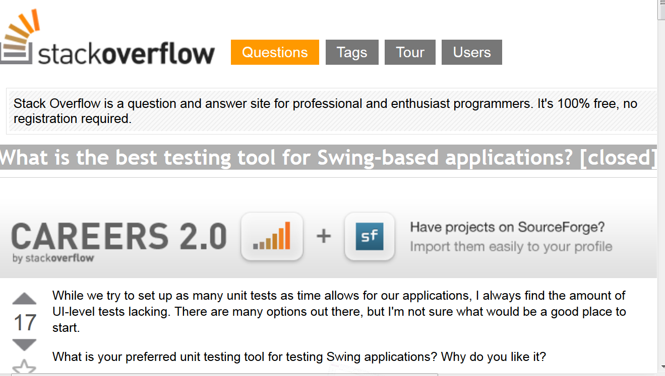
Java-Swing
What is the best testing tool for Swing-based applications? [closed]
http://en.wikipedia.org/wiki/X_Window_System_protocols_and_architecture

Slide 40
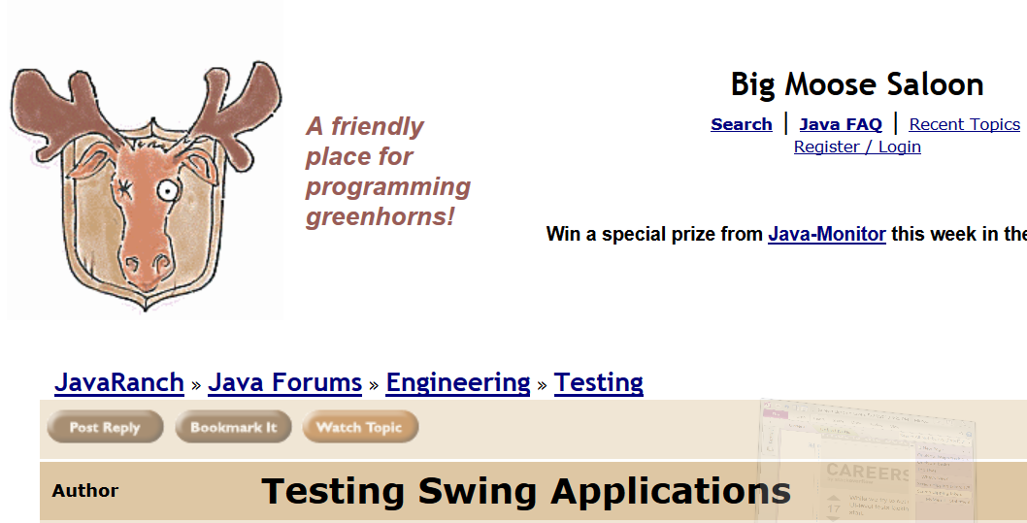
Testing Swing Applications
http://www.coderanch.com/t/95772/Testing/Testing-Swing-Applications

Slide 41
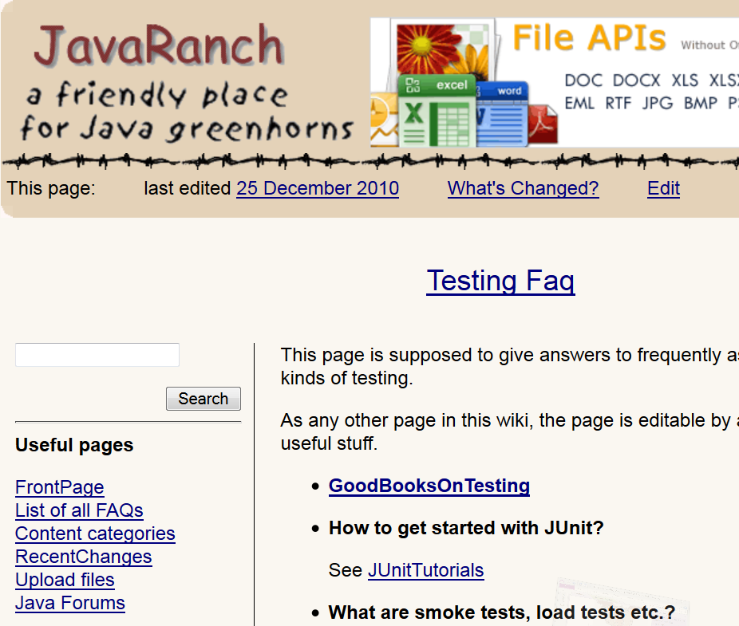

Slide 42
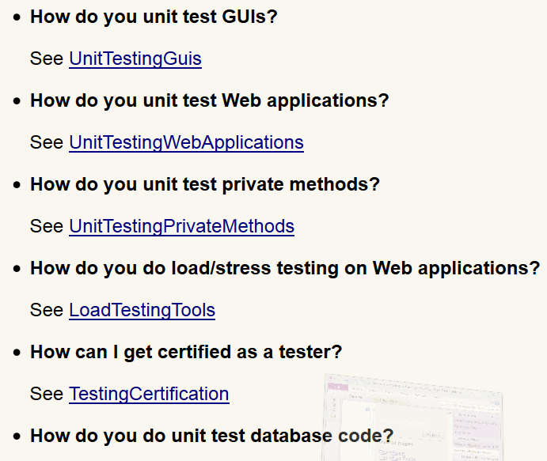

Slide 43
Unit Testing Guis
An important part of UnitTestingGuis is not to have to. Seriously, GUIs should be as thin and contain as little logic as possible. If the GUI additionally is only loosely coupled to the business logic (via ModelViewController? or ModelViewPresenter?), UnitTestingGuis should become rather simple. A good example on testing Swing UIs with pure JUnit can be found at http://www.xp123.com/xplor/xp0001/index.shtml
If you still need to write more complicated tests, take a look at http://jfcunit.sourceforge.net/

Slide 44
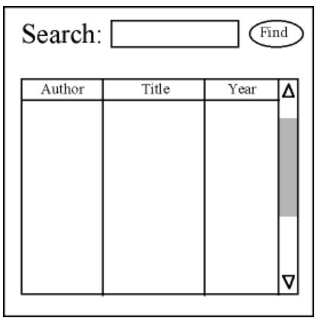
http://xp123.com/articles/the-testcode-cycle-in-xp-part-2-gui/
developing a simple search engine
develop and test the model first

Slide 45
public class SearcherFactory {
public static Searcher get(String s) throws IOException {...}
}
public interface Searcher {
public Result find(Query q);
}
public class Query {
public Query(String s) {...}
public String getValue() {...}
}

Slide 46
public interface Result {
public int getCount();
public Document getItem(int i);
}
public interface Document {
public String getAuthor();
public String getTitle();
public String getYear();
}

Slide 47
The GUI Connection
What we'd like to happen:
a searcher is associated with the GUI
a query is entered
the button is clicked
the table fills up with the result

Slide 48
Testing Key Widgets
We proposed a screen design earlier. The first thing we can test is that key widgets are present: a label, a query field, a button, and a table. There may be other components on the panel (e.g., sub-panels used for organization), but we don't care about them.
So, we'll create testWidgetsPresent(). To make this work, we need a panel for the overall screen ("SearchPanel"), the label ("searchLabel"), a textfield for entering the query ("queryField"), a button ("findButton"), and a table for the results ("resultTable"). We'll let these widgets be package-access, so our test can see them.

Slide 49
public void testWidgetsPresent() {
SearchPanel panel = new SearchPanel(); assertNotNull(panel.searchLabel); assertNotNull(panel.queryField); assertNotNull(panel.findButton); assertNotNull(panel.resultTable);
}

Slide 50
Things to notice:
The test helped design the panel's (software) interface.
The test is robust against even dramatic re-arrangements of the widgets.
We took very small steps, bouncing between test, code, and design.
Our panel might not (and in fact, does not) actually display anything – we haven't tested that.
The panel still doesn't do anything (e.g., if the button were clicked).

Slide 51
public void testInitialContents() {
SearchPanel sp = new SearchPanel(); assertEquals("Search:",
sp.searchLabel.getText());
assertEquals("", sp.queryField.getText()); assertEquals("Find",
sp.findButton.getText());
assert("Table starts empty",
sp.resultTable.getRowCount() == 0);
}

Slide 52
Testing Interconnection
public void testSearcherSetup() {
Searcher s = new Searcher() {
public Result search(Query q) {
return null;
}
};
SearchPanel panel = new SearchPanel();
assert ("Searcher not set", panel.getSearcher() != s);
panel.setSearcher(s);
assert("Searcher now set", panel.getSearcher() == s);
}

Slide 53
Testing with a Fake Searcher
public void testTestSearcher() {
assertEquals(new Query("1").getValue(), "1");
Document d = new TestDocument(1);
assertEquals("y1", d.getYear());
Result tr = new TestResult(2);
assert(tr.getCount() == 2);
assertEquals("a0", tr.getItem(0).getAuthor());
TestSearcher ts = new TestSearcher();
tr = ts.find(ts.makeQuery("2"));
assert("Result has 2 items", tr.getCount() == 2);
assertEquals("y1", tr.getItem(1).getYear());
}

Slide 54
public class TestDocument implements Document {
int count;
public TestDocument(int n) {count = n;}
public String getAuthor() {return "a" + count;} public String getTitle() {return "t" + count;} public String getYear() {return "y" + count;}
}

Slide 55
Adapter Stub
public class ResultTableAdapter extends DefaultTableModel {
public ResultTableAdapter(Result r) {}
}

Slide 56
Adapter Implementation Test First
public void testResultTableAdapter() {
Result result = new TestResult(2);
ResultTableAdapter rta = new ResultTableAdapter(result);
assertEquals("Author", rta.getColumnName(0));
assertEquals("Title", rta.getColumnName(1));
assertEquals("Year", rta.getColumnName(2));
assert("3 columns", rta.getColumnCount() == 3);
assert("Row count=2", rta.getRowCount() == 2);
assertEquals("a0", rta.getValueAt(0,0).toString());
assertEquals("y1", rta.getValueAt(1,2).toString());
}

Slide 57
public class ResultTableAdapter
extends AbstractTableModel implements TableModel {
final static String columnNames[] = {"Author", "Title", "Year"};
Result myResult;
public ResultTableAdapter(Result r) {myResult = r;}
public String getColumnName(int i) {return columnNames[i];}
public int getColumnCount() {return columnNames.length;}
public int getRowCount() {return myResult.getItemCount();} public Object getValueAt(int r, int c) {
Document doc = myResult.getItem(r);
switch(c) {
case 0: return doc.getAuthor();
case 1: return doc.getTitle();
case 2: return doc.getYear();
default: return "?";
}

Slide 58
Testing for Looks
We have a properly connected panel. We can check the widgets' relative locations:
label left-of queryField
queryField left-of findButton
queryField above table

Slide 59
Testing for Looks
public void testRelativePosition() {
SearchPanel sp = new SearchPanel();
JFrame display = new JFrame("test"); display.getContentPane().add(sp); display.setSize(500,500);
display.setVisible(true);
//try {Thread.sleep(3000);} catch (Exception ex) {} assert ("label left-of query", sp.searchLabel.getLocationOnScreen().x < sp.queryField.getLocationOnScreen().x);
…

