Slide 1
CSCE 747 Software Testing and Quality Assurance
Lecture 13 Test Driven Object Oriented Design

Slide 2
Last Time
Writing Readable Fests
Matchers
Hamcrest
Growing Object Oriented Software
Today
Growing Object Oriented Software again
Jorgensen, Paul C. Software Testing
A Craftsman Approach

Slide 3
Manifesto for Agile Software Development
We are uncovering better ways of developing software by doing it and helping others do it. Through this work we have come to value:
Individuals and interactions over processes and tools
Working software over comprehensive documentation
Customer collaboration over contract negotiation
Responding to change over following a plan
That is, while there is value in the items on the right, we value the items on the left more.

Slide 4
Agile Manifesto Signees
Kent Beck Mike Beedle Arie van Bennekum Alistair Cockburn Ward Cunningham Martin Fowler
James Grenning Jim Highsmith Andrew Hunt
Ron Jeffries Jon Kern Brian Marick
Robert C. Martin Steve Mellor Ken Schwaber Jeff Sutherland Dave Thomas

Slide 6
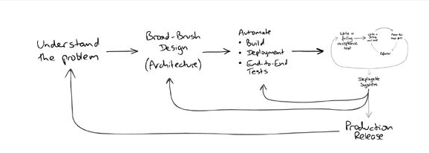

Slide 7
Iterative Projects – Man on the Moon
Unmanned Command/ Service Module (CSM) test
Unmanned Lunar Module (LM) test
Manned CSM in low Earth orbit
Manned CSM and LM in low Earth orbit
Manned CSM and LM in an elliptical Earth orbit with an apogee of 4600 mi (7400 km)
Manned CSM and LM in lunar orbit
Manned lunar landing

Slide 8
Growing Object-Oriented Software, Guided by Tests Freeman and Pryce

Slide 9
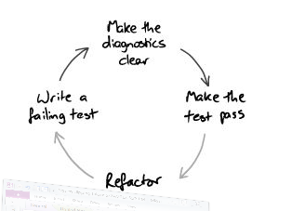
Make the tests clear
Write the test you’d like to read
refining the cycle
Cycle
Write the test
Run the test
Watch it fail
Read the diagonstic
Write the code
Refactor
Growing Object-Oriented Software, Guided by Tests Freeman and Pryce

Slide 10
Separate Tests That Measure Progress from Those That Catch Regressions
When we write acceptance tests to describe a new feature, we expect them to fail until that feature has been implemented;
new acceptance tests describe work yet to be done.
The activity of turning acceptance tests from red to green gives the team a measure of the progress it’s making.
Growing Object-Oriented Software, Guided by Tests Freeman and Pryce

Slide 11
Start Testing with the Simplest Success Case
XP maxim to do “the simplest thing that could possibly work” -- Beck02
Growing Object-Oriented Software, Guided by Tests Freeman and Pryce

Slide 12
Develop from the Inputs to the Outputs
We start developing a feature by considering the events coming into the system that will trigger the new behavior.
The end-to-end tests for the feature will simulate these events arriving.
At the boundaries of our system, we will need to write one or more objects to handle these events.
discover that these objects need supporting services from the rest of the system to perform their responsibilities.
Growing Object-Oriented Software, Guided by Tests Freeman and Pryce

Slide 13
Unit-Test Behavior, Not Methods
just writing lots of tests, is not the objective
even when it produces high test coverage, does not guarantee a codebase that’s easy to work with.
Many developers who adopt TDD find their early tests hard to understand when they revisit them
Growing Object-Oriented Software, Guided by Tests Freeman and Pryce

Slide 14
Describing Behavior, Not API Features
Growing Object-Oriented Software, Guided by Tests Freeman and Pryce

Slide 15
Listen to the Tests
When writing unit and integration tests, stay alert for areas of the code that are difficult to test.
we don’t just ask ourselves how to test it,
but also why is it difficult to test.
when code is difficult to test, the most likely cause is that our design needs improving.
Growing Object-Oriented Software, Guided by Tests Freeman and Pryce

Slide 16
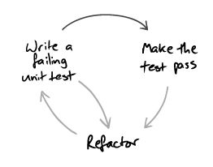
Modifying the Cycle: Listen to Tests
Growing Object-Oriented Software, Guided by Tests Freeman and Pryce

Slide 17
“ Expect Unexpected Changes”
maxim—“ Expect Unexpected Changes”—
guides development
maintain quality of the system by refactoring when we see a weakness in the design, we will be able to make it respond to whatever changes turn up.
The alternative is the usual “software rot”
Growing Object-Oriented Software, Guided by Tests Freeman and Pryce

Slide 18
Designing for Maintainability
Designing for Maintainability
Growing Object-Oriented Software, Guided by Tests Freeman and Pryce

Slide 19
Information Hiding
the distinction between “encapsulation” and “information hiding”
The terms are largely orthogonal, qualities:
Encapsulation - Ensures that the behavior of an object can only be affected through its API.
Information Hiding - Conceals how an object implements its functionality behind the abstraction of its API.
Growing Object-Oriented Software, Guided by Tests Freeman and Pryce

Slide 20
Composite Simpler Than the Sum of Its Parts
The API of a composite object should not be more complicated than that of any of its components.
Growing Object-Oriented Software, Guided by Tests Freeman and Pryce

Slide 21
Achieving Object-Oriented Design
In matters of style, swim with the current; in matters of principle, stand like a rock. —Thomas Jefferson
Growing Object-Oriented Software, Guided by Tests Freeman and Pryce

Slide 22
How Writing a Test First Helps the Design
starting with a test means that we have to describe what we want to achieve before we consider how
second, to keep unit tests understandable we have to limit their scope
to construct an object for a unit test, we have to pass its dependencies to it, which means that we have to know what they are
Growing Object-Oriented Software, Guided by Tests Freeman and Pryce

Slide 23
Interface and Protocol
useful distinction in a conference talk:
an interface describes whether two components will fit together,
while a protocol describes whether they will work together.
Growing Object-Oriented Software, Guided by Tests Freeman and Pryce

Slide 24
The Tests Say
The Tests Say... Break up an object if it becomes too large to test easily, or if its test failures become difficult to interpret. Then unit-test the new parts separately.
Growing Object-Oriented Software, Guided by Tests Freeman and Pryce

Slide 25
The Tests Say
The Tests Say - When writing a test, we ask ourselves, “If this worked, who would know?”
If the right answer to that question is not in the target object, it’s probably time to introduce a new collaborator.
Growing Object-Oriented Software, Guided by Tests Freeman and Pryce

Slide 26
The Tests Say
The Tests Say - When the test for an object becomes too complicated to set up
— when there are too many moving parts to get the code into the relevant state
— consider bundling up some of the collaborating objects.
Growing Object-Oriented Software, Guided by Tests Freeman and Pryce

Slide 27
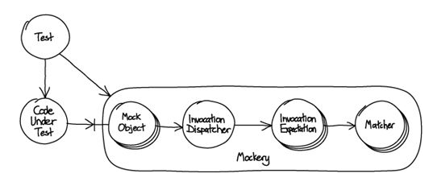
Growing Object-Oriented Software, Guided by Tests Freeman and Pryce

Slide 28
Growing Object-Oriented Software, Guided by Tests Freeman and Pryce

Slide 29
Building on Third-Party Code
Programming today is all about doing science on the parts you have to work with. —Gerald Jay Sussman
Growing Object-Oriented Software, Guided by Tests Freeman and Pryce

Slide 30
Only Mock Types That You Own
Don’t Mock Types You Can’t Change
When we use third-party code we often do not have a deep understanding of how it works.
Even if we have the source available, we rarely have time to read it thoroughly enough to explore all its quirks.
We can read its documentation, which is often incomplete or incorrect.
The software may also have bugs that we will need to work around.
Growing Object-Oriented Software, Guided by Tests Freeman and Pryce

Slide 31
providing mock implementations of third-party types is of limited use when unit-testing the objects that call them.
We find that tests that mock external libraries often need to be complex to get the code into the right state for the functionality we need to exercise.
Growing Object-Oriented Software, Guided by Tests Freeman and Pryce

Slide 32
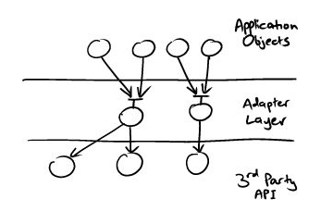
Write an Adapter Layer
If we don’t want to mock an external API, how can we test the code that drives it?
We will have used TDD to design interfaces for the services our objects need— which will be defined in terms of our objects’
Growing Object-Oriented Software, Guided by Tests Freeman and Pryce

Slide 33
Mock Application Objects in Integration Tests
As described above, adapter objects are passive, reacting to calls from our code. Sometimes, adapter objects must call back to objects from the application.
Event-based libraries, for example, usually expect the client to provide a callback object to be notified when an event happens.
In this case, the application code will give the adapter its own event callback (defined in terms of the application domain).
The adapter will then pass an adapter callback to the external library to receive external events and translate them for the application callback.
Growing Object-Oriented Software, Guided by Tests Freeman and Pryce

Slide 34
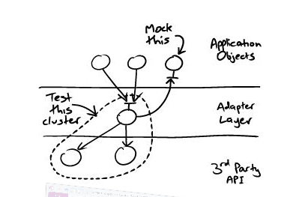
Growing Object-Oriented Software, Guided by Tests Freeman and Pryce

Slide 35
Commissioning an Auction Sniper
we are commissioned to build an application that automatically bids in auctions.
We sketch out how it should work and what the major components should be.
We put together a rough plan for the incremental steps in which we will grow the application.
Growing Object-Oriented Software, Guided by Tests Freeman and Pryce

Slide 36
Requirements: Terminology
Requirements discussions with customer and agree on some basic terms:
Item is something that can be identified and bought.
Bidder is a person or organization that is interested in buying an item price for an item.
Current price is the current highest bid for the item.
Stop price is the most a bidder is prepared to pay for an item.
Auction is a process for managing bids for an item.
Auction house is an institution that hosts auctions.
Growing Object-Oriented Software, Guided by Tests Freeman and Pryce

Slide 37
Snipper: Java Swing application
run on a desktop and allow the user to bid for multiple items at a time.
It will show the identifier, stop price, and the current auction price and status for each item it’s sniping.
Buyers will be able to add new items for sniping through the user interface, and the display values will change in response to events arriving from the auction house
Growing Object-Oriented Software, Guided by Tests Freeman and Pryce

Slide 38
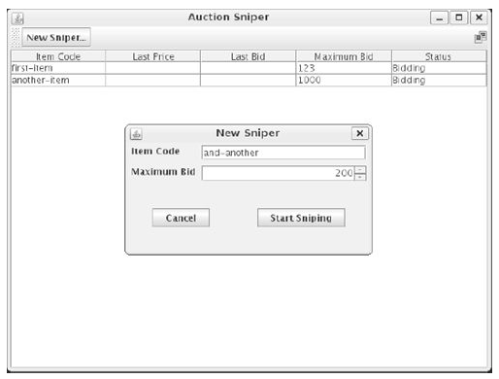
First Draft of User Interface
Growing Object-Oriented Software, Guided by Tests Freeman and Pryce

Slide 39
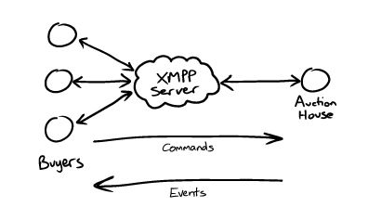
XMPP: the eXtensible Messaging and Presence Protocol
Growing Object-Oriented Software, Guided by Tests Freeman and Pryce

Slide 40
Communicating with an Auction
The Auction Protocol - The protocol for messages between a bidder and an auction house is simple.
Bidders send commands, which can be:
Join - A bidder joins an auction. The sender of the XMPP message identifies the bidder, and the name of the chat session identifies the item.
Bid - A bidder sends a bidding price to the auction.
Price - An auction reports the currently accepted price.
Close - An auction announces that it has closed. The winner of the last price event has won the auction.
Growing Object-Oriented Software, Guided by Tests Freeman and Pryce

Slide 41
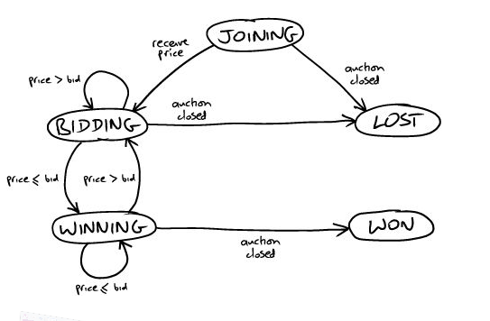
Bidder – state machine
Growing Object-Oriented Software, Guided by Tests Freeman and Pryce

Slide 42
Getting it Started
We can cut through this “first-feature paradox” by splitting it into two smaller problems.
First, work out how to build, deploy, and test a “walking skeleton,” then
use that infrastructure to write the acceptance tests for the first meaningful feature.
Growing Object-Oriented Software, Guided by Tests Freeman and Pryce

Slide 43
The Walking Skeleton
A “walking skeleton” is an implementation of the thinnest possible slice of real functionality that we can automatically build, deploy, and test end-to-end
Growing Object-Oriented Software, Guided by Tests Freeman and Pryce

Slide 44
Deciding the Shape of the Walking Skeleton
context of the first test
Growing Object-Oriented Software, Guided by Tests Freeman and Pryce

Slide 45
Prioritize Initial Requirements
Single item: join, lose without bidding
This is our starting case where we put together the core infrastructure.
Single item: join, bid, and lose
Add bidding to the basic connectivity.
Single item: join, bid, and win - Distinguish who sent the winning bid.
Show price details - Start to fill out the user interface.
Multiple items - Support bidding for multiple items in the same application.
Add items through the user interface Implement input via the user interface.
Stop bidding at the stop price - More intelligence in the Sniper algorithm.
Growing Object-Oriented Software, Guided by Tests Freeman and Pryce

Slide 46
A First Test: join, lose
When an auction is selling an item,
And an Auction Sniper has started to bid in that auction,
Then the auction will receive a Join request from the Auction Sniper.
When an auction announces that it is Closed,
Then the Auction Sniper will show that it lost the auction.
Growing Object-Oriented Software, Guided by Tests Freeman and Pryce

Slide 47
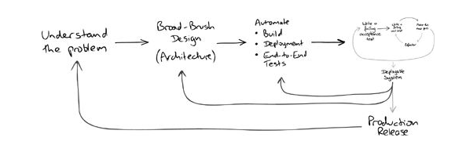
Requirements Feedback
Growing Object-Oriented Software, Guided by Tests Freeman and Pryce

Slide 48
Growing Object-Oriented Software, Guided by Tests Freeman and Pryce

Slide 49
Growing Object-Oriented Software, Guided by Tests Freeman and Pryce

Slide 50
Growing Object-Oriented Software, Guided by Tests Freeman and Pryce

Slide 51
Growing Object-Oriented Software, Guided by Tests Freeman and Pryce

Slide 52
Growing Object-Oriented Software, Guided by Tests Freeman and Pryce

