Slide 1
CSCE 747 Software Testing and Quality Assurance
Lecture 08 – Structural Testing Wrap-up

Slide 2
Last Time
Dataflow Testing
Ch 10, pp 151-167
Reading assignment Google( Mockito Tutorial Vogel)
.
Today
Structural Testing WrapUp
Ch 11, pp 169-177
Jorgensen, Paul C. Software Testing
A Craftsman Approach

Slide 3
When should testing stop?
Here are some possible answers:
1. When you run out of time
2. When continued testing causes no new failures
3. When continued testing reveals no new faults
4. When you cannot think of any new test cases
5. When you reach a point of diminishing returns
6. When mandated coverage has been attained
7. When all faults have been removed

Slide 4
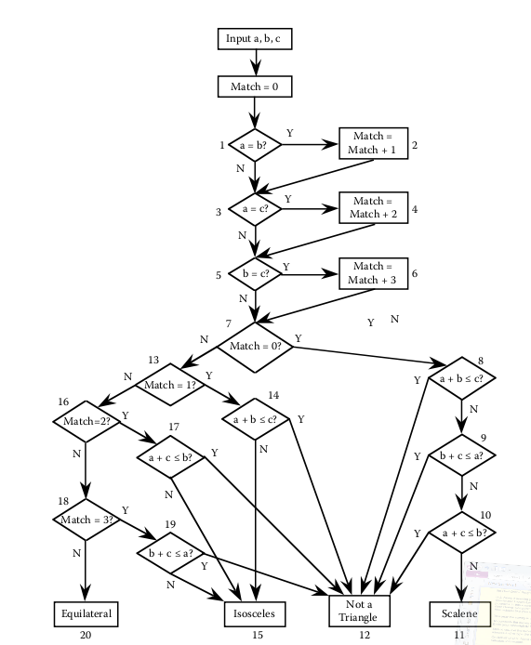
Triangle Program

Slide 5
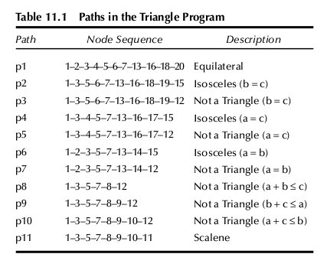
Gaps and Redundancies
Paths in Triangle

Slide 6
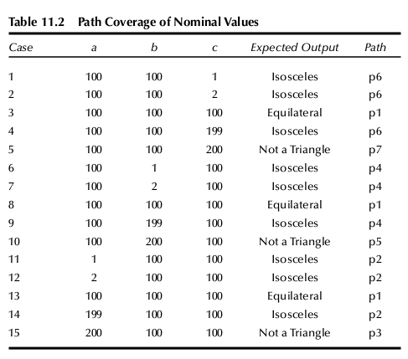
,

Slide 7
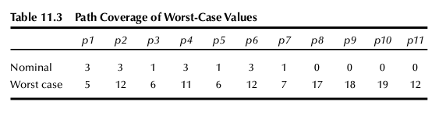

Slide 8
Metrics for Method Evaluation
Definition: The coverage of a methodology M with respect to a metric S is the ratio of n to s. We denote it as C(M, S).
Definition: The redundancy of a methodology M with respect to a metric S is the ratio of m to s. We denote it as R(M, S).
Definition: The net redundancy of a methodology M with respect to a metric S is the ratio of m to n. We denote it as NR(M, S).

Slide 9
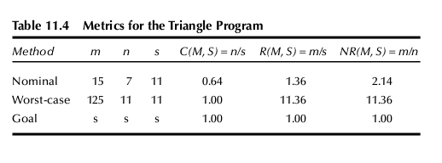

Slide 10
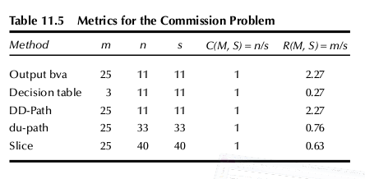

Slide 11
Pseudo-code for the Insurance Premium Program
1. Input(baseRate, driverAge, points)
2. premium = 0
3. Select Case driverAge
4. Case 1: 16<= driverAge < 20
5. ageMultiplier = 2.8
6. If points < 1 Then
7. safeDrivingReduction = 50
8. EndIf
9. Case 2: 20<= driverAge < 25
10. ageMultiplier = 1.8
11. If points < 3 Then
12. safeDrivingReduction = 50
13. EndIf
14. Case 3: 25<= driverAge < 45
15. ageMultiplier = 1#
16. If points < 5 Then
17. safeDrivingReduction = 100
18. EndIf
19. Case 4: 45<= driverAge < 60
20. ageMultiplier = 0.8
21. If points < 7 Then
22. safeDrivingReduction = 150
23. EndIf
24. Case 5: 60<= driverAge < 120
25. ageMultiplier = 1.5
26. If points < 5 Then
27. safeDrivingReduction = 200
28. EndIf
29. Case 6: Else
30. Output (“Driver age out of range”)
31. End Select
32. premium = baseRate * ageMultiplier - safeDrivingReduction
33. Output (premium)

Slide 12
cyclomatic complexity
The cyclomatic complexity of the program graph of the insurance premium program is V(G) = e – n + 2p = 11,
Jorgensen, Paul C. (2011-07-16). Software Testing (Page 175). Auerbach Publications. Kindle Edition.

Slide 13
11.3.1 Path–Based Testing
Acyclic ➔ only a finite number of paths exist

Slide 14
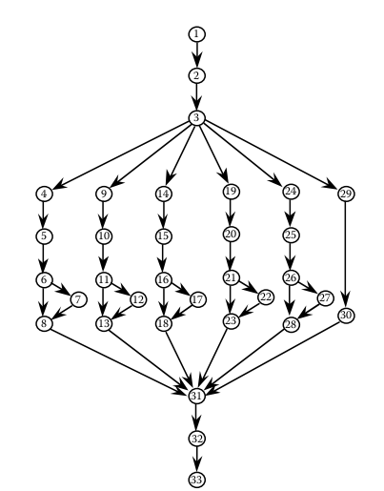
Fig11.4

Slide 15
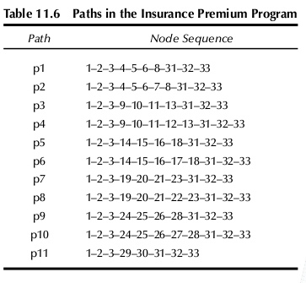

Slide 16
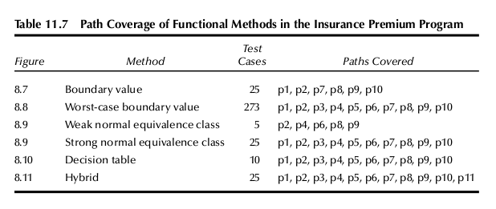

Slide 17
Dataflow Testing
Jorgensen, Paul C. (2011-07-16). Software Testing (Page 177). Auerbach Publications. Kindle Edition.

Slide 18
11.3.3 Slice Testing
Slice testing does not provide much insight either. There are only four interesting slices:
S(safeDrivingReduction, 32) = {1, 3, 4, 6, 7, 9, 11, 12 14, 16, 17, 19, 21, 22, 24, 26, 27, 31}
S(ageMultiplier, 32) = {1, 3, 4, 5, 9, 10, 14, 15, 19, 20, 24, 25, 31}
S(baseRate, 32) = {1}
S(Premium, 31) = {2}
The union of these slices

Slide 19
References
Brown, J.R. and Lipov, M., Testing for software reliability, Proceedings of the International Symposium on
Reliable Software, Los Angeles, April 1975, pp. 518–527.
Pressman, R.S., Software Engineering: A Practitioner’s Approach, McGraw-Hill, New York, 1982.
Jorgensen, Paul C. (2011-07-16). Software Testing (Page 177). Auerbach Publications. Kindle Edition.

Slide 20
