Slide 1
Lecture 03 Quality Attributes
CSCE 742 Software Architectures
Topics
Chapter 3 – Why Software Architecture?
Chapter 4 – Quality Attributes
May 10, 2017

Slide 2
What is Software Architecture?
The software architecture of a system is the set of structures needed to reason about the system, which comprise software elements, relations among them, and properties of both.

Slide 3
Why is Software Architecture Important?
An architecture will inhibit or enable a system’s driving quality attributes.
The decisions made in an architecture allow you to reason about and manage change as the system evolves.
The analysis of an architecture enables early prediction of a system’s qualities.
A documented architecture enhances communication among stakeholders.
The architecture is a carrier of the earliest and hence most fundamental, hardest-to-change design decisions.

Slide 4
Why is Software Architecture Important?
An architecture defines a set of constraints on subsequent implementation.
The architecture dictates the structure of an organization, or vice versa.
An architecture can provide the basis for evolutionary prototyping.
An architecture is the key artifact that allows the architect and project manager to reason about cost and schedule.
An architecture can be created as a transferable, reusable model that form the heart of a product line.

Slide 5
Why is Software Architecture Important?
An architecture can be created as a transferable, reusable model that form the heart of a product line.
Architecture-based development focuses attention on the assembly of components, rather than simply on their creation.
By restricting design alternatives, architecture channels the creativity of developers, reducing design and system complexity.
An architecture can be the foundation for training a new team member.

Slide 6
Contexts of Software Architecture
Sometimes we consider software architecture the center of the universe!
Here, though, we put it in its place relative to four contexts:
Technical. What technical role does the software architecture play in the system or systems of which it’s a part?
Project life cycle. How does a software architecture relate to the other phases of a software development life cycle?
Business. How does the presence of a software architecture affect an organization’s business environment?
Professional. What is the role of a software architect in an organization or a development project?

Slide 7
Architecture Activities
1. Making a business case for the system
2. Understanding the architecturally significant requirements
3. Creating or selecting the architecture
4. Documenting and communicating the architecture
5. Analyzing or evaluating the architecture
6. Implementing and testing the system based on the architecture
7. Ensuring that the implementation conforms to the architecture

Slide 8
Business Context
Architectures and systems are not constructed frivolously.
They serve some business purposes.
These purposes may change over time.

Slide 9
Architecture and Business Goals
Systems are created to satisfy the business goals of one or more organizations.
Development organizations want to make a profit, or capture market, or stay in business, or help their customers do their jobs better, or keep their staff gainfully employed, or make their stockholders happy, or a little bit of each.
Customers have their own goals for acquiring a system, usually involving some aspect of making their lives easier or more productive. Other organizations involved in a project’s life cycle, such as subcontractors or government regulatory agencies, have their own goals dealing with the system.
Architects need to understand who the vested organizations are and what their goals are. Many of these goals will have a profound influence on the architecture.

Slide 10
Architecture and Business Goals
Every quality attribute—such as a user-visible response time or platform flexibility or ironclad security or any of a dozen other needs—should originate from some higher purpose that can be described in terms of added value.
“Why do you want this system to have a really fast response time?”
This differentiate the product from its competition and let the developing organization capture market share.
Some business goals will not show up in the form of requirements.
Still other business goals have no effect on the architecture whatsoever.
A business goal to lower costs might be realized by asking employees to work from home, or turn the office thermostats down in the winter, or using less paper in the printers.

Slide 11
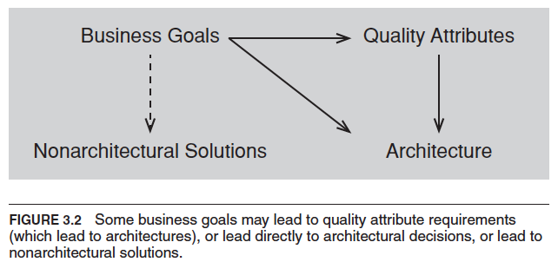
Architecture and business goals

Slide 12
Professional Context
You will perform many duties beyond directly producing an architecture.
You will need to be involved in supporting management and dealing with customers.
Architects need more than just technical skills.
Architects need to explain to one stakeholder or another the chosen priorities of different properties, and why particular stakeholders are not having all of their expectations fulfilled.
Architects need diplomatic, negotiation, and communication skills.
Architects need the ability to communicate ideas clearly
You will need to manage a diverse workload and be able to switch contexts frequently.
You will need to be a leader in the eyes of developers and management.
Architects need up-to-date knowledge.
You will need to know about (for example) patterns, or database platforms, or web services standards.
You will need to know business considerations.

Slide 13
Stakeholders
A stakeholder is anyone who has a stake in the success of the system
Stakeholders typically have different specific concerns that they wish the system to guarantee or optimize.
Early engagement of stakeholders allows you to understand the constraints of the task, manage expectations, negotiate priorities, and make tradeoffs.

Slide 14
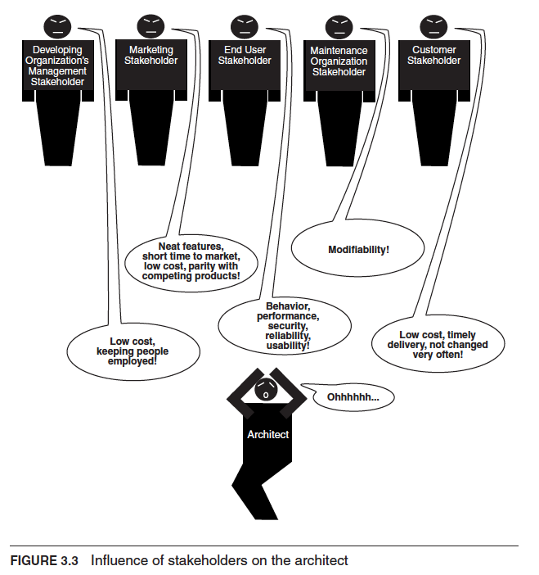
Stakeholders

Slide 15
Stakeholders
Know your stakeholders!
Talk to them, engage them, listen to them, and put yourself in their shoes.
See Table 3.1 for a list of example stakeholders and their interests and concerns.

Slide 16
How is Architecture Influenced?
Requirements influence the architecture, of course.
But the requirements specification only begins to tell the story.
A software architecture is a result of business and social influences, as well as technical ones.
The existence of an architecture in turn affects the technical, business, and social environments that subsequently influence future architectures.
In particular, each of the contexts for architecture plays a role in influencing an architect and the architecture.

Slide 17
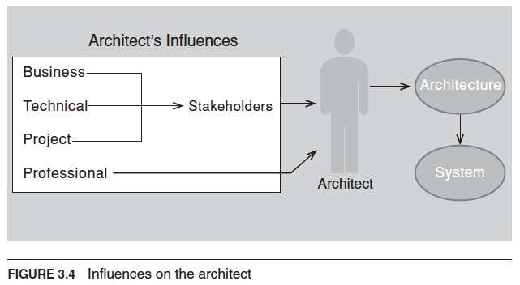
How is Architecture Influenced?

Slide 18
What Do Architectures Influence?
Technical context
The architecture can affect stakeholder requirements for the next system
It gives the customer the opportunity to receive a system (based on the same architecture) in a more reliable, timely, and economical manner than if built from scratch.
A customer may in fact be willing to relax some of their requirements to gain these economies.
Shrinkwrapped software has clearly affected people’s requirements by providing solutions that are not tailored to any individual’s precise needs but are instead inexpensive and (in the best of all possible worlds) of high quality.

Slide 19
What Do Architectures Influence?
Project context
The architecture affects the structure of the developing organization.
An architecture prescribes the units of software that must be implemented (or otherwise obtained) and integrated to form the system.
These units are the basis for the development project’s structure.
Teams are formed for individual software units; and the development, test, and integration activities all revolve around the units.
Teams become embedded in the organization’s structure.

Slide 20
What Do Architectures Influence?
Business context
The architecture can affect the business goals of the developing organization.
A successful system built from an architecture can enable a company to establish a foothold in a particular market segment.
The architecture can provide opportunities for the efficient production and deployment of similar systems, and the organization may adjust its goals to take advantage of its newfound expertise to plumb the market.

Slide 21
What Do Architectures Influence?
Professional context
The process of system building will affect the architect’s experience with subsequent.
A system that was successfully built around a particular technical approach will make the architect more inclined to build systems using the same approach in the future.
Architectures that fail are less likely to be chosen for future projects.

Slide 22
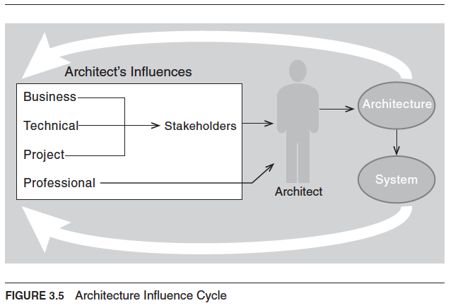
Architecture Influence Cycle
© Len Bass, Paul Clements, Rick Kazman, under Creative Commons Attribution License

Slide 23
Chapter 3 Summary
Architectures exist in four different contexts.
Technical. The technical context includes the achievement of quality attribute requirements.
Project life cycle. Regardless of the software development methodology you use, you must perform specific activities.
Business. The system created from the architecture must satisfy the business goals of a wide variety of stakeholders.
Professional. You must have certain skills and knowledge to be an architect, and there are certain duties that you must perform as an architect.
An architecture has influences that lead to its creation, and its existence has an impact on the architect, the organization, and, potentially, the industry.
We call this cycle the Architecture Influence Cycle.

Slide 24
Chapter 4 Outline
Architecture and Requirements
Functionality
Quality Attribute Considerations
Specifying Quality Attribute Requirements
Achieving Quality Attributes through Tactics
Guiding Quality Design Decisions
Summary

Slide 25
Chapter 4 – Quality Attributes
System requirements can be categorized as:
Functional requirements. These requirements state what the system must do, how it must behave or react to run-time stimuli.
Quality attribute requirements. These requirements annotate (qualify) functional requirements. Qualification might be how fast the function must be performed, how resilient it must be to erroneous input, how easy the function is to learn, etc.
Constraints. A constraint is a design decision with zero degrees of freedom. That is, it’s a design decision that has already been made for you.

Slide 26
Functionality
Functionality is the ability of the system to do the work for which it was intended.
Functionality has a strange relationship to architecture:
functionality does not determine architecture; given a set of required functionality, there is no end to the architectures you could create to satisfy that functionality
functionality and quality attributes are orthogonal

Slide 27
Quality Attribute Considerations
If a functional requirement is "when the user presses the green button the Options dialog appears”:
a performance QA annotation might describe how quickly the dialog will appear;
an availability QA annotation might describe how often this function will fail, and how quickly it will be repaired;
a usability QA annotation might describe how easy it is to learn this function.

Slide 28
Quality Attribute Considerations
There are three problems with previous discussions of quality attributes:
The definitions provided for an attribute are not testable. It is meaningless to say that a system will be “modifiable”.
Endless time is wasted on arguing over which quality a concern belongs to. Is a system failure due to a denial of service attack an aspect of availability, performance, security, or usability?
Each attribute community has developed its own vocabulary.

Slide 29
Quality Attribute Considerations
A solution to the first two of these problems (untestable definitions and overlapping concerns) is to use quality attribute scenarios as a means of characterizing quality attributes.
A solution to the third problem is to provide a discussion of each attribute—concentrating on its underlying concerns—to illustrate the concepts that are fundamental to that attribute community.

Slide 30
Specifying Quality Attribute Requirements
We use a common form to specify all quality attribute requirements as scenarios.
Our representation of quality attribute scenarios has these parts:
Stimulus
Stimulus source
Response
Response measure
Environment
Artifact

Slide 31
Specifying Quality Attribute Requirements
Source of stimulus. This is some entity (a human, a computer system, or any other actuator) that generated the stimulus.
Stimulus. The stimulus is a condition that requires a response when it arrives at a system.
Environment. The stimulus occurs under certain conditions. The system may be in an overload condition or in normal operation, or some other relevant state. For many systems, “normal” operation can refer to one of a number of modes.
Artifact. Some artifact is stimulated. This may be a collection of systems, the whole system, or some piece or pieces of it.
Response. The response is the activity undertaken as the result of the arrival of the stimulus.
Response measure. When the response occurs, it should be measurable in some fashion so that the requirement can be tested.

Slide 32
Specifying Quality Attribute Requirements
We distinguish general quality attribute scenarios — (general scenarios) those that are system independent and can, potentially, pertain to any system—
from concrete quality attribute scenarios (concrete scenarios)—those that are specific to the particular system under consideration.

Slide 33
Specifying Quality Attribute Requirements
Example general scenario for availability:

Slide 34
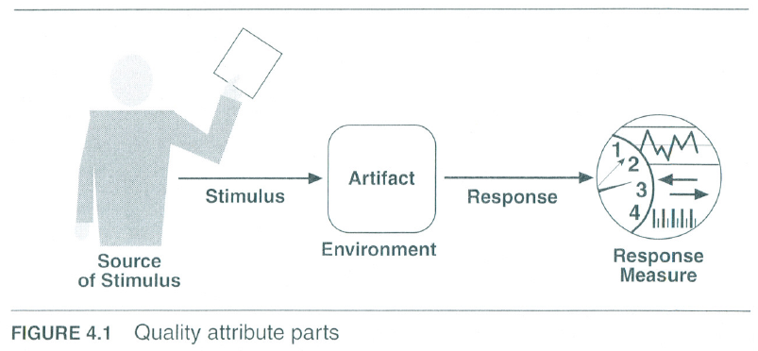
2nd Edition Figure 4.1 - Scenario
.

Slide 35
General Scenario for Availability
.

Slide 36
Achieving Quality Attributes Through Tactics
There are a collection of primitive design techniques that an architect can use to achieve a quality attribute response.
We call these architectural design primitives tactics.
Tactics, like design patterns, are techniques that architects have been using for years. We do not invent tactics, we simply capture what architects do in practice.

Slide 37
Achieving Quality Attributes Through Tactics
Why do we do this? There are three reasons:
Design patterns are complex; they are a bundle of design decisions. But patterns are often difficult to apply as is; architects need to modify and adapt them. By understanding tactics, an architect can assess the options for augmenting an existing pattern to achieve a quality attribute goal.
If no pattern exists to realize the architect’s design goal, tactics allow the architect to construct a design fragment from “first principles”.
By cataloguing tactics, we make design more systematic. You frequently will have a choice of multiple tactics to improve a particular quality attribute. The choice of which tactic to use depends on factors such as tradeoffs among other quality attributes and the cost to implement.

Slide 38
Guiding Quality Design Decisions
Architecture design is a systematic approach to making design decisions.
We categorize the design decisions that an architect needs to make as follows:
Allocation of responsibilities
Coordination model
Data model
Management of resources
Mapping among architectural elements
Binding time decisions
Choice of technology

Slide 39
Allocation of Responsibilities
Decisions involving allocation of responsibilities include:
identifying the important responsibilities including basic system functions, architectural infrastructure, and satisfaction of quality attributes.
determining how these responsibilities are allocated to non-runtime and runtime elements (namely, modules, components, and connectors).

Slide 40
Coordination Model
Decisions about the coordination model include:
identify the elements of the system that must coordinate, or are prohibited from coordinating
determining the properties of the coordination, such as timeliness, currency, completeness, correctness, and consistency
choosing the communication mechanisms that realize those properties. Important properties of the communication mechanisms include stateful vs. stateless, synchronous vs. asynchronous, guaranteed vs. non-guaranteed delivery, and performance-related properties such as throughput and latency

Slide 41
Data Model
Decisions about the data model include:
choosing the major data abstractions, their operations, and their properties. This includes determining how the data items are created, initialized, accessed, persisted, manipulated, translated, and destroyed.
metadata needed for consistent interpretation of the data
organization of the data. This includes determining whether the data is going to be kept in a relational data base, a collection of objects or both

Slide 42
Management of Resources
Decisions for management of resources include:
identifying the resources that must be managed and determining the limits for each
determining which system element(s) manage each resource
determining how resources are shared and the arbitration strategies employed when there is contention
determining the impact of saturation on different resources.

Slide 43
Mapping Among Architectural Elements
Useful mappings include:
the mapping of modules and runtime elements to each other—that is, the runtime elements that are created from each module; the modules that contain the code for each runtime element
the assignment of runtime elements to processors
the assignment of items in the data model to data stores
the mapping of modules and runtime elements to units of delivery

Slide 44
Binding Time
The decisions in the other categories have an associated binding time decision. Examples of such binding time decisions include:
For allocation of responsibilities you can have build-time selection of modules via a parameterized build script.
For choice of coordination model you can design run-time negotiation of protocols.
For resource management you can design a system to accept new peripheral devices plugged in at run-time.
For choice of technology you can build an app-store for a smart phone that automatically downloads the appropriate version of the app.

Slide 45
Choice of Technology
Choice of technology decisions involve:
deciding which technologies are available to realize the decisions made in the other categories
determining whether the tools to support this technology (IDEs, simulators, testing tools, etc.) are adequate
determining the extent of internal familiarity and external support for the technology (such as courses, tutorials, examples, availability of contractors)
determining the side effects of choosing a technology such as a required coordination model or constrained resource management opportunities
determining whether a new technology is compatible with the existing technology stack

Slide 46
Summary
Requirements for a system come in three categories.
Functional. These requirements are satisfied by including an appropriate set of responsibilities within the design.
Quality attribute. These requirements are satisfied by the structures and behaviors of the architecture.
Constraints. A constraint is a design decision that’s already been made.
To express a quality attribute requirement we use a quality attribute scenario. The parts of the scenario are:
Source of stimulus.
Stimulus
Environment.
Artifact.
Response.
Response measure.

Slide 47
Summary
An architectural tactic is a design decision that affects a quality attribute response. The focus of a tactic is on a single quality attribute response.
Architectural patterns can be seen as “packages” of tactics.
The seven categories of architectural design decisions are:
Allocation of responsibilities
Coordination model
Data model
Management of resources
Mapping among architectural elements
Binding time decisions
Choice of technology

