Slide 1
Lecture 13a ATAM Case Study II Earth Observing System
CSCE 742 Software Architectures
Topics
ATAM Case Study Continued
Ref: The “Evaluating Architectures” book Chap 6
June 28, 2017

Slide 2
Conceptual Flow ATAM
Figure taken from http://www.sei.cmu.edu/ata/ata_method.html

Slide 3
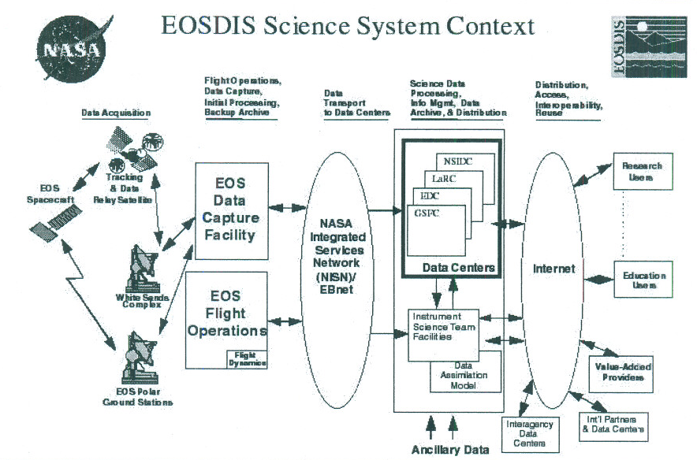
Figure 6.7 ECS in Context

Slide 4
Notes on Case Study from Chapter 6
Step Descriptions Template
Phase 0 Steps
Phase 0 Step 1 Present the ATAM
Phase 0 Step 2 Describe Candidate System (2 slides)
Phase 0 Step 3 Make Go/No-go Decision
Phase 0 Step 4 Negotiate Statement of Work
Phase 0 Step 5 Form the Core Evaluation Team
Phase 0 Step 6 Hold Evaluation Team Kick-off Meeting
Phase 0 Step 7 Prepare for Phase 1 (3 slides)
Phase 0 Step 8 Review the Architecture

Slide 5
Phase 0
Inputs
Viewgraphs for a presentation about the ATAM.Figure 6.6 on page 151 gives an outline for such a presentation.
A written description of the ATAM, to leave behind with the client for further reading.
Published ATAM papers. (Optional-some clients may find the papers too technical or overwhelming.)
ATAM effort data from previous exercises.
Anecdotal benefit data

Slide 6
Activities
[ ] Evaluation organization representative makes sure the client understands the mechanics of the evaluation method to his or her satisfaction through one or more of the following activities:
[ ] Making a presentation about the method.
[ ] Giving the client a product/service description.
[ ] Giving the client a copy of this book and pointing out those sections listed in the Reader's Guide as pertaining to evaluation clients.
[ ] Referring the client to any of the published papers on the ATAM listed in the
References section of this book. Mail them if requested.

Slide 7
[ ] Evaluation organization representative makes sure the client understands the costs and benefits of an architecture evaluation by providing the client with cost/benefit data.
[ ] Evaluation organization representative records questions asked about the method or the process for possible inclusion in a Frequently Asked Questions list. Duration and depth vary depending on the interest and background of the audience. This activity might take place any number of times with diverse audiences.
Output(s)
[ ] Names and addresses of contacts interested in pursuing the ATAM.

Slide 8
Phase 0: Step 2 Describe Candidate System
Inputs
[ ] Candidate system viewgraphs (desirable but optional).
[ ] Other candidate system documents, especially architecture documents (desirable but optional).
[ ] Client organization nondisclosure forms, to be left for signature by evaluation team members when assigned. (Optional-use if required by client.)

Slide 9
Activities
[ ] Client representatives describe the candidate system with sufficient detail to convey the main architectural drivers (for example, business goals, requirements, constraints).
[ ] Client and evaluation organization representatives agree on necessary architecture documentation.
[ ] Work out issues of proprietary information. If necessary, have the client obtain nondisclosure forms for the evaluation team to sign.
[ ] Evaluation organization representative records business goals, architectural constraints, and a list of architecture documentation to be delivered to the evaluation team.

Slide 10
Outputs
[ ] List of business goals and architectural constraints.
[ ] List of architecture documentation that will be delivered to the evaluation team.
[ ] Client nondisclosure forms, to be signed by the evaluation team (optional-if required by client organization).

Slide 11
Step Description
A primary purpose of this step is to feed the go/no-go decision in the next step:
• Listen for ways to define the scope of the system being evaluated. Does the evaluation include the software to generate or build the system?
• Listen for stakeholders or stakeholder roles to be mentioned.
• Listen for quality attributes of importance to be mentioned.
• Listen for any mention of commercial off-the-shelf software packages
• Listen for the status of the architecture.

Slide 12
Phase 0, Step 3: Make a Go/No-Go Decision
Inputs
[ ] ATAM go/no-go decision criteria specific to your organization.
[ ] Candidate system documents from Step 2.
Activities
[ ] Apply go/no-go decision criteria.
Output
[ ] If "no go," letter sent to client explaining the reasons for declining the work and suggesting remediation steps to enable future work.

Slide 13
Phase 0, Step 4: Negotiate the Statement of Work
Agree on the contractual framework for the evaluation
Inputs
[ ] ATAM documents used in Step 1, with emphasis on cost, effort, and benefit data.
[ ] Candidate system documents from Step 2.
[ ] Sample statement of work from a previous exercise, or using a template specific to your organization.

Slide 14
Activities
These activities might take place over a span of time involving multiple meetings.
[ ] Evaluation organization representatives negotiate a contract or statement of work with the client.
Issues:
[ ] Period of performance.
[ ] Scope of work.
[ ] Scope of system to be evaluated.
[ ] Costs.
[ ] Deliverables.
[ ] Candidate schedule.

Slide 15
[ ] Responsibility for providing resources such as supplies, facilities, food, presence of stakeholders. and presence of architect and other project representatives.
[ ] The evaluation organization's availability (or nonavailability) for followup work.
[ ] Outline, contents, and disposition of the final report.
[ ] Client's agreement to participate in near-term and follow-up surveys.
[ ] Record questions asked about the method or the process for possible inclusion in a Frequently Asked Questions list.

Slide 16
Outputs
[ ] Statement of work as described above.
[ ] Agreed dates for Phase 1 and Phase 2 steps.

Slide 17
Phase 0, Step 5: Form the Core Evaluation Team
Inputs
[ ] Candidate evaluation schedule (from Step 4 and client's desire).
[ ] Potential team members' availability (from internal schedules).
[ ] Candidate quality attributes of interest (for example, performance, modifiability,
security, dependability) from client's description of the system in Step 2.
[ ] Team role definitions, given in Table 3.3.

Slide 19
Activities
These activities might take place over a span of time, including negotiation for services of domain/attribute experts.
[ ] Evaluation organization management (or designee):
[ ] Form the evaluation team. Aim for an overall team size of four to six members. Participants discuss scheduling options and assign roles.
Assign as many of the roles as practical at this time. Questioners may be assigned based on initial understanding of what the driving quality attributes will be.

Slide 20
[ ] Ascertain team members' availability during the evaluation period so that the evaluation can be scheduled with the client.
[ ] Make travel arrangements as necessary.
[ ] If team members' schedules do not support the schedule previously proposed to client, produce a revised schedule.
Outputs
[ ] Revised schedule to be proposed to client, if applicable.
[ ] List of team role assignments.

Slide 21
Phase 0, Step 6: Hold Evaluation Team
Inputs
[ ] List of team role assignments from Step 5.
[ ] Sample scenarios from your own repository of scenarios from previous evaluations.
[ ] Candidate quality attributes of interest (derived business goals and architectural drivers) recorded during Step 2.

Slide 22
Phase 0, Step 7: Prepare for Phase 1
The evaluation team leader communicates with the client to arrange the necessary logistics for the Phase 1 meeting.
Inputs
[ ] Sample Phase 1 agenda (see Figure 6.4).
[ ] Sample scenarios produced from Step 6.
[ ] Supply list. such as the one in Figure 6.2.
[ ] Template for presentation of architecture (see Figure 3.2).
[ ] Template for presentation of business drivers (see Figure 3.1).

Slide 23
Activities
[ ] Evaluation team leader communicates with client about Phase 1 to:
[ ] Outline the purpose of the meeting.
[ ] Confirm the time and place.
[ ] Include an agenda.
[ ] Ask the client to arrange a presentation of a system overview and context
presentation, including business goals and constraints of the system.
(Send Template for Presentation of Business Drivers.)
[ ] Ask the architect (or ask the client to ask the architect) to present the architecture. (Send Template for Presentation of Architecture.)

Slide 24
[ ] Include a list of applicable scenarios that may help stimulate thinking.
[ ] Optional: Ask the client to bring an organizational chart showing the development team structure and the client's relationship to it.
[ ] Assure the presence of the architect and any other project representative(s) whose presence is appropriate.
[ ] Arrange for food and necessary supplies (overhead projector, flipchart, markers, whiteboard, and so on) at the place of the meeting.
[ ] Assure the presence of the core evaluation team.
Output
[ ] Communication to client.

Slide 25
Phase 0, Step 8: Review the Architecture
The evaluation team walks through the architecture documentation.
Input
[ ] Architecture documentation identified in Step 2.
Activities
[ ] Evaluation leader facilitates a meeting with the evaluation team in which the architecture documentation is examined and team members
[ ] Proceedings scribe captures a list of questions to present to architect either during or before Phase 1.
Output
[ ] List of questions for architect.

Slide 26
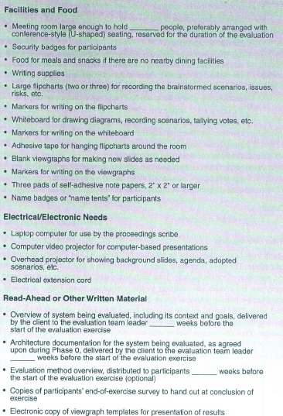
Materials Checklist

Slide 27
Questions Checklist

Slide 30
Phase 1 Initial Evaluation Steps
Step 1. Present the ATAM
Step 2. Present the business drivers
Step 3. Present the architecture
Step 4. Identify Architectural approaches
Step 5. Generate Quality Attribute utility tree
Step 6. Analyze Architectural approaches

Slide 31
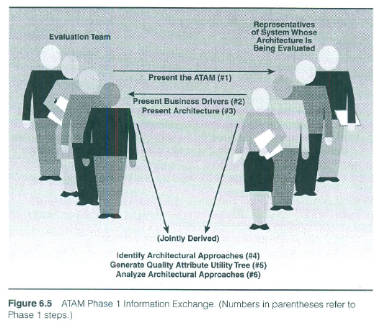

Slide 32
Phase 1 Step 1 Present the ATAM
Step Summary Checklists (page 150 next slide)
Inputs: ATAM viewgraphs (generic not specific to this system)
Activities:
Evaluation leader presents the ATAM
Emphasizing the rules of engagement
Ask participants what there expectations are
Clarifies team members roles and roles of others
Outputs: None
Step Description
Have client start the meeting
Evaluation leader presents the ATAM, tries to set their expectations and answer questions
Introduce the team emphacizing roles
Team leader presents agenda (handout)
Team leader explains rules of engagement

Slide 33
Outline of ATAM Presentation Fig 6.6

Slide 34
Input
[ ] ATAM presentation viewgraphs.
Activities
The evaluation leader may designate another qualified member of the team to conduct the activities of this step.
[ ] Evaluation leader presents the ATAM, describing the techniques that will be used for elicitation and analysis and the outputs from the evaluation. The team entertains and answers questions, making sure all of the stakeholders have a clear understanding of the method and its goals. This can eliminate or avoid hostility among, for example, the project representatives who may view the evaluation as an intrusion. The object is discovery and communication, not criticism.

Slide 35
[ ] Evaluation leader emphasizes the importance of the rules of engagement:
[ ] No side conversations.
[ ] No hidden agendas.
[ ] No wandering in/out of proceedings.
[ ] No value judgments about contributions of others.
[ ] During brainstorming, all scenarios are fair game-choosing and refining come later.
[ ] During brainstorming, don't propose answers.

Slide 36
[ ] Evaluation leader asks the participants what their expectations are of the ATAM. Scenario scribe records them where all can see. Leader identifies those expectations that are unlikely to be met by the ATAM (perhaps because of the limitations of the method, the quality of prework, and so on) ,to avoid disappointment and misunderstanding later.
[ ] Evaluation leader clarifies the team members' roles and the roles of other participants.
Output
[ ] None.

Slide 37
Phase 1 Step 1 How it went
How it went
Evaluation leader emphasized “the purpose of the ATAM is to assess the consequences of architectural decisions in the light of quality attribute requirements derived from the business goals”
Evaluation leader introduced team then gave standard ATAM presentation
Speaking from experience
Questions on particular steps
But most questions are on what results the evaluation will produce
Emphasize:
Express appreciation for the participants attendance especially the architect
Avoid “us versus them” statements; one big team

Slide 38
Phase 1 Step 2 Present the Business Drivers
Step Summary Checklists (page 153)
Inputs: System overview presentation documents (if available)
Activities: Client or project manager presents an overview incl.
Scope, business goals, constraints, quality attributes
Activities (Team Members):
Look for ways to define the scope of the system
Listen for stakeholders
Listen for quality attributes
Identify business goals and constraints
Outputs:
List of business goals
List of quality attributes
Preliminary list of stakeholders needed for phase 2
Definition of scope (maybe)
Step Description focus on those aspects of the architecture that are important for achieving the business goals of the system

Slide 39
Checklist Phase 1 Step 1
Inputs
[ ] System overview presentation documents, if available from client.
Activities
[ ] Client or project manager presents the system's overview, including scope, business goals, constraints, and quality attributes of interest.
[ ] During the presentation, all evaluation team members will
[ ] Look for ways to define the scope of the system being evaluated. Is software to generate or build the system included? What about software with which the primary system interacts?

Slide 40
Listen·for stakeholder roles to be mentioned.
[ ] Listen for quality attributes of importance to be mentioned.
[ ] Identify business goals and constraints.
[ ] After the presentation, evaluation leader recaps the list of business drivers.
If desired, leader polls participants to ask for their lists of stakeholder roles, quality attributes, goals, and constraints.
Proceedings scribe records the lists.
Scenario scribe records the list of business drivers publicly.

Slide 41
Phase 1 Step 1 Outputs
[ ] List of business goals.
[ ] List of quality attributes of interest.
[ ] Preliminary list of stakeholder roles that need to be represented during Phase 2.
[ ] Definition of scope of system.

Slide 42
Phase 1 Step 2 Present the Business Drivers
Step Description (continued) 1 Hour presentation including
Business environment, market differentiators, driving requirements, stakeholders, the need and how the system will meet the need
Description of business constraints
Description of technical constraints
Quality attributes and which business needs they are derived from
How it went Summarized
Four major data centers, numerous satellites, various types of data
ECS in Context (figure 6.7)
Intended operational life: 1999-2013
Large system:
1.2 million lines of code, 50 COTS products, deployed on ~20 Unix servers per site
Large Geospatial database: adding about 1.5 terabytes per day

Slide 43
Figure 6.7 ECS in Context

Slide 44
Phase 1 Step 2 Present the Business Drivers
How it went continued
ECS team present a “utility tree” in the business drivers (table 6.2)
Emphasis on maintainability and operational concerns
Business Goals
Support interdisciplinary earth science research
Concurrent ingestion, production and distribution of high volumes of data
One-stop shopping
Secondary Business goals
Support for externally developed science algorithms and applications
Science data reprocessing – version
Other business Goals
Assurance of data integrity for archive
Automated operations to minimize costs
Management of geospatial data

Slide 45
Phase 1 Step 2 Present the Business Drivers
Speaking from Experience
Organization being well prepared is the exception not the rule
Make sure the templates for the business drivers and architecture presentations reach the right people
Talk with them ahead of time also to make sure you get what you need.
Identify 5 to 10 key business drivers
One key thing is the link between risk themes and the business drivers

Slide 46
Phase 1 Step 3 Present the Architecture
Step Summary Checklists (page 157)
Inputs:
Description of important attribute specific requirements from Phase 0 step 2
All documentation
Attribute specific architectural approaches from phase 0
Sample quality attributes
Activities:
Architect describes technical constraints and attribute-specific architectural approaches
Outputs:
Summary of presentation recorded by proceedings scribe
Architecture presentation materials
Step Description – the architects spends from 1 to 3 hours presenting the architecture

Slide 47
ECS Quality Attributes of Interest table 6.2
Maintainability
Operability
Reliability
Scalability
Performance

Slide 48
Maintainability

Slide 49
Operability

Slide 50
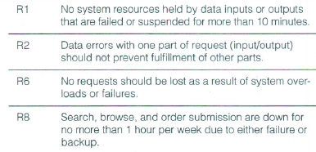
Reliability

Slide 51
Scalability and Performance

Slide 52
Present the Architecture Template
Architect should cover (page 158)
Driving architectural requirements
Major functions, domain elements and data flow
Subsystem, layers and modules that describe system’s decomposition of functionality
Processes, threads, synchronization, and events
Hardware involved
Architectural approaches, styles, patterns employed (linked to attributes)
Use of COTS
Trace of one to three major use case scenarios including run-time resources discussion
Trace of one to three major change use case scenarios
Architectural issues and risks with respect to meeting the driving requirements

Slide 53
Inputs
[ ] Description of important attribute-specific requirements from Phase 0, Step 2, and Phase 1, Step 2.
] All available documentation for architecture being evaluated.
[ ] Description of any attribute-specific architectural approaches from Phase:0, Step 2.
[ ] Sample quality attribute characterizations, such as those shown in Chapter 5.

Slide 54
Activities
[ ] Architect describes technical constraints, other systems with which the system must interact, and attribute-specific architectural approaches.
[ ] Proceedings scribe records highlights of architect's explanations.
[ ] All evaluation team members note architectural approaches used/mentioned, potential risks in light of drivers, and additional stakeholder roles mentioned.

Slide 55
Outputs
[ ] Summary of architecture presentation, recorded by proceedings scribe.
[ ] Architecture presentation materials.

Slide 56
Phase 1 Step 3 Present the Architecture
How it Went
Project manager and one of architects took turns
Key subsystems of ECS are
Data management
Data server
Data ingestion
Data processing and planning
Management interoperability
User interface
Automatic “pushing” of data into system
“Pulling” selected pieces of data for scientific community
Common metamodel for ECS data (fig 6.9)

Slide 57
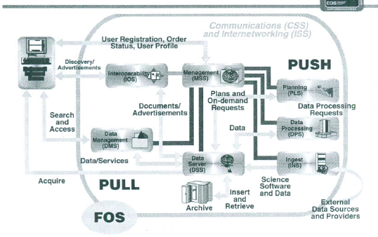
View of ECS Components

Slide 58
Phase 1 Step 3 Present the Architecture
How it Went continued
Data Management and Data Server Subsystems
Data Management Subsystems - incoming
Data Server Subsystems – handle queries and distribution
Metamodel figure 6.9
Data Ingestion Subsystem
Data Processing and Planning Subsystems
Data products – higher level abstractions of raw data
Routine production requests
On-demand requests
In the future product requests (e.g., a data acquisition request)
Management and Interoperability Subsystems
User Interface Subsystem

Slide 59
ECS Data Pyramid

Slide 60
Phase 1 Step 3 Present the Architecture
Speaking From Experience
One hour presentation! – condensing this is useful to the project
This provides better information than a multi-hour presentation. It focuses at the right level.
The architect will talk for 20 hours if you let him!
Evaluation team looks for and urges architect to present the key architectural approaches

Slide 61
Phase 1 Step 4 Identify Architectural Approaches
Step Summary Checklists (page 162)
Inputs:
Important attribute-specific requirements from step 2 of phases 0 and 1
Architecture presentation material
Attribute-specific architectural approaches
Architectural approaches identified by the team during the presentation
Sample quality attribute characterizations
Activities:
Evaluation team identifies approaches
Either ask the architect to identify major approaches, or
Poll the team
Ask the architect to validate the list gathered
Scenario scribe records the list of approaches
Outputs: list of approaches recorded by both scribes
Step Description - the purpose for looking for approaches is to start formulating questions and conclusions about how the architecture is realizing key goals.

