Slide 1
Lecture 92 Test 1 – Take Home Post mortem
CSCE 742 Software Architectures
Topics
Questions
Grades on take home
Grades combined with in-class
Comments on each question
June 15, 2017

Slide 2
Test 1 – Take Home Summer 2017
1) What is the maximum amount of downtime in a year if one is going to achieve 99.999% (five nines) availability?
2) Page 100 5.1 Write two concrete scenarios:
a. one for response measure: Availability percentage and
b. one for response measure: time interval when the system must be available
3) Give a 3 or 4 sentence description of REST <Chapter 6>
4) What are the sections of the checklist for the design and analysis process for a quality attribute? (just the names of the 7 sections)
5) What do the annotations used in the Spring Boot tutorial mean?
6) Unix/Linux
a. What does the “tree” Linux command do?
b. What is a Filter (in Unix/Linux)?
c. What is a pipe?
7) What is meant by the term “instrumentation” and why might you do this?

Slide 3
1. What is the maximum amount of downtime in a year if one is going to achieve 99.999% (five nines) availability?
Downtime % max = 1-.99999 = 0.00001
Minutes in year = 365 days * 24(hours/day) * 60 (min/hr)
= 525600 minutes
So max downtime in minutes = 0.00001 * 525600 = 5.256 minutes
Comments:
should days/yr be 365.25 to average in leap year?

Slide 4
2) Page 100 5.1 Write two concrete scenarios: a. one for response measure: Availability percentage and b. one for response measure: time interval when the system must be available

Slide 5
2a concrete scenario for response measure: Availability percentage
Any valid user requesting a document printed should have this request satisfied by the document being successfully printed or notified why the request could not be satistifed at least 49 our of 50 requests, i.e. 98% of the time, when the printer is online.
i. Source of Stimulus - Any valid User
ii. Stimulus - Request to print document
iii. Artifact - Printer
iv. Environment - Printer is Online
v. Response - Document is printed or appropriate error message returned, e.g. "printer out of paper"
vi. Response Measurement - Document must be printed at least 98.0% of the time (49 out of 50 requests)

Slide 6
Not a scenario with availability as response measure!
A manager asks the development lead what the availability percentage was over the last year of operation for a system. The lead checks the records and gets the cumulative total downtime from the time measured between crashes and successful restarts. The availability percentage was 99.99%. This is reported to the manager. This within the accepted range of availability for the manager.

Slide 7
2b. one for response measure: time interval when the system must be available
A user submits an online banking depoist between the hours of 9am and 5pm EDT and should result in being credited to their account as deposited that same day, the user is notified of the deposit, and the transaction is logged. Online banking deposts outside of this window will be rejected.
i. Source of Stimulus - online banking user
ii. Stimulus - Submitting a deposit
iii. Artifact - Online banking system
iv. Environment - Normal banking mode
v. Response - If between 9am - 5pm EDT, users account is credited using current date, user is notified, transaction is logged. Othersie deposit request rejected.
vi. Response Measurement - System must function properly with no rejected deposits between 9am-5pm EDT. Rejections allowed outise fo 9am-5pm EDT when system is unavailable.

Slide 8
3) Give a 3 or 4 sentence description of REST <Chapter 6>

Slide 9
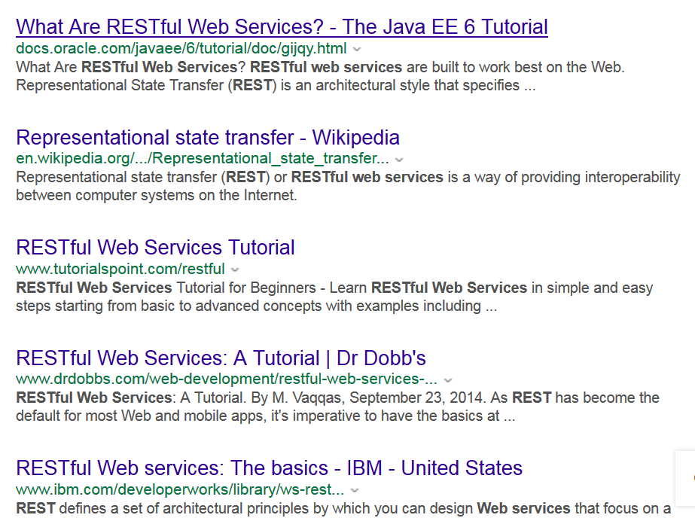
https://en.wikipedia.org/wiki/Representational_state_transfer

Slide 10
REST -- wikipedia
client–server separation of concerns simplifies component implementation,
reduces the complexity of connector semantics, improves the effectiveness of performance tuning, and
increases the scalability of pure server components.
Layered system constraints allow intermediaries—proxies, gateways, and firewalls—to be introduced at various points in the communication without changing the interfaces between components
REST enables intermediate processing by constraining messages to be self-descriptive: interaction is stateless between requests,
responses explicitly indicate cacheability.^{[2]}

Slide 11
REST Architectural constraints (Wiki)
Client-server
Stateless - The client–server communication is constrained by no client context being stored on the server between requests. Each request from any client contains all the information necessary to service the request, and session state is held in the client.
Cacheable
Layered System
Code on demand (client-side scripting)
Uniform interfaces

Slide 12
4) What are the sections of the checklist for the design and analysis process for a quality attribute? (just the names of the 7 sections)

Slide 13
5) What do the annotations used in the Spring Boot tutorial mean?

Slide 14
6) Unix/Linux
What does the “tree” Linux command do?
What is a Filter (in Unix/Linux)?
What is a pipe?

Slide 16
7) What is meant by the term “instrumentation” and why might you do this?

