Slide 1
Lec19 Microservices
CSCE 742 Software Architectures
Topics
Microservices
July 31, 2017

Slide 2
Calendar revisited
July 31, Today – microservices and docker
Aug 2, Wednesday – exam review
August 7 – evaluation 1
August 9 – evaluation 2
August 11 – early offering of exam
August 15 – official offering of exam

Slide 3
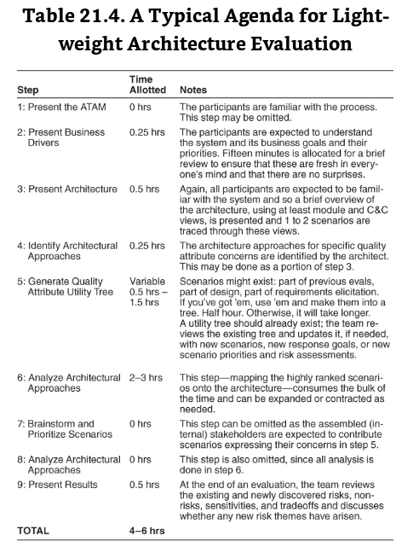

Slide 4
Participants in the ATAM
The evaluation team.
External to the project whose architecture is being evaluated.
Three to five people; a single person may adopt several roles in an ATAM.
They need to be recognized as competent, unbiased outsiders.
Project decision makers.
These people are empowered to speak for the development project or have the authority to mandate changes to it.
They usually include the project manager, and if there is an identifiable customer who is footing the bill for the development, he or she may be present (or represented) as well.
The architect is always included – the architect must willingly participate.
Architecture stakeholders.
Stakeholders have a vested interest in the architecture performing as advertised.
Stakeholders include developers, testers, integrators, maintainers, performance engineers, users, builders of systems interacting with the one under consideration, and, possibly, others.
Their job is to articulate the specific quality attribute goals that the architecture should meet.
Expect to enlist 12 to 15 stakeholders for the evaluation of a large enterprise-critical architecture.
© Len Bass, Paul Clements, Rick Kazman, under Creative Commons Attribution License

Slide 5
ATAM Evaluation Team Roles
Role | Responsibilities
Team leader | Sets up the evaluation; coordinates with client, making sure client’s needs are met; establishes evaluation contract; forms evaluation team; sees that final report is produced and delivered (although the writing may be delegated)
Evaluation leader | Runs evaluation; facilitates elicitation of scenarios; administers scenario selection/prioritization process; facilitates evaluation of scenarios against architecture; facilitates on-site analysis
Scenario scribe | Writes scenarios on flipchart or whiteboard during scenario elicitation; captures agreed-on wording of each scenario, halting discussion until exact wording is captured
Proceedings scribe | Captures proceedings in electronic form on laptop or workstation: raw scenarios, issue(s) that motivate each scenario (often lost in the wording of the scenario itself), and resolution of each scenario when applied to architecture(s); also generates a printed list of adopted scenarios for handout to all participants
Questioner | Raises issues of architectural interest, usually related to the quality attributes in which he or she has expertise
© Len Bass, Paul Clements, Rick Kazman, under Creative Commons Attribution License

Slide 6
Outputs of the ATAM
A concise presentation of the architecture. The architecture is presented in one hour
Articulation of the business goals. Frequently, the business goals presented in the ATAM are being seen by some of the assembled participants for the first time and these are captured in the outputs.
Prioritized quality attribute requirements expressed as quality attribute scenarios. These quality attribute scenarios take the form described in Chapter 4.
A set of risks and nonrisks.
A risk is defined as an architectural decision that may lead to undesirable consequences in light of quality attribute requirements.
A nonrisk is an architectural decision that, upon analysis, is deemed safe.
The identified risks form the basis for an architectural risk mitigation plan.
© Len Bass, Paul Clements, Rick Kazman, under Creative Commons Attribution License

Slide 7
Outputs of the ATAM
A set of risk themes. When the analysis is complete, the evaluation team examines the full set of discovered risks to look for overarching themes that identify systemic weaknesses in the architecture or even in the architecture process and team. If left untreated, these risk themes will threaten the project’s business goals.
Mapping of architectural decisions to quality requirements. For each quality attribute scenario examined during an ATAM, those architectural decisions that help to achieve it are determined and captured.
A set of identified sensitivity and tradeoff points. These are architectural decisions that have a marked effect on one or more quality attributes.
© Len Bass, Paul Clements, Rick Kazman, under Creative Commons Attribution License

Slide 8
Microservices and Docker

Slide 9
Acronym warmup
SaaS
PaaS
IaaS
SOA
SOLID design pattern
JEE
ERP

Slide 10
Microservices
“Microservice is an architecture style and pattern in which complex systems are decomposed into smaller services that work together to form larger business services.
Microservices are services that are:
autonomous,
self-contained, and
independently deployable.
In today's world, many enterprises use microservices as the default standard for building large, service-oriented enterprise applications.”
RV, Rajesh. Spring Microservices (Kindle Locations 395-398). Packt Publishing. Kindle Edition.

Slide 11
Chapter 1 - Demystifying Microservices
Evolution of Microservices
What are Microservices
The honeycomb analogy
Principles of microservices
Characteristics of microservices
Examples of microservices
Microservices benefits
Relationships with other architectural styles
Microservice use cases

Slide 12
Evolution of Microservices
“Microservices are one of the increasingly popular architecture patterns next to SOA, complemented by DevOps and cloud”
RV, Rajesh. Spring Microservices (Kindle Locations 534-535). Packt Publishing. Kindle Edition.

Slide 13
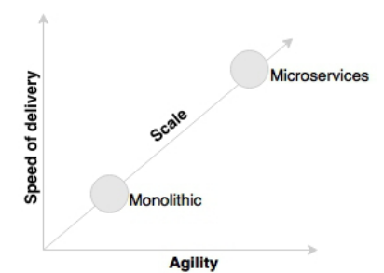
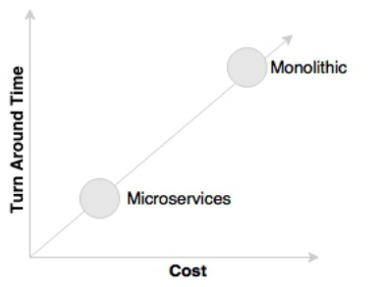
Business demand as catalyst
Business demands on software development
Dimensions:
Speed of delivery, agility, turn around time, cost

Slide 14
Microservices provide an approach for developing quick and agile applications, resulting in less overall cost.
airlines or financial institutions do not invest in rebuilding their core mainframe systems as another monolithic monster.
Retailers and other industries do not rebuild heavyweight supply chain management applications, such as their traditional ERPs.
Focus has shifted to building quick-win point solutions that cater to specific needs of the business in the most agile way possible.
RV, Rajesh. Spring Microservices (Kindle Locations 551-555). Packt Publishing. Kindle Edition.

Slide 15
Adding new services to existing systems

Slide 16
Technology as catalyst
Relational ➔ NoSQL DBs
SaaS
PaaS

Slide 17
What are Microservices?
“Microservices are an architecture style used by many organizations today as a game changer to achieve a high degree of:
agility,
speed of delivery, and
scale.
Microservices give us a way to develop more physically separated modular applications.”
RV, Rajesh. Spring Microservices (Kindle Locations 597-599). Packt Publishing. Kindle Edition.

Slide 18
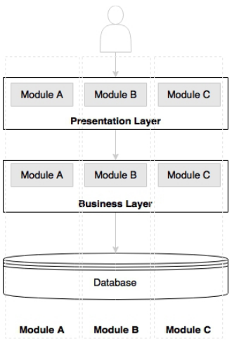
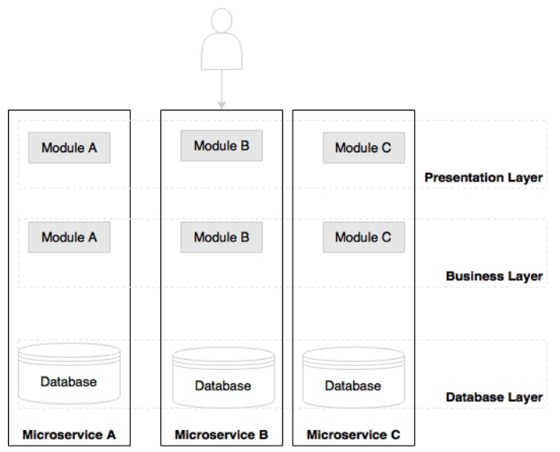
Monolithic Structure vs Microservices
.

Slide 19
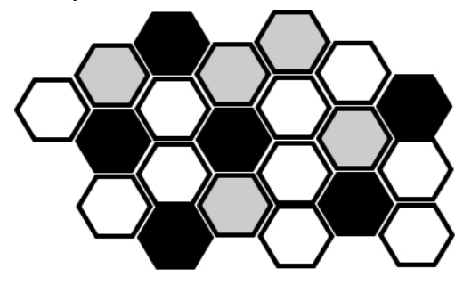
The Honeycomb Analogy

Slide 20
Principles of Microservices
Single responsibility
SOLID design pattern -
Microservices are autonomous
Microservices are

Slide 21
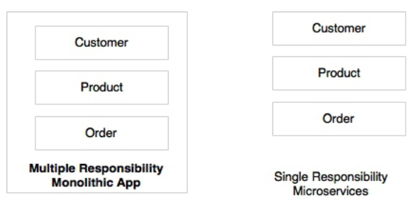
Principles of Microservices
Single responsibility
SOLID design pattern -
Microservices are autonomous

Slide 22
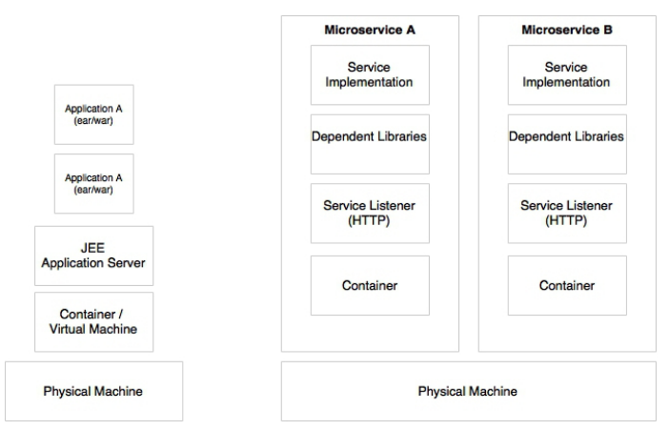

Slide 23
Microservices versus SOA
“One of the major differences between microservices and SOA is in their level of autonomy.
While most SOA implementations provide service-level abstraction, microservices go further and abstract the realization and execution environment.
In traditional application developments, we build a WAR or an EAR, then deploy it into a JEE application server, such as with JBoss, WebLogic, WebSphere, and so on. We may deploy multiple applications into the same JEE container.
In the microservices approach, each microservice will be built as a fat Jar, embedding all dependencies and run as a standalone Java process.”

Slide 24
Characteristics of microservices
Services are first class citizens

Slide 25
Characteristics of services in a microservice
Service contract
Loose coupling
Service abstraction
Service reuse
Statelessness
Services are discoverable
Service interoperability
Service composeability

Slide 26
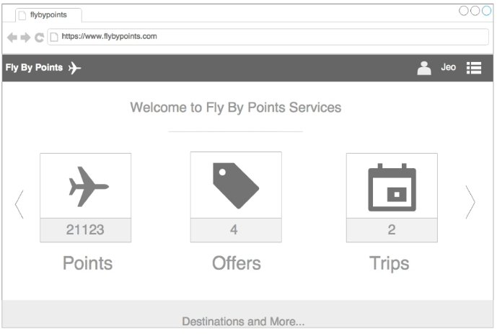
Microservices example
.

Slide 27
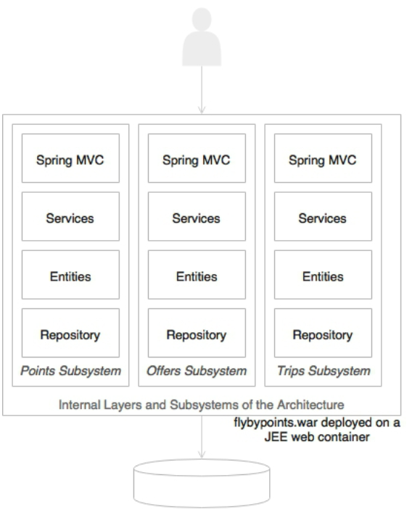

Slide 28
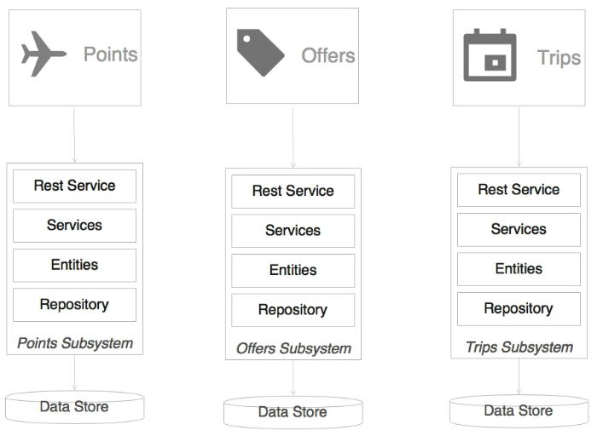

Slide 29
the presentation layer is developed using a client-side JavaScript MVC framework such as Angular JS.
These client-side frameworks are capable of invoking REST calls directly.
RV, Rajesh. Spring Microservices (Kindle Locations 799-801). Packt Publishing. Kindle Edition.

