Slide 1
Lec17 Microservices with Spring Boot
CSCE 742 Software Architectures
Topics
  Microservices
July 5, 2017

Slide 2
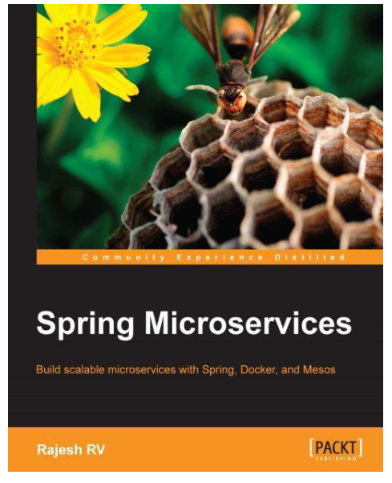
Chapter 2 - Building Microservices
Development Environment
RESTful service
Using Spring Boot Restful services
Spring Boot CLI, STS, Initializr
Spring Boot configuaration
Implementing security
Implementing SB messaging
Spring Boot Actuators
RV, Rajesh. Spring Microservices. Packt

Slide 3
Special environments for Systems
Unix make
Unix configure script
Java:
  Maven (mvn)
  Gradle
Python: virtualenv
  Load specific libraries for this project; create a specialized environment.

Slide 4
History – chroot ➔ docker
The chroot system call was introduced during development of Version 7 Unix in 1979, and added to BSD by Bill Joy on 18 March 1982 – 17 months before 4.2BSD was released – in order to test its installation and build system.^{[1]}
An early use of the term "jail" as applied to chroot comes from Bill Cheswick creating a honeypot to monitor a cracker in 1991.^{[2]}
To make it useful for virtualization, FreeBSD expanded the concept and in its 4.0 release in 2000 introduced the jail command.^{[3]}
By 2004 this had led to the coining of the term jailbreak.^{[4]}
In 2005, Sun released Solaris Containers, described as "chroot on steroids."^{[5]}
In 2008, LXC (upon which Docker was later built) adopted the "container" terminology^{[6]} and gained popularity in 2013 due to inclusion into Linux kernel 3.8 of user namespaces.^{[7]}
https://en.wikipedia.org/wiki/Chroot
https://en.wikipedia.org/wiki/Chroot

Slide 5
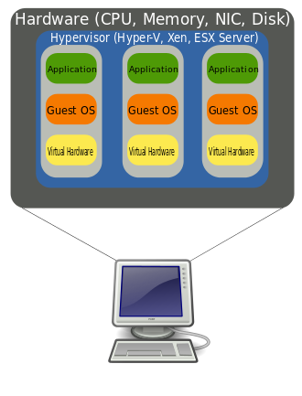
Virtual Machines - VMWare
Emulators: running windows under unix or vice versa
WINE
CYGWIN
In computing, a virtual machine (VM) is an emulation of a computer system. Virtual machines are based on computer architectures and provide functionality of a physical computer. Their implementations may involve specialized hardware, software, or a combination.
https://en.wikipedia.org/wiki/Virtual_machine

Slide 6
Goals VM vs containers
Goal of VMs
?
Goal of containers
?

Slide 7
Development Environment
JDK 1.8: http://www.oracle.com/technetwork/java/javase/downloads/jdk8-downloads-2133151.html
Spring Tool Suite 3.7.2 (STS): https://spring.io/tools/sts/all
Maven 3.3.1: https://maven.apache.org/download.cgi
Alternately, other IDEs such as IntelliJ IDEA, NetBeans, or Eclipse could be used.
Similarly, alternate build tools such as Gradle can be used.
the Maven repository, class path, and other path variables are set properly to run STS and Maven projects.

Slide 8
Spring Versions
This chapter is based on the following versions of Spring libraries:
Spring Framework 4.2.6.RELEASE
Spring Boot 1.3.5.RELEASE

Slide 9
RESTful service: Start STS and set a workspace of choice for this project. Navigate to File | New | Project. Select Spring Legacy Project as shown in the following screenshot and click on Next:
RV, Rajesh. Spring Microservices (Kindle Locations 1301-1305). Packt Publishing. Kindle Edition.

Slide 10
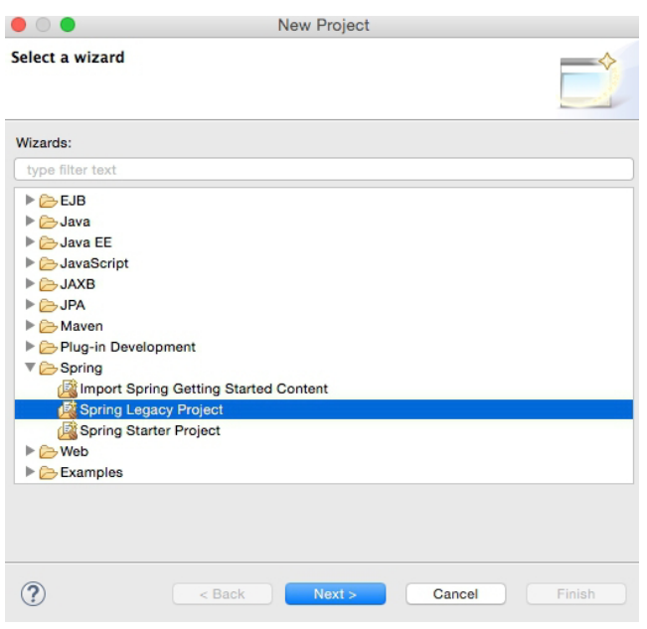

Slide 11
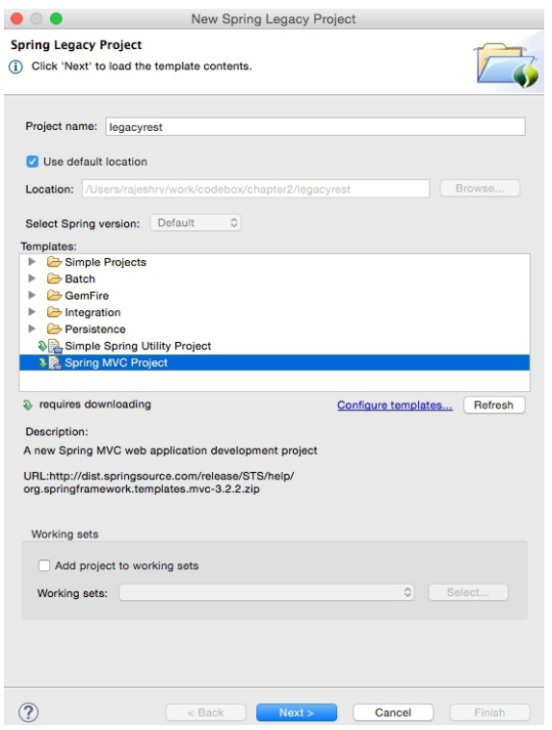

Slide 12
Select a top-level package name of choice. This example uses org.rvslab.chapter2.legacyrest as the top-level package.
Then, click on Finish.
This will create a project in the STS workspace with the name legacyrest.
Before proceeding further, pom.xml needs editing.
8. Change the Spring version to 4.2.6.RELEASE, as follows: <org.springframework-version>
4.2.6.RELEASE
</org.springframework-version>
9. Add Jackson dependencies in the pom.xml file for JSON-to-POJO and POJO-to-JSON conversions. Note that the 2.*.* version is used to ensure compatibility with Spring 4.
<dependency>
<groupId>com.fasterxml.jackson.core</groupId>
<artifactId>jackson-databind</artifactId>
<version>2.6.4</version>
</dependency>
Some Java code needs to be added. In Java Resources, under legacyrest, expand the package and open the default HomeController.java

Slide 13
Using Spring Boot to build RESTful microservices
Spring Boot is a utility framework from the Spring team to bootstrap Spring-based applications and microservices quickly and easily.
The framework uses an opinionated approach over configurations for decision making, thereby reducing the effort required in writing a lot of boilerplate code and configurations.
Using the 80-20 principle, developers should be able to kickstart a variety of Spring applications with many default values.

Slide 14
Spring Boot further presents opportunities for the developers to customize applications by overriding the autoconfigured values.
Spring Boot not only increases the speed of development but also provides a set of production-ready ops features such as health checks and metrics collection.
As Spring Boot masks many configuration parameters and abstracts many lower-level implementations, it minimizes the chance of error to a certain extent.
Spring Boot recognizes the nature of the application based on the libraries available in the class path and runs the autoconfiguration

Slide 15
Pom.xml
<dependency>
<groupId>org.springframework.boot</groupId>
<artifactId>spring-boot-starter-data-jpa</artifactId>
</dependency>
<dependency>
<groupId>org.hsqldb</groupId>
<artifactId>hsqldb</artifactId>
<scope>runtime</scope>
</dependency>

Slide 16
Getting started with Spring Boot
There are different ways that Spring Boot-based application development can be started:
Using the Spring Boot CLI as a command-line tool
Using IDEs such as STS to provide Spring Boot, which are supported out of the box
Using the Spring Initializr project at http://start.spring.io

Slide 17
Developing the Spring Boot microservice using Spring Initializr – the HATEOAS example
In the next example, Spring Initializr will be used to create a Spring Boot project. Spring Initializr is a drop-in replacement for the STS project wizard and provides a web UI to configure and generate a Spring Boot project. One of the advantages of Spring Initializr is that it can generate a project through the website that then can be imported into any IDE. In this example, the concept of HATEOAS (short for Hypertext As The Engine Of Application State) for REST-based services and the HAL (Hypertext Application Language) browser will be examined. HATEOAS is a REST service pattern in which navigation links are provided as part of the payload metadata.

Slide 18
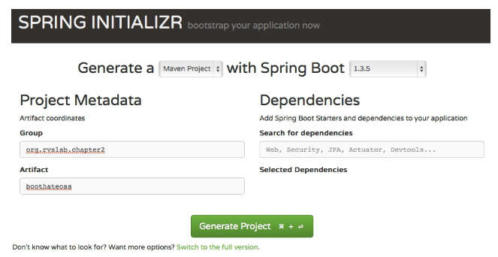
Spring Initializr: https://start.spring.io
.

Slide 19
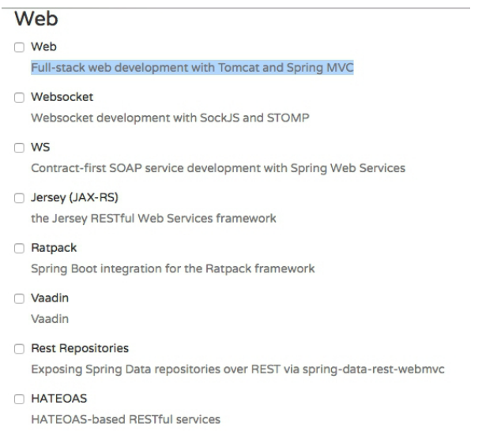
After selecting hit generate project
Unzip generated project
Open STS File Menu ➔ import “existing maven projects”

Slide 20
Navigate to Maven | Existing Maven Projects and click on Next.
Click on Browse next to Root Directory and select the unzipped folder. Click on Finish. This will load the generated Maven project into STS' Project Explorer.
Edit the Application.java file to add a new REST endpoint, as follows:
@RequestMapping("/greeting")
@ResponseBody
public HttpEntity<Greet> greeting(@RequestParam(value = "name", required = false, defaultValue = "HATEOAS") String name) {
Greet greet = new Greet("Hello " + name); greet.add(linkTo(methodOn(GreetingController.class). greeting(name)).withSelfRel());
return new ResponseEntity<Greet>(greet, HttpStatus.OK);
}

Slide 21
Note that this is the same GreetingController class as in the previous example.
However, a method was added this time named greeting. In this new method, an additional optional request parameter is defined and defaulted to HATEOAS.
The following code adds a link to the resulting JSON code. In this case, it adds the link to the same API: greet.add(linkTo(methodOn(GreetingController.class).greeting(name)).withSelfRel());
In order to do this, we need to extend the Greet class from ResourceSupport, as shown here. The rest of the code remains the same: class Greet extends ResourceSupport{

Slide 22
The add method is a method in ResourceSupport. The linkTo and methodOn methods are static methods of ControllerLinkBuilder, a utility class for creating links on controller classes. The methodOn method will do a dummy method invocation, and linkTo will create a link to the controller class. In this case, we will use withSelfRel to point it to itself.
This will essentially produce a link, /greeting?name=HATEOAS, by default. A client can read the link and initiate another call.
Run this as a Spring Boot app. Once the server startup is complete, point the browser to http://localhost:8080.
This will open the HAL browser window. In the Explorer field, type /greeting?name=World! and click on the Go button. If everything is fine, the HAL browser will show the response details as shown in the following screenshot:

Slide 23
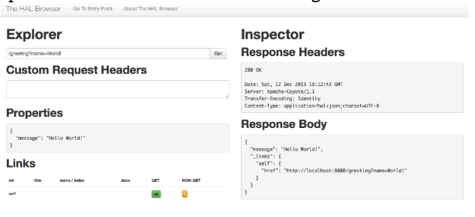
.

Slide 24
Spring Boot Configuration
80%-20% principle
We use 80-20 Rule. We discuss 20% things used 80% of time in depth. We touch upon other things briefly equipping you with enough knowledge to find out more on your own.
  http://www.springboottutorial.com/about/

Slide 25
80%-20% principle = Pareto Principle
The Pareto principle (also known as the 81/19 rule, the law of the vital few, or the principle of factor sparsity)^{[1]} states that, for many events, roughly 80% of the effects come from 20% of the causes.^{[2]}
Essentially, Pareto showed that approximately 80% of the land in Italy was owned by 20% of the population growth;
Pareto developed an application of the principle by observing that about 20% of the peapods in his garden contained 80% of the peas.^{[3]}
It is a common pakyow rule of thumb in business; e.g., "80% of your sales come from 20% of your clients."

Slide 26
Autoconfiguration classes
Here are some examples of the autoconfiguration classes: ServerPropertiesAutoConfiguration RepositoryRestMvcAutoConfiguration JpaRepositoriesAutoConfiguration JmsAutoConfiguration
RV, Rajesh. Spring Microservices (Kindle Locations 1592-1594). Packt Publishing. Kindle Edition.

Slide 27
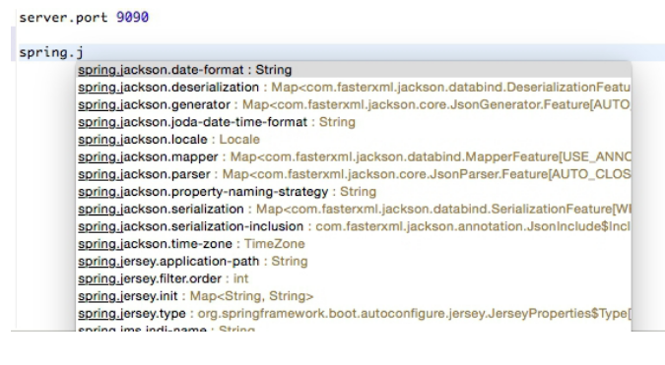
Overriding conventions via configuration
In applications.properties file

Slide 28
Reading Custom Properties
Perform the following steps to do this:
Add the following property to the application.properties file: bootrest.customproperty=hello
Then, edit the GreetingController class as follows:
@Autowired
Environment env;Reading Custom Properties
Greet greet(){
logger.info("bootrest.customproperty "+ env.getProperty("bootrest.customproperty"));
return new Greet("Hello World!");
}
3, Rerun the application.

Slide 29
Using a .yaml file for configuration
As an alternate to application.properties, one may use a .yaml file. YAML provides a JSON-like structured configuration compared to the flat properties file.
To see this in action, simply replace application.properties with application.yaml and add the following property:
server
port: 9080
Rerun the application to see the port printed in the console.

Slide 30
Multiple Configuration Profiles
spring:
profiles: development
server:
port: 9090
-----------------------------------------------------------------------------
spring:
profiles: production
server:
port: 8080
Run the Spring Boot application as follows to see the use of profiles: mvn -Dspring.profiles.active=production install

Slide 31
Setting profile programmatically
Active profiles can be specified programmatically using the @ActiveProfiles annotation, which is especially useful when running test cases, as follows:
@ActiveProfiles("test")

Slide 32
Webserver: Tomcat ➔ Undertow
Spring Boot supports Tomcat, Jetty, and Undertow.
<dependency>
<groupId>org.springframework.boot</groupId>
<artifactId>spring-boot-starter-web</artifactId>
<exclusions>
<exclusion>
<groupId>org.springframework.boot</groupId>
<artifactId>spring-boot-starter-tomcat</artifactId>
</exclusion>
</exclusions>
</dependency>
spring-boot-starter-undertow

Slide 33
Implementing Spring Boot Security for Microservices
Securing microservices with basic security Adding basic authentication to Spring Boot is pretty simple.
Add the following dependency to pom.xml.
<dependency>
<groupId>org.springframework.boot</groupId>
<artifactId>spring-boot-starter-security</artifactId>
</dependency>
What does this do for us?

Slide 34
@EnableGlobalMethodSecurity
Open Application.java and add @EnableGlobalMethodSecurity to the Application class. This annotation will enable method-level security:
@EnableGlobalMethodSecurity
@SpringBootApplication
public class Application {
public static void main(String[] args) {
SpringApplication.run(Application.class, args);
}
}

Slide 35
OAuth2 logins
The default basic authentication assumes the user as being user. The default password will be printed in the console at startup.
Alternately, the username and password can be added in application.properties, as shown here:
security.user.name=guest
security.user.password=guest123
Test cases

Slide 36
new test case in ApplicationTests
@Test
public void testSecureService() {
String plainCreds = "guest:guest123";
HttpHeaders headers = new HttpHeaders();
headers.add("Authorization", "Basic " + new String(Base64.encode(plainCreds.getBytes())));
HttpEntity<String> request = new HttpEntity<String>(headers);
RestTemplate restTemplate = new RestTemplate();
ResponseEntity<Greet> response = restTemplate.exchange("http://localhost:8080", HttpMethod.GET, request, Greet.class);
Assert.assertEquals("Hello World!", response.getBody().getMessage());
}

Slide 37
Securing a microservice with OAuth2
When a client application requires access to a protected resource, the client sends a request to an authorization server.
The authorization server validates the request and provides an access token.
This access token is validated for every client-to-server request.
The request and response sent back and forth depends on the grant type.
Tip Read more about OAuth and grant types at http://oauth.net.

Slide 38
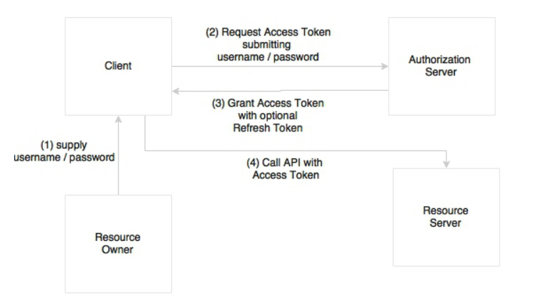

Slide 39
Authentication to service: Step 1
As a first step, update pom.xml with the OAuth2 dependency, as follows:
<dependency>
<groupId>org.springframework.security.oauth</groupId>
<artifactId>spring-security-oauth2</artifactId>
<version>2.0.9.RELEASE</version>
</dependency>

Slide 40
Authentication to service: Step 2
Add two new annotations to the Application.java file,
  @EnableAuthorizationServer and
  @EnableResourceServer.
The @EnableAuthorizationServer annotation creates an authorization server with an in-memory repository to store client tokens and provide clients with a username, password, client ID, and secret.
The @EnableResourceServer annotation is used to access the tokens.
This enables a spring security filter that is authenticated via an incoming OAuth2 token.

Slide 41
Separate Servers for Resources & Authorization
@EnableResourceServer
@EnableAuthorizationServer
@SpringBootApplication
public class Application { …
Add the following properties to the application.properties file:
  security.user.name=guest
  security.user.password=guest123
  security.oauth2.client.clientId: trustedclient
  security.oauth2.client.clientSecret: trustedclient123
  security.oauth2.client.authorized-grant-types: authorization_code,refresh_token,password
  security.oauth2.client.scope: openid
Then, add another test case to test OAuth2,

Slide 42
@Test
public void testOAuthService() {
ResourceOwnerPasswordResourceDetails resource = new ResourceOwnerPasswordResourceDetails();
resource.setUsername("guest");
resource.setPassword("guest123");
resource.setAccessTokenUri("http://localhost:8080/oauth/token");
resource.setClientId("trustedclient");
resource.setClientSecret("trustedclient123");
resource.setGrantType("password");
DefaultOAuth2ClientContext clientContext = new DefaultOAuth2ClientContext();
OAuth2RestTemplate restTemplate = new OAuth2RestTemplate(resource, clientContext);
Greet greet = restTemplate.getForObject("http://localhost:8080", Greet.class);
Assert.assertEquals("Hello World!", greet.getMessage());
}

