Slide 1
Lecture 12 Attribute Driven Design Again
CSCE 742 Software Architecture
Topics
ATAM – team expertise and experience needed
Chapter 24
Next Time:
June 25, 2017

Slide 2
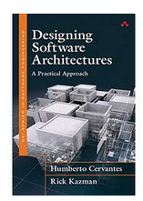
SEI series on Software Architecture

Slide 4
Meaning of Analysis
The Meaning of Analysis In the Merriam-Webster Dictionary, the word analysis is defined as follows:
The careful study of something to learn about its parts, what they do, and how they are related to each other
An explanation of the nature and meaning of something
Cervantes, Humberto; Kazman, Rick. Designing Software Architectures: A Practical Approach (SEI Series in Software Engineering) (Kindle Locations 474-478). Pearson Education. Kindle Edition.
Cervantes; Kazman, Designing Software Architectures: A Practical Approach

Slide 5
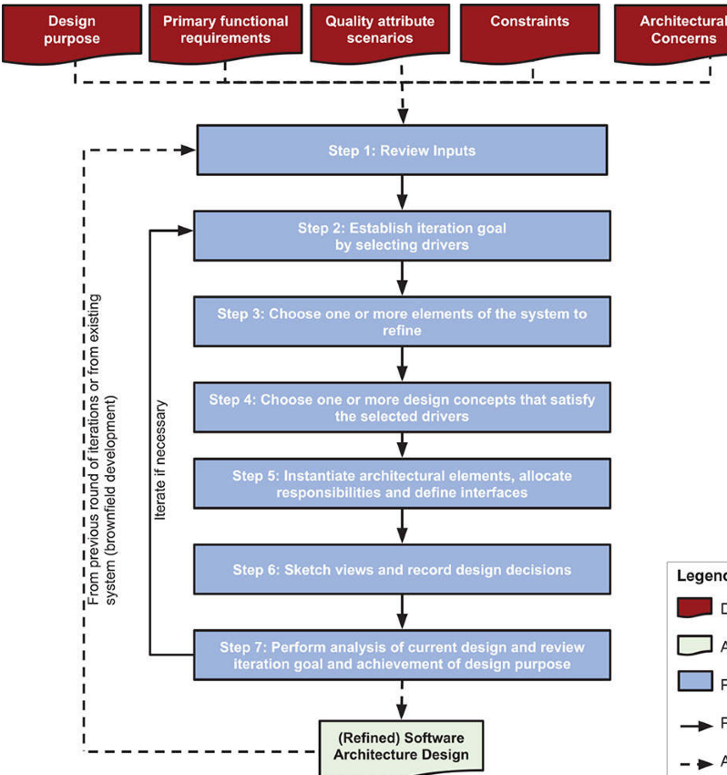
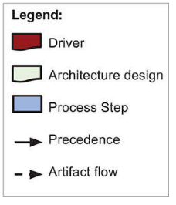
Attribute Driven Design (3.0)

Slide 6
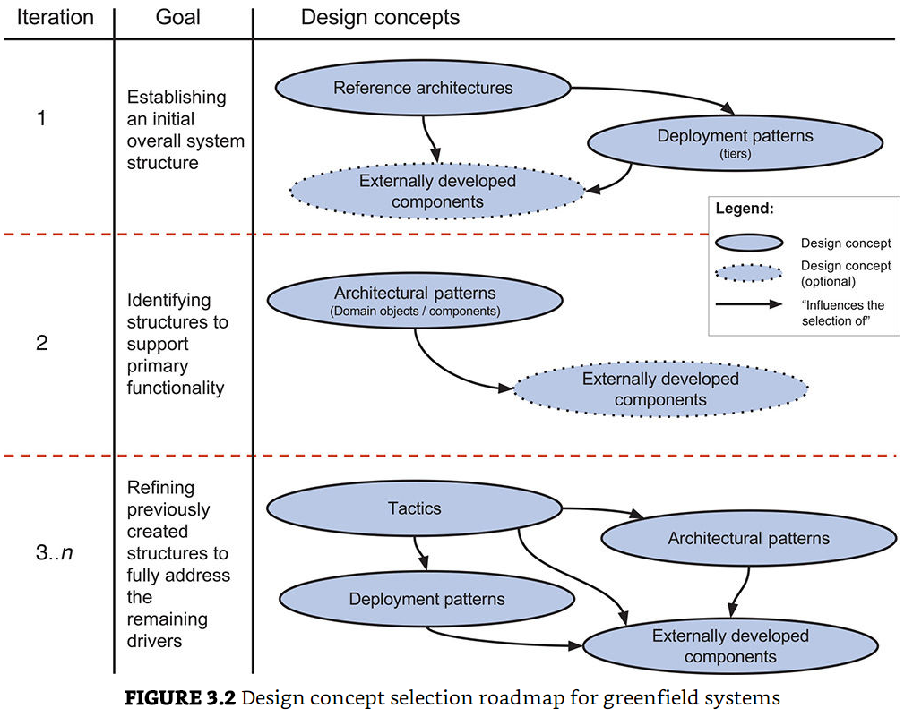

Slide 7
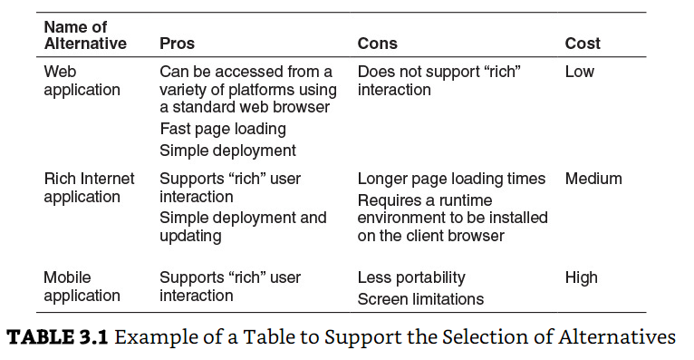

Slide 8
Cost Benefit Analysis Method (CBAM)
CBAM is a method that guides the selection of design alternatives using a quantitative approach.
It considers that architectural strategies (i.e., combinations of design concepts) affect quality attribute responses, and
that the level of each response in turn provides system stakeholders with some benefit called utility.
Each architectural strategy provides a different level of utility, but also has a cost and takes time to implement.
The idea behind the CBAM is that by studying levels of utility and costs of implementation, particular architectural strategies can be selected based on their associated return on investment (ROI).

Slide 9
levels of response for each scenario
The worst-case scenario, which represents the minimum threshold at which a system must perform (utility = 0)
The best-case scenario, which represents the level after which stakeholders foresee no further utility (utility = 100)
The current scenario, which represents the level at which the system is already performing (the utility of the current scenario is estimated by stakeholders)
The desired scenario, which represents the level of response that the stakeholders are hoping to achieve (the utility of the desired scenario is estimated by stakeholders)

Slide 10
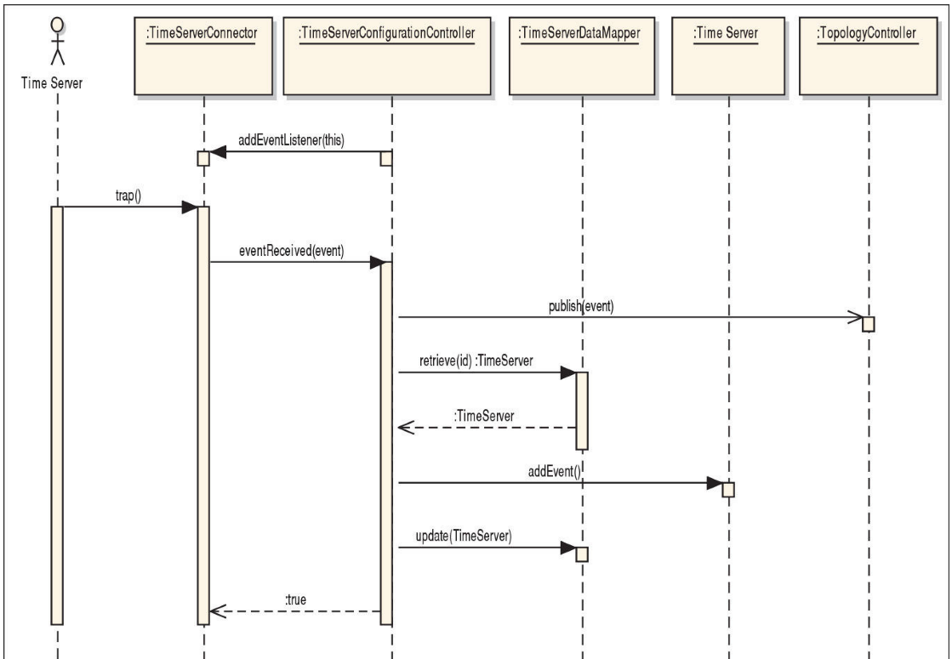

Slide 11
Active Reviews for Intermediate Design
ARID
the architecture design (or part of it) is presented to a group of reviewers
engineers who will make use of this design.
After the design presentation, a set of scenarios is selected by the participants. The selected scenarios are used for the core of the exercise, where the reviewers use the elements present in the architecture to satisfy them.
In standard ARID, the reviewers are asked to write code or pseudo-code or perhaps sequence diagrams

Slide 12
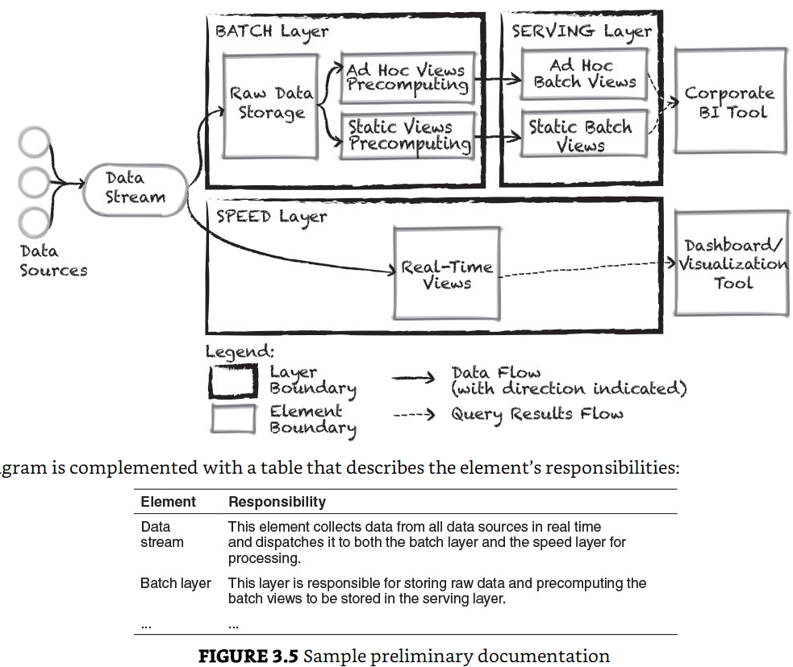
Picture Plus

Slide 13
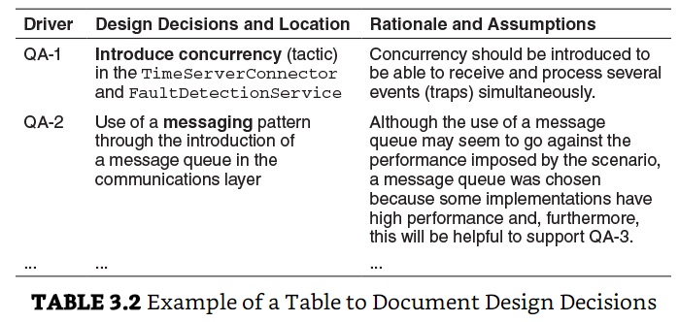

Slide 14
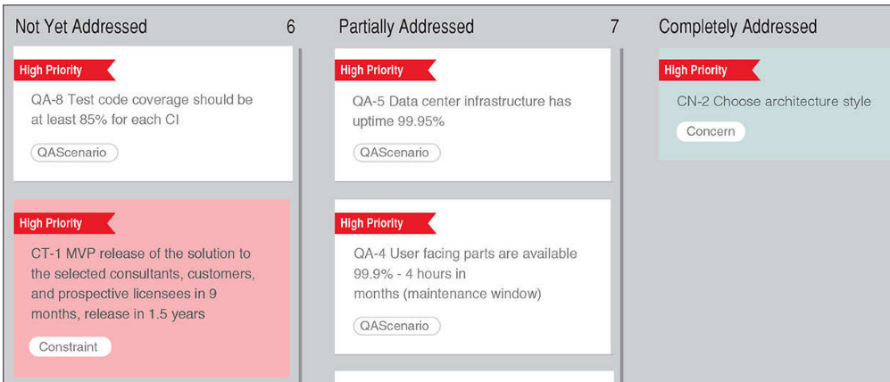
SA with Agile: Architectural Backlog
Pivotal Tracker – Kanban board
…

Slide 15
Case Study: FCAPS System (Chap 4)
Greenfield system in a mature domain
Business case
Time servers – 100 of them to supply consistent time
Fault management. The goal of fault management is to recognize, isolate, correct, and log faults that occur in the network.
Configuration management includes gathering and storing configurations from network devices,
Accounting. The goal here is to gather device information.
Performance management. This category focuses on determining the efficiency of the current network.
Security management. This is the process of controlling access to assets in the network.

Slide 16
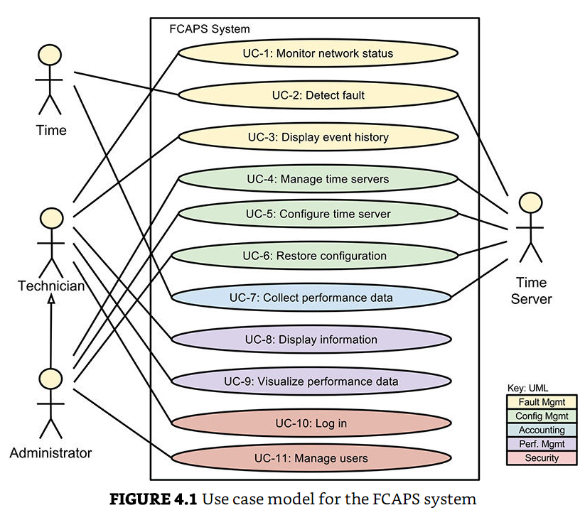
Use-Case Model

Slide 17
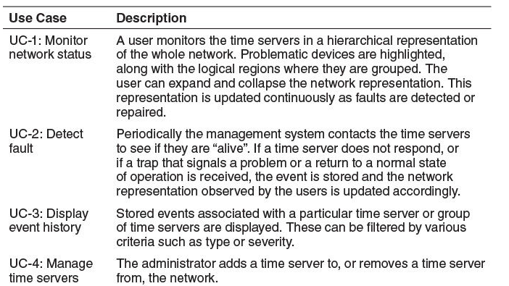
Use-Case Table

Slide 18
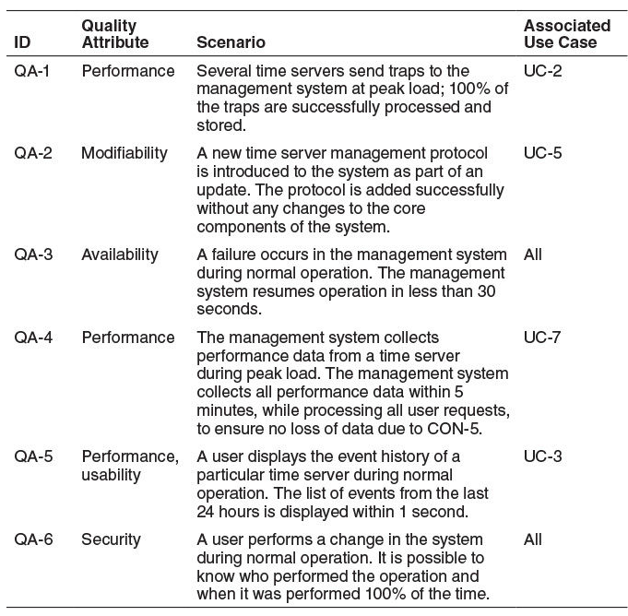
Quality Attribute Scenarios

Slide 19
Concerns

Slide 20
4.3.1 ADD Step 1:

Slide 21
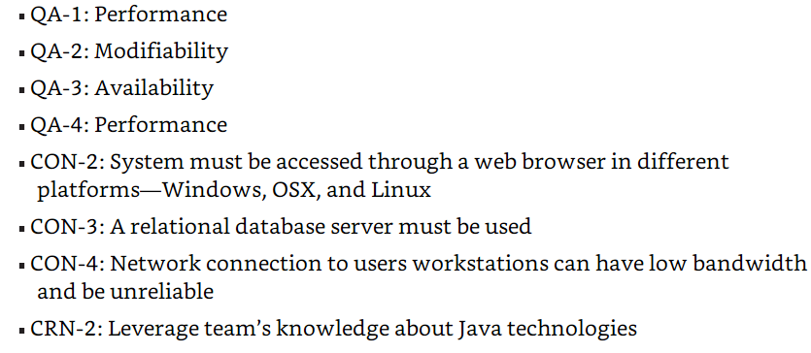
ADD Step 2: Select Drivers

Slide 22
ADD Step 3:

Slide 23
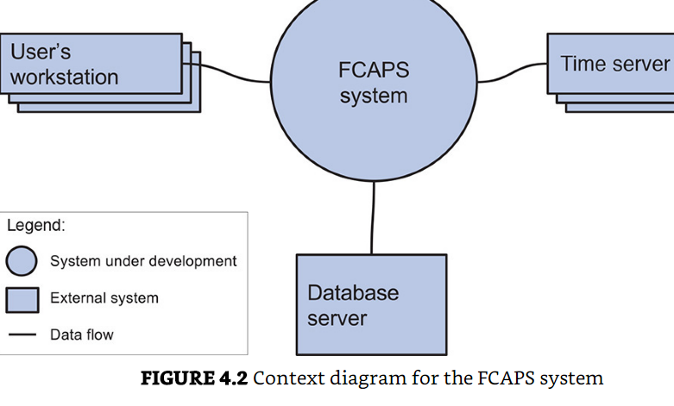
ADD Step 3: Choose Element to Refine
Start with entire system

Slide 24
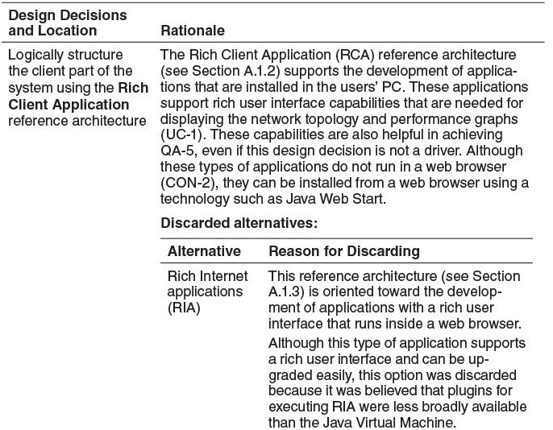
Step 4: Choose One or More Design Concepts That Satisfy the Selected Drivers

Slide 25
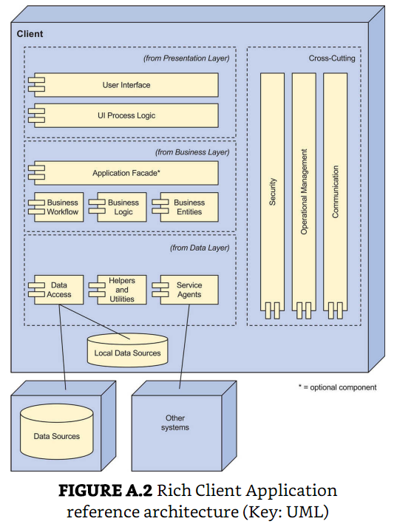
Rich Internet Application
Step 5: Instantiate Architectural Elements, Allocate Responsibilities, and Define Interfaces
from the catalog in appendix A
Web App
Rich Inter. App
Mobile App
Service App

Slide 26
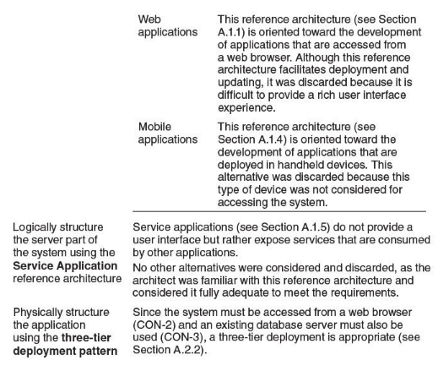
Design Decisions
continued

Slide 27
Design Decisions
continued

Slide 28
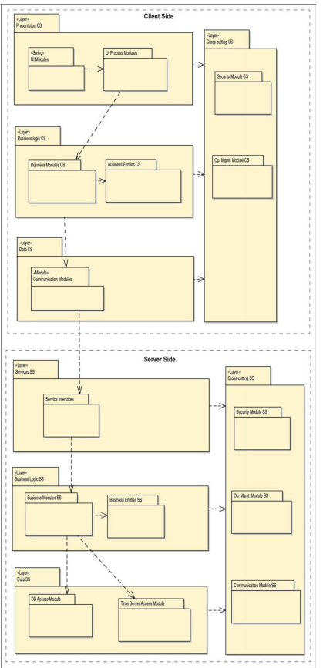
Step 6: Sketch Views and Record Design Decisions

Slide 29
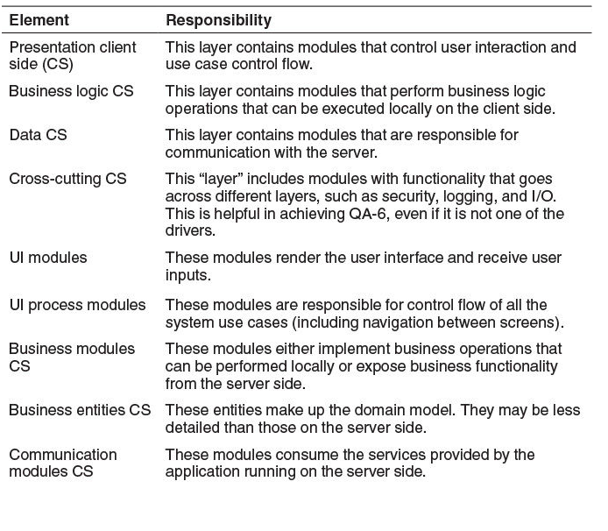
The words

Slide 30
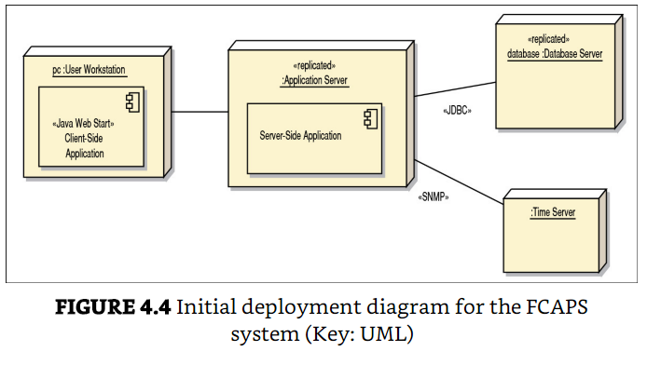
Initial Deployment Diagram

Slide 31
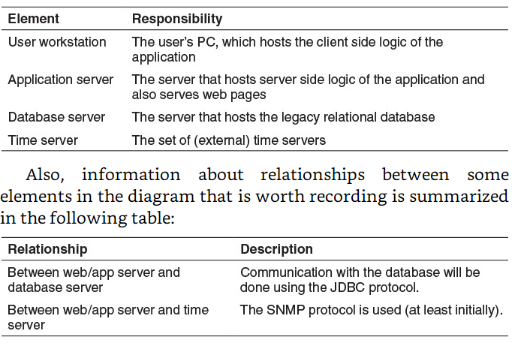

Slide 32
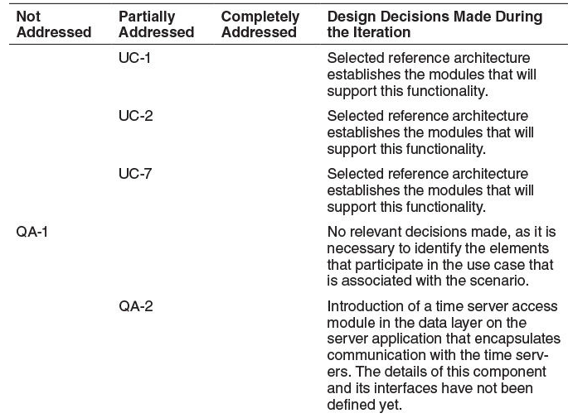
Step 7: Perform Analysis of Current Design and Review Iteration Goal and Achievement of Design Purpose
Kanban Board

Slide 33
Iteration 2: Identifying Structures to Support Primary Functionality

Slide 34
Step 2: Establish Iteration Goal by Selecting Drivers
The goal of this iteration is to address the general architectural concern of identifying structures to support primary functionality.
Identifying these elements is useful not only for understanding how functionality is supported, but also for addressing CRN-3, the allocation of work to members of the development team.
In this second iteration, besides CRN-3, the architect considers the system’s primary use cases:
UC-1
UC-2
UC-7

Slide 35
Step 3: Choose One or More Elements of the System to Refine
The elements that will be refined in this iteration are the modules located in the different layers defined by the two reference architectures from the previous iteration.
In general, the support of functionality in this system requires the collaboration of components associated with modules that are located in the different layers.

Slide 36
Step 4: Choose One or More Design Concepts That Satisfy the Selected Drivers
In this iteration, several design concepts— in this case, architectural design patterns— are selected from the book Pattern Oriented Software Architecture, Volume 4.

Slide 37
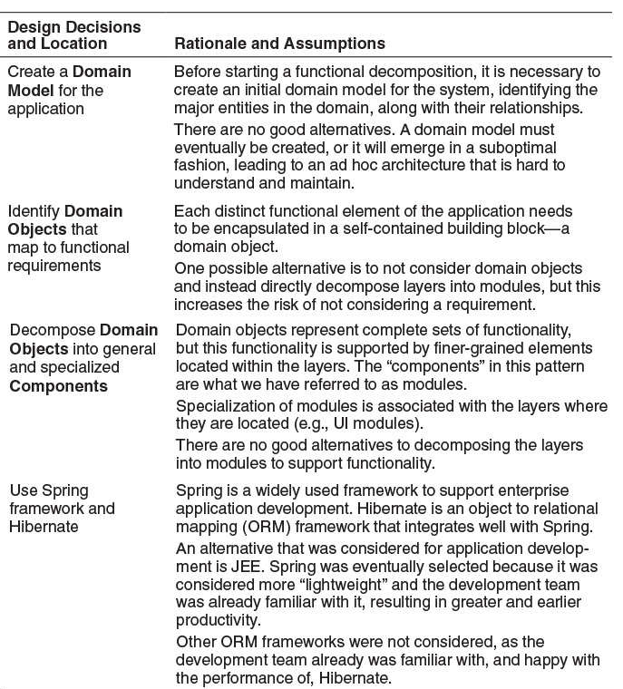

Slide 38
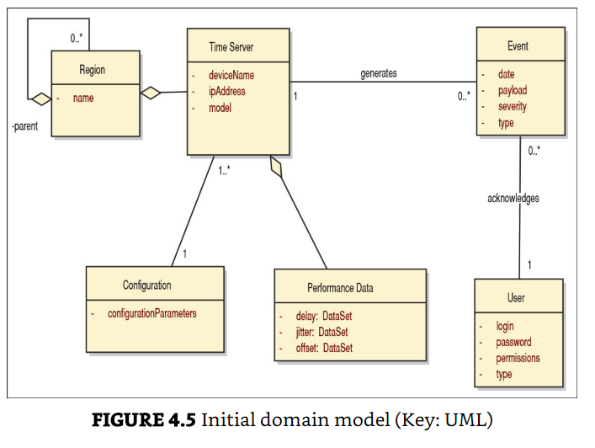
Step 6: Sketch Views and Record Design Decisions

Slide 39
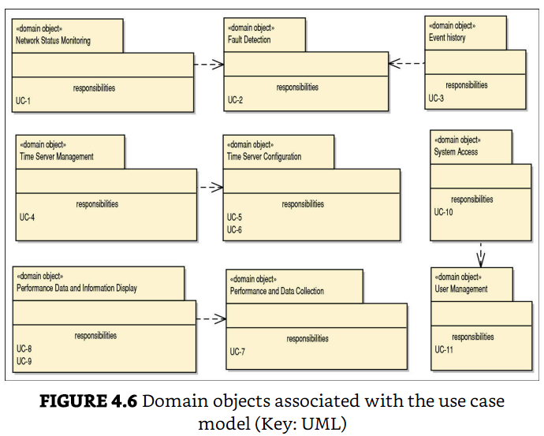

Slide 40
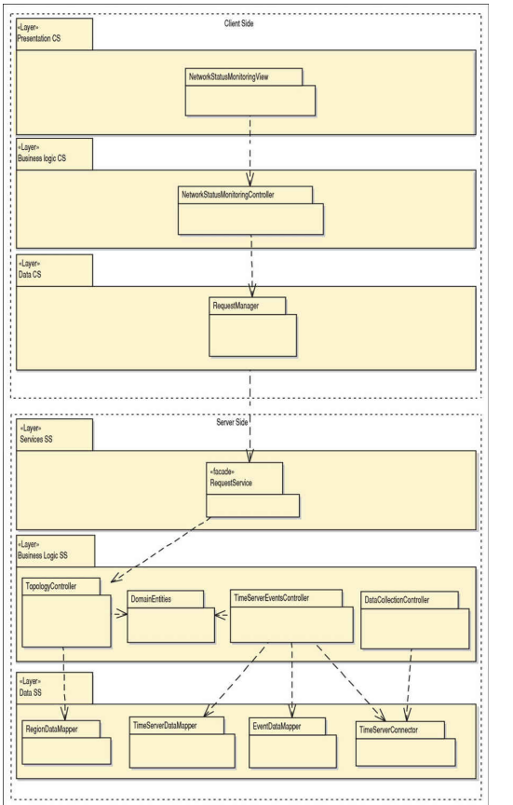

Slide 41
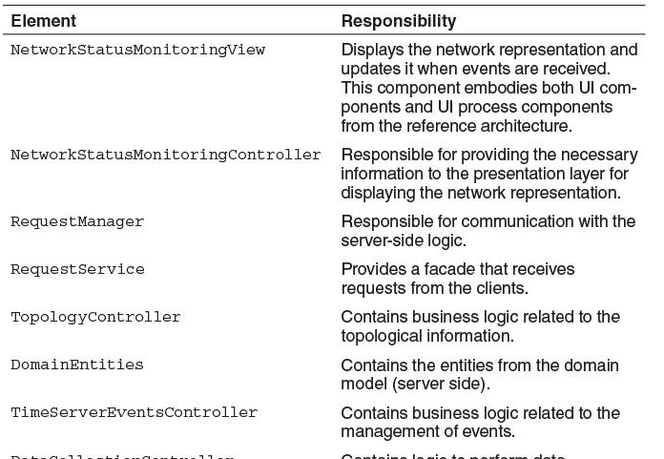
Plus words table

Slide 42
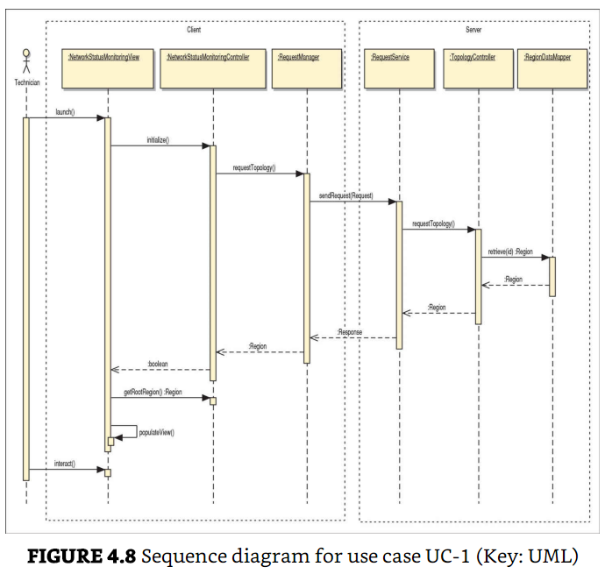

Slide 43
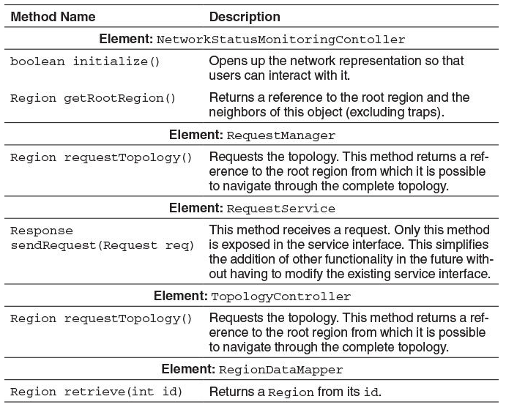

Slide 44
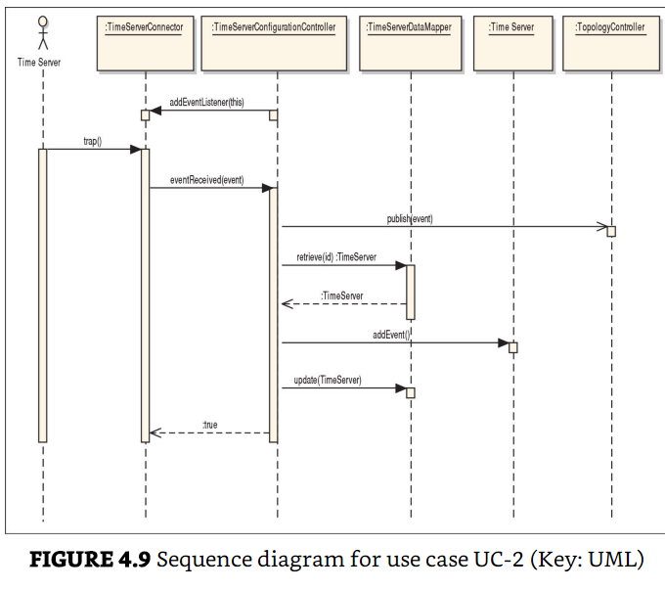
UC-2 Detect Fault

Slide 46
Step 7: Perform Analysis of Current Design and Review Iteration Goal and Achievement of Design Purpose

Slide 49
Iteration 3: Addressing Quality Attribute Scenario Driver (QA-3)
4.3.4 Iteration 3: Addressing Quality Attribute Scenario Driver (QA-3) This section presents the results of the activities that are performed in each of the steps of ADD in the third iteration of the design process. Building on the fundamental structural decisions made in iterations 1 and 2, we can now start to reason about the fulfillment of some of the more important quality attributes. This iteration focuses on just one of these quality attribute scenarios.

Slide 50
4.3.4.1 Step 2: Establish Iteration Goal by Selecting Drivers For this iteration, the architect focuses on the QA-3 quality attribute scenario: A failure occurs in the management system during operation. The management system resumes operation in less than 30 seconds.
4.3.4.2 Step 3: Choose One or More Elements of the System to Refine For this availability scenario, the elements that will be refined are the physical nodes that were identified during the first iteration:
Application server
Database server

Slide 51
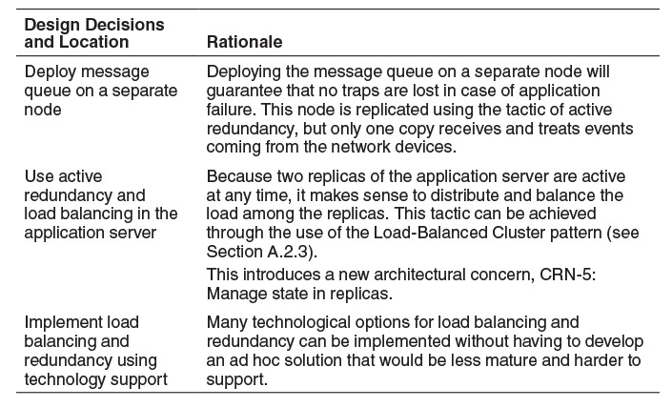
4.3.4.4 Step 5: Instantiate Architectural Elements, Allocate Responsibilities, and Define Interfaces
The instantiation design decisions are summarized in the following table:

Slide 52
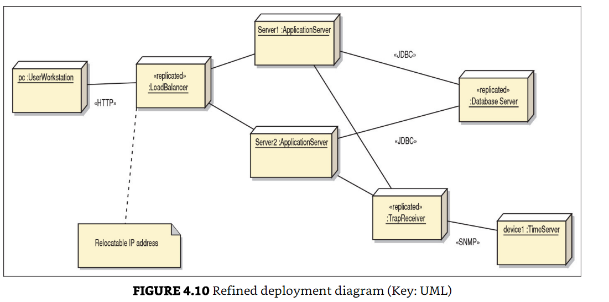
Step 6: Sketch Views and Record Design Decisions

Slide 53
New responsibilities – not listed before

Slide 54
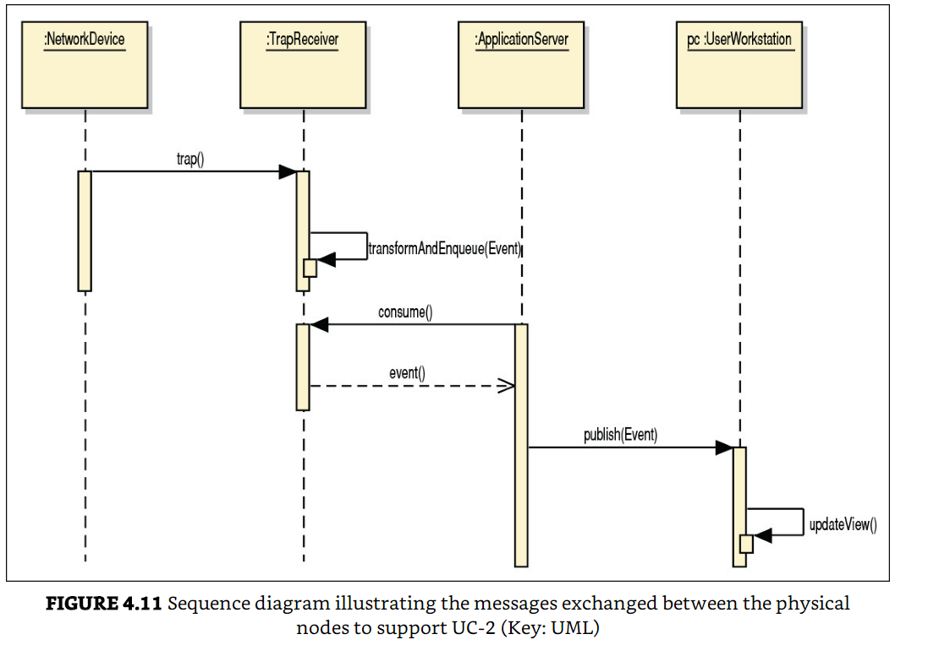

Slide 55
Step 7: Perform Analysis of Current Design and Review Iteration Goal and Achievement of Design Purpose

Slide 56
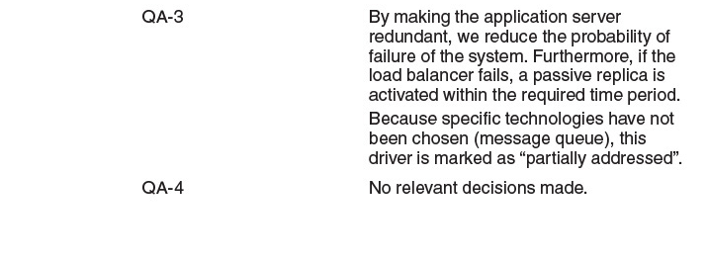

Slide 57
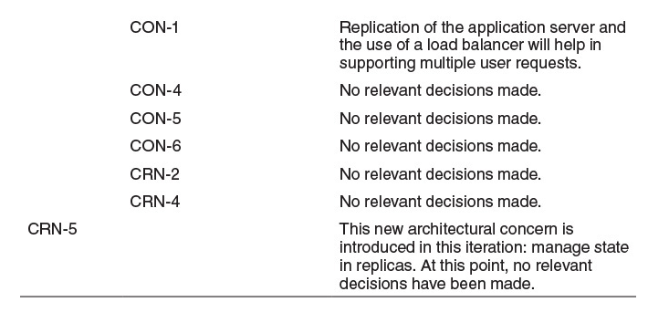

Slide 58
Summary

