Slide 1
Lecture 09 Designing to Satisfy Quality Requirements
CSCE 742 Software Architectures
Topics
Chapter 17 Designing an Architecture
June 14, 2017

Slide 2
Overview
Last Time
Agile[Ch15]
ASRs[Ch16]
Today
Designing SA[Ch17]
SA example
Garage Door
Future
Test 2 – July 10
ATAM meetings
Scores on in-class
48/50 several
Teams
TBD and emailed

Slide 3
7-Jun | Wed | Test 1 |  |  |  | 85
12-Jun | Mon | Arch. Significant Requirements; SA in Agile projects | Chap 16-17, + Designing SA text |  |  | 85
14-Jun | Wed | Designing Architecture; Case Study |  |  | Self-Service Carolina Design | 85
19-Jun | Mon | Architecture Evaluation - ATAM | Chap 21 |  | ATAM homework | 85
21-Jun | Wed | ATAM Case Study - BCS | Chap 18 |  |  | 85
24-Jun | Sat | Last Day W can be assigned
26-Jun | Mon | Documenting Software Architectures |  |  | Documenting Project | 85
28-Jun | Wed | ATAM Case Study - Earth Observing System |  |  |  | 85
3-Jul | Mon | No classes
5-Jul | Wed | Designing Architectures Again; ATAM again |  |  |  | 85
10-Jul | Mon | Test 2 |  |  |  | 85
12-Jul | Wed | No class
17-Jul | Mon | out (Team meeting - Finalize Architecture) |  |  | Architecture meeting Report | 85
19-Jul | Wed | No class |  |  | Software Architecture
24-Jul | Mon | out (Team meeting - ATAM 0) |  |  | ATAM 0 - minutes | 85
26-Jul | Wed | No class |  |  | ATAM plan
31-Jul | Mon | Cloud Computing Architectures | Chap 26 |  |  | 85
2-Aug | Wed | ATAM Evaluation Team1 evaluates Team 3's SA |  |  |  | 180
7-Aug | Mon | ATAM Evaluation Team2 evaluates Team 1's SA |  |  |  | 180
9-Aug | Wed | ATAM Evaluation Team3 evaluates Team 2's SA |  |  |  | 180
15-Aug | Tue | Exam - Aug. 15, Tuesday - 12:30 p.m.

Slide 4
SOAP
SOAP is a protocol specification for XML-based information that distributed applications can use to exchange information and hence interoperate.
It is most often accompanied by a set of SOA middleware interoperability standards and compliant implementations, referred to (collectively) as WS*.
SOAP and WS* together define many standards, including the following:
An infrastructure for service composition. SOAP can employ the Business Process Execution Language (BPEL) as a way to let developers express business processes that are implemented as WS* services.
Transactions. There are several web-service standards for ensuring that transactions are properly managed: WS-AT, WS-BA, WS-CAF, and WS-Transaction.
Service discovery. The Universal Description, Discovery and Integration (UDDI) language enables businesses to publish service listings and discover each other.
Reliability. SOAP, by itself, does not ensure reliable message delivery. Applications that require such guarantees must use services compliant with SOAP’s reliability standard: WS-Reliability.

Slide 5
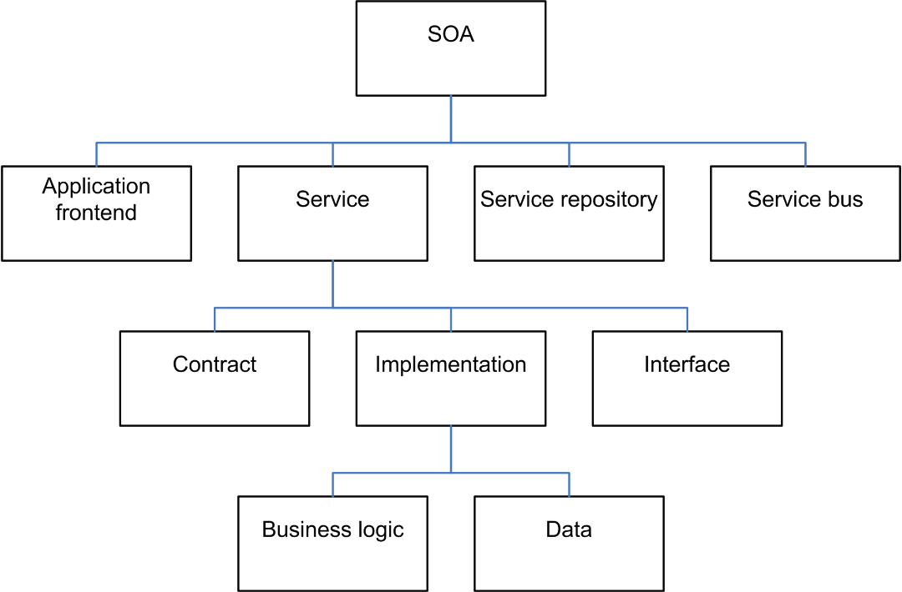
Service Oriented Architecture (SOA)
Some enterprise architects believe that SOA can help businesses respond more quickly and more cost-effectively to changing market conditions.^{[25]}
This style of architecture promotes reuse at the macro (service) level rather than micro (classes) level. It can also simplify interconnection to—and usage of—existing IT (legacy) assets.
https://en.wikipedia.org/wiki/Service-oriented_architecture#/media/File:SOA_Elements.png

Slide 6
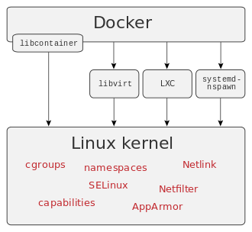
Virtual Machines vs Containers
chroot() jail
Way to restrict access to a process to a portion of file hierarchy
Only use for processes that run as non-root (e.g., nobody)
Virtual Machines
Vmware
VirtualBox
Containers – “lightweight” VMs
Docker [https://www.docker.com/]

Slide 7
Designing an Architecture – Chap 17
In most people’s vocabularies, design means veneer. It’s interior decorating. It’s the fabric of the curtains or the sofa. But to me, nothing could be further from the meaning of design. Design is the fundamental soul of a human-made creation that ends up expressing itself in successive outer layers of the product or service. —Steve Jobs
Bass, Len. Software Architecture in Practice (3rd Edition) (SEI Series in Software Engineering) (Kindle Locations 5814-5818). Pearson Education. Kindle Edition.

Slide 8
Design Strategy
Decomposition
Designing to Architecturally Significant Requirements
Generate and Test

Slide 9
Decomposition
Architecture determines quality attributes
Important quality attributes are characteristics of the whole system.
Design therefore begins with the whole system
The whole system is decomposed into parts
Each part may inherit
all of or
part of the quality attribute requirements
from the whole

Slide 10
Design Doesn’t Mean Green Field
If you are given components to be used in the final design, then the decomposition must accommodate those components.
New component
New
Component
Given components
New
Component
New
Component

Slide 11
Designing to Architecturally Significant Requirements
Remember architecturally significant requirements (ASRs)?
These are the requirements that you must satisfy with the design
There are a small number of these
They are the most important (by definition)

Slide 12
How Many ASRs Simultaneously?
If you are inexperienced in design then design for the ASRs one at a time beginning with the most important.
As you gain experience, you will be able to design for multiple ASRs simultaneously.

Slide 13
What About Other Quality Requirements?
If your design does not satisfy a particular non ASR quality requirement then either
Adjust your design so that the ASRs are still satisfied and so is this additional requirement or
Weaken the additional requirement so that it can be satisfied either by the current design or by a modification of the current design or
Change the priorities so that the one not satisfied becomes one of the ASRs or
Declare the additional requirement non-satisfiable in conjunction with the ASRs.

Slide 14
Generate and Test
View the current design as a hypothesis.
Ask whether the current design satisfies the requirements (test)
If not, then generate a new hypothesis
Generate Initial Hypothesis
Test hypothesis
Generate Next Hypothesis

Slide 15
Raises the Following Questions
Where does initial hypothesis come from?
How do I test a hypothesis?
When am I done?
How do I generate the next hypothesis?
You already know most of the answers; it is just a matter of organizing your knowledge.

Slide 16
Where Does the Initial Hypothesis Come From?
Desirable sources
Existing systems
Frameworks
Less desirable sources
Patterns and tactics
Domain decomposition
Design checklists
Why “less desirable”?
The less desirable ones do not cover all of the requirements. They typically omit many of the quality attribute requirements.

Slide 17
How Do I Test a Hypothesis?
Use the analysis techniques already covered
Design checklists from quality attribute discussion.
Architecturally significant requirements
What is the output of the tests?
List of requirements – either responsibilities or quality – not met by current design.

Slide 18
How Do I Generate the Next Hypothesis?
Add missing responsibilities.
Use tactics to adjust quality attribute behavior of hypothesis.
The choice of tactics will depend on which quality attribute requirements are not met.
Be mindful of the side effects of a tactic.

Slide 19
When Am I Done?
When…
All ASRs are satisfied and/or…
You run out of budget for design activity
In this case, use the best hypothesis so far.
Begin implementation
Continue with the design effort although it will now be constrained by implementation choices.

Slide 20
The Attribute-Driven Design Method
Packaging of many of the techniques already discussed.
An iterative method. At each iteration you
Choose a part of the system to design.
Marshal all the architecturally significant requirements for that part.
Generate and test a design for that part.
ADD does not result in a complete design
Set of containers with responsibilities
Interactions and information flow among containers
Does not produce an API or signature for containers.

Slide 21
ADD Inputs and Outputs
Requirements
Functional
Quality
Constraints
ADD Process
Containers
Responsibilities
Interactions
Information flow

Slide 22
The Steps of ADD
Choose an element of the system to design.
Identify the ASRs for the chosen element.
Generate a design solution for the chosen element.
Inventory remaining requirements and select the input for the next iteration.
Repeat steps 1–4 until all the ASRs have been satisfied.

Slide 23
Step 1: Choose an Element of the System to Design
For green field designs, the element chosen is usually the whole system.
For legacy designs, the element is the portion to be added.
After the first iteration:
Whole System
Element 1
Element N

Slide 24
Which Element Comes Next?
Two basic refinement strategies:
Breadth first
Depth first
Which one to choose?
It depends ☺
If using new technology => depth first: explore the implications of using that technology.
If a team needs work => depth first: generate requirements for that team.
Otherwise => breadth first.

Slide 25
Step 2: Identify the ASRs for the Chosen Element
If the chosen element is the whole system, then use a utility tree (as described earlier).
If the chosen element is further down the decomposition tree, then generate a utility tree from the requirements for that element.

Slide 26
Step 3: Generate a Design Solution for the Chosen Element
Apply generate and test to the chosen element with its ASRs

Slide 27
Step 4: Select the Input for the Next Iteration
For each functional requirement
Ensure that requirement has been satisfied.
If not, then add responsibilities to satisfy the requirement.
Add them to container with similar requirements
If no such container may need to create new one or add to container with dissimilar responsibilities (coherence)
If container has too many requirements for a team, split it into two portions. Try to achieve loose coupling when splitting.

Slide 28
Quality Attribute Requirements
If the quality attribute requirement has been satisfied, it does not need to be further considered.
If the quality attribute requirement has not been satisfied then either
Delegate it to one of the child elements
Split it among the child elements
If the quality attribute cannot be satisfied, see if it can be weakened. If it cannot be satisfied or weakened then it cannot be met.

Slide 29
Constraints
Constraints are treated as quality attribute requirements have been treated.
Satisfied
Delegated
Split
Unsatisfiable

Slide 30
Repeat Steps 1–4 Until All ASRs are Satisfied
At end of step 3, each child element will have associated with it a set of:
functional requirements,
quality attribute requirements, and
constraints.
This sets up the child element for the next iteration of the method.

Slide 31
Summary
Designing the architecture is a matter of
Determining the ASRs
Performing generate and test one an element to decompose it to satisfy the ASRs
Iterating until requirements are satisfied.

Slide 32
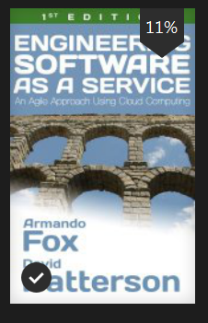
SaaS book
Fox and Patterson
Contributor to Architecture and Software Engineering?
IBM 360 / Mythical Man-month
MIPS/
Engineering Software as a Service by Fox and Patterson

Slide 33
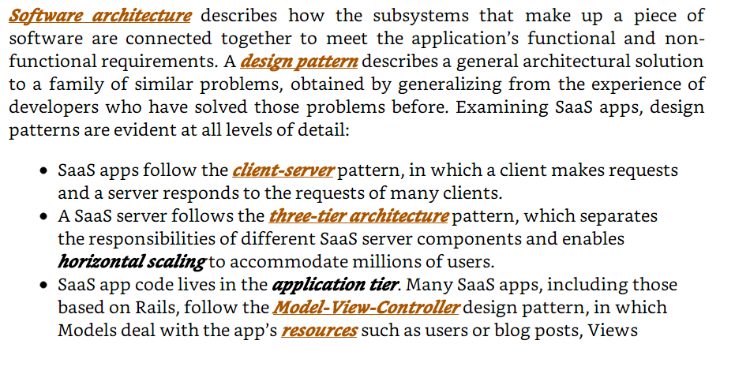
Patterson and Fox’s def. of Soft. Arch.
Engineering Software as a Service by Fox and Patterson

Slide 34
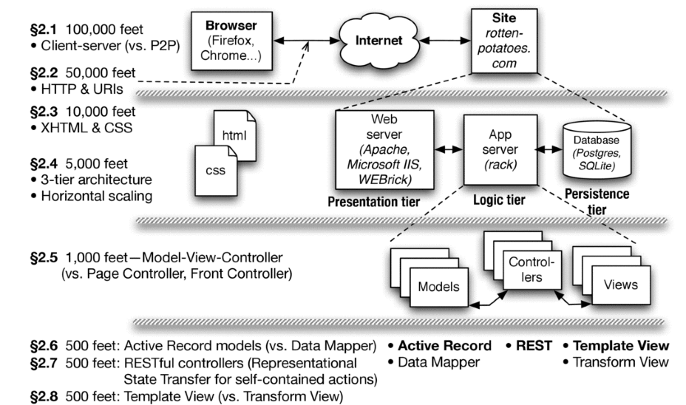
Views 100,000 ft view ➔ 500 ft view
Engineering Software as a Service by Fox and Patterson

Slide 35
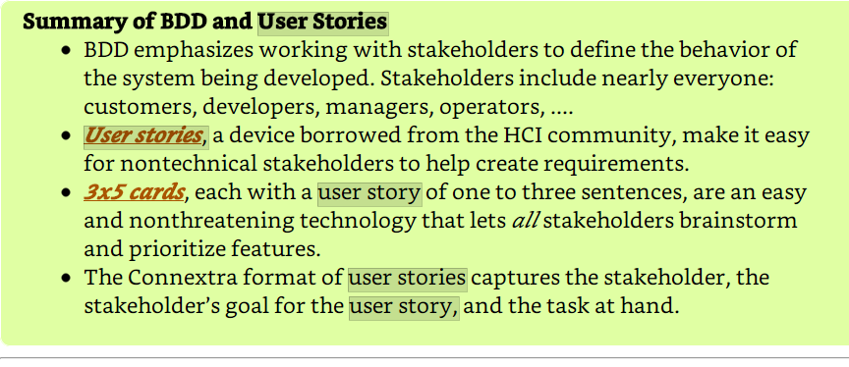
User Stories Connextra format
Engineering Software as a Service by Fox and Patterson

Slide 36
Example User Story Connextra format
Feature: Add a movie to RottenPotatoes
As a movie fan
So that I can share a movie with other movie fans
I want to add a movie to RottenPotatoes database
Engineering Software as a Service by Fox and Patterson

Slide 37
Acronym Soup
ASRs
Agile – well not an acronym
QAs
QAW
PALM - Pedigreed Attribute eLictation Method
ADD – Attribute Driven Design
…

