Slide 1
Lecture 6z Case Study Interoperability
CSCE 742 Software Architectures
Topics
Case Study
Interoperability
Architecture for the system
May 24, 2017

Slide 2
Architecture Deja Vu
Rediscovering principles laid out a quarter of a century ago by Brooks, Dijkstra, Parnas
Fred Brooks –
1969 “architecture” of a computer system as “conceptual view of a computer … as seen by the programmer”
“Mythical Man-Month” essays on Software engineering
Dijkstra
told us to be concerned with modularity
layered approach
CSP
Parnas – foundational contributions to SE field
Information hiding for maintainability and reusability 1972
Exception handling 1979
Viewing program as member of family; abstracting qualitites
Software Architecture in Practice 2nd Ed Bass, Clements, Kazman

Slide 3
Example of System with emphasis on Interoperability
Software Architecture in Practice 2nd Ed Bass, Clements, Kazman

Slide 4
Architecture Business Cycle for X
Stakeholders
Management
Developing Organization
Researcher
Technical Environment
Heterogenous distributed computing
Architect’s experience
hypertext
networking
Requirements (Qualities)
Remote Access
Interoperability
Extensibility
Scalability
Architect
Architecture
library
Client Server
System
x
Software Architecture in Practice 2nd Ed Bass, Clements, Kazman

Slide 5
Original Requirements
Remote access across networks. Any information had to be accessible from any machine on a network.
Heterogeneity. The system could not be limited to run on any specific hardware or software platform.
Noncentralization - there could not be any single source of data or services.
Access to existing data. Existing databases had to be accessible.
Ability for users to add data. Users should be able to “publish” their own data using the same interface used to read others’ data.
Private links. Links and nodes had to be capable of being privately annotated.
Bells and whistles. The only form of data display originally planned was display on a 24 × 80 character ASCII terminal. Graphics were considered optional.
Software Architecture in Practice 2nd Ed Bass, Clements, Kazman

Slide 6
Original Requirements (continued)
Private links. Links and nodes had to be capable of being privately annotated.
Bells and whistles. The only form of data display originally planned was display on a 24 × 80 character ASCII terminal. Graphics were considered optional.
Data analysis. Users should be able to search across the various databases and look for anomalies, regularities, irregularities, and so on.
Live links. Given that information changes all the time, there should be some way of updating a user’s view of it. This could be by simply retrieving the information every time the link is accessed or (in a more sophisticated fashion) by notifying a user of a link whenever the information has changed.
Software Architecture in Practice 2nd Ed Bass, Clements, Kazman

Slide 7
Architectural Solution
client and server
Special protocol for communication for transferring documents
a library to hide machine dependencies
Software Architecture in Practice 2nd Ed Bass, Clements, Kazman

Slide 8
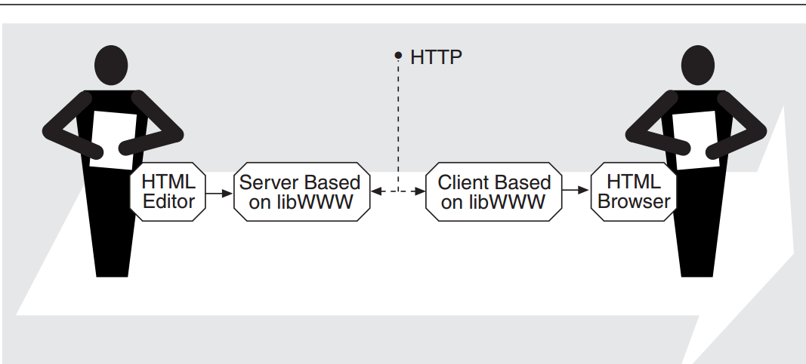
What system are we talking about?
Protocol
Software Architecture in Practice 2nd Ed Bass, Clements, Kazman

Slide 9
Software Architecture in Practice 2nd Ed Bass, Clements, Kazman

Slide 10
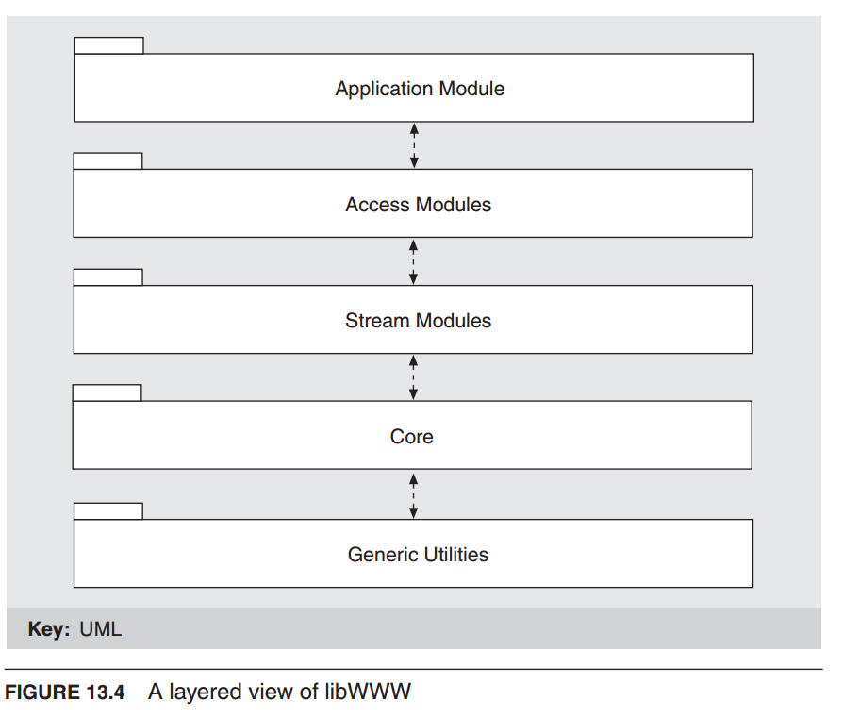
Software Architecture in Practice 2nd Ed Bass, Clements, Kazman

Slide 11
LESSONS FROM libWWW
Formalized application programming interfaces (APIs) are required.
Functionality and the APIs that present it must be layered
The library must support a dynamic, open-ended set of features.
Processes built on the software must be thread safe
Software Architecture in Practice 2nd Ed Bass, Clements, Kazman

Slide 12
It turns out that libWWW does not support all of these goals as well as it might.
For example, the libWWW core makes some assumptions about essential services, so not all features can be dynamically replaced.
Furthermore, libWWW is meant to run on many different platforms, and so it can not depend on a single thread model.
Thus, it has implemented pseudothreads, which provide some, but not all, of the required functionality.
Finally, most current Web applications do not support dynamic feature configuration; they require a restart before new services can be registered.
Software Architecture in Practice 2nd Ed Bass, Clements, Kazman

Slide 13
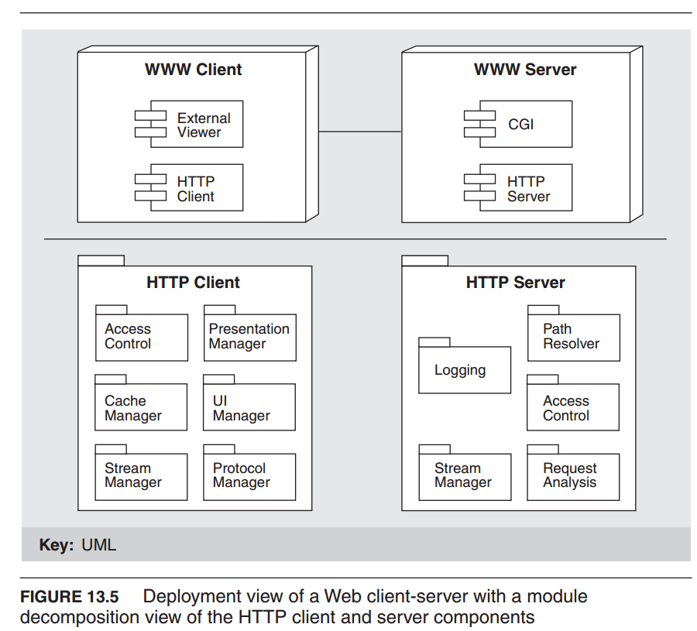
Software Architecture in Practice 2nd Ed Bass, Clements, Kazman

Slide 14
COMMON GATEWAY INTERFACE
Most information returned by a server is static, changing only when modified on its home file system.
CGI scripts, on the other hand, allow dynamic, request specific information to be returned.
CGI has historically been used to augment server functionality: for input of information, for searches, for clickable images.
The most common use of CGI, however, is to create virtual documents—documents that are dynamically synthesized in response to a user request
Software Architecture in Practice 2nd Ed Bass, Clements, Kazman

Slide 15
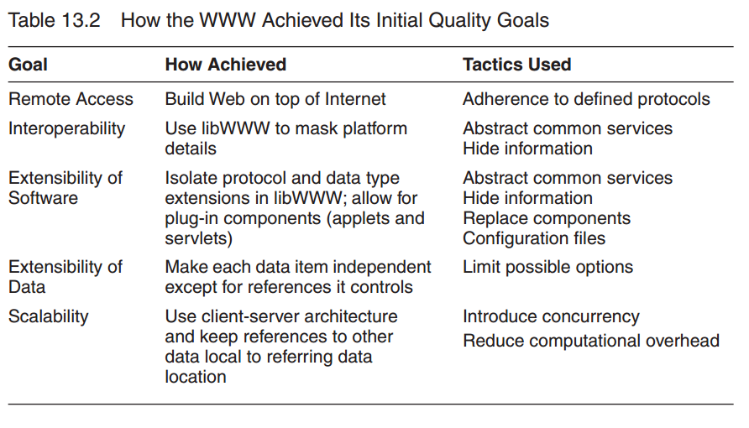
ACHIEVING INITIAL QUALITY GOALS
Software Architecture in Practice 2nd Ed Bass, Clements, Kazman

Slide 16
Another Cycle through the ABC: The Evolution of Web-Based E-Commerce Architectures
Quality Attributes for E-commerce on web?
Software Architecture in Practice 2nd Ed Bass, Clements, Kazman

Slide 17
Quality Attributes for E-commerce on web
High performance. A popular Web site will typically have tens of millions of “hits” per day, and users expect low latency from it. Customers will not tolerate the site simply refusing their requests.
High availability. E-commerce sites are expected to be available “24/7.” They never close, so must have minimal downtime—perhaps a few minutes per year.
Scalability. As Web sites grow in popularity, their processing capacity must be able to similarly grow, to both expand the amount of data they can manage and maintain acceptable levels of customer service.
Security. Users must be assured that any sensitive information they send across the Web is secure from snooping. Operators of Web sites must be assured that their system is secure from attack (stealing or modifying data, rendering data unusable by flooding it with requests, crashing it, etc.).
Modifiability. E-commerce Web sites change frequently, in many cases daily, and so their content must be very simple to change.
Software Architecture in Practice 2nd Ed Bass, Clements, Kazman

Slide 18
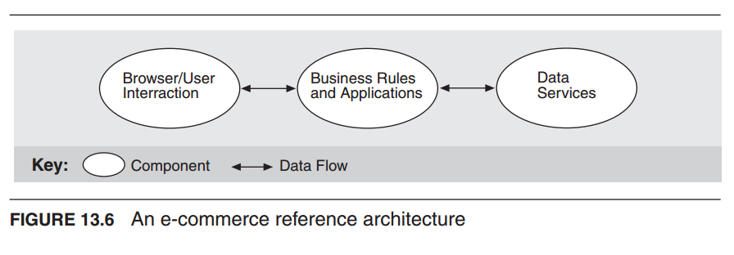
An e-commerce reference architecture
Software Architecture in Practice 2nd Ed Bass, Clements, Kazman

Slide 19
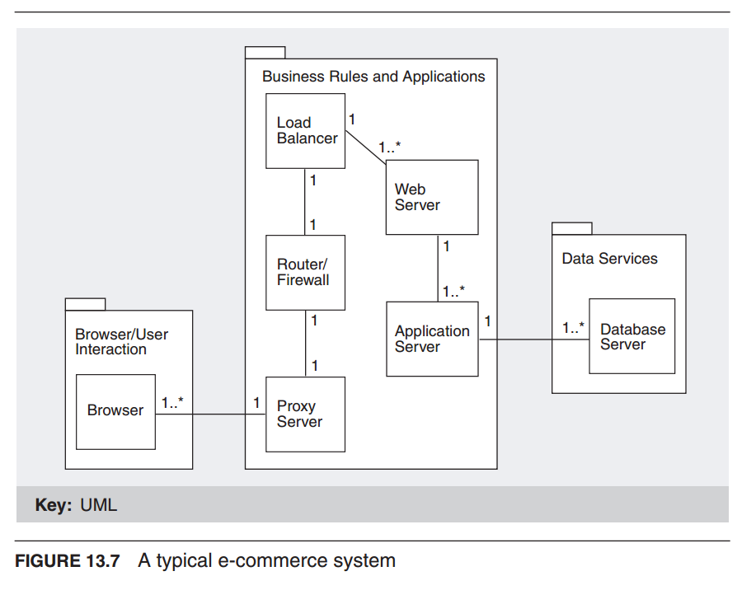
Software Architecture in Practice 2nd Ed Bass, Clements, Kazman

Slide 20
Summary of tactics
WEB BROWSERS FOR MODIFIABILITY
HTTPS FOR SECURITY
PROXY SERVERS FOR PERFORMANCE
ROUTERS AND FIREWALLS FOR SECURITY
LOAD BALANCING FOR PERFORMANCE, SCALABILITY, AND AVAILABILITY
WEB SERVERS FOR PERFORMANCE
APPLICATION SERVERS FOR MODIFIABILITY, PERFORMANCE, AND SCALABILITY
DATABASES FOR PERFORMANCE, SCALABILITY, AND AVAILABILITY
Software Architecture in Practice 2nd Ed Bass, Clements, Kazman

Slide 21
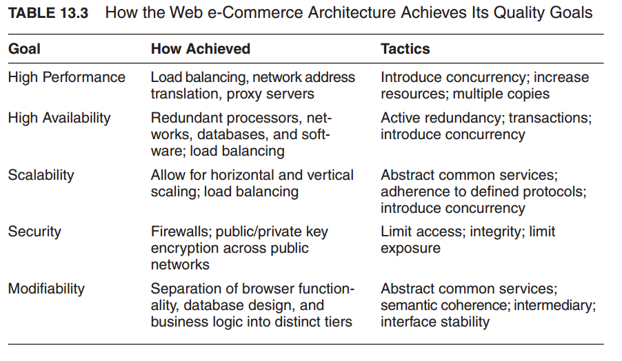
Software Architecture in Practice 2nd Ed Bass, Clements, Kazman

Slide 22
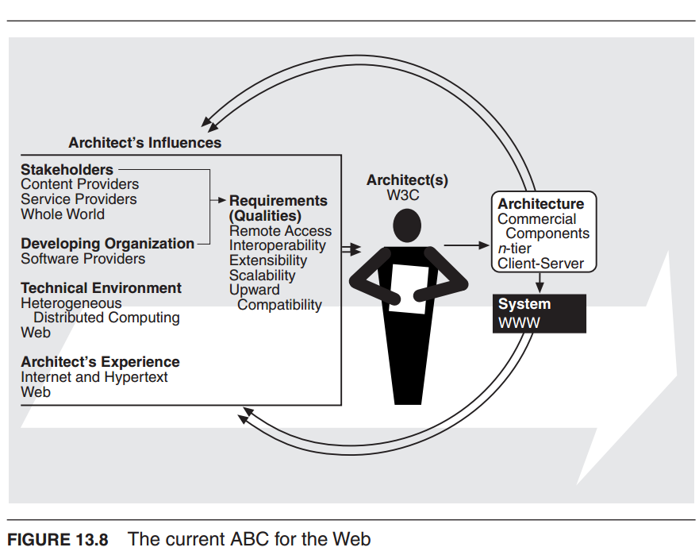
Software Architecture in Practice 2nd Ed Bass, Clements, Kazman

Slide 23
Further Reading
Readers interested in discovering more about hypertext should see [Bush 45] and the special issue of the CACM devoted to hypertext [CACM 88].
Information on the Web’s history and growth can be found primarily on the Web
[Berners-Lee 96a],
[Gray (http://www.mit.edu/people/mkgray/net)],
[Zakon (http://www.zakon.com/robert/internet/timeline)].
Much of the detail about libWWW comes from the W3C Reference Library at http://www.w3.org/pub/WWW/Library.
Software Architecture in Practice 2nd Ed Bass, Clements, Kazman

Slide 24
For a good general discussion of network security issues and cryptography, including all aspects of Web security, see [Stallings 99].
A good discussion of performance issues in e-commerce systems may be found in [Menasce 00]
The architectural style used in Web-based applications is treated in [Fielding 96].
A comparison of modern Web server patterns may be found in [Hassan 00], from which we adapted the client-server architecture shown in Figure 13.5.
Netcraft’s May 2001 survey of Web server usage can be found at http://www.netcraft.com/survey/.
Software Architecture in Practice 2nd Ed Bass, Clements, Kazman

