Slide 1
Lecture 5z Linux Tools – Call graphs Virtual Machines
CSCE 742 Software Architectures
Topics
Call graphs
Regular expressions
May 22, 2017

Slide 2
Call Graph Links
Wikipedia –
https://en.wikipedia.org/wiki/Call_graph
Java Call graph –
https://github.com/gousiosg/java-callgraph

Slide 3
Environment Variable
SHELL, PATH, HOME, JAVA_HOME, CLASS_PATH ??
What is the PATH anyway?
export PATH= ~/bin:$PATH
//add ~/bin to the front of the PATH

Slide 4
.bashrc
ls –a

Slide 5
Virtual Machines

Slide 6
ssh – Secure Shell

Slide 7
scp – Secure copy

Slide 8
Logging in Remotely to CSE machines

Slide 9
Core Duo

Slide 10
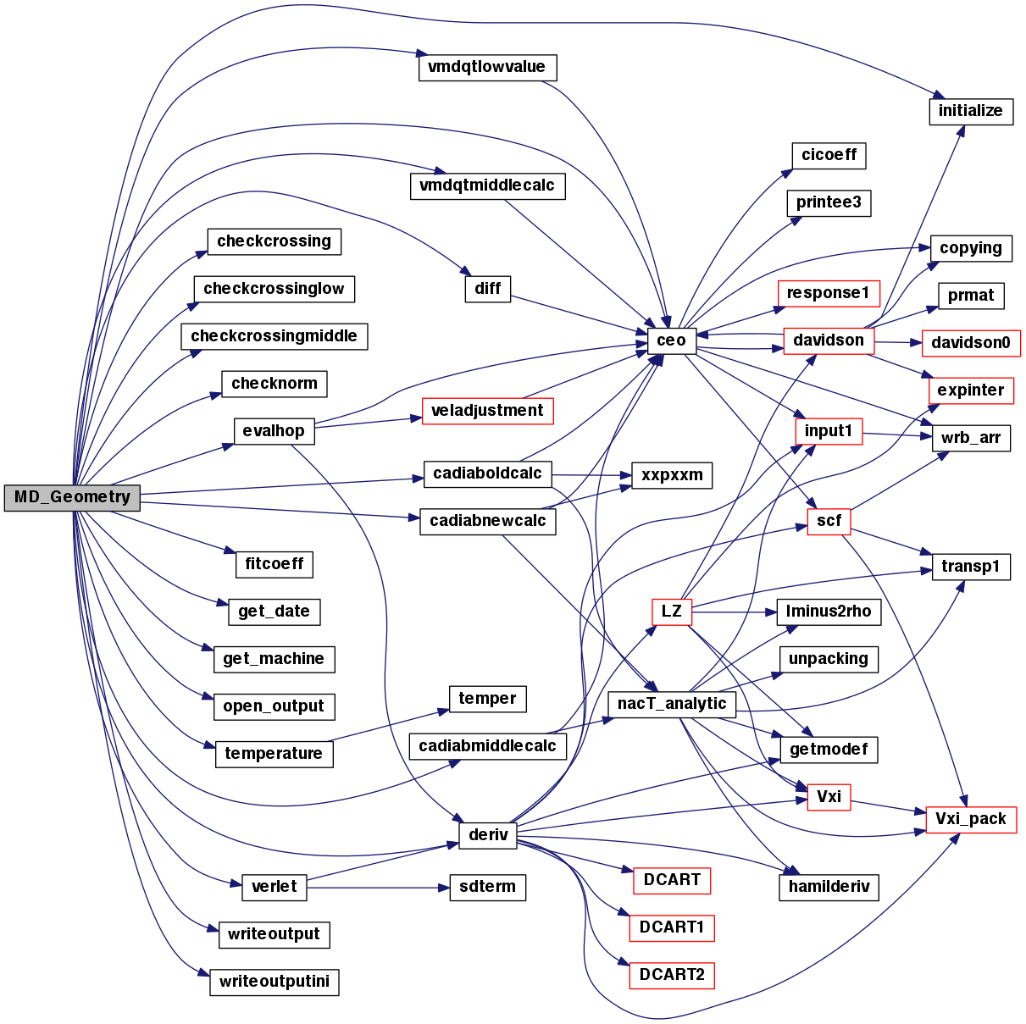
Doxygen
http://gustavoseabra-qtp.blogspot.com/2012_01_01_archive.html

Slide 11
Static vs Dynamic Call Graphs

Slide 12
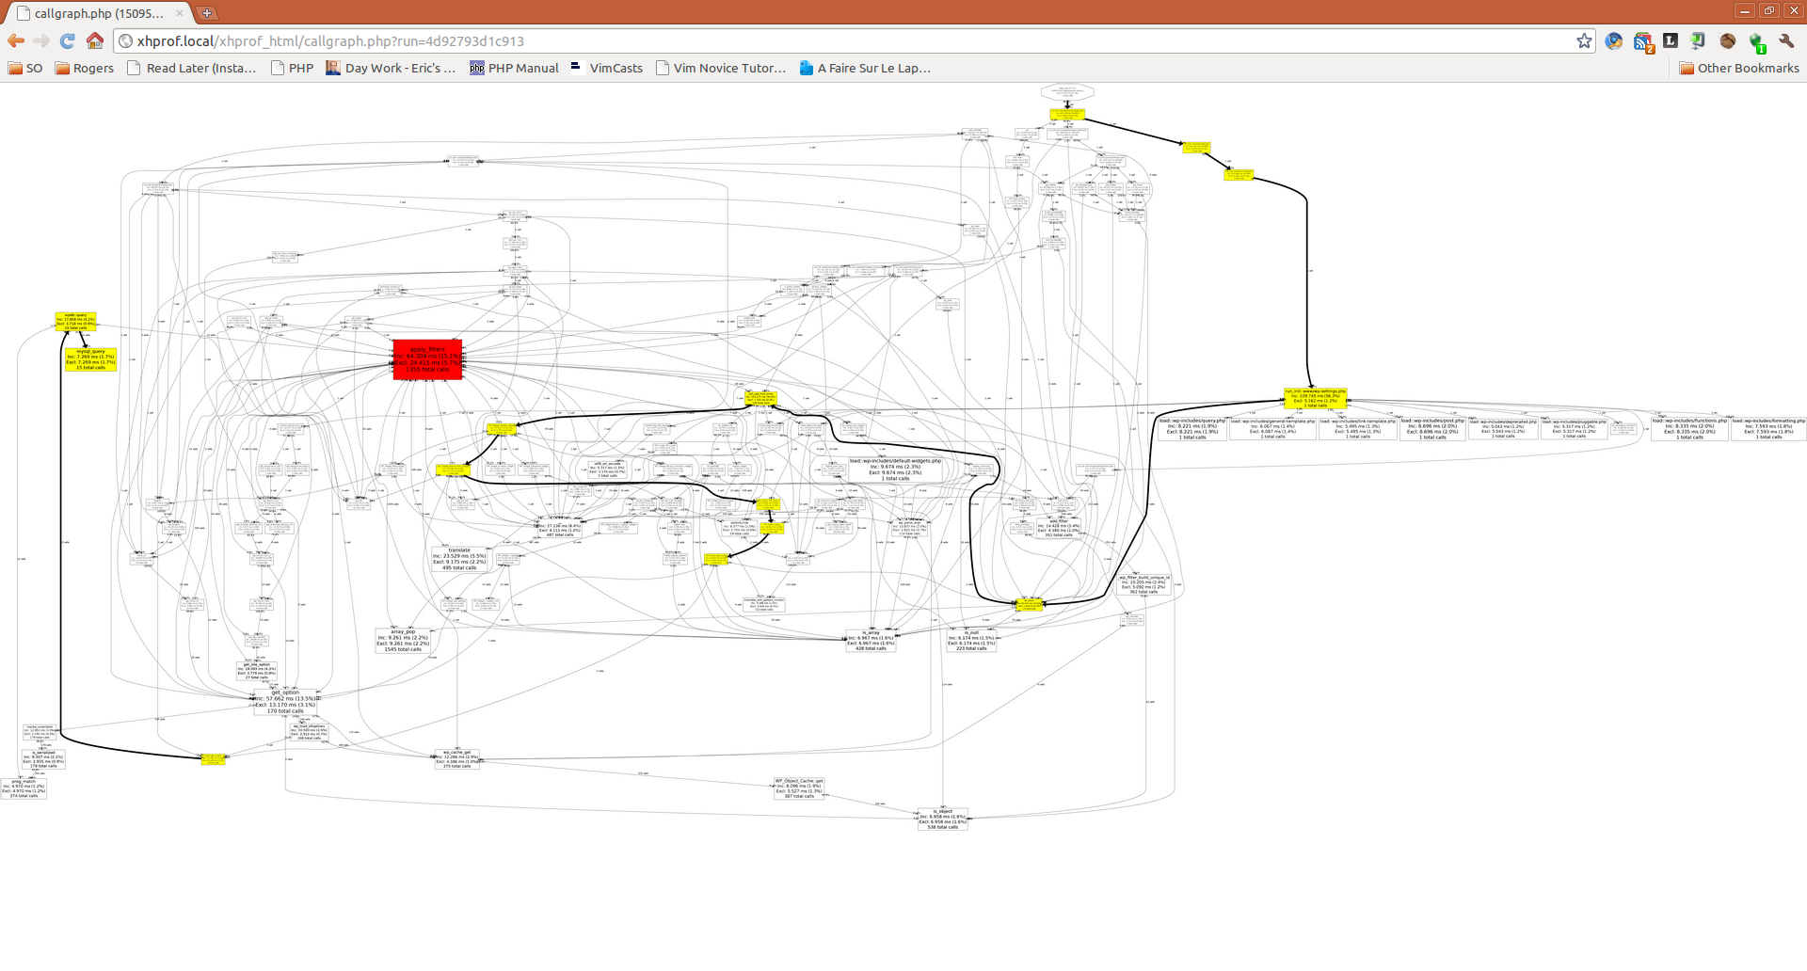
http://stackoverflow.com/questions/8576226/get-full-app-call-graph-in-kcachegrind

Slide 13
Dynamic Call Graphs - Run-time call-graph
Most profilers with callgraph functionality
gprof : included in BSD or part of the GNU Binary Utilities
KCachegrind : powerful tool to generate and analyze call graphs based on data generated by Valgrind's callgrind tool.
Mac OS X Activity Monitor : Apple GUI process monitor Activity Monitor has a built-in call graph generator that can sample processes and return a call graph.
OpenPAT : includes the control_flow tool which automatically creates a Graphviz call-graph picture from runtime measurements.
pprof, open source tool for visualization and analysis of profile data, to be used in conjunction with gperftools.
CodeAnalyst from AMD (released under GPL)
makeppgraph is a dependency graph generator (at module level) for builds performed with makepp.
Intel(R) Single Event API (free, open-source)

Slide 14
Static Call Graph Tools (for C)
doxygen : Uses graphviz to generate static call/inheritance diagrams
cflow : GNU cflow is able to generate the direct and inverted call graph of a C program
egypt : a small Perl script that uses gcc and Graphviz to generate the static call graph of a C program.
CCTree : Native Vim plugin that can display static call graphs by reading a cscope database. Works for C programs.
codeviz : a static call graph generator (the program is not run). Implemented as a patch to gcc; works for C and C++ programs.
calltree.sh : Bash shell functions that glue together cscope, graphviz, and a sampling of dot-rendering tools to display "caller" and "callee" relationships above, below, and/or between the C functions you specify.
tceetree : like calltree.sh, it connects Cscope and Graphviz, but it is an executable rather than a bash script.

Slide 15
PHP, Perl and Python
Devel::NYTProf : a perl performance analyzer and call chart generator
phpCallGraph : a call graph generator for PHP programs that uses Graphviz. It is written in PHP and requires at least PHP 5.2.
pycallgraph : a call graph generator for Python programs that uses Graphviz.
gprof2dot : A call graph generator written in Python that converts profiling data for many languages/runtimes to a Graphviz callgraph.
code2flow: A call graph generator for Python and Javascript programs that uses Graphviz

Slide 16
java-callgraph: Java Call Graph Utilities
A suite of programs for generating static and dynamic call graphs in Java.
javacg-static: Reads classes from a jar file, walks down the method bodies and prints a table of caller-caller relationships.
javacg-dynamic: Runs as a Java agent and instruments the methods of a user-defined set of classes in order to track their invocations. At JVM exit, prints a table of caller-callee relationships, along with a number of calls
Download or clone
https://github.com/gousiosg/java-callgraph

Slide 17
Compile
Compile - The java-callgraph package is built with maven. Install maven and do:
mvn install
This will produce a target directory with the following three jars:
javacg-0.1-SNAPSHOT.jar: This is the standard maven packaged jar with static and dynamic call graph generator classes
javacg-0.1-SNAPSHOT-static.jar: This is an executable jar which includes the static call graph generator
javacg-0.1-SNAPSHOT-dycg-agent.jar: This is an executable jar which includes the dynamic call graph generator
https://github.com/gousiosg/java-callgraph

Slide 18
Running Static Call Graph Generator
javacg-static accepts as arguments the jars to analyze.
java -jar javacg-0.1-SNAPSHOT-static.jar lib1.jar lib2.jar...
javacg-static produces combined output in the following format:
For methods
M:class1:<method1>(arg_types) (typeofcall)class2:<method2>(arg_types)
The line means that method1 of class1 called method2 of class2. The type of call can have one of the following values (refer to the JVM specification for the meaning of the calls):
M for invokevirtual call
I for invoke interface call
O for invokespecial calls
S for invokestatic calls
D for invokedynamic calls
https://github.com/gousiosg/java-callgraph

Slide 19
Instrumentation

