Slide 1
Lecture 05 Interoperability, Modifiability, Performance
CSCE 742 Software Architectures
Topics
Chapter 6 Interoperability,
Chapter 7 Modifiability,
Chapter 8 Performance
May 22, 2017

Slide 2
Overview
Last Time
Chapter 5 – Availability
Availability General Scenario
Tactics for Availability
A Design Checklist for Availability (almost)
Not Covered last time
Availability checklist
New
Interoperability, Modifiability, Performance
Case Study

Slide 3
What is Interoperability?
Interoperability is about the degree to which two or more systems can usefully exchange meaningful information.
Like all quality attributes, interoperability is not a yes-or-no proposition but has shades of meaning.

Slide 4
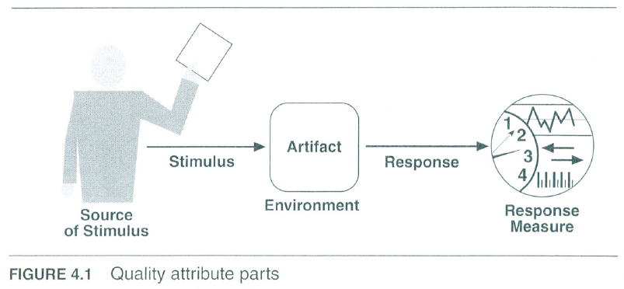
Interoperability Scenario

Slide 5
Interoperability General Scenario
 | Possible Values
Source | A system
Stimulus | A request to exchange information among system(s).
Artifact | The systems that wish to interoperate
Environment | System(s) wishing to interoperate are discovered at run time or known prior to run time.
Response | One or more of the following: the request is (appropriately) rejected and appropriate entities (people or systems) are notified the request is (appropriately) accepted and information is exchanged successfully the request is logged by one or more of the involved systems
Response Measure | One or more of the following: percentage of information exchanges correctly processed percentage of exchanges correctly rejected

Slide 6
Sample Concrete Interoperability Scenario
Our vehicle information system sends our current location to the traffic monitoring system.
The traffic monitoring system combines our location with other information, overlays this information on a Google Map, and broadcasts it.
Our location information is correctly included with a probability of 99.9%.

Slide 7
Goal of Interoperability Tactics
For two or more systems to usefully exchange information they must
Know about each other. That is the purpose behind the locate tactics.
Exchange information in a semantically meaningful fashion. That is the purpose behind the manage interfaces tactics. Two aspects of the exchange are
Provide services in the correct sequence
Modify information produced by one actor to a form acceptable to the second actor.

Slide 8
Goal of Interoperability Tactics

Slide 9
Interoperability Tactics

Slide 10
Locate
Discover service: Locate a service through searching a known directory service. There may be multiple levels of indirection in this location process – i.e. a known location points to another location that in turn can be searched for the service.

Slide 11
Manage Interfaces
Orchestrate: uses a control mechanism to coordinate, manage and sequence the invocation of services. Orchestration is used when systems must interact in a complex fashion to accomplish a complex task.
Tailor Interface: add or remove capabilities to an interface such as translation, buffering, or data-smoothing.

Slide 12
Design Checklist for Interoperability Allocation of Responsibilities
 | Determine which of your system responsibilities will need to interoperate with other systems. Ensure that responsibilities have been allocated to detect a request to interoperate with known or unknown external systems Ensure that responsibilities have been allocated to accept the request exchange information reject the request notify appropriate entities (people or systems) log the request (for interoperability in an untrusted environment, logging for non-repudiation is essential)

Slide 13
Design Checklist for Interoperability Coordination Model
 | Ensure that the coordination mechanisms can meet the critical quality attribute requirements. Considerations for performance include: Volume of traffic on the network both created by the systems under your control and generated by systems not under your control. Timeliness of the messages being sent by your systems Currency of the messages being sent by your systems Jitter of the messages arrival times. Ensure that all of the systems under your control make assumptions about protocols and underlying networks that are consistent with the systems not under your control.

Slide 14
Design Checklist for Interoperability Data Model
 | Determine the syntax and semantics of the major data abstractions that may be exchanged among interoperating systems. Ensure that these major data abstractions are consistent with data from the interoperating systems. If your system’s data model is confidential and must not be made public, you may have to apply transformations to and from the data abstractions of systems with which yours interoperates.

Slide 15
Design Checklist for Interoperability Mapping Among Architectural Elements
 | For interoperability, the critical mapping is that of components to processors. Beyond the necessity of making sure that components that communicate externally are hosted on processors that can reach the network, the primary considerations deal with meeting the security, availability, and performance requirements for the communication. These will be dealt with in their respective chapters.

Slide 16
Design Checklist for Interoperability Resource Management
 | Ensure that interoperation with another system (accepting a request and/or rejecting a request) can never exhaust critical system resources (e.g., can a flood of such requests cause service to be denied to legitimate users?). Ensure that the resource load imposed by the communication requirements of interoperation is acceptable. Ensure that if interoperation requires that resources be shared among the participating systems, an adequate arbitration policy is in place.

Slide 17
Design Checklist for Interoperability Binding Time
 | Determine the systems that may interoperate, and when they become known to each other. For each system over which you have control Ensure that it has a policy for dealing with binding to both known and unknown external systems. Ensure that it has mechanisms in place to reject unacceptable bindings and to log such requests. In the case of late binding, ensure that mechanisms will support the discovery of relevant new services or protocols, or the sending of information using chosen protocols.

Slide 18
Design Checklist for Interoperability Choice of Technology
 | For any of your chosen technologies, are they “visible” at interface boundary of a system? If so, what interoperability effects do they have? Do they support, undercut, or have no effect on the interoperability scenarios that apply to your system? Ensure the effects they have are acceptable. Consider technologies that are designed to support interoperability, e.g. Web Services. Can they be used to satisfy the interoperability requirements for the systems under your control?

Slide 19
Summary
Interoperability refers to the ability of systems to usefully exchange information.
Achieving interoperability involves the relevant systems locating each other and then managing the interfaces so that they can exchange information.

Slide 20
What is Modifiability?
Modifiability is about change and our interest in it is in the cost and risk of making changes.
To plan for modifiability, an architect has to consider three questions:
What can change?
What is the likelihood of the change?
When is the change made and who makes it?

Slide 21
Modifiability General Scenario
 | Possible Values
Source | End user, developer, system administrator
Stimulus | A directive to add/delete/modify functionality, or change a quality attribute, capacity, or technology
Artifacts | Code, data, interfaces, components, resources, configurations, …
Environment | Runtime, compile time, build time, initiation time, design time
Response | One or more of the following: make modification test modification deploy modification
Response Measure | Cost in terms of: number, size, complexity of affected artifacts effort calendar time money (direct outlay or opportunity cost) extent to which this modification affects other functions or quality attributes new defects introduced

Slide 22
Sample Concrete Modifiability Scenario
The developer wishes to change the user interface by modifying the code at design time by adding a radio button to select the background color.
The modifications are made with no side effects within three hours.

Slide 23
Goal of Modifiability Tactics
Tactics to control modifiability have as their goal controlling the complexity of making changes, as well as the time and cost to make changes.

Slide 24
Goal of Modifiability Tactics

Slide 25
Modifiability Tactics

Slide 26
Reduce Size of a Module
Split Module: If the module being modified includes a great deal of capability, the modification costs will likely be high. Refining the module into several smaller modules should reduce the average cost of future changes.

Slide 27
Increase Cohesion
Increase Semantic Coherence: If the responsibilities A and B in a module do not serve the same purpose, they should be placed in different modules.
This may involve creating a new module or it may involve moving a responsibility to an existing module.
“High cohesion often correlates with loose coupling, and vice versa.”
https://en.wikipedia.org/wiki/Cohesion_%28computer_science%29

Slide 28
Reduce Coupling
Encapsulate: Encapsulation introduces an explicit interface to a module. This interface includes an API and its associated responsibilities, such as “perform a syntactic transformation on an input parameter to an internal representation.”
Use an Intermediary: Given a dependency between responsibility A and responsibility B (for example, carrying out A first requires carrying out B), the dependency can be broken by using an intermediary.

Slide 29
Reduce Coupling
Restrict Dependencies: restricts the modules which a given module interacts with or depends on.
Refactor: undertaken when two modules are affected by the same change because they are (at least partial) duplicates of each other.
Abstract Common Services: where two modules provide not-quite-the-same but similar services, it may be cost-effective to implement the services just once in a more general (abstract) form.

Slide 30
Defer Binding
In general, the later in the life cycle we can bind values, the better.
If we design artifacts with built-in flexibility, then exercising that flexibility is usually cheaper than hand-coding a specific change.
However, putting the mechanisms in place to facilitate that late binding tends to be more expensive.

Slide 31
Design Checklist for Modifiability Allocation of Responsibilities
 | Determine which changes or categories of changes are likely to occur through consideration of changes in technical, legal, social, business, and customer forces. For each potential change or category of changes Determine the responsibilities that would need to be added, modified, or deleted to make the change. Determine what other responsibilities are impacted by the change. Determine an allocation of responsibilities to modules that places, as much as possible, responsibilities that will be changed (or impacted by the change) together in the same module, and places responsibilities that will be changed at different times in separate modules.

Slide 32
Design Checklist for Modifiability Coordination Model
 | Determine which functionality or quality attribute can change at runtime and how this affects coordination; for example, will the information being communicated change at run-time, or will the communication protocol change at run-time? If so, ensure that such changes affect a small number set of modules. Determine which devices, protocols, and communication paths used for coordination are likely to change. For those devices, protocols, and communication paths, ensure that the impact of changes will be limited to a small set of modules. For those elements for which modifiability is a concern, use a coordination model that reduces coupling such as publish/subscribe, defers bindings such as enterprise service bus, or restricts dependencies such as broadcast.

Slide 33
Design Checklist for Modifiability Data Model
 | Determine which changes (or categories of changes) to the data abstractions, their operations, or their properties are likely to occur. Also determine which changes or categories of changes to these data abstractions will involve their creation, initialization, persistence, manipulation, translation, or destruction. For each change or category of change, determine if the changes will be made by an end user, system administrator, or developer. For those changes made by an end user or administrator, ensure that the necessary attributes are visible to that user and that the user has the correct privileges to modify the data, its operations, or its properties. For each potential change or category of change determine which data abstractions need to be added, modified, or deleted determine whether there would be any changes to the creation, initialization, persistence, manipulation, translation, or destruction of these data abstractions determine which other data abstractions are impacted by the change. For these additional abstractions, determine whether the impact would be on their operations, properties, creation, initialization, persistence, manipulation, translation, or destruction. ensure an allocation of data abstractions that minimizes the number and severity of modifications to the abstractions by the potential changes Design your data model so that items allocated to each element of the data model are likely to change together.

Slide 34
Design Checklist for Modifiability Mapping Among Architectural Elements
 | Determine if it is desirable to change the way in which functionality is mapped to computational elements (e.g. processes, threads, processors) at runtime, compile time, design time, or build time. Determine the extent of modifications necessary to accommodate the addition, deletion, or modification of a function or a quality attribute. This might involve a determination of, for example: execution dependencies assignment of data to databases assignment of runtime elements to processes, threads, or processors Ensure that such changes are performed with mechanisms that utilize deferred binding of mapping decisions.

Slide 35
Design Checklist for Modifiability Resource Management
 | Determine how the addition, deletion, or modification of a responsibility or quality attribute will affect resource usage. This involves, for example, determining what changes might introduce new resources or remove old ones or affect existing resource usage. determining what resource limits will change and how Ensure that the resources after the modification are sufficient to meet the system requirements. Encapsulate all resource managers and ensure that the policies implemented by those resource managers utilize are themselves encapsulated and bindings are deferred to the extent possible.

Slide 36
Design Checklist for Modifiability Binding Time
 | For each change or category of change Determine the latest time at which the change will need to be made. Choose a defer-binding mechanism (see Section 7.2.4) that delivers the appropriate capability at the time chosen. Determine the cost of introducing the mechanism and the cost of making changes using the chosen mechanism Do not introduce so many binding choices that change is impeded because the dependencies among the choices are complex and unknown.

Slide 37
Design Checklist for Modifiability Choice of Technology
 | Determine what modifications are made easier or harder by your technology choices. Will your technology choices help to make, test, and deploy modifications? How easy is it to modify your choice of technologies itself (in case some of these technologies change or become obsolete)? Choose your technologies to support the most likely modifications. For example, an Enterprise Service Bus makes it easier to change how elements are connected but may introduce vendor lock in.

Slide 38
Summary
Modifiability deals with change and the cost in time or money of making a change, including the extent to which this modification affects other functions or quality attributes.
Tactics to reduce the cost of making a change include making modules smaller, increasing cohesion, and reducing coupling. Deferring binding will also reduce the cost of making a change.

Slide 39
Chapter Outline
What is Performance?
Performance General Scenario
Tactics for Performance
A Design Checklist for Performance
Summary

Slide 40
What is Performance?
Performance is about time and the software system’s ability to meet timing requirements.
When events occur – interrupts, messages, requests from users or other systems, or clock events marking the passage of time – the system, or some element of the system, must respond to them in time.
Characterizing the events that can occur (and when they can occur) and the system or element’s time-based response to those events is the essence is discussing performance.

Slide 41
Performance General Scenario
Portion of Scenario | Possible Values
Source | Internal or external to the system
Stimulus | Arrival of a periodic, sporadic, or stochastic event
Artifact | System or one or more components in the system.
Environment | Operational mode: normal, emergency, peak load, overload.
Response | Process events, change level of service
Response Measure | Latency, deadline, throughput, jitter, miss rate

Slide 42
Sample Concrete Performance Scenario
Users initiate transactions under normal operations. The system processes the transactions with an average latency of two seconds.

Slide 43
Goal of Performance Tactics
Tactics to control Performance have as their goal to generate a response to an event arriving at the system within some time-based constraint.

Slide 44
Goal of Performance Tactics

Slide 45
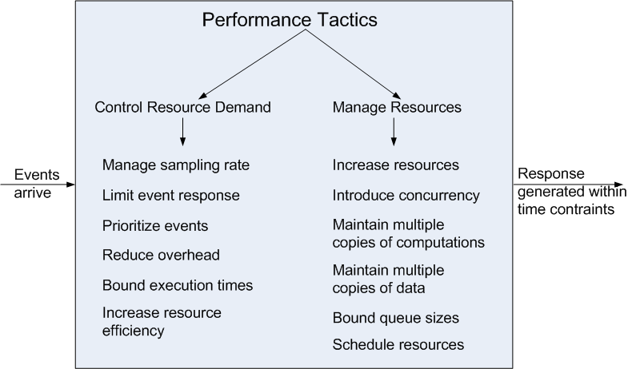
Performance Tactics

Slide 46
Control Resource Demand
Manage Sampling Rate: If it is possible to reduce the sampling frequency at which a stream of data is captured, then demand can be reduced, typically with some loss of fidelity.
Limit Event Response: process events only up to a set maximum rate, thereby ensuring more predictable processing when the events are actually processed.
Prioritize Events: If not all events are equally important, you can impose a priority scheme that ranks events according to how important it is to service them.

Slide 47
Control Resource Demand
Reduce Overhead: The use of intermediaries (important for modifiability) increases the resources consumed in processing an event stream; removing them improves latency.
Bound Execution Times: Place a limit on how much execution time is used to respond to an event.
Increase Resource Efficiency: Improving the algorithms used in critical areas will decrease latency.

Slide 48
Manage Resources
Increase Resources: Faster processors, additional processors, additional memory, and faster networks all have the potential for reducing latency.
Increase Concurrency: If requests can be processed in parallel, the blocked time can be reduced. Concurrency can be introduced by processing different streams of events on different threads or by creating additional threads to process different sets of activities.
Maintain Multiple Copies of Computations: The purpose of replicas is to reduce the contention that would occur if all computations took place on a single server.

Slide 49
Manage Resources
Maintain Multiple Copies of Data: keeping copies of data (possibly one a subset of the other) on storage with different access speeds.
Bound Queue Sizes: control the maximum number of queued arrivals and consequently the resources used to process the arrivals.
Schedule Resources: When there is contention for a resource, the resource must be scheduled.

Slide 50
Design Checklist for Performance Allocation of Responsibilities
 | Determine the system’s responsibilities that will involve heavy loading, have time-critical response requirements, are heavily used, or impact portions of the system where heavy loads or time critical events occur. For those responsibilities, identify processing requirements of each responsibility and determine whether they may cause bottlenecks additional responsibilities to recognize and process requests appropriately including Responsibilities that result from a thread of control crossing process or processor boundaries. Responsibilities to manage the threads of control —allocation and de-allocation of threads, maintaining thread pools, and so forth. Responsibilities for scheduling shared resources or managing performance-related artifacts such as queues, buffers, and caches. For the responsibilities and resources you identified, ensure that the required performance response can be met (perhaps by building a performance model to help in the evaluation).

Slide 51
Design Checklist for Performance Coordination Model
 | Determine the elements of the system that must coordinate with each other—directly or indirectly—and choose communication and coordination mechanisms that supports any introduced concurrency (for example, is it thread-safe?), event priorization, or scheduling strategy ensures that the required performance response can be delivered can capture periodic, stochastic, or sporadic event arrivals, as needed have the appropriate properties of the communication mechanisms, for example, stateful, stateless, synchronous, asynchronous, guaranteed delivery, throughput, or latency.

Slide 52
Design Checklist for Performance Data Model
 | Determine those portions of the data model that will be heavily loaded, have time critical response requirements, are heavily used, or impact portions of the system where heavy loads or time critical events occur. For those data abstractions, determine whether maintaining multiple copies of key data would benefit performance partitioning data would benefit performance whether reducing the processing requirements for the creation, initialization, persistence, manipulation, translation, or destruction of the enumerated data abstractions is possible whether adding resources to reduce bottlenecks for the creation, initialization, persistence, manipulation, translation, or destruction of the enumerated data abstractions is feasible.

Slide 53
Design Checklist for Performance Mapping Among Architectural Elements
 | Where heavy network loading will occur, determine whether co-locating some components will reduce loading and improve overall efficiency. Ensure that components with heavy computation requirements are assigned to processors with the most processing capacity. Determine where introducing concurrency (that is, allocating a piece of functionality to two or more copies of a component running simultaneously) is feasible and has a significant positive effect on performance. Determine whether the choice of threads of control and their associated responsibilities introduces bottlenecks.

Slide 54
Design Checklist for Performance Resource Management
 | Determine which resources in your system are critical for performance. For these resources ensure they will be monitored and managed under normal and overloaded system operation. For example system elements that need to be aware of, and manage, time and other performance-critical resources process/thread models prioritization of resources and access to resources scheduling and locking strategies deploying additional resources on demand to meet increased loads

Slide 55
Design Checklist for Performance Binding Time
 | For each element that will be bound after compile time, determine the time necessary to complete the binding additional overhead introduced by using the late binding mechanism Ensure that these values do not pose unacceptable performance penalties on the system.

Slide 56
Design Checklist for Performance Choice of Technology
 | Will your choice of technology let you set and meet hard real time deadlines? Do you know its characteristics under load and its limits? Does your choice of technology give you the ability to set scheduling policy priorities policies for reducing demand allocation of portions of the technology to processors other performance related parameters Does your choice of technology introduce excessive overhead for heavily used operations?

Slide 57
Summary
Performance is about the management of system resources in the face of particular types of demand to achieve acceptable timing behavior.
Performance can be measured in terms of throughput and latency for both interactive and embedded real time systems.
Performance can be improved by reducing demand or by managing resources more appropriately.

