Slide 1
Lecture 4z Case Study A-7E Avionics System
CSCE 742 Software Architectures
Topics
Case Study
Information Hiding, Cooperating Seq. Proc. In real-time embedded systems
Architecture for the system
May 17, 2017

Slide 2
Architecture Deja Vu
Rediscovering principles laid out a quarter of a century ago by Brooks, Dijkstra, Parnas
Fred Brooks –
1969 “architecture” of a computer system as “conceptual view of a computer … as seen by the programmer”
“Mythical Man-Month” essays on Software engineering
Dijkstra
old us to be concerned with modularity
layered approach
Parnas – foundational contributions to SE field
Information hiding for maintainability and reusability 1972
Exception handling 1979
Viewing program as member of family; abstracting qualitites

Slide 3
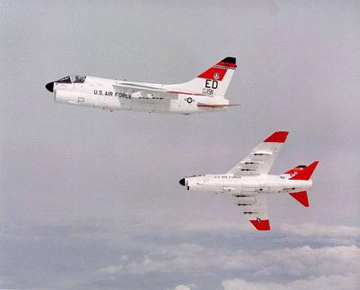
A-7E Avionics System
Reference:
http://www.fas.org/man/dod-101/sys/ac/a-7.htm
Facts:
1965 introduced
In 1992 final ones replaced by F/A-18
20mm gun and can carry payloads of up to 15,000 pounds of bombs and missiles
7E = pilot only version
Cost - $2,860,000

Slide 4
A-7E Avionics System
System started in 1977 (pre-SA terminology)
Software Engr. Group of Naval Research Lab
To test Hypothesis that: information hiding and cooperative sequential processes were appropriate for high-performance embedded real-time systems
Information hiding ( Parnas et al ➔ OO)
Cooperative sequential processes
EW Dijkstra 1965, semaphores P and V operations

Slide 5
Architecture Business Cycle A-7E
Stakeholders
navy aviators
Developing Organization
Naval Research lab
Technical Environment
OO information hiding
Cooperating seq. proc.
Real-time system
Architect’s experience
Academic
Access to other avionics systems
Requirements (Qualities)
Modifiability
Performance
Architect
Architecture Module structure Uses structure Process structure
System A-7E Avionics

Slide 6
A-7E Corsair Architecture Structures
Modular decomposition and information hiding
Uses: dependency
Processes: threads, schedules, synchronization, etc.
Physical structure is not covered in chapter 3.
These structures are largely independent and in fact orthogonal.

Slide 7
Requirements: Situation Awareness
Mission: carrier-based attack, ground-support
Data input from sensors
multiple sources of altitude, range, speed, position,
weapons status
Data output to pilot displays
moving map, direction, distance, time to go, etc.
head-up display: target, trajectory, navigation and weapon mode status, etc.
lights, dials, audibles
Pilot input
mode select switches and keyboard
target selection (lat/lon on keypad, map slew with “cone hat,” FLIR designation, HUD slew

Slide 8
Quality Requirements
Real-time performance and availability
Embedded (“situated”)
Modifiability
Mission-critical, but not flight-critical
“Hidden” Requirements as an R&D effort
demonstrate advanced computer science
software engineering methods
information hiding for real-time, embedded systems
interface specification
requirements documentation
multiple architectural views
publication of lessons learned

Slide 9
Module Structure
Divide into modules that can be developed independently then easily integrated
Work Breakdown Structure; Module Guide
no overlap or gaps
separation of concerns
inter-module dependency trace
multi-level functional hierarchy
issue: must get it right, early
Module structure is the “anchor” architecture
Goals
each module is simple enough to be understood
can change implementation of a module without knowledge of other modules
easy to modify things that are expected to change
large changes are a set of independent changes to individual modules

Slide 10
Uses Structure
Captures run-time dependency
Procedure A uses Procedure B if a correctly functioning B must be present in order for A to meet its requirements
e.g., procedure call
e.g., write, then read shared memory or bus message
e.g., raise an interrupt
Defines transitive closure of functionally complete subsets
Procedures are usually more fine-grained than modules

Slide 11
Process Structure
Anticipated multi-processor implementation
Cooperating sequential processes
synchronize use of shared resources
off-line (fixed) schedule of steps in a thread triggered by event or a time clock
Processes
compute system outputs
periodic – 40 ms
event-triggered
pre-compute “expensive” outputs
periodic – 100 ms
“Executive” scheduler with merged independent processes

Slide 12
Physical structure

Slide 13
Module Decomposition View
Hardware-Hiding Module
Extended Computer Module
Device Interface Module
Behavior-Hiding Module
Function-Driving Module
Shared Services Module
Software Decision Module
Application Data Type Module
Data Banker Module
Filter Behavior Module
Physical Models Module
Software Utility Module
System Generation Module
See Figure 3.4 (2nd edition), p. 59

Slide 14
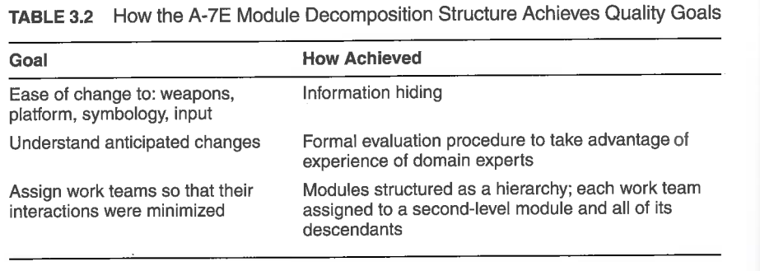

Slide 15
Module Specification
Introduction
Interface overview
Access procedure table
Events signaled
Local types dictionary
Dictionary
Undesired event dictionary
System generation parameters
Interface design issues
Implementation notes
Assumption lists
Accuracy, timing and efficiency guide

Slide 16
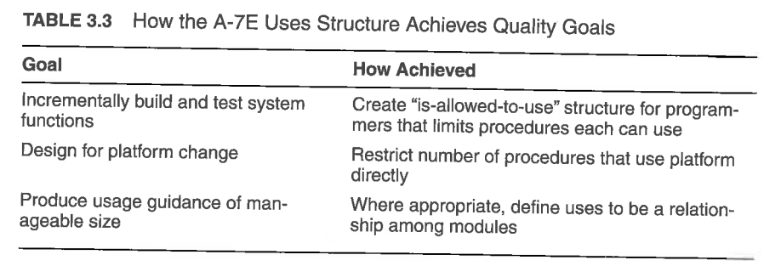

Slide 17
Process Structure
Mapping of procedures to process threads
Identification of re-entrant procedures
Identification of procedure service load
Mutual exclusions
Drove schedule executive design

Slide 18
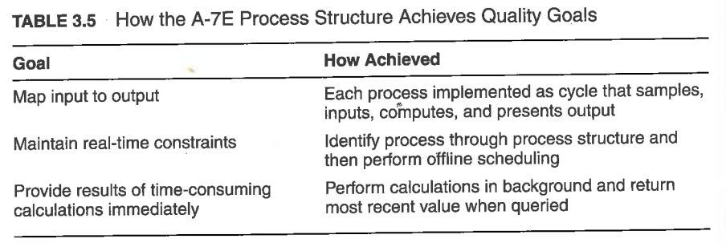

Slide 19
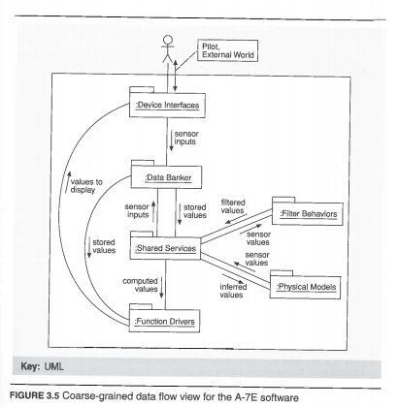
Coarse-grained data Flow (figure 3.5)

Slide 20
Creating An Architecture
Part Two of Readings book chapters 4-10.
“Beauty is in the eye of the beholder”
Booth Tarkington (1838–1918). The Magnificent Ambersons. 1918.
So whose concept of “Quality” does the architect use?
His/her own?
Customer?
Can’t we all just agree? (paraphrasing Rodney King)
Can we move to a more objective less subjective def.?
We will use quality attribute scenarios

Slide 21
Understanding Quality Attributes

