Slide 1
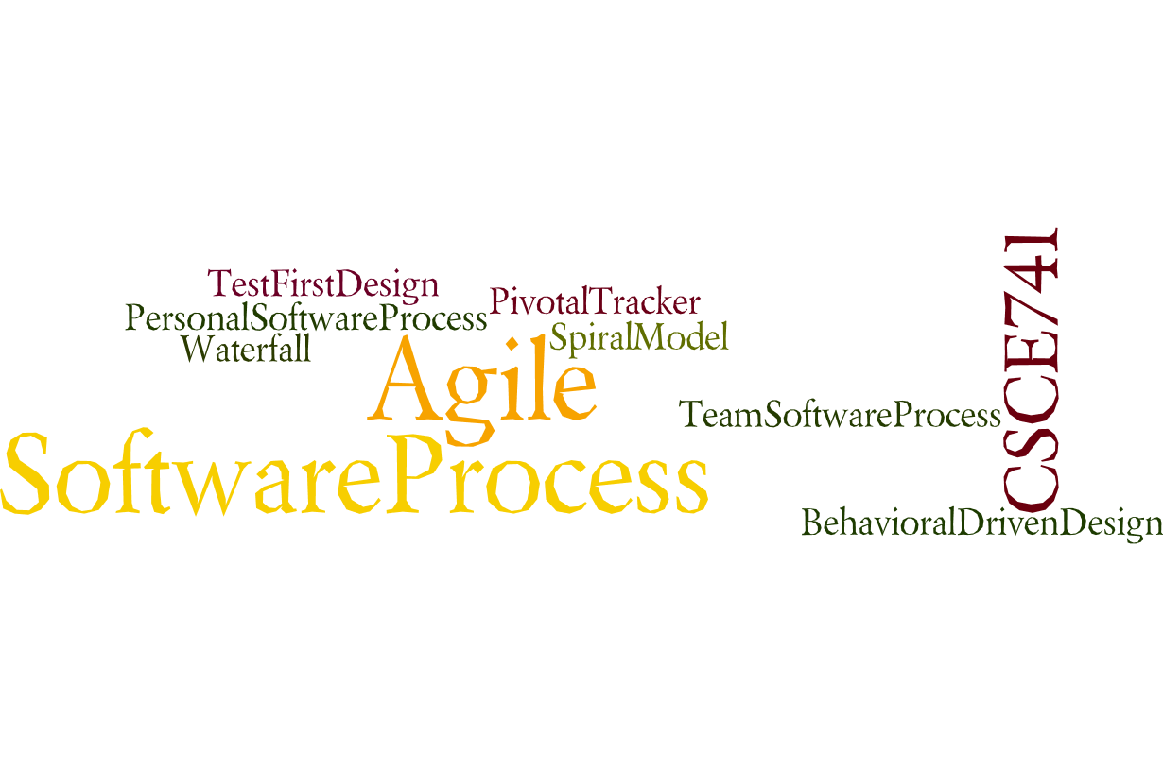

Lecture 04
Availability
CSCE 741 Software Process
Topics
  Chapter 5 – Availability
Lecture 10 - Sprinting
  Product Owner
  Scrum Master
  Development Team
  Scrum Team Structures and Managers
Readings: ES Part II -- Roles
October 2, 2017

Slide 2
Last Time
  Questions about project
  Roles in Scrum
  Product Owner
  Scrum Master
  DevelopmentTeam
    Source code Apress.com. … (back of cover page has URL)
New
  External Databases
    Mysql
    mongoDB
  Sprinitng

Slide 3
Sprint Planning – Essential Scrum Ch19
A product backlog may represent many weeks or months of work, which is much more than can be completed in a single, short sprint.
To determine the most important subset of product backlog items to build in the next sprint, the Scrum team performs sprint planning.
During sprint planning the Scrum team agrees on a goal for the sprint, and the development team determines the specific product backlog items that are aligned with that goal and that it can realistically deliver by the end of the sprint.
To acquire confidence in what it can deliver, the development team creates a plan for how to complete the product backlog
Essential Scrum by Rubin, Ch 19 Sprint Planning

Slide 4
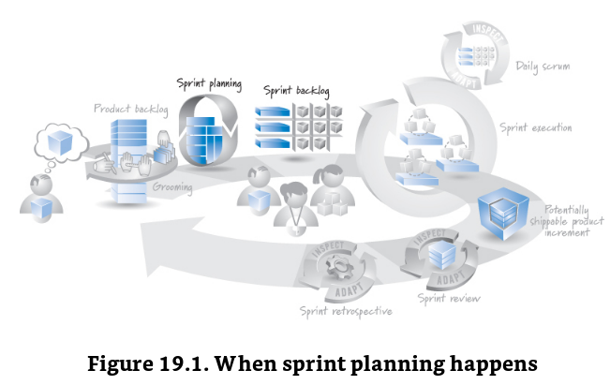
Sprint planning – recurring, just-in-time
4-8 hours should be sufficient
Essential Scrum by Rubin, Ch 19 Sprint Planning

Slide 5
Participants
Everybody: Product owner, scrum master, dev team
product owner:
  shares the initial sprint goal,
  presents the prioritized product backlog, and
  answers any questions the team might have regarding the product backlog items.
Development team
  works diligently to determine what it can deliver and then
  makes a realistic commitment at the end of sprint planning.
ScrumMaster,
  acting as the Scrum team coach,
  observes the planning activity,
  asks probing questions, and facilitates to help ensure a success
  the ScrumMaster is not in charge of the development team, she cannot decide on behalf of the development team what commitment to make.
  The ScrumMaster can, however, challenge the team’s commitment to ensure that it is realistic and appropriate.
Essential Scrum by Rubin, Ch 19 Sprint Planning

Slide 6
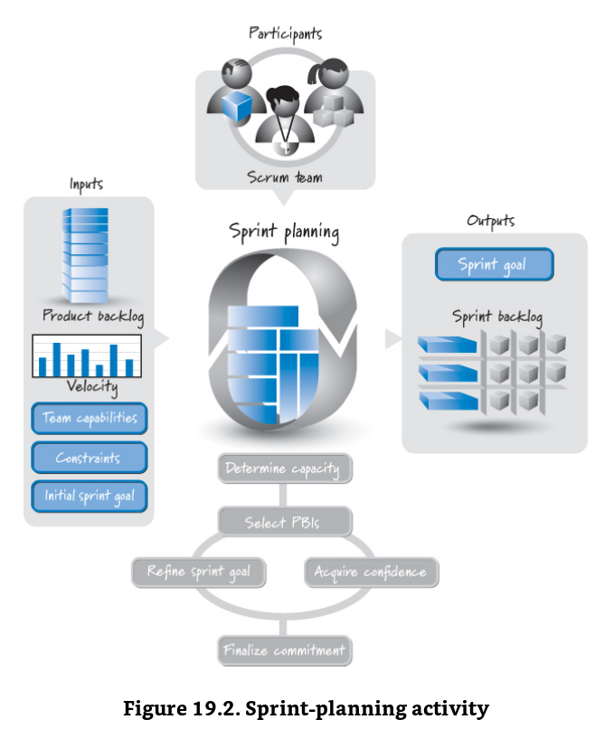
Essential Scrum by Rubin, Ch 19 Sprint Planning

Slide 7
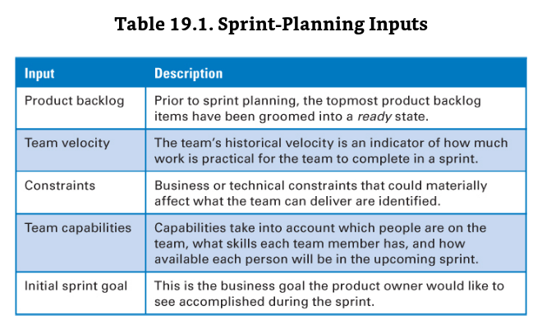
Sprint Planning Inputs
Essential Scrum by Rubin, Ch 19 Sprint Planning

Slide 8
Two part Sprint planning
“How much or capacity part”
  how many points we can accomplish and
  “what” a selection of user stories from the backlog that totals that number of points
The “How” part – a little introspection or confidence building that the selection of backlog items is a good one
Essential Scrum by Rubin, Ch 19 Sprint Planning

Slide 9
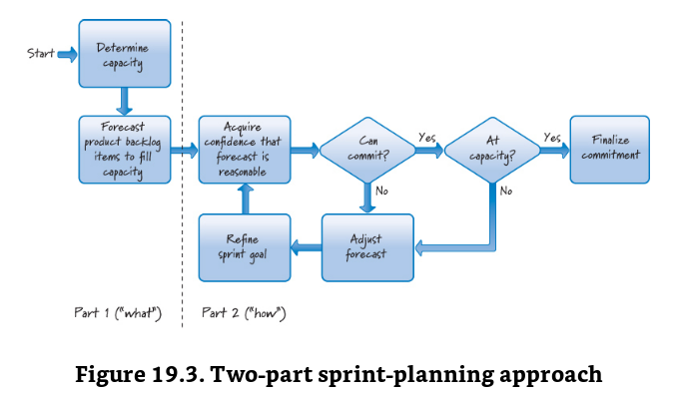
Essential Scrum by Rubin, Ch 19 Sprint Planning

Slide 10
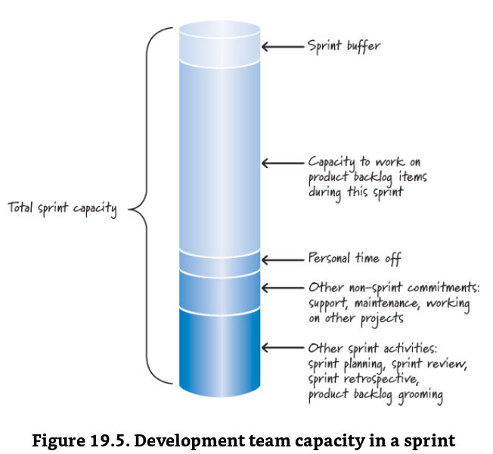
Determining Capacity in Points
What is capacity?
10% backlog grooming
Time-off?
Upfront planning
Sprint review
Sprint retrospective
Unit of measure = points
Essential Scrum by Rubin, Ch 19 Sprint Planning

Slide 11
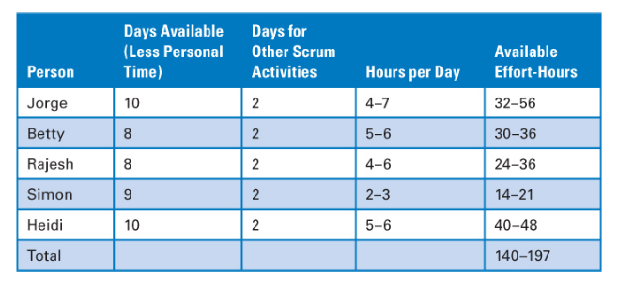
Capacity in Effort hours (man-hours)
Essential Scrum by Rubin, Ch 19 Sprint Planning

Slide 12
Selecting Product Backlog Items
User Stories or Product Backlog Items (more general)\
  Refactoring
  Paying technical debt – such as mastering mongoDB
“we don’t start what we can’t finish”
  Start only what you can finish rule
What do you do if an item is too big?
We need a good definition of user story “being ready”
Essential Scrum by Rubin, Ch 19 Sprint Planning

Slide 13
Acquiring Confidence
Studying, discussing the proposed Sprint goal (selection of User stories) should
Lead to refinement or
Give confidence that it is a good selection
Essential Scrum by Rubin, Ch 19 Sprint Planning

Slide 14
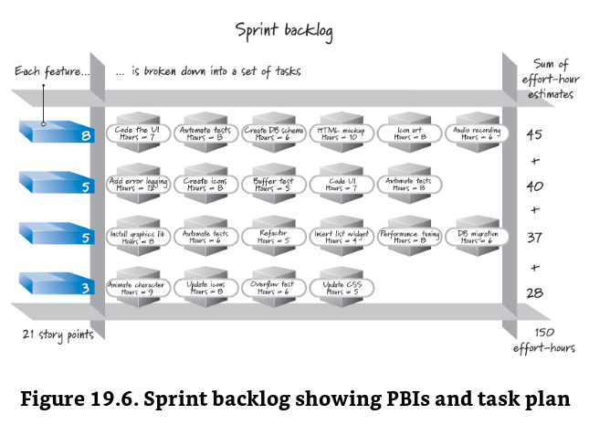
Essential Scrum by Rubin, Ch 19 Sprint Planning

Slide 15
Expertise capacity checks
User interface (or DB or …) expertise might be concentrated in one member of the development team
Essential Scrum by Rubin, Ch 19 Sprint Planning

Slide 16
Refine and Finalize the Commitment
Essential Scrum by Rubin, Ch 19 Sprint Planning

Slide 17
Essential Scrum by Rubin, Ch 19 Sprint Planning

Slide 18
Essential Scrum by Rubin, Ch 19 Sprint Planning

Slide 19
Essential Scrum by Rubin, Ch 19 Sprint Planning

Slide 20
Essential Scrum by Rubin, Ch 19 Sprint Planning

Slide 21
Essential Scrum by Rubin, Ch 19 Sprint Planning

