Slide 1
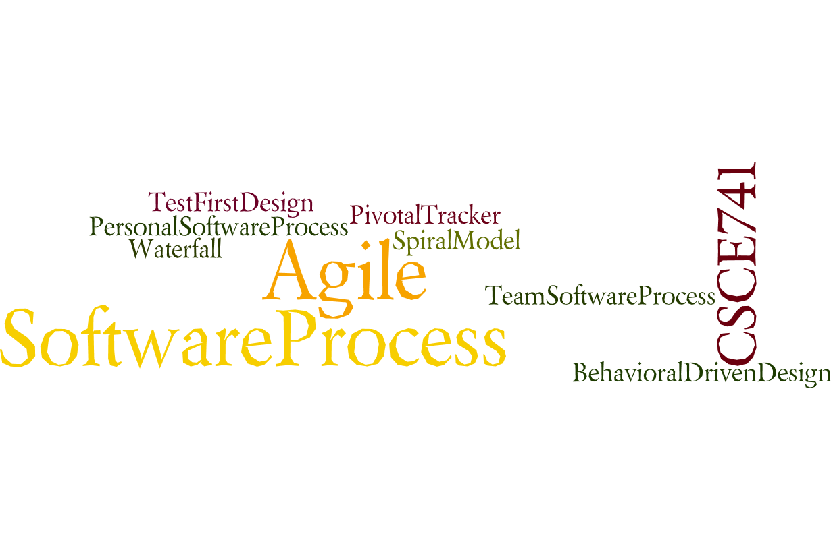
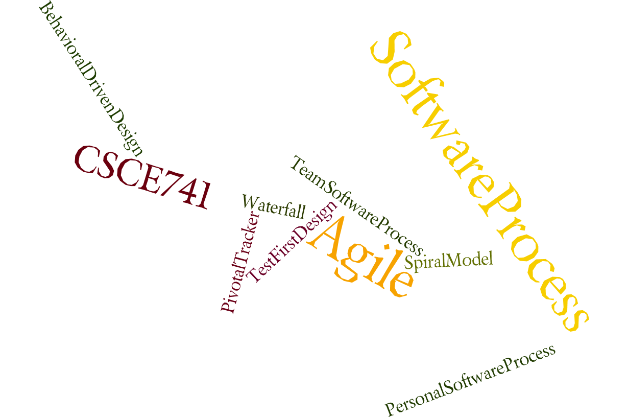
Lecture 04
Availability
CSCE 741 Software Process
Topics
  Chapter 5 – Availability
Lecture 10 – Spring Boot and Mysql
  Spring Boot JPA
  Spring Boot Mysql
  Spring Boot MongoDB
Readings: Accessing Data Spring Boot Style
October 4, 2017

Slide 2
Last Time
  PSB Chapter 6
  PSB Chapter 7 – data access
    H2 in memory DB
    Source code Apress.com. … (back of cover page has URL)
New
  Questions about project
  Roles in Scrum
  Product Owner
  Scrum Master
  DevelopmentTeam
  Scrum Team Structures and Managers
  External Databases
    Mysql
    mongoDB

Slide 3
Pro Spring Boot
Ch 07 External DB
Ch 08 MVC = Webdevelopment
Ch 09 Security
Ch 10 Messaging ???
Ch 11 Spring Boot Actuator
Ch 12 Deploying
Ch 13 Spring in the Cloud
Ch 14 Extending Spring Boot Applications
Pro Spring Boot by Gutierrez, Felipe, Ch 01

Slide 4
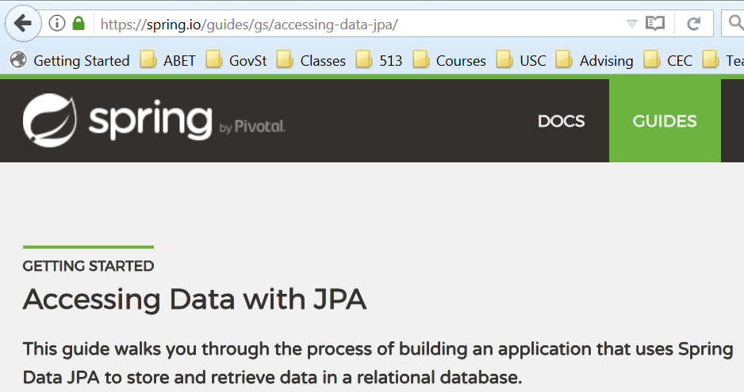
https://spring.io/guides/gs/accessing-data-jpa/

Slide 5
What you’ll build
You’ll build an application that stores Customer POJOs in a memory-based database.
What you’ll need
About 15 minutes
A favorite text editor or IDE
JDK 1.8 or later
Gradle 2.3+ or Maven 3.0+
You can also import the code straight into your IDE:
Spring Tool Suite (STS)
IntelliJ IDEA
https://spring.io/guides/gs/accessing-data-jpa/

Slide 6
How to complete this guide
Like most Spring Getting Started guides, you can start from scratch and complete each step, or you can bypass basic setup steps that are already familiar to you. Either way, you end up with working code.
To start from scratch, move on to Build with Gradle.
To skip the basics, do the following:
Download and unzip the source repository for this guide, or clone it using Git: git clone https://github.com/spring-guides/gs-accessing-data-jpa.git
cd into gs-accessing-data-jpa/initial
Jump ahead to Define a simple entity.
https://spring.io/guides/gs/accessing-data-jpa/

Slide 7
When you’re finished, you can check your results against the code in gs-accessing-data-jpa/complete.
Build with Gradle
First you set up a basic build script. You can use any build system you like when building apps with Spring, but the code you need to work with Gradle and Maven is included here. If you’re not familiar with either, refer to Building Java Projects with Gradle or Building Java Projects with Maven.
https://spring.io/guides/gs/accessing-data-jpa/

Slide 8
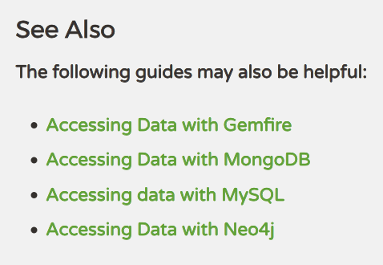
Dot dot dot = see handout
https://spring.io/guides/gs/accessing-data-jpa/

Slide 9
https://spring.io/guides/gs/accessing-data-jpa/

Slide 10
https://spring.io/guides/gs/accessing-data-jpa/

Slide 11
https://spring.io/guides/gs/accessing-data-jpa/

Slide 12
https://spring.io/guides/gs/accessing-data-jpa/

Slide 13
https://spring.io/guides/gs/accessing-data-jpa/

Slide 14
https://spring.io/guides/gs/accessing-data-jpa/

Slide 15
https://spring.io/guides/gs/accessing-data-jpa/

