Slide 1
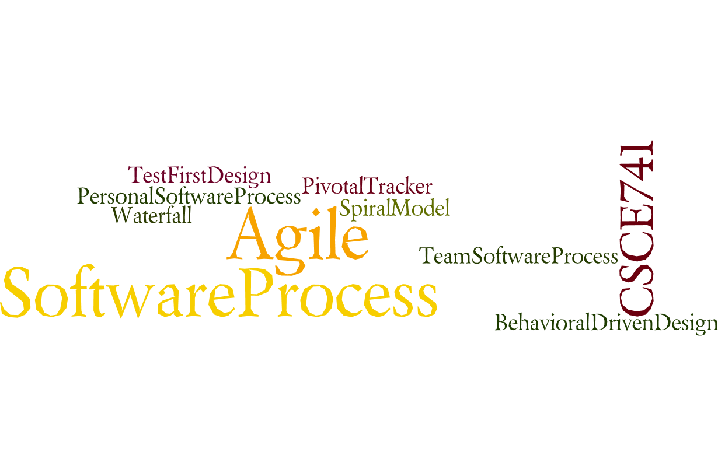

Lecture 04
Availability
CSCE 741 Software Process
Topics
  Chapter 5 – Availability
Lecture 9 – Scrum Roles
  Product Owner
  Scrum Master
  Development Team
  Scrum Team Structures and Managers
Readings: ES Part II -- Roles
October 2, 2017

Slide 2
Last Time
  PSB Chapter 6
  PSB Chapter 7 – data access
    H2 in memory DB
    Source code Apress.com. … (back of cover page has URL)
New
  Questions about project
  Roles in Scrum
  Product Owner
  Scrum Master
  DevelopmentTeam
  Scrum Team Structures and Managers
  External Databases
    Mysql
    mongoDB

Slide 3
Essential Scrum Ch 9 Product Owner
Role relative to the rest of the Scrum Team
A Day in the life of a product owner
Essential Scrum by Rubin, Ch 09 Product Owner

Slide 4
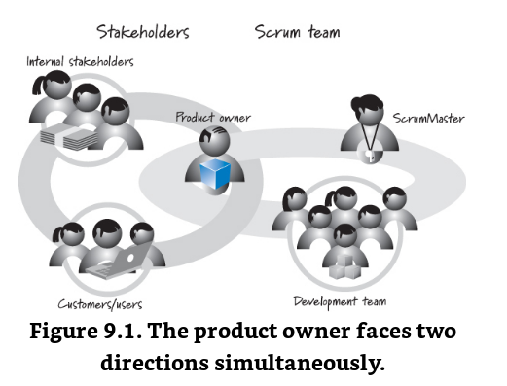
Product Owner looks in two directions
Essential Scrum by Rubin, Ch 09 Product Owner

Slide 5
Product owner must understand
Product owner must understand needs and priorities of:
Customers,
Data entry staff
Operations staff
Management of Customer side
Ensure “the right system is developed”
Essential Scrum by Rubin, Ch 09 Product Owner

Slide 6
Product owner must Communicate
Communicate with Development team
What to build
What order to build it (within constraints)
Make sure criteria for acceptance tests are developed
Verify criteria determine when features are complete
Make sure acceptance tests are run
Doesn’t write detailed tests but ensures that high level ones are written
Essential Scrum by Rubin, Ch 09 Product Owner

Slide 7
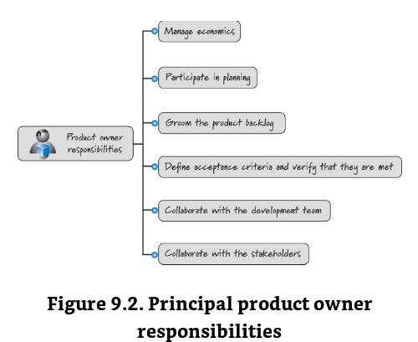
Essential Scrum by Rubin, Ch 09 Product Owner

Slide 8
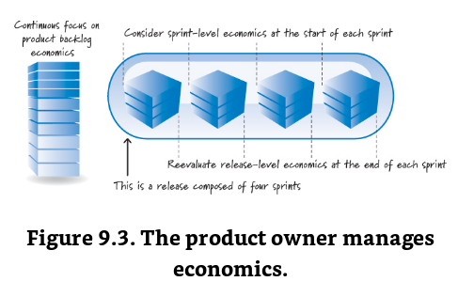
Essential Scrum by Rubin, Ch 09 Product Owner

Slide 9
Release level economics
product owner continuously makes trade-offs in:
  scope,
  date,
  budget, and
  quality
as a stream of economically important information arrives during product development.
Trade-offs made at the beginning of a release might no longer be appropriate in the presence of new information that arrives during the release.
Essential Scrum by Rubin, Ch 09 Product Owner

Slide 10
Sprint level Economics
Sprint level Economics
The product owner also manages sprint-level economics:
ensuring that a good return on investment (ROI) is delivered from each sprint.
Good product owners treat their organization’s money as if it were their own money.
In most cases the product owner knows the cost of the next sprint (the duration and team composition of the sprint are known.)
Essential Scrum by Rubin, Ch 09 Product Owner

Slide 11
Product Backlog Economics
Product Backlog Economics
Cost/benefit ratio might change
Reprioritize the backlog
Participate in Planning
Groom the Product Backlog
  Creating new backlog items
  Refining existing ones
  Estimating (making sure done and still correct over time)
  prioritizing
Essential Scrum by Rubin, Ch 09 Product Owner

Slide 12
Define Acceptance Criteria and Verify That They Are Met
The product owner is responsible for defining the acceptance criteria for each product backlog item.
These are the conditions under which the product owner would be satisfied that the functional and nonfunctional requirements have been met.
The product owner may also write acceptance tests corresponding to the acceptance criteria, or he could enlist the assistance of subject matter experts (SMEs) or development team members.
product owner should ensure that these acceptance criteria (and frequently specific acceptance tests) are created before an item is considered at a sprint-planning meeting.
Without them, the team would have an incomplete understanding of the item
Verify tests during review, do not wait till sprint-review
Essential Scrum by Rubin, Ch 09 Product Owner

Slide 13
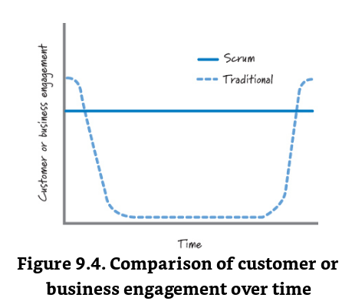
Customer Engagement in Agile
Essential Scrum by Rubin, Ch 09 Product Owner

Slide 14
Collaborate with the Stakeholders
The product owner is the single voice of the entire stakeholder community, internal and external.
Internal stakeholders can include:
  business systems owners,
  executive management,
  program management,
  marketing, and sales.
External stakeholders can include:
  customers, users, partners, regulatory bodies, and others.
The product owner must work closely with the entire stakeholder community to gather input and synthesize a coherent vision to guide product development.
Essential Scrum by Rubin, Ch 09 Product Owner

Slide 15
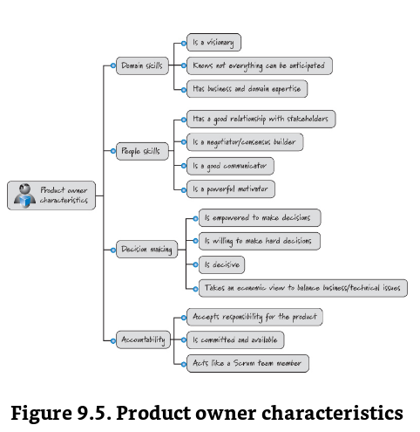
Essential Scrum by Rubin, Ch 09 Product Owner

Slide 16
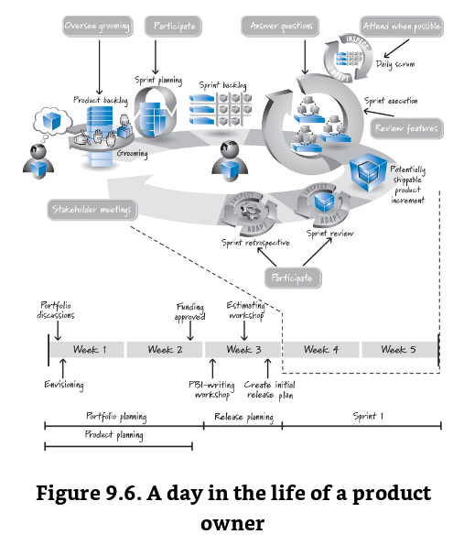
A Day in the Life of a Product Owner
Essential Scrum by Rubin, Ch 09 Product Owner

Slide 17
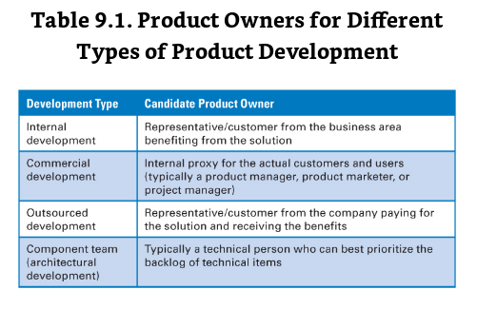
Essential Scrum by Rubin, Ch 09 Product Owner

Slide 18
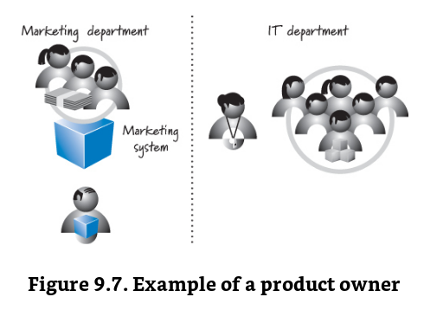
Internal Development
Essential Scrum by Rubin, Ch 09 Product Owner

Slide 19
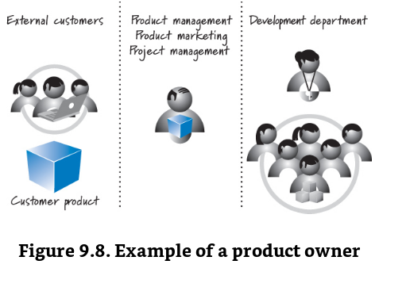
Commercial Development
Essential Scrum by Rubin, Ch 09 Product Owner

Slide 20
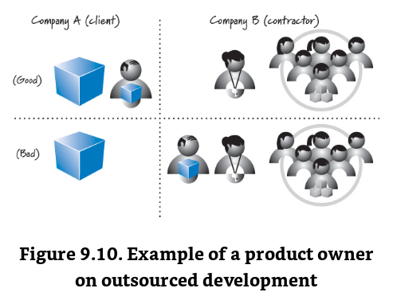
Essential Scrum by Rubin, Ch 09 Product Owner

Slide 21
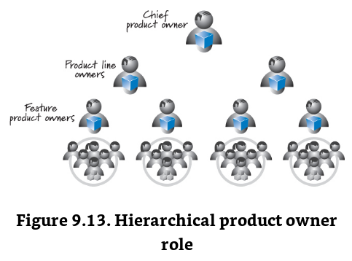
Proxies for Product owner
Hierarchy
Essential Scrum by Rubin, Ch 09 Product Owner

Slide 22
Essential Scrum Ch 10 ScrumMaster
3 roles :
Product owner,
development team,
scrum master
Essential Scrum by Rubin, Ch 10 Scrum Master

Slide 23
The ScrumMaster is focused on helping everyone understand and embrace the Scrum values, principles, and practices.
The ScrumMaster acts as a coach to both the development team and the product owner.
A ScrumMaster also provides process leadership, helping the Scrum team and the rest of the organization develop their own high-performance, organization-specific Scrum approach.
Essential Scrum by Rubin, Ch 10 Scrum Master

Slide 24
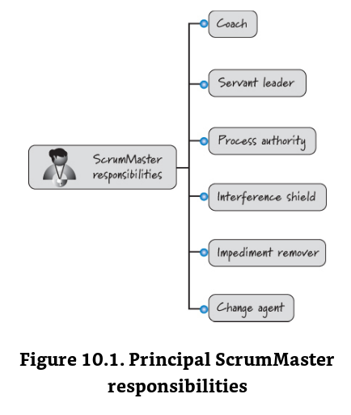
Essential Scrum by Rubin, Ch 10 Scrum Master

Slide 25
Roles of ScrumMaster
Coach
Servant leader
  “Kennedy “ask not what your country can do for you, ask what you can do for your country.”
  ScrumMaster “What can I do today to help you and the team be more effective.”
Process Authority – assure team enacts and adheres to scrum principles and practices
Interference shield
Impediment remover
Change agent – “change minds” in addition to …
Essential Scrum by Rubin, Ch 10 Scrum Master

Slide 26
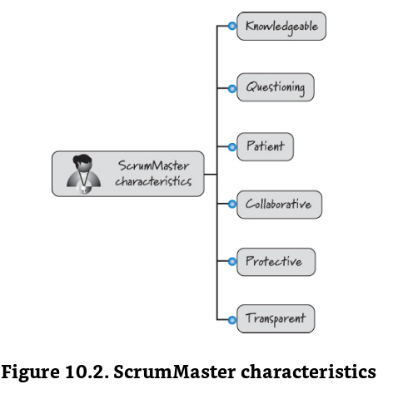
Essential Scrum by Rubin, Ch 10 Scrum Master

Slide 27
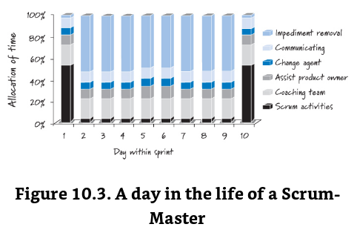
A day in the Life of ScrumMaster
Essential Scrum by Rubin, Ch 10 Scrum Master

Slide 28
Who should be a ScrumMaster?
Traditional Project managers
  More likely product owners
Technical lead?
Essential Scrum by Rubin, Ch 10 Scrum Master

Slide 29
Is Scrum Master a full-time job?
Is Scrum Master a full-time job?
Combining ScrumMaster with other Roles
ScrumMaster on more than one team
Essential Scrum by Rubin, Ch 10 Scrum Master

Slide 30
ES Ch 11 - Development Team
Traditional roles:
Architect
Programmer
Tester
Database administrator
UI designer
Scrum cross-functional collection of these types
Essential Scrum by Rubin, Ch 11 Development Team

Slide 31
Role Specific Teams
Essential Scrum by Rubin, Ch 11 Development Team

Slide 32
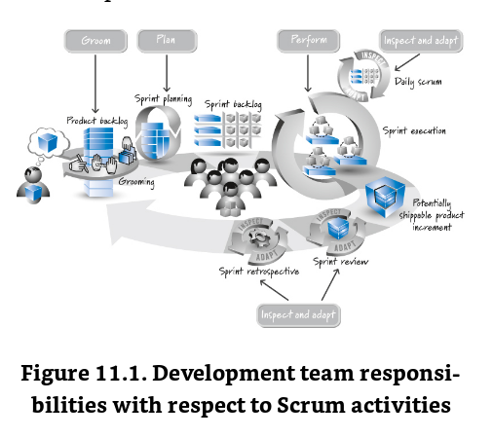
Essential Scrum by Rubin, Ch 11 Development Team

Slide 33
Perform sprint execution
Inspect and adapt each day (Daily Scrum = Daily Standup)
Groom the product backlog
Plan the sprint
Inspect and adapt the product and process
Essential Scrum by Rubin, Ch 11 Development Team

Slide 34
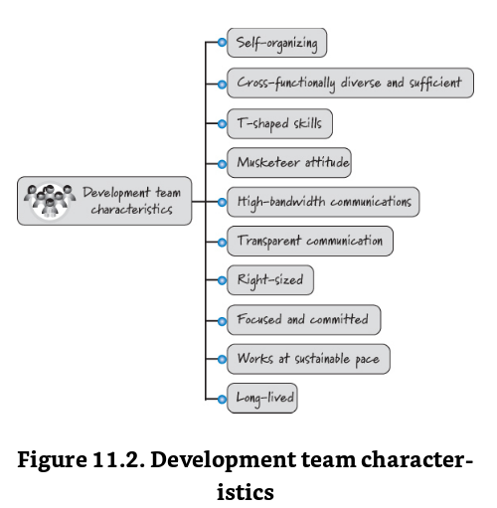
Essential Scrum by Rubin, Ch 11 Development Team

Slide 35

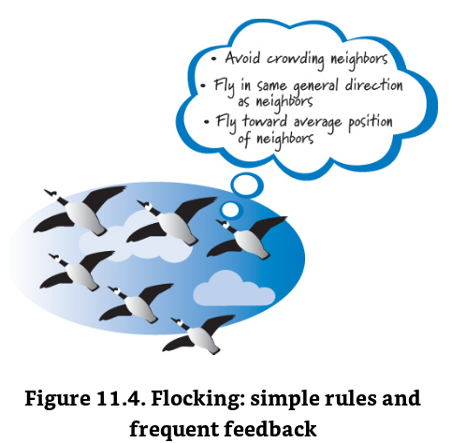
Self-organizing not ScrumMaster
Essential Scrum by Rubin, Ch 11 Development Team

Slide 36
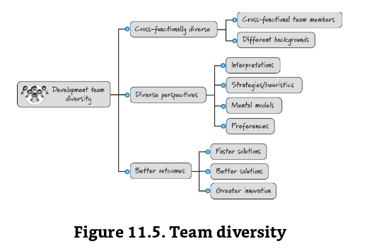
Diversity
.
Essential Scrum by Rubin, Ch 07

Slide 37
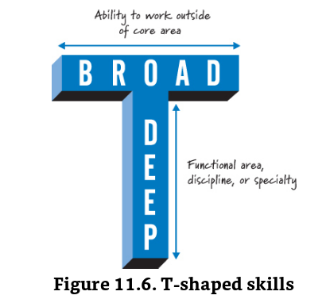
Type of expertise
.
Essential Scrum by Rubin, Ch 07

Slide 38
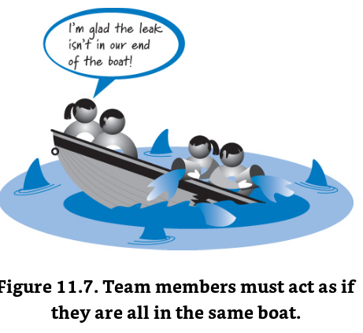
Attitude of Three Musketeers
“All for one and one for all.” A. Dumas
“They win as a team or they fail as a team.”
Essential Scrum by Rubin, Ch 07

Slide 39
Reasons to keep teams small
• There is less social loafing—people exerting less effort because they believe that others will pick up the slack.
• Constructive interaction is more likely to occur on a small team.
• Less time is spent coordinating efforts.
• No one can fade into the background.
• Small teams are more satisfying to their members.
• Harmful overspecialization is less likely to occur.
  Cohn 2009
Essential Scrum by Rubin, Ch 11 Development Team

Slide 40
Scrum of Scrums
Essential Scrum by Rubin, Ch 11 Development Team

Slide 41
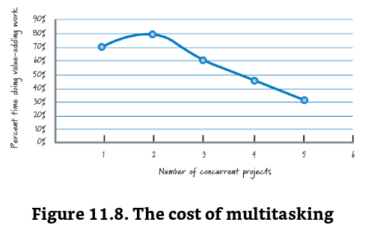
Cost of multitasking
Essential Scrum by Rubin, Ch 11 Development Team

Slide 42
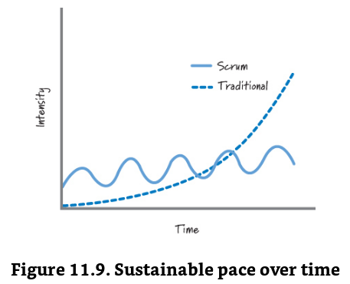
Sustaining Intensity/Pace
Essential Scrum by Rubin, Ch 11 Development Team

Slide 43
Managers and Team Structures –
Later
Essential Scrum by Rubin, Ch 11 Development Team

Slide 44
Pro Spring Boot
Ch 07 External DB
Ch 08 MVC = Webdevelopment
Ch 09 Security
Ch 10 Messaging ???
Ch 11 Spring Boot Actuator
Ch 12 Deploying
Ch 13 Spring in the Cloud
Ch 14 Extending Spring Boot Applications

