Slide 1
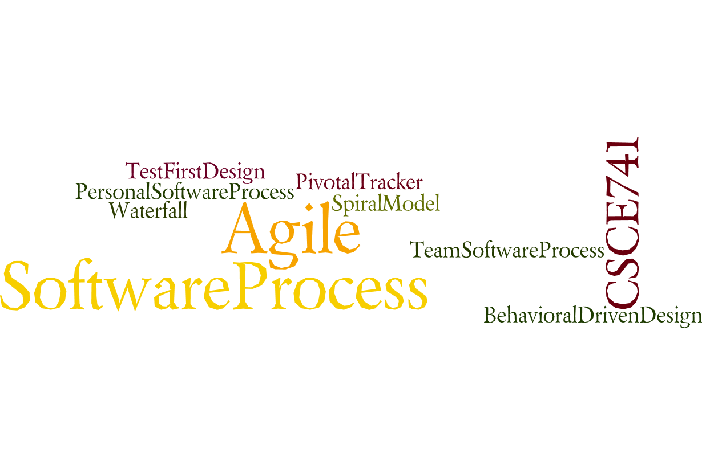
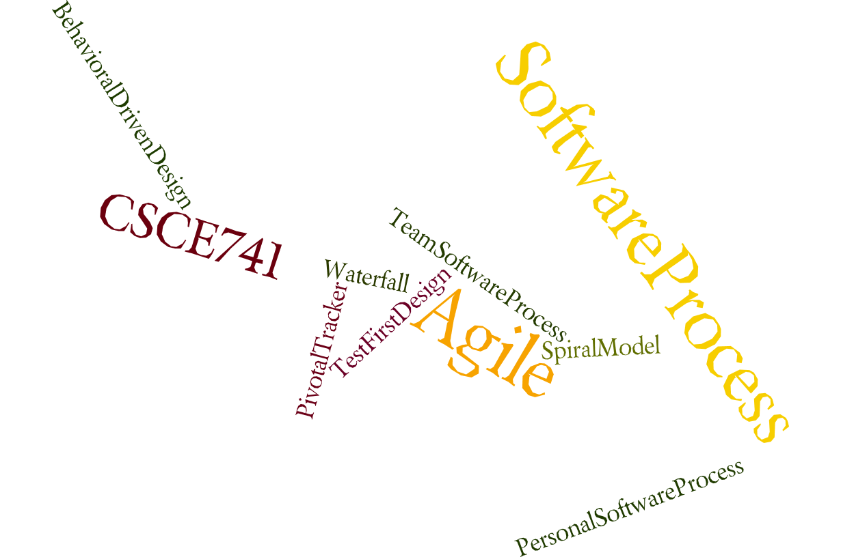
Lecture 04
Availability
CSCE 741 Software Process
Topics
  Chapter 5 – Availability
Lecture 6 -- Spring Boot, points
  Testing with Spring Boot
  Point evaluation of User Stories
  Velocity
Readings:PSB Ch 6-7
September 27, 2017

Slide 2
Last Time
  Sprints <ES=Essential Scrum chapter 4>
  ProSpringBoot chapter 2
Abbreviations
  ES for Essential Scrum = Rubin, Kenneth S.. Essential Scrum: A Practical Guide to the Most Popular Agile Process (Addison-Wesley Signature Series (Cohn)) (p. 61). Pearson Education. Kindle Edition.
  PSB for Gutierrez, Felipe. Pro Spring Boot (Kindle Location 3292). Apress. Kindle Edition.
New References
  PSB chapter 3
  ES Chapter 8 and 9

Slide 3
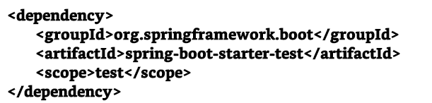
Testing with Spring Boot Ch06
.
Includes JARs :
spring-test,
junit,
hamcrest,
objenesis, and
mockito.
Pro Spring Boot by Gutierrez, Felipe. Ch 06

Slide 4
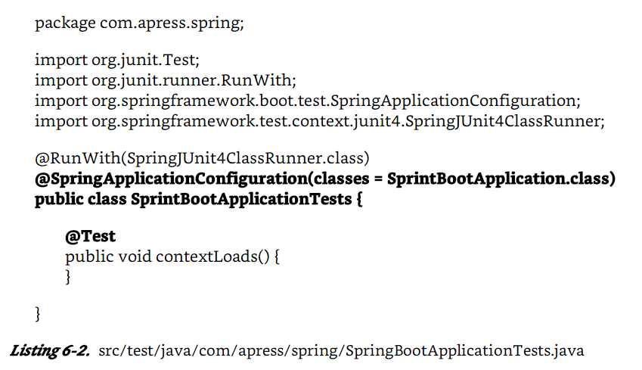
Listing 6.2
Pro Spring Boot by Gutierrez, Felipe. Ch 06

Slide 5
Web Testing
$ mkdir spring-boot-web
$ cd spring-boot-web
$ spring init -d = web, thymeleaf --package = com.apress.spring -g = com.apress.spring -a = spring-boot-web -name = sprint-boot-web –x
Thymeleaf as the view engine
Gutierrez, Felipe. Pro Spring Boot (Kindle Locations 2414-2415). Apress. Kindle Edition.
Pro Spring Boot by Gutierrez, Felipe. Ch 06

Slide 6
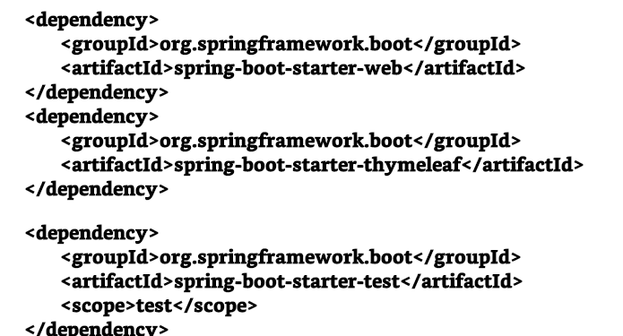
Pom.xml - thymeleaf
Pro Spring Boot by Gutierrez, Felipe. Ch 06

Slide 7
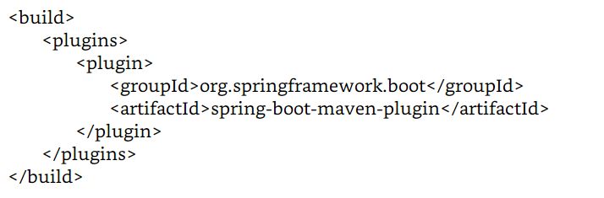
Pro Spring Boot by Gutierrez, Felipe. Ch 06

Slide 8
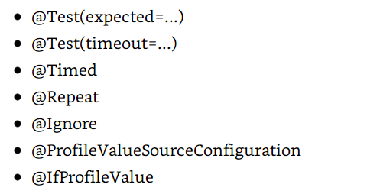
SpringJUnit4ClassRunner
SpringJUnit4ClassRunner supports:
Pro Spring Boot by Gutierrez, Felipe. Ch 06

Slide 9
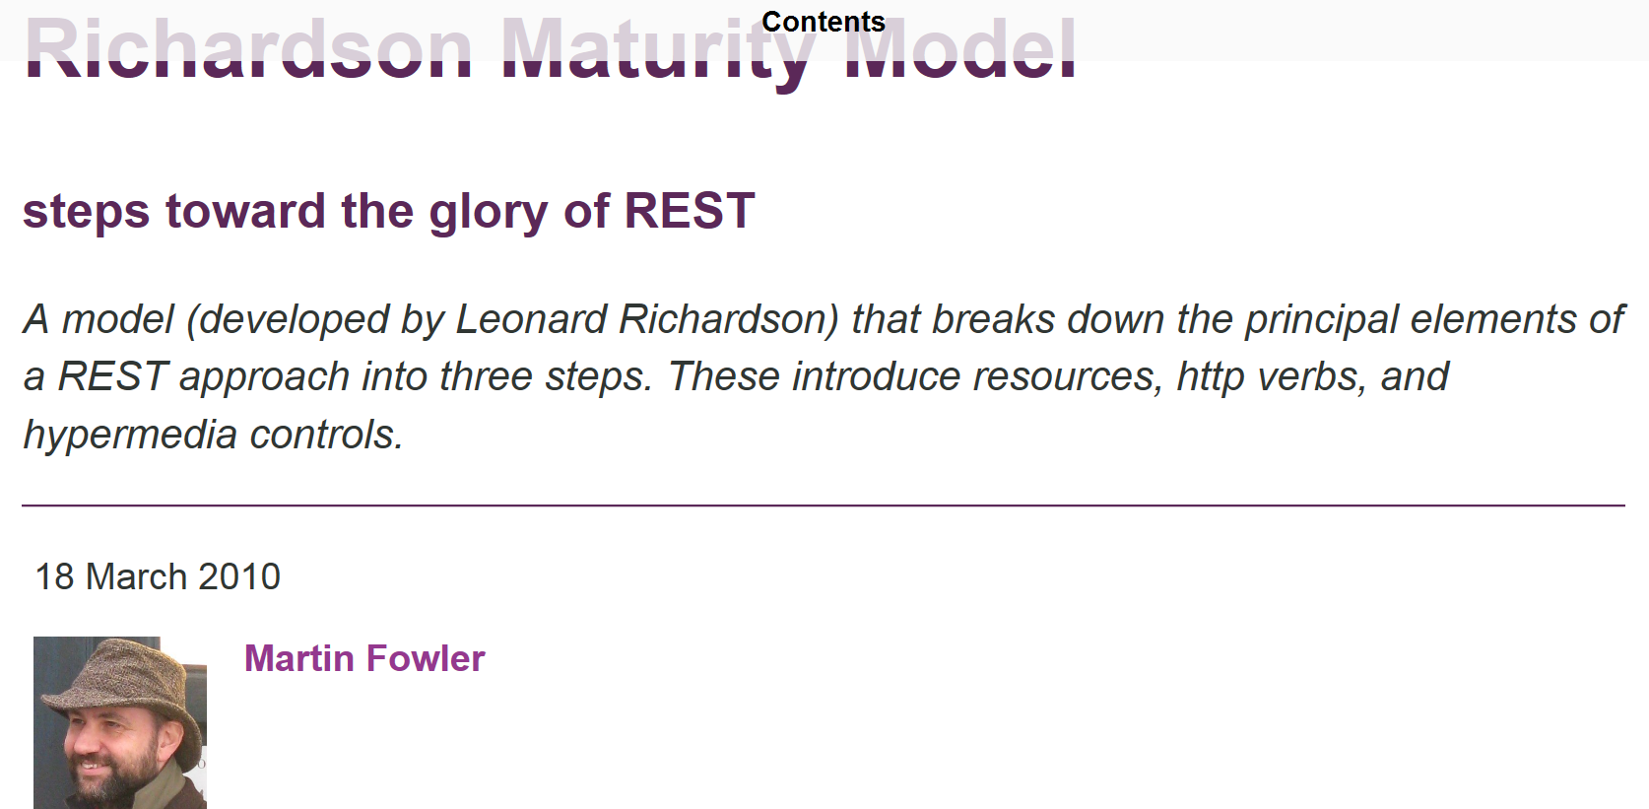
Richardson Maturity Model
https://martinfowler.com/articles/richardsonMaturityModel.html

Slide 10
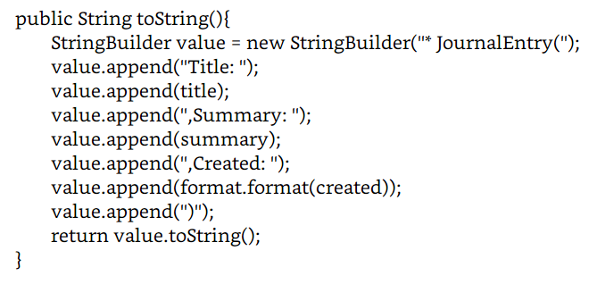
toString()
Pro Spring Boot by Gutierrez, Felipe. Ch 06

Slide 11
Mvc-test
http:// docs.spring.io/ spring-framework/ docs/ current/ spring-framework-reference/ html/ integration-testing.html# spring-mvc-test-framework .
setConverters
toJsonString(Object)
setup()
getAll()
findByTitle() // Journal running example
add()
Pro Spring Boot by Gutierrez, Felipe. Ch 06

Slide 12
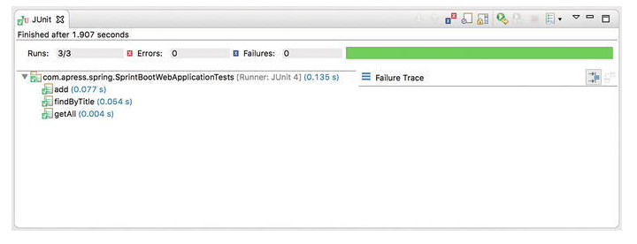
Running Tests with STS
Pro Spring Boot by Gutierrez, Felipe. Ch 06

Slide 13
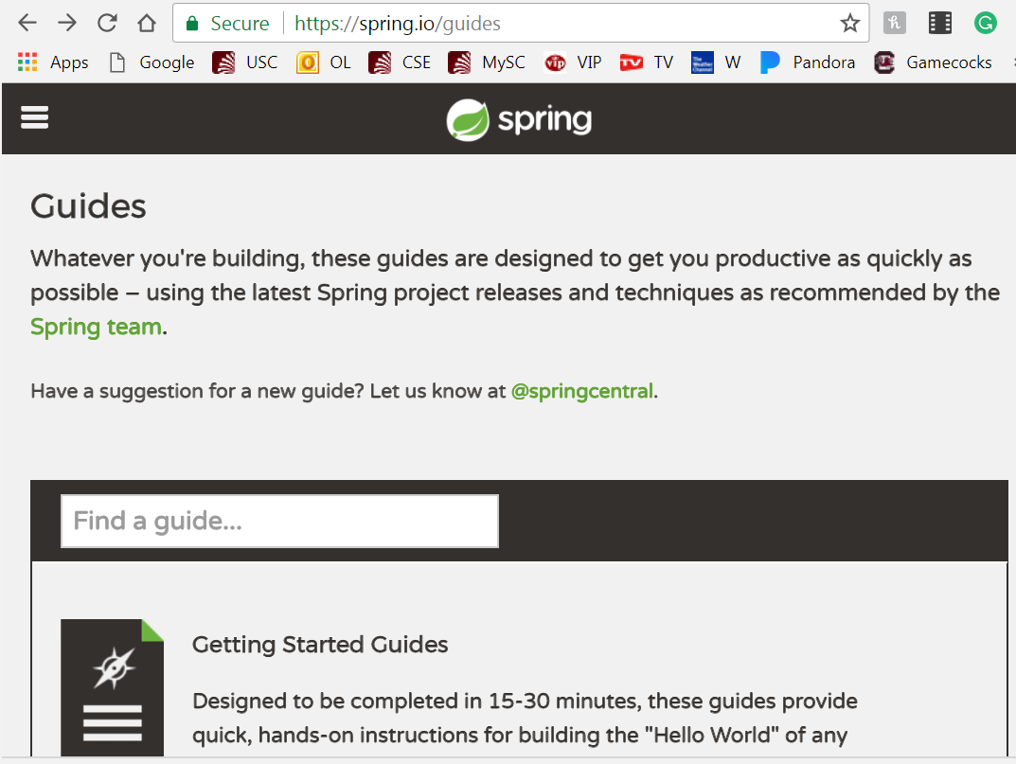
https://spring.io/guides

Slide 14
Spring Guides
Integrating Data - fetch data, process it, and write it to a file
Serving Web Content with Spring MVC
Handling Form Submission
Working a Getting Started guide with STS
Consuming a RESTful Web Service with rest.js
Accessing MongoDB Data with REST
Accessing JPA Data with REST
Spring Boot with Docker
…
Spring Security Architecture
Uploading Files
https://spring.io/guides

Slide 15
What is a Java Bean?
JavaBeans are classes that:
encapsulate many objects into a single object (the bean).
They are serializable,
They have a zero-argument constructor, and
They allow access to properties using getter and setter methods.
No special syntax, just a standard.
“There is a term for it because the standard allows libraries to programmatically do things with class instances you define in a predefined way.”
https://stackoverflow.com/questions/3295496/what-is-a-javabean-exactly

Slide 16
Serializability of a class
Serializability of a class is enabled by the class implementing the java.io.Serializable interface.
Classes that do not implement this interface will not have any of their state serialized or deserialized.
All subtypes of a serializable class are themselves serializable.
The serialization interface has no methods or fields and serves only to identify the semantics of being serializable.
In other words, serializable objects can be written to streams, and hence files, object databases, anything really.
Pro Spring Boot by Gutierrez, Felipe. Ch 07 Data Aceess

Slide 17
Serializable Objects
To serialize an object means to convert its state to a byte stream so that the byte stream can be reverted back into a copy of the object.
A Java object is serializable if its class or any of its superclasses implements either the java.io.Serializable interface or its subinterface, java.io.Externalizable.
Deserialization is the process of converting the serialized form of an object back into a copy of the object.
https://docs.oracle.com/javase/tutorial/jndi/objects/serial.html

Slide 18
Pro Spring Boot by Gutierrez, Felipe. Ch 07 Data Aceess

Slide 19
Ch 07 – Data Access with Spring Boot
https://www.w3schools.com/sql/sql_intro.asp
SQL
Relational DB
JDBC
NoSQL
Mongrel
Lightweight
Sqllite DB in flat file
H2- in memory DB
Pro Spring Boot by Gutierrez, Felipe. Ch 07 Data Aceess

Slide 20
JDBC
Tasks to use JDBC:
download the correct drivers and connection strings,
open and close connections,
SQL statements,
get result sets, and transactions, and
convert from result sets to objects.
ORM (Object Relational Mapping) //Automate the boring stuff
frameworks started to emerge to manage these tasks
frameworks like Castor XML, Object-Store, and Hibernate
allowed you to identify the domain classes and create XML that was related to the database’s tables.
Pro Spring Boot by Gutierrez, Felipe. Ch 07 Data Aceess

Slide 21
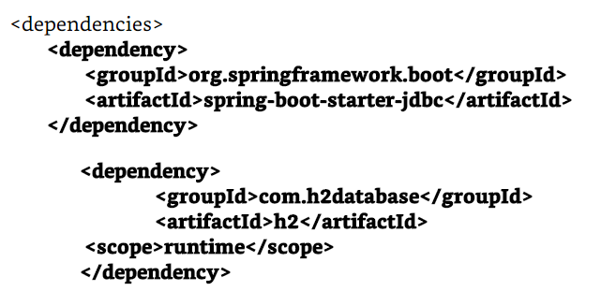
Using H2 in memory DB
Using H2 in memory DB
  http://www.h2database.com/html/cheatSheet.html
$ spring init -d=jdbc, h2 -g=com.apress.spring -a=simple-jdbc-app –package- name=com.apress.spring -name=simple-jdbc-app -x
Pom.xml
Pro Spring Boot by Gutierrez, Felipe. Ch 07 Data Aceess

Slide 22
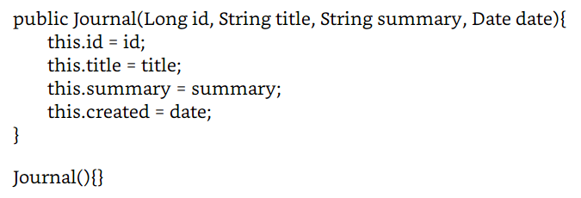
Listing 7-2
…
//Constrructor
Pro Spring Boot by Gutierrez, Felipe. Ch 07 Data Aceess

Slide 23
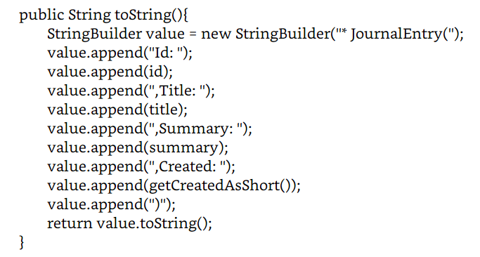
7-2 toString()
Pro Spring Boot by Gutierrez, Felipe. Ch 07 Data Aceess

Slide 24
7-3 Journal Service
package com.apress.spring.service;
import …
@Service
public class JournalService {
private static final Logger log = LoggerFactory.getLogger( JournalService.class);
@ Autowired
JdbcTemplate jdbcTemplate;
public void insertData(){
log.info(" > Table creation");
jdbcTemplate.execute(" DROP TABLE JOURNAL IF EXISTS");
jdbcTemplate.execute(" CREATE TABLE JOURNAL( id SERIAL, title VARCHAR( 255), summary VARCHAR( 255), created TIMESTAMP)");
log.info(" > Inserting data...");
jdbcTemplate.execute(" INSERT INTO JOURNAL( title, summary, created) VALUES(' Get to know …”
Pro Spring Boot by Gutierrez, Felipe. Ch 07 Data Aceess

Slide 25
Comments on 7-3
JdbcTemplate.
  It auto-wires a JdbcTemplate class that will be the responsible for executing tasks against the database. This particular class is based on the template design pattern that allows developers to focus only on the data and leave all the database tasks (insert, delete, etc.) to the template.
insertData.
  This method will first try to drop a Journal table if it exists, then it will create the Journal table with its fields and, finally, it will insert the data into the database. All these actions will be through the jdbcTemplate instance by executing its method execute (this execute method accepts the SQL query syntax).
findAll.
  This method will use the jdbcTemplate instance and the query method (that accepts a SQL syntax) to get all the data; it will return a collection of Journal instances.
Logger.
  A log instance that prints out what is going on in the method calls.
Pro Spring Boot by Gutierrez, Felipe. Ch 07 Data Aceess

Slide 26
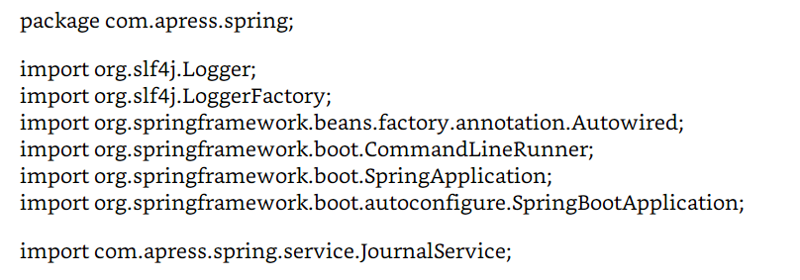
7-4 Preamble (Imports)
Pro Spring Boot by Gutierrez, Felipe. Ch 07 Data Aceess

Slide 27
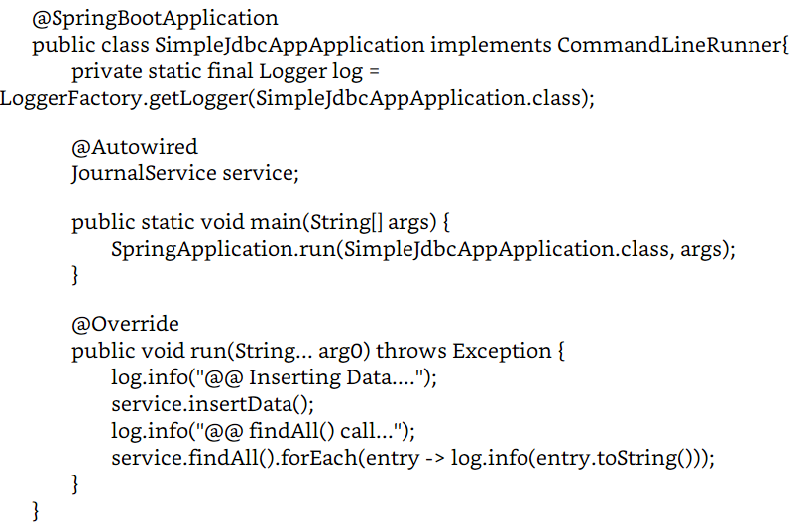
Pro Spring Boot by Gutierrez, Felipe. Ch 07 Data Aceess

Slide 28
It declares the auto-wired version of the JournalService, making it available when the run method executes.
It implements the CommandLineRunner interface,
  you need to implement its public void run( String... args).
  Remember that this run method will be executed after the Spring Boot has started.
  This is a good place to call the JournalService instance and execute the data insertion and to call the findAll method.
The Logger log instance prints out what is going on in the execution of the class
Essential Scrum by Rubin, Ch 07

Slide 29
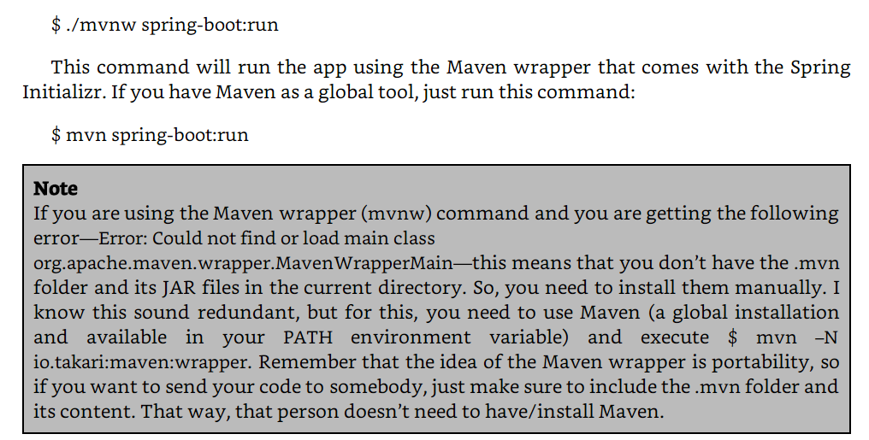
Running 7-4
.
Essential Scrum by Rubin, Ch 07

Slide 30
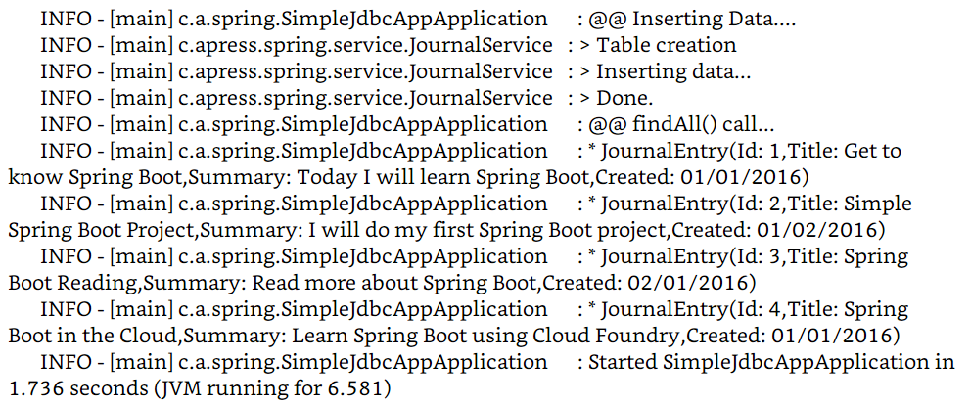
The execution trace - Log
.
Essential Scrum by Rubin, Ch 07

Slide 31
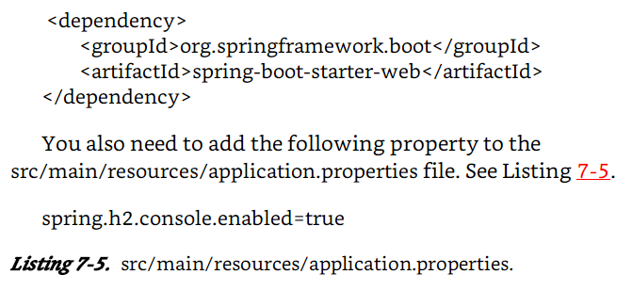
Access to the H2 DB Engine Console
Since the console for H2 is implement as a web app.
Essential Scrum by Rubin, Ch 07

Slide 32
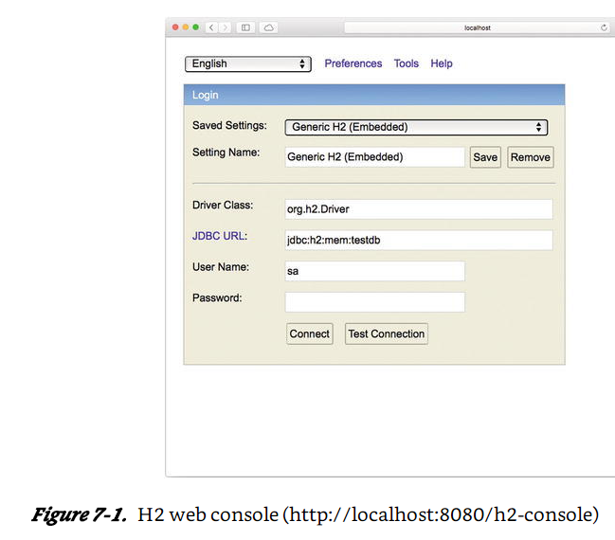
Screenshot of console
http://localhost:8080/h2-console
Essential Scrum by Rubin, Ch 07

Slide 33
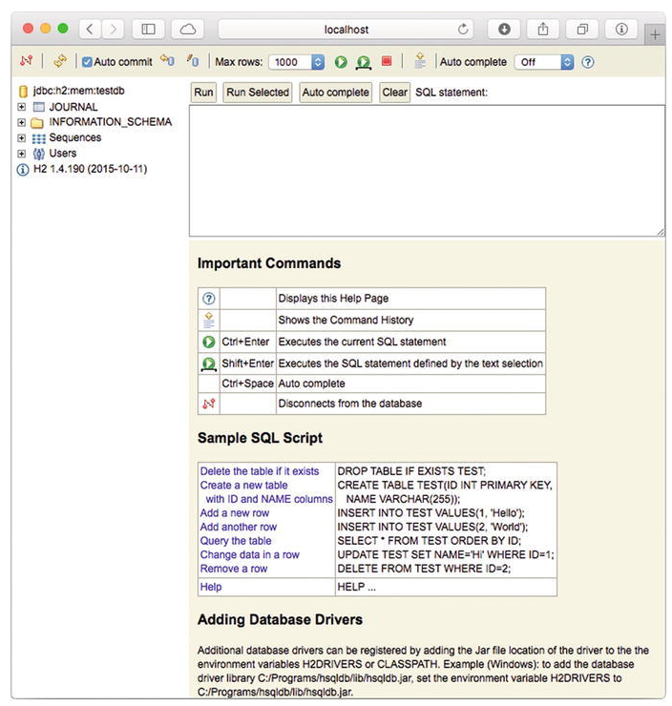
SQL Queries
Essential Scrum by Rubin, Ch 07

Slide 34
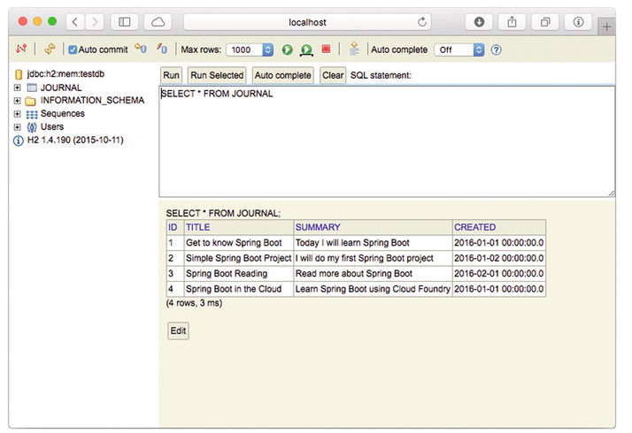
SQL: Select * from Journal
.
Essential Scrum by Rubin, Ch 07

Slide 35
Data Access Using JPA
JPA (Java Persistence API), is a J2EE specification.
  http:// www.oracle.com/ technetwork/ articles/ java/ jpa-137156. html )
JPA is another alternative to using lightweight persistence objects.
  Hibernate and Eclipse TopLink are the primary implementations of the JPA.
JPA from SpringBoot CLI
$ spring init -d=data-jpa,h2 -g=com.apress.spring -a=simple-jpa-app --package-name=com.apress.spring -name=simple-jpa-app -x
Essential Scrum by Rubin, Ch 07

Slide 36
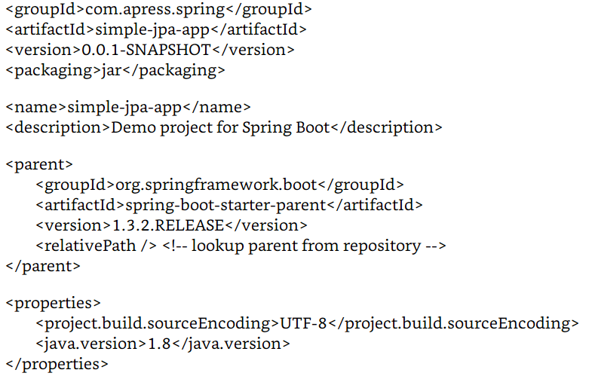
Pom.xml generated Listing 7-6
.
Essential Scrum by Rubin, Ch 07

Slide 37
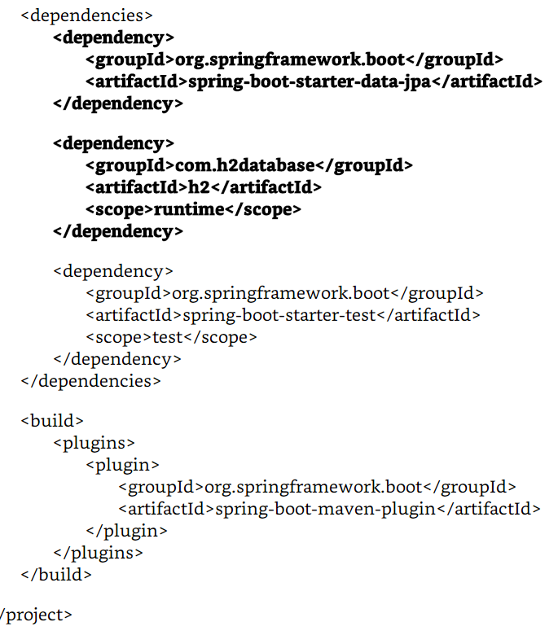
pom.xml continued
.
Essential Scrum by Rubin, Ch 07

Slide 38
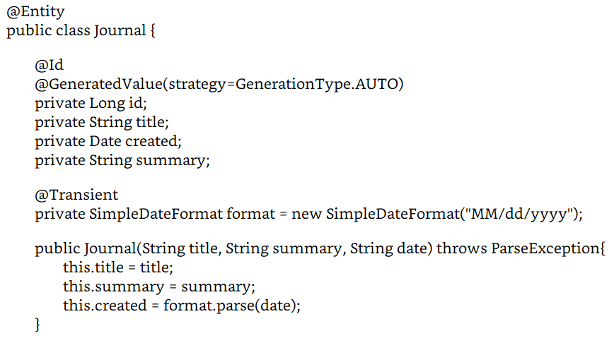
Listing 7-7
src/main/java/com/apress/spring/domain/Journal.java
Essential Scrum by Rubin, Ch 07

Slide 39
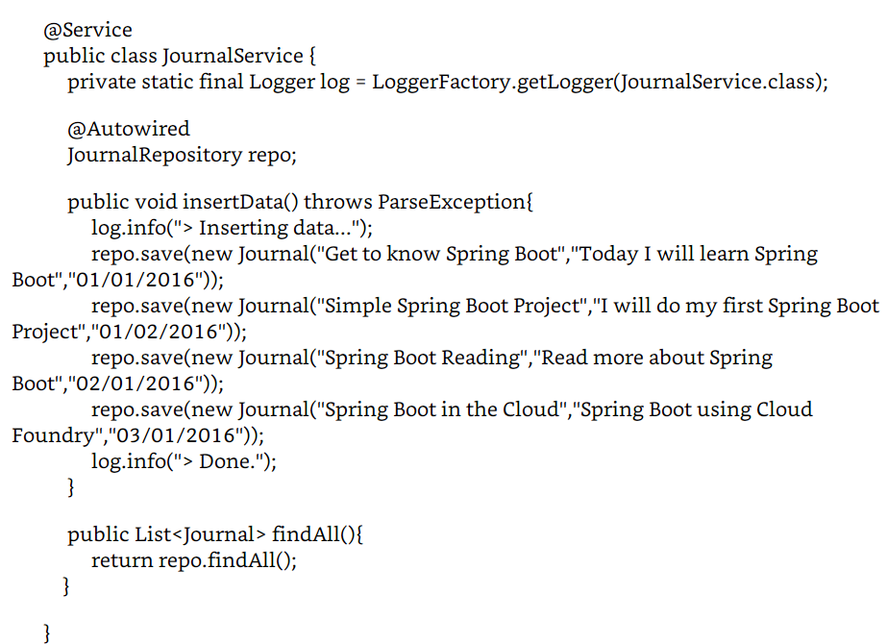
.
Essential Scrum by Rubin, Ch 07

Slide 40
@Service. This annotation marks the class as a stereotype that will be recognized as a bean by the Spring container.
JournalRepository.
  is being auto-wired, but where is this JournalRepository interface?
  you need to think of it as an instance that has the knowledge of how to use the data, from connecting to the database, to accessing it for its usage.
insertData. This method will insert the data into the database.
  Note that there is no database or table creation; everything will be done by the abstraction of the JournalRepository.
findAll. This method will call return a list of Journal instances.
Gutierrez, Felipe. Pro Spring Boot (Kindle Locations 2912-2919). Apress. Kindle Edition.
Essential Scrum by Rubin, Ch 07

Slide 41
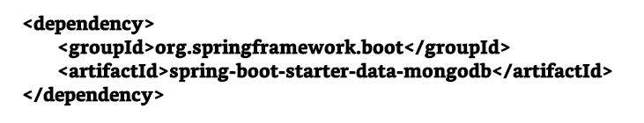
Scalability of Relational DBs
A big problem
Hence move to non-relational (NoSQL)
  MongoDB Listing 7-14 pom.xml excerpt
Essential Scrum by Rubin, Ch 07

Slide 42
$ brew install mongodb
You can run it with this command:
$ mongod
Alternatively install MongoDB by downloading it from the web site at https:// www.mongodb.org/ downloads# production
$ mkdir simple-mongo-app
$ cd simple-mongo-app
$ spring init -d = data-mongodb -g = com.apress.spring -a = simple-mongo-app --package-name = com.apress.spring -name = simple-mongo-app -x
Gutierrez, Felipe. Pro Spring Boot (Kindle Locations 3018-3024). Apress. Kindle Edition.
Essential Scrum by Rubin, Ch 07

Slide 43
.
Essential Scrum by Rubin, Ch 07

Slide 44
.
Essential Scrum by Rubin, Ch 07

