Slide 1


Lecture 04
Availability
CSCE 741 Software Process
Topics
  Chapter 5 – Availability
Lecture 7 -- Testing in Java
  JUnit
  Hamcrest
  Mockito
Readings:
September 25, 2017

Slide 2
Last Time
New
  J2EE testing http://www.softwaretestinghelp.com/testing-java-applications-part-1/ Also Parts 2 and 3
  Practical Unit Testing with Junit and Mockito by Tomek Kaczanowski
    http://practicalunittesting.com/
    Source code
Testing Levels
  Unit, Integration, system (acceptance), performance
Java Testing world and tools
  Junit 4, Hamcrest, Mockito
  Manual vs Automated
  GUIs(Swing)
  Web Applications – Selenium
  Jenkins – continuous integration

Slide 3
Validation and Verification V&V
The PMBOK guide (Project Manager’s Body of Knowledge), a standard adopted by IEEE, defines them as follows in its 4th edition:^{[2]}
"Validation. The assurance that a product, service, or system meets the needs of the customer and other identified stakeholders. It often involves acceptance and suitability with external customers. Contrast with verification."
"Verification. The evaluation of whether or not a product, service, or system complies with a regulation, requirement, specification, or imposed condition. It is often an internal process. Contrast with validation."

Slide 4
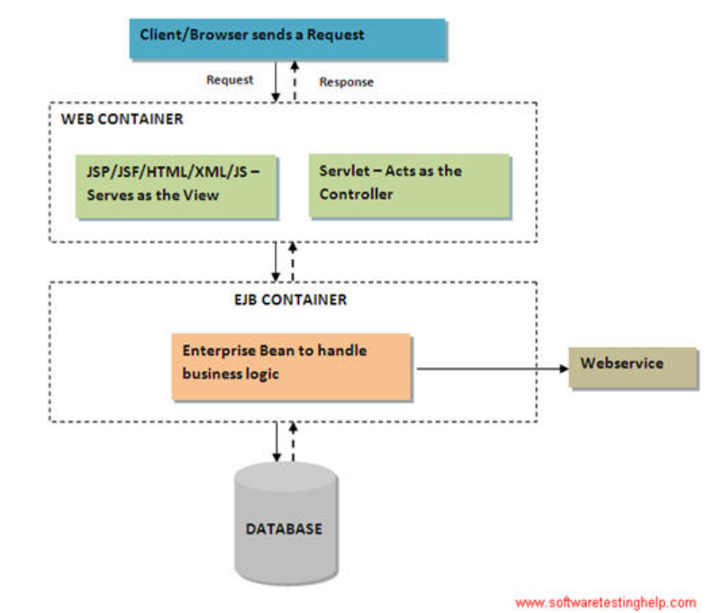
J2EE App

Slide 5
Junit4 References
Test Infected: programmers like Writing Tests, Java Report, 3(7) 37-50, 1998.
  Kent Beck and Eric Gamma(Famous Tutorial, but 3.8)
Practical Unit Testing with Junit and Mockito by Tomek Kaczanowski
  http://practicalunittesting.com/
  Source code
http://en.wikipedia.org/wiki/JUnit
http://www.vogella.com/articles/JUnit/article.html
http://practicalunittesting.com/

Slide 6
Testing Levels
Unit Tests
  “make sure the class that you are working on right now works correctly”
  In isolation; no db; stubs for other classes
Integration Tests
System Tests

Slide 7
Unit Tests
Goal of a Unit Test - “Make sure the class you are working on right now works correctly”
Scope of a Unit Test
Test one thing in isolation
SUT (system under test)
Depended On Collaborator DOC

Slide 8
What isn’t a Unit Test (Michael Feathers)
A test is not a unit test if:
  It talks to the database
  It communicates across the network
  It touches the file system
  It can't run at the same time as any of your other unit tests
  You have to do special things to your environment (such as editing config files) to run it.

Slide 9
Unit Tests with no Collaborators
Actually Unit tests for which the SUT (system under test) has no collaborators
Ridiculous!, of course in most cases
  We will eventually use stubs to ensure testing insolation
  But for now let’s us focus the discussion

Slide 10
JUnit - Tutorial - Lars Vogel
Table of Contents
1. Introduction to unit testing 1.1. Unit tests and unit testing 1.2. Unit testing with JUnit 1.3. Available JUnit annotations 1.4. Assert statements 1.5. Create a JUnit test suite 1.6. Run your test outside Eclipse
2. Installation of JUnit 2.1. Using JUnit integrated into Eclipse 2.2. Downloading the JUnit library
3. Eclipse support for JUnit 3.1. Creating JUnit tests 3.2. Running JUnit tests 3.3. JUnit static imports 3.4. Wizard for creating test suites 3.5. Testing exception
4. Exercise: Using JUnit 4.1. Project preparation 4.2. Create a Java class 4.3. Create a JUnit test 4.4. Run your test in Eclipse
5. Advanced JUnit options 5.1. Parameterized test 5.2. Rules
6. Mocking with EasyMock
7. Thank you
8. Questions and Discussion
9. Links and Literature 9.1. JUnit Resources 9.2. vogella Resources

Slide 11
Unit testing with JUnit4
Creating a JUnit test method
  via File → New → JUnit → JUnit Test case
@Test
public void testMultiply() {
// MyClass is tested
MyClass tester = new MyClass();
// Check if multiply(10,5) returns 50
assertEquals("10 x 5 must be 50", 50,tester.multiply(10, 5));
}

Slide 12
General approach JUnit4 within Eclipse
JUnit assumes that all test methods can be executed in an arbitrary order.
Therefore tests should not depend on other tests.
To write a test with JUnit you annotate a method with the @org.junit.Test annotation and
use assert or another method provided by JUnit to check the expected result of the code execution versus the actual result
run the test, via right-click on the test class and selecting Run → Run As → JUnit Test.

Slide 13
JUnit annotations
Annotation | Description
@Test public void method() | The annotation @Test identifies that a method is a test method.
@Before public void method() | This method is executed before each test. This method can prepare the test environment (e.g. read input data, initialize the class).
@After public void method() | This method is executed after each test. This method can cleanup the test environment (e.g. delete temporary data, restore defaults). It can also save memory by cleaning up expensive memory structures.

Slide 14
Annotation | Description
@BeforeClass public static void method() | method executed once, before the start of all tests.
@AfterClass public static void method() | This method is executed once, after all tests have been finished. --clean-up activities
@Ignore | Ignores the test method. out-of-date, too expensive
@Test (expected = Exception.class) | Fails, if the method does not throw the named exception.
@Test(timeout=100) | Fails, if the method takes longer than 100 milliseconds.

Slide 15
Assert statements
Statement | Description
fail(String) | Let the method fail. Might be used to check that a certain part of the code is not reached. Or to have a failing test before the test code is implemented.
assertTrue([message], boolean condition) | Checks that the boolean condition is true.
assertsEquals([String message], expected, actual) | Tests that two values are the same. Note: for arrays the reference is checked not the content of the arrays.
assertsEquals([String message], expected, actual, tolerance) | Test that float or double values match. The tolerance is the number of decimals which must be the same.
assertNull([message], object) | Checks that the object is null.
assertNotNull([message], object) | Checks that the object is not null.
assertSame([String], expected, actual) | Checks that both variables refer to the same object.
assertNotSame([String], expected, actual) | Checks that both variables refer to different objects.

Slide 16
Assert statements
Statement | Description
assertsEquals([String message], expected, actual, tolerance) | Test that float or double values match. The tolerance is the number of decimals which must be the same.
assertNull([message], object) | Checks that the object is null.
assertNotNull([message], object) | Checks that the object is not null.
assertSame([String], expected, actual) | Checks that both variables refer to the same object.
assertNotSame([String], expected, actual) | Checks that both variables refer to different objects.

Slide 17
Creating a JUnit test suite
package com.vogella.junit.first;
import org.junit.runner.RunWith;
import org.junit.runners.Suite;
import org.junit.runners.Suite.SuiteClasses;
@RunWith(Suite.class)
@SuiteClasses({ MyClassTest.class, MySecondClassTest.class })
public class AllTests {
}

Slide 18
Run your test outside Eclipse
org.junit.runner.JUnitCore class provides the runClasses() method which allows you to run one or several tests classes

Slide 19
In your test folder create a new class MyTestRunner
package de.vogella.junit.first;
import org.junit.runner.JUnitCore;
import org.junit.runner.Result;
import org.junit.runner.notification.Failure;
public class MyTestRunner {
public static void main(String[] args) {
Result result = JUnitCore.runClasses(MyClassTest.class);
for (Failure failure : result.getFailures()) {
System.out.println(failure.toString());
}
}
}

Slide 20
Eclipse support for JUnit
3.1 Creating JUnit tests
3.2. Running JUnit tests
3.3. JUnit static imports
3.4. Wizard for creating test suites
  select New → Other... → JUnit → JUnit Test Suite
3.5. Testing exception
4. Exercise: Using JUnit

Slide 21
Auto-Configuration
The previous chapter explained that auto-configuration is one of the important features in Spring Boot because it will try to do its best to
configure your Spring Boot application according to
  your classpath
  (this will be according to your maven pom.xml or gradle build.gradle files),
  annotations, and
  any Java configuration declarations.
Gutierrez, Felipe. Pro Spring Boot (Kindle Locations 1056-1059). Apress. Kindle Edition.
Pro Spring Boot by Gutierrez, Felipe, Ch 03

Slide 22
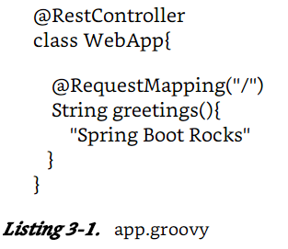
Auto-Configuration example
$ spring run app.groovy
Pro Spring Boot by Gutierrez, Felipe, Ch 03

Slide 23
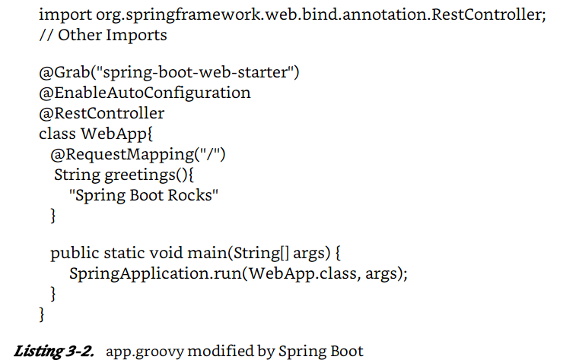
Code generated??? In memory
Pro Spring Boot by Gutierrez, Felipe, Ch 03

Slide 24
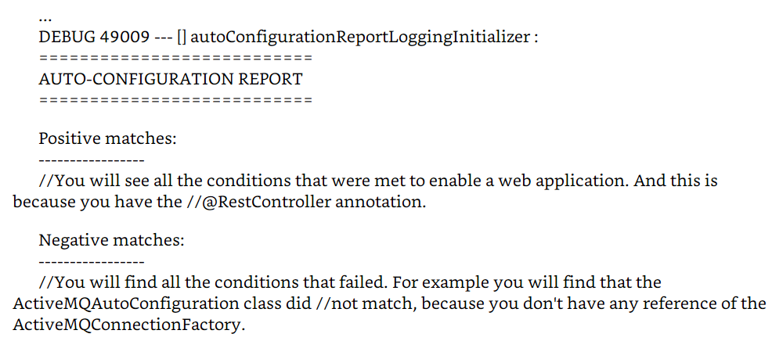
Debug parameter
$ spring run app.groovy --debug
Pro Spring Boot by Gutierrez, Felipe, Ch 03

Slide 25
Disabling a specific AutoConfiguration
@SpringBootApplication annotation is equivalent to:
  the @Configuration,
  @ComponentScan, and
  @EnableAutoConfiguration annotations.
  You can disable a specific auto-configuration by … adding the @EnableAutoConfiguration annotation to your class with the exclude parameter.
import org.springframework.boot.autoconfigure.jms.activemq.ActiveMQAutoConfiguration
@RestController
@EnableAutoConfiguration( exclude =[ ActiveMQAutoConfiguration.class])
class WebApp{
@ RequestMapping("/")
Pro Spring Boot by Gutierrez, Felipe, Ch 03

Slide 26
$ spring init -g = com.apres.spring -a = spring-boot-simple --package = com.apress.spring -name = spring-boot-simple -x
This command will create a Maven Java project with:
  a groupId = com.apress.spring,
  an artifactId = spring-boot-simple,
  and a package = com.apress.spring
  with a project’s name = spring-boot-simple.
  It will be created in the current directory (-x).
Don’t worry too much about the parameters; yet
Gutierrez, Felipe. Pro Spring Boot (Kindle Locations 1203-1206). Apress. Kindle Edition.
Pro Spring Boot by Gutierrez, Felipe, Ch 03

Slide 27
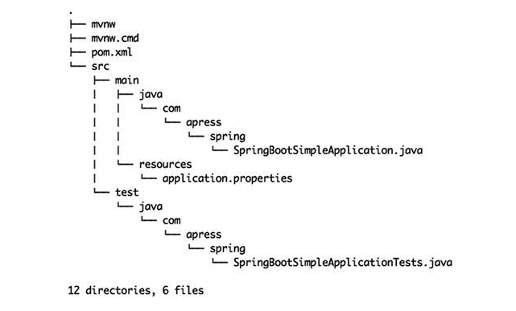
Tree generated
Pro Spring Boot by Gutierrez, Felipe, Ch 03

Slide 28
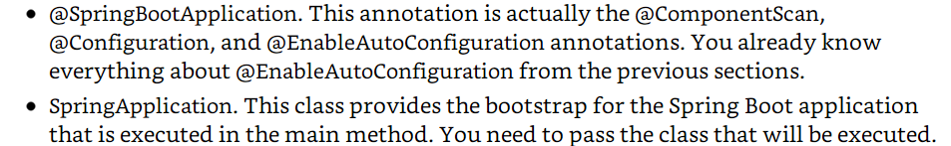
Running with maven wrapper
./mvnw spring-boot:run
Pro Spring Boot by Gutierrez, Felipe, Ch 03

Slide 29
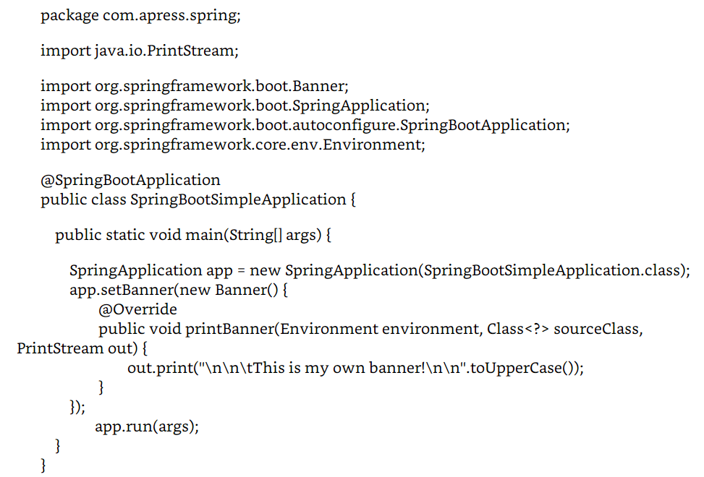
New Banner
New Banner
Pro Spring Boot by Gutierrez, Felipe, Ch 03

Slide 30
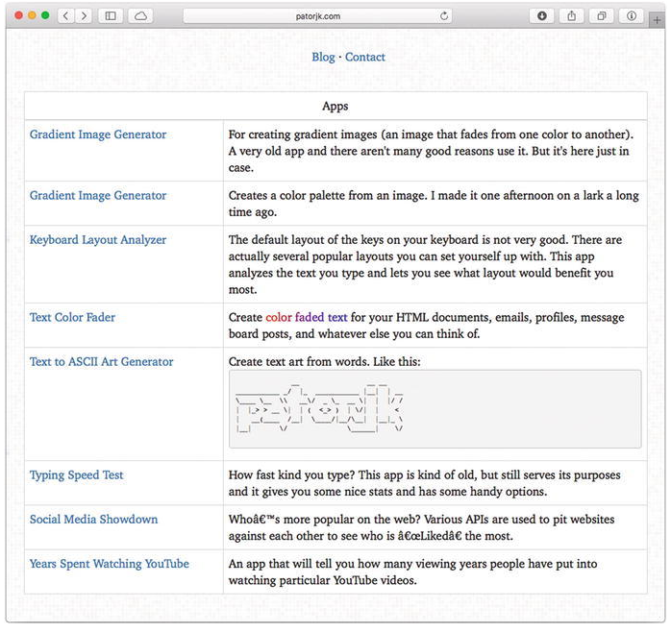
Text to ASCII Art Generator
Pro Spring Boot by Gutierrez, Felipe, Ch 03

Slide 31
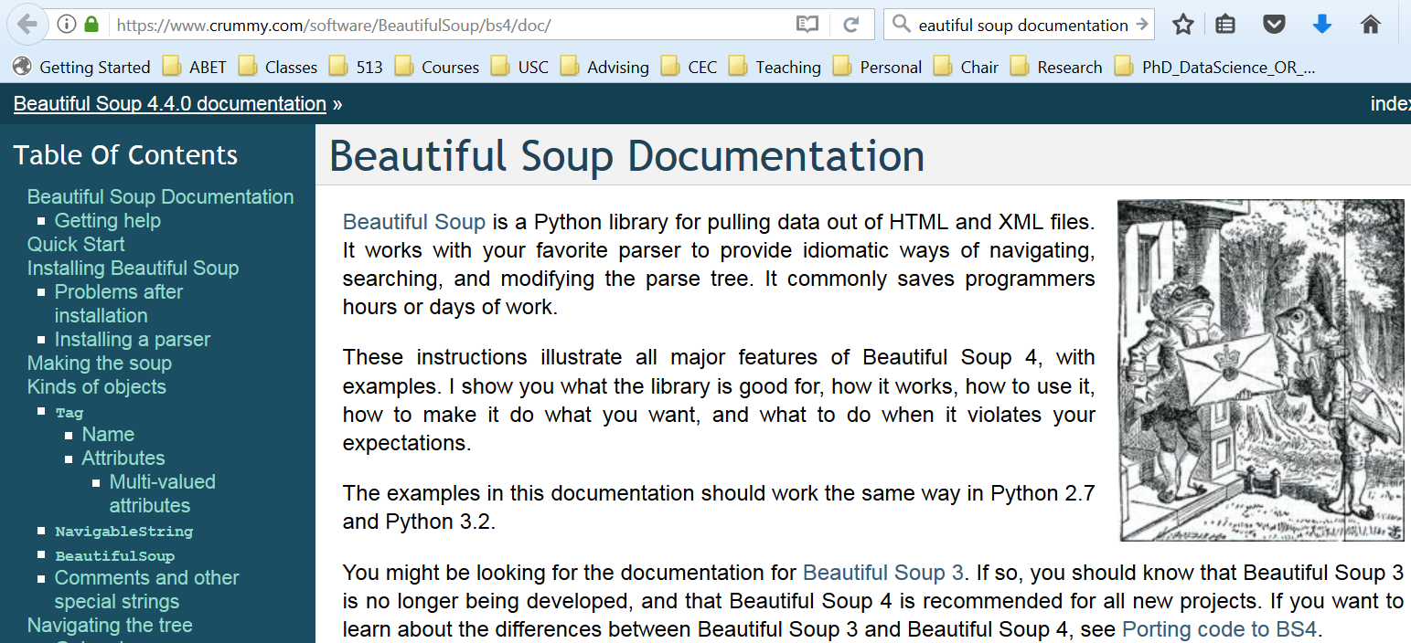
Beautiful Soup – python url reading/parsing
https://www.crummy.com/software/BeautifulSoup/bs4/doc
Pro Spring Boot by Gutierrez, Felipe, Ch 03

Slide 32
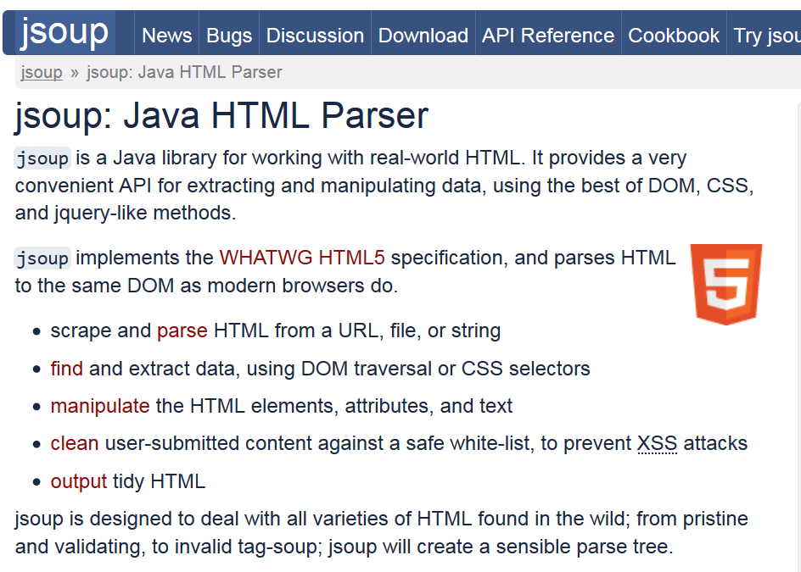
https://jsoup.org
Pro Spring Boot by Gutierrez, Felipe, Ch 03

Slide 33
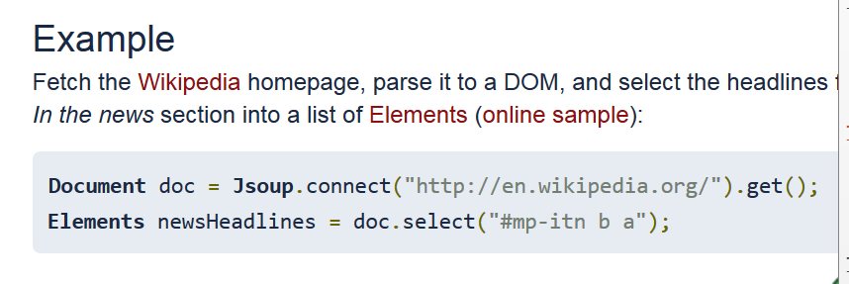
Jsoup Example
Pro Spring Boot by Gutierrez, Felipe, Ch 03

Slide 34
Is there a better library?
One part of spring?
Spring-boot?
Pro Spring Boot by Gutierrez, Felipe, Ch 03

Slide 35
Schedule project
User Stories -Schedule Project
 | Points
1 |  |  | Add course number semester and year, Department, columns to the database
2 |  |  | Using Selenium/Java==> Jsoup program to scrape current semester for CSCE courses
3 |  |  | Add Gui User interface -submit queries to DB, JS-Angular/Spring Framework
4 |  |  | Add menu-bar, file menu, SQL menu
5 |  |  | Calculate Number of students taught per semester by each faculty/TA
6 |  |  | Read Fall 2016 schedule add it to the database
7 |  |  | Add credit hours
8 |  |  | Solve technical debt problem learn about reading and parsing web pages with Jsoup or other suitable library.
9

Slide 36
Pivotal Tracker Project
User Stories -Pivotal Tracker Project
 | Points
1 |  |  | Technical debt - what does pivotal do for you?
2 |  |  | Initial change tutorial to "tracker"
3 |  |  | Add User stories ala Connextra format to system; not changing code, as the program runs add a new user story.
4 |  |  | Modify the status of user stories
5 |  |  | Assign points
6 |  |  | Play planning poker with user story; (i.e. assign points. Note you need to keep track of the team and decide what algorithm to use.)
7 |  |  | Add team members
8 |  |  | Assign team member to implement user story
9

Slide 37
Changes in version JUnit 4.4 (Summary)
assertThat
Joe Walnes built a new assertion mechanism on top of what was then JMock 1. The method name was assertThat, and the syntax looked like this:
assertThat(x, is(3));
assertThat(x, is(not(4)));
assertThat(responseString, either(containsString("color")).or(containsString("colour")));
assertThat(myList, hasItem("3")); More generally:
assertThat([value], [matcher statement]);
http://junit.sourceforge.net/README.html

Slide 38
Readability
Advantages of this assertion syntax include:
More readable and typeable: this syntax allows you to think in terms of subject, verb, object (assert "x is 3") rathern than assertEquals, which uses verb, object, subject (assert "equals 3 x")
Combinations: any matcher statement s can be negated (not(s)), combined (either(s).or(t)), mapped to a collection (each(s)), or used in custom combinations (afterFiveSeconds(s))

Slide 39
Readabilty Examples
Readable failure messages. Compare
assertTrue(responseString.contains("color") || responseString.contains("colour")); //
==> failure message: // java.lang.AssertionError:
assertThat(responseString, anyOf(containsString("color"), containsString("colour"))); //
==> failure message: // java.lang.AssertionError: // Expected: (a string containing "color" or a string containing "colour") // got: "Please choose a font"
Custom Matchers. By implementing the Matcher interface yourself, you can get all of the above benefits for your own custom assertions.

Slide 40
What is Hamcrest?
http://hamcrest.org/
http://code.google.com/p/hamcrest/wiki/Tutorial
http://junit.sourceforge.net/doc/cookbook/cookbook.htm
http://hamcrest.org/JavaHamcrest/javadoc/1.3/
http://junit.org/javadoc/4.10/org/hamcrest/Matcher.html

Slide 41
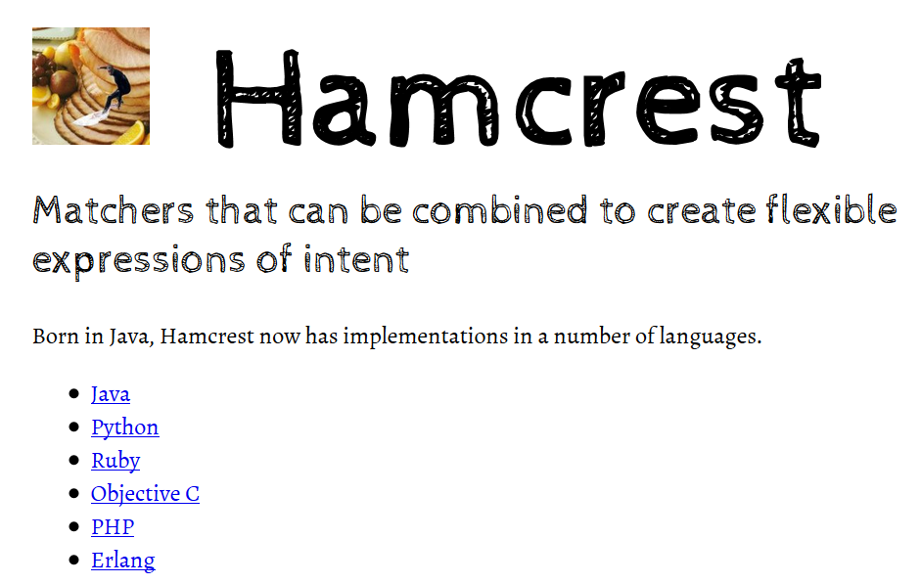

Slide 42
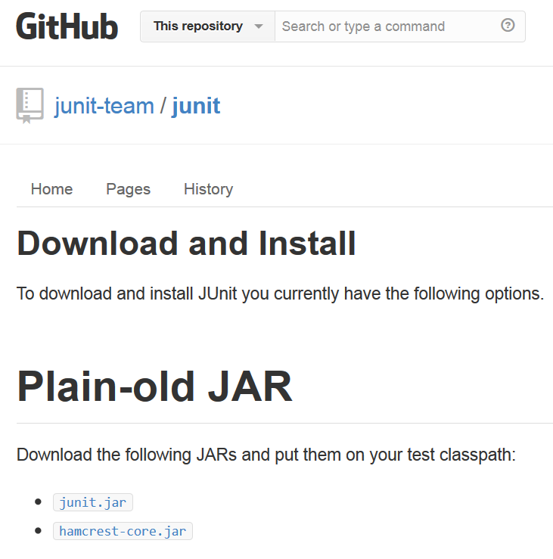
https://github.com/junit-team/junit/wiki/Download-and-Install
Eclipse comes with JUnit4 but what version?

Slide 43
Hamcrest is a framework for writing matcher objects allowing 'match' rules to be defined declaratively.
There are a number of situations where matchers are invaluble, such as UI validation, or data filtering,
but it is in the area of writing flexible tests that matchers are most commonly used.
http://code.google.com/p/hamcrest/wiki/Tutorial

Slide 44
My first Hamcrest test
import static org.hamcrest.MatcherAssert.assertThat;
import static org.hamcrest.Matchers.*;
import junit.framework.TestCase;
public class BiscuitTest extends TestCase {
public void testEquals() {
Biscuit theBiscuit = new Biscuit("Ginger");
Biscuit myBiscuit = new Biscuit("Ginger");
assertThat(theBiscuit, equalTo(myBiscuit));
}
}
// Note JUnit3
http://code.google.com/p/hamcrest/wiki/Tutorial

Slide 45
If you have more than one assertion in your test you can include an identifier for the tested value in the assertion:
assertThat("chocolate chips", theBiscuit.getChocolateChipCount(), equalTo(10));
assertThat("hazelnuts", theBiscuit.getHazelnutCount(), equalTo(3));
http://code.google.com/p/hamcrest/wiki/Tutorial

Slide 46
Hamcrest Common Matchers
A tour of Hamcrest comes with a library of useful matchers. Here are some of the most important ones.
Core
  anything - always matches, useful if you don't care what the object under test is
  describedAs - decorator to adding custom failure description
  is - decorator to improve readability - see "Sugar", below
Logical
  allOf - matches if all matchers match, short circuits (like Java &&)
  anyOf - matches if any matchers match, short circuits (like Java ||)
  not - matches if the wrapped matcher doesn't match and vice versa

Slide 47
Object
  equalTo - test object equality using Object.equals
  hasToString - test Object.toString
  instanceOf, isCompatibleType - test type
  notNullValue, nullValue - test for null
  sameInstance - test object identity
Beans
  hasProperty - test JavaBeans properties
http://code.google.com/p/hamcrest/wiki/Tutorial

Slide 48
Collections
  array - test an array's elements against an array of matchers
  hasEntry, hasKey, hasValue - test a map contains an entry, key or value
  hasItem, hasItems - test a collection contains elements
  hasItemInArray - test an array contains an element
Number
  closeTo - test floating point values are close to a given value
  greaterThan, greaterThanOrEqualTo, lessThan, lessThanOrEqualTo - test ordering
http://code.google.com/p/hamcrest/wiki/Tutorial

Slide 49
Text
  equalToIgnoringCase - test string equality ignoring case
  equalToIgnoringWhiteSpace - test string equality ignoring differences in runs of whitespace
  containsString, endsWith, startsWith - test string matching
http://code.google.com/p/hamcrest/wiki/Tutorial

Slide 50
Syntactic Sugar
Hamcrest strives to make your tests as readable as possible.
For example, the “is” matcher is a wrapper that doesn't add any extra behavior to the underlying matcher., but increases readability.
The following assertions are all equivalent:
  assertThat(theBiscuit, equalTo(myBiscuit));
  assertThat(theBiscuit, is(equalTo(myBiscuit)));
  assertThat(theBiscuit, is(myBiscuit));
The last form is allowed since is(T value) is overloaded to return is(equalTo(value)).
http://code.google.com/p/hamcrest/wiki/Tutorial

Slide 51
Writing custom matchers
matcher for testing if a double value has the value NaN (not a number). This is the test we want to write:
public void testSquareRootOfMinusOneIsNotANumber() {
assertThat(Math.sqrt(-1), is(notANumber()));
}
http://code.google.com/p/hamcrest/wiki/Tutorial

Slide 52
isNotANumber Implementation
package org.hamcrest.examples.tutorial;
import org.hamcrest.Description;
import org.hamcrest.Factory;
import org.hamcrest.Matcher;
import org.hamcrest.TypeSafeMatcher;
http://code.google.com/p/hamcrest/wiki/Tutorial

Slide 53
public class IsNotANumber extends TypeSafeMatcher<Double> {
@Override
public boolean matchesSafely(Double number) {
return number.isNaN();
}
public void describeTo(Description description) {
description.appendText("not a number");
}
@Factory
public static <T> Matcher<Double> notANumber() {
return new IsNotANumber();
}
}
http://code.google.com/p/hamcrest/wiki/Tutorial

Slide 54
assertThat(1.0, is(notANumber()));
fails with the message
java.lang.AssertionError:
Expected: is not a number
got : <1.0>
http://code.google.com/p/hamcrest/wiki/Tutorial

Slide 55
Sugar generation
create an XML configuration file listing all the Matcher classes
<matchers>
<!-- Hamcrest library -->
<factory class="org.hamcrest.core.Is"/>
<!-- Custom extension -->
<factory class= "org.hamcrest.examples.tutorial.IsNotANumber"/>
</matchers>
http://code.google.com/p/hamcrest/wiki/Tutorial

Slide 56
Run the org.hamcrest.generator.config.XmlConfigurator command-line tool that comes with Hamcrest
http://code.google.com/p/hamcrest/wiki/Tutorial

Slide 57
// Generated source
package org.hamcrest.examples.tutorial;
public class Matchers {
public static <T> org.hamcrest.Matcher<T> is(T param1) {
return org.hamcrest.core.Is.is(param1);
}
public static <T> org.hamcrest.Matcher<T> is(java.lang.Class<T> param1) {
return org.hamcrest.core.Is.is(param1);
}
public static <T> org.hamcrest.Matcher<T> is(org.hamcrest.Matcher<T> param1) {
return org.hamcrest.core.Is.is(param1);
}
public static <T> org.hamcrest.Matcher<java.lang.Double> notANumber() {
return org.hamcrest.examples.tutorial.IsNotANumber.notANumber();
}
}
http://code.google.com/p/hamcrest/wiki/Tutorial

Slide 58
update our test to use the new Matchers class
import static org.hamcrest.MatcherAssert.assertThat;
import static org.hamcrest.examples.tutorial.Matchers.*;
import junit.framework.TestCase;
public class CustomSugarNumberTest extends TestCase {
public void testSquareRootOfMinusOneIsNotANumber() {
assertThat(Math.sqrt(-1), is(notANumber()));
}
}
http://code.google.com/p/hamcrest/wiki/Tutorial

Slide 59
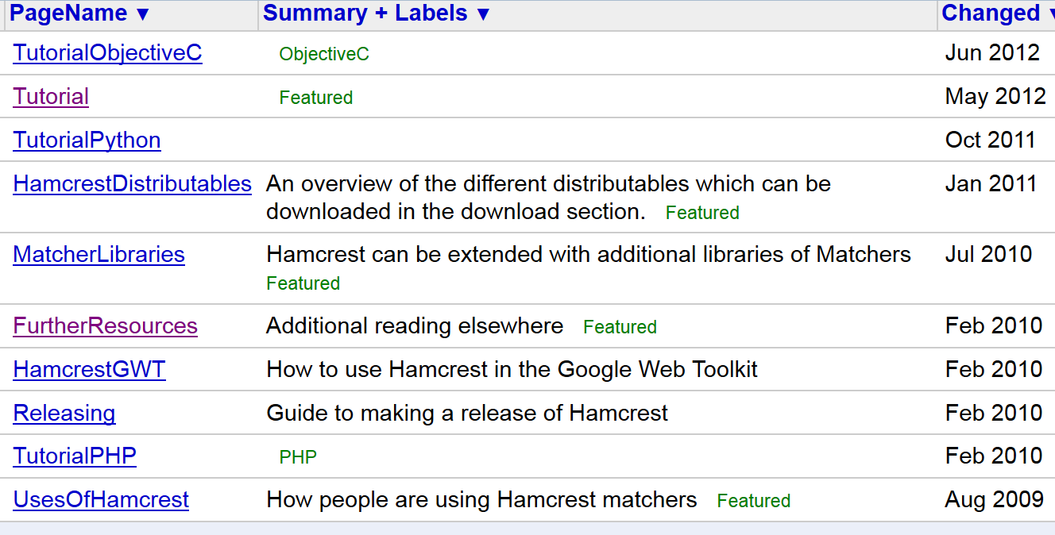

Slide 61
import static org.junit.Assert.*;
import static org.hamcrest.CoreMatchers.*;
public class Junit4FeaturesTest {
@org.junit.Test
public void testArrays() {
assertThat(new Integer[] {1,2,3,4,5}, equalTo(new Integer[]{1,2,3,4,5})); assertThat(new Integer[] {1,2,3,4,5}, not(new Integer[] {1,2}));
}
}

Slide 62
import static org.junit.Assert.*;
import static org.hamcrest.Matchers.*;
// provided by additional jar
import org.junit.Test;
public class Junit4FeaturesTest {
@Test public void testNumericComparison() { assertThat(1,lessThan(2)); assertThat(2,greaterThan(1));
assertThat(2,greaterThanOrEqualTo(2)); assertThat(1,lessThanOrEqualTo(1));

Slide 63
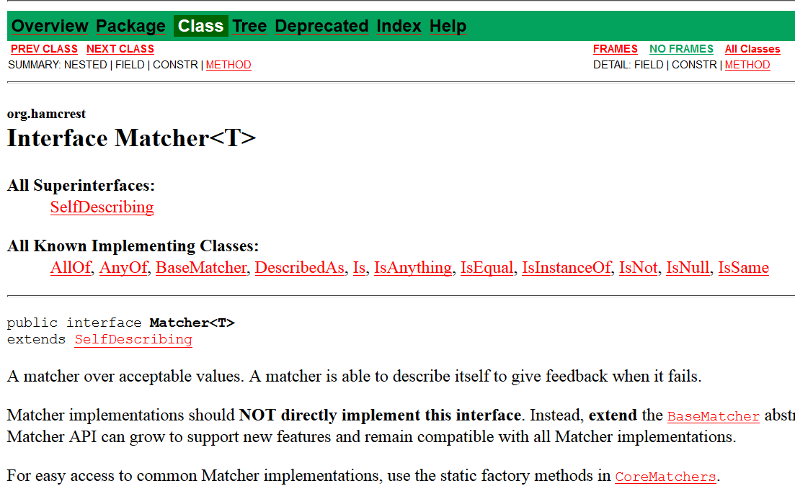
Hamcrest API

Slide 64
http://hamcrest.org/JavaHamcrest/javadoc/1.3/
org.hamcrest
Interface Matcher<T>
All Superinterfaces: SelfDescribing
All Known Implementing Classes: AllOf, AnyOf, BaseMatcher, BigDecimalCloseTo, CombinableMatcher, CustomMatcher, CustomTypeSafeMatcher, DescribedAs, DiagnosingMatcher, Every, FeatureMatcher, HasProperty, HasPropertyWithValue, HasToString, HasXPath, Is, IsAnything, IsArray, IsArrayContaining, IsArrayContainingInAnyOrder, IsArrayContainingInOrder, IsArrayWithSize, IsCloseTo, IsCollectionContaining, IsCollectionWithSize, IsCompatibleType, IsEmptyCollection, IsEmptyIterable, IsEmptyString, IsEqual, IsEqualIgnoringCase, IsEqualIgnoringWhiteSpace, IsEventFrom, IsIn, IsInstanceOf, IsIterableContainingInAnyOrder, IsIterableContainingInOrder, IsIterableWithSize, IsMapContaining, IsNot, IsNull, IsSame, OrderingComparison, SamePropertyValuesAs, SamePropertyValuesAs.PropertyMatcher, StringContains, StringContainsInOrder, StringEndsWith, StringStartsWith, SubstringMatcher, TypeSafeDiagnosingMatcher, TypeSafeMatcher

Slide 65
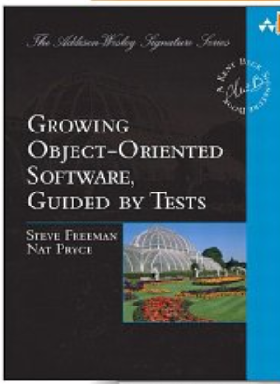
Freeman, Steve; Pryce, Nat (2009-10-12). Growing Object-Oriented Software, Guided by Tests

Slide 66
The Dilemma
One of the dilemmas posed by the move to shorter and shorter release cycles is how to release more software in less time— and continue releasing indefinitely.
  Kent Beck
Freeman, Steve; Pryce, Nat (2009-10-12). Growing Object-Oriented Software, Guided by Tests

Slide 67
What if?
What if instead, we treated software more like a valuable, productive plant, to be nurtured, pruned, harvested, fertilized, and watered?
Traditional farmers know how to keep plants productive for decades or even centuries.
How would software development be different if we treated our programs the same way?

Slide 68
“A complex system that works is invariably found to have evolved from a simple system that works.”
  John Gall 2003
Freeman, Steve; Pryce, Nat (2009-10-12). Growing Object-Oriented Software, Guided by Tests

Slide 69
Growing Objects
Alan Kay’s concept of objects being similar to biological cells that send each other messages.
Alan Kay was one of the authors of Smalltalk and coined the term “object-oriented.”
Freeman, Steve; Pryce, Nat (2009-10-12). Growing Object-Oriented Software, Guided by Tests

Slide 70
Test Driven Development (TDD)
Test-Driven Development (TDD) is a deceptively simple :
  Write the tests for your code before writing the code itself.
it transforms the role testing plays in the development process
Testing is no longer just about keeping defects from the users;
instead, it’s about helping the team to understand the features that the users need
and to deliver those features reliably and predictably.
TDD
  radically changes the way we develop software
  dramatically improves the quality of the systems
Freeman, Steve; Pryce, Nat (2009-10-12). Growing Object-Oriented Software, Guided by Tests

Slide 71
What Is the Point of Test-Driven Development?
One must learn by doing the thing; for though you think you know it, you have no certainty, until you try. —Sophocles
Software Development as a Learning Process
  developers learn
  customers learn - codify business rules/goals
Feedback Is the Fundamental Tool
Freeman, Steve; Pryce, Nat (2009-10-12). Growing Object-Oriented Software, Guided by Tests

Slide 72
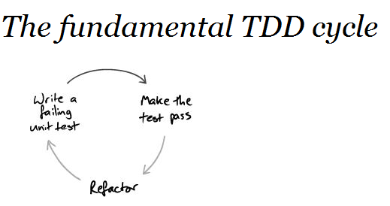
Test-Driven Development in a Nutshell
Freeman, Steve; Pryce, Nat (2009-10-12). Growing Object-Oriented Software, Guided by Tests

Slide 73
Writing tests:
  makes us clarify the acceptance criteria for the system
  encourages us to write loosely coupled components, so they can easily be tested in isolation and, at higher levels, combined together
  adds an executable description of what the code does
  adds to a complete regression suite
whereas running tests:
  detects errors while the context is fresh in our mind
  lets us know when we’ve done enough, discouraging “gold plating” and unnecessary features (design).
Freeman, Steve; Pryce, Nat (2009-10-12). Growing Object-Oriented Software, Guided by Tests

Slide 74
Golden Rule of Test-Driven Development
Never write new functionality without a failing test.
Freeman, Steve; Pryce, Nat (2009-10-12). Growing Object-Oriented Software, Guided by Tests

Slide 75
Refactoring. Think Local, Act Local
“Refactoring means changing the internal structure of an existing body of code without changing its behavior.
The point is to improve the code so that it’s a better representation of the features it implements, making it more maintainable.
Freeman, Steve; Pryce, Nat (2009-10-12). Growing Object-Oriented Software, Guided by Tests

Slide 76
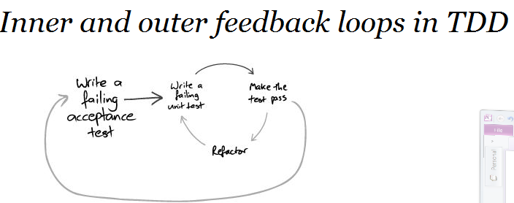
Freeman, Steve; Pryce, Nat (2009-10-12). Growing Object-Oriented Software, Guided by Tests

Slide 77
Coupling and Cohesion
Coupling and cohesion are metrics that (roughly) describe how easy it will be to change the behavior of some code.
They were described by Larry Constantine in [Yourdon79].
Elements are coupled if a change in one forces a change in
Freeman, Steve; Pryce, Nat (2009-10-12). Growing Object-Oriented Software, Guided by Tests

Slide 78
Coupling
Elements are coupled if a change in one forces a change in the other
For example, if two classes inherit from a common parent, then a change in one class might require a change in the other.
Freeman, Steve; Pryce, Nat (2009-10-12). Growing Object-Oriented Software, Guided by Tests

Slide 79
Cohesion
Cohesion is a measure of whether its responsibilities form a meaningful unit.
For example, a class that parses both dates and URLs is not coherent, because they’re unrelated concepts.
Freeman, Steve; Pryce, Nat (2009-10-12). Growing Object-Oriented Software, Guided by Tests

Slide 80
Object Oriented
Music is the space between the notes. —Claude Debussy
The big idea is “messaging” [...] The key in making great and growable systems is much more to design how its modules communicate rather than what their internal properties and behaviors should be. - Alan Kay [1998]
Freeman, Steve; Pryce, Nat (2009-10-12). Growing Object-Oriented Software, Guided by Tests

Slide 81
An object communicates by messages:
An object-oriented system is a web of collaborating objects.
A system is built by creating objects and plugging them together so that they can send messages to one another.
Freeman, Steve; Pryce, Nat (2009-10-12). Growing Object-Oriented Software, Guided by Tests

Slide 82
Man is a tool-using animal. Without tools he is nothing, with tools he is all. —Thomas Carlyle
Freeman, Steve; Pryce, Nat (2009-10-12). Growing Object-Oriented Software, Guided by Tests

Slide 83
NUnit Behaves Differently from JUnit
.Net should note that NUnit reuses the same instance of the test object for all the test methods,
so any values that might change must either be reset in [Setup] and [TearDown] methods (if they’re fields) or made local to the test method.
Freeman, Steve; Pryce, Nat (2009-10-12). Growing Object-Oriented Software, Guided by Tests

Slide 84
Test Fixtures
A test fixture is the fixed state that exists at the start of a test.
A test fixture ensures that a test is repeatable—
  every time a test is run it starts in the same state so it should produce the same results.
Freeman, Steve; Pryce, Nat (2009-10-12). Growing Object-Oriented Software, Guided by Tests

Slide 85
Test Fixture Example
public class CatalogTest {
final Catalog catalog = new Catalog();
final Entry entry = new Entry(" fish", "chips");
@ Before public void fillTheCatalog(){
catalog.add( entry);
}
@ Test public void containsAnAddedEntry() {
assertTrue( catalog.contains( entry));
}
@ Test public void indexesEntriesByName() {
assertEquals( equalTo( entry), catalog.entryFor(" fish"));
Freeman, Steve; Pryce, Nat (2009-10-12). Growing Object-Oriented Software, Guided by Tests

Slide 86
assertNull( catalog.entryFor(" missing name"));
}
@ Test( expected = IllegalArgumentException.class)
public void cannotAddTwoEntriesWithTheSameName() {
catalog.add( new Entry(" fish", "peas");
}
}
Freeman, Steve; Pryce, Nat (2009-10-12). Growing Object-Oriented Software, Guided by Tests

