Slide 1
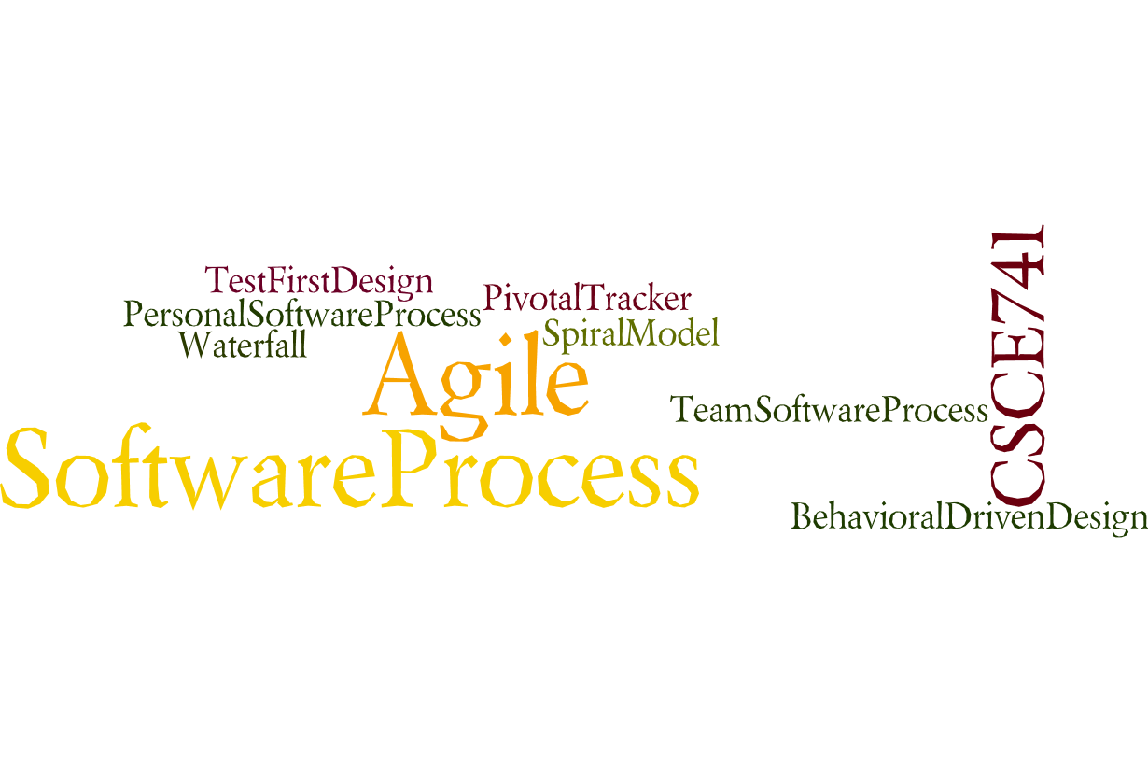
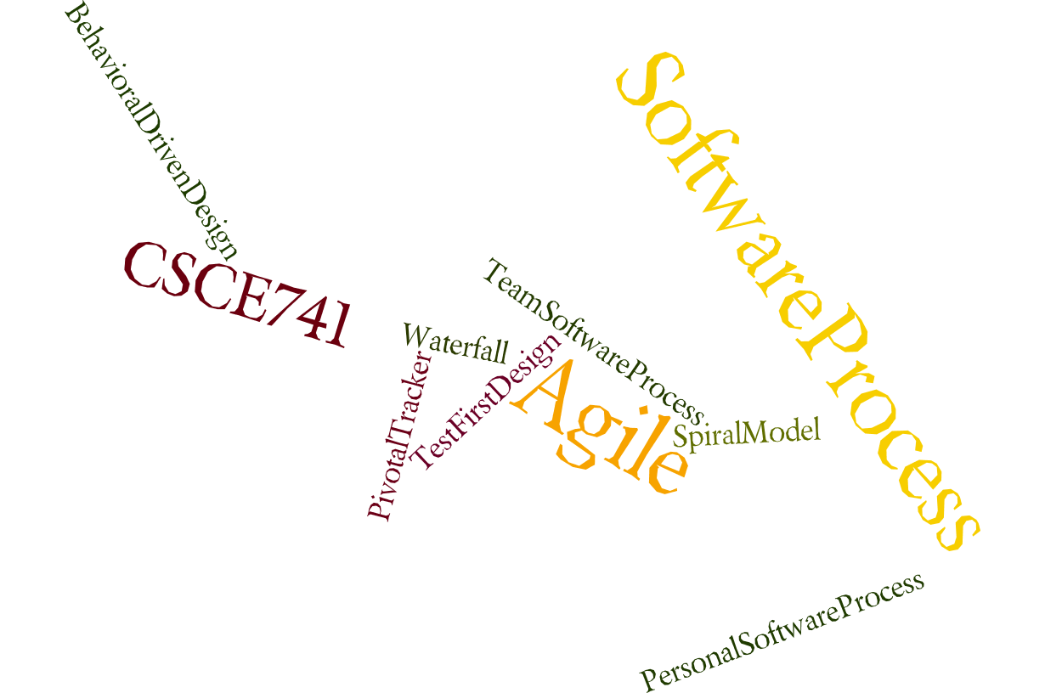
Lecture 04
Availability
CSCE 741 Software Process
Topics
  Chapter 5 – Availability
Lecture 6 -- Spring Boot, points
  Spring Boot example from PSP
  Point evaluation of User Stories
  Velocity
Readings:PSB Ch 2-
September 20, 2017

Slide 2
Last Time
  Sprints <ES=Essential Scrum chapter 4>
  ProSpringBoot chapter 2
Abbreviations
  ES for Essential Scrum = Rubin, Kenneth S.. Essential Scrum: A Practical Guide to the Most Popular Agile Process (Addison-Wesley Signature Series (Cohn)) (p. 61). Pearson Education. Kindle Edition.
  PSB forGutierrez, Felipe. Pro Spring Boot (Kindle Location 3292). Apress. Kindle Edition.
New
  PSB chapter 3
  ES Chapter 8 and 9

Slide 3
Auto-Configuration
The previous chapter explained that auto-configuration is one of the important features in Spring Boot because it will try to do its best to
configure your Spring Boot application according to
  your classpath
  (this will be according to your maven pom.xml or gradle build.gradle files),
  annotations, and
  any Java configuration declarations.
Gutierrez, Felipe. Pro Spring Boot (Kindle Locations 1056-1059). Apress. Kindle Edition.
Pro Spring Boot by Gutierrez, Felipe, Ch 03

Slide 4
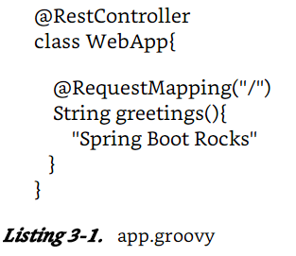
Auto-Configuration example
$ spring run app.groovy
Pro Spring Boot by Gutierrez, Felipe, Ch 03

Slide 5
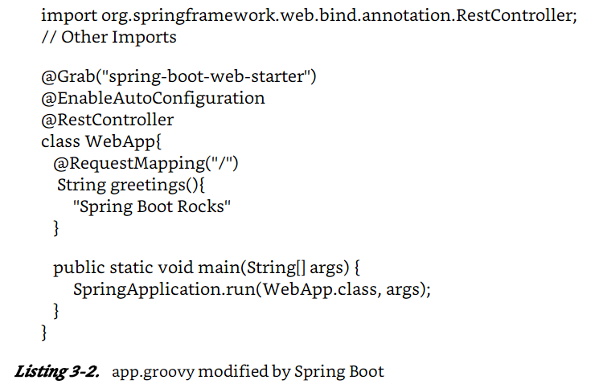
Code generated??? In memory
Pro Spring Boot by Gutierrez, Felipe, Ch 03

Slide 6
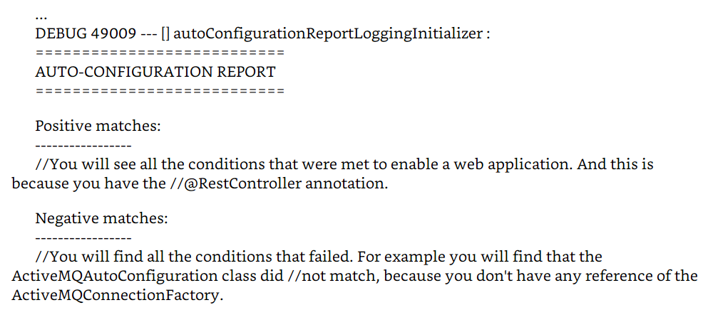
Debug parameter
$ spring run app.groovy --debug
Pro Spring Boot by Gutierrez, Felipe, Ch 03

Slide 7
Disabling a specific AutoConfiguration
@SpringBootApplication annotation is equivalent to:
  the @Configuration,
  @ComponentScan, and
  @EnableAutoConfiguration annotations.
  You can disable a specific auto-configuration by … adding the @EnableAutoConfiguration annotation to your class with the exclude parameter.
import org.springframework.boot.autoconfigure.jms.activemq.ActiveMQAutoConfiguration
@RestController
@EnableAutoConfiguration( exclude =[ ActiveMQAutoConfiguration.class])
class WebApp{
@ RequestMapping("/")
Pro Spring Boot by Gutierrez, Felipe, Ch 03

Slide 8
$ spring init -g = com.apres.spring -a = spring-boot-simple --package = com.apress.spring -name = spring-boot-simple -x
This command will create a Maven Java project with:
  a groupId = com.apress.spring,
  an artifactId = spring-boot-simple,
  and a package = com.apress.spring
  with a project’s name = spring-boot-simple.
  It will be created in the current directory (-x).
Don’t worry too much about the parameters; yet
Gutierrez, Felipe. Pro Spring Boot (Kindle Locations 1203-1206). Apress. Kindle Edition.
Pro Spring Boot by Gutierrez, Felipe, Ch 03

Slide 9
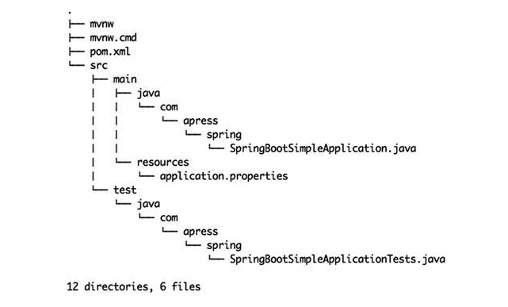
Tree generated
Pro Spring Boot by Gutierrez, Felipe, Ch 03

Slide 10
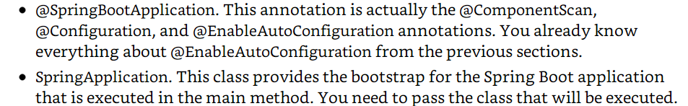
Running with maven wrapper
./mvnw spring-boot:run
Pro Spring Boot by Gutierrez, Felipe, Ch 03

Slide 11
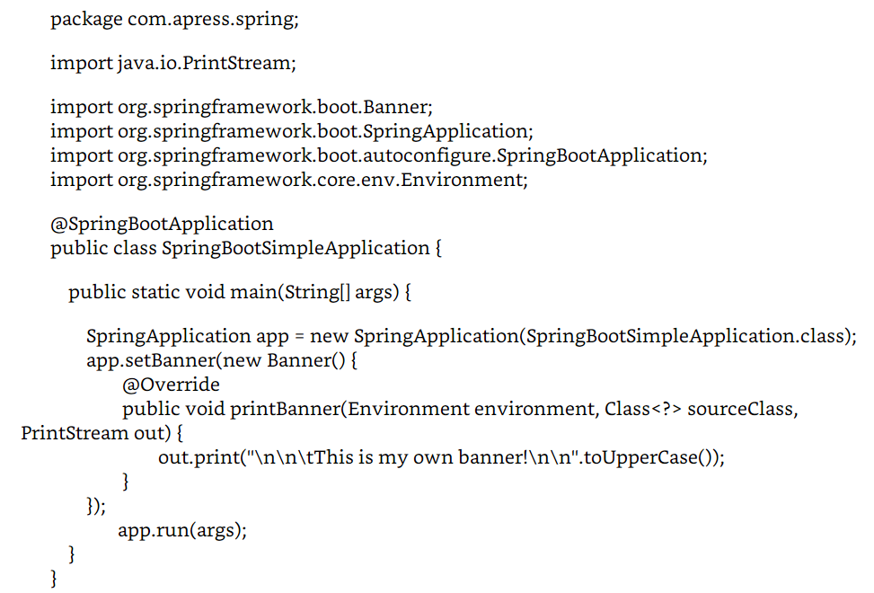
New Banner
New Banner
Pro Spring Boot by Gutierrez, Felipe, Ch 03

Slide 12
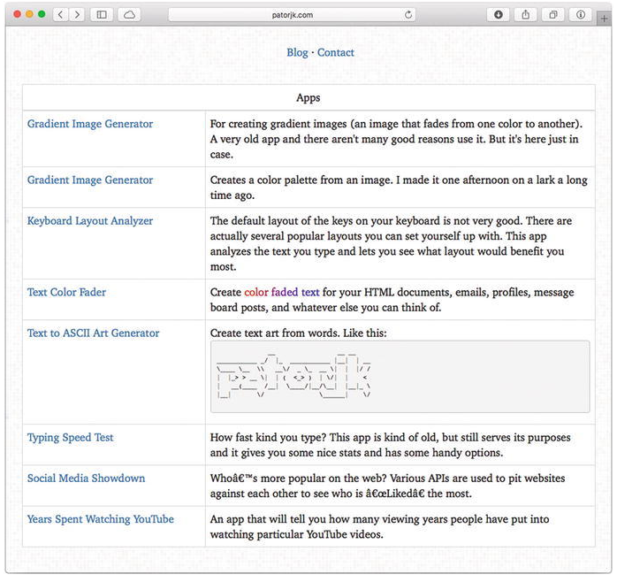
Text to ASCII Art Generator
Pro Spring Boot by Gutierrez, Felipe, Ch 03

Slide 13
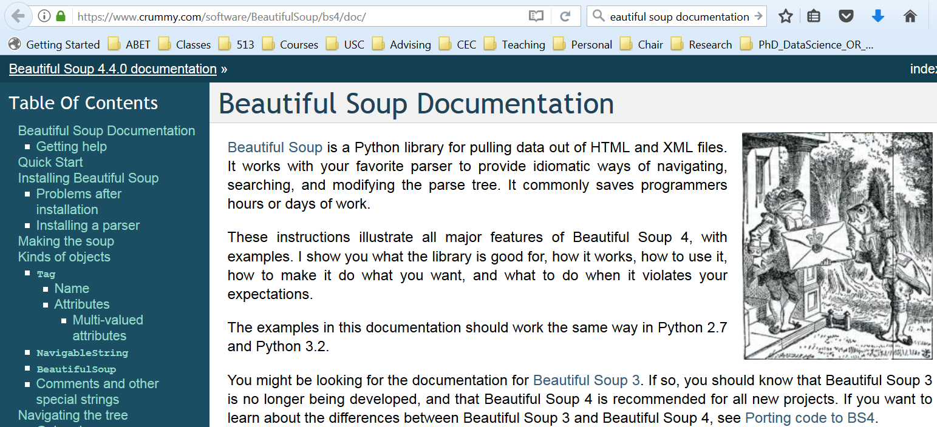
Beautiful Soup – python url reading/parsing
https://www.crummy.com/software/BeautifulSoup/bs4/doc
Pro Spring Boot by Gutierrez, Felipe, Ch 03

Slide 14
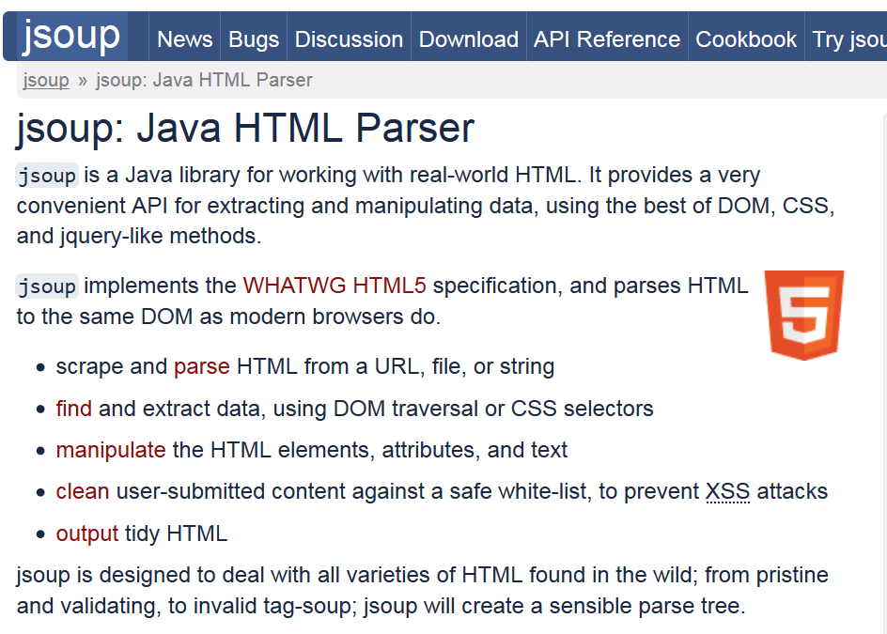
https://jsoup.org
Pro Spring Boot by Gutierrez, Felipe, Ch 03

Slide 15
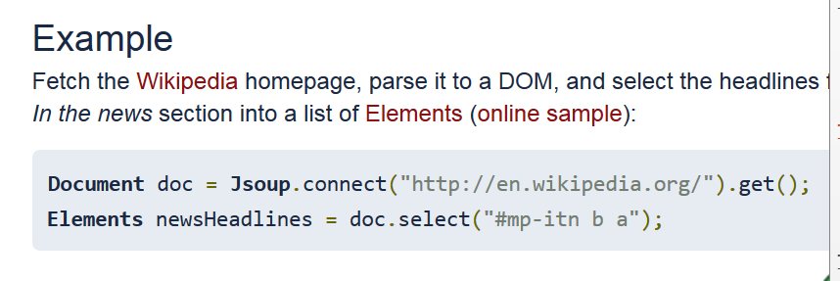
Jsoup Example
Pro Spring Boot by Gutierrez, Felipe, Ch 03

Slide 16
Is there a better library?
One part of spring?
Spring-boot?
Pro Spring Boot by Gutierrez, Felipe, Ch 03

Slide 17
Schedule project
User Stories -Schedule Project
 | Points
1 |  |  | Add course number semester and year, Department, columns to the database
2 |  |  | Using Selenium/Java==> Jsoup program to scrape current semester for CSCE courses
3 |  |  | Add Gui User interface -submit queries to DB, JS-Angular/Spring Framework
4 |  |  | Add menu-bar, file menu, SQL menu
5 |  |  | Calculate Number of students taught per semester by each faculty/TA
6 |  |  | Read Fall 2016 schedule add it to the database
7 |  |  | Add credit hours
8 |  |  | Solve technical debt problem learn about reading and parsing web pages with Jsoup or other suitable library.
9

Slide 18
Pivotal Tracker Project
User Stories -Pivotal Tracker Project
 | Points
1 |  |  | Technical debt - what does pivotal do for you?
2 |  |  | Initial change tutorial to "tracker"
3 |  |  | Add User stories ala Connextra format to system; not changing code, as the program runs add a new user story.
4 |  |  | Modify the status of user stories
5 |  |  | Assign points
6 |  |  | Play planning poker with user story; (i.e. assign points. Note you need to keep track of the team and decide what algorithm to use.)
7 |  |  | Add team members
8 |  |  | Assign team member to implement user story
9

Slide 19
Essential Scrum by Rubin, Ch 07

Slide 20
Essential Scrum by Rubin, Ch 07

