Slide 1
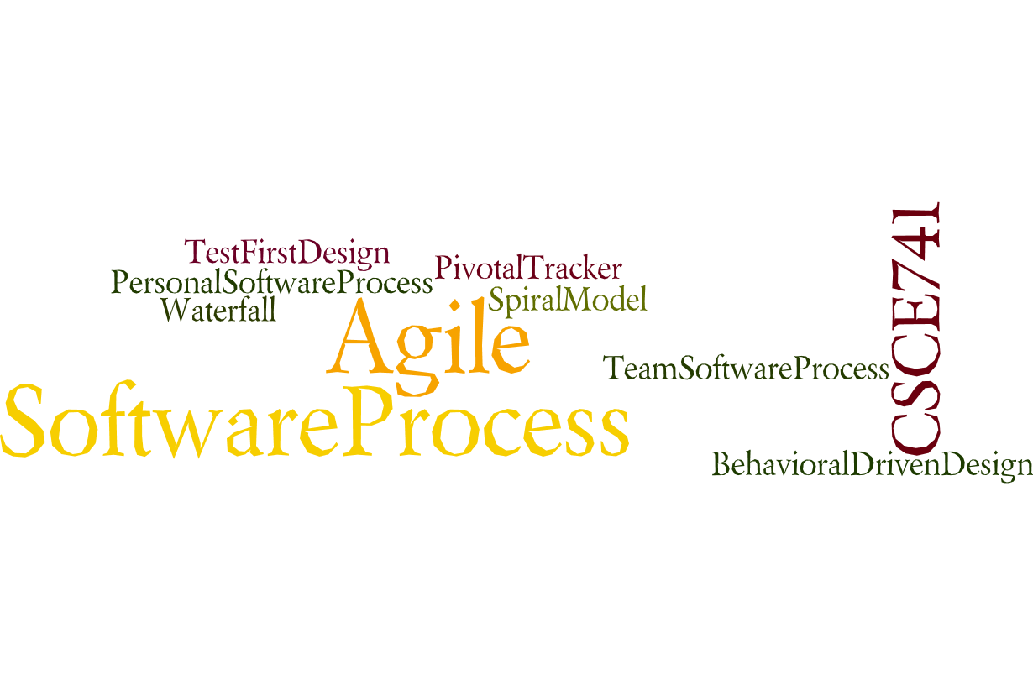
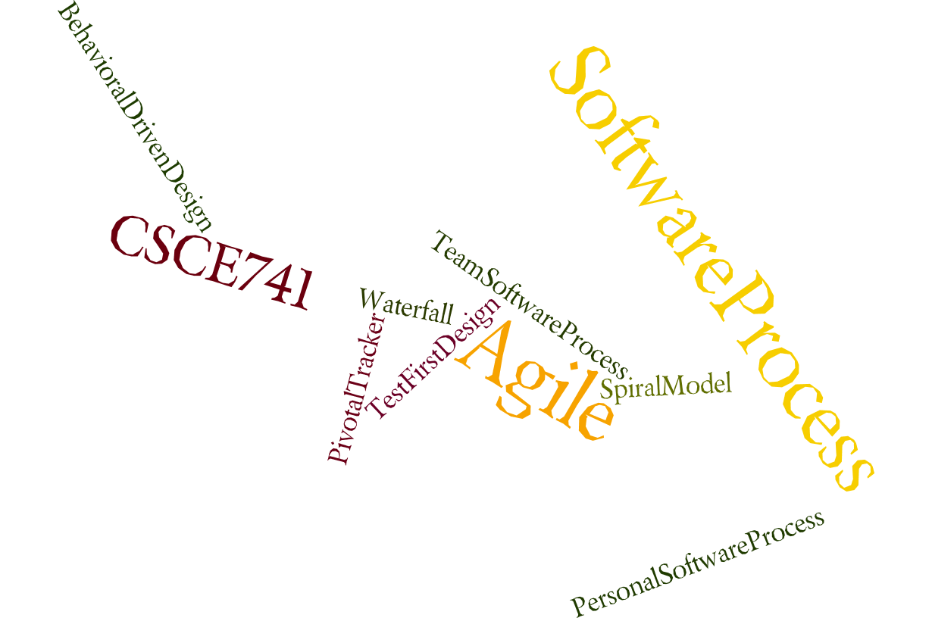
Lecture 04
Availability
CSCE 741 Software Process
Topics
  Chapter 5 – Availability
Lecture 5 -- Spring Boot - points
  Spring Boot example from PSP
  Point evaluation of User Stories
  Velocity
Readings:PSB Ch 2-,
September 18, 2017

Slide 2
Last Time
  Sprints <ES=Essential Scrum chapter 4>
  ProSpringBoot chapter 1
Abbreviations
  ES for Essential Scrum = Rubin, Kenneth S.. Essential Scrum: A Practical Guide to the Most Popular Agile Process (Addison-Wesley Signature Series (Cohn)) (p. 61). Pearson Education. Kindle Edition.
  PSB forGutierrez, Felipe. Pro Spring Boot (Kindle Location 3292). Apress. Kindle Edition.
New
  PSB chapter 2, 3
  ES Chapter 7, little of 8

Slide 3
Login/configuration to a Unix System
Shell
Shell /Environment Variables
Env, set
e.g. HOME, PATH, CLASSPATH
Shell
(bash)
Command
interpreter
.bash_progile, .bashrc
set PATH=~/bin:$PATH
alias lsd = ‘ls –l | grep “^d”’
alias lsa = ‘ls –a’
More configuration files
System wide: /etc/termcap
Net …

Slide 4
.bash_profile
source "$HOME/.sdkman/ bin/ sdkman-init.sh"
Gutierrez, Felipe. Pro Spring Boot (Kindle Location 553). Apress. Kindle Edition.
Pro Spring Boot by Gutierrez, Felipe, Ch 01

Slide 5
OS X – Homebrew package manager
Homebrew package manager http:// brew.sh/
install brew, you must execute this command:
$ ruby -e "$(curl -fsSL https:// raw.githubusercontent.com/Homebrew/install/ master/ install)"
You might need to open a new terminal and/or do a source over the .bash_profile file to get it working,
to install Spring Boot:
$ brew tap pivotal/ tap
$ brew install springboot
Pro Spring Boot by Gutierrez, Felipe, Ch 02

Slide 6
Installing SpringBoot CLI
http://sdkman.io/
$ curl -s get.sdkman.io | bash
After it finishes, you can execute the following line to run the sdk command:
$ source "$ HOME/. sdkman/ bin/ sdkman-init.sh"
$ sdk version SDKMAN 3.2.4
$ sdk install springboot
$ spring --version Spring CLI v1.3.2. RELEASE
Gutierrez, Felipe. Pro Spring Boot (Kindle Locations 550-558). Apress. Kindle Edition.
Pro Spring Boot by Gutierrez, Felipe, Ch 02

Slide 7
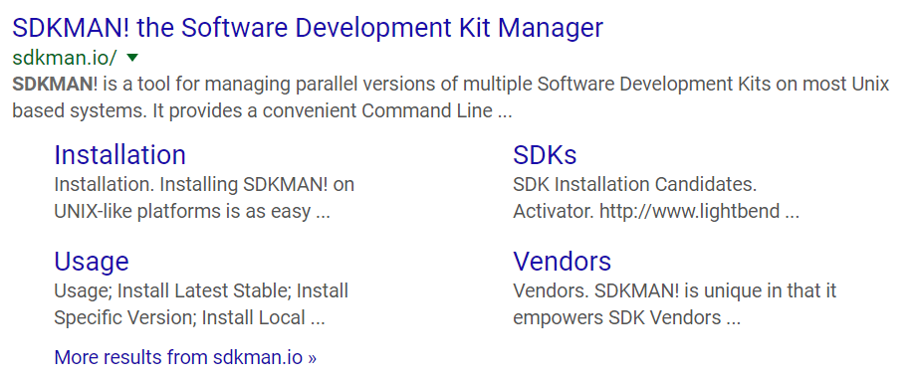
SDKMAN – Software Dev. Kit Manager
Pro Spring Boot by Gutierrez, Felipe, Ch 02

Slide 8
Windows OS
download the ZIP binary distribution and uncompress
http://repo.spring.io/release/org/springframework/ boot/ spring-boot-cli/1.3.2.RELEASE/spring-boot-cli-1.3.2.RELEASE-bin.zip
http://repo.spring.io/snapshot/org/springframework/ boot/ spring-boot-cli/
https:// docs.spring.io/ spring-boot/ docs/ current/ reference/ html/ getting-started-installing-spring-boot.html# getting-started-manual-cli-installation .
You must have the JAVA_HOME variable set (pointing to your Java SDK) and the SPRING_HOME variable pointing to where you uncompress the binary distribution. Also make sure to set up your PATH variable, which includes the %SPRING_HOME%\ bin path (or, if you are using UNIX, it’s $ SPRING_HOME/ bin)
Pro Spring Boot by Gutierrez, Felipe, Ch 02

Slide 9
More software needed later
RabbitMQ,
Redis, and
MySQL.
Gutierrez, Felipe. Pro Spring Boot (Kindle Location 577). Apress. Kindle Edition.
Pro Spring Boot by Gutierrez, Felipe, Ch 02

Slide 10
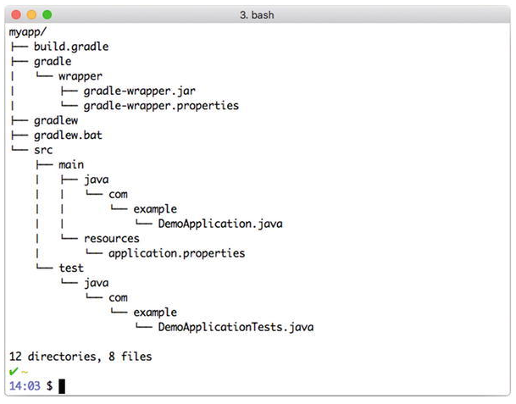
Pro Spring Boot by Gutierrez, Felipe, Ch 02

Slide 11
Add more capabilities
$ spring init -dweb, data-jpa, h2, thymeleaf --build maven myapp --force
Gutierrez, Felipe. Pro Spring Boot (Kindle Locations 605-606). Apress. Kindle Edition.
Pro Spring Boot by Gutierrez, Felipe, Ch 02

Slide 12
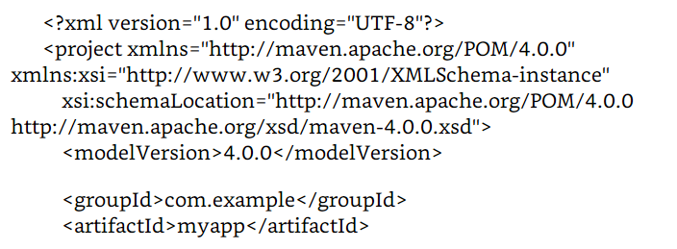

Spring Boot with Maven and Gradle
Pom.xml – listing 2.1
Pro Spring Boot by Gutierrez, Felipe, Ch 02

Slide 13
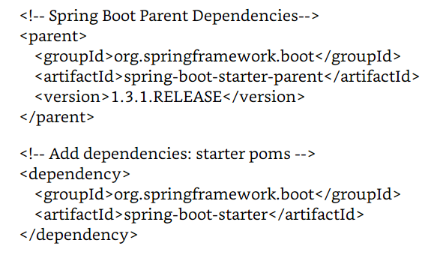
Pom.xml (continued)
Pro Spring Boot by Gutierrez, Felipe, Ch 02

Slide 14
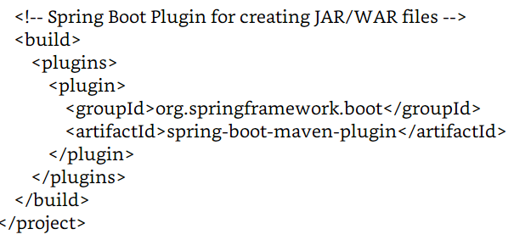
Pom.xml (continued)
Pro Spring Boot by Gutierrez, Felipe, Ch 02

Slide 15
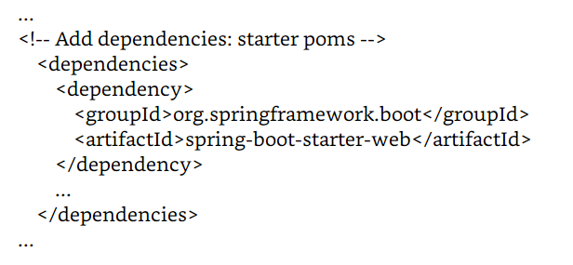
Pom.xml (continued)
Pro Spring Boot by Gutierrez, Felipe, Ch 02

Slide 16
Spring Boot with Gradle
buildscript {
repositories {
jcenter()
maven { url "http:// repo.spring.io/ snapshot" }
maven { url "http:// repo.spring.io/ milestone" }
}
dependencies {
classpath(" org.springframework.boot:spring-boot-gradle-plugin: 1.3.1. RELEASE")
}
}
Pro Spring Boot by Gutierrez, Felipe, Ch 02

Slide 17
apply plugin: 'java'
apply plugin: 'spring-boot'
jar {
baseName = 'myproject‘
version = ' 0.0.1-SNAPSHOT'
}
repositories {
jcenter()
maven { url "http:// repo.spring.io/ snapshot" }
maven { url "http:// repo.spring.io/ milestone" }
}
dependencies {
// starter poms dependencies
compile(' org.springframework.boot:spring-boot-starter')
}
Pro Spring Boot by Gutierrez, Felipe, Ch 02

Slide 18
web application with testing
add the following in the dependencies section:
compile(" org.springframework.boot:spring-boot-starter-web")
testCompile(" org.springframework.boot:spring-boot-starter-test")
If you want to use a starter pom, you have to add the following syntax. For Maven:
< dependency >
< groupId > org.springframework.boot </ groupId>
< artifactId > spring-boot-starter-[ TECHNOLOGY] </ artifactId >
</ dependency >
For Gradle: compile(" org.springframework.boot:spring-boot-starter-[ TECHNOLOGY]")
Pro Spring Boot by Gutierrez, Felipe, Ch 02

Slide 19
Gradle wrapper - gradlew
When using Gradle you can use the Gradle wrapper, which allows you to have a binary Gradle when you want to distribute your application and the computer doesn’t have Gradle.
See http://www.gradle.org/docs/current/userguide/ gradle_wrapper.html
Gutierrez, Felipe. Pro Spring Boot (Kindle Locations 685-687). Apress. Kindle Edition.
Pro Spring Boot by Gutierrez, Felipe, Ch 02

Slide 20
Spring Intializr again
…
With curl
$ curl -s https:// start.spring.io/ starter.zip -o myapp.zip
Gradle-based project,
$ curl -s https:// start.spring.io/ starter.zip -o myapp.zip –d type = gradle-project
Gutierrez, Felipe. Pro Spring Boot (Kindle Locations 711-716). Apress. Kindle Edition.
Pro Spring Boot by Gutierrez, Felipe, Ch 02

Slide 21
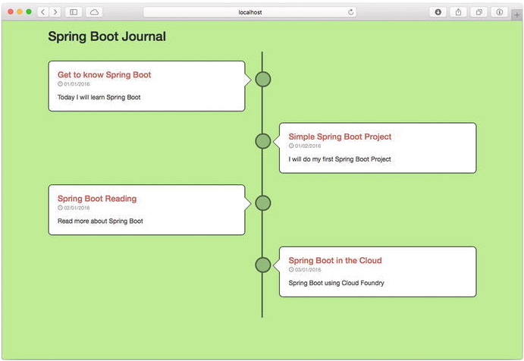
Spring Boot Journal Example
Pro Spring Boot by Gutierrez, Felipe, Ch 02

Slide 22
What Spring Boot gives you
Aoid the headache of a J2EE web application.
No configuration file— no XML (web.xml),
no @Configuration class, or any other Spring Beans definition file.
Maybe you are thinking that Spring Boot generated code— some classes to create all the necessary files to run this application— but that’s not the case,
Spring Boot never generates code and will never output any source code.
Spring Boot is an opinionated technology, which means that it follows the best practices to create a very robust application with minimum effort.
Pro Spring Boot by Gutierrez, Felipe, Ch 02

Slide 23
Spring Boot Journal Application
@SpringBootApplication annotation. This annotation looks like Listing 2-12. package org.springframework.boot.autoconfigure;
@Target( ElementType.TYPE)
@Retention( RetentionPolicy.RUNTIME)
@Documented
@Inherited
@Configuration
@EnableAutoConfiguration
@ComponentScan
public @interface SpringBootApplication {
Class <? >[] exclude() default {};
String[] excludeName() default {};
@ AliasFor( annotation = ComponentScan.class, attribute = "basePackages")
String[] scanBasePackages() default {};
@ AliasFor( annotation = ComponentScan.class, attribute = "basePackageClasses") Class <? >[] scanBasePackageClasses() default {}; }
Pro Spring Boot by Gutierrez, Felipe, Ch 02

Slide 24
Chapter 3. Spring Boot Auto-Configuration, Features, and More
Pro Spring Boot by Gutierrez, Felipe, Ch 03

Slide 25
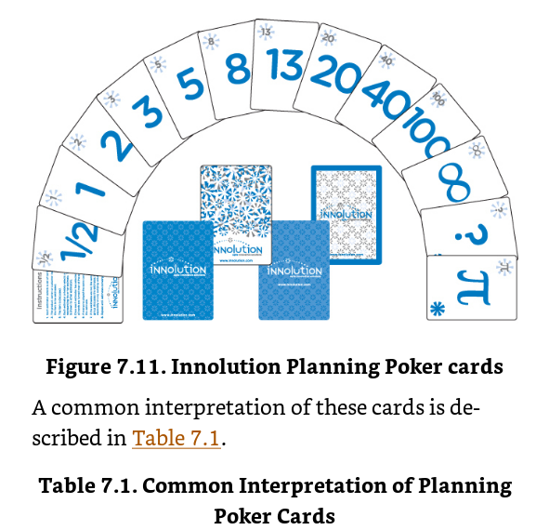
Planning Poker
Essential Scrum by Rubin, Ch 07

Slide 26
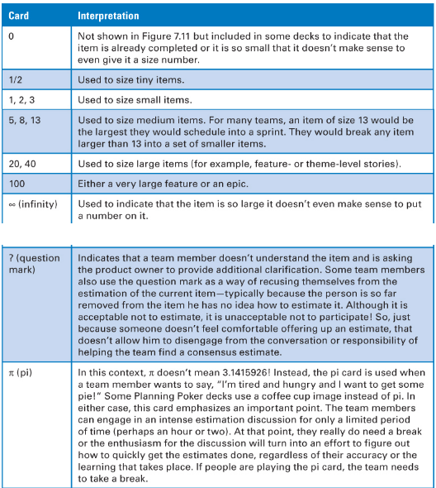
Essential Scrum by Rubin, Ch 07

Slide 27
Rules of Planning Poker
Product Owner selects PBI to be estimated
Development team members discuss the item and ask clarifying questions to the product owner, who answers the questions.
Each estimator privately selects a card representing his estimate.
Once each estimator has made a private selection, all private estimates are simultaneously exposed to all estimators.
If everyone selects the same card, we have consensus, and that consensus number becomes the PBI estimate.
If the estimates are not the same, the team members engage in a focused discussion to expose assumptions and misunderstandings. Typically we start by asking the high and low estimators to explain or justify their estimates. 7. After the discussion, we return to step 3 and repeat until consensus is reached.
Essential Scrum by Rubin, Ch 07

Slide 28
Value in Planning Poker
Debate over value of the estimates
But the process involves discussion to clarify the user story
Essential Scrum by Rubin, Ch 07

Slide 29
What is velocity?
Velocity is the amount of work completed in each sprint
Velocity measures output not outcome
Essential Scrum by Rubin, Ch 07

Slide 30
Velocity Range
Essential Scrum by Rubin, Ch 07

Slide 31
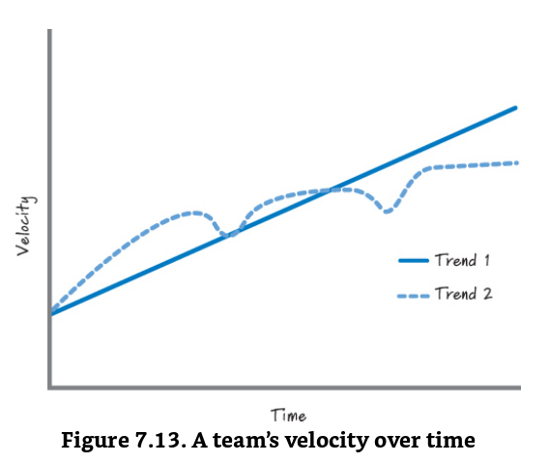
Affecting velocity
“Last year my team’s velocity averaged 30 points per sprint. This year I’m expecting the team to achieve 35 points per sprint.”
Essential Scrum by Rubin, Ch 07

Slide 32
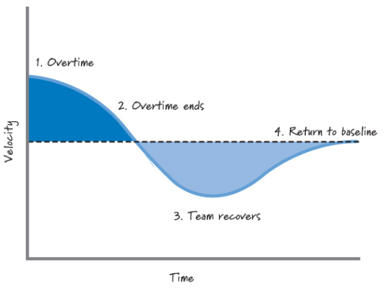
Overtime increases velocity
Essential Scrum by Rubin, Ch 07

Slide 33
Chapter 8 Techincal Debt
Shipping first time code is like going into debt. A little debt speeds development so long as it is paid back promptly with a rewrite. . . . The danger occurs when the debt is not repaid. Every minute spent on not-quite-right code counts as interest on that debt. Entire engineering organizations can be brought to a stand-still under the debt load of an unconsolidated implementation. . . .
    Ward Cunningham 1992
Essential Scrum by Rubin, Ch 08

Slide 34
Technical Debts = Shortcuts
• Unfit (bad) design—a design that once made sense but no longer does, given important changes to the business or technologies we now use
• Defects—known problems in the software that we haven’t yet invested time in removing
• Insufficient test coverage—areas where we know we should do more testing but don’t
• Excessive manual testing—testing by hand when we really should have automated tests
• Poor integration and release management—performing these activities in a manner that is time-consuming and error-prone
• Lack of platform experience—for example, we have mainframe applications written in COBOL but we don’t have many experienced COBOL programmers around anymore
• And many more, because the term technical debt today is really used as a placeholder for a multidimensional problem
Essential Scrum by Rubin, Ch 08

Slide 35
Naïve Debt Cunnigham did not expect
Cunningham didn’t intend for technical debt to refer to team member or business immaturity or process deficiencies that lead to sloppy design, poor engineering practices, and a lack of testing.
This kind of debt can be eliminated through proper training, a good understanding of how to apply technical practices, and sound business decision making.
Because of the irresponsible and frequently accidental nature of how this type of debt is generated, naïve debt.
Essential Scrum by Rubin, Ch 08

Slide 36
Types of Technical Debt
Naïve - AKA
  Reckless debt (Fowler 2009)
  Unintentional debt( Connell 2007)
  Mess (Martin 2008)
strategic
Essential Scrum by Rubin, Ch 08

Slide 37
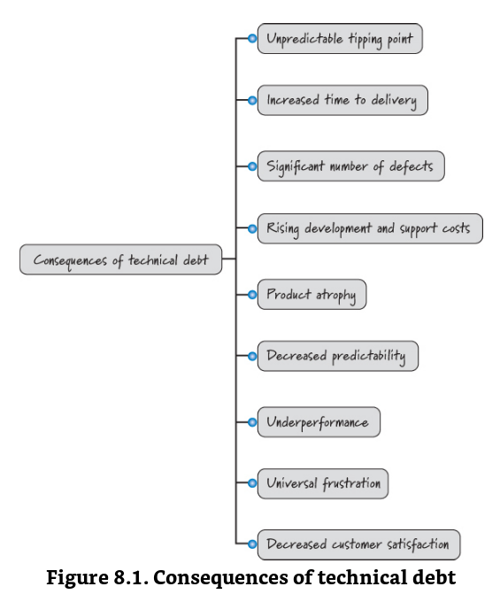
Essential Scrum by Rubin, Ch 08

