Slide 1
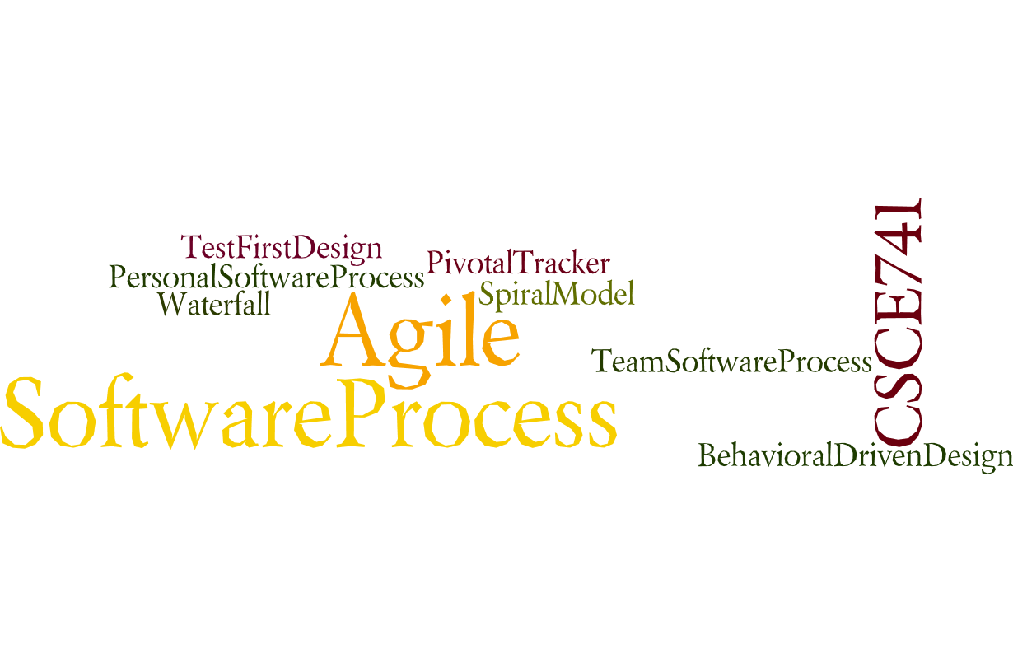

Lecture 04
Availability
CSCE 741 Software Process
Topics
  Chapter 5 – Availability
Lecture 3 -- Sprints and Spring
  Agile
  Scrum
  Spring Boot
Readings:ES Ch 4-
August 30, 2017

Slide 2
Last Time
  Scrum and Agile <ES=Essential Scrum chapters 2-3>
Abbreviations
  ES for Essential Scrum = Rubin, Kenneth S.. Essential Scrum: A Practical Guide to the Most Popular Agile Process (Addison-Wesley Signature Series (Cohn)) (p. 61). Pearson Education. Kindle Edition.
New
  yyy

Slide 3
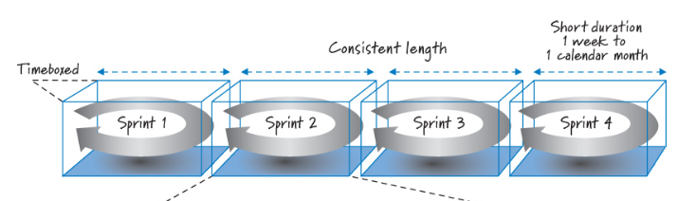
Sprints
Scrum organizes work in iterations or cycles of up to a calendar month called sprints.
Sprints
are timeboxed, have a short and consistent duration,
  Fixed length 2-4 weeks
  Exception might be made for first sprint to get framework up
have a goal that shouldn’t be altered once started, and must reach the end state specified by the team’s definition of done.
Essential Scrum by Rubin Ch 04

Slide 4
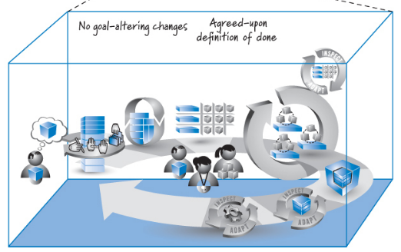
Figure 4.1
Planning
Implementation
Sprint Review
Sprint retrospective
<Refactor if necessary>
Essential Scrum by Rubin Ch 04

Slide 5
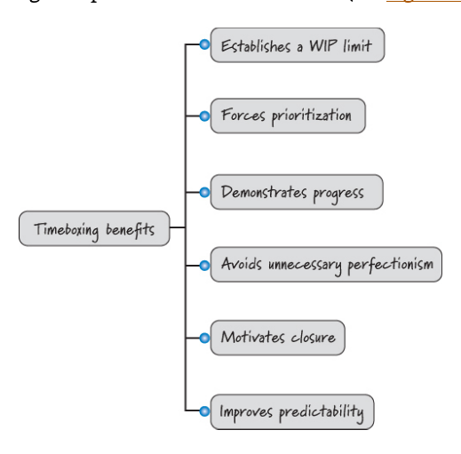
Figure 4.2 Benefits of timeboxing
Work in Progress limited
Prioritization
Essential Scrum by Rubin Ch 04

Slide 6
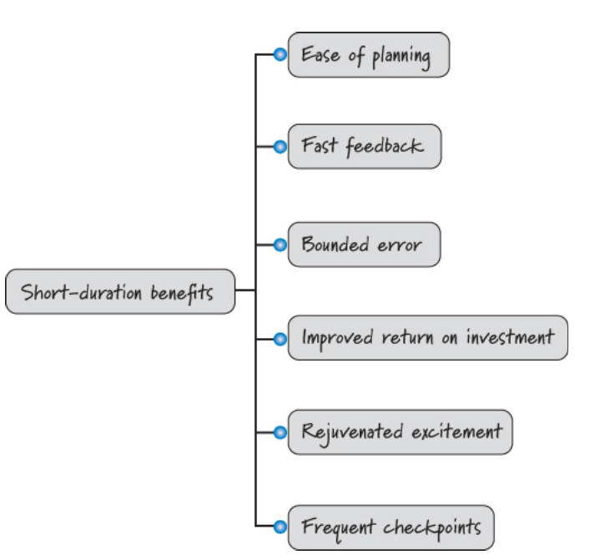
Benefits of short duration
Essential Scrum by Rubin Ch 04

Slide 7
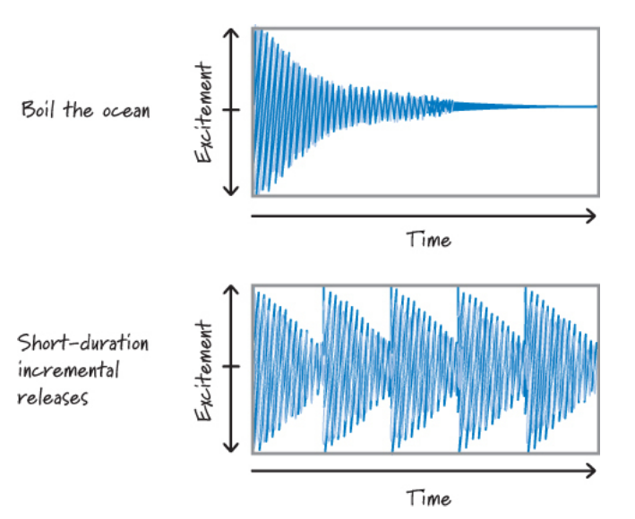
Excitement over time
Essential Scrum by Rubin Ch 04

Slide 8
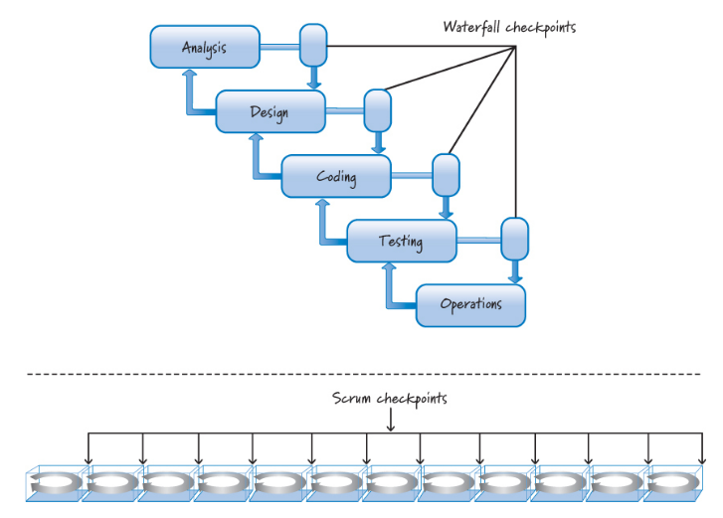
Checkpoints waterfall vs scrum
Essential Scrum by Rubin Ch 04

Slide 9
Exceptions to consistent duration
First iteration might need to be longer
Considering a change from longer to shorter cycle
Annual holidays occur in middle of sprint
Product release in one week
Essential Scrum by Rubin Ch 04

Slide 10
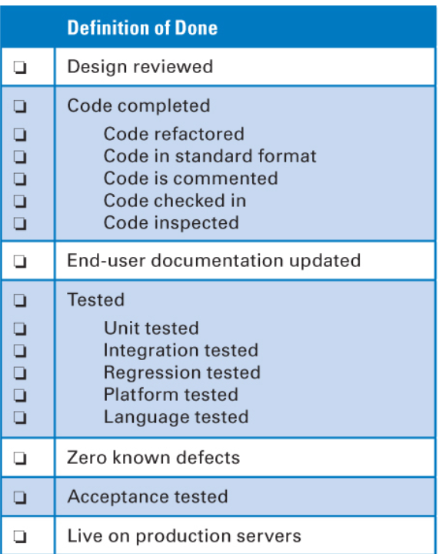
When are we done?
Essential Scrum by Rubin Ch 04

Slide 11
Chapter 5 Requirements and User Stories
Essential Scrum by Rubin Ch 05

Slide 12
That might be what I said it is not what I want
Customer: “Now that I see these built features, I realize I need this other feature that isn’t in the requirements document.”
Developers: “If you wanted that feature, why didn’t you specify it up front?”
Customer: “Well, I didn’t realize I needed that feature until I saw the product coming together.”
Developers: “Well, if you had thought longer and harder about the requirements up front, you would have found that feature then instead of now.”
Essential Scrum by Rubin Ch 05

Slide 13
User Stories
Conextra format
Essential Scrum by Rubin Ch 05

Slide 14
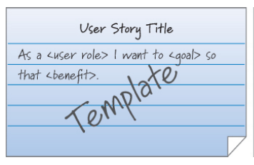
User Story Template
Essential Scrum by Rubin Ch 05

Slide 15
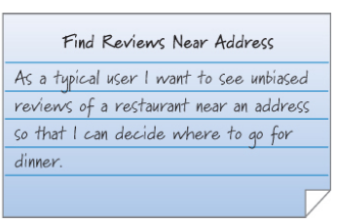
Example
Essential Scrum by Rubin Ch 05

Slide 16
Conversations
Conversations among product owner (customer), developers and stake holders
Conversations
  When written
  When revised
  When prioritized
  When estimated
  During sprint planning
  During design, implementation, and testing
Frequent conversations “enable a richer exchange of information”
Essential Scrum by Rubin Ch 05

Slide 17
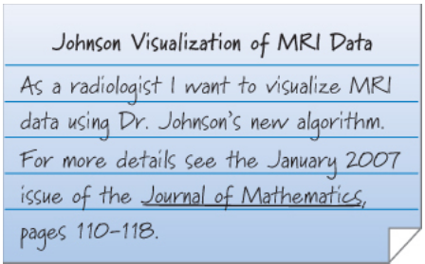
User Story with extra reference data
Essential Scrum by Rubin Ch 05

Slide 18
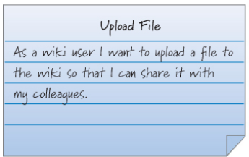
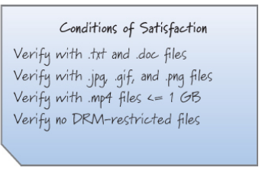
Conditions of satisfaction of a user story
Essential Scrum by Rubin Ch 05

Slide 19
Behavioral Driven Design (BDD)
Specification by example
Acceptance-test-driven-design (ATDD)
Essential Scrum by Rubin Ch 05

Slide 20
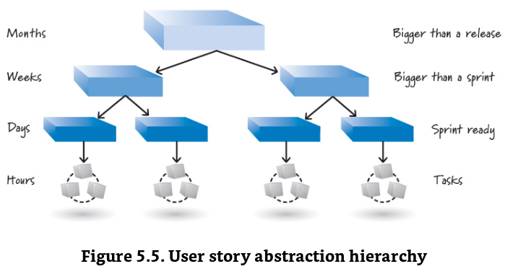
Essential Scrum by Rubin Ch 05

Slide 21
Acronyms for good user stories
The INVEST criteria are Independent, Negotiable, Valuable, Estimatable, Small (sized appropriately), and Testable. <ES Ch 05>
SMART User Stories are specific, measurable, assignable, realistic, time-related
    https://www.scrumalliance.org/community/articles/2017/january/create-smart-user-stories-with-the-definition-of-d
Essential Scrum by Rubin Ch 05

Slide 22
Invest in User Stories
Independent,
Negotiable,
Valuable,
Estimatable,
Small (sized appropriately), and
Testable
Essential Scrum by Rubin Ch 05

Slide 23
SMART User Stories
SMART User Stories
S – specific
M – measurable
A – assignable
R - realistic
T - time-related
Essential Scrum by Rubin Ch 05

Slide 24
Non-functional requirements
Essential Scrum by Rubin Ch 05

Slide 25
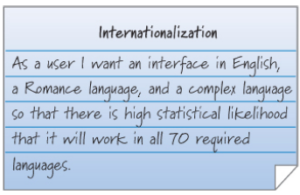
Examples of Non-functional requirements
Essential Scrum by Rubin Ch 05

Slide 26
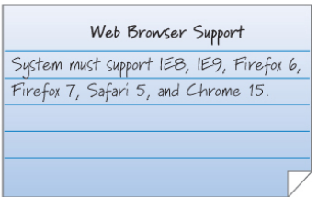
Examples of Non-functional requirements
Essential Scrum by Rubin Ch 05

Slide 27
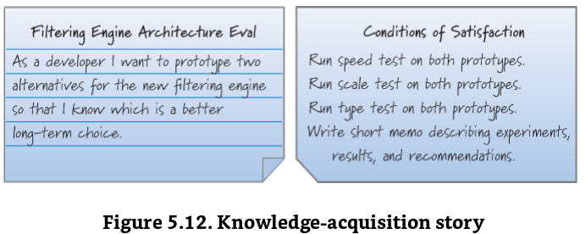
Essential Scrum by Rubin Ch 05

Slide 28
User story workshops
User Story maps
Storyboards
Essential Scrum by Rubin Ch 05

Slide 29
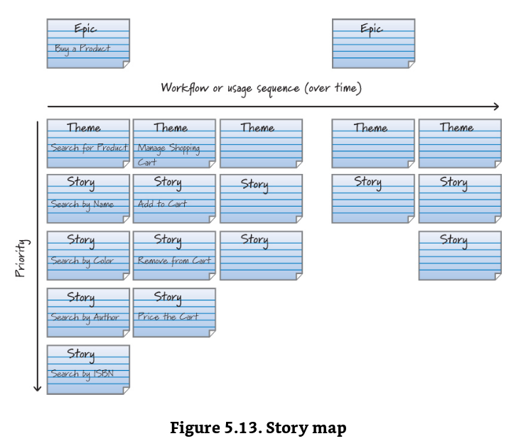
Essential Scrum by Rubin Ch 05

Slide 30
Setting up
Install Java
Install Eclipse
Install STS
Maven, … other things I might be forgetting
Essential Scrum by Rubin Ch 05

Slide 31
Spring Framework

Slide 32
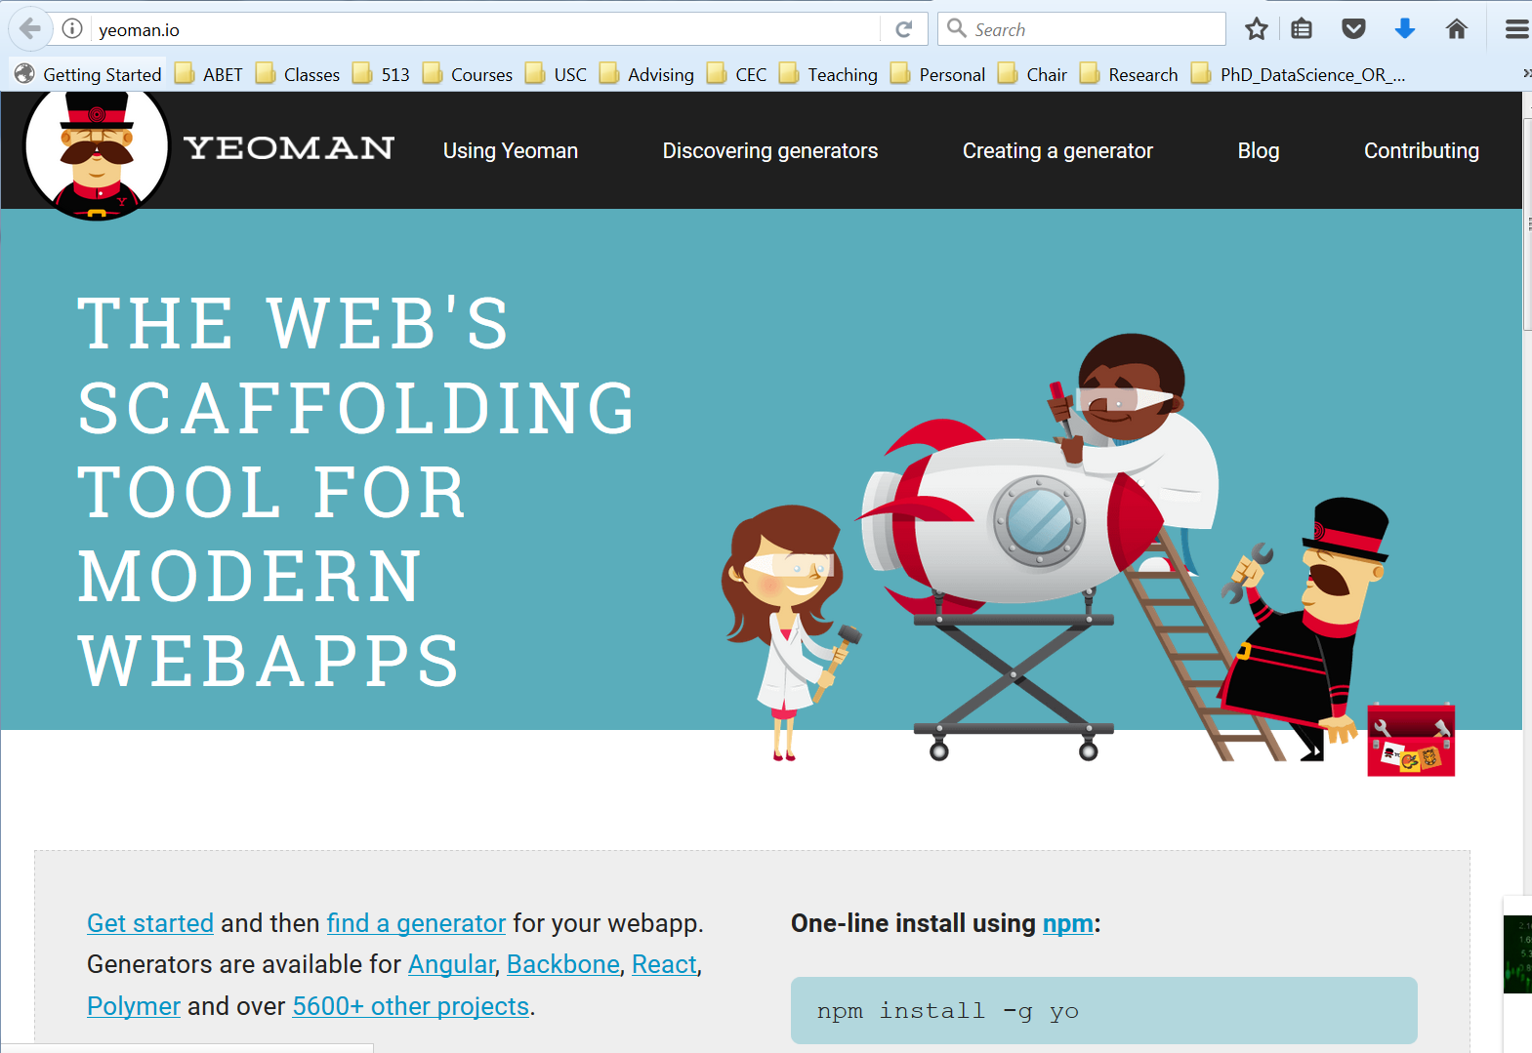
Yeoman – Yet another framework

Slide 33
Schedule -DB
Read schedules, and then be able to answer:
Who is teaching a particular section?
Particular course?
Has ever taught a particular course?
Number of students taught by each faculty by semester?
  Number of sections?
  Number of courses?
Same as 4 except for dept.
How many adjuncts, lecturers, Tas, Assistant prof. Associate Prof., Prof.?

Slide 34
Object Model, DB ER model

Slide 35
Reading the Web
Open URLs
Read and parse HTML
Beautiful Soup (Python)
Jsoup

